Slide 1
Introduction 90L52609 Philosophy of Social Science
Matti Häyry

Slide 2
One-minute self-introductions
Name
From
Studies and experience
Why in Aalto
Discipline, area, field
How far in doctoral studies
Course expectations
Matti
Yian
Karelia
Ronja
Emilia
Meng
Outi
Marjukka
Tejas
Jiancai
Zhiqiang
Elizabeth
Sahar
Martta
Jukka-Pekka
Aleksandra
Siddhant
Ali
Mostafa
Claire
Thanh
Floris
Elizaveta

Slide 3
Introduction 90L52609 Philosophy of Social Science
Matti Häyry

Slide 4
Course contents
Preliminary literature exam
Participation in online sessions
Literature readings between sessions
Preparation and facilitation of a discussion
Two presentations of the research you do / plan

Slide 5
Course contents
Preliminary literature exam – Assessment: Pass / Fail
Done and dusted – congratulations to all, well done!

Slide 6
Course contents
Preliminary literature exam – Assessment: Pass / Fail
Done and dusted – congratulations to all, well done!
Most answers were on what Mill thought about (1) the possibility of a science of human nature and (2) a science studying social phenomena, i.e. social science

Slide 7
Course contents
Preliminary literature exam – Assessment: Pass / Fail
Done and dusted – congratulations to all, well done!
Most answers were on what Mill thought about (1) the possibility of a science of human nature and (2) a science studying social phenomena, i.e. social science
You identified, correctly, the main difficulties according to Mill, namely that
we have limited access to the mental phenomena that underlie actions; &
we have even more limited access to the plenitude of social interactions

Slide 8
Course contents
Preliminary literature exam – Assessment: Pass / Fail
Done and dusted – congratulations to all, well done!
Most answers were on what Mill thought about (1) the possibility of a science of human nature and (2) a science studying social phenomena, i.e. social science
You identified, correctly, the main difficulties according to Mill, namely that
we have limited access to the mental phenomena that underlie actions; &
we have even more limited access to the plenitude of social interactions
Which for Mill means that social science cannot be as exact as some others

Slide 9
Course contents
Participation in online sessions – Assessment: Pass / Fail
We have 11 scheduled sessions – you need to attend 10 – this is the 2nd
If you miss more than one, that (or those) need to be compensated

Slide 10
Course contents
Participation in online sessions – Assessment: Pass / Fail
We have 11 scheduled sessions – you need to attend 10 – this is the 2nd
If you miss more than one, that (or those) need to be compensated
Try not to miss any lecture sessions – they are the backbone
Email me about your absences and we shall work it out

Slide 11
Course contents
Participation in online sessions – Assessment: Pass / Fail
We have 11 scheduled sessions – you need to attend 10 – this is the 2nd
If you miss more than one, that (or those) need to be compensated
Try not to miss any lecture sessions – they are the backbone
Email me about your absences and we shall work it out
After my lectures, you will email me questions
Further instructions on guest lectures

Slide 12
Course contents
Literature readings between sessions – Assessment: Pass / Fail
Before the guest lectures, you will have reading assignments
The materials are in MyCourses under Course Materials
Their reading order is also specified in this niche

Slide 13
Course contents
Literature readings between sessions – Assessment: Pass / Fail
Before the guest lectures, you will have reading assignments
The materials are in MyCourses under Course Materials
Their reading order is also specified in this niche
My lectures: 29 Sept (Ontology) – 6 Oct (Epistemology) – 20 Oct (My research)
Guest lectures: 13 Oct (Scientific realism) – 3 Nov (Social constructivism)

Slide 14
Course contents
Preparation and facilitation of a discussion – Assessment: Pass / Fail
You will prepare and facilitate a discussion with 4 or 5 of your classmates
The topics are positivism, interpretivism, ethnography and positionality

Slide 15
Course contents
Preparation and facilitation of a discussion – Assessment: Pass / Fail
You will prepare and facilitate a discussion with 4 or 5 of your classmates
The topics are positivism, interpretivism, ethnography and positionality
The format is free – but there are tentative instructions in MyCourses
Ask veterans of this course (when I have taught it) how they did it

Slide 16
Course contents
Preparation and facilitation of a discussion – Assessment: Pass / Fail
You will prepare and facilitate a discussion with 4 or 5 of your classmates
The topics are positivism, interpretivism, ethnography and positionality
The format is free – but there are tentative instructions in MyCourses
Ask veterans of this course (when I have taught it) how they did it
You should make your own arrangements for your meetings
All others should also check the topic out in advance

Slide 17
Course contents
Preparation and facilitation of a discussion – Assessment: Pass / Fail
For this task, I have divided you into four groups
Positivism, 6 October, Student group 1: Karelia, Ronja, Emilia, Outi, Martta
Interpretivism, 13 October, Student group 2: Marjukka, Tejas, Jiancai, Zhiqiang, Elizabeth, Sahar
Ethnography, 20 October, Student group 3: Jukka-Pekka, Aleksandra, Siddhant, Ali, Yian, Meng
Positionality, 3 November, Student group 4: Mostafa, Claire, Thanh, Floris, Elizaveta

Slide 18
Course contents
Two presentations of your research – Assessment: Pass / Fail
Seven-minute pitches: theme (= how related to the real world) – topic (= how related to science) – what you hope to find out (= your novelty) – general methodological drift

Slide 19
Course contents
Two presentations of your research – Assessment: Pass / Fail
Seven-minute pitches: theme (= how related to the real world) – topic (= how related to science) – what you hope to find out (= your novelty) – general methodological drift
10 November: Yian, Karelia, Ronja, Emilia, Meng, Outi, Marjukka, Tejas, Jiancai, Zhiqiang, Elizabeth
17 November: Sahar, Martta, Jukka-Pekka, Aleksandra, Siddhant, Ali, Mostafa, Claire, Thanh, Floris, Elizaveta

Slide 20
Course contents
Two presentations of your research – Assessment: Pass / Fail
Seven-minute pitches: theme (= how related to the real world) – topic (= how related to science) – what you hope to find out (= your novelty) – general methodological drift
10 November: Yian, Karelia, Ronja, Emilia, Meng, Outi, Marjukka, Tejas, Jiancai, Zhiqiang, Elizabeth
17 November: Sahar, Martta, Jukka-Pekka, Aleksandra, Siddhant, Ali, Mostafa, Claire, Thanh, Floris, Elizaveta
Shows of methodological awareness: research questions – how you intend to answer them – linked to “what you hope to find out” (duration tentatively eight – 8 – minutes)

Slide 21
Course contents
Two presentations of your research – Assessment: Pass / Fail
Seven-minute pitches: theme (= how related to the real world) – topic (= how related to science) – what you hope to find out (= your novelty) – general methodological drift
10 November: Yian, Karelia, Ronja, Emilia, Meng, Outi, Marjukka, Tejas, Jiancai, Zhiqiang, Elizabeth
17 November: Sahar, Martta, Jukka-Pekka, Aleksandra, Siddhant, Ali, Mostafa, Claire, Thanh, Floris, Elizaveta
Shows of methodological awareness: research questions – how you intend to answer them – linked to “what you hope to find out” (duration tentatively eight – 8 – minutes)
24 November: Yian, Karelia, Ronja, Emilia, Meng, Outi, Marjukka, Tejas
1 December: Jiancai, Zhiqiang, Elizabeth, Sahar, Jukka-Pekka, Aleksandra
8 December: Siddhant, Ali, Mostafa, Claire, Thanh, Floris, Elizaveta, Martta

Slide 22
Technicalities

Slide 23
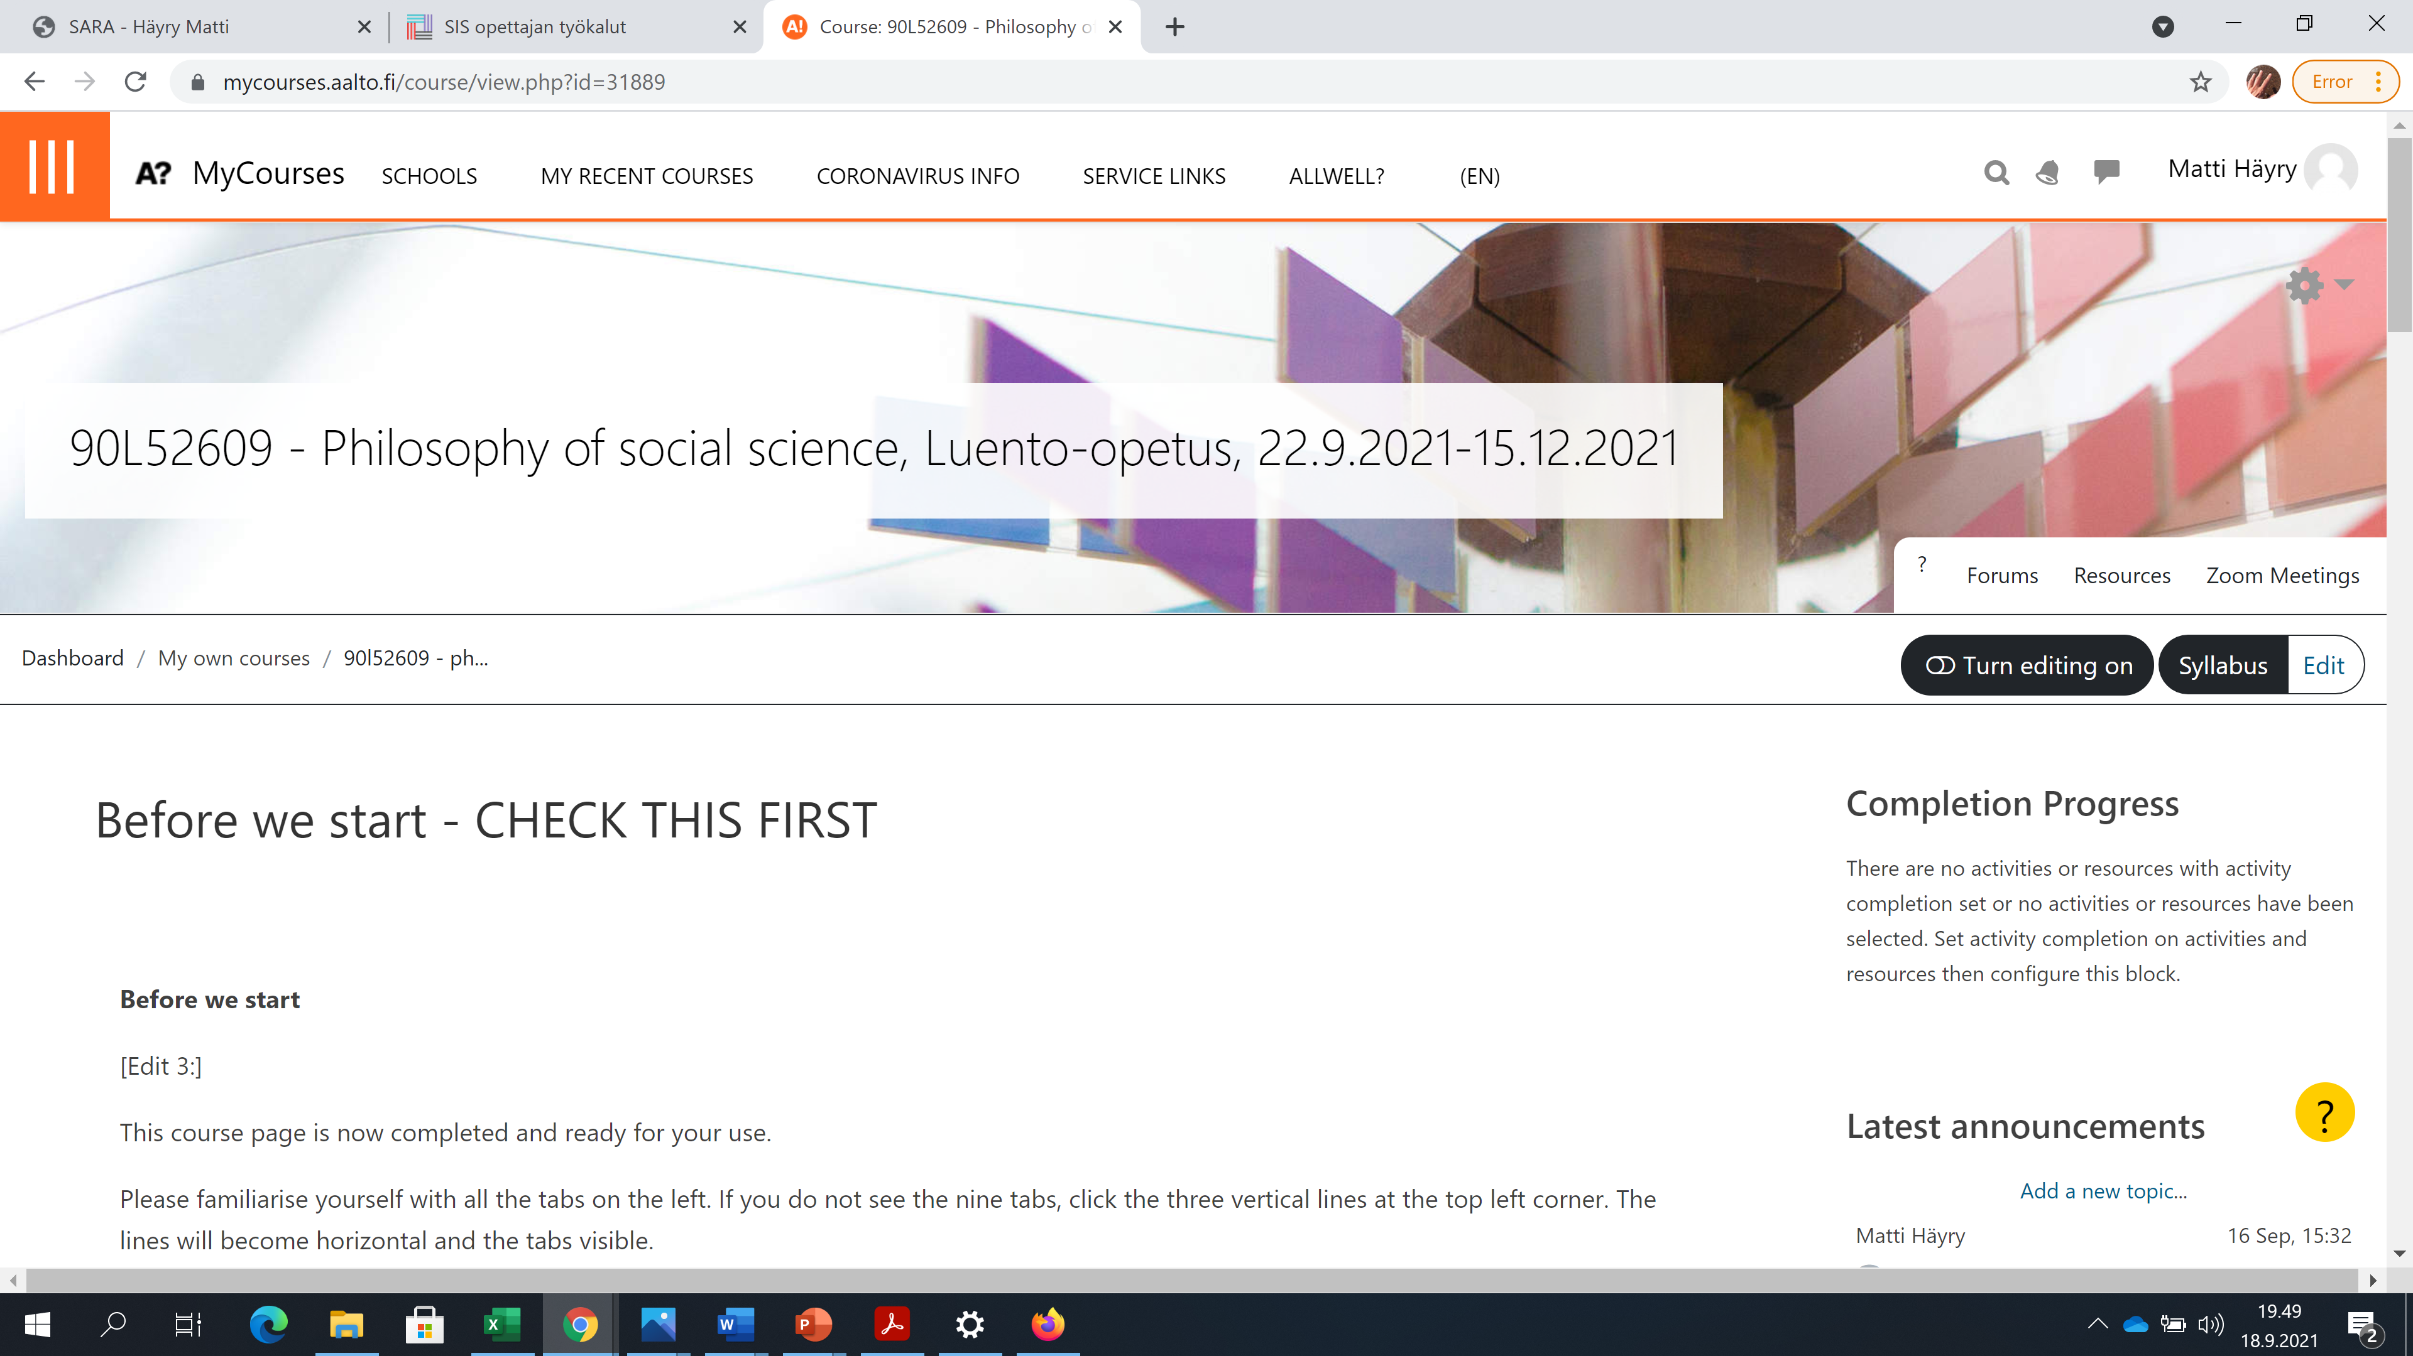

Slide 25
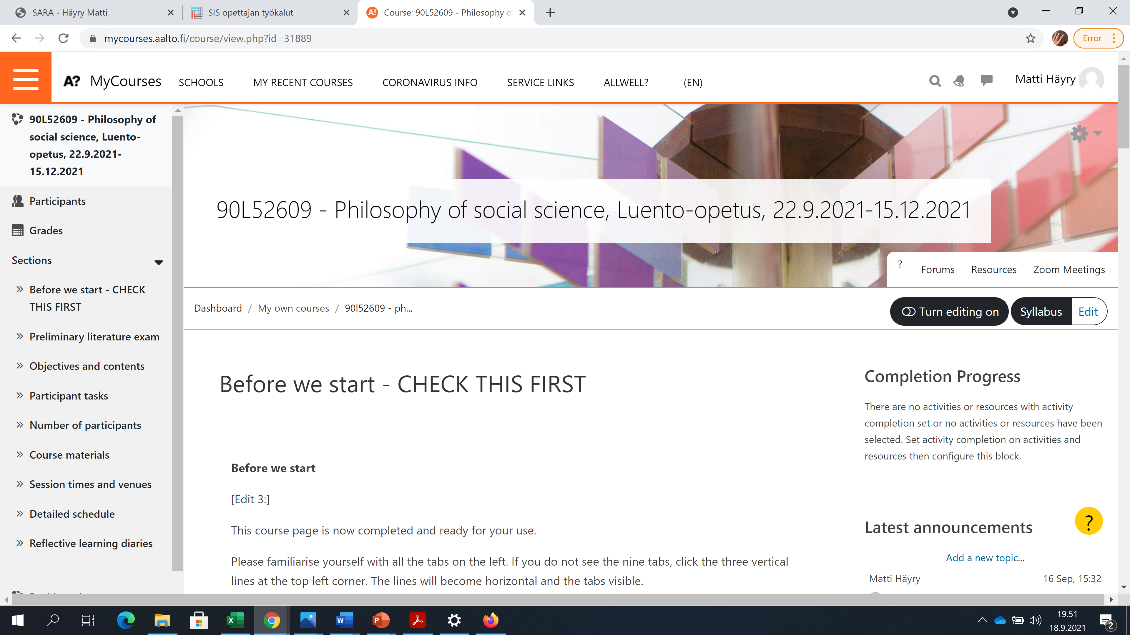

Slide 26
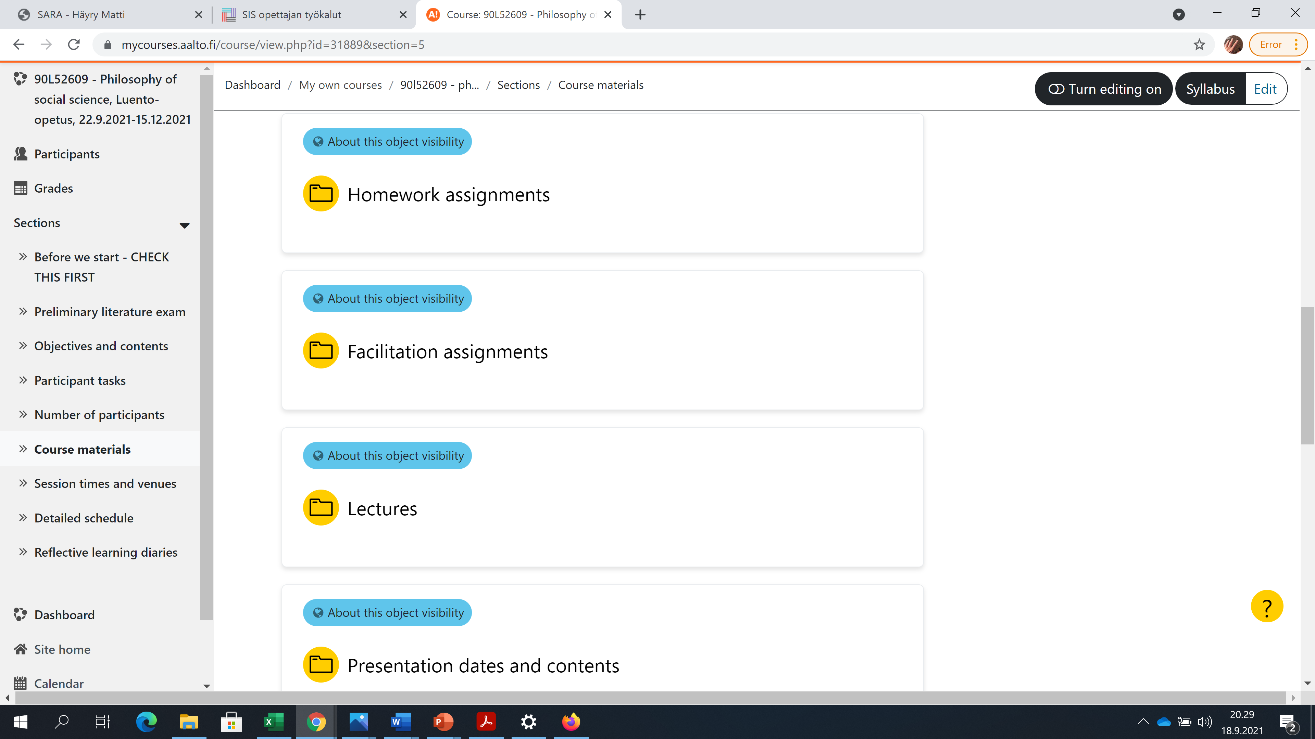
Articles worth reading
You will be notified when reading is required
Your responsibilities
Questions to be answered – all read these
Lectures just before sessions
Mine also with narration
When your turns are
Both for the 7-minute and the 8-minute

Slide 27
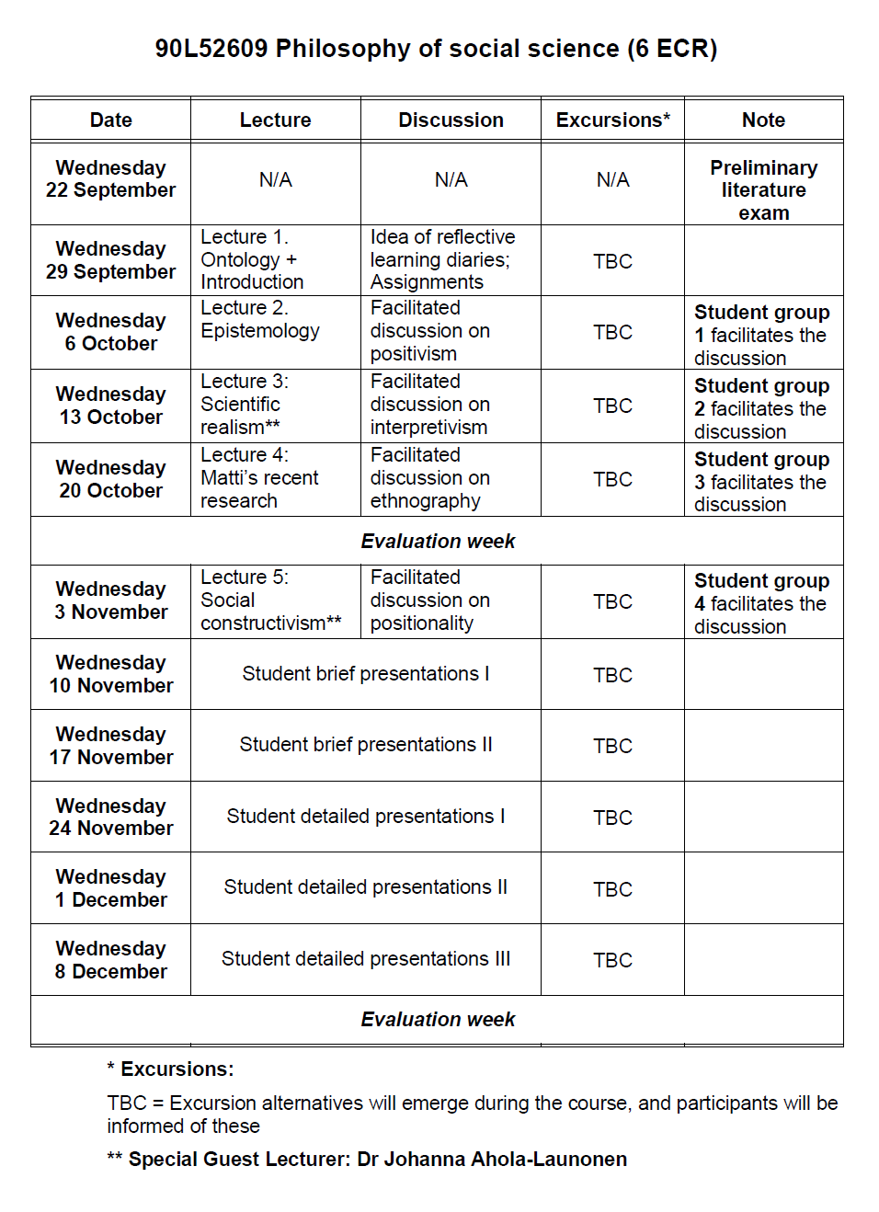

Slide 28
If you have questions about this intro, course, or schedule, please email them to me at: matti.hayry@aalto.fi
If your questions have general relevance,
I will (in addition to answering to you)
post them in the Read This section
Now let’s take a break.
10 minutes and I’ll be back with Ontology

Slide 29
If you have questions about this intro, course, or schedule, please email them to me at: matti.hayry@aalto.fi
If your questions have general relevance,
I will (in addition to answering to you)
post them in the Read This section
Now let’s take a break.
10 minutes and I’ll be back with Ontology

