Slide 1
CS-A113 Basics in Programming Y1
10th Lecture 23.11.2021

Slide 2
The Lecture: Different Today
Join with Video – We are coding together
Open your microphone – we discuss things together
We will NOT record the session today

Slide 3
Interactions Today:
Go to: http://presemo.aalto.fi/csa1113

Slide 4
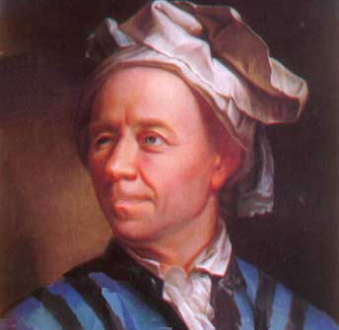
Goldbach`s Conjecture (1742)
Every even number greater than two can be written as the sum of two primes

Slide 5
Implement a checker for Goldbach’s Theorem for the first n numbers:
How do we start such a task?
1. Write down what you need
2. Write down a rough sketch of your code and define your subtasks
3. Structure each subtask
4. Implement the subtasks

Slide 6
Implement a checker for Goldbach’s Theorem for the first n numbers:
How do we start such a task?
1. Write down what you need
2. Write down a rough sketch of your code and define your subtasks
3. Structure each subtask
4. Implement the subtasks

Slide 7
What are the parts needed?

Slide 8
What are the parts needed
List of Prime numbers
Iterating through all numbers up to and inclusive n
Test if there is a sum of 2 prime numbers
Iterating through the prime number list twice

Slide 9
Implement a checker for Goldbach’s Theorem for the first n numbers:
How do we start such a task?
1. Write down what you need
2. Write down a rough sketch of your code and define your subtasks
3. Structure each subtask
4. Implement the subtasks

Slide 10
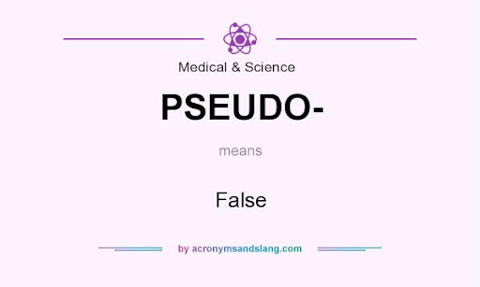
Code overview
test_Goldbach(n):
for i in range(all even numbers larger than 2 until n):

Slide 11
Code overview
test_Goldbach(n):
for i in range(all even numbers larger than 2 until n):
can i be the sum of two primes?

Slide 12
Code overview
find all Prime numbers until n
test_Goldbach(n):
for i in range(all even numbers larger than 2 until n):
can i be the sum of two primes?

Slide 13
Code overview
#find all Prime numbers until n
myPrimes = getPrimes(n)
test_Goldbach(n):
for i in range(all even numbers larger than 2 until n):
can i be the sum of two primes?

Slide 14
Implement a checker for Goldbach’s Theorem for the first n numbers:
How do we start such a task?
1. Write down what you need
2. Write down a rough sketch of your code and define your subtasks
3. Structure each subtask (pseudocode)
4. Implement the subtasks

Slide 15
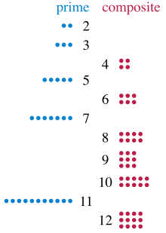
What is a Prime Number?
A prime number is a natural number greater than 1 that is not a product of two smaller natural numbers.
Prime numbers: 2,3,5,7,11,...
NOT Prime numbers: 1,4,6,8,9,10,12,...

Slide 16
Prime Number Sieve
Add numbers to a list if it is not divisible by any of the number already in the list:
With which number do you start?
myPrimes =
2 | 3 | 5 | 7 | 11 | 13 | 17 | 19 | 23 | 29

Slide 17
Prime Number Sieve
Add numbers to a list if it is not divisible by any of the number already in the list:
With which number do you start?
myPrimes =
2 | 3 | 5 | 7 | 11 | 13 | 17 | 19 | 23 | 29

Slide 18
Prime Number Sieve
Add numbers to a list if it is not divisible by any of the number already in the list:
Next number 3 – is 3 dividable by any number on the list so far?
myPrimes =
2 | 3 | 5 | 7 | 11 | 13 | 17 | 19 | 23 | 29

Slide 19
Prime Number Sieve
Add numbers to a list if it is not divisible by any of the number already in the list:
Next number 4 – is 4 dividable by any number on the list so far?
myPrimes =
2 | 3 | 5 | 7 | 11 | 13 | 17 | 19 | 23 | 29

Slide 20
Prime Number Sieve
Add numbers to a list if it is not divisible by any of the number already in the list:
Next number 5 – is 5 dividable by any number on the list so far?
myPrimes =
2 | 3 | 5 | 7 | 11 | 13 | 17 | 19 | 23 | 29

Slide 21
Prime Number Sieve
Add numbers to a list if it is not divisible by any of the number already in the list:
Next number 6 – is 6 dividable by any number on the list so far?
myPrimes =
2 | 3 | 5 | 7 | 11 | 13 | 17 | 19 | 23 | 29

Slide 22
Prime Number Sieve
Add numbers to a list if it is not divisible by any of the number already in the list:
Next number 7 – is 7 dividable by any number on the list so far?
myPrimes =
2 | 3 | 5 | 7 | 11 | 13 | 17 | 19 | 23 | 29

Slide 23
Prime Number Sieve
Add numbers to a list if it is not divisible by any of the number already in the list:
Next number 8 – is 8 dividable by any number on the list so far?
myPrimes =
2 | 3 | 5 | 7 | 11 | 13 | 17 | 19 | 23 | 29

Slide 24
Prime Number Sieve
Add numbers to a list if it is not divisible by any of the number already in the list:
Next number 9 – is 9 dividable by any number on the list so far?
myPrimes =
2 | 3 | 5 | 7 | 11 | 13 | 17 | 19 | 23 | 29

Slide 25
Prime Number Sieve
Add numbers to a list if it is not divisible by any of the number already in the list:
Next number 10 – is 10 dividable by any number on the list so far?
myPrimes =
2 | 3 | 5 | 7 | 11 | 13 | 17 | 19 | 23 | 29

Slide 26
Prime Number Sieve
Add numbers to a list if it is not divisible by any of the number already in the list:
Next number 11 – is 11 dividable by any number on the list so far?
myPrimes =
2 | 3 | 5 | 7 | 11 | 13 | 17 | 19 | 23 | 29

Slide 27
Prime Number Sieve
Add numbers to a list if it is not divisible by any of the number already in the list:
Next number 12,13...
myPrimes =
2 | 3 | 5 | 7 | 11 | 13 | 17 | 19 | 23 | 29

Slide 28
Prime Number Sieve
Add numbers to a list if it is not divisible by any of the number already in the list:
Next number 14,15,16,17
myPrimes =
2 | 3 | 5 | 7 | 11 | 13 | 17 | 19 | 23 | 29

Slide 29
Prime Number Sieve
Add numbers to a list if it is not divisible by any of the number already in the list:
Next number 14,15,16,17
myPrimes =
2 | 3 | 5 | 7 | 11 | 13 | 17 | 19 | 23 | 29

Slide 30
Prime Number Sieve
Add numbers to a list if it is not divisible by any of the number already in the list:
Next number 18,19,...
myPrimes =
2 | 3 | 5 | 7 | 11 | 13 | 17 | 19 | 23 | 29

Slide 31
Prime Number Sieve
Add numbers to a list if it is not divisible by any of the number already in the list:
Next number 18,19,...
myPrimes =
2 | 3 | 5 | 7 | 11 | 13 | 17 | 19 | 23 | 29

Slide 32
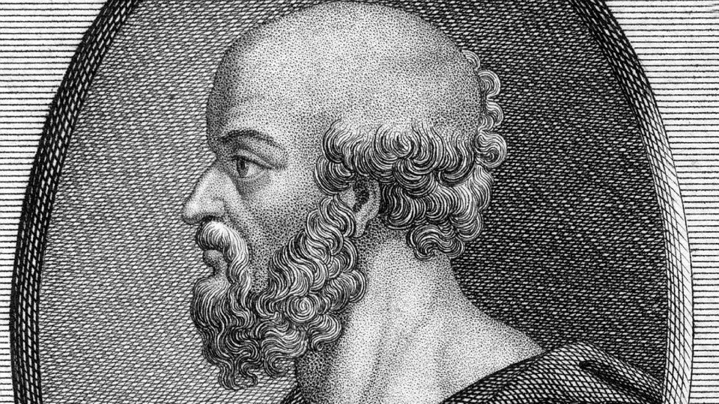
Sieve of Eratosthenes
Division is expensive for computers: Can we find the Prime numbers in a better way without testing for division?
YES → Sieve of Eratosthenes
Idea: Start with a list of numbers. If you find a prime, mark all multiples of this number as NOT prime:
2 → 4,6,8,10,12,14,... marked
3 → 6,9,12,15,18,... marked
4 is marked
5→ 10,15,20,25,... marked
6 is marked
7 → 14,21,28
9 is marked
10 is marked
11 → 22,33,44,

Slide 33
Sieve of Eratosthenes

Slide 34
How to implement the Sieve of Eratosthenes?
Start with a list of size n where each entry is ”True”
myPrimes = [True]*n
Mark all the multiples (of numbers that are still True when you iterate over them) with False
Iterate over the remaining list – all indices with entry True are prime numbers
myPrimesClean = []

Slide 35
Implement a checker for Goldbach’s Theorem for the first n numbers:
How do we start such a task?
1. Write down what you need
2. Write down a rough sketch of your code and define your subtasks
3. Structure each subtask
4. Implement the subtasks and the main task

Slide 36
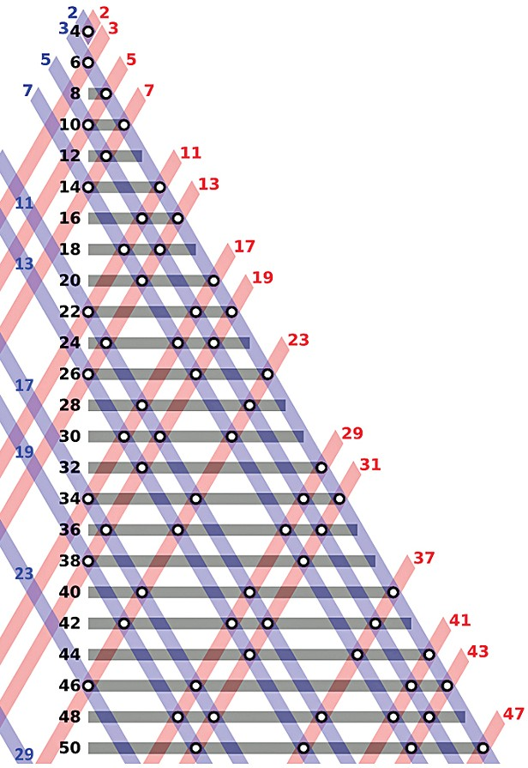
Code overview
#find all Prime numbers until n
myPrimes = getPrimes(n)
test_Goldbach(n):
for i in range(all even numbers larger than 2 until n):
can i be the sum of two primes?
range(x,y,z)

Slide 37
Code overview
#find all Prime numbers until n
myPrimes = getPrimes(n)
test_Goldbach(n):
for i in range(4,n+1,2):
can i be the sum of two primes?

Slide 38
Code overview
#find all Prime numbers until n
myPrimes = getPrimes(n)
test_Goldbach(n):
for i in range(4,n+1,2):
can i be the sum of two primes?
Iterate through ALL pairs of primes

Slide 39
Code overview
#find all Prime numbers until n
myPrimes = getPrimes(n)
test_Goldbach(n):
for i in range(4,n+1,2):
can i be the sum of two primes?
Iterate through ALL pairs of primes
Prim1/Prime2 | 2 | 3 | 5 | 7
2 | 2 / 2 | 2 / 3 | 2 / 5 | 2 / 7
3 | 3 / 2 | 3 / 3 | 3 / 5 | 3 / 7
5 | 5 / 2 | 5 / 3 | 5 / 5 | 5 / 7
7 | 7 / 2 | 7 / 3 | 7 / 5 | 5 / 7

Slide 40
Code overview
#find all Prime numbers until n
myPrimes = getPrimes(n)
test_Goldbach(n):
for i in range(4,n+1,2):
for prime1 in myPrimes: for prime2 in myPrimes:
if (What do I test here?):
print()
Iterate through ALL pairs of primes

Slide 41
Code overview
#find all Prime numbers until n
myPrimes = getPrimes(n)
test_Goldbach(n):
for i in range(4,n+1,2):
for prime1 in myPrimes: for prime2 in myPrimes:
if (prime1+prime2==i):
print(f '{i} = {prime1} + {prime2}.)
Iterate through ALL pairs of primes

Slide 42
getPrimes
def getPrimes(myN):
if myN < 2:
return []
else:
myPrimes = [2]
for i in range(3,myN + 1):
isPrime = True
for testDivider in myPrimes:
if ((i % testDivider) == 0):
isPrime = False
if isPrime:
myPrimes.append(i)
return myPrimes

Slide 43
checkGoldbach
def checkGoldbach():
n = 40
primeList = getPrimes(n)
for i in range(4,n+1,2):
#test if i can be written by 2 primes
sumSuccess = False
for prime1 in primeList:
for prime2 in primeList:
if (prime1+prime2 == i) and (not sumSuccess):
sumSuccess = True
print(f'{i} = {prime1} + {prime2}.')
if not sumSuccess:
print(f'{i} = could not be formulated by the sum of two primes.')

