Slide 1
Lecture 3:
Scarcity and choice: labor supply
Juuso Välimäki
September 22, 2021

Slide 2
This lecture: how much to work?
How to decide working hours?
Basic model with constant wages
  Income and substitution effects
  Backward bending labor supply
Real world complications and empirical observations
What does actual disposable income look like?
  How can we think of basic income?
  Do wealthier people work more or less?
  Observations on work across time and across countries

Slide 3
Working for wages
After graduating Ann starts working for a wage
  Assume first a wage of 15€/h, but jobs differ according to working hours so any length of a working day is available
    We shall discuss the implications of this unrealistic assumption and consider a model with full time of half-day work only
She chooses between earnings (market consumption) and free time
  Budget constraint: the set of affordable combinations of consumption and free time
    An hour less of free time<-> 15€ more of consumption
    Notice that wage per hour does not depend on working hours (no bonus for overtime)
  Preferences: Ann likes consumption and free time

Slide 4
Choice between consumption and free time
Ann chooses the point on the highest indifference curve within her budget set (feasible set), point A
What is her marginal rate of substitution (MRS) at point A? How do you know this?
A
Budget constraint: c = w(24-t)
c = consumption
w = wages (15€/tunti)
t = free time
Slope of the budget line: c’(t) = -w = -15

Slide 5
Income effect
Ann’s uncle gives Ann an allowance of 50€ per day.
Her budget line moves up but its slope is unchanged since the wage did not change.
B
A
Ann’s best choice from the new budget set is at B. It is hard to know a priori if she should work more or less.

Slide 6
Wage increase
What happens if Ann gets a raise?
Slope of budget line = wage
  Higher wage <->
  Steeper budget line <->
  More expensive free time, but effectively richer Ann
Under the new budget constraint, Ann works more (for these indifference curves)
B
This conclusion is not general. Because Ann becomes richer, she could also consume more free time
A

Slide 7
Bigger raise in wages
C
B
Now Ann chooses C. How is it possible that raising wages induces less work?
A

Slide 8
Income and substitution effetcs
1. Income effect: If Ann does not change her working hours she is effectively richer since she can consume more
We can demonstrate this by asking what Ann would do if her uncle gave her enough to money to reach the indifference curve after the wage increase (but at old wages). Recall the case from before.
B
D
A
Income effect

Slide 9
Income and substitution effects
2. Substitution effect: The opportunity cost of free time is higher when wages are higher
Higher wage <-> an hour more of free time leads to a higher reduction in other consumption
Substitution effect = difference between D and B in the figure
B
Here the substitution effect dominates the income effect. In the previous picture an even higher wage resulted in choice of point C where income effect dominates.
D
A
substitution effect

Slide 10
Restricted choice set
Consider now the case where Ann cannot adjust ner hours freely. She can choose to work at 15€/h full-time(8h) or half-day(4h) or not to work at all.
Her choice set then consists of just three points
How would Ann choose here? What if she could adjust working hours more flexibly?

Slide 11
Restricted choice set
Consider again the case where Ann’s uncle gives her an allowance of 50€/day.
With more wealth, she chooses part time work instead of full time.
This more realistic model yields the same conclusions but hides the mechanics of optimal choice that are based on comparison of the opportunity costs and marginal rates of substitution
Sometimes a less realistic model can allow for a clearer view of the problem at hand.

Slide 12
Is this a good model?
Is it realistic?
  Who thinks about indifference curves when choosing work?
  But does this really matter if you behave as if you chose a point on the highest indifference curve?
  Most people cannot adjust hours freely
    See slides above
  What about non-wage effects of work (to earn a promotion, to earning a reputation as a hard worker, to conform to social norm etc.)
Tw ways to judge the merits of a model
  Does it give rise to a meaningful though experiment? Do we gain in understanding the tradeoffs when we assume adjustable hours?
  Can we test at least some of its implications empirically?

Slide 13
Is this a good model?
Assessing the relevance and cedibility of the model
  helps in understanding the conceptual distinction between opportunities (feasible set, budget set) and preferences (indifference curves)
  learning over time the best individual combimation of free time and earnings
  assumption that workers can control (at least to some extent) their working hours
    overtime, part-time, …
  also useful for understanding labor force participation decisions
    when to retire, how much of parental leave to take…
Empirical testing
  falsifiable predictions
  check these predictions against data

Slide 14
Empirical testing of causal effects
One of the testable implications of the model
  less time spent working if non-labor income is increased
An example of a causal relation
  non-labor income causes a reduction in hours
  includes a comparison to a counterfactual state of affairs: since Ann either gets more income or not, one of these cases is not observable
measured in data
real case :
(Ann has the generous uncle):
Ann’s true working hours
vs.
counterfactual:
Ann’s hours if she did not receive the transfer
estimated
(typically using a control group)

Slide 15
Measuring causal effects: bad choices
Compare Ann before and after allowance
  challenge: the world changes all the time in many different ways
    e.g if Ann gets the allowance at the onset of a recession, she could change her hours due to business cycle and not the non-labor allowance.
    the world is so complicated that we cannot account for everything
Compare the hours between rich and poor families
  empirical challenge: rich and poor families may differ along many dimensions
    e.g. rich have better education, they may be more connected, they may be able to bear risk better etc.

Slide 16
Measuring causal effects: good choices
Randomized controlled trial
  e.g. choose 100 000 workers and give 100 000€ to a random sample of 50 000 of the workers. -> compare the working hours across the treatment group (those that received the money) and the control group (those that didn’t)
  because of randomization, the groups are homogenous on average otherwise -> differences in working hours depend credibly on the non-labor income
    for obvious reason, we have not seen such an experiment thus far
Natural experiment, quasi-experiment
  a real life situation that resembles a natural experiment
  credibility revolution in empirical economics (see e.g.. https://www.aeaweb.org/articles?id=10.1257/jep.24.2.3)

Slide 17
An example of a natural experiment: lottery winners
Treatment group
  Ca. 200 000 Swedes that participated in official lotteries in 1980’s and 1990’s. 1 470 winners of more than 1M SEK.
Control group
  those who participated but did not win
    not credible to compare winners to general population (why?)
Data
  anonymized register data on winners from tax authorities, data from occupational sources etc.
    similar data available in Finland (not similar lottery though)
  possible to observe individuals also over time
Source: Cesarini, Lindqvist, Notowidigdo, Östling (2017): The Effect of Wealth on Individual and Household Labor Supply: Evidence from Swedish Lotteries. American Economic Review, 107 (12): 3917-46. http://faculty.wcas.northwestern.edu/noto/research/CLNO%20Labor%20Supply.pdf

Slide 18
Winning reduces wage income (by a bit)
Equal earnings for winners and non-winners before the winnings
After winning in lottery, working hours decline
Small effect (100 000 SEK winnings reduces yearly earnings by 1000 SEK)
95% confidence interval
Source: Cesarini, Lindqvist, Notowidigdo, Östling (2017): The Effect of Wealth on Individual and Household Labor Supply: Evidence from Swedish Lotteries. American Economic Review, 107 (12): 3917-46. http://faculty.wcas.northwestern.edu/noto/research/CLNO%20Labor%20Supply.pdf

Slide 19
Taxes, transfers and basic income

Slide 20
Taxes in Finland, 2015
Source: Viitamäki (2015): Työnteon kannustimet – mitä jää käteen? VATT-muistio 50.

Slide 21
Taxes and transfers, 2015
Living alone, rent 440 €/kk
Lähde: Viitamäki (2015): Työnteon kannustimet – mitä jää käteen? VATT-muistio 50.

Slide 22
Taxes and transfers in Finland, 2015
Single parent, one child (2y.), rent 660 €/month
rent subsidy
labor market subsidy
Source: Viitamäki (2015): Työnteon kannustimet – mitä jää käteen? VATT-muistio 50.
Source: Viitamäki (2015): Työnteon kannustimet – mitä jää käteen? VATT-muistio 50.

Slide 23
Taxes and transfers
Scandinavian welfare states (and many other societies) have chosen to provide basic services to those outside regular work
  To guarantee adequate material living standards to the sick, old and other individuals that cannot participate in labor force
    in Principles II, a deeper look into reasons for unemployment
  Those able to work can often choose to rely on transfers
    not easy to determine who is voluntarily unemployed
  Paid through transfers that are financed by taxing incomes and consumption
    public services are also financed through taxes
One of the most important topics for public policy debates
  much more on this in Principles II
  today: a first look at incentives to work

Slide 24
Comparison: no transfers
Ann earns 12€/h. she chooses point A, i.e. She works for 8h per day and
2 064 €/month.
(8h*21,5*12€ = 2064, computed with 21,5 working days per month)
A

Slide 25
Current system (roughly)
Compare to the case from previous slides where Ann lives alone and pays 440€/month in rent.
A
Anne chooses now B (more free time, less consumption)
C
B
Rent subsidy
At 8h of work per day she would be clearly worse off than in the situation without subsidies.
Labor market subsidy
Net wages

Slide 26
Basic Income (one possible version)
Basic income of 25€/day and 20% flat income tax.
A
C
Ann’s optimal choice at C (7h of work)
B
Those that remain unemployed suffer a loss in income of 40%.

Slide 27
Basic income (second version)
Basic income of 40€/day. To finance the reform, flat income tax of 50%.
A
C
Ann’s best choice is now D with 5h of work per day.
D
B

Slide 28
How should taxes and transfers be reformed?
Economics does not provide an answer to such questions
  depends on the objectives
  economics does not tell what is a good objective
    economic analysis predicts how well economic institutions achieve the goals set
Economics helps in analyzing complex problems
  what incentives do different tax systems create
    what do individual budget constraints look like?
  how do individuals react to incentives
    e.g. empirical evidence from the basic income experiment
  how are individual decisions linked to each other?

Slide 29
Working hours and free time: the role of technological change

Slide 30
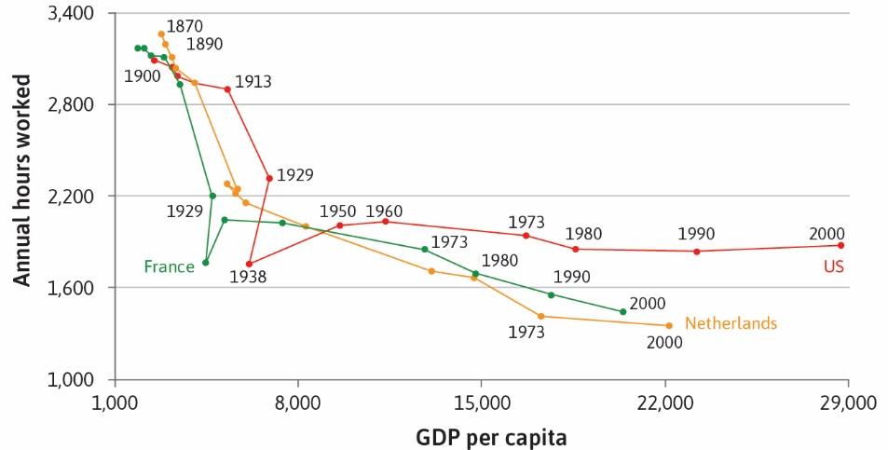
Big picture goal: how can we make sense of income and working hours across times and across countries?

Slide 31
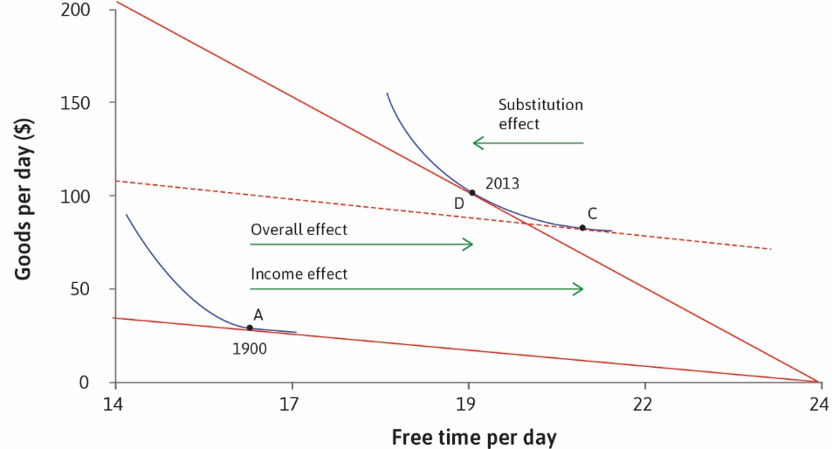
Working hours: US choices over time
Income and substitution effects can explain trends in working hours over time. E.g. In the US, the income effect dominated the substitution effect, so consumption and free time both increased.

Slide 32
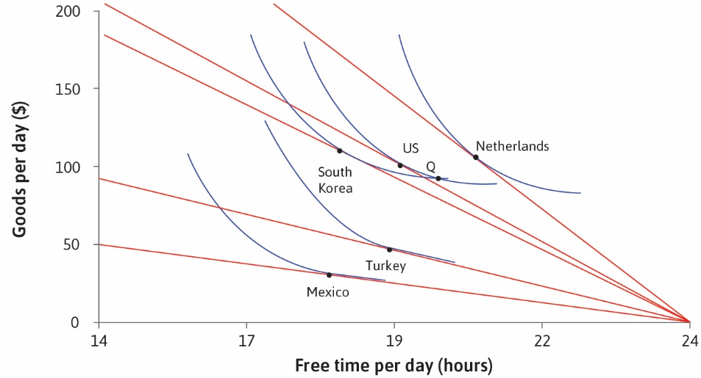
Working hours: Cross-country differences
Differences in working hours can be explained by preferences
that differ across countries.
Other explanations?
Differences in culture (norms)
Politics (legal limits on hours)
Social preferences (e.g. ‘Keeping up with the Joneses’)

Slide 33
Is this a good model?
Not realistic: Most people cannot choose their working hours.
BUT still a good approximation: Over time, people learn what combination of working hours and free time suits them best. Working hours can change due to culture and politics (indirect choice); people can choose which jobs to apply for.
Helps us understand real-world phenomena: preferences and income/substitution effects can explain differences in working hours across countries and over time.

Slide 34
Lectures 2-3: Summary
A very simple model of choice
  Preferences given by indifference curves
  Feasible set and budget set describe the possible options
  Optimal choice when marginal rate of substitution equals marginal rate of transformation
    MRT from the slope budget constraing or production possibility set
    MRS from slope of indifference curves
Application to supply of labor
  Opportunity cost of free time is the wage
  Income and substitution effects from increasing wages
  Taxes and transfers, and the labor supply decision
Some evidence over time and across different countries
  Importance of technological progress and cultural norms

Slide 35
Next lecture
Strategic interactions: Game theory
  Choice when I care about what others do
Institutions
  How do the rules of the game shape the decisions?

