Slide 1
Lecture 5: Social interactions and elements of game theory continued
Juuso Välimäki
September 29, 2021

Slide 2
Social Interactions and Game Theory
Last lecture: elements of games
Simultaneous choice of strategies
Outcomes and preferences (payoffs resulting from them)
Dominant strategy equilibria and Nash equilibria
Not all equilibrium outcomes are good: social dilemmas
This lecture: closer look at social dilemmas, measuring preferences?
Definition and examples of social dilemmas?
Public goods, externalities, business stealing, race to the bottom
Societal responses to social dilemmas: institutions
Game theoretic responses: reciprocity in repeated games
Measuring preferences in games
Experimental method
A sequential game: backward induction
Results on other regarding preferences in some famous experiments

Slide 3
Social dilemmas and some solutions

Slide 4
Defining social dilemmas
Inefficient outcomes
An outcome (i.e. a pair of strategies) in a two-player game is said to be inefficient if there is an alternative outcome that is at least as good as the original outcome for both players and strictly better for at least one of the players
Social dilemma
A game results in a social dilemma if it has a dominant strategy solution (or a unique Nash equilibrium) that is inefficient
Pareto efficiency
An outcome is Pareto efficient if it is not inefficient
Another way of phrasing this is that an outcome is Pareto efficient if improving the outcome for one player makes some other player worse off
Is Pareto efficiency a good criterion for societal welfare?

Slide 5
Examples of social dilemmas: public goods
Two players decide whether to
Keep €3 or Contribute it to a public project yielding €2 for each player
Players: Ann, Bob
Strategy of each player: contribute, keep
Information: simultaneous choice: neither knows what the other chose
Outcomes: profile of choices
Payoffs: final income
Bob
Contribute
Keep
4
4
5
2
Contribute
Ann
2
5
3
3
Keep

Slide 6
Examples of social dilemmas: pricing
Ann and Bob own competing firms. Consumers select the firm with the lower price, at equal prices, buyers are shared between firms
Players: Ann, Bob
Strategy of each player: high or low price
Information: simultaneous choice: neither knows what the other chose
Outcomes: profile of choices
Payoffs: profits (industry profit higher at high prices)
Bob
high
low
4
4
6
0
high
Ann
0
6
3
3
low

Slide 7
Examples of social dilemmas: tax competition
Belgium and Netherlands decide on corporate taxes with an idea to lure international companies with low rates
Players: Belgium, Netherlands
Strategy of each player: 20% or 18% corporate tax
Information: simultaneous choice: neither knows what the other chose
Outcomes: profile of choices
Payoffs: tax revenues
Belgium
20%
18%
2
2
3.6
0
20%
Netherlands
0
3.6
1.8
1.8
18%

Slide 8
What do we learn from this?
Maybe the invisible hand does not always apply
Many privately decided activities have impacts on others: speeding, smoking, talking loud on mobile…
Invisible hand is really about the price mechanism in competitive (price taking) markets
Lessons applicable to games with many players
International pollution control, global tax competition etc.
Lessons applicable with many strategies
When setting prices, undercutting the price of competitor leads to ever lower prices
In tax competition, undercutting neighboring countries’ tax rates leads to lower rates
Result: Race to the bottom
Notice that only players are considered here
Buyers benefit from price competition (but not considered players)

Slide 9
Solving social dilemmas

Slide 10
How to escape social dilemmas?
The only way is by changing the payoffs
Ways of doing this:
Legislation: use outside enforcement capacity to punish (e.g. by jail sentences) for undesirable behavior
This changes the payoffs directly
Fiscal means: taxes for bad and subsidies for good behavior
Educational campaigns to raise consciousness of the harm imposed on others (manipulating subjective payoffs?)
Voluntary participation in binding contracts
Montreal protocol (1987) to save the ozone layer (phasing out CFC’s and NCFC’s). All countries signed. What explains the success?
Acid rain: US (and European) cap and trade programs hugely successful. What explains this success?
Why is it so hard to get similar success with CO2 control?

Slide 11
How to escape social dilemmas?
Responses without external enforcement
Responses using timing:
Reciprocity: since most of social interactions take place over time, rewarding for good behavior and punishing for bad in future periods may work: e.g. firms may charge high prices if undercutting leads to price wars in the future
This response requires a future to give incentives for current behavior
Linking together different decisions
Social norms: the traditional way of dealing with stealing, adultery etc. Bad behavior leads to exclusion from the group of players or other punishment in other interactions
Even if punishment is unpleasant (…this hurts me more than it hurts you but…), the social norm must insist that the group members carry out the punishment
Forgiveness may be good, but too much of it takes away the effect of the social norm
Subjective payoffs may be such that social dilemmas in terms of the material payoffs are actually not social dilemmas (altruism and other regarding preferences)

Slide 12
Measuring social preferences

Slide 13
How to figure out actual preferences
Questionnaires
ask directly how individuals value various alternatives
how can you make sure that they respond truthfully
e.g. Becker-De Groot-Marschak (BDM) method does this nicely
Here is an example from development economics: how valuable is a portable water purifier for a potential recipient? Put € X in an envelope and ask what is the value Y of the purifier to the family. After answering, one randomly selected family gets to open the envelope and gets € X if X>Y and gets the purifier if Y>X. Now you want to tell the truth!
the answers may depend on how the question is framed
an amusing example: https://www.youtube.com/watch?v=G0ZZJXw4MTA

Slide 14
How to figure out actual preferences
Observing actual choices
economists often insist on revealed preferences
the only information that the economist has consists of the observed choices -> the preferences must be consistent with these choices (-> we can test the consistency or coherence of choices in observational data)
very hard to tell preferences from other factors
e.g. did Ann choose an apple over an orange because she likes them more or because apples were less expensive
unless we have full information about all the factors affecting the decisions (prices in this example) we will not be able to find out the preferences in observational data
the obvious advantage is that with this method, the economist observes real decisions with economic consequences

Slide 15
How to figure out actual preferences
Laboratory experiments
subjects recruited for an experimental session
college students participate in a game or in a task in a laboratory (often a collection of isolated computer terminals)
M-Turk and other online platforms for incentivized tasks and games
choices, outcomes, payoffs and all other factors in the game are under the experimenter’s control -> the design (often called the treatment) can be manipulated along many dimensions
the experiment may be reproduced in the same form for different subjects, different populations etc. -> makes possible to test the sensitivity of behavior to different populations
strange context -> what does behavior in an experimental setting imply about behavior in the real world? -> external validity

Slide 16
How to figure out actual preferences
Field Experiments
Different types of field experiments
Artefactual field experiments: Lab experiment with a different population of players
Use a public goods experiment to predict non-experimental outcomes (examples of this: increased giving correlates in some studies with higher wages in public sector and with less pressure in the working place in another)
Framed field experiments: tasks or games that correspond to the actual activities of the players but are performed in controlled and observed settings
Trading decisions by professional traders
Financial decisions by finance professionals
Auctions for professionals organizing procurement or bidding in procurement
Natural experiments
Subjects not aware that they are participating in an experiment
Examples: experiments to infer price responses from consumers, effect of nudges in taxation etc., natural experiments on hiring (imaginary CV’s with experimentally chosen names that indicate sex, ethnicity, etc.)

Slide 17
The simplest laboratory game: dictator game
Two players, but a single decision maker
The players do not know each other and they do not see each other during the game
One of the players is given €10 and she must divide it between the two players: € X for herself and € (10-X) for the other player
At the end of the game, the players are awarded the sums as decided by the decision maker
Material (monetrary payoffs) are just € X for the decision maker and € (10-X) for the other player
Material payoff maximization: decision maker should keep all for herself
In lab, often €6 or €7 is kept: therefore altruism?
What about external validity: what does this tell about preferences outside the lab?

Slide 18
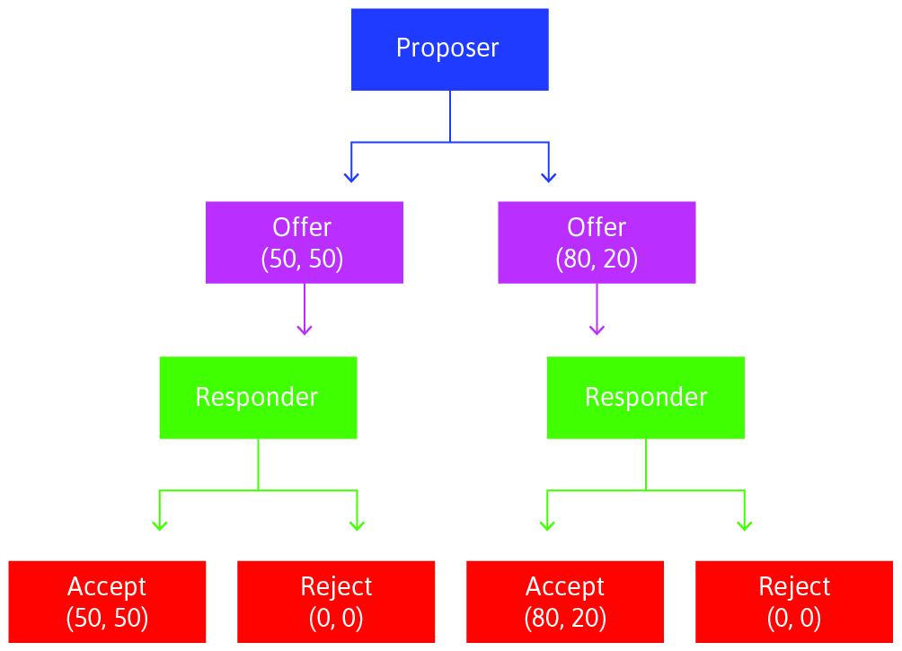
A more interesting game: the ultimatum game
Sequential decisions
Player 1 proposes a division of 100 €
Player 2 accepts or rejects (if rejected neither player gets anything)
What would you propose, what would you accept?
This calls for new type of analysis

Slide 19
Backward induction
What should you propose
Even if you only care about monetary payoffs, you should make a proposal that gets accepted
To get a sense of what gets accepted, put yourself in the shoes of Player 2.
Backward induction is the process of solving the game from its end
The game ends with Player 2’s decision: Player 1’s decisions are all know at this point
Therefore Player 2 accepts if it is the most preferred choice
With material payoffs, she should accept all positive offers
But then with material payoffs, Player 1 should propose the split (99 €, 1 €).
Do we really expect this?
Subjective payoffs
Would you accept all proposals that give you a positive amount of money or would you have different subjective preferences
Most people reject outrageously low offers (how low is considered outrageous varies by individual)
Let’s see how this plays out:

Slide 20
What is accepted? (Kenyan farmers vs. US students)
all accept 50/50 offer
more than half accept 90/10 at Emory U:ssa
almost all formers reject 90/10 offer
Source: The Economy perustuen artikkeliin Henrich ym. (2006): Costly Punishment Across Human Societies. Science 312 (5781): pp. 1767–1770. http://tinyco.re/2043845

Slide 21
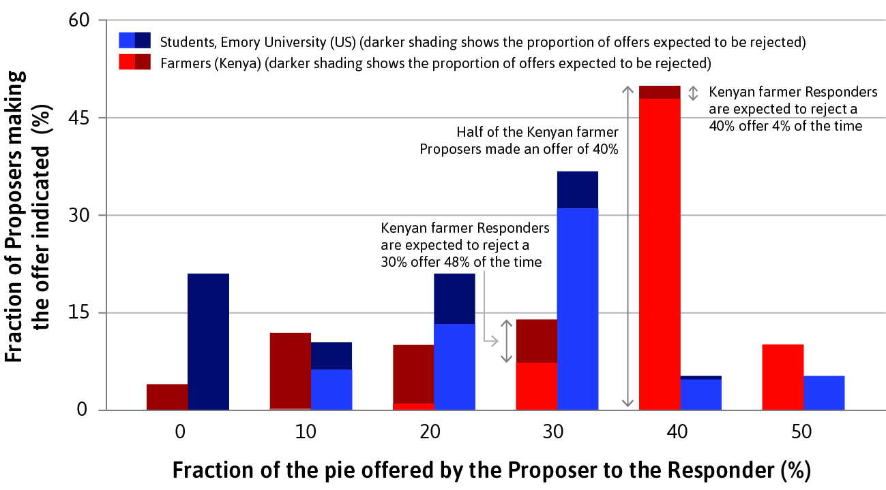
Ultimatum game in two populations:Kenyan farmers and US students

Slide 22
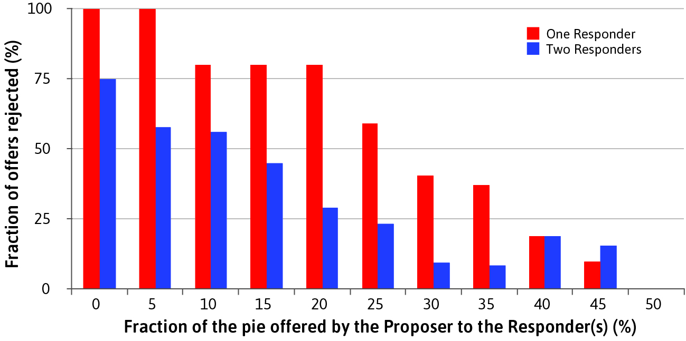
A version with three players
Otherwise as before, but now two responders and the offer is shared
between all responders that accept (if both reject, nobody gets anything)

Slide 23
Some lessons from ultimatum games
Social preferences seem to be at play here
many players reject offers considered unfair (’punish the greedy’ or ’don’t be a sucker’)
even for maximizing own material payoff, the optimal offer depends on its probability of being accepted
you may want to calculate the expected monetary gains for various proposals from the graphs above
Proposer gets more than half
taking the initiative is valuable in other contexts too, e.g. setting the agenda for committees
Credible threat is also useful
you should offer me at least 50% if you believe I turn down all smaller offers
Competition amongst the responders improves the power of the proposer

Slide 24
Summary
Games as models of social interactions
Solution concepts
Social dilemmas
Misalignment of private and societal preferences
Solving the dilemmas: binding contracts, laws, social norms, reciprocal behavior
Next lecture
Institutions and power
Efficiency, fairness and negotiations

