Slide 1
Strategy and Marketing from a Business History Perspective
Session 3
Prof. Dr. Henrikki Tikkanen
Aalto University School of Business, Helsinki, Finland

Slide 2
Founding Fathers & Schools of Thought
1990
Lewin & Volberda
Robert Burgelman
Hamel & Prahalad
Mintzberg & Miller
1980
Hannan & Freeman
Michael Porter
DiMaggio & Powell & Meyer & Scott
Oliver Williamson
Igor Ansoff
James March
1960
Alfred Chandler
Edith Penrose
Herbert Simon
1900
Economics
Joseph Schumpeter
Organization theory
500 ekr
Warfare

Slide 3
Warfare: from Sun Tzu to Jomini and the Prussian School (500 ekr—1820)
1900
Clausewitz
Moltke
Jomini
1800
Vauban
1600
Gustavus II Adolphus
Machiavelli
1500
0
Caesar
500 ekr
Sun Tzu

Slide 4
Strategic Planning (the Prussians)
”In war as an art, no general rules exist ...no plan of operations survives the first collision with the main enemy body.”
von Clausewitz

Slide 5
Frameworks for Strategic Analysis

Slide 6
Michael E. Porter (1977; 1980; 1985)
Corporate survival and performance can be explained by:
The extent and quality of the rivalry within the industry (choosing in which sandboxes to play)
The choice of generic strategies (Cost, Differentiation, Niche/Focus)
Don’t get stuck in the middle!
The quality of the strategies themselves, e.g. in terms on unique customer value propositions (cf. Porter, 1996, Porter & Heppelmann, 2014)

Slide 7
Michael E. Porter
Bishop William Lawrence University Professor, Harvard Business School
16 books, 100+ articles
”Prince of Strategy”

Slide 8
The SCP Framework
Industry
features of the relevant production technology etc
Structure
entry barriers, cost structures, number and size of the rivals
Conduct
pricing, product strategy, advertising, R&D, capital investment
Performance
production and allocative effiency, technological progress, full employment, distributional equity

Slide 9
Caves, Porter and Strategic Groups
Caves and Porter defended the SCP paradigm in the late 1970s by translating it into a Conduct-Structure-Performance form.
Key element was the notion of strategic groups as determinants of performance: a set of firms competing within an industry on the basis of similar combinations of scope and resource commitments.

Slide 10
The Five Forces Model
Potential entrants
threat
bargaining power
bargaining power
Suppliers
Rivalry among existing firms
Buyers
threat
Substitutes

Slide 11
The Value of Porterian Thinking
Concrete tool for industry analysis.
Successful consulting career until the Monitor corp. de facto bankruptcy in 2012
One of the founders of modern strategic management.
IO in general and Porter in particular have offered insights how firms can obtain competitive advantage through positioning in the context of industry structure and pursuing strategies appropriate to that structure.

Slide 12
Evolutionary Economics (Klepper, 1996; Winter, 2006)
The survival of firm is explained by:
Their age and size (the older and bigger, the better)
R&D Expenditure (accumulation of technological capablities)
The developmental phase of the industry (emergent, growing, mature, stagnant)

Slide 13
Population Ecology (Hannan & Freeman, 1989)
Survival vs. Death is explained by
Age
Size
Consistency
Multiplicity of businesses/operations
Credibility of actions
Management can do little or nothing, just optimizing current operations!

Slide 14
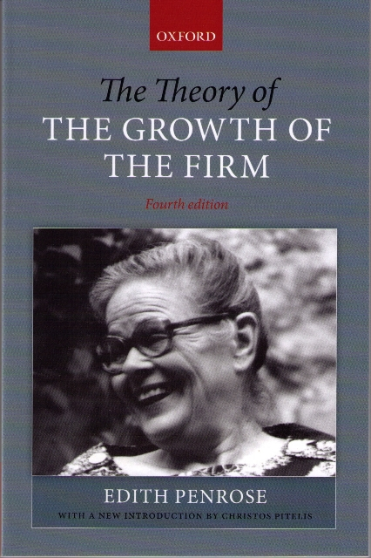
The Development of the RBV
Edith T. Penrose (1959): The Theory of the Growth of the Firm
A firm is more than an administrative unit; it is also a collection of productive resources the disposal of which between different users and over time is determined by administrative decision.
Generally recognized as the founder of RBV

Slide 15
RBV, Dynamic Capabilities Research (Teece, Pisano & Shuen, 1997; Teece, 2007)
Questions of Life and Death:
The assets, knowledge base and capabilities of the firm
Quality and number of executives, especially in the upper echelons
Corporate structure and routines
Ability to renew itself from time to time (cf. IBM, also Nokia)

Slide 16
Core Competence
Provides potential access to a wide variety of markets,
Makes a significant contribution to the perceived customer benefits,
”Core competencies are the collective learning in the organization, especially how to coordinate diverse production skills and integrate multiple streams of technologies.” (Prahalad & Hamel, 1990)

Slide 17
Competitive Dynamics Research (e.g. Miller & Chen, 1994; Ferrier, 2001)
Competitive advantage is centrally explained by competitive actions (marketing, sales, supply, investments, M&A… i.e. How the business model is)
Speed of actions/reactions (e.g. Price wars)
Aggressiveness
Uniqueness
Levels of action (i.e. How many actions are conducted)
Action repertoires (and their renewal, i.e. SOME marketing)
Rhythm of actions (cf. KONE corporation as a ’serial acquisitor’ of small local service firms all around the Globe)

Slide 18
The Hoskisson et al. (1999) classical state-of-the art article “Theory and Research in Strategic Management: Swings of a Pendulum.” Journal of Management, 25(3), 417-456.

Slide 19
Strategy Schools of Thought
Hoskisson et al. (1999) ‘Swings of a Pendulum’ => Inside vs. Outside view to the organization
Original Business Policy of the 1950s &1960s: Inside
Managerial capabilities, corporate procedures, administrative systems…
E.g. the Cyert and March (1963) Behavioral Theory of the Firm
Industrial Organization Economics 1970s & 1980s: Outside
Industry Structures Determine Firm Behavior, Strategic Groups, the SCP framework
Most prominently the ‘Prince of Strategy’ Michael E. Porter
Porter’s Value Chain Analysis, Generic Strategies, 5 Forces Framework, Competitive Advantage of Nations
The Resource-Based View (RBV) from the 1980s: Inside
The Dynamic Capabilities, Core Competencies Approaches
The Knowledge-Based View of the Firm

Slide 20
Strategy Schools of Thought
The Competitive Dynamics and Strategic Leadership approaches of the 1990s and 2000s: both Inside and Outside
Competitive actions and responses on the market
The AMC (Awareness, Motivation, Interest) Framework
Upper Echelons approaches to strategic leadership
Corporate Governance in the era of corporate crises (Enron, Parmalat in Italy etc.)
Still: population ecology alive and kicking (i.e. Outside)
The economic approches to the theory of the firm (TCE, evolutionary economics, game theory, simulations etc.), both approaches
Missing: the Business Model viewpoint, emerging from the 2000s
Interlinkedness of firm functions, earnings logic central
‘The Business Model Canvas’ by Dr. Alexander Osterwalder

Slide 21
Strategy Schools of Thought
In the economic approaches (often termed as the ‘theory of the firm’), the central questions concern:
Why are firms more efficient than markets in taking care of many transactions? (i.e. why do firms exist and what are their functions?)
Where are the boundaries of the firm in different economic systems? (Firm vs. hybrids/networks/ vs. hierarchies)
What is the internal organization of the firm? Why are firms different even in the same industry, and why does it matter?
Differing answers, generally the governance (TCE, agency theory, contract theory etc.) vs. competence (knowledge-based theories) appraches (see Williamson, 1996).
Strategy schools of thought have centrally followed these economic approaches, but add recently more behavioral and cognitive perspectives (evolutionary psychology & biology)

Slide 22
Thank you!
Kuva: Tuuli Sotamaa
Aalto-yliopisto

