Slide 1
Characterization
Engineering
Advanced Micro and Nano
2021
Jari Koskinen

Slide 2
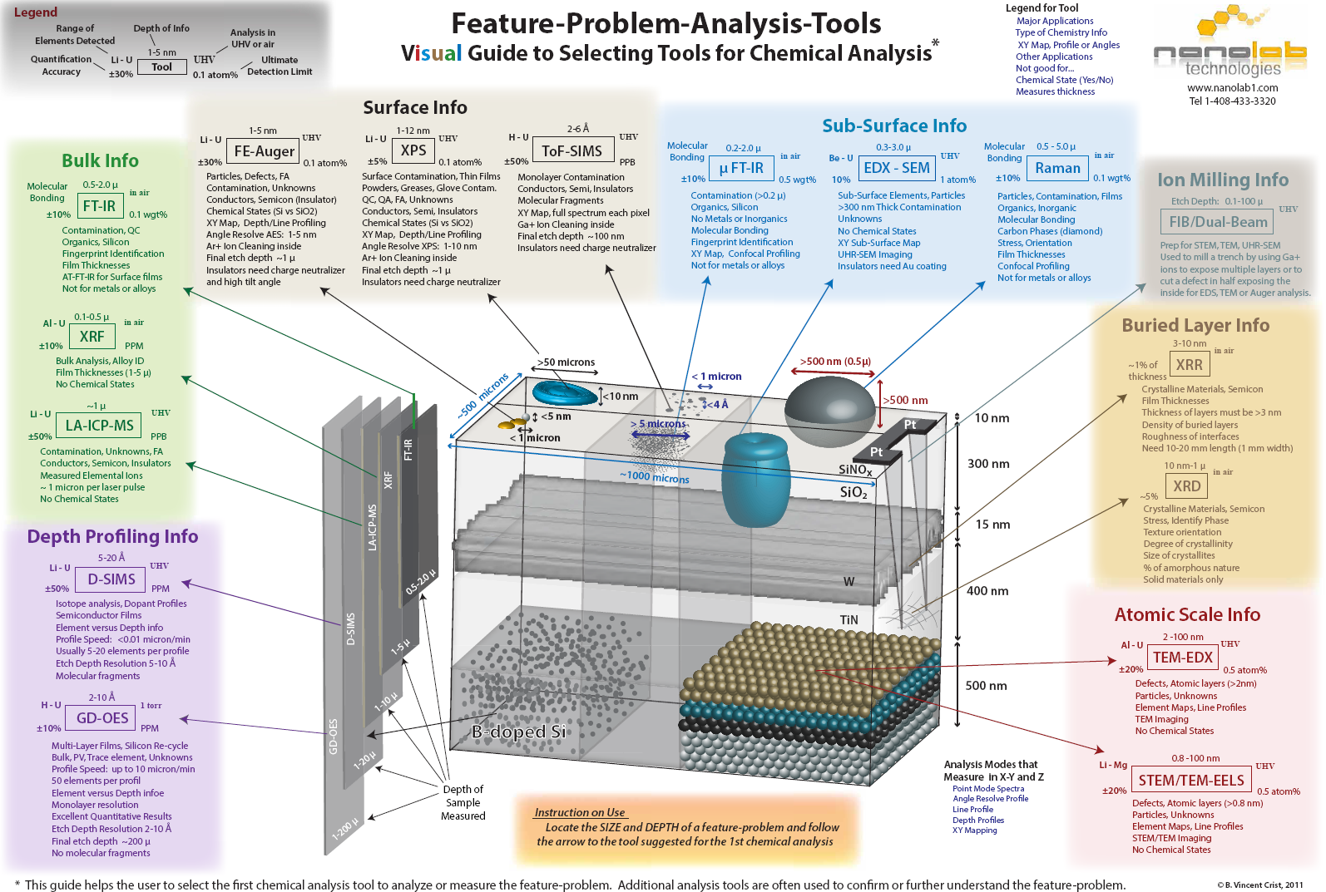

Slide 4
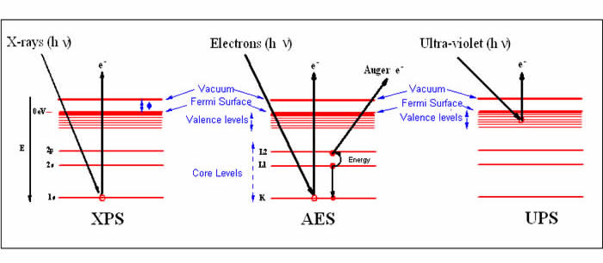
Photoelectron spectroscopy techniques
X-ray photoelectron spectroscopy -
Electron Spectroscopy for Chemical Analysis ESCA
Auger electron spectroscopy
Ultraviolet phoelectron spectroscopy

Slide 5
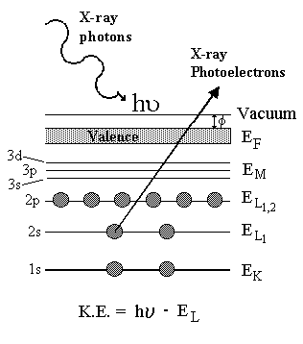
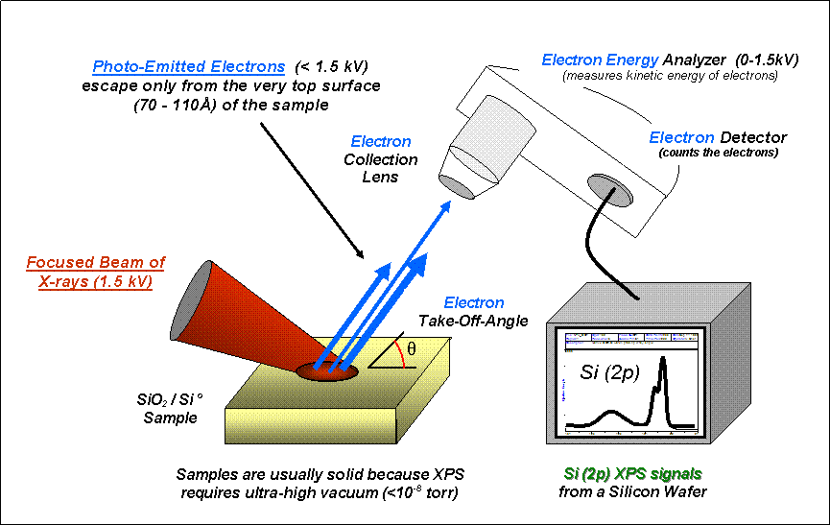
XPS

Slide 6
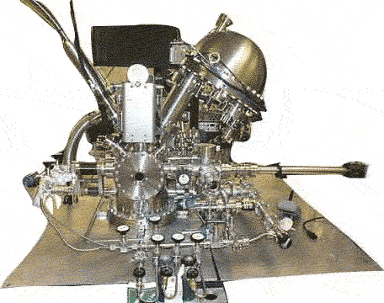
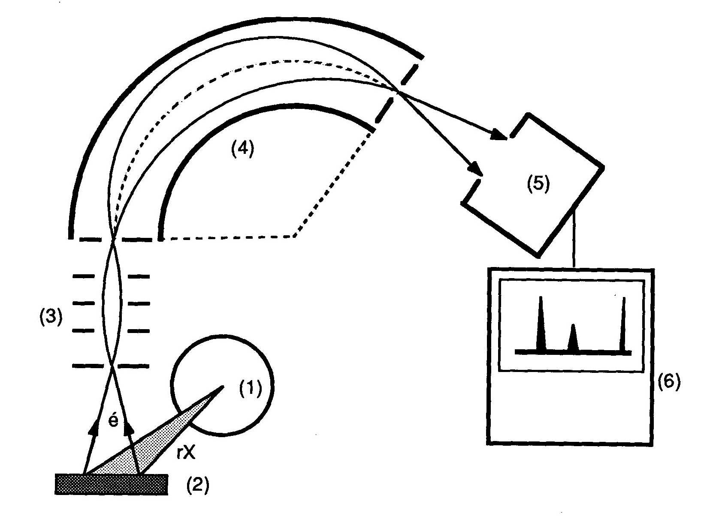
XPS

Slide 7
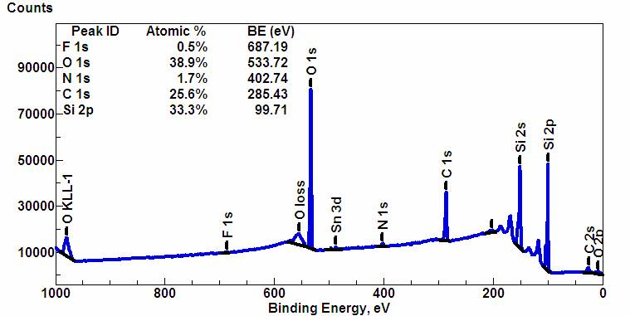
XPS
used for elemental analysis
all elements Z > 2
detection limit 1/1000
1 – 10 nm depth
x-ray beam 20 – 200 µm
mapping

Slide 8
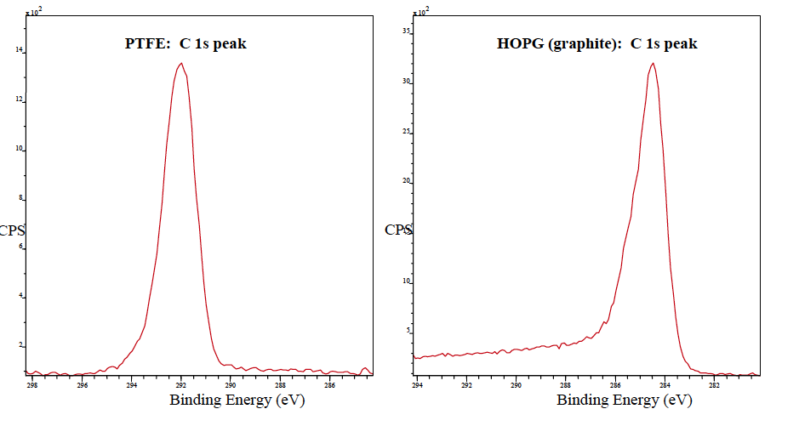
XPS
sensitive to chemical bonding, e.g. type of bonding of carbon

Slide 9
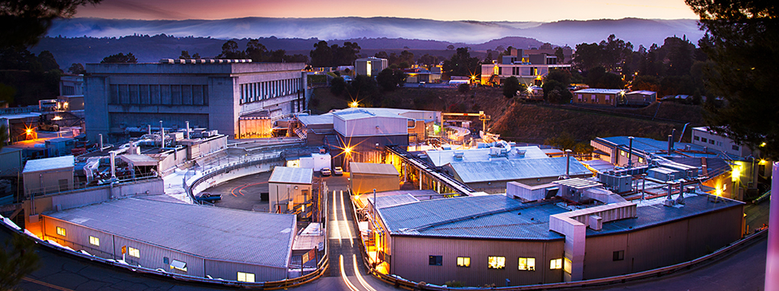
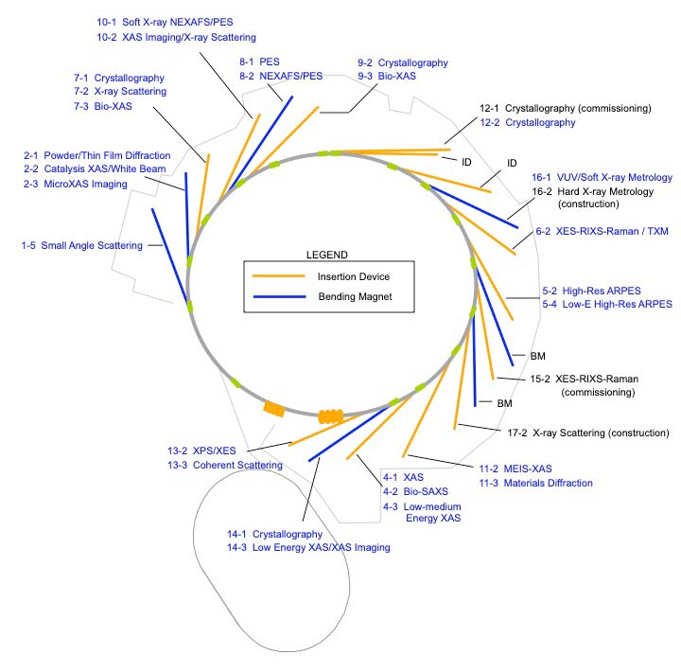
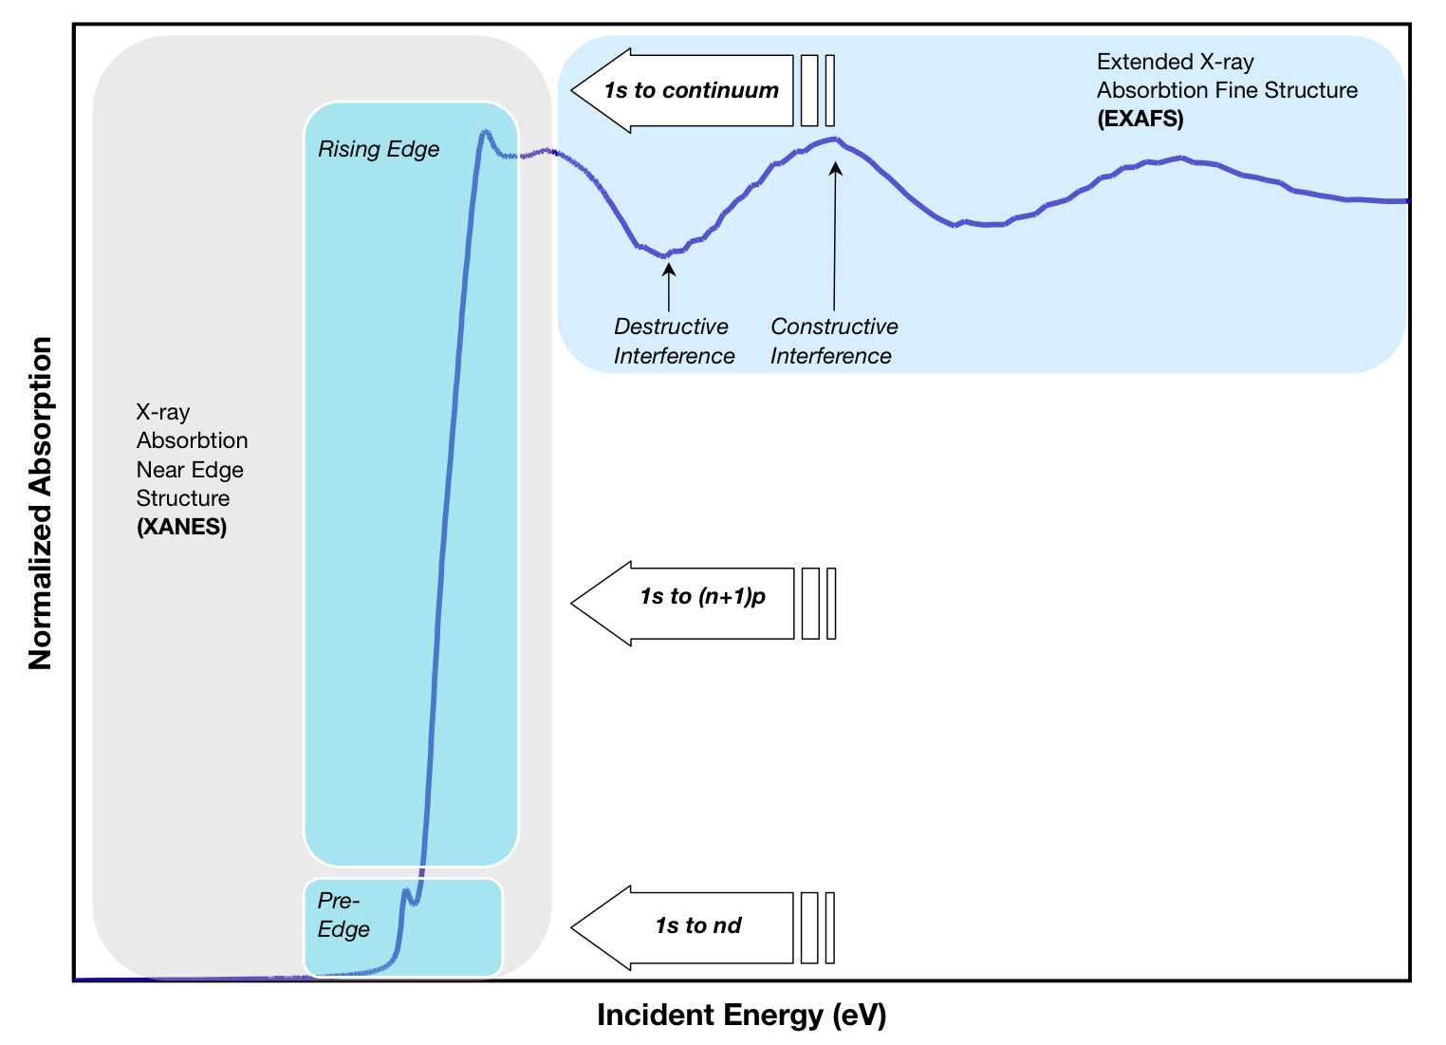
X-ray Absorption Spectroscopy XAS
The Stanford Synchrotron Radiation Lightsource (SSRL)
wikipedia
https://lightsources.org/lightsources-of-the-world/americas/stanford-synchrotron-radiation-lightsource-ssrl/

Slide 10
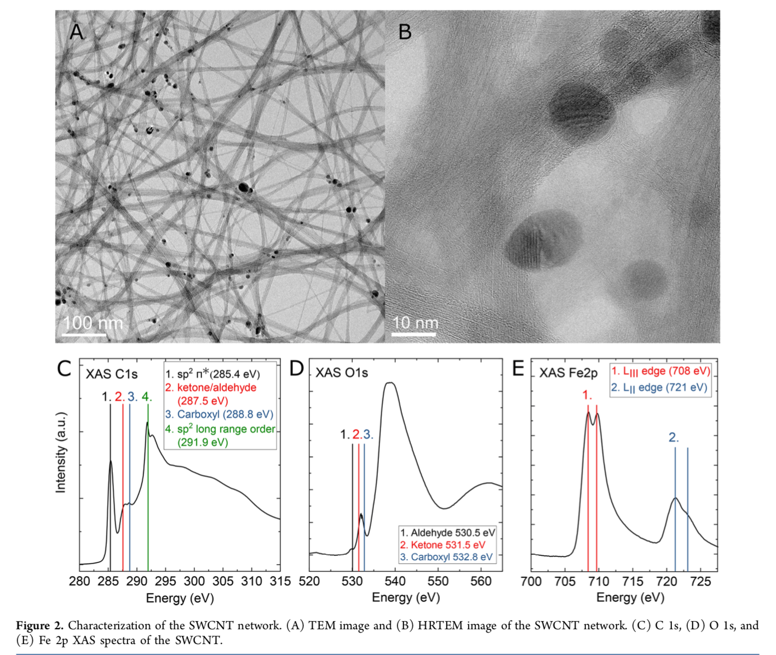
N. Wester et al., ACS Appl. Nano Mater. 2020, 3, 1203−1212

Slide 11
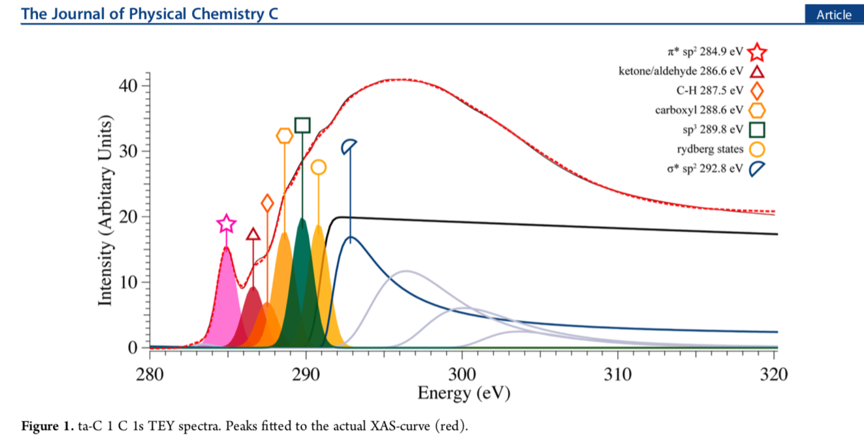
S. Sainio et al., J. Phys. Chem. C 2016, 120, 8298−8304

Slide 12
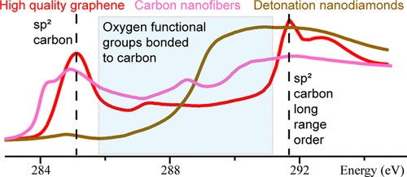

Slide 13
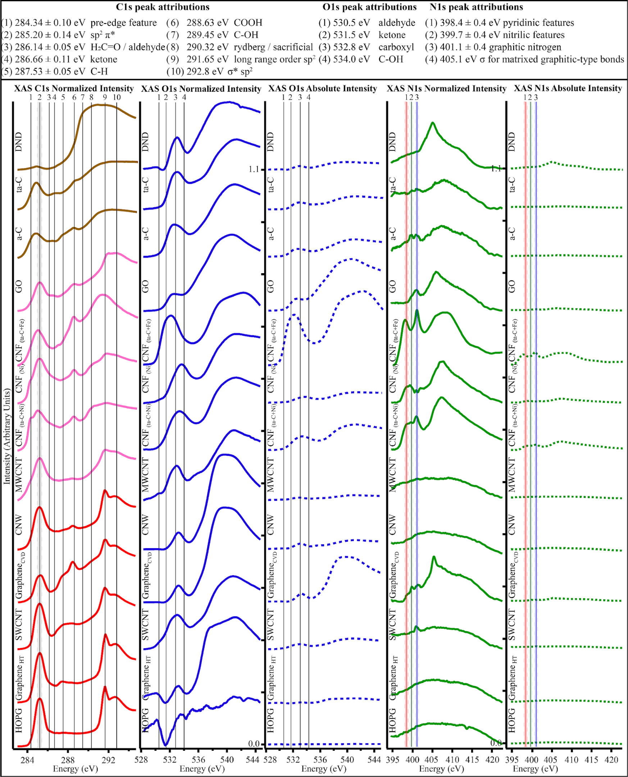

Slide 14
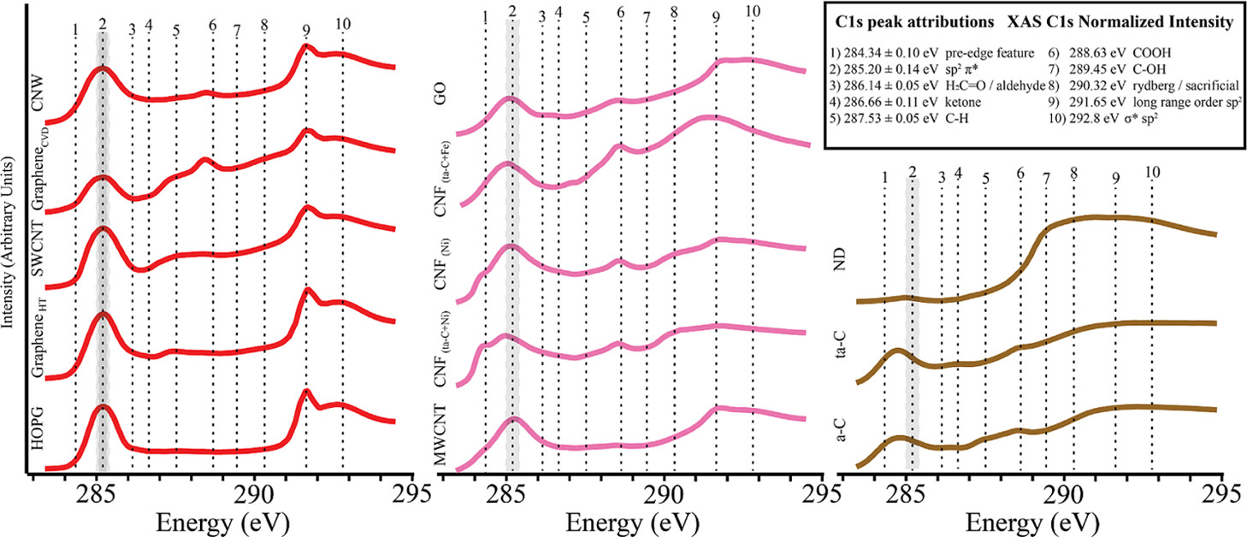
Trends in Carbon, Oxygen, and Nitrogen Core in the X-ray Absorption Spectroscopy of Carbon Nanomaterials: A Guide for the Perplexed
Sami Sainio, Niklas Wester, Anja Aarva, Charles J. Titus, Dennis Nordlund, Esko I. Kauppinen, Elli Leppänen, Tommi Palomäki, Jessica E. Koehne, Olli Pitkänen, Krisztian Kordas, Maria Kim, Harri Lipsanen, Miran Mozetič, Miguel A. Caro, M. Meyyappan, Jari Koskinen, and Tomi Laurila
The Journal of Physical Chemistry C 2021 125 (1), 973-988
DOI: 10.1021/acs.jpcc.0c08597

Slide 15
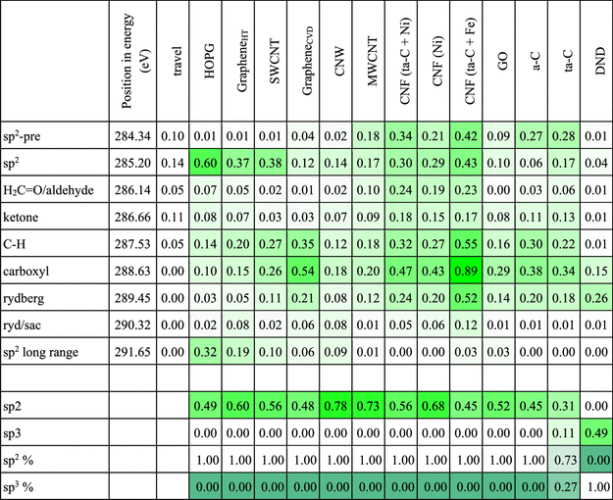

Slide 16
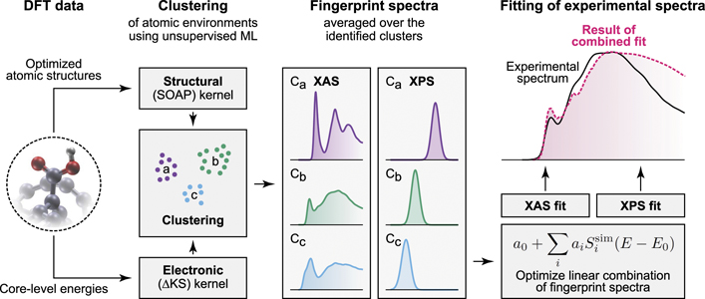
Molecular dynamic modelling, Artificial Intelligence
Elli Leppänen et al 2021 J. Phys.: Condens. Matter 33 434002

Slide 17
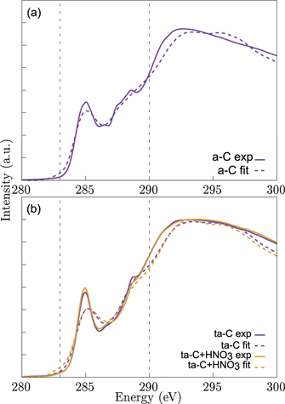
Elli Leppänen et al 2021 J. Phys.: Condens. Matter 33 434002

Slide 18
Small/Medium Angle X-ray Scattering (SAXS/MAXS) using 2D-detector (Rigaku Smartlab)
- Formation of periodic supramolecular lamellar structures from polymers

Slide 20
SEM EDS and WDS
Microanalysis EDS and WDS (material of an other course)

Slide 21
Excerpts from lectures in X-ray microanalysis
Thin surface layer analysis by SEM + x-ray microanalysis (EDS or WDS)
https://www.youtube.com/watch?v=KfQ4VNpWN4M
E. Heikinheimo
Aalto - Dept. of MS & E - 2011

Slide 22
Thin-film analysis (I)
Excitation volume
* Thickness of surface film d_{f} > r_{x}, substrate does not influence
* Film can be processed as bulk, with normal matrix correction program
* d_{f} = 0.2…2 µm (e.g. by adjusting beam energy)

Slide 23
Thin film analysis (II)
d_{f} << r_{x}, d_{f} > 1 nm
Substrate signal is decisive
There can be several films on top of each other: “sandwich structure”
Thin-film software is needed, which is based on calculating Φ(ρz)- function (amount of generated radiation) as function of depth; a hypothesis of studied film structure is needed
In principle thickness and composition of film is obtained from both film and substrate signal (checking possibility).
Non-destructive method, same sample can be analysed by other methods, e.g. RBS.

Slide 24
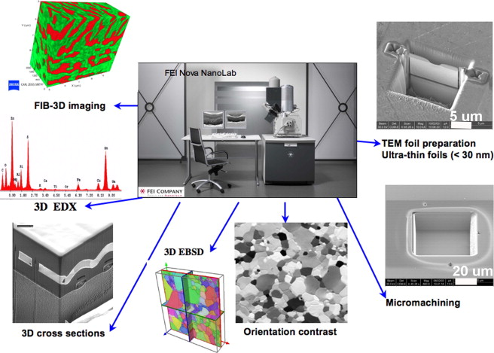
FIB focused ion beam
R. Wirth, Chemical Geology 261 (2009) 217–229

Slide 25
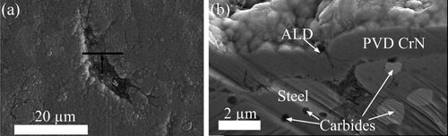
FIB
Figure 9. FIB/SEM analysis done on the hybrid PVD/ALD-coated steel after the LSV5-Wear4. Top view (a) of a major defect on a wear track. The black arrow denotes the location of the cross-sectional image (b) prepared by FIB milling
J. Leppäniemi et al., ACS Omega 2018, 3, 2, 1791–1800

Slide 26
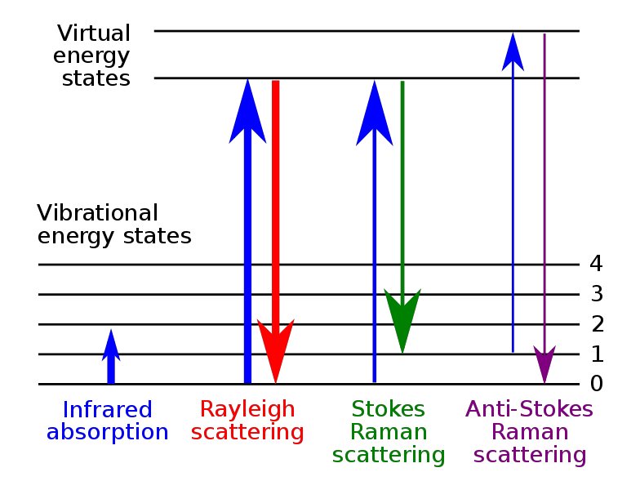
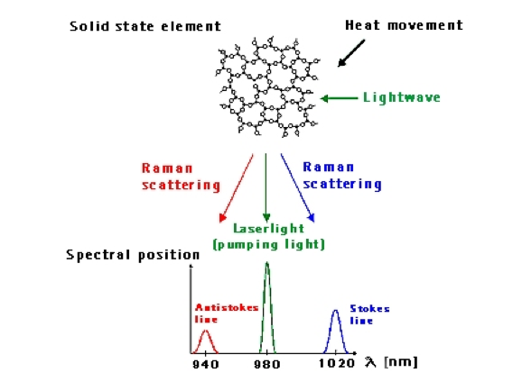
RAMAN

Slide 27
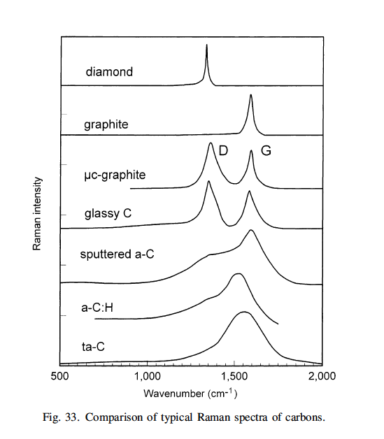
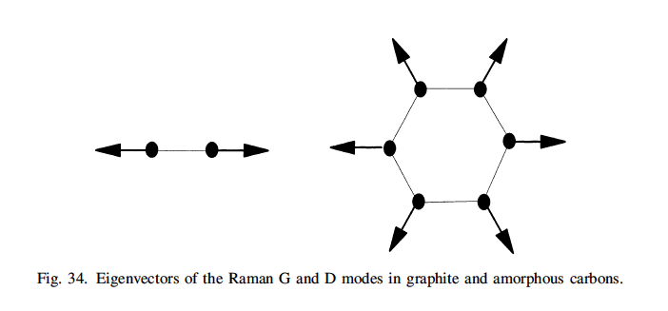
RAMAN example carbon

Slide 28
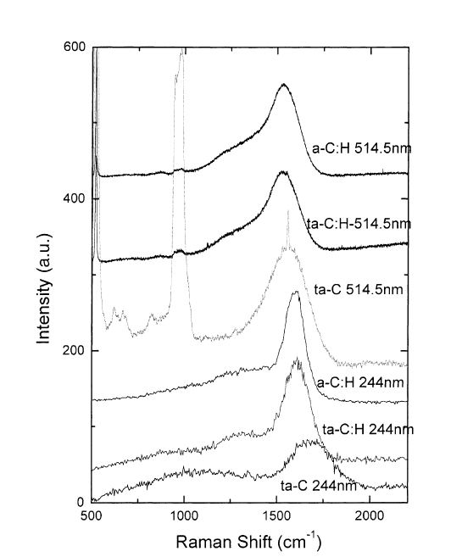
RAMAN example carbon
amorphous materials
finger print of different bonds (materials)
mapping

Slide 29
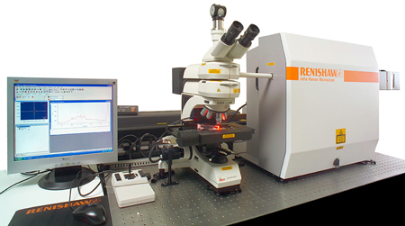
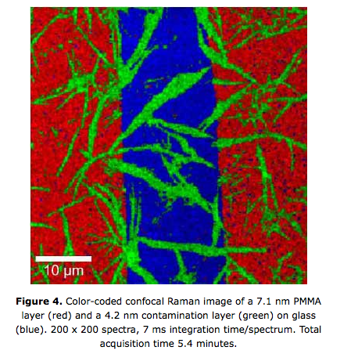
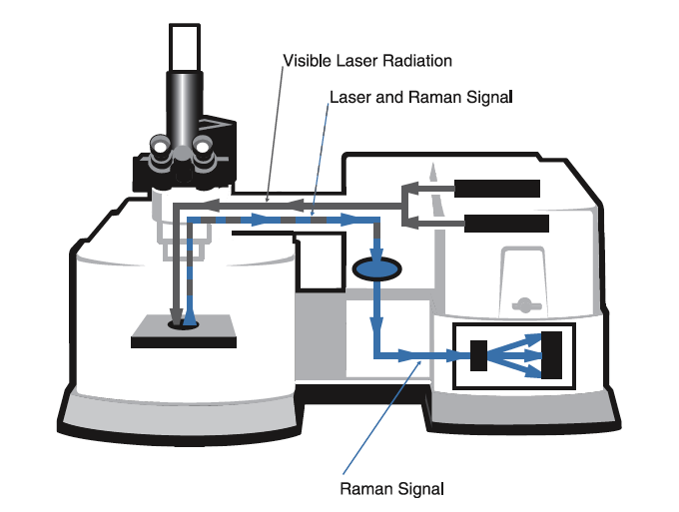
Mapping

Slide 30
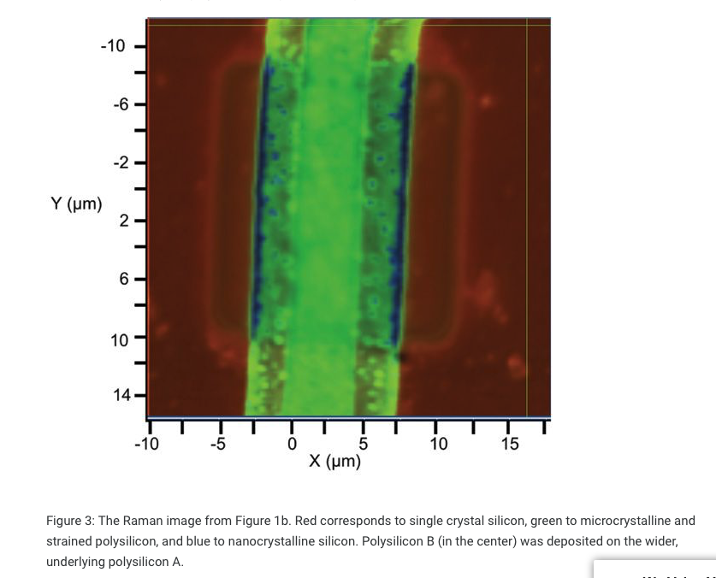
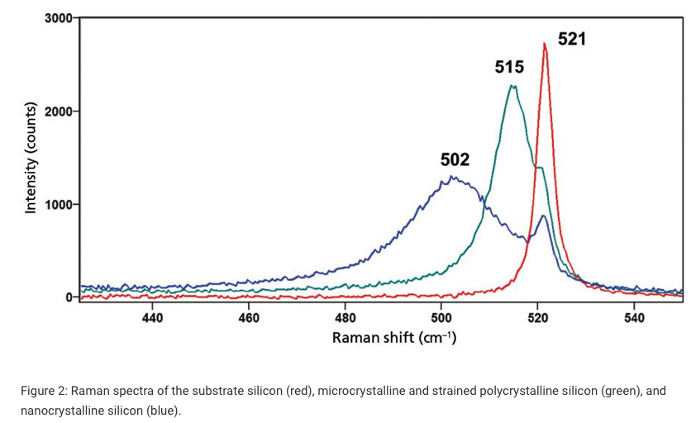
RAMAN Stress and strain
Stress, Strain, and Raman Spectroscopy
September 1, 2019
David Tuschel
Spectroscopy, Spectroscopy-09-01-2019, Volume 34, Issue 9

Slide 32
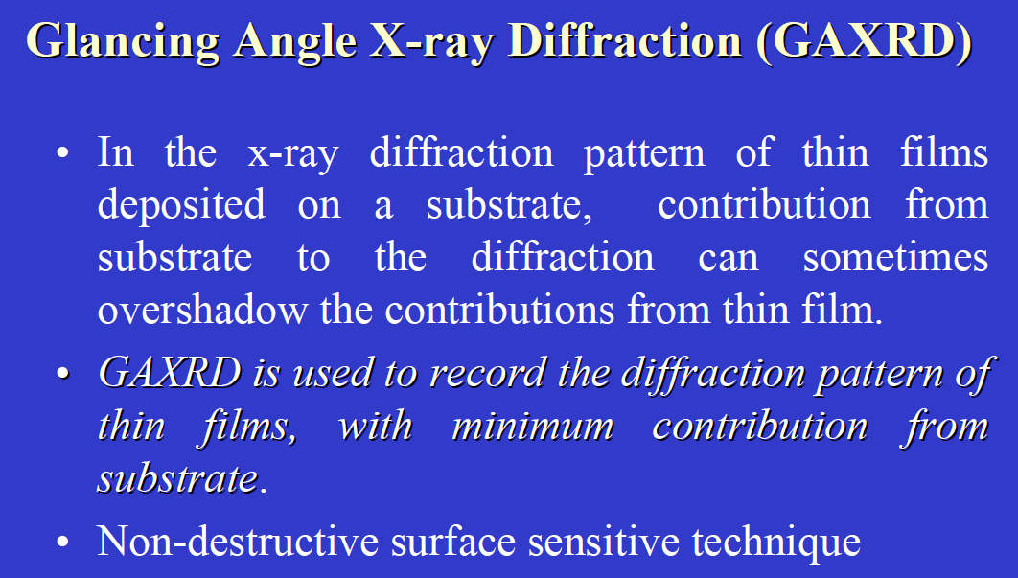
www1.chm.colostate.edu/Files/GAXRD.pdf

Slide 33
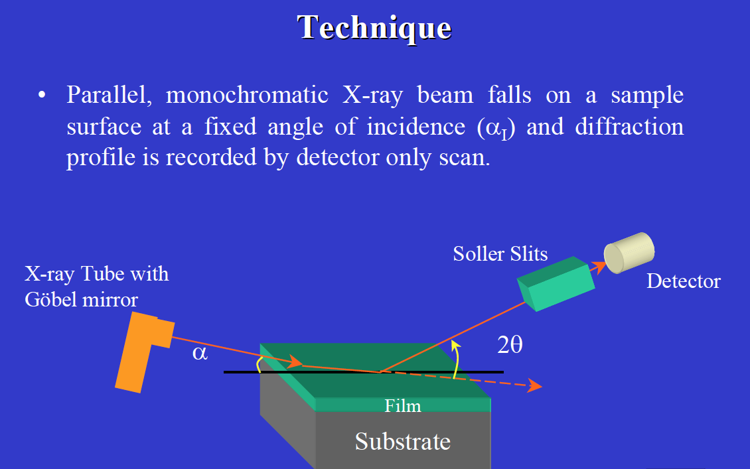
www1.chm.colostate.edu/Files/GAXRD.pdf

Slide 34
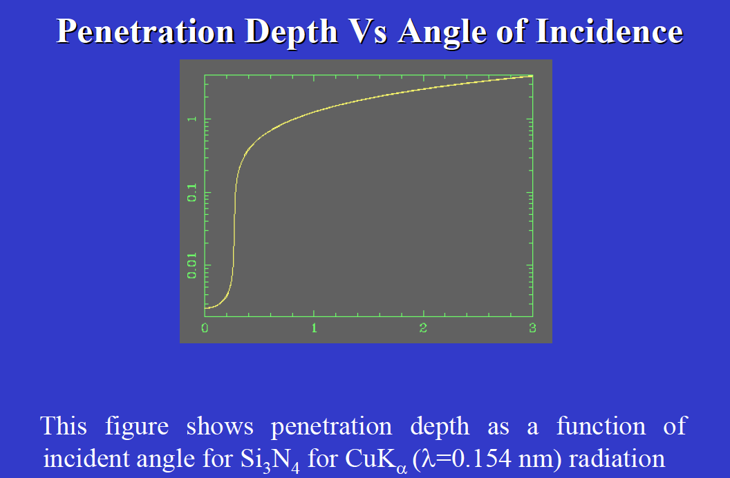
mm
degrees
www1.chm.colostate.edu/Files/GAXRD.pdf

Slide 35
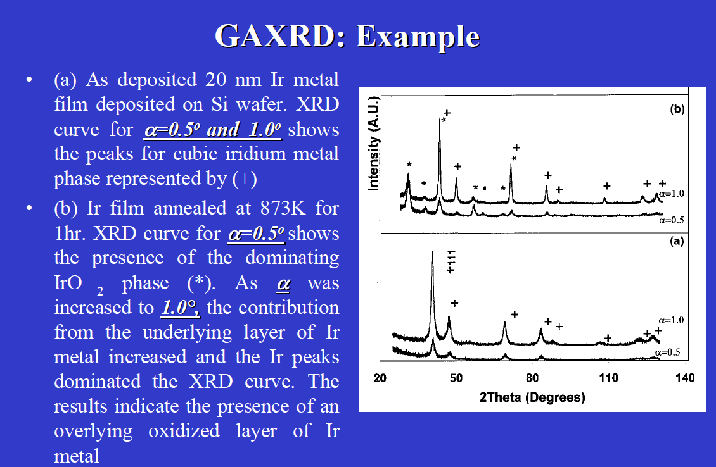
www1.chm.colostate.edu/Files/GAXRD.pdf

Slide 36
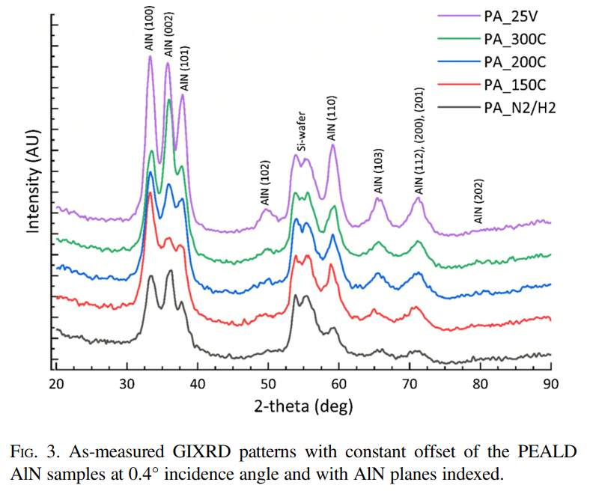
P. Sippola, A. P. Perros, O. M. E. Ylivaara, H. Ronkainen, J. Julin, X. Liu, T. Sajavaara, J. Etula, H. Lipsanen and R. L. Puurunen, Cit. J. Vac. Sci. Technol. A, 2018, 36, 51508.
In-situ XRD spectra of heated/LN2-cooled energy storage material: Rapid freezing from +150C to -120C inhibits crystallization. Subsequent warming from -120C to 0C induces crystallization and heat release.
Grazing angle (GIXRD) and normal theta/2theta X-ray Diffraction using Rigaku Smartlab

Slide 37
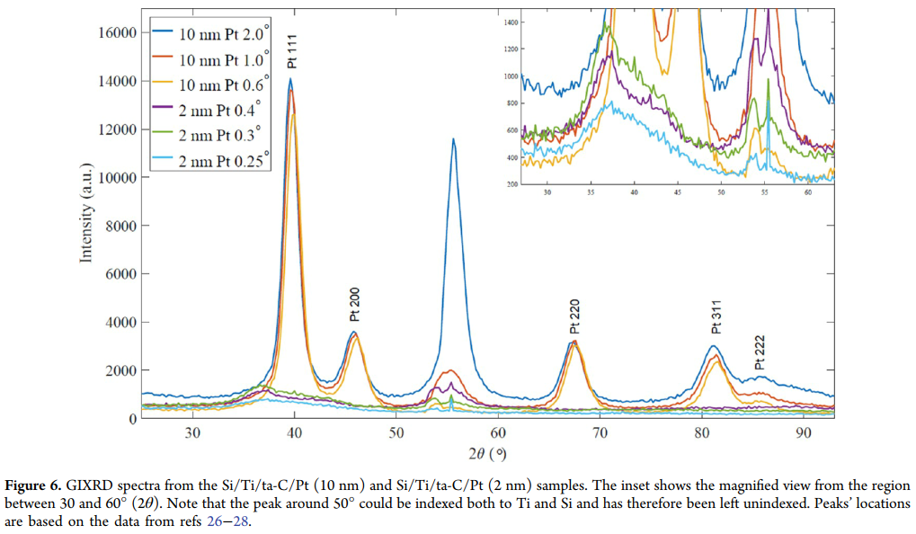
T. Laurila, S. Sainio, H. Jiang, N. Isoaho, J. E. Koehne, J. Etula, J. Koskinen and M. Meyyappan, ACS Omega, 2017, 2, 496–507.
Grazing angle X-ray Diffraction (GIXRD) using Rigaku Smartlab
- Ultra-sensitive detection of 8.4 nm Pt film crystallinity

Slide 38
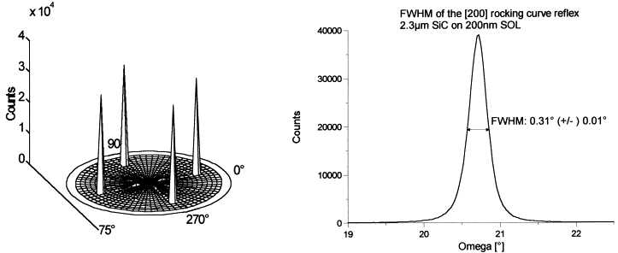
Fig. 1. Polfigure of a SiC on SOI film in [111] and X-ray rocking curve of the [200] reflex.
Materials Science and Engineering B61 – 62 (1999) 567 – 57

Slide 39
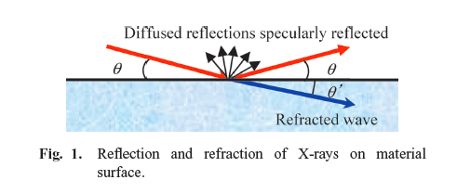
X-Ray Reflectivity XRR
Thin Film
  thickness
  density
  roughness
  rougness of interface
Miho Yasaka, The Rigaku Journal, 26(2), 2010

Slide 40
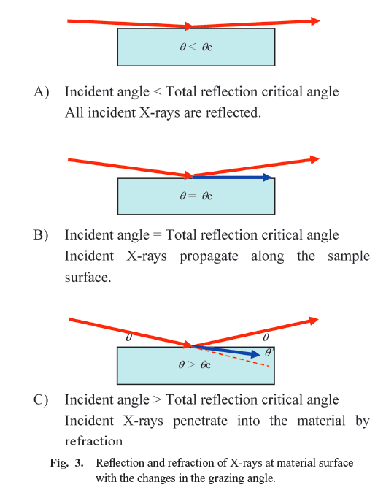
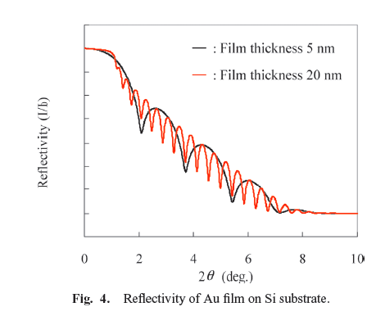
X-Ray Reflectivity XRR
Miho Yasaka, The Rigaku Journal, 26(2), 2010

Slide 41
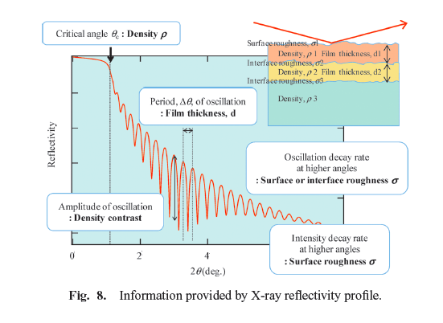
X-Ray Reflectivity XRR
Miho Yasaka, The Rigaku Journal, 26(2), 2010

Slide 42
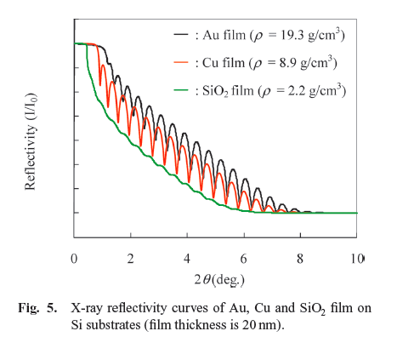
X-Ray Reflectivity XRR
Miho Yasaka, The Rigaku Journal, 26(2), 2010

Slide 43
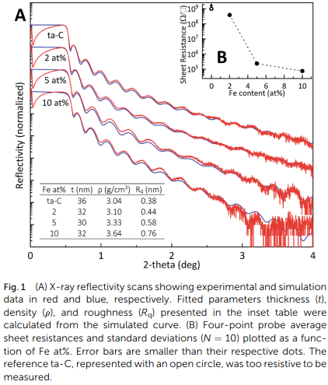
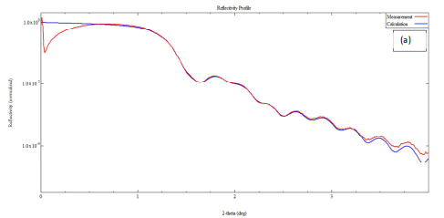
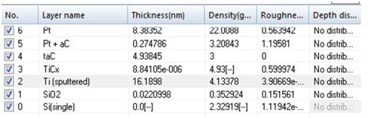
X-ray Reflectivity (XRR)
Fe-doped carbon films Platinum/ta-C/Ti/Si films
1 J. Etula, N. Wester, S. Sainio, T. Laurila and J. Koskinen, , DOI:10.1039/c8ra04719g.
T. Laurila, S. Sainio, H. Jiang, N. Isoaho, J. E. Koehne, J. Etula, J. Koskinen and M. Meyyappan, ACS Omega, 2017, 2, 496–507.

Slide 44
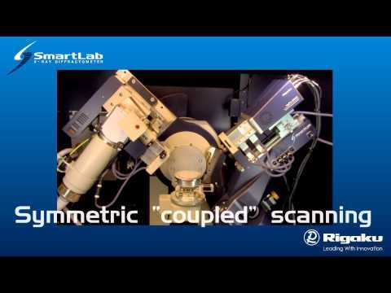

Slide 45
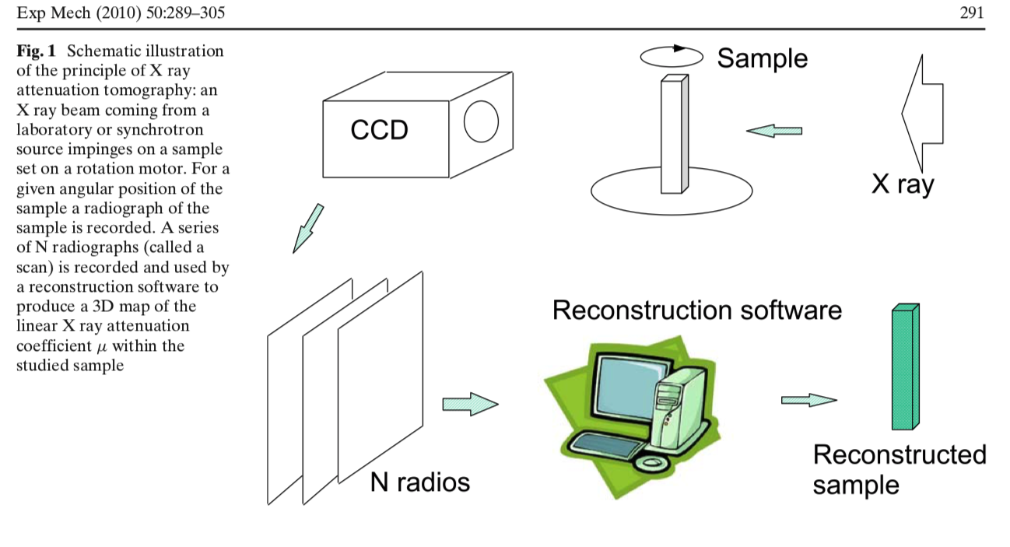
X Ray tomography

Slide 46
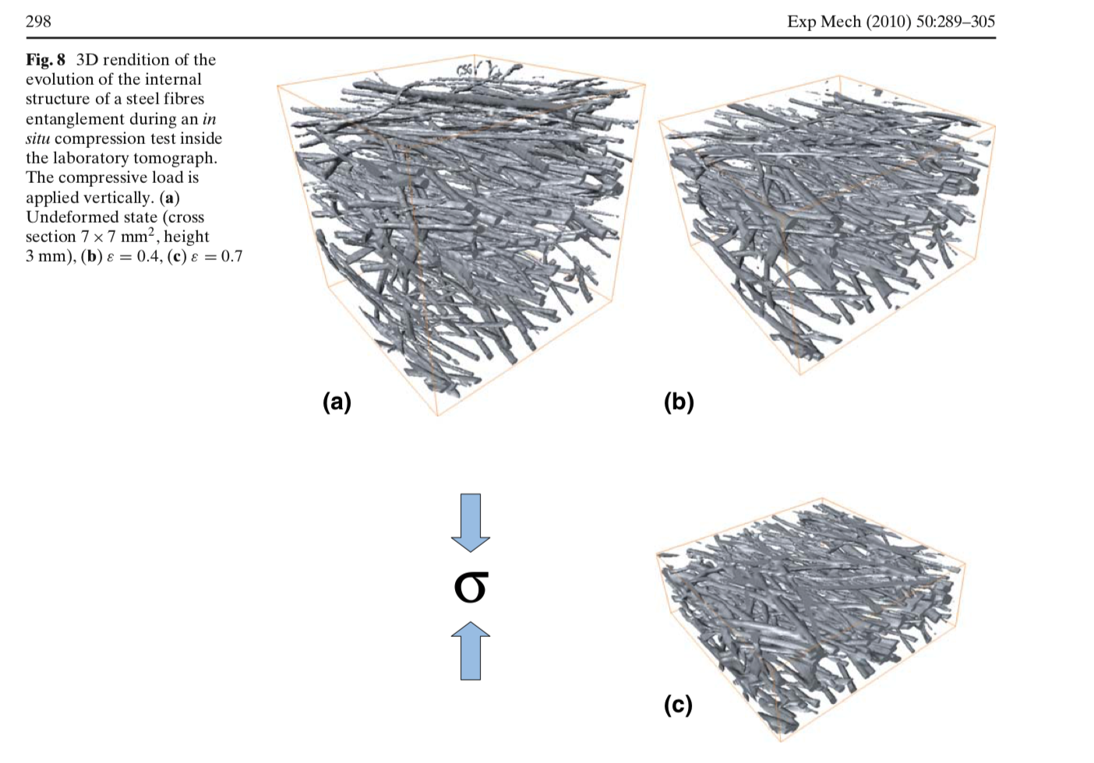
X Ray tomography

Slide 47
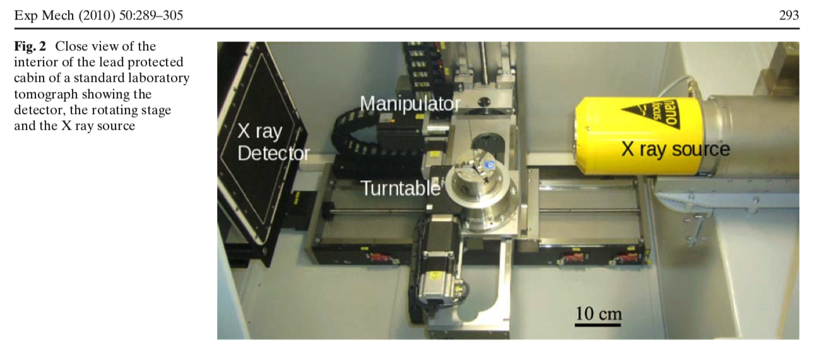
X Ray tomography

Slide 48


Slide 49


Slide 50
X-Ray Tomography
Resolution
δ_{F} ≈ √λb
b distance from source
Λ wavelength
P. Bleuet, et al. https://www.spiedigitallibrary.org/
conference-proceedings-of-spie on 17 Sep 2021

Slide 51




x-ray computed microtomography at GTK Otaniemi
XCT scanner: GE phoenix v|tome|x s
Accelerating voltage: 10-240 kV (microfocus tube) / 10-180 kV (nanofocus tube)
Max. power: 320 W (microfocus tube) / 20 W (nanofocus tube)
Best resolution: 5 μm (microfocus tube) / 900 nm (nanofocus tube)
Detector: 400x400 mm² 4 MPix temperature stabilized DXR, 200 μm pixel size
Max. sample size: 400 mm diameter, 420 mm height, 10 kg weight
Extensions: helix|CT, offset|CT, easy|calib
Software: FEI PerGeos 2019.3, ImageJ, Drishti

Slide 53


Slide 54


Secondary Ion Mass Spectrometry - SIMS
1. Cesium ion source
2. Duoplasmatron
3. Electrostatic lens
4. Sample
5. Electrostatic sector - ion energy analyser
6. Electromagnet - mass analyser
7. Electron multiplier / Faraday cup
8. Channel-plate / Fluorescent screen - ion image detector
SIMS by Leena-Sisko Johansson

Slide 55

SIMS

Slide 56

SIMS - also molecular ions

Slide 58

Transmission electron microscopy TEM
Atomic level resolution
0.7 Å

Slide 59

NiSi thin film
Results from TEM analysis of NiSi thin films: (a) XTEM highlighting equiaxed grains in the NiSi film in which Moiré (interference) fringes due to orientation differences between grains can be observed; (b) notable features in the as-obtained image (a) are indicated; (c) plan view, elastic hollow cone dark field image of the film, highlighting individual grains with diameters of 60–200 nm; and (d) plan view TEM image showing polygon al NiSi grains.

Slide 60

Electron diffraction
Measured diffraction pattern of a plan-view prepared ReSi1.75 film on Si (100) (——— guiding line for orientation); (b) theoretical diffraction diagram of ReSi1.75 with zone axis [0 1 0] and four superposed patterns, each turned around 45°.

Slide 61

Electron energy loss spectroscopy EELS
energy filtered

Slide 62

Electron energy loss spectroscopy EELS
Elemental analysis
  light elements C ➔ 3d transition metals Sc, Zn
chemical bonding e.g carbon sp²/sp³

Slide 63

Electron energy loss spectroscopy EELS

Slide 64



Ion beam analysis
Backscattering spectroscopy
Ion beam accelerator with several beam lines and ion sources

Slide 65


Slide 66




Ion beam analysis
Backscattering spectroscopy
E₀ =
recoil energy ->
what element
E₁ = k * E₀
atomic mass of element
E₁
Probability of recoil -> amount of element
Kinetic energy loss inside material – stopping -> depth scale

Slide 67

Ion beam analysis
Backscattering spectroscopy

Slide 68


Ion beam analysis
⁴ He⁺ ion

Slide 69

⁶³ Cu⁺ ion

Slide 70




Slide 71

Scanning Probe Microscopy
nanoScience Inc.

Slide 72


Slide 73

Nano wear
TiO₂ ALD, varying deposition temperature
°C
100 °C
200 °C
300 °C
J. Lyytinen et al. / Wear 342-343 (2015) 270–278272

Slide 74

Wear depth
J. Lyytinen et al. / Wear 342-343 (2015) 270–278272

Slide 75

Indentation
H = constant*load/(indentation area)
Thin film/substrate: composite hardness
Coating hardness: h< film thickness
Very thin coatings: hardness by modelling (FEM, MD)

Slide 76



Elastic modulus E from loading - unloading curve
h < 1/10 film thickness
Very thin coatings: E by modelling (FEM, MD)

Slide 77

Indentation test

Slide 78


Hardness and E as a function of indentation depth
Depth profiles of Er and H data from 200 μN partial-unload nanoindentation tests on 50 nm TiN thin film samples. www.hysitron.com

Slide 79



Investigation of the Bulge Test Response of Molybdenum Thin Films at Room Temperature and at 100 °C
t
Strain, Volume: 45, Issue: 3, Pages: 238-248, First published: 14 May 2009, DOI: (10.1111/j.1475-1305.2008.00496.x)
Notes:
(A) A schematic of the bulge formed by pressurisation of one side of a free‐standing thin film. (B) A schematic of the apparatus used for pressurising the film and measuring the bulge height
IF THIS IMAGE HAS BEEN PROVIDED BY OR IS OWNED BY A THIRD PARTY, AS INDICATED IN THE CAPTION LINE, THEN FURTHER PERMISSION MAY BE NEEDED BEFORE ANY FURTHER USE. PLEASE CONTACT WILEY'S PERMISSIONS DEPARTMENT ON PERMISSIONS@WILEY.COM OR USE THE RIGHTSLINK SERVICE BY CLICKING ON THE 'REQUEST PERMISSIONS' LINK ACCOMPANYING THIS ARTICLE. WILEY OR AUTHOR OWNED IMAGES MAY BE USED FOR NON-COMMERCIAL PURPOSES, SUBJECT TO PROPER CITATION OF THE ARTICLE, AUTHOR, AND PUBLISHER.

Slide 80

Investigation of the Bulge Test Response of Molybdenum Thin Films at Room Temperature and at 100 °C
Stress–strain curves from room temperature experiments for a 170-nm molecular beam epitaxy film with small grains compared with a 200-nm sputter film with large grains. The tangent moduli are approximately 300 and 133 GPa for the 170- and 200-nm films respectively
Strain, Volume: 45, Issue: 3, Pages: 238-248, First published: 14 May 2009, DOI: (10.1111/j.1475-1305.2008.00496.x)
Notes:
Stress–strain curves from room temperature experiments for a 170‐nm molecular beam epitaxy film with small grains compared with a 200‐nm sputter film with large grains. The tangent moduli are approximately 300 and 133 GPa for the 170‐ and 200‐nm films respectively
IF THIS IMAGE HAS BEEN PROVIDED BY OR IS OWNED BY A THIRD PARTY, AS INDICATED IN THE CAPTION LINE, THEN FURTHER PERMISSION MAY BE NEEDED BEFORE ANY FURTHER USE. PLEASE CONTACT WILEY'S PERMISSIONS DEPARTMENT ON PERMISSIONS@WILEY.COM OR USE THE RIGHTSLINK SERVICE BY CLICKING ON THE 'REQUEST PERMISSIONS' LINK ACCOMPANYING THIS ARTICLE. WILEY OR AUTHOR OWNED IMAGES MAY BE USED FOR NON-COMMERCIAL PURPOSES, SUBJECT TO PROPER CITATION OF THE ARTICLE, AUTHOR, AND PUBLISHER.

Slide 81
Bonding
Chemical reactions particularly on surface
Cemical bonding in amorphous thin films (oxides, carbon, some metals)
Contaminations
Methods used also to determine composition

Slide 82


Slide 83

IR microscopy

Slide 84

IR microscopy

Slide 85
Optical coatings
Control of reflectance and emission
  Lenses
  Photo voltaic
  Solar thermal
Protective optical coatings
Self-cleaning or easy to clean films on optical surfaces
Measuring thin dielectric film properties

