Slide 1
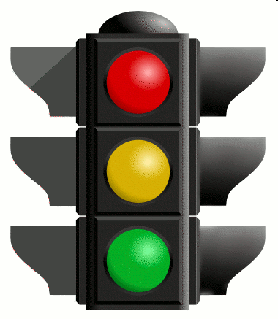
Traffic lights of stress and wellbeing
Breakdown: exhaustion, don’t feel like doing anything, no energy to do things, everything feels pointless and hopeless
=> DON’T BE ALONE, SEEK HELP
Under a lot of stress: mind and body overstressed – if continuous, stress symptoms, problems with concentration and sleeping, restlessness, tiredness may arise. => STOP AND EVALUATE (WITH SOMEONE)
Life in balance: right amount of challenges and strain, enought time to rest and recover.
=> KEEP ON GOING

