Slide 1
Lecture 9: Supply and Demand: Price-Taking and Competitive Markets
Juuso Välimäki
October 13, 2021

Slide 2
Gains from Trade

Slide 3
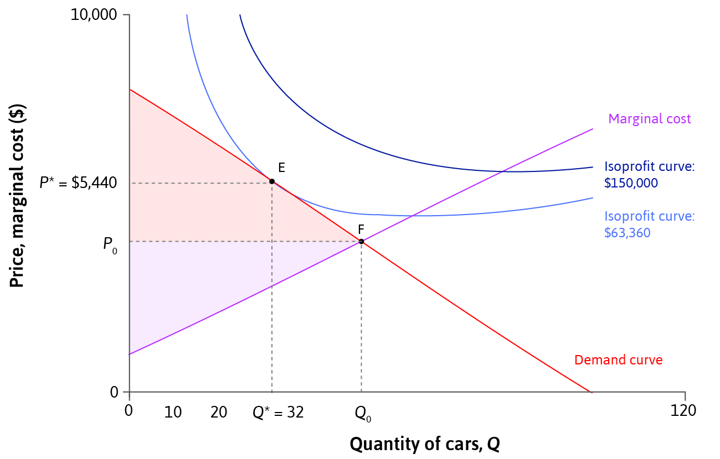
Measuring Surplus
Consumer surplus (CS) = the total difference between willingness-to-pay and purchase price
Producer surplus (PS) = the total difference between revenue and marginal cost
(Profit = PS – fixed costs)
Total surplus = Consumer surplus + Producer surplus
= Total gains from trade

Slide 4
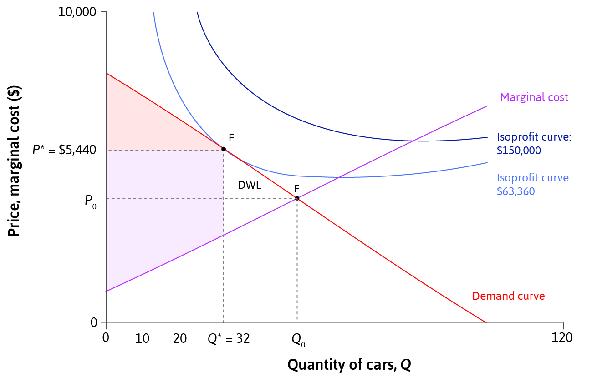
Deadweight Loss
Deadweight loss = a loss of total surplus relative to a Pareto efficient allocation (unexploited gains from trade)
Total surplus is highest when
Demand = Marginal Cost
(Pareto efficient allocation)

Slide 5
Understanding deadweight loss
When setting its price, a firm cares only about its own profit
Restricting the quantity to increase the price imposes a negative effect on the consumers
By allowing firms to set individual prices to individual consumers results in the firm capturing the entire surplus (if the firm knows the individual wtp)
In practice, the wtp is private information and the firm may try to find this out (privacy on the net)
Competition authorities care about the distribution of surplus between the firm and customers

Slide 6
Price Elasticity of Demand

Slide 7
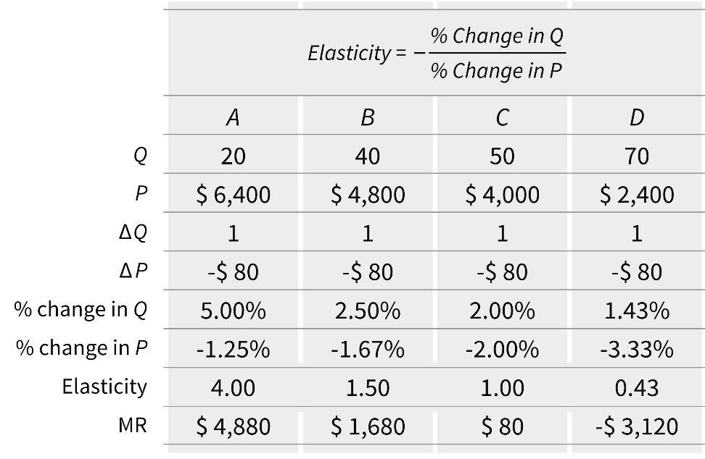
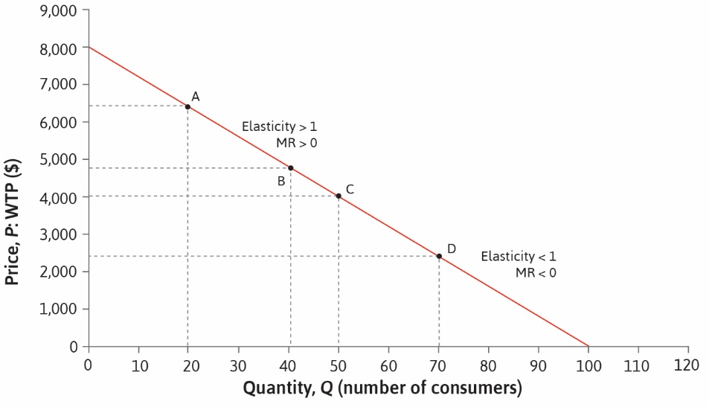
Price Elasticity of Demand
A firm’s pricing decision depends on the slope of the demand curve.
Price elasticity of demand = degree of responsiveness (of consumers) to price change.
We say that demand is elastic if 𝛆 > 1.
Marginal revenue is positive whenever demand is elastic.

Slide 8
Price Elasticity of Demand
In the definition of the elasticity,
𝛆 = - $\frac{\frac{ΔQ}{Q}}{\frac{ΔP}{P}}=− \frac{\frac{P}{Q}}{\frac{ΔP}{ΔQ}}$ = - $\frac{P}{\frac{QΔP}{ΔQ}}$.
For small price changes, we can use P’(Q) to approximate $\frac{ΔP}{ΔQ}$ and we get:
𝛆 = - $\frac{\text{P}}{\text{QP}\text{’(}\text{Q}\text{)}}$.
Price elasticity is one of the most important concepts in economics and it will feature in the coming lectures and courses heavily.

Slide 9
Elasticity and profit maximization
Recall from profit maximization that at optimal $\text{Q}\text{∗}$
P’($\text{Q}\text{∗}$) = - $\frac{\text{P}\text{(}\text{Q}\text{∗}\text{)−}\text{C}\text{’(}\text{Q}\text{∗}\text{)}}{\text{Q}\text{∗}}$.
Divide both sides by P(Q*) and multiply by Q* to get:
$\frac{\text{Q}\text{∗} \text{P}\text{’(}\text{Q}\text{∗}\text{)}}{\text{P}\text{(}\text{Q}\text{∗}\text{)}}$= - $\frac{\text{P}\text{(}\text{Q}\text{∗}\text{)} \text{−}\text{C}\text{’(}\text{Q}\text{∗}\text{)}}{\text{P}\text{(}\text{Q}\text{∗}\text{)}}$.
Or
$\frac{\text{P}\text{(}\text{Q}\text{∗}\text{)} \text{−}\text{C}\text{’(}\text{Q}\text{∗}\text{)}}{\text{P}\text{(}\text{Q}\text{∗}\text{)}}$= $\frac{1}{\text{ε}}$.
We call $\frac{\text{P}\text{(}\text{Q}\text{∗}\text{)} \text{−}\text{C}\text{’(}\text{Q}\text{∗}\text{)}}{\text{P}\text{(}\text{Q}\text{∗}\text{)}}$the markup.
Markups are inversely related to the elasticity of demand
High elasticity leads to low markups (prices)

Slide 10
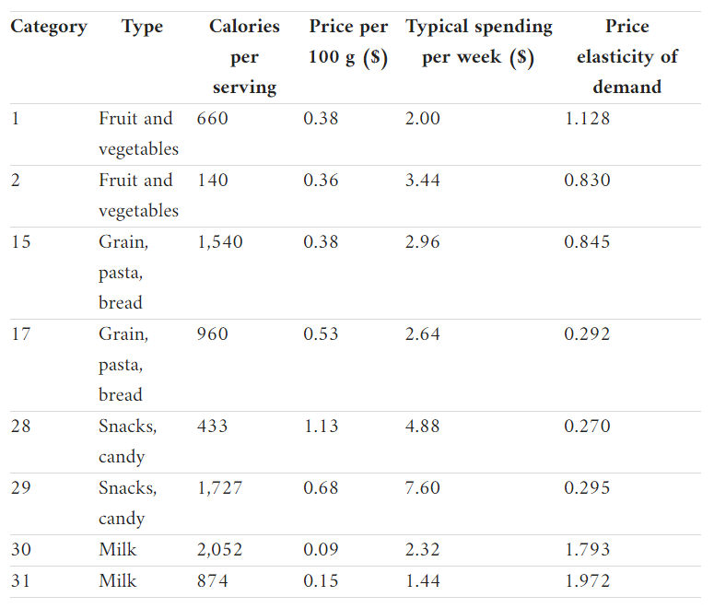
Price Elasticity and Policy
The effect of good-specific taxes depends on the elasticity of demand for those goods.
Governments raise more tax revenue by levying taxes on price-inelastic goods.
Several countries e.g. Denmark and France have introduced taxes on unhealthy foods – to reduce consumption not to raise revenue.

Slide 11
Price Elasticity and Market Power
A firm’s profit margin depends on the elasticity of demand, which is determined by competition:
Demand is relatively inelastic if there are few close substitutes
Firms with market power have enough bargaining power to set prices without losing customers to competitors
Competition policy (limits on market power) can be beneficial to consumers when firms collude to keep prices high.

Slide 12
Market Power: Monopolies
Example of market power: A firm selling specialized products.
They face little competition and hence have inelastic demand.
They can set price above marginal cost without losing customers, thus earning monopoly rents.
This is a form of market failure because there is deadweight loss.
A natural monopoly arises when one firm can produce at lower average costs than two or more firms e.g. utilities.
Instead of encouraging competition, policymakers may put price controls or make these firms publicly owned.

Slide 13
Gaining market power
Firms can increase their market power by:
Innovating – Technological innovation can allow firms to differentiate their products from competitors’ e.g. hybrid cars. Firms that invent a completely new product may prevent competition altogether through patents or copyright laws.
Advertising – Firms can attract consumers away from competing products and create brand loyalty. Advertising can be more effective than discounts in increasing demand for a brand.
Both of these tactics can shift the firm’s demand curve.

Slide 14
Summary
1. Model of a firm with market power (price-setter)
Price and production decisions depend on a firm’s demand curve and cost function.
Profit-maximising choice where MRS = MRT
Or, in terms of revenue and costs, where MR = MC
2. Surplus measures the gains from trade
Total surplus = Producer surplus + Consumer surplus
Deadweight loss when allocation not Pareto efficient
Price elasticity of demand affects surplus and profits

Slide 15
Outline for Lecture 9
Introduction
Competitive equilibrium: Key concepts
Factors that affect equilibrium
Commodity taxation
Perfect competition

Slide 16
The Context for Lecture 9
Firms with market power can set their own price.
Market outcomes are generally not Pareto-efficient.
In reality, many firms are price-takers.
How does their behavior differ from price-setting firms?
Can competition improve market outcomes?
(Lecture 8)

Slide 17
This Lecture
Model of interactions between price-taking firms and customers
Perfect competition = special case of the model
Similarities and differences between price-taking and price-setting firms

Slide 18
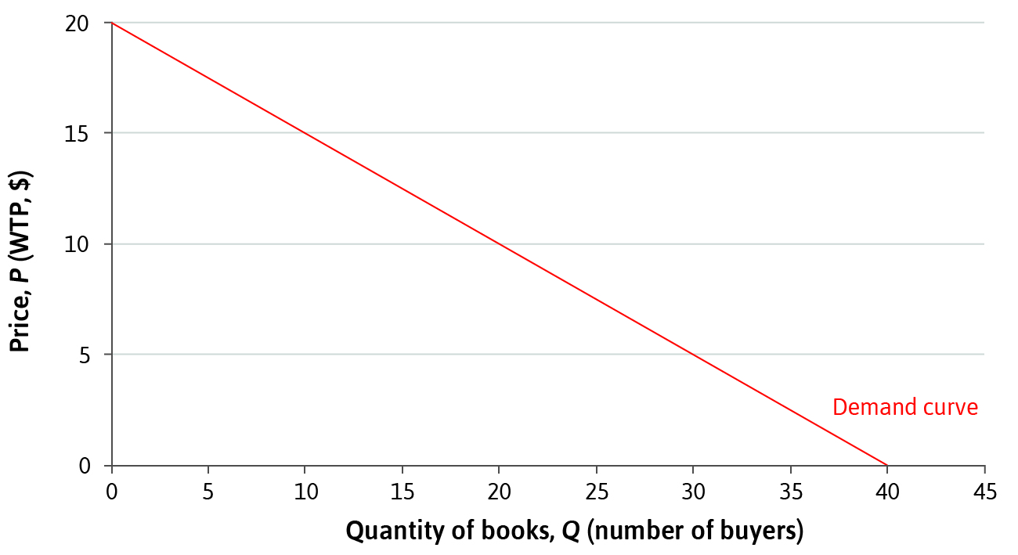
Key concepts: Demand curve
In some markets, supply and demand are easy to understand:
Consider the market for second-hand textbooks
Demand curve = Price at which Q books can be sold
Represents the willingness to pay (WTP) of buyers.
Imagine the buyers ordered by their willingness to pay
At any price, those willing to pay the most buy first

Slide 19
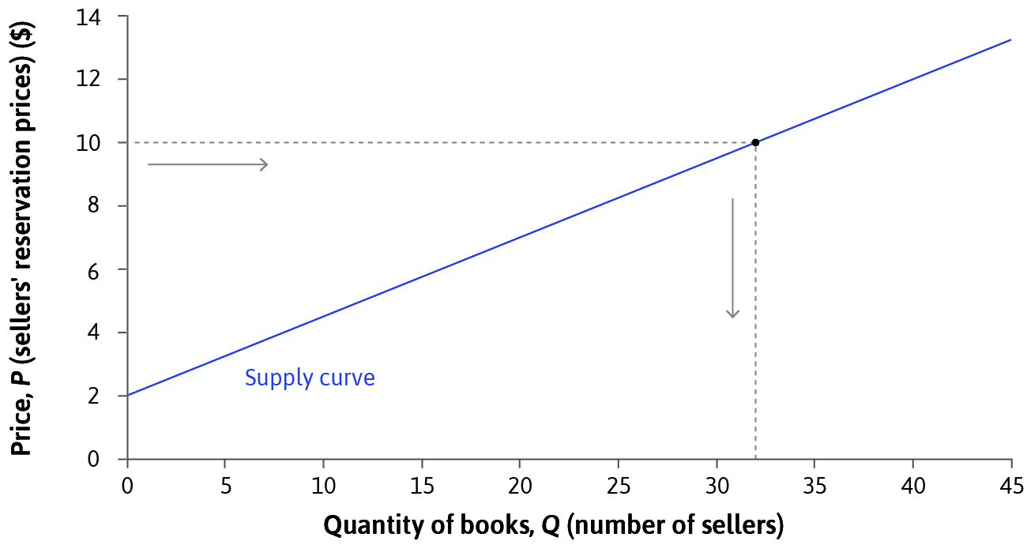
Key concepts: Supply curve
Supply curve = total number of the books that would be sold at any given price.
Represents the willingness to accept (WTA) of sellers.
Sellers may have different reservation prices.

Slide 20
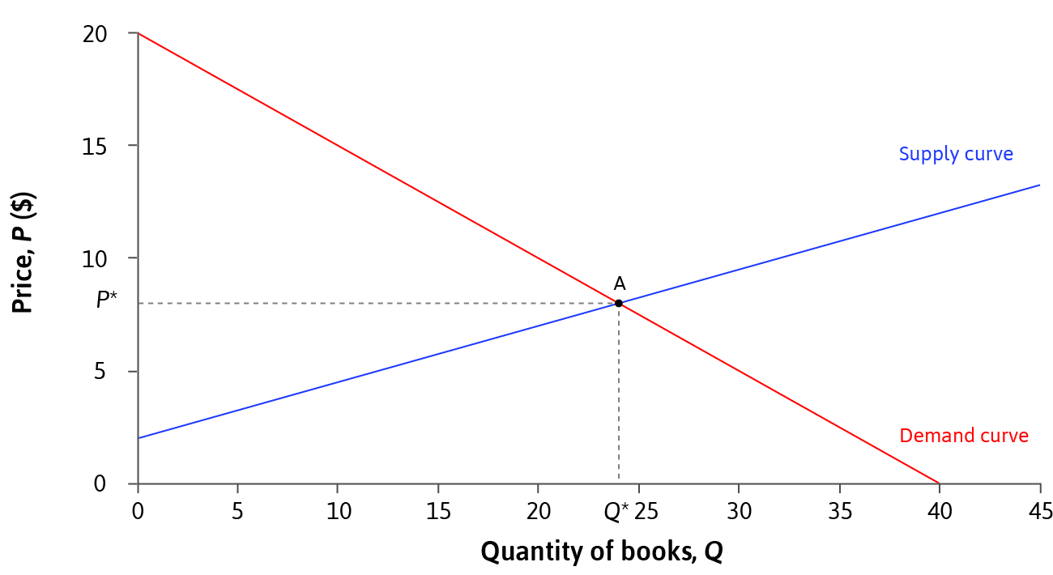
Key concepts: Equilibrium price
At the equilibrium (market-clearing) price, supply equals
demand.
No other price is an equilibrium. At any price above P*, there would be excess supply, i.e. more units supplied than demanded: rationing of sellers
At prices below P*, more would be demanded than supplied: rationing of buyers

Slide 21
Equilibrium price dynamics
An informal price adjustment mechanism justifies the equilibrium
If price is above P*, the producers whose products were left unsold compete for new buyers by lowering prices
At prices below P*, the buyers left without the goods bid up the prices
In intermediate micro, you will play a market game and see this at work

Slide 22
Key concepts: Price-taking firms
Price-taking firms perceive a flat demand curve: P(Q)=P
for all Q.
What is the reason for this?
Start with a market where price falls to zero at Q=10
For simplicity, assume P(Q) = 10 - Q for Q below 10
Double the market by adding to the market a copy of each consumer in the market
Sum the two demand curves horizontally
The new demand function is now given by P(Q) = 10 – $\frac{1}{2}$Q
By increasing the market to 10-fold copy of the original, the demand curve is P(Q) = 10 - $\frac{1}{10}$Q
Increasing the market size makes the demand curve flatter: for N-fold copy, P(Q) = 10 - $\frac{1}{N}$Q

Slide 23
Price-taking firms
Price-taking firms are small relative to the market size
If a firm can produce only a small quantity relative to total market size, its impact on prices is small
Imagine that all other firms produce a total of Q in the market and our firm in question produces q
If the firm’s marginal cost is above 10 when own production q >10. The firm never produces above 10
The maximal effect of the firm on the price in the N-fold market is
P(Q) – P(Q+10) = 10 - $\frac{1}{N}$Q – (10 - $\frac{1}{N}$(Q+10)) = $\frac{10}{N}.$
If N is large (so that the firm is small relative to market), the price impact is small.

Slide 24
Price-taking firms
How to determine Q above?
Imagine all firms are alike, i.e. same marginal cost MC(q) = q
Price taking: MR(q) = P(Q)
Since MR(q) = P(Q+q) – qP’(Q+q) ≈ P(Q) for N large, this is a good approximation as shown on the previous slide
Profit maximization in this case:
MC(q) = MR(q) = P(Q)
For concreteness, let N=100 so that P(Q) = 10 - $\frac{1}{100}$Q
Suppose there are 200 other firms
Then Q=200q and P(Q) = P(200q) = 10 -2q
On the other hand, MC(q) = q = P(200q) = 10-2q from profit maximization
Thus MC(q) = q = $\frac{10}{3}$ = P(Q) and Q = $\frac{2000}{3}$
You get the total supply by summing horizontally the MC(q) curves over all firms in the market

Slide 25
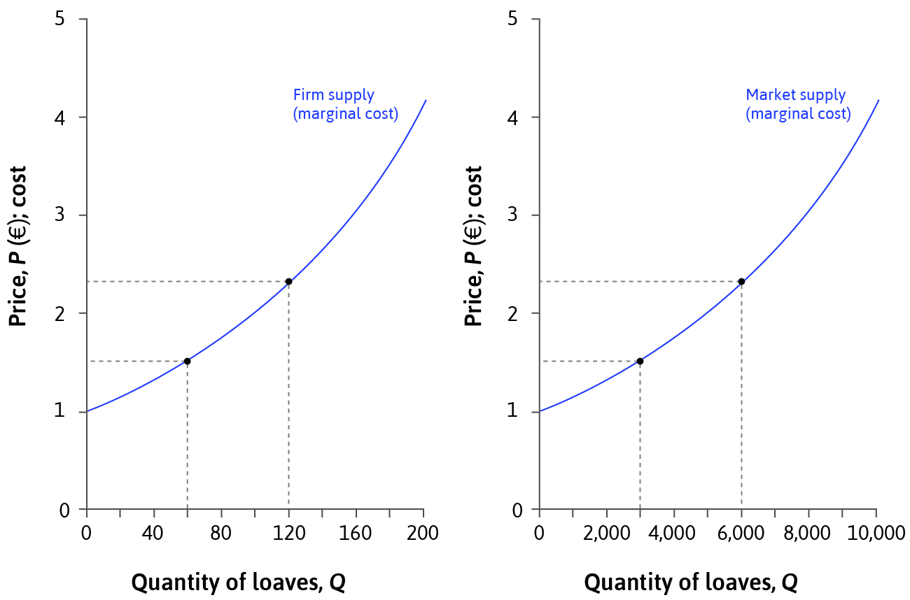
Price-taking firms: Market supply curve
Here is the story from the previous slides in pictures: Market for bread
Market consists of
50 identical firms
Market supply curve – the total amount produced by all firms at each price. If firms have identical cost functions, market supply curve = market marginal cost curve.

Slide 26
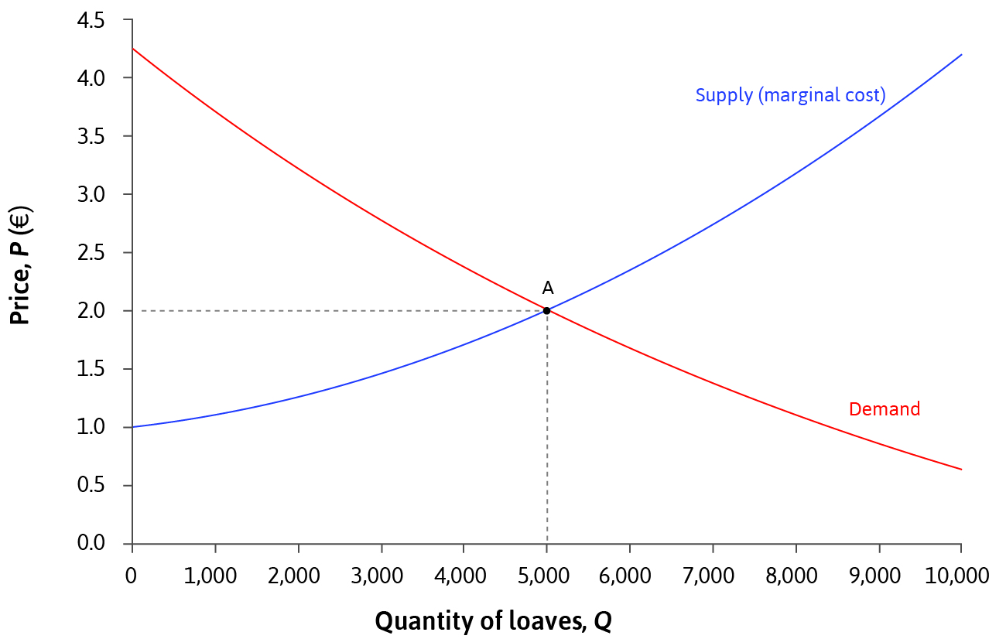
Key concepts: Competitive equilibrium
Competitive equilibrium:
All buyers and sellers are price-takers
At the prevailing market price, supply = demand and price equals marginal cost

Slide 27
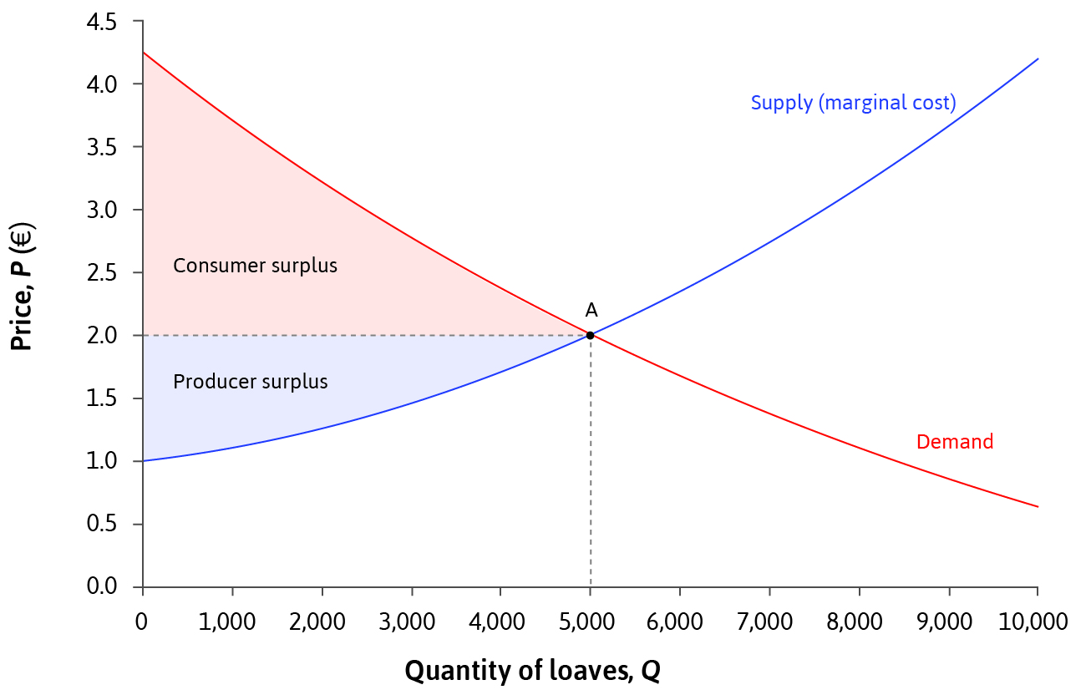
Competitive equilibrium: Characteristics
All gains from trade are exploited in equilibrium (no deadweight loss), invisible hand.
The cost of producing additional units (the marginal cost) is at least as large as the wtp of any consumer that does not buy
Transaction only affects buyers and sellers (no external effects)

Slide 28
Competitive equilibrium: Caveats
We saw in the case of price-setting firms that market power leads to deadweight loss (price above MC)
To gain market power, homogenous goods are often differentiated along some dimensions (different delivery options, different add-ons)
Travel costs, past experiences etc. may make it hard to change suppliers

Slide 29
Competitive equilibrium: Is it a good model?
Clear view of the market forces in an idealized setting
No market power is clearly an approximation, but the model is the limit outcome of models with small firms with limited market power (more on this in later courses)
Allows for a clean analysis of external changes to the market such as the introduction of taxes

Slide 30
Factors that affect equilibrium

Slide 31
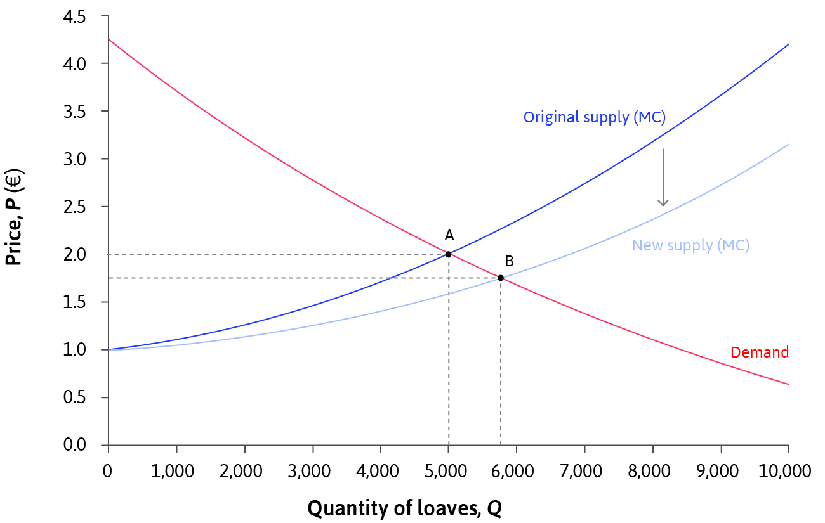
Changes in supply and demand
The entire supply or demand curve can shift due to exogenous shocks e.g. technological change, popularity, arrival of close substitutes etc.
Buyers and sellers adjust their behavior so that the market clears.
E.g. introduction of electric ovens
1. Supply of bread increases at every price (supply curve shifts)
2. Excess supply at the going market price (move along demand curve)
3. Price falls to a new equilibrium
4. Do we know that sellers make bigger profits with the new technology?

Slide 32
Shifting demand curve
Due to increased concern for animal welfare, demand for bread is shifted away from meat towards bread
New demand
Market supply
Market demand
In the new equilibrium,
the price of bread is higher and the bakers make bigger profits
B
A

Slide 33
Market Entry
The supply curve can also shift due to market entry
If existing firms are earning economic rents and costs of entry are not too high, other firms may enter the market
Similarly, the demand may shift due to entry of new buyers

Slide 34
Changes in supply and demand
Demand curve shifters:
Changes in income or population
Changes in substitute or complement prices
Demand conditions (weather etc.)
Changes in tastes
Changes in expectations
Taxes and subsidies
Supply curve shifters
Technological innovations
Input prices
Production conditions (weather etc.)
Taxes and subsidies
Expectations
Entry and exit of producers

Slide 35
Changes in supply and demand
How can you tell shifts in demand and supply apart?
If price and quantity move in the same direction you are likely to see movements on the supply curve, i.e. shifts in demand
If prices and quantities move in opposite directions, you see movements on the demand curve (i.e. shifts in supply)
How can you estimate the demand and supply curves?
In general a very tricky question because you observe equilibrium prices and quantities determined by both (lack of identification)
If you can observe shocks that shift only supply (e.g. weather conditions in Australia and Canada for wheat production), you have hope for estimating the demand
In general not very easy to find such shifters for either demand or supply. More on this in Principles of Empirical Analysis and Introduction to Econometrics

Slide 36
Commodity taxes and equilibrium

Slide 37
Commodity taxes
Value added tax (vat) is an extremely important source of tax revenue in Finland and EU
As the name suggests, tax on additional value
Added to the price of the good, at the moment 24%
some groups of goods have lower vat (food, pharmaceuticas, magazine subscriptions, some cultural services)
Tax independent of income
Consider a situation where the state government levies a 50 cent tax on loaves of bread
The baker pays 50 cents per loaf to the state -> marginal cost goes up by 50%. The case with taxes as a percentage of price is similar and yilds the same conclusions
I leave the discussion of the purposes of taxation and forms of taxes to Principles II

Slide 38
Bread tax levied on bakers
Supply after tax
Supply curve
Demand curve
2,30
Bakers must get 50 cents more than before tax to be willing to sell the same amount
1,80
In the new equilibrium, buyers pay 2,30€. Baker pays 50 cents to the state and gets 1,80€. Less bread sold than before tax

Slide 39
Fiscal burden on buyer
Bakers’ union lobby for consumers to pay the tax
Supply curve
Demand curve
To buy the same amount of bread, buyers must get it 50 cents cheaper from the bakers
D
2,30
A
1,80
Demand after tax
In new equilibrium, buyer pays 2,30€: baker gets 1,80€ and state takes 50 cents.
Same outcome as before

Slide 40
Who bears the economic burden?
Situation before tax.
Supply curve
Demand curve
Consumer
surplus
A
Producer
surplus

Slide 41
And who bears the economic cost?
Consumer surplus
Both the buyers and the bakers pay their share (as lower prices and smaller quantities)
Supply curve
Demand curve
The tax causes also a deadweight loss (the black trianglre) = the loss in consumer and producer surplus not collected in taxes
Tax revenue
Producer surplus

Slide 42
The effect of price elasticity of demand: elastic demand
Consumer surplus
Supply curve
Demand curve
Tax revenue
Producer surplus

Slide 43
Demand elasticity and deadweight loss
Consumer surplus
Tax revenue
Price change has a smaller effect on quantities and hence a smaller deadweight loss
Producer surplus

Slide 44
Price elasticity of demand and deadweight loss
Consumer
surplus
Tax revenue
For inelastic demand, no deadweight losses, consumers bear the economics cost of the taxes
In the past, salt
Producer
surplus

Slide 45
Price elasticity of supply and dwl
With perfectly inelastic supply, no dwl and producers bear the cost of tax
Example: land (not real necessarily real estate tax as applied now)
Consumer surplus
ylijäämä
Tax revenue
Producer surplus

Slide 46
Perfect competition

Slide 47
Definition
A perfectly competitive market has the following properties:
The good or service being exchanged is homogeneous
Very large number of potential buyers and sellers
Buyers and sellers all act independently of one another, no collusion
Price information easily available to buyers and sellers

Slide 48
Characteristics of perfect competition
Law of One Price: All transactions take place at a single price.
At that price, the market clears (supply = demand).
Buyers and sellers are all price-takers.
All potential gains from trade are realized.
Perfect competition may not hold completely in reality,
but can be a good approximation to actual firm behavior.

Slide 49
Evidence of perfect competition?
Economists have used two tests for competitive equilibrium:
Do all trades take place at the same price?
Are firms selling goods at a price equal to marginal cost?
It is hard to find examples of perfect competition:
Even when consumers can easily check the price of products (online shopping sites), prices of the same product differ.
Fulton Fish Market study – within the same market, prices of the same fish product differed for different customer types.

Slide 50
Price-setters vs. Price-takers
Price-setters (Monopoly) | Price-takers (Perfect Competition)
MC < Price | MC = Price
Deadweight losses (Pareto inefficient) | No deadweight losses (can be Pareto efficient)
Owners receive economic rents in both long- and short-run | No economic rents in the long-run
Firms advertise their unique product | Little advertising expenditure
Firms invest in R&D, seek to prevent copying | Little incentive for innovation

Slide 51
Summary
Model of price-taking firms
Competitive equilibrium where demand = supply
Firms maximize profits where MC = Price
Perfect competition is a special case
Comparison with price-setting firms
2. Used model to show how equilibrium can change
Exogenous shocks to demand/supply or market entry
Effect of taxation on surplus and economic incidence of taxes

Slide 52
In the next lecture:
Interfering with the market
Tariffs
Rent Control
Short-run and long-run equilibrium
Market dynamics and rent-seeking

