Slide 1
Speech Processing
Acoustic Echo Cancellation
Pablo Pérez Zarazaga
07.10.2021

Slide 2
What is echo?
Acoustic definition
  Sound caused by the reflection of sound waves from a surface back to the listener
In communications
  A transmitted signal in a communications circuit can return to the sender creating a disturbing effect that affects the communication.
  Common effect in full-duplex communications.

Slide 3

Acoustic echo in communications
In analogic communications:
  Circuit causes the reflection.
  Impedance adaptation in signal divider.
  Not a problem anymore in digital communications.

Slide 4
Acoustic echo in communications
Digital communications:
  Acoustic echo caused by the room and the relative position of microphone and loudspeaker.

Slide 5

Consequences of echo
Echo from remote side:
  The speaker will hear his own voice with delay, which is annoying and confusing.
  The speech from the remote speaker will be affected by the echo signal.
Echo on both sides:
  Worst case scenario. Feedback can make communication impossible.

Slide 6


Solutions for Echo Cancellation
The effect of the room can be modelled as a FIR filter.
If we can estimate this filter, we can subtract the echo from the recorded signal before sending.
$$\hat{h}(n)$$
$$h(n)$$

Slide 7


Echo path modelling
Echo path is unknown at the beginning of communication.
Speech signal is not stationary, hard to estimate the echo path.
It is necessary to monitor the performance of the echo canceller and act accordingly.
$$\hat{h}(n)$$
$$h(n)$$

Slide 8







Adaptive filters
$$x(n)$$
h(n) can be estimated in every time frame.
Assuming small changes over time, the optimum solution is approached on every iteration.
Adaptive filters aim to minimize the error in the output signal.
$$\hat{h}(n)$$
$$h(n)$$
$$\hat{y}(n)$$
$$y(n)$$
$$e(n)$$
$$d(n)$$

Slide 9

LMS optimization
Objective:
  Model an unknown filter over time.
Method:
  Update the estimation of the filter on every time step.
  Minimize the error between recorded signal and noise model.
$${\min\left|h\left(n\right)∗x\left(n\right)−\hat{h}\left(n\right)∗x\left(n\right)\right|}^{2}$$

Slide 10
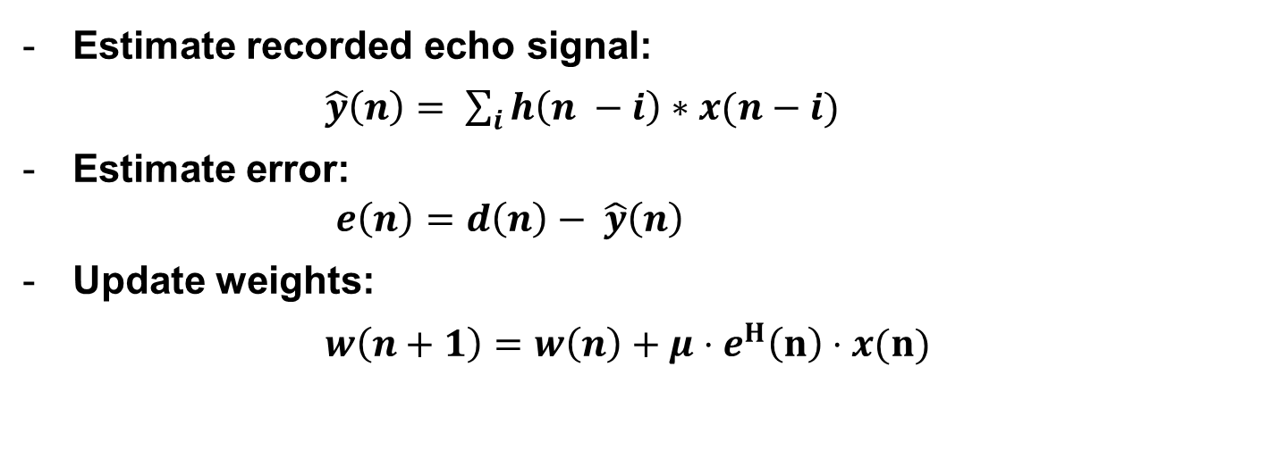
LMS algorithm
Estimate recorded echo signal:
$\hat{y}\left(n\right)= \sum_{i}{h\left(n −i\right)∗x(n−i)}$
Estimate error:
  $e\left(n\right)=d\left(n\right)− \hat{y}\left(n\right)$
Update weights:
$w\left(n+1\right)=w\left(n\right)+μ⋅e^{H}\left(n\right)⋅x(n)$

Slide 11
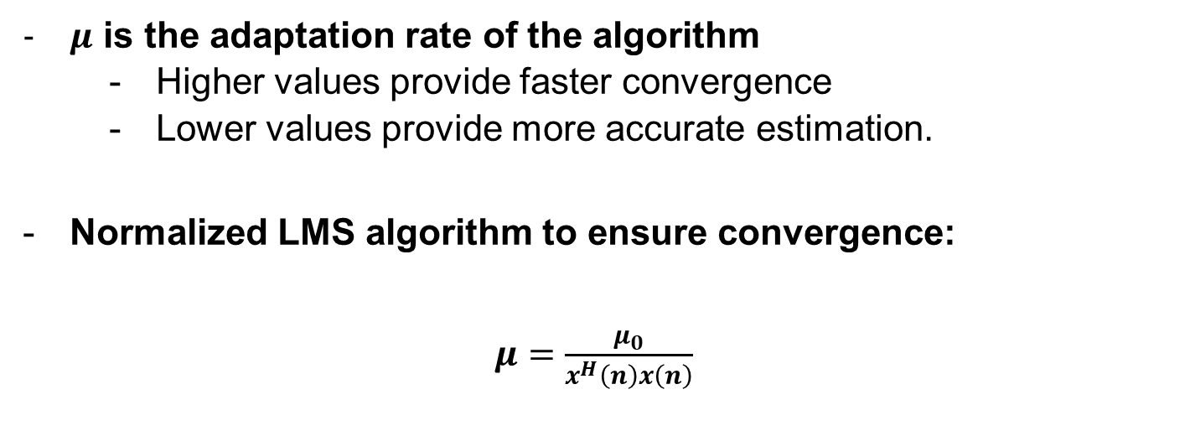
LMS algorithm
$μ$ is the adaptation rate of the algorithm
  Higher values provide faster convergence
  Lower values provide more accurate estimation.
Normalized LMS algorithm to ensure convergence:
$μ=\frac{μ_{0}}{x^{H}\left(n\right)x\left(n\right)}$

Slide 12
Audio samples:
Original sample:
Lambda 0.5:
Lambda 0.9:
Lambda 1:

Slide 13
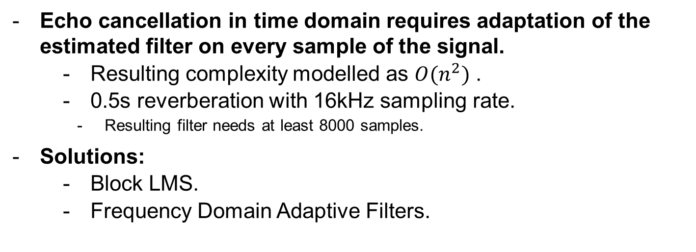
Optimization of LMS
Echo cancellation in time domain requires adaptation of the estimated filter on every sample of the signal.
  Resulting complexity modelled as $O(n^{2})$ .
  0.5s reverberation with 16kHz sampling rate.
    Resulting filter needs at least 8000 samples.
Solutions:
  Block LMS.
  Frequency Domain Adaptive Filters.

Slide 14
Frequency domain filters
One LMS filter for every frequency band.
Same example in frequency domain:
  0.5s reverberation, 16000 kHz sampling rate.
  Assume we use 30ms windows with 15ms overlap.
  32 windows cover the length of the reverberation.
  512 sample FFT → 257 effective samples.
  257 filters of 32 samples.
Additional processing can be applied in the frequency domain

Slide 15
Double Talk
It is likely that far-end and near-end speaker are active at the same time.
  This will lead to the filter diverging.
The echo canceller needs to detect double talk and react accordingly:
  Double talk detector.
  Adapt learning rate.

Slide 16
Double Talk
Energy based detection (Geigel detector):
  Assuming echo level is clearly different than near-end speech.
  Pros:
    Simplicity
  Cons:
    Highly influenced by noise and signal misalignment.
    Requires tuning for each configuration.

Slide 17

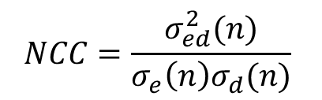
Double Talk
Normalized cross-correlation
  Measure similarity between input and processed signals
  Pros:
    More robust than energy levels.
    Estimation can be used to scale learning rate.
  Cons:
    Susceptible to noise and signal misalignment.
$$NCC=\frac{σ_{ed}^{2}(n)}{σ_{e}{\left(n\right)σ}_{d}(n)}$$
$$σ_{x}=E[xx^{H}]$$
$$σ_{x}\left(n\right)=λσ_{x}\left(n −1\right)+\left(1 −λ\right)σ_{x}$$

Slide 18




Double Talk
Two-path echo cancellation
  An additional background filter decides if update will be beneficial or not.
  Pros:
    Robustness
  Cons:
    Complexity
$${\hat{h}}_{B}(n)$$
Control
$$h(n)$$
$${\hat{h}}_{F}(n)$$
$${\hat{h}}_{B}(n)$$

Slide 19
Multi-channel AEC
Stereo or higher order systems:
  Highly correlated signals.
  Non-uniqueness problem.
  Multiple solutions for filter equation system.
Signals need to be decorrelated before echo cancellation.
  All-pass filter.

Slide 20
Limitations of echo cancellation
Real life echo cancellers rarely work in optimal conditions.
  Noisy environment.
  Short speech segments.
  High double talk rate.
Combine echo canceller with additional speech enhancement:
  Post-filter
  Noise gate

Slide 21
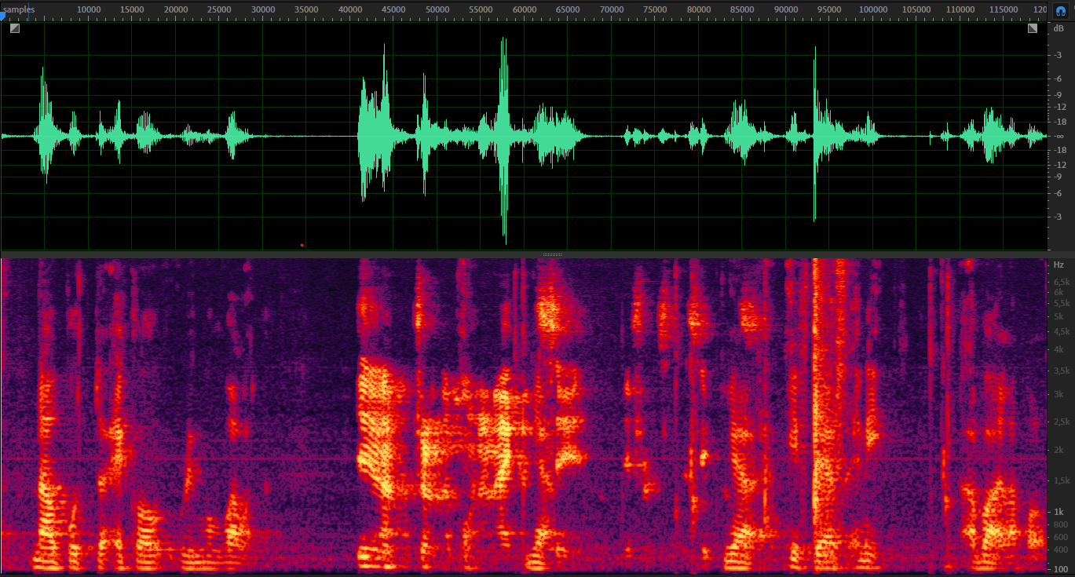
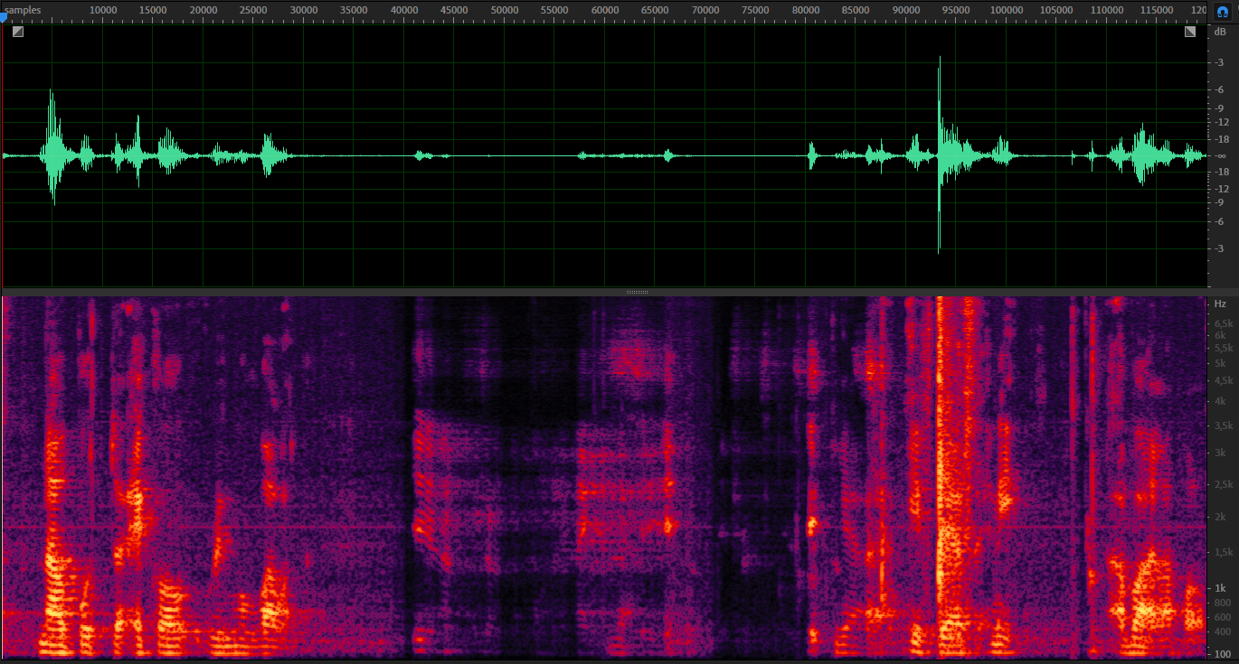
Limitations of echo cancellation

Slide 22
Post filter
A filter can be used to analyse the echo residual and attempt to remove the remaining information that the echo canceller was not able to remove.
A noise gate is a simple solution that can be used after an echo canceller. If the echo is reduced enough, the noise gate will consider it as noise and automatically remove it.

Slide 23
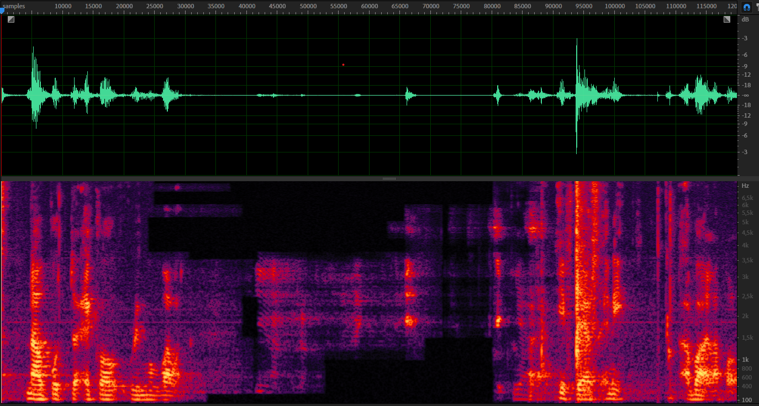
Post filter

Slide 24
Machine learning in AEC
Machine learning methods such as neural networks can be applied on every step of the echo cancellation.
  The main drawback of using neural networks as echo cancellers is their complexity.
  They are most effective as additional speech enhancement modules after an adaptive filter.
  These solutions were presented leading systems of the Acoustic Echo Cancellation Challenge in ICASSP 2021.

Slide 25
Recap
Acoustic echo can significantly hinder proper communication in current communications systems.
Continuous estimation of echo path using adaptive filters in the frequency domain is a fast and effective solution.
  Optimum solution happens when echo cancellation is combined with other speech enhancement algorithms to deal with echo residual and additional noise.

