Slide 1
Exercise B
Building a portfolio of codesign activities

Slide 2
The idea of portfolio of codesign activities
In many settings single codesign action is too limited even if multiplied
Diverse aims and publics for participation call for different activities
Some people prefer light and quick participation - others deep and influential
Some people have high abilities to contribute to design and require only modest support – others require thorough support or can only participate in less demanding design tasks
Different people prefer different types and channels of particiapation: f2f, digiplatform, events, invitational workshops, hearings, participation in tailored tasks…
Some actions can be sequential building on each other (but not necessarily and not necessarily a ‘series’ with same peoples)
Some actions can be parallel, complementing each other
Some actions can be quick and cheap per contacted person
Some actions can be deep and intensive and more expensive
The resources spent on pre-in-post practicalities and analysing the codesign activities and turning them to design concepts and solutions need to be considered (but also potential resources gained from users!)
The strategic aims from the codesign need to be considered; is something else than design achieved as well?

Slide 3
Outcome of the exercise
List of the codesign actions you seek to pursue (for inspiration see codesign journey planner, actioncalogue.eu, DSCC slides etc resources)
1-2 slides max
Short desciption (3-4 sentences) why each action is done: who it targets, for what reason and by what means
Short explanation of how the different actions relate to each other ie the ‘logic’ in your portfolio
Max 2 slides, aim at 1
Additional considerations, max 1 slide
To sanity check your portfolio
Estimate how much resources go to each action ‘
Estimate what all is gained with the portfolio
Estimate how the participation is turned into design solutions and when

Slide 4
Brief: Aim and scope
Build a portfolio of participation activities that supports the design of a flagship library of the new era in Gothenburgh Sweden
Most of the features of the library are new cultural production (not just access to culture): music and film studios, digital learning spaces, digital-physical making, open workspaces, public event spaces, games…
Timeframe: preplanning Jan 2022 – dec 2023 prior to arc competition ;opening in 2030
Phase: exact space and service offering is to be defined
Resources:
two full time participation planners, other staff available for occasional events (to an extent)
cost budget 50 000€
more budget could be attracted through partnering … but remember that parners have a say!
If you use the spaces owned by the city, the space use is free (but needs to be booked)
Costs example: 1 halfday basic workshop with 50 people; 2 days to plan, one day to run, two weeks to refine the results, additional running costs 500€ (the planning and refining time goes down if you repeat) (x2 people)
Cost example: external codesign consultant 750€ a day, senior 1500€ a day
Cost example: running an open call one day event (two days to plan, 5 people to run, 4 weeks to analyse the results)
Cost example: Digi and platform development 500€ a day

Slide 5
With whom? ie the ‘public’ and ‘customers’
The library is for ‘everyone’ but it is also seeking to renew what libraries are, who uses them and for what
The heaviest current userbase tends towards educated, +60 and female customers … as well as families with children.
Continuing with the current operation model and clientele has led to gradual decline in loans and visitors in next to all countries, questioning the remit (right to existence) of libraries
Most of the new features of the library would be used by groups of people that do not use library spaces intensively currently: games, studios, learning spaces, digital-physical making, open workspaces, public event spaces…
The participation activities need to reach ‘everyone’ openly as well as ‘counter-sample’ to those peoples whose participation the new era library needs (see the above bullet on activities)
Various close city internal stakeholder groups: immigration, tourism, youth services, other cultural institutions, busines services

Slide 6
155 years old institution creating something new…
|Meeting- and lounge area 440 m2 | Stage 30 m2 | Pop-up-infos 100m2 | Cinema 490m2 | Multi-purpose hall 350m2 | Lobby areas 150m2 | Back Stage 40m2 | Living lab 200m2 | Exhibition spaces 300m2 | Café 200m2 | Restaurant 300m2 | Interactive spaces 240m2 | Living rooms 500m2 | Children’and Families’ World 600m2 | PersonalOffice-area 400m2 | Studios 160m2 | Makerspace 100m2 | Listening, viewing, game rooms 230m2 | Music, recording and videostudio 400m2 | Service-points & collection area 1600 m2
Future library transitioning to a space for citizens, and community connections
From
storing books
to support
citizens’ needs;
from collections
to connections

Slide 8
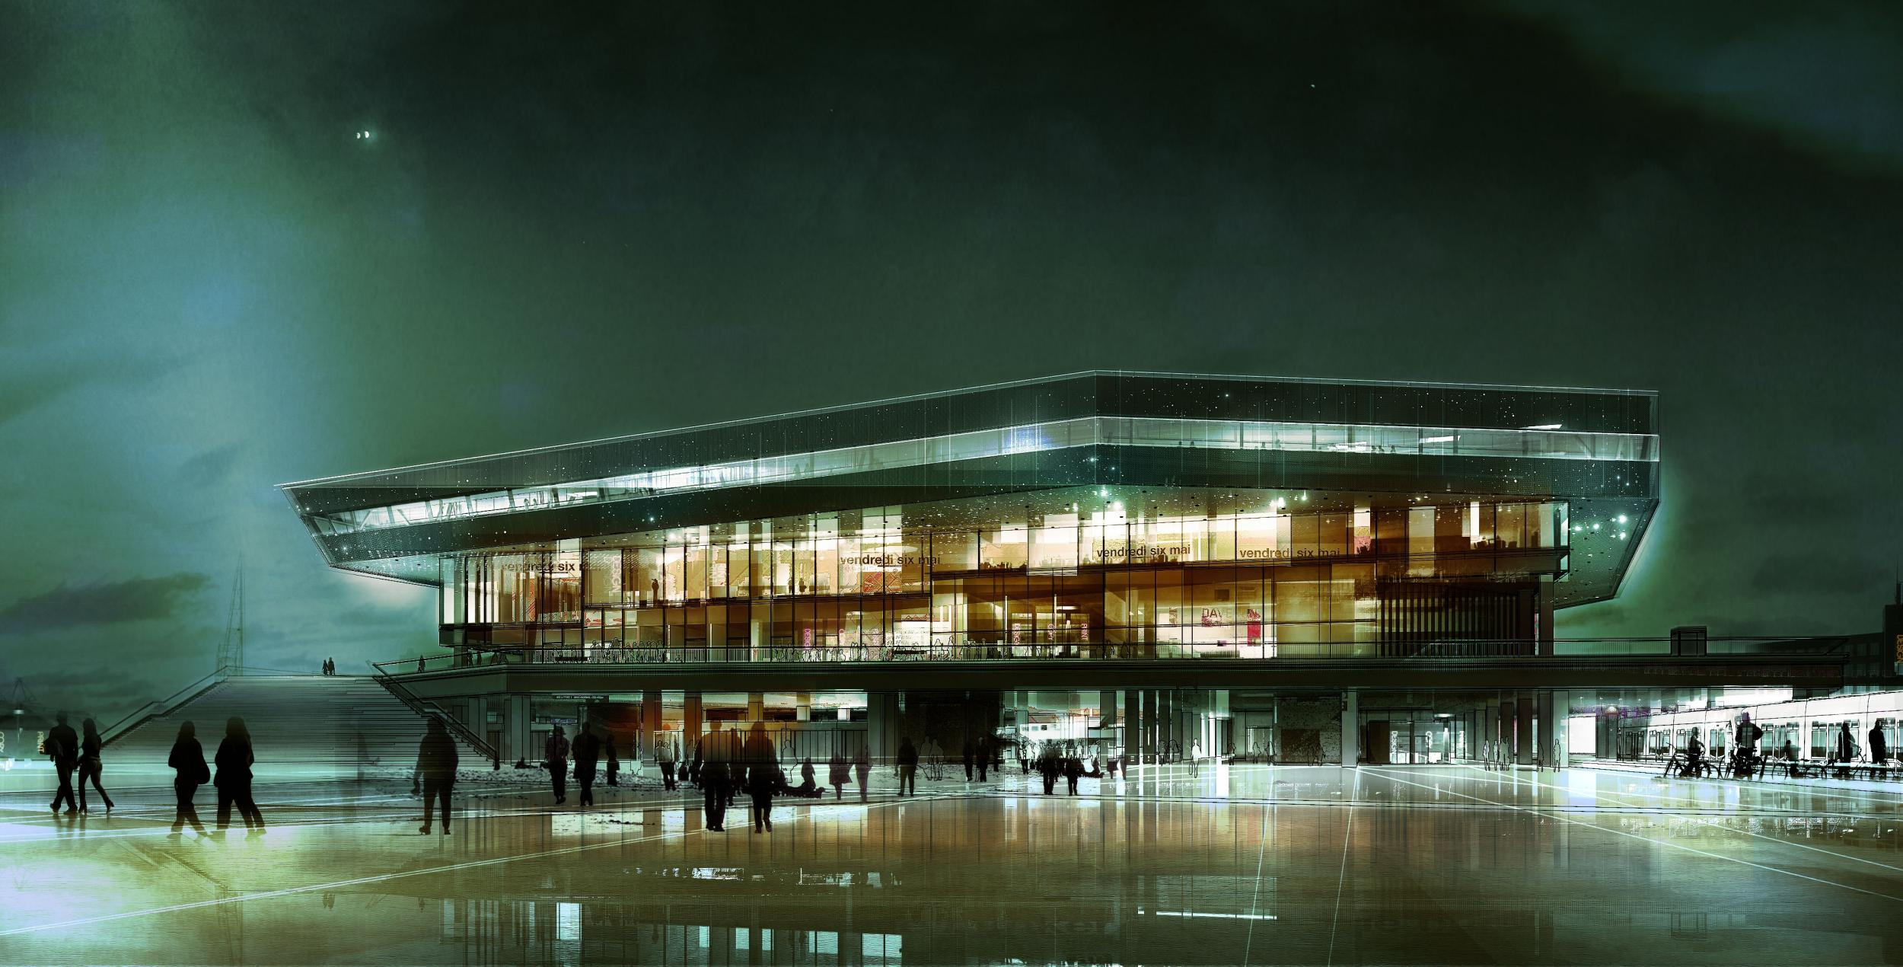
Aarhus/ Dokk 1
Urban Mediaspace will provide you with many opportunities for experience, learning, activity and contemplation.

Slide 9
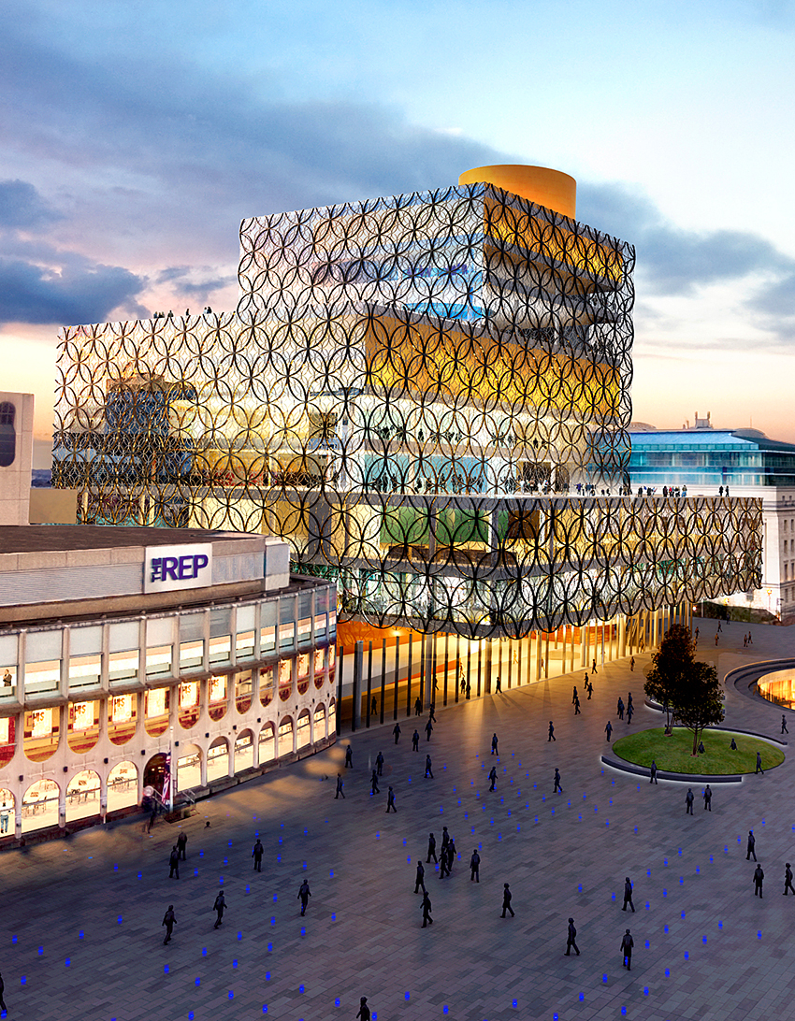
Birmingham
Rewriting the book. We aim to transform lives through learning, knowledge and culture.

Slide 10
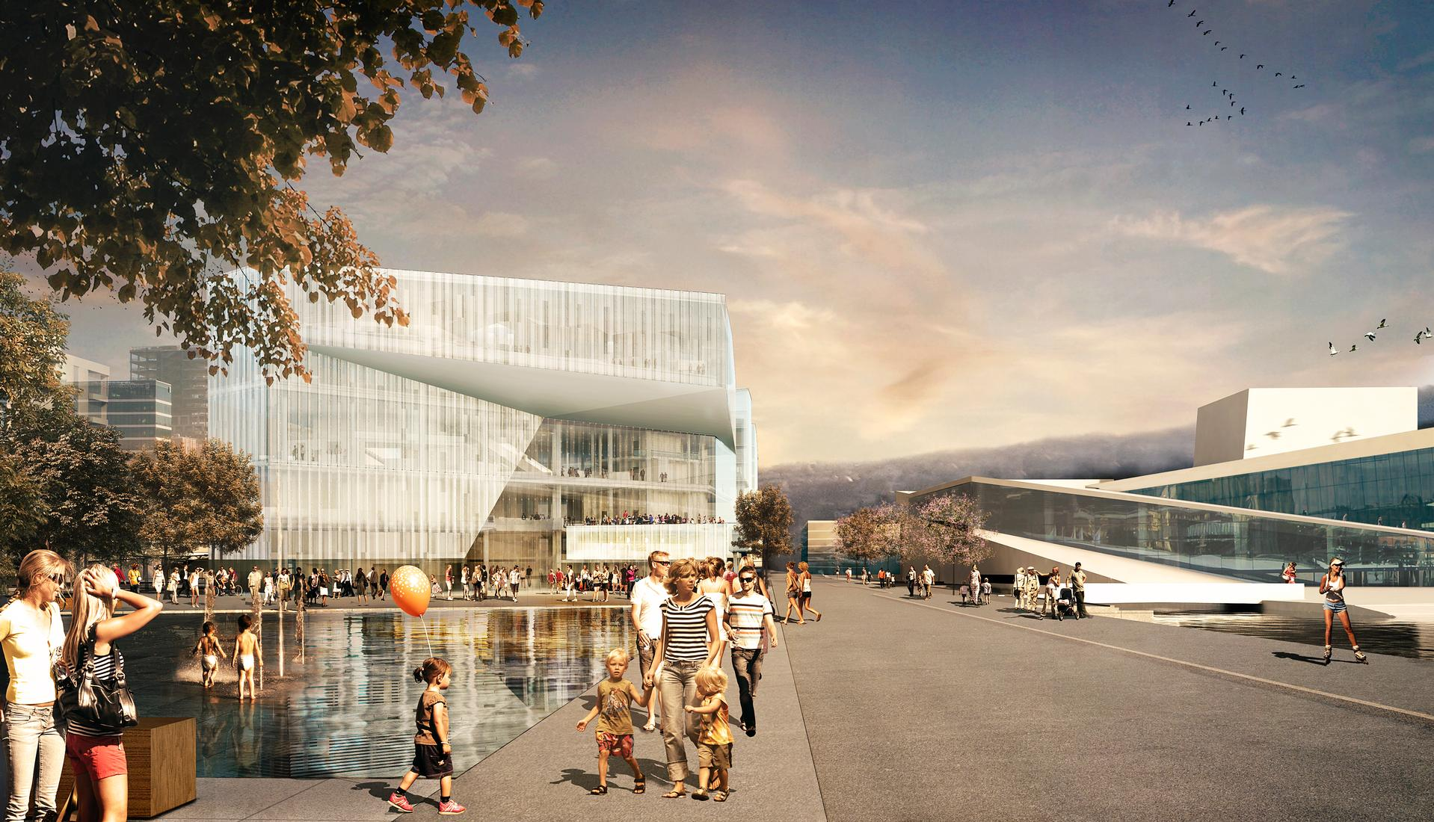
Oslo/ New Deichmanske
Keeps Oslo awake. The most innovative, visible and available library and public space in Europe.

