Slide 1
Exercise A
what we did and how it went

Slide 2
The workshop organization
Open call to delfoi panel of 200 people
Parallel groups 4-12 people, self-select but we presented wishes to some people when some areas less covered (some people multiple expertize areas)
Flexibility built through having facilitator-note-taker pairs if possible, if beyond 70 people then just facilitator to some groups; ‘overflow’ room ready if more than 90 people come, max 120
Documentation by voice recorders as back up, note-taking, coded post-its and large structured canvas
Two coffee breaks with nibbly bits, sandwich/salad lunch to stop people from escaping and to allow them to look and talk with other groups

Slide 3
Intermediate design: backcast canvas
A0 canvas, temporally and spatially structured use
Four scale quadrants
Phase one : what amount and type of technology solutions there will be in 15 years time (middle)
Phase two : what needs to be added in the energy system for this to happen (investment, regulation etc.) (outer rim)
Phase three : what needs to be removed (/what will be removed) from the energy system for this to happens (outer rim)
Post-it color codes to direct attention and to help in the interpretation of written down statements
Working style: talk and write, explain to peer-participants your posting, use full written sentences
Strict time keeping with 5 mins warnings
Facilitators first leave room to open talk, then encourage posting onto canvas, then enforce posting by just curbing talk, at 5 mins left potentially stop discussion and everybody posts what has been covered
Facilitators given open remit but to ensure all get to talk, Facilitators designated to substance group to ensure fair substance competency and ability to gauge if something obvious or likely emerging has not been covered
Profs Jalas and Lovio as ‘jokers’ who can join as participant or facilitator where needed
Prof Hyysalo as ‘floater’ to keep the overall time and organization running, Pyhälammi as assistant in running whatever errands arise
Eventually 10 groups (?!) scarcity of people on wind, abundance on demand response (split to two groups)

Slide 4
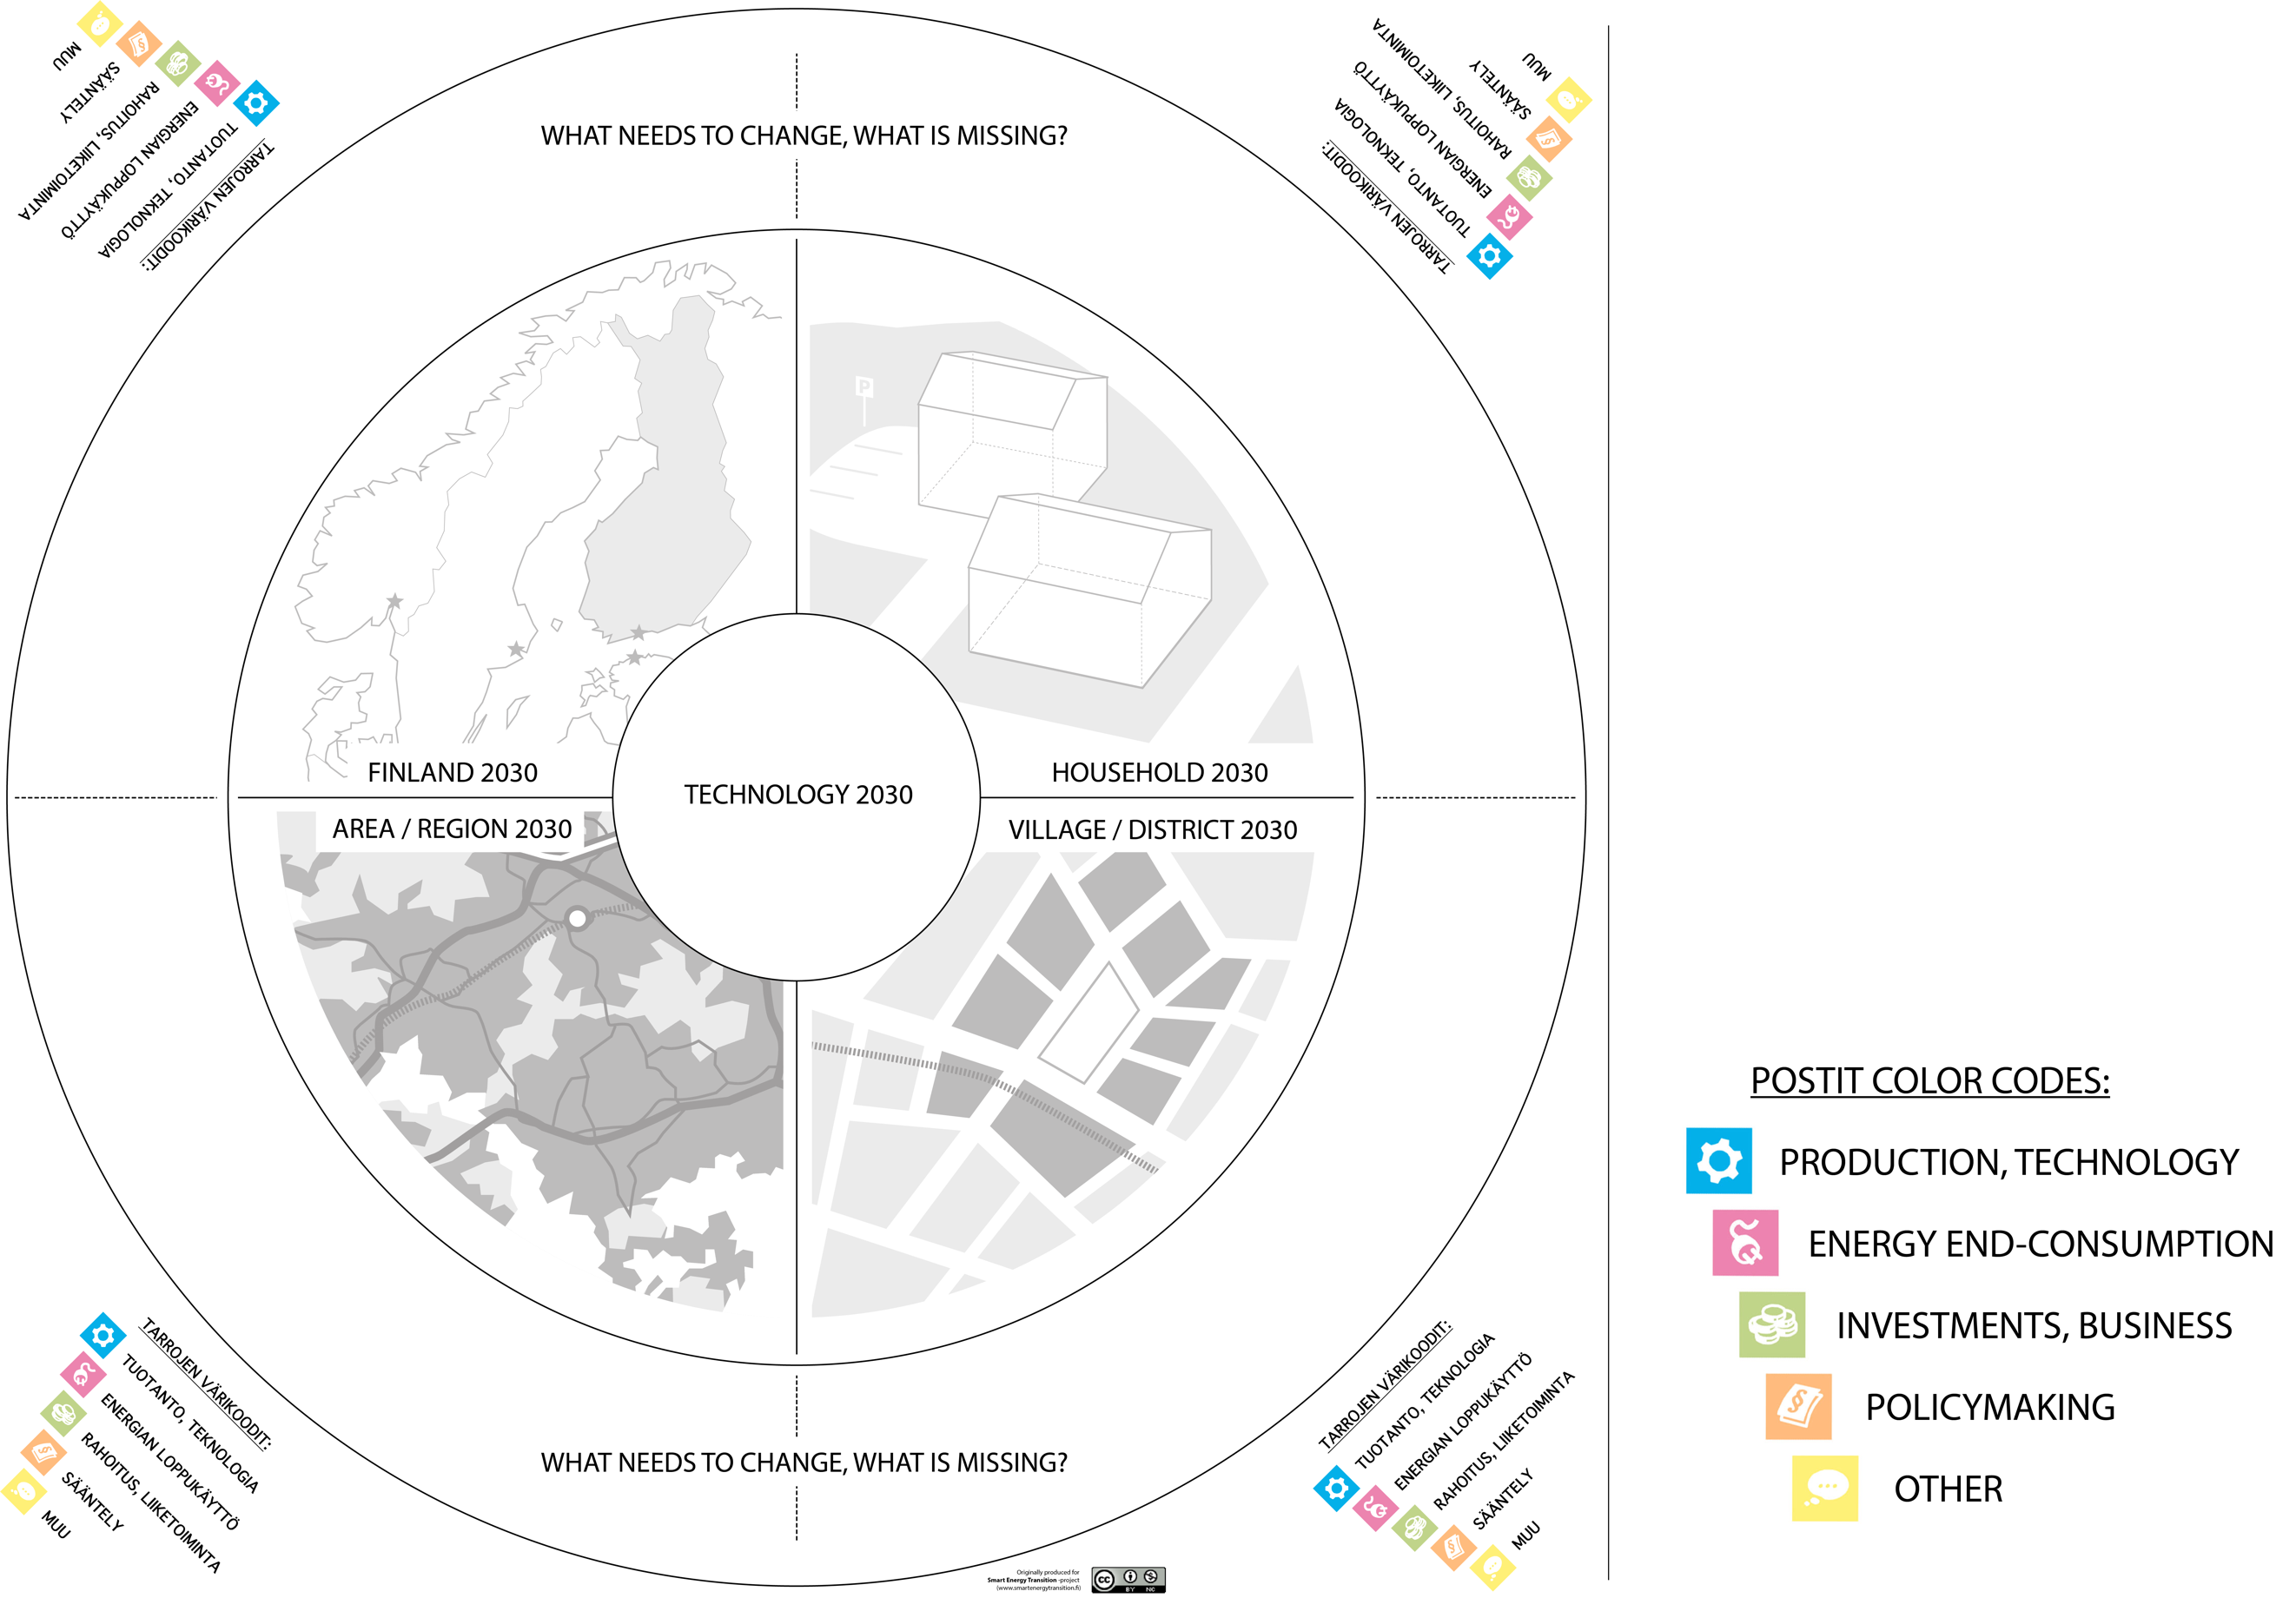

Slide 5
‘best workshop I have participated’ … or
Participant feedback averages 4.3, in 1-5 very positive open feedback
Some groups 20-30 post-its, some groups filled the A0 canvas with more than 100
Results at first looked academically very interesting and rich … but in closer analysis not that much new albeit an important complement to delfoi and complemented/questioned some estimates there.
Did we capture all that was interesing and novel in the discussions?
Transcriptions a nightmare to analyse, not done beyond simple back up checks
Post-its simplify considerations a lot, did the design ‘stupidify’ participant considerations?

