Slide 1
Beyond and instead of the workshop a.k.a codesign is not about workshops, its about adequate ways to include people in envisioning, designing and making decisions

Slide 2
WEEK 3, TOPIC 1:
Design during use
Kohtala, C., Hyysalo, S. & Whalen, J (2019) A taxonomy of user’ active design engagement in 21st century. Design Studies 67, 27-54 https://doi.org/10.1016/j.destud.2019.11.008

Slide 3
A common shift in several disciplines 1990 - 2010: People are “active”
in appropriating and using technologies, objects and systems
But how exactly are they “active”? Do they “design” or not?
Are there conflating terms or missing scope of action?
Review and examination against 12 in-depth longitudinal studies

Slide 4
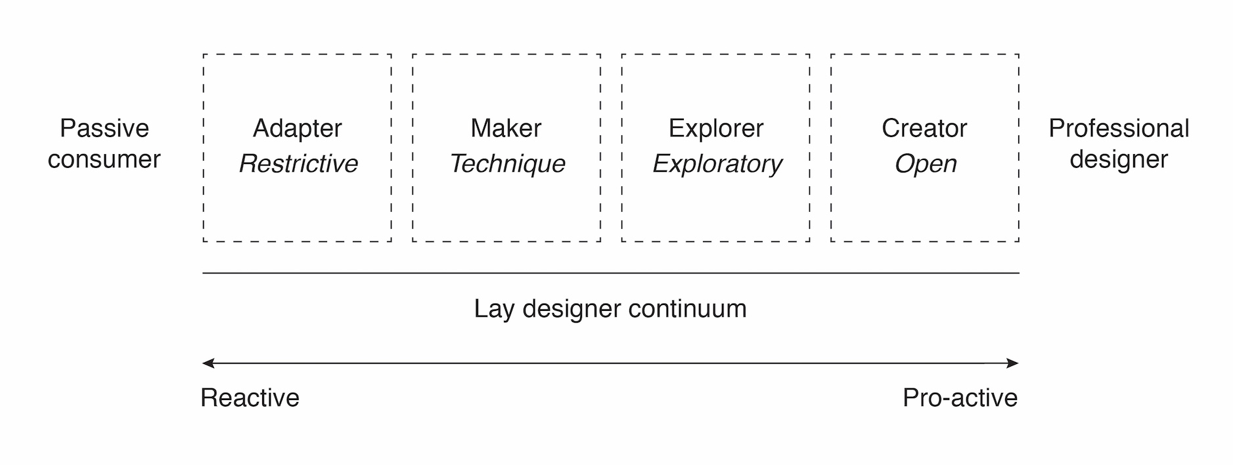
Design Studies:
“passive consumer, adapter, maker, explorer, creator, professional designer”
(Sanders, 2006)
'Schema XI Lay designer continuum, from adaptor [sic], to maker, to explorer, to creator, adopted from Sanders (2006)'. Source: Hermans, 2015: 157.

Slide 5
User Innovation:
“routine use, user modifications and user innovations”
(de Jong, von Hippel, Gault, Kuusisto, Raasch, 2015)
“routine use – repurposing – material adaptation – user modifications – additions by users – system wide designs by users”
(Hyysalo, Juntunen, Freeman, 2013;
Hyysalo, Jensen, Oudshoorn, 2016)

Slide 6
Consumption Studies:
“cultural dupe, personalization, customization, craft consumption”
(Campbell, 2005)
“appropriation – objectification – incorporation – conversion”
(Silverstone, Hirsch, Morley, 1992;
Berger, Hartmann, Punie, Ward, 2006)

Slide 7
Information Systems, HCI:
“Direct appropriation ­­– Substitution – Combination – Enlargement – Contrasting – Constraining”
(DeSanctis and Poole, 1994)
(Salovaara, 2012;
Liikkanen and Salovaara, 2015;
Helminen, Ainoa, Mäkinen, 2016)

Slide 8
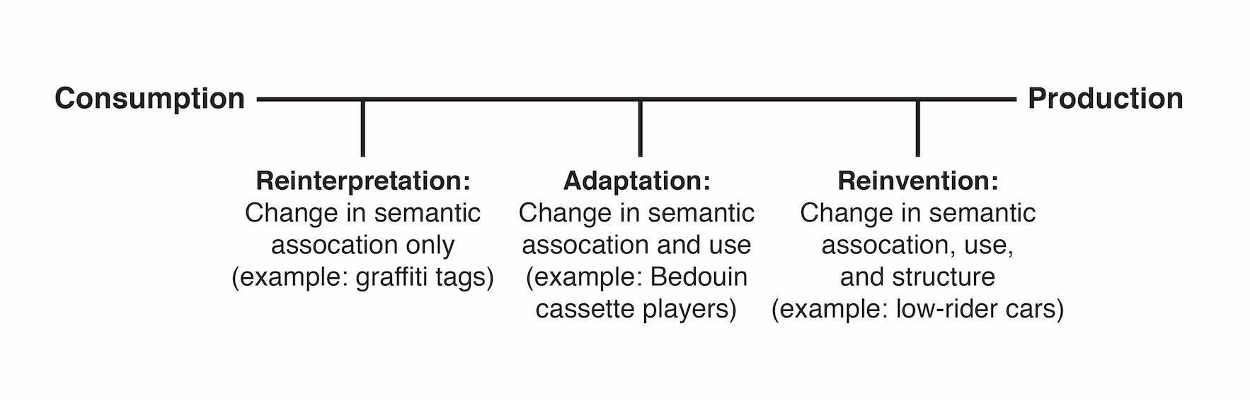
Science & Technology Studies:
“technological regularization, technological adjustment, technological reconstitution”
(Pfaffenberger, 1992)
'The consumption-production dimension'. Source: Eglash (2004: xi).

Slide 9
Design Studies:
'Framework for a structure of the design space’. Source: Botero, Kommonen, Marttila. 2010.

Slide 10
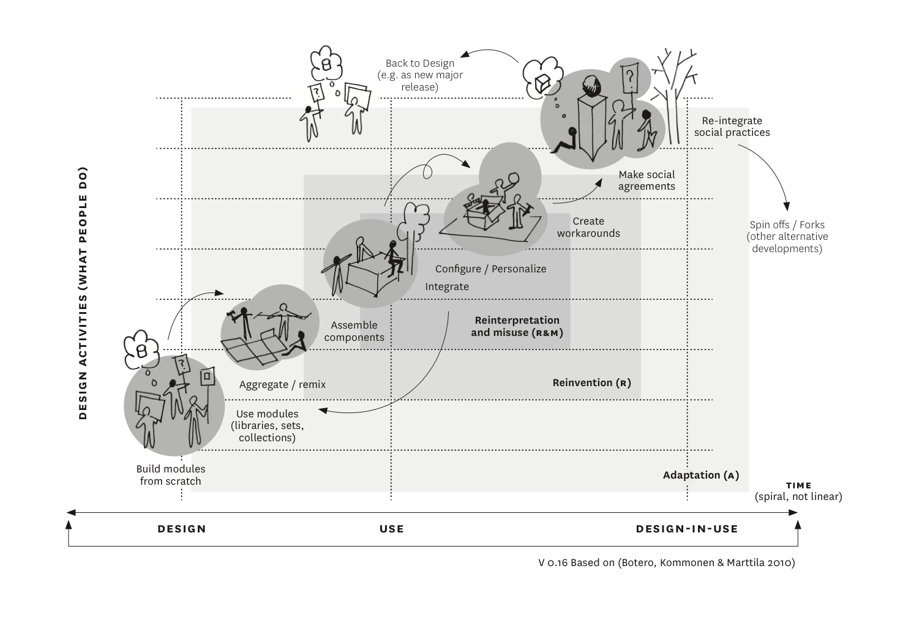
Design Studies:
'Reinterpretation, adaptation, and reinvention in design spaces’. Source: Botero 2013: 93 (adapted from Botero et al. 2010).

Slide 11
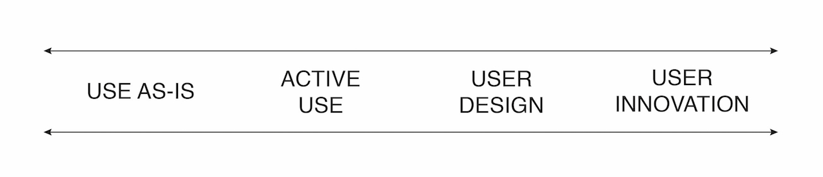
A Basic Framework for Users’ Active Engagement with Products and Services

Slide 12
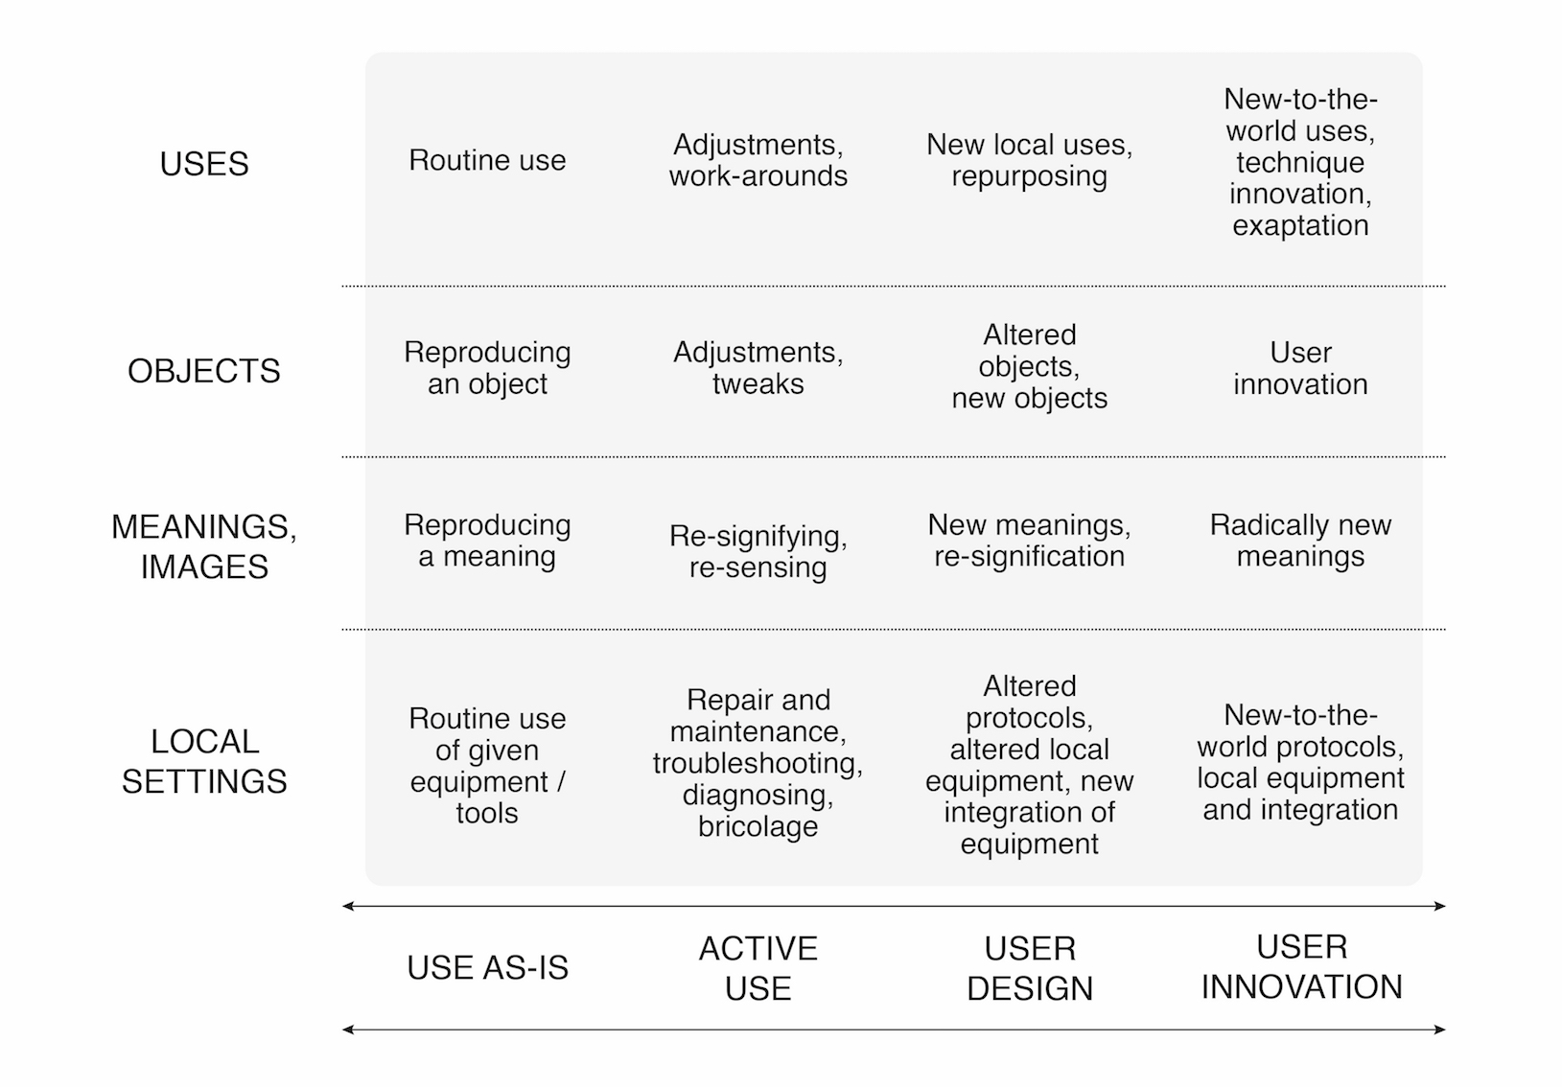
A minimal framework for discussing users’ active design engagement in a given setting

Slide 13
A minimal framework for discussing users’ active design engagement in a given setting

Slide 14
A minimal framework for discussing users’ active design engagement in a given setting

Slide 15
A minimal framework for discussing users’ active design engagement in a given setting

Slide 16
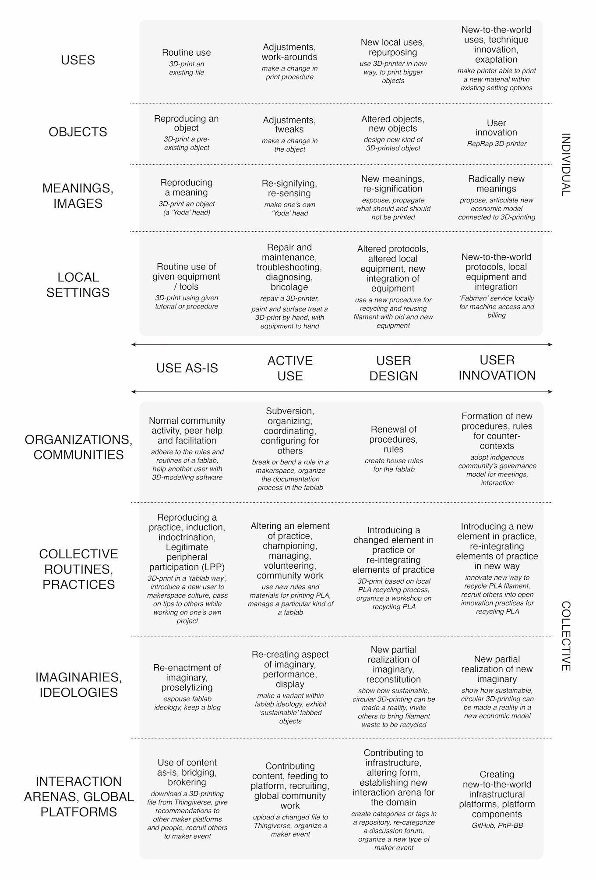
A minimal framework for discussing users’ active design engagement: example of fablabs

Slide 17
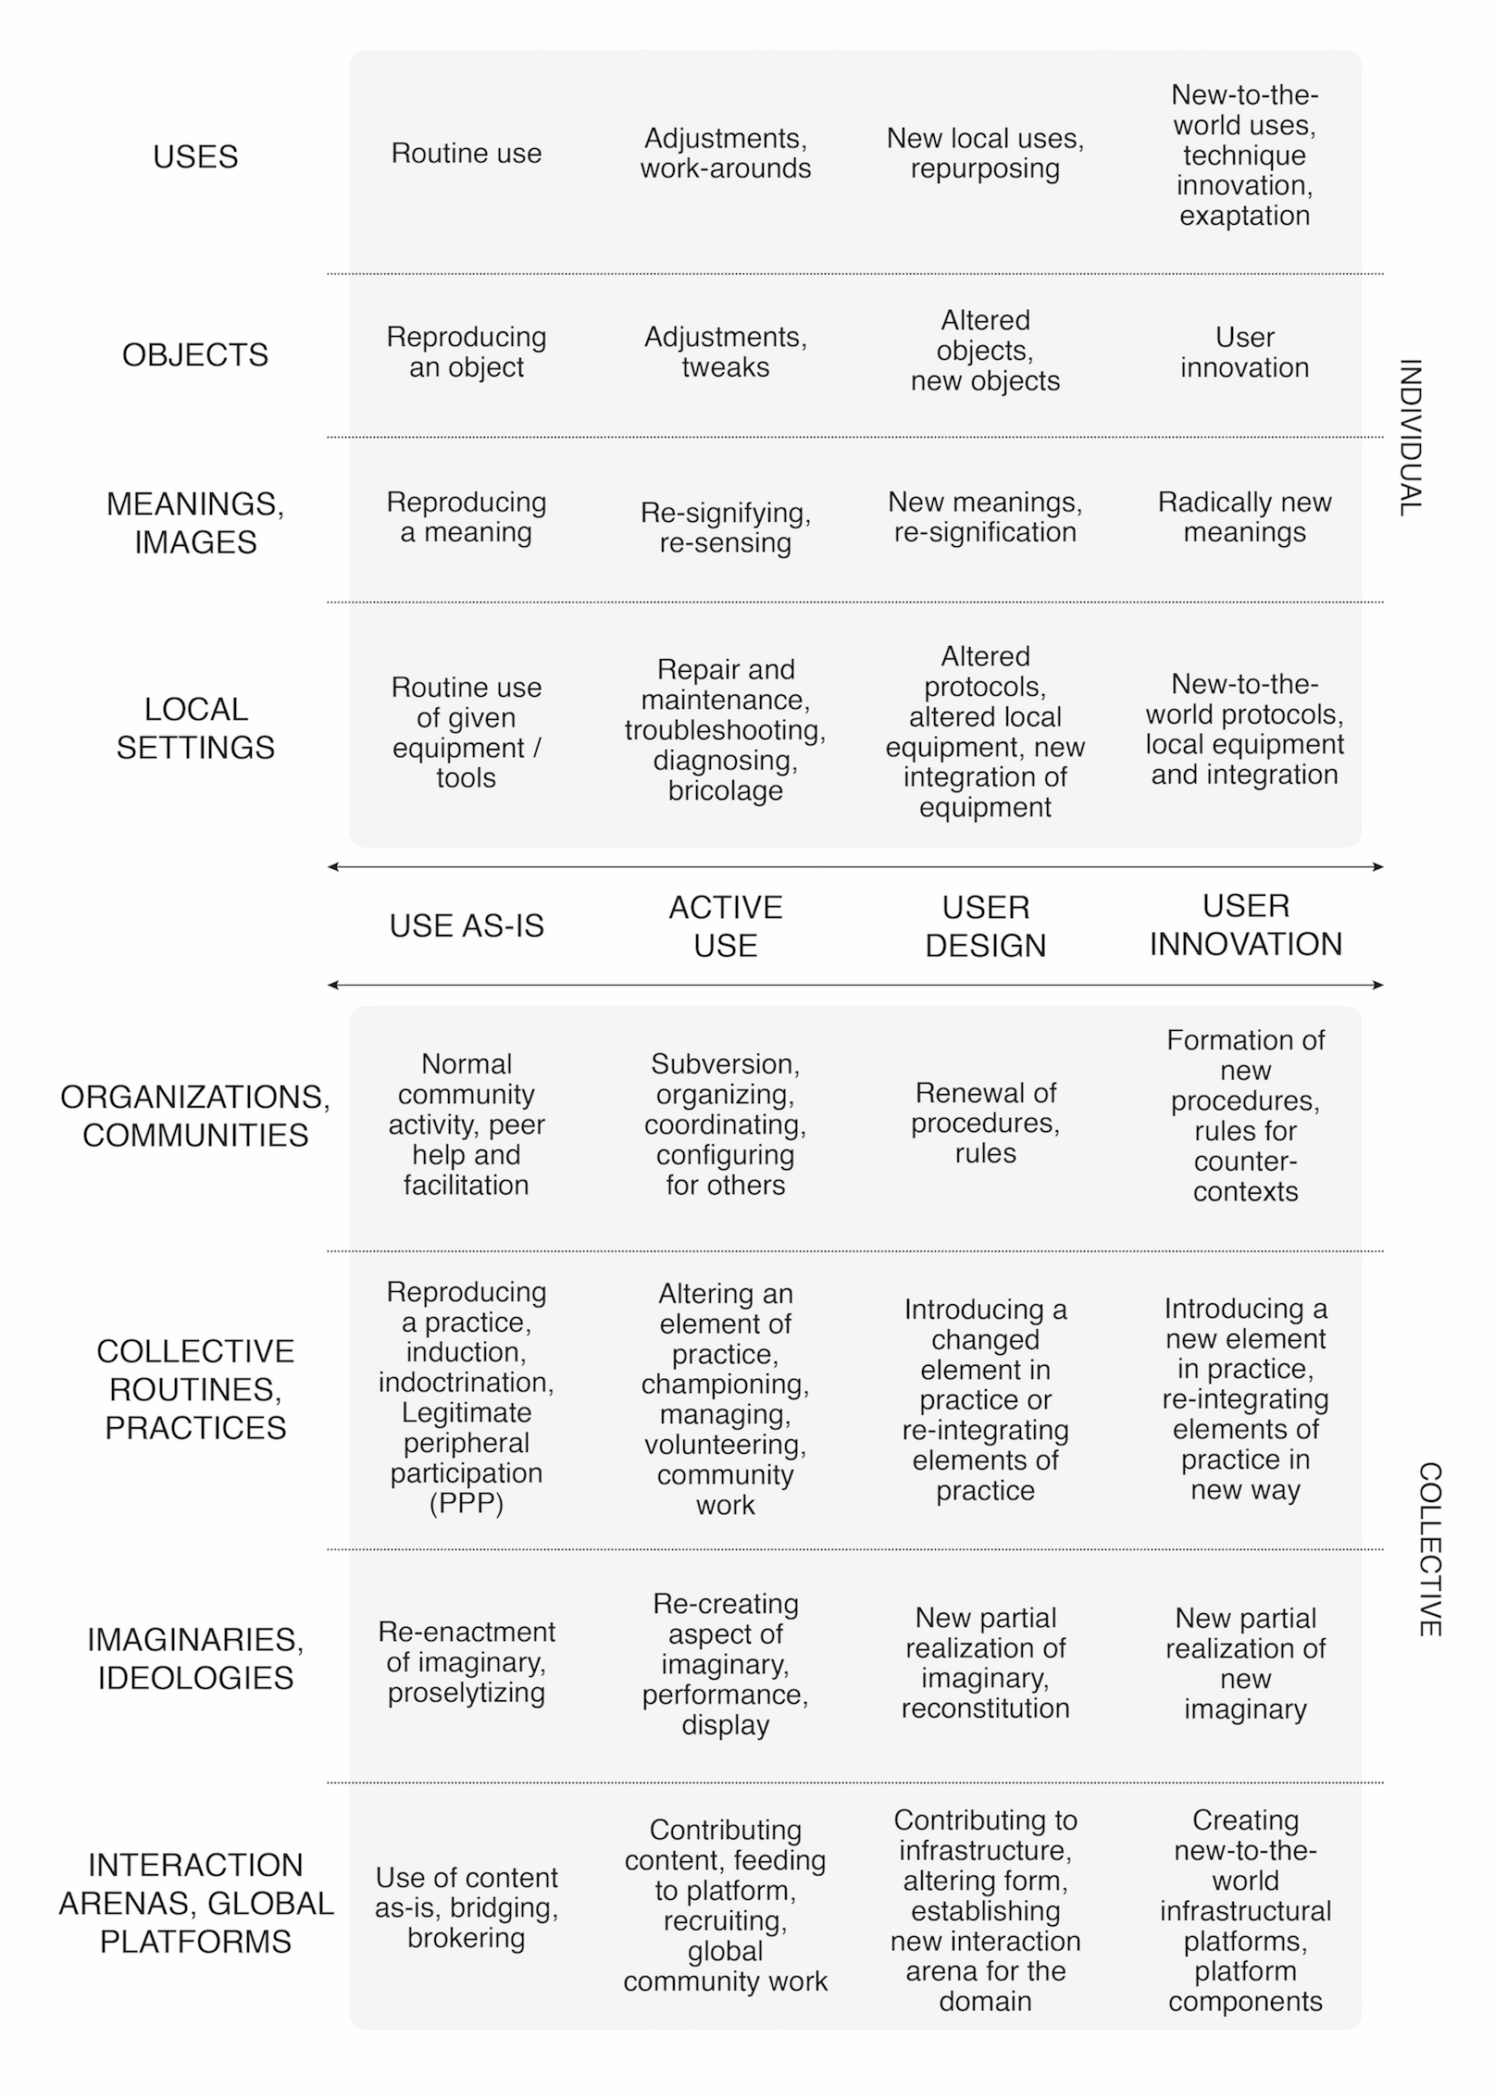
Varieties of user engagement

Slide 18
Varieties of user engagement: example of fablabs

Slide 19
Varieties of user engagement

Slide 20
Varieties of user engagement: example of fablabs

Slide 21
Varieties of user engagement

Slide 22
Varieties of user engagement: example of fablabs

Slide 23
Varieties of user engagement

Slide 24
Varieties of user engagement: example of fablabs

Slide 25
Varieties of user engagement

Slide 26
CODO cases

Slide 27
Mapping forms of users’ active design engagement across cases

Slide 28
Conclusions
active users in the 21st century:
in a single domain (fablabs), we can see all dimensions (possible harbinger of future production/consumption patterns)
more encompassing view on users’ active design engagement:
as individuals, as collectives
physical settings, digital settings, hybrid

Slide 29
Conclusions
not only intended design – but we need to pay attention to design-in-use
is there user innovation?
if so, what?
not only objects, but also local settings, meanings, organizations
active use, yes – but how much – to what depth?
‘First hand’ use and interacting with ‘objects’ blend with ‘sociological’ topics, particularly with collective forms of active use: organizations, social practices, global platforms, imaginaries and ideologies
… less frequently changed but clearly not just reproduced either

Slide 30
WEEK 3, TOPIC 2:
Extending design to use-time

Slide 31
Aging together: steps towards evolutionary co-design in everyday practices
Andrea Botero, Media Lab
Sampsa Hyysalo, Design

Slide 32
intro

Slide 33
Old days: Designer came, saw, and solved the problem & left the public to admire the fruit of his genius
Since then: Techniques and methods to place design on more collaborative grounds have been developed

Slide 34
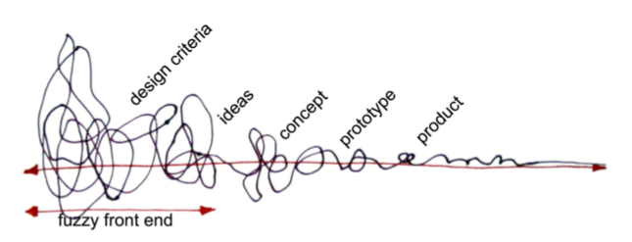
Sanders and Stappers (2008 p6) model for codesigning
Sanders, E. B.-N., & Stappers, P. J. (2008). Co-creation and the new landscapes of design. CoDesign, 4(1), 5-18.

Slide 35
So 80s!
Design in use: Tech & consumption studies, user innovation…
Social media, peer to peer, co creation, user innovation platforms, open source dev, etc)
Nonetheless, extended timeframe of co-design is halfway realized

Slide 36
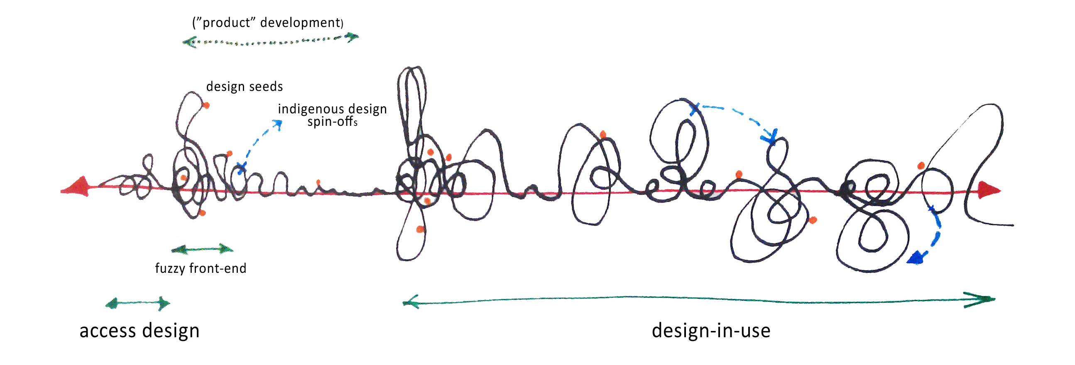
Aging together type of codesign (Botero & Hyysalo ).

Slide 37
Continuing co-design in use

Slide 38
Designing for the evolving workplace
Co-realization (Hartswood et al 2002)
  Premised on difficulties to anticipate new possibilities and shortcomings in prior design: extend design to use-setting and use-time (in high usability and dependability settings)
Metadesign (Fisher and Scarff 2002, Fischer and Giaccardi 2006)
  Designing tools, means and environments where (fairly design competent) people can design for themselves (cf. Lego)
Co-configuration (Engeström 2007)
  Placing a producer representative into user’s practice to continue improving the technical instrumentation (in high capital turnover settings)
→ Extending design for ordinary practices?

Slide 39
Aging together
gradually uncover and make visible the design space available for a community of practice (Wenger, 1998), that is being worked with, while helping them gain a better grasp of their technological wishes and design potentials. The ultimate objective is to evolve well-suited technologies, media and practices with-in a community

Slide 40
Mobilizing in the collaboration pre-setups

Slide 41
Active seniors: setting a communal alternative for growing old
Active Seniors Association (www.aktiivisetseniorit.fi)
shared housing arrangement Loppukiri house (last spurt)
four basic principles: neighborliness, self-help, community spirit and open decision-making process (Dalström and Minkkinen 2009).

Slide 42
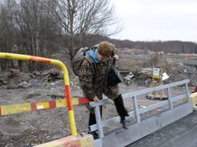
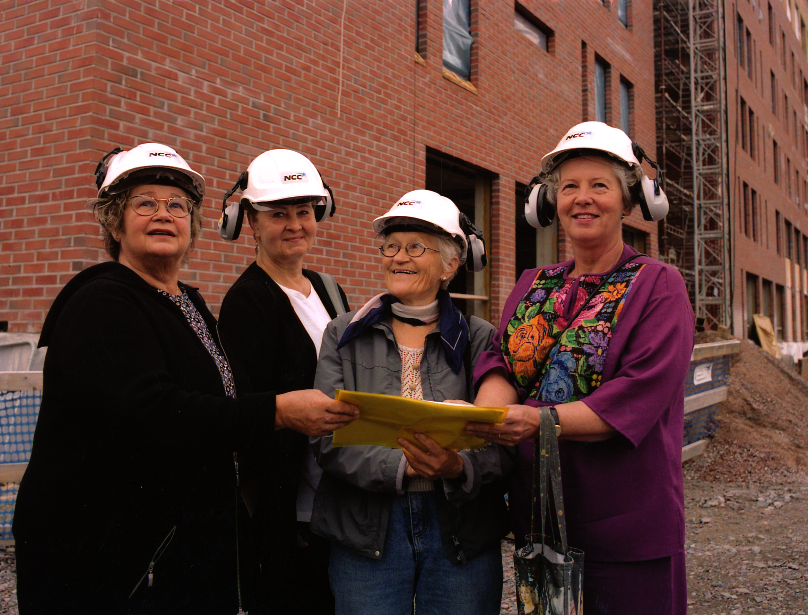
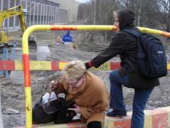
During construction time…

Slide 43
Organizational and technological setting: Arabianranta “forerunner” district
a relatively recent regeneration district of Helsinki
The area was advertised as a future “innovation hub” (today presented as a “living lab”) with a high speed network

Slide 44
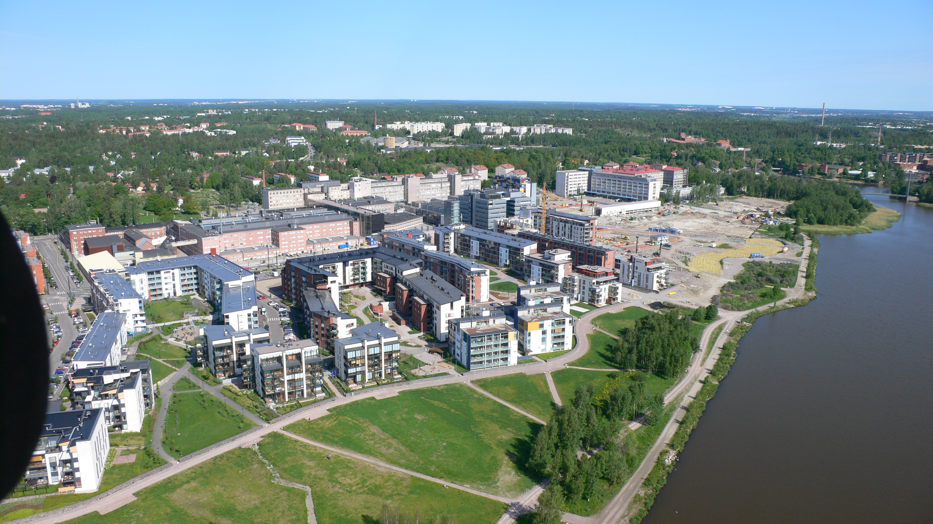
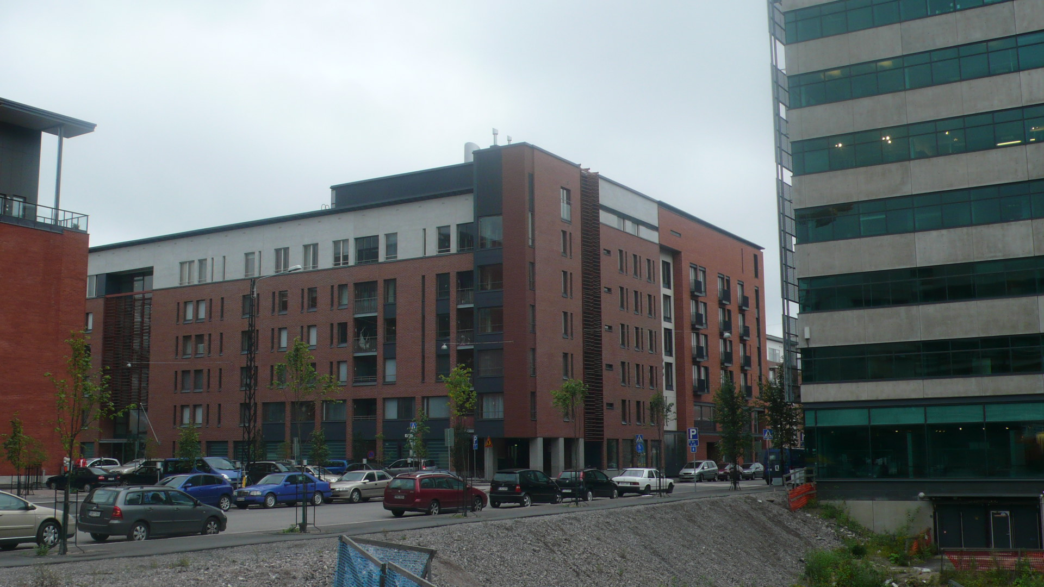
Areal view of Arabianranta
Loppukiri house when finished in 2006

Slide 45
Researchers: new media in mundane everyday life
looking for communities to collaborate with an open-ended participatory project
hidden agenda to offer some “common sense” scenarios for the Arabianranta network

Slide 46
From access design to constituency building

Slide 47
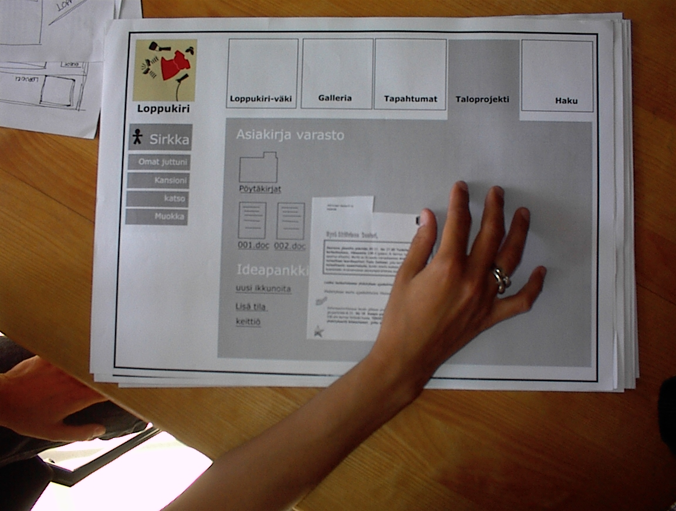
“small and relevant” website and intra for the community (common ground for our cooperation, trust and knowledge of each other )
Early paper protos of the website

Slide 48
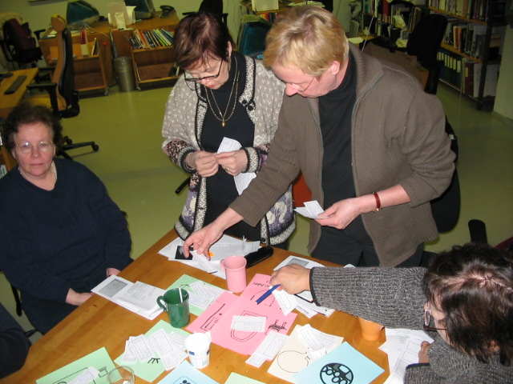
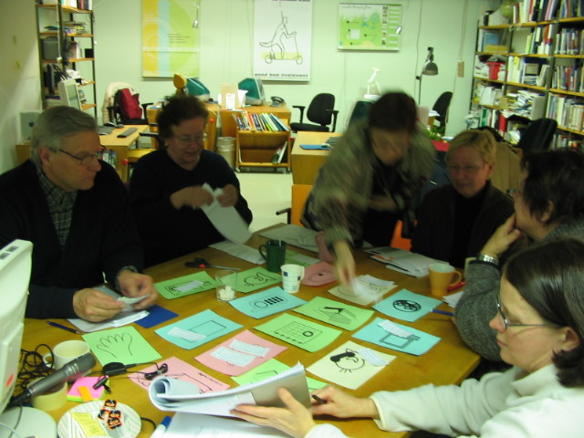
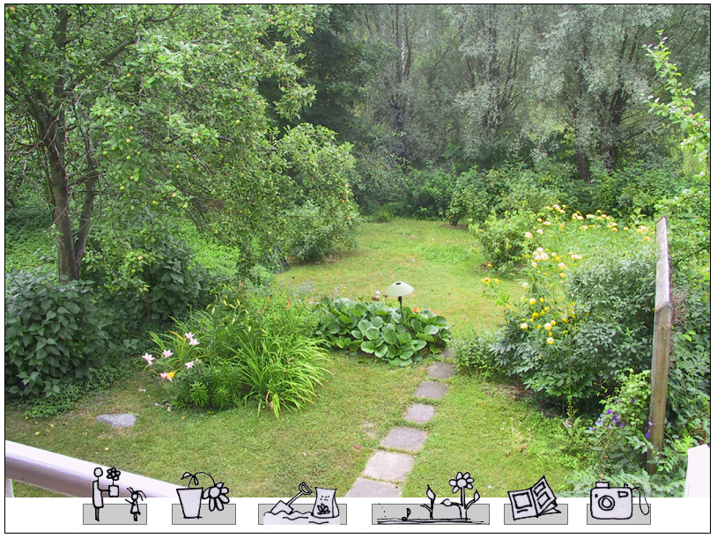
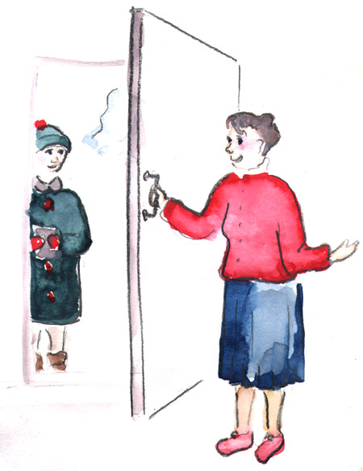
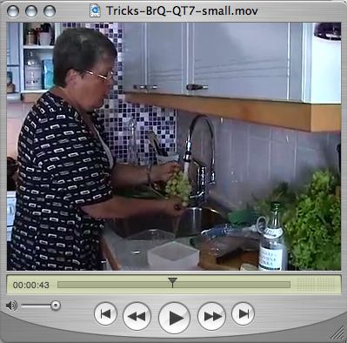
“design seeds” some grew as co-design experiments; others resulted in “indigenous design” evolution
Scenes from workshop and ideation sessions (2005)
Audiovisual library of gardening and cooking tips (Mockups)
Idea for a porter duty role for the house
(Illustration by KL)

Slide 49
Co-designing through prototypes
Community calendar
After several rounds of paper prototypes, the calendar idea morphed into something the Seniors themselves call their Everyday Life Management System = Miina

Slide 50
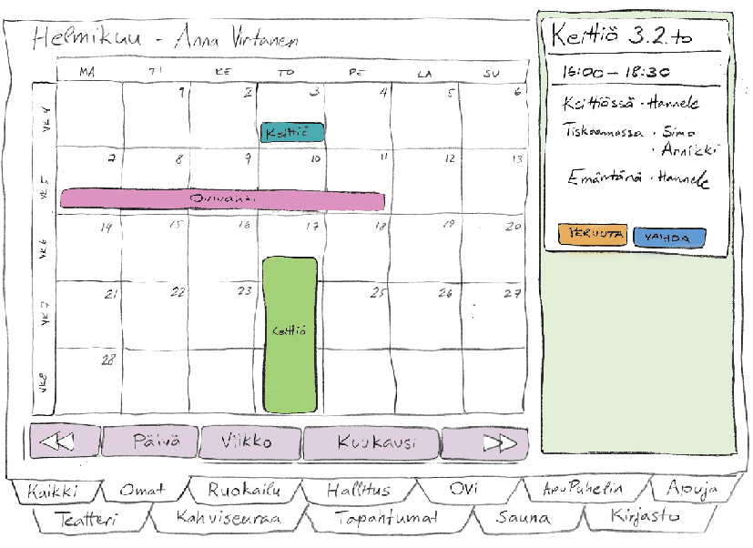
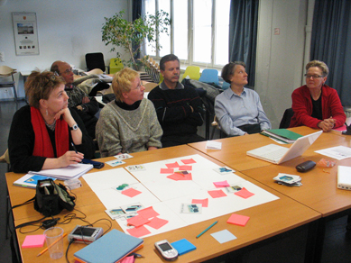
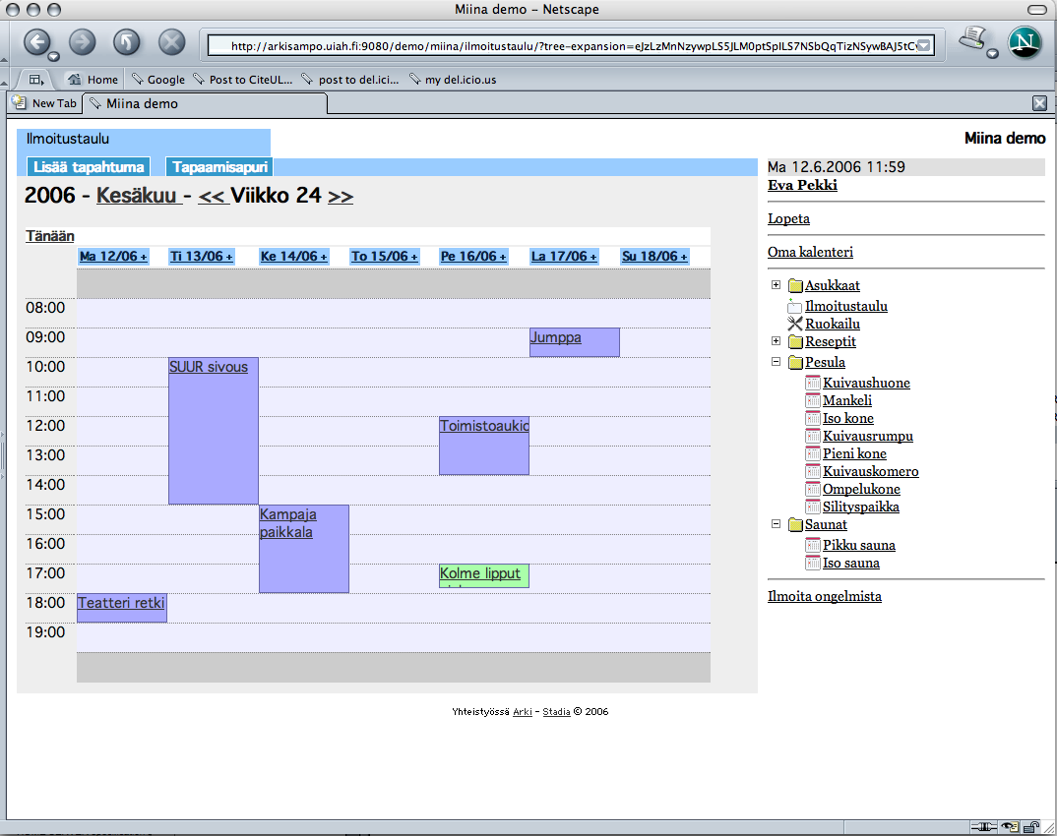
The first working prototype was released when seniors moved to their new house in May 2006

Slide 51
Evolutionary re-designs

Slide 52
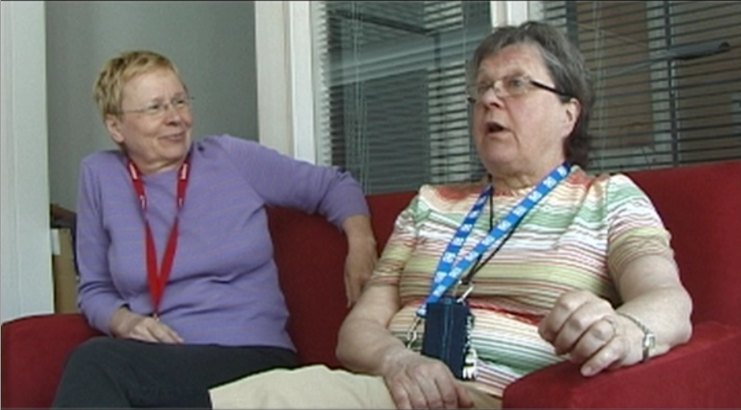
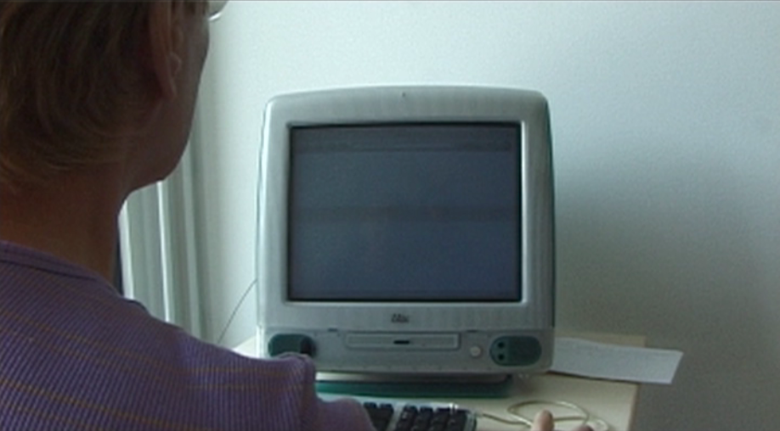
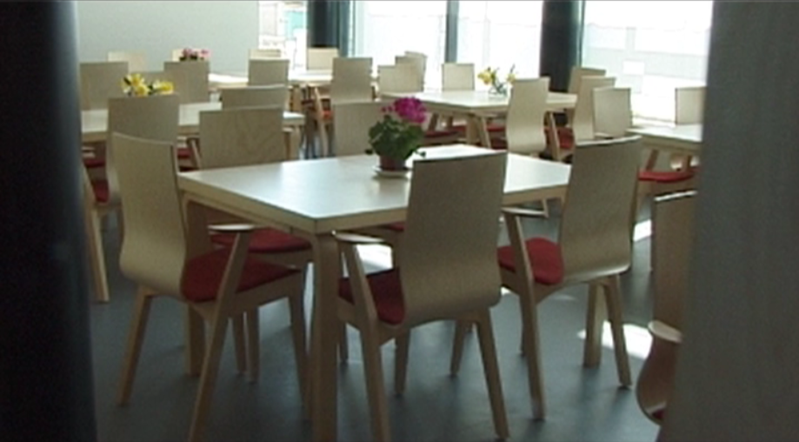
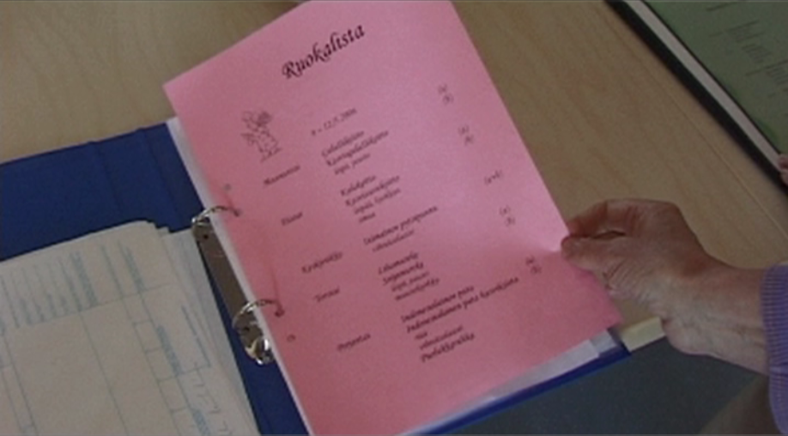
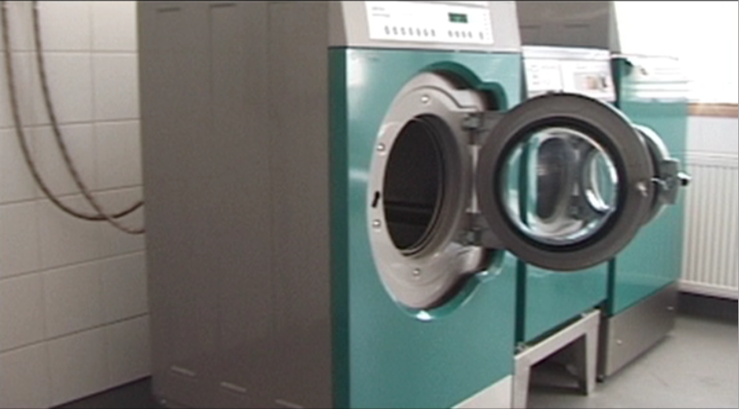
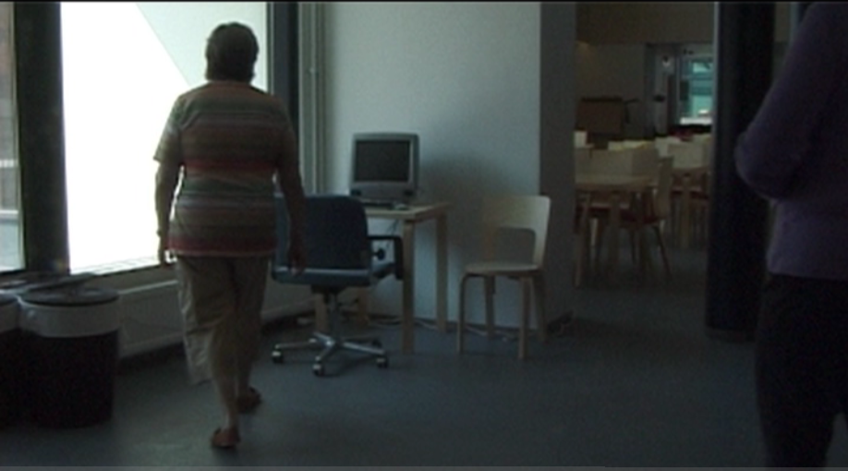
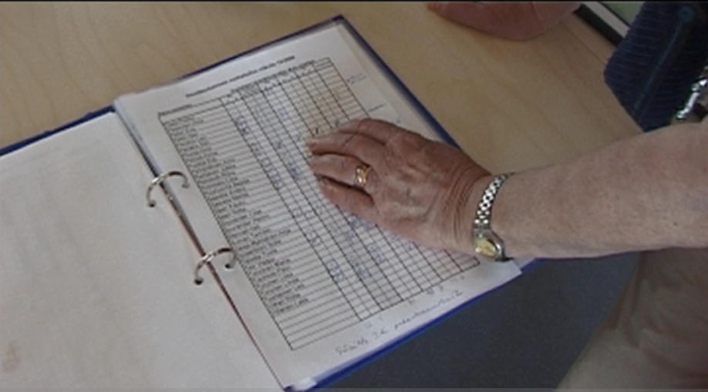
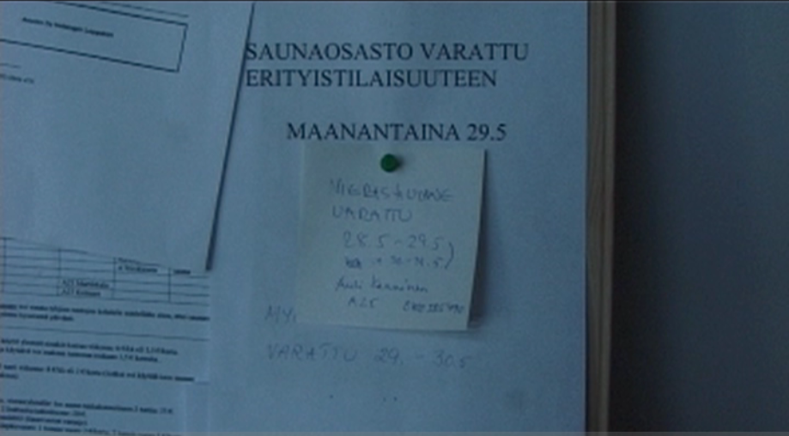
(collaboration with STADIA)
[Dailyworks]
In the house, some of the shared spaces and facilities

Slide 53
RecipeBook gets appropriated as a notice board

Slide 54
Aging together design strategies
Start with social practices
Understand the constituency, build and explore new ones if needed
Go there, be there
Start small and relevant
Foster ownership of the process, technology and media
Avoid design locking-in with crucial choices (e.g. technology)

Slide 55
Aging together design strategies
Build scaffolds
Provide seed prototypes to rehearse collective and cumulative “rapid prototyping”
Keep attentive to partial failures and what can be learned from them
Embed design at different levels
Alternate close working periods with lighter engagement
Manage expectations

Slide 56
Its about time

Slide 57
The designed systems, usages, users practices and designers need to become more seasoned, that is, “aged together”

Slide 58
elaborate a repertoire for long-term design engagement that should be more aware of the converging, parallel, and often also mutually exclusive, projects of all that should be involved.

Slide 59
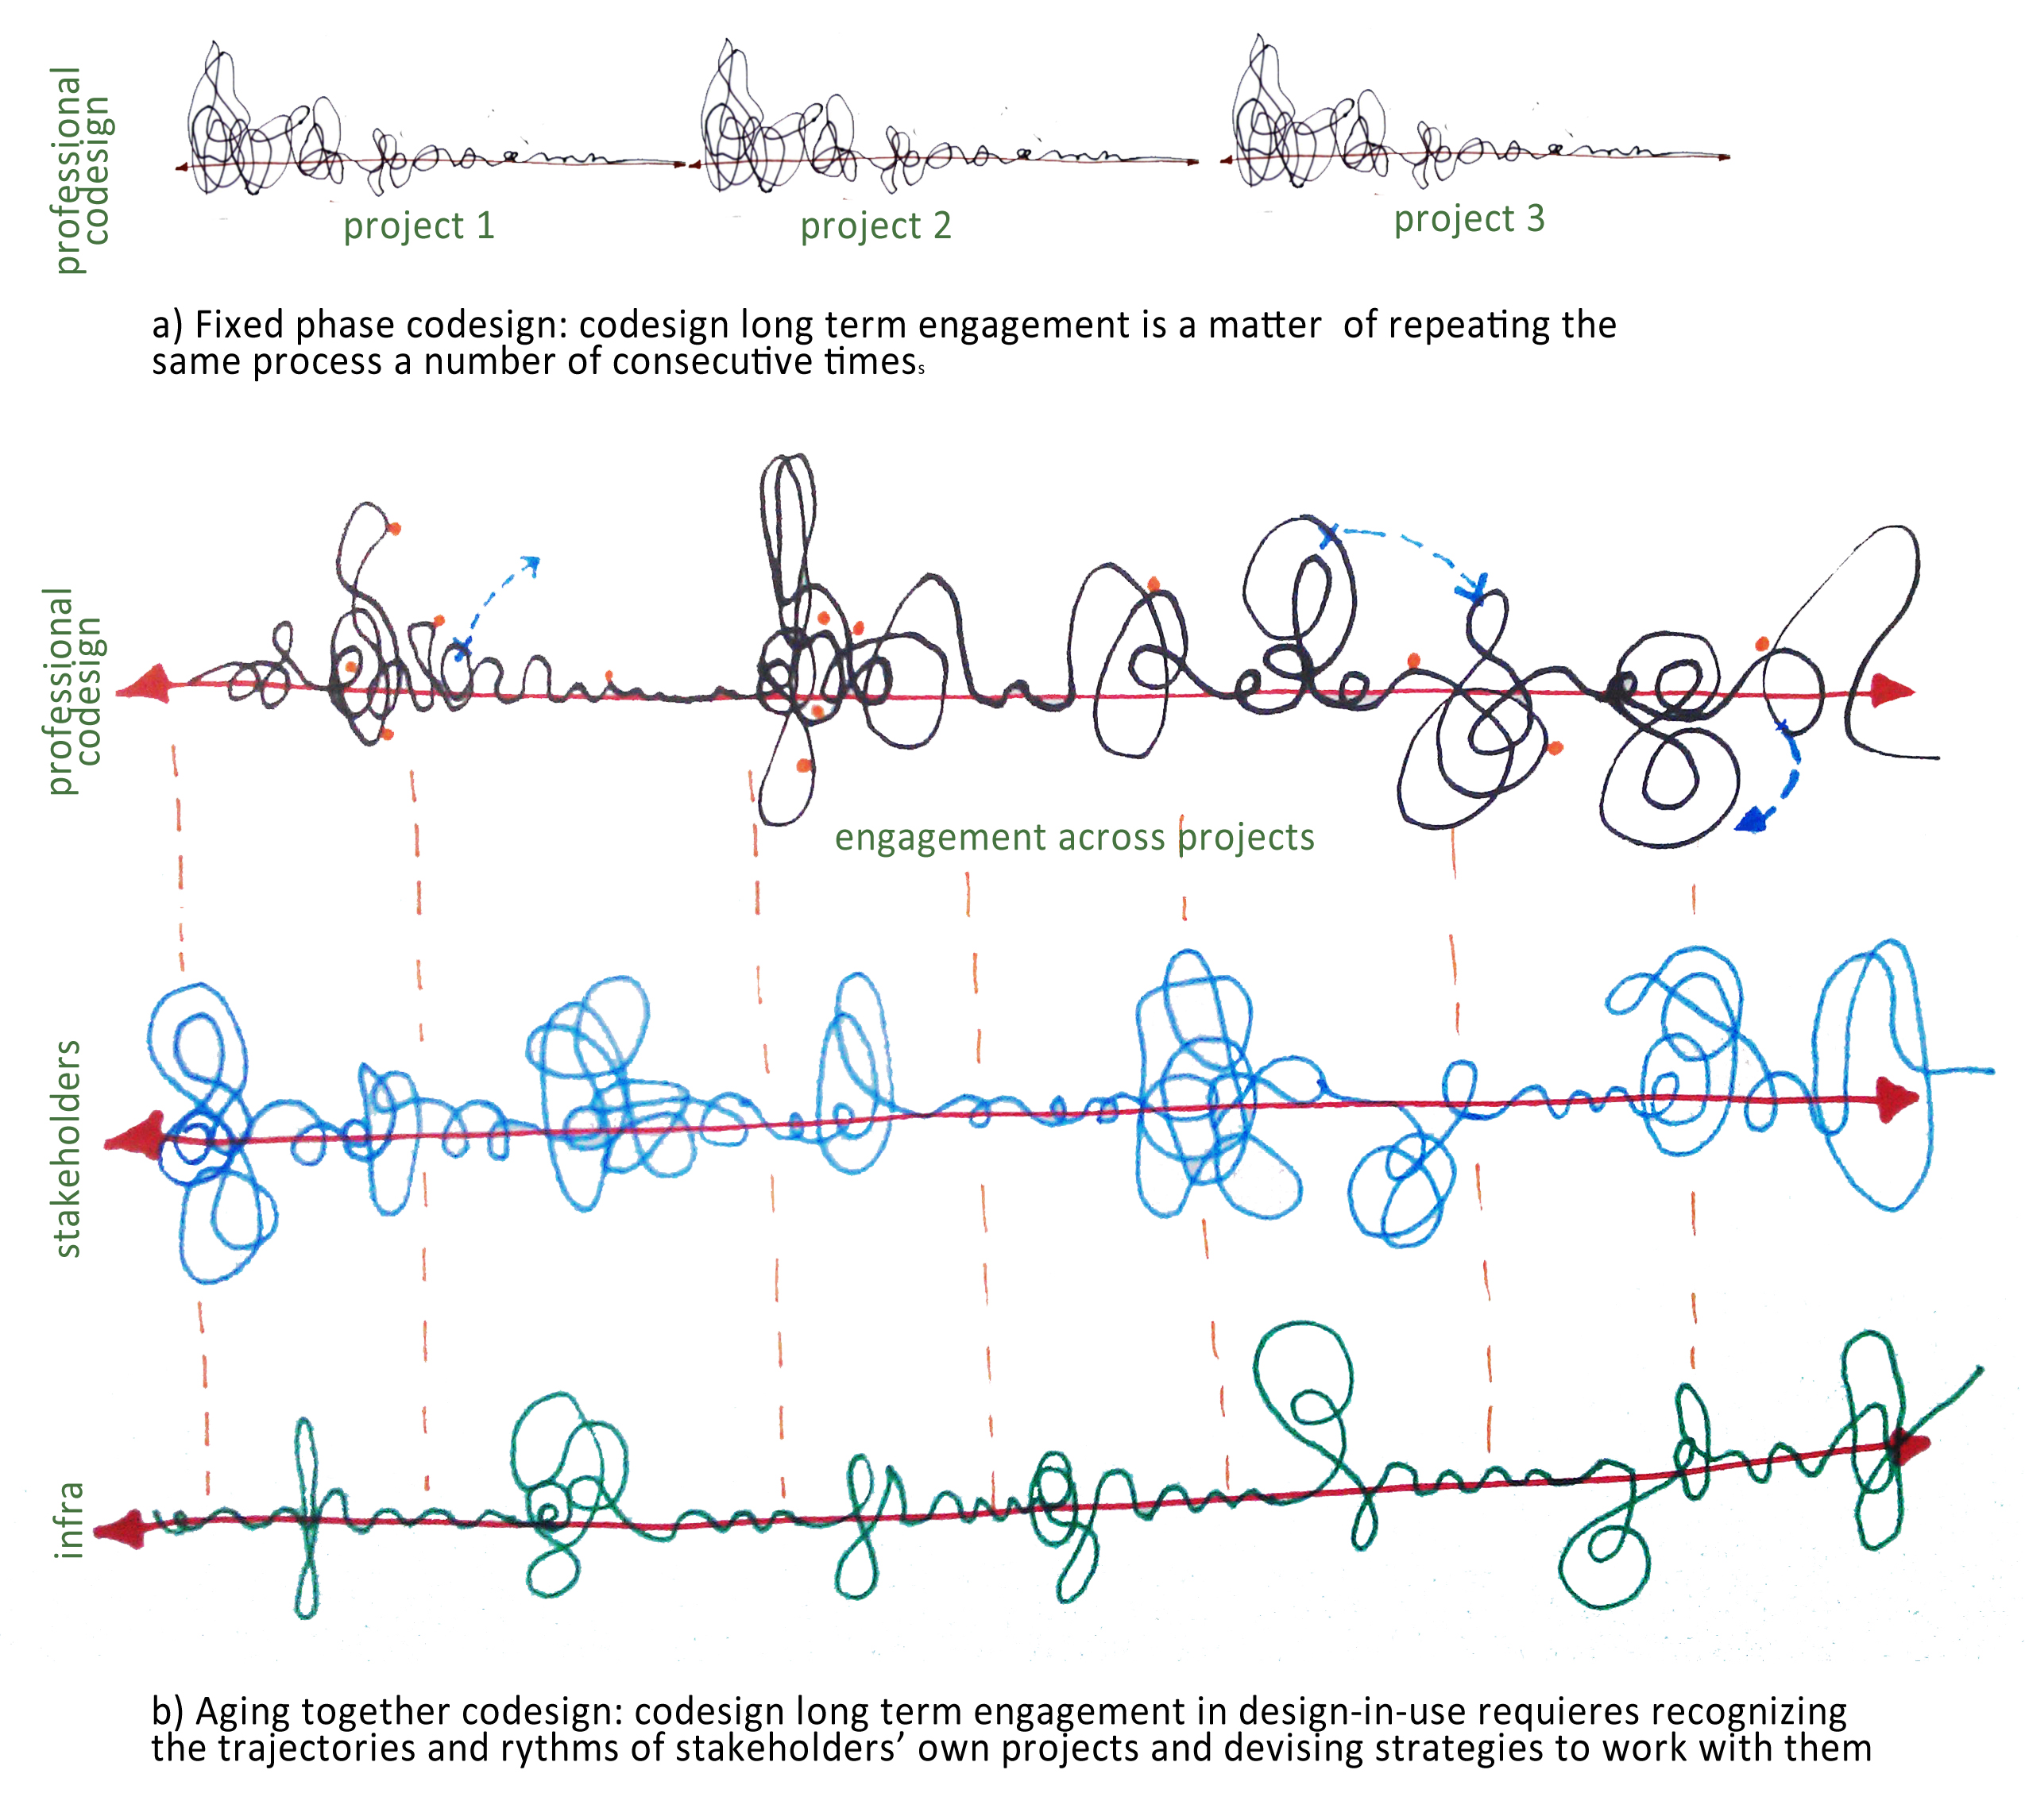
Fixed phase codesign vs Aging together codesign

Slide 60
platform development and commitment?
“Hi Andrea how is life with two children? …I do not wish to burden you, but one active seniors thing keeps running in my head. Do you think Miina would work in the new web? I use many iGoogle applications and have lots of photos in Picasa. These days Twitter is available for quick communications. You Andrea have an understanding of web, our house and all the different actors. Do not use too much time to this question now, just tell what do you think of it.
With Sunny spring morning wishes!”

Slide 61
Ageing together with seniors: portfolio
Starts with collaborative predesign
Extends to co-creative design during the use-time
Extends to supportend user community design

Slide 62
WEEK 3, TOPIC 3:
Building a portfolio on collaborative design

Slide 63
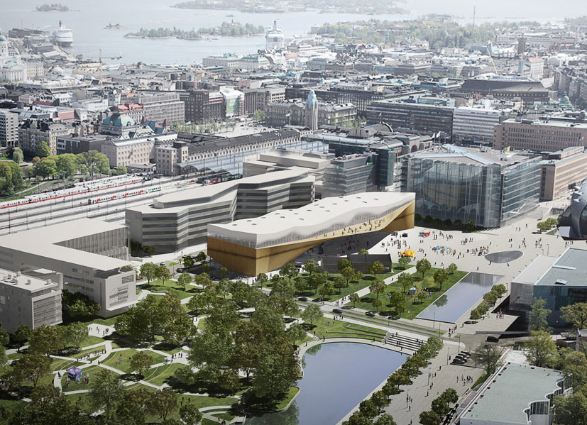
The mundane and strategic work of collaborative design:
Case Helsinki Central Library
Virve Hyysalo, Helsinki City Library Services & University of Lapland, Department of Design, Finland.
Sampsa Hyysalo, Aalto University, Department of Design, Finland.
DESIGN ISSUES 2018 (3) summer 42-58.
sampsa.hyysalo@aalto.fi

Slide 64
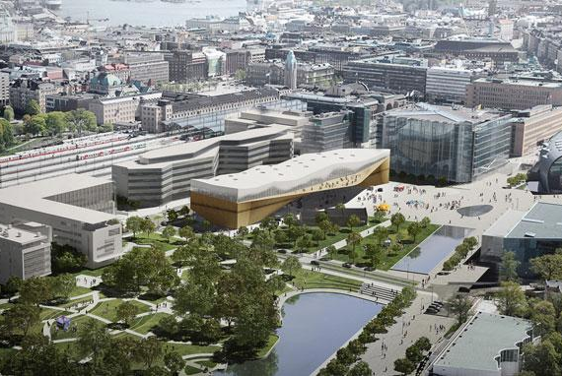
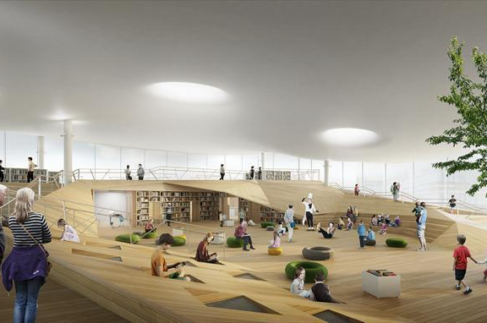
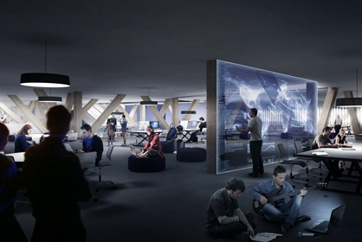
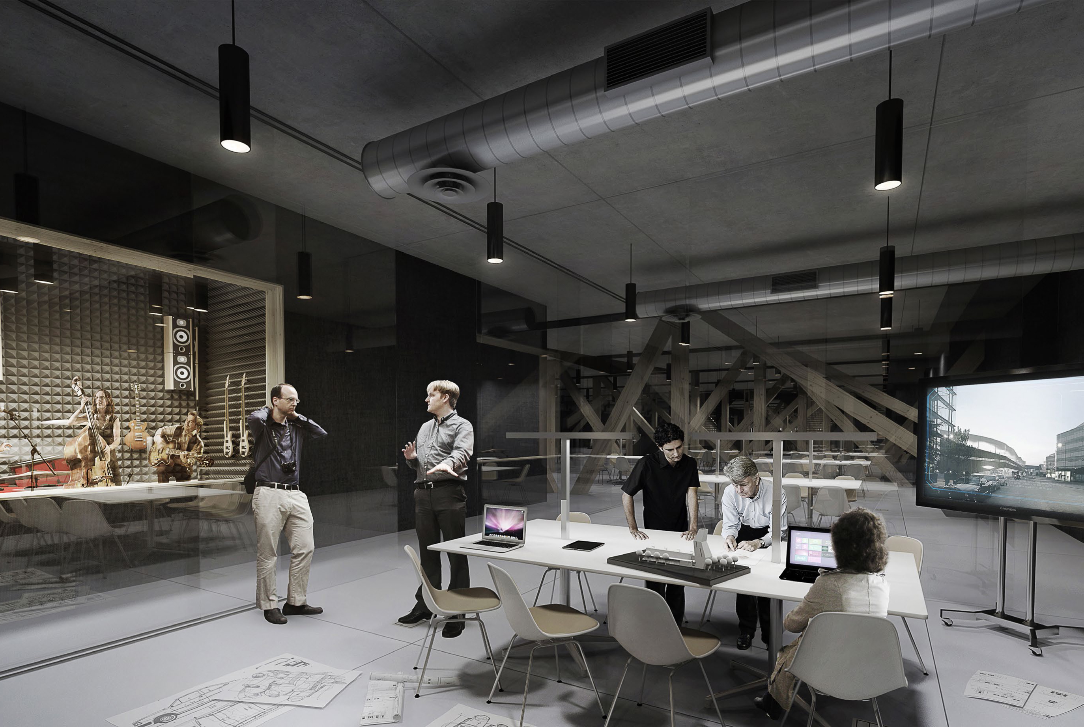
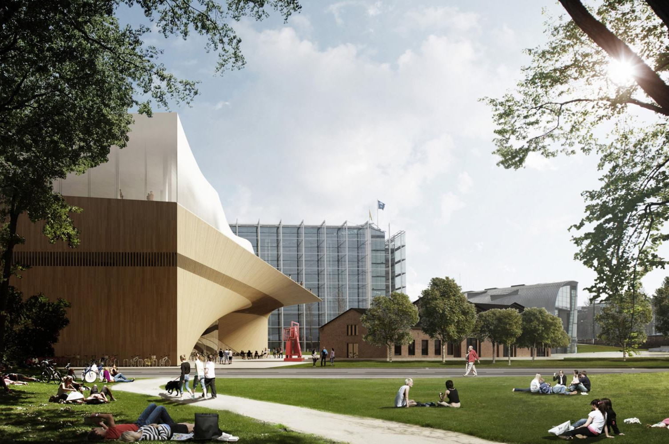
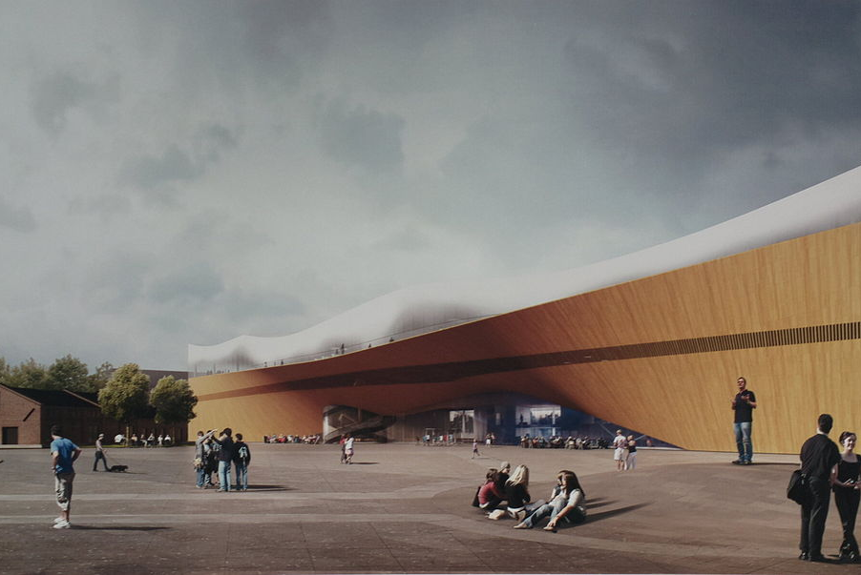
The Helsinki central library will open its doors 6.12.2018.
Its contents and operation models have been sought in co-operation with city residents, and partners through participatory design.

Slide 65
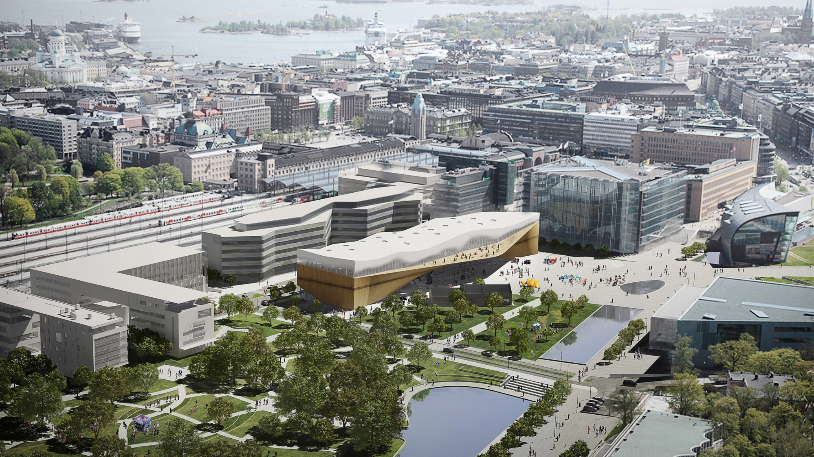
155 years old institution creating something new…
|Meeting- and lounge area 440 m2 | Stage 30 m2 | Pop-up-infos 100m2 | Cinema 490m2 | Multi-purpose hall 350m2 | Lobby areas 150m2 | Back Stage 40m2 | Living lab 200m2 | Exhibition spaces 300m2 | Café 200m2 | Restaurant 300m2 | Interactive spaces 240m2 | Living rooms 500m2 | Children’and Families’ World 600m2 | PersonalOffice-area 400m2 | Studios 160m2 | Makerspace 100m2 | Listening, viewing, game rooms 230m2 | Music, recording and videostudio 400m2 | Service-points & collection area 1600 m2
Future library transitioning to a space for citizens, and community connections
From
storing books
to support
citizens’ needs;
from collections
to connections

Slide 66
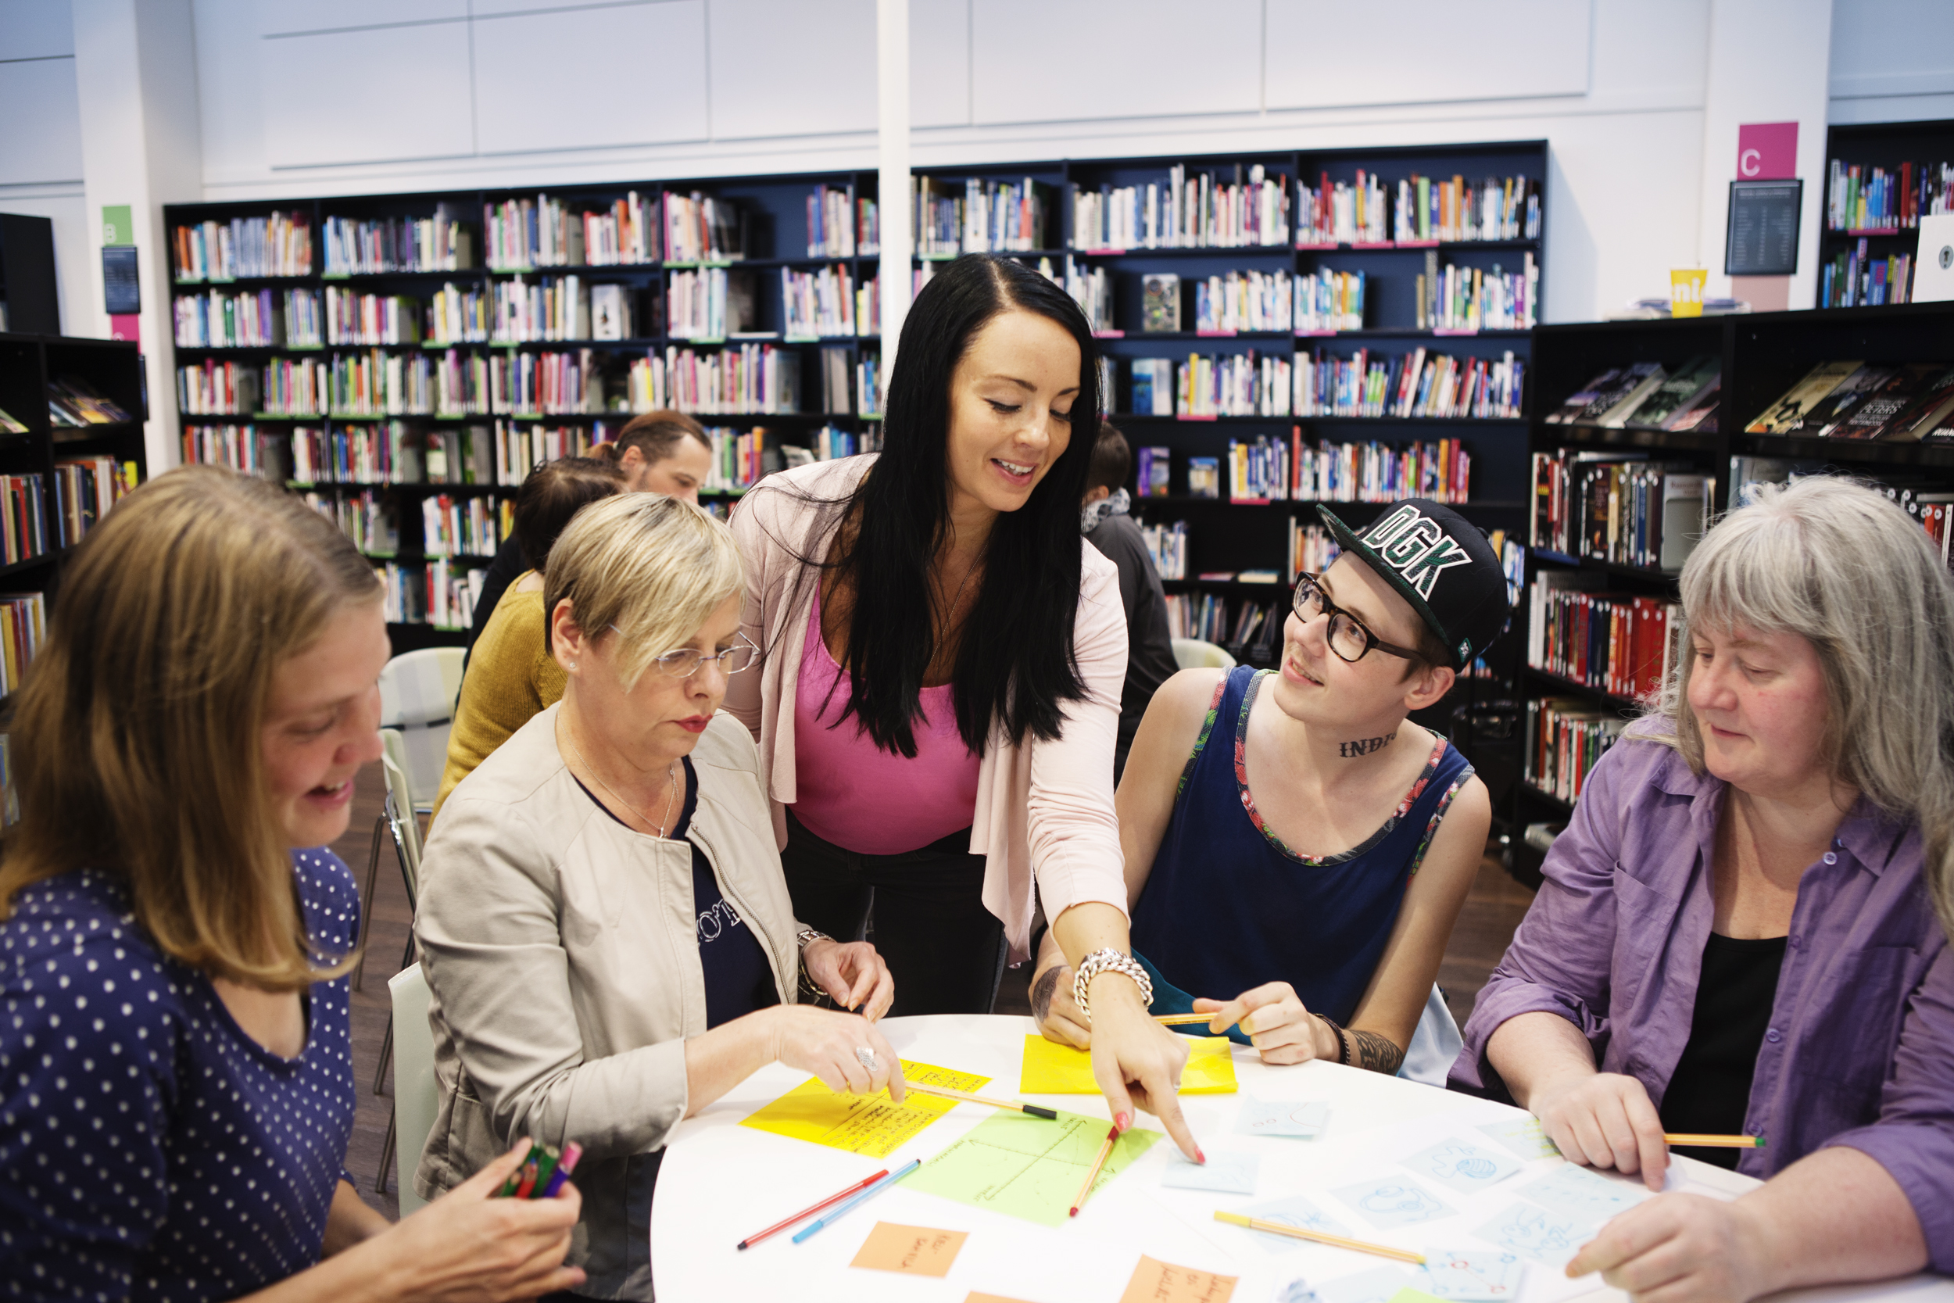
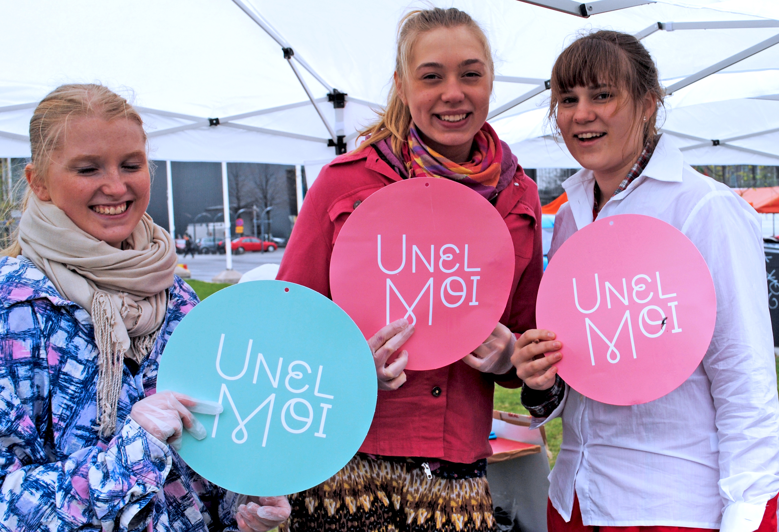
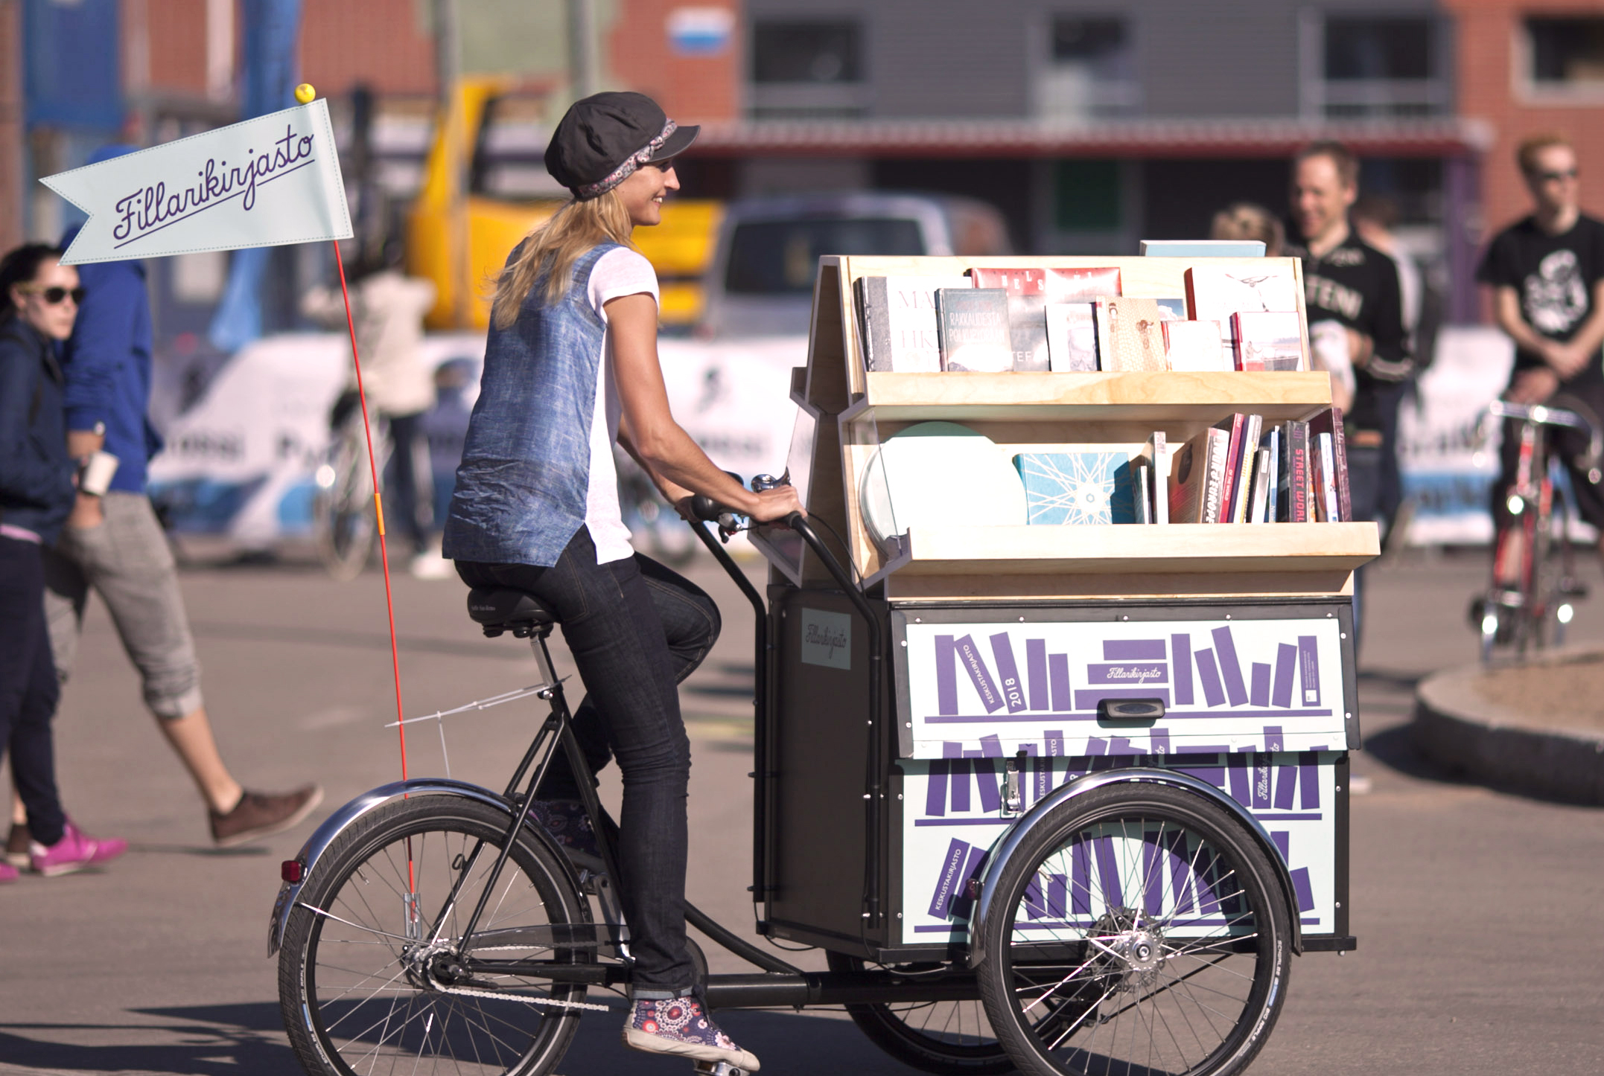
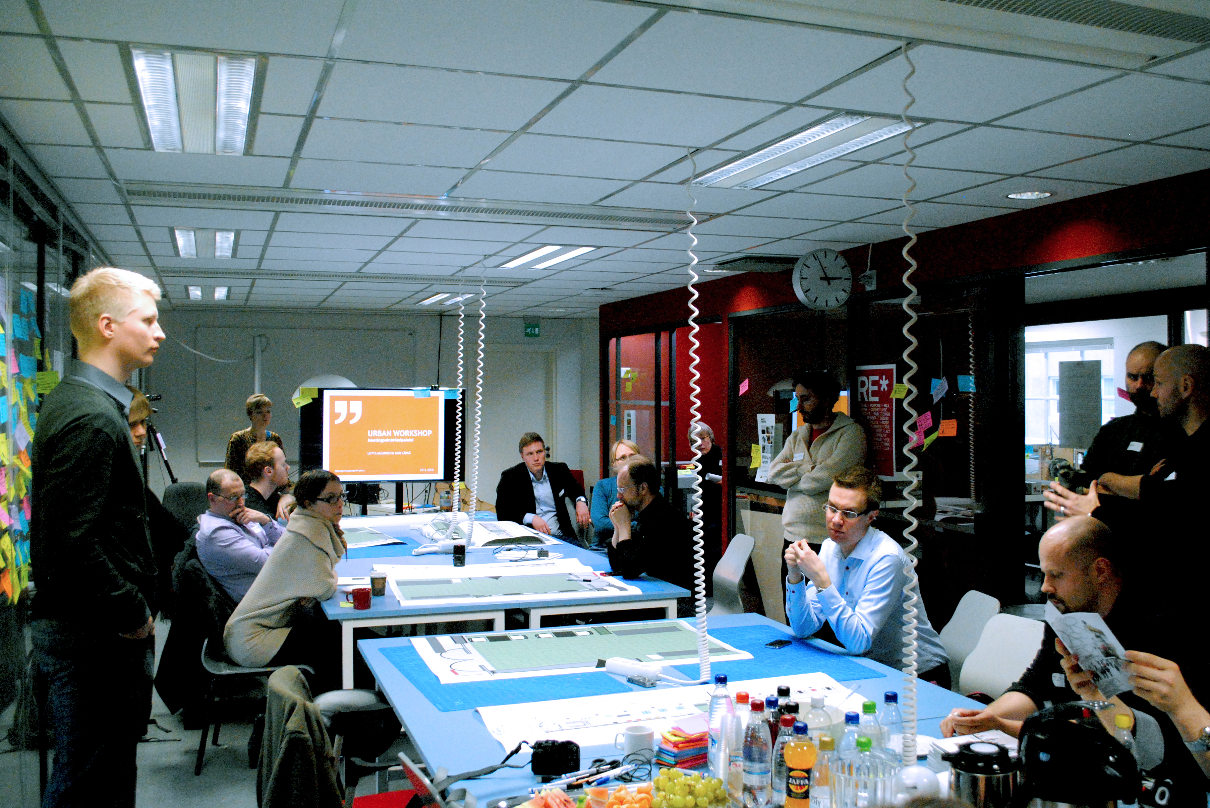
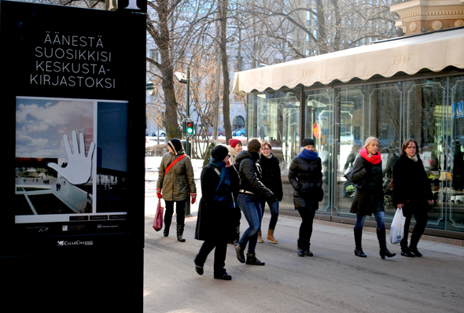
Collaborative design activities have included a wide variety of different kind of tools and methods, campaigns and approaches – the aim has also been to try out what participation and engagement can mean in public sector context.
Partici-patory budgeting
Open ideas harvesting: digital platform, urban events and advertizing campaign
Marketing
and reaching new
audiences
Invitational participatory workshop
series
Citizen designer community
”Move to feet” to meet the citizens with talkative librarybikes
Co-creation
of social value with stake-holder
network
Open & interactive architectural competition

Slide 67
Collaborative design in Celib: RED 2019 paper, BLACK 2020 paper
I Dream-On! Raising awareness, collecting ideas and inviting people in planning
II Urban experientiality of future library in urban events: Street art, Jurttasauna, World Design Capital Paviljonki, Knit’n Tag – yearn bombing, WÄRK-fest…
III Dream Job analysis of the 2600 library dreams by staff
IV Participatory budgeting – Together with Sitra, Emobitin ja Avanto Insight
V Invitational workshops and events to reach target groups identified as crucial – growing the key stakeholder network
VI Open display of architecture competition entries Over 500 entries to architectural competition open to viewing in public.
VII Citizen discussion through web brainstorming
VIII Signal us! all libraries joint campaign day, where customers could give feedback by placing post-its directly in library spaces
IX Bicycling libraries – Mini libraries brought library activities to people in streets 13.-14.6. raising awareness of the closing of architectural competition
X Friends of central library user-designer community build up through three month intensive process
XI Pilots in new and renovated libraries: Maunula, Töölö,
Herttoniemi, Lasipalatsi
XII Friends of Library user community

Slide 68
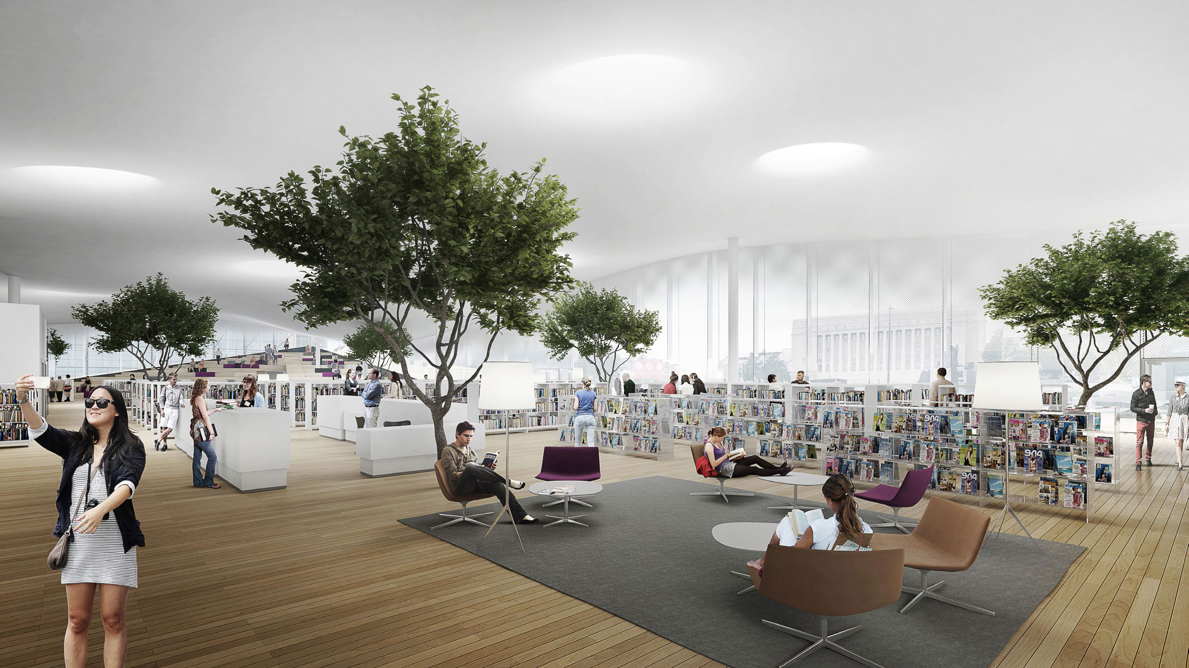
All collaborative design activities regarded as useful and successful
RETROSPECTIVES BY PARTICIPATION PLANNER AND CONSULTANT AFTER EACH ACTIVITY
OBVIOUS EFFECTS OF SET-UPS
higher amount of work in filling and registering information in f2f interactions compared to web-based participation; the higher likelihood of reduced and terse communications in web-based participation
PERMEATION BY
Practical work
Strategic considerations
Staff competencies
…
AFFECTED MERITS AND OUTCOMES STRONGLY
Notes:
supporting democracy was added to the tasks of public libraries.

Slide 69
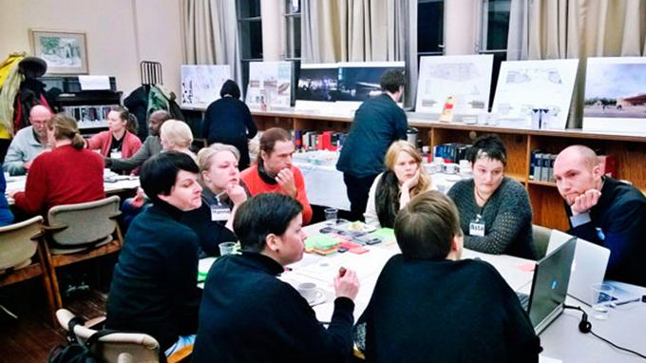
PERMEATION BY PRACTICAL WORK
Variation in pre-, in- and post-collaboration practicalities…
Affected what could be made of the participations.
For instance, the weeks of work analyzing the 2600 library dreams meant that only the most salient themes and categories were refined into themed descriptions.
That these were available meant that it was these concepts that were taken as pilot suggestions for participatory budgeting.
It “straddled” ideals of citizen empowerment or fears of exploitation (Jensen and Petersen, 2016)

Slide 70
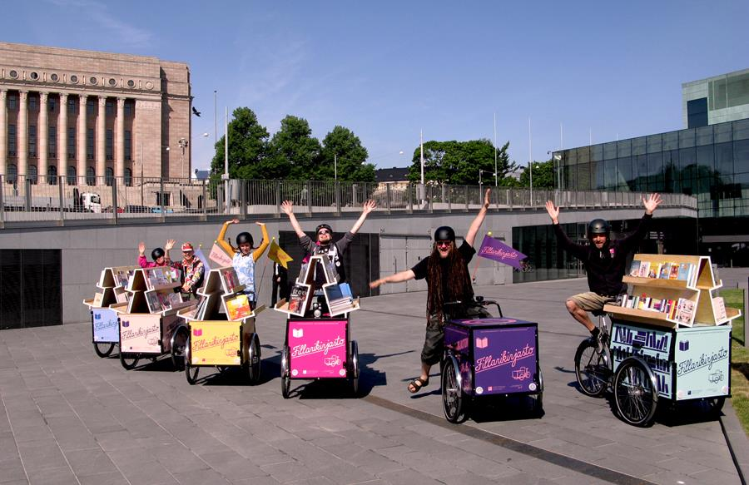
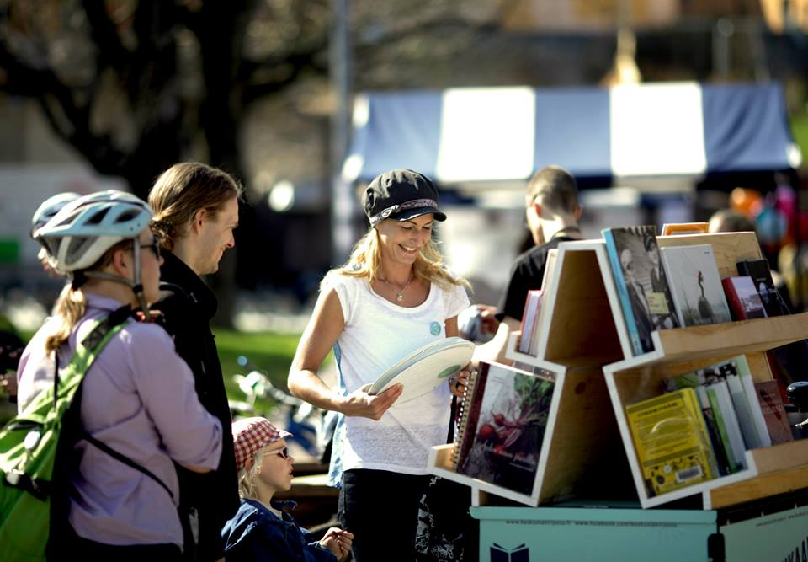
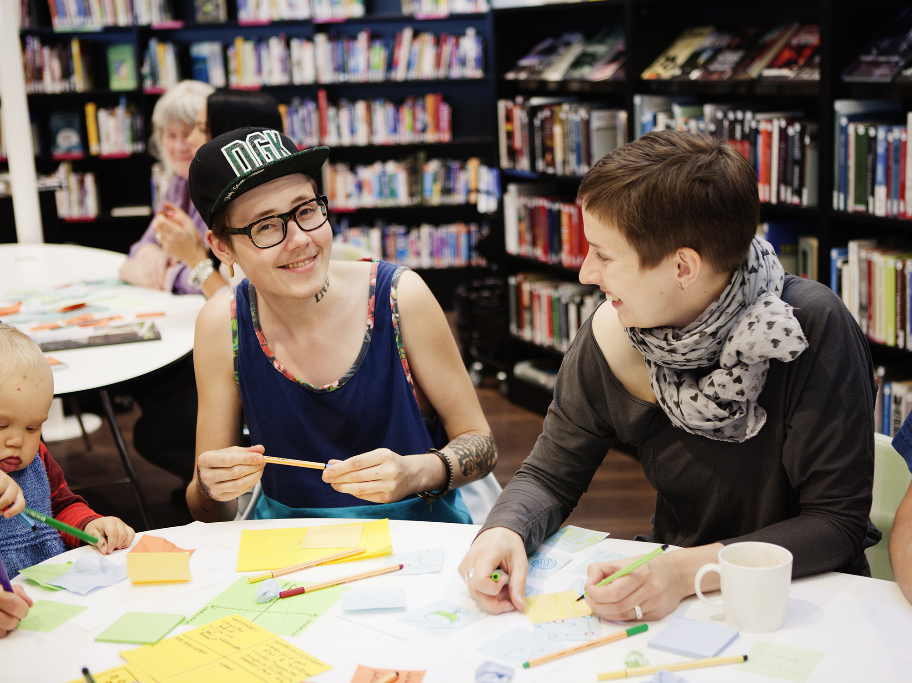


PERMEATION BY STRATEGIC OBJECTIVES
Collaborative design serves aims beyond design: In CeLib participatory marketing and PR
Other objectives did not just “compromise” the design process, but a more intricate relationship:
The democratically ambitious and new activities, such as participatory budgeting and user design community, were best for capturing publicity.
In turn, this allowed much higher investment in participant recruiting and scale of participation
In turn, affected how the participation activities were conducted: unprofessionally run events, failing to publicize the results or failing to act on them could have public repercussions.
In turn, affected the choice of formats, working methods, budgeting, reporting and acting on the results.
…even higher transparency and pressure could have ensured due implementation.

Slide 71

PERMEATION BY INTERNAL CONSTITUENCIES AND COMPETENCIES
The execution of collaborative design activities hinged on the contributions from a broader circle of people in the library organization than designers
Limited the complexity collaboration set ups, tools to be used, as well as how wide and deep analysis was possible.
Staff who participated reported high satisfaction in learning more interactive ways to engage with customers and how to take a more active stance towards their work
The uptake of citizen ideas and solutions depended on the staff in the branch libraries, the other planners and managers.

Slide 72
TO CONCLUDE
the relative merits, and the shortcomings of collaborative design activities are permeated by mundane practicalities, strategizing work, and the involvement of wider organizational staff.
Instead of external factors that aid or complicate collaborative design, these are internal design issues in the work of collaborative design.
Work of collaborative design is what designers (have to) do even though it goes beyond what has traditionally thought of as designing.
Making the most of this potential requires skill in handling the intertwined normative, strategic, and practical aspects of user participation

Slide 73
Central library portfolio excercise

