Slide 1
Exercise 1
Design a solution oriented workshop for a sustainable maker space

Slide 2
Brief
Design a workshop to ideate a concept for a sustainable maker space and its activities that engages also the sustainability of latest distributed manufacturing technologies.
Location downtown Helsinki
Just one workshop
Aim1: is to move towards a specification of what this maker facility would be like
Aim2: is to define the key user and stakeholder groups for a realizable concept
A step by step exercise to prime the DfSCC following exercises

Slide 3
distributed
software
distributed
hardware
Web 2.0
prosumption
Factory 2.0
digital
distributed,
personalized
commons-
based
peer
production
digital
manufacturing
material
distributed,
personal
DIY 2.0
Notes:
distributed production, peer production

Slide 4
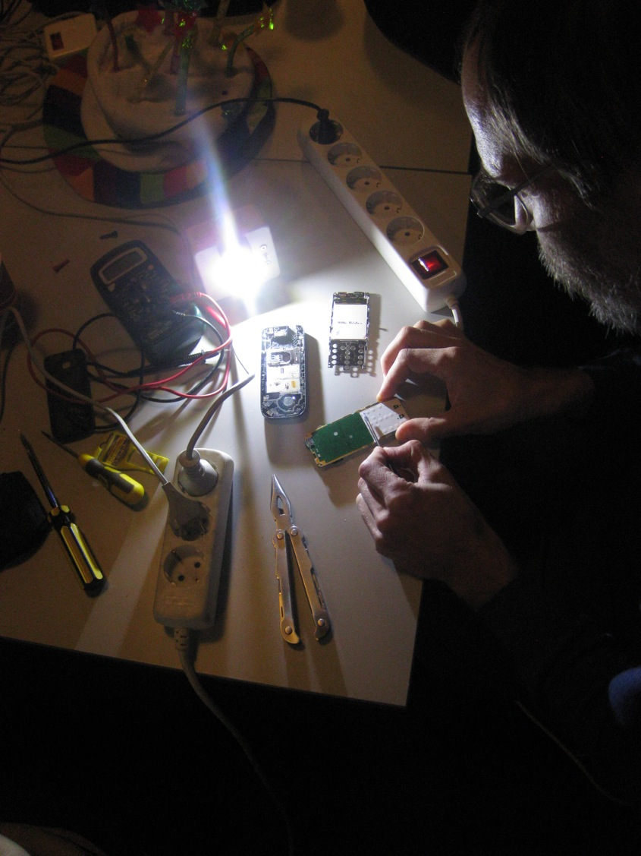
SUSTAINABILITY AND THE MAKER MOVEMENT: ENVIRONMENTAL ISSUES IN FAB LABS
Notes:
environmental issues

Slide 5
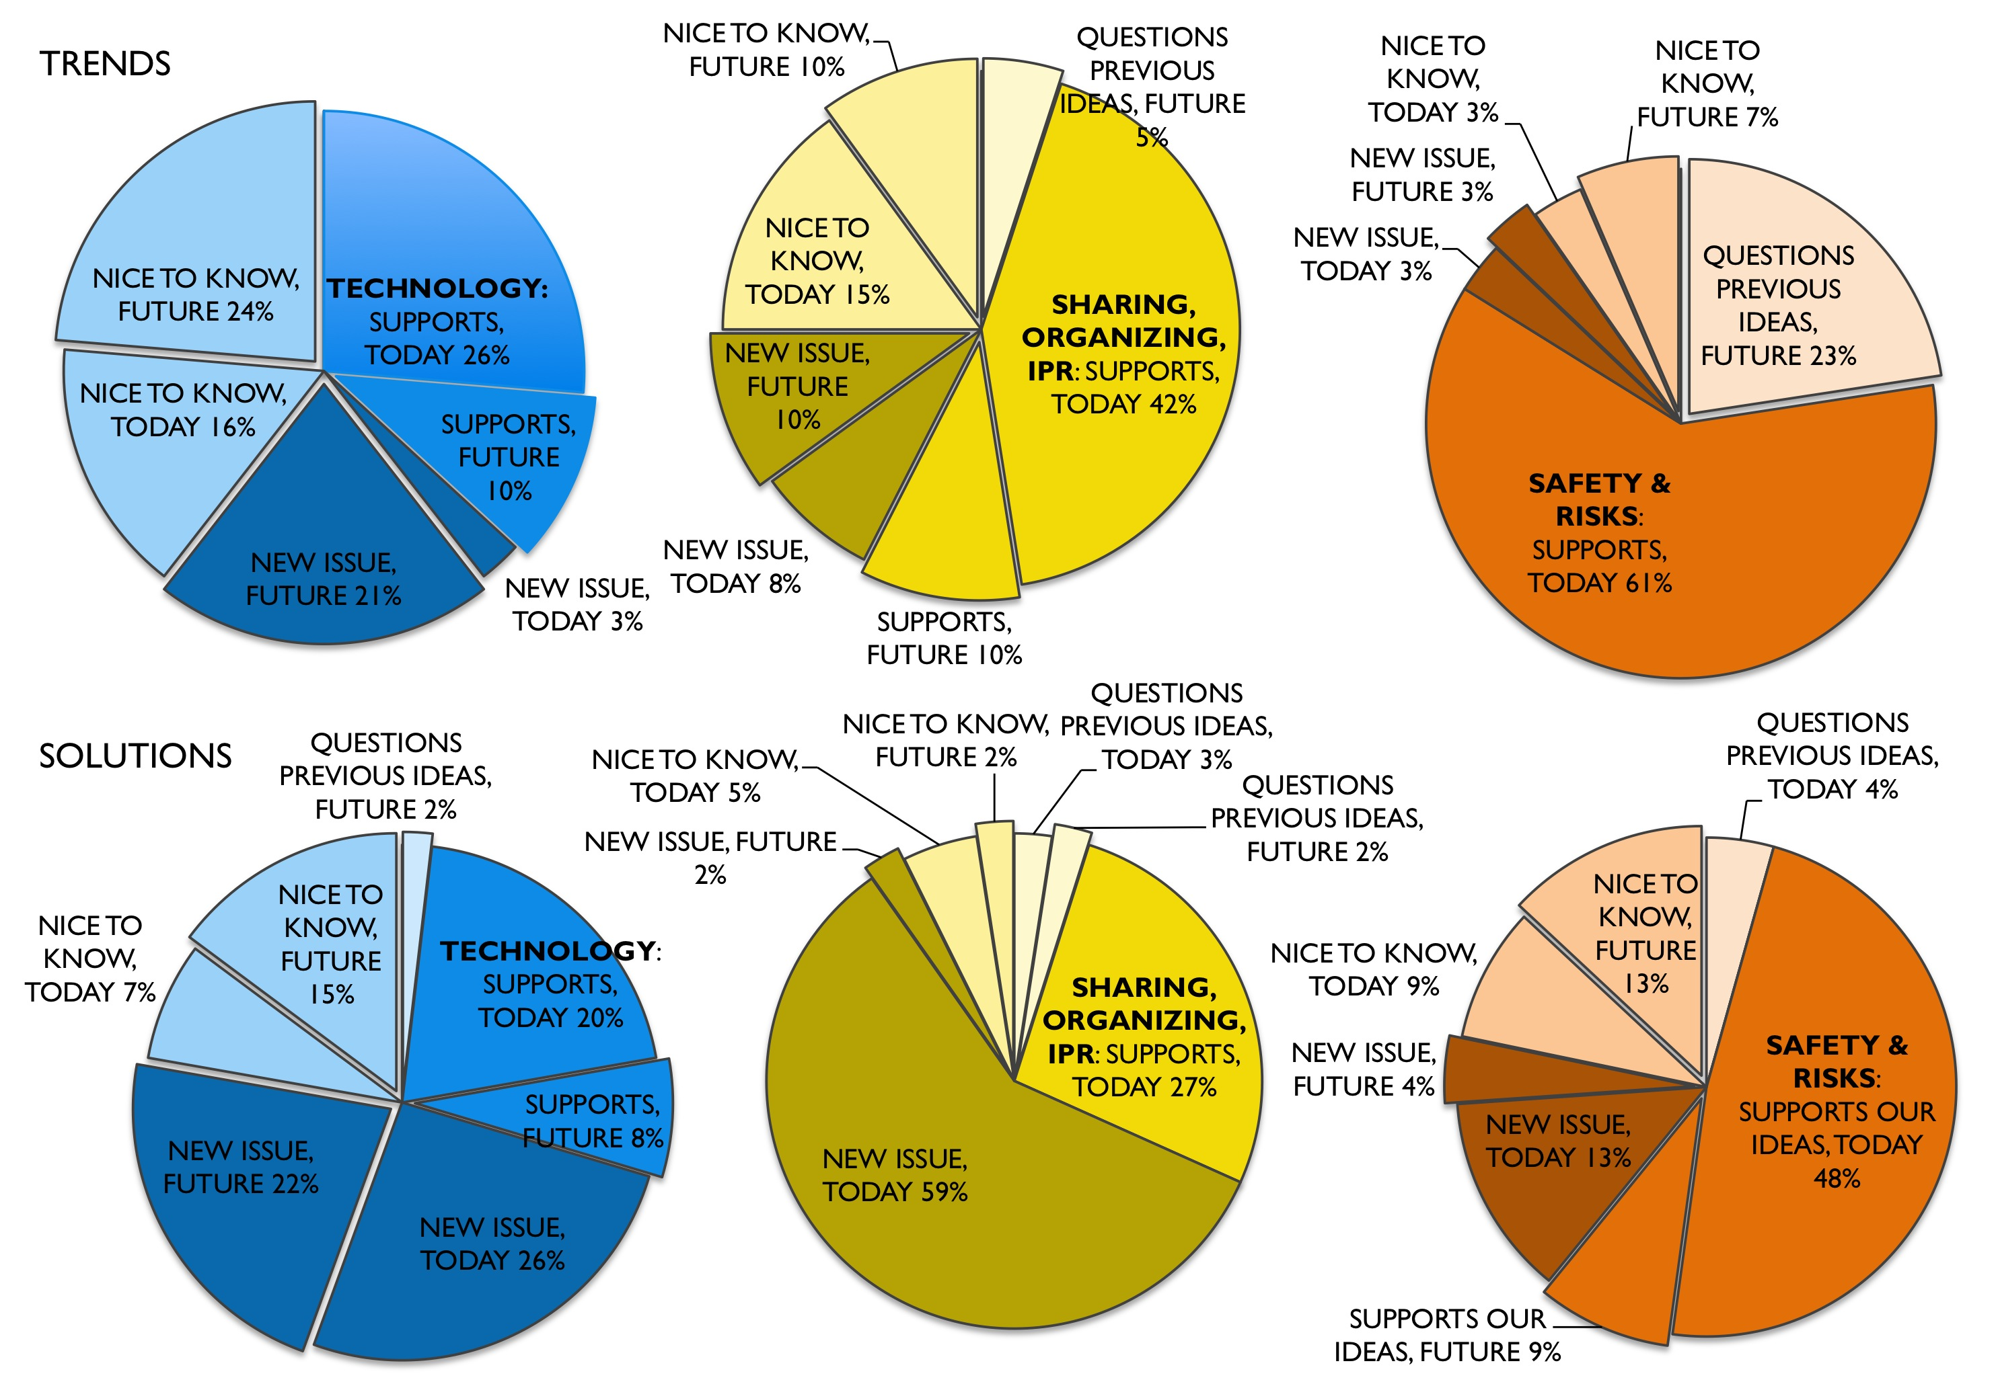
Relative relevance scorings of trends (upper pie charts) and solutions (lower pie charts) in each of the categories

Slide 6
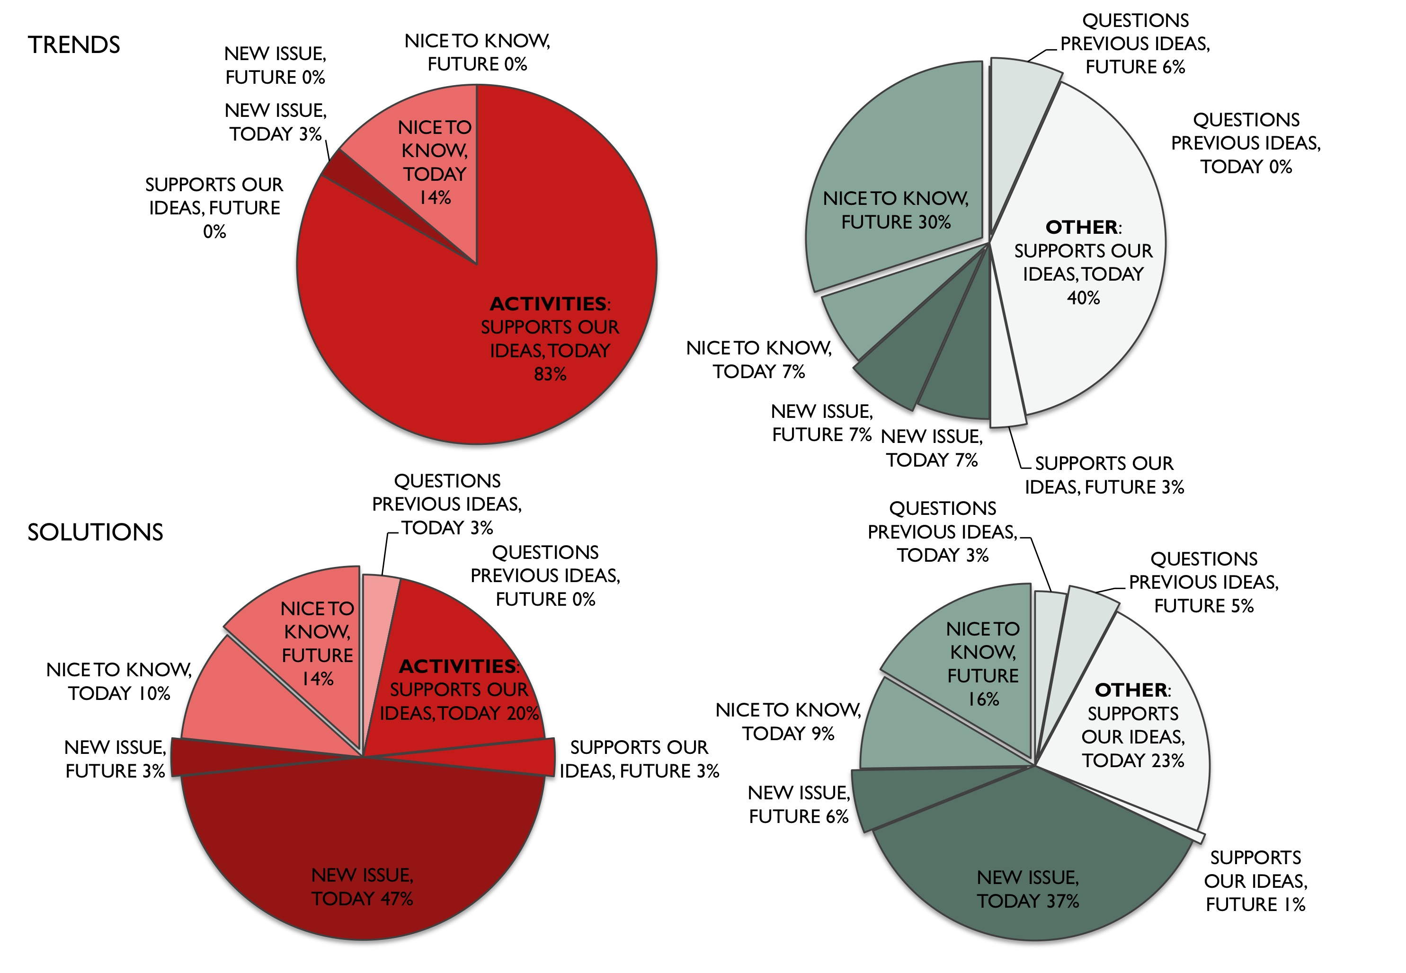
Relative relevance scorings of trends (upper pie charts) and solutions (lower pie charts) in each of the categories

Slide 7
38% of category
34% of category
24% of category
24% of category
13%
of category
TOTAL TRENDS
PRODUCED: 177
WHERE WE FIND ‘SUSTAINABILITY’
Notes:
also top 3

Slide 8
SOLUTIONS AFTER PROMPTING ‘SUSTAINABILITY’ = 262
WHO ADDRESSES SUSTAINABILITY

Slide 9
 | NO SUS SOLUTION | IMPLIED SUS SOLUTION (NOT MARKED) | EXPRESSED SUS SOLUTION
NO SUS TREND | Everything else 129 no sus trends 197 no sus solutions | Implied solution isolates hand tools lending | Difficult to trend solutions related to obsolescence…
IMPLIED SUS TREND (NOT MARKED) | Not (sus+sol) concretized trends nano tech, local production, distributed prod’n, alternative economies | Passed over DIY BIO, tool lending, shared makerspaces, new equipment development | Expressed only in solution updatable and repairable hardware, consumer products…
EXPRESSED SUS TREND | Not concretized trends mainstreaming repair, making bikes… | Unrecognized expression risky materials, set-up of bio-regional networks… | The strong case greenhouse, lots of repair solutions, reuse of waste…

Slide 10
Discussion
Early findings
Issues
Implications
Majority of trends and solutions related to making do not have explicit or implicit sustainability implication
“Passed over” includes important issues about sustainability of future making such as DIY bio, nano tech, development of digital fabrication tech – and the green section is not engaging with any of these
“The explicit sus trend – sus solution” is dominated by concerns about waste and recycling – and dominated by the green section
NOT: Everything concerns sustainability meaningfully
NOT: Just the green section
NOT: Just words ie trends
AMIDST: The activists do not think sustainability in systematic or encompassing manner
PRESENT: The sustainability issues foregrounded are presently apparent ones
Sustainability of distributed making is covered in uneven fashion by actives: some topics such as repair, recycle, logistics and energy use dominant.
- Not same dispersion than in research literature, which is highly dispersed nonetheless.
The new technologies and materials related sus aspects are thinly covered
- by “green section”
- less recognized by more tech savvy actives
- in research
The actives are not highly proficient re sustainability
Following guidelines, handbooks… that deal with making in general
There is a clear need for sustainability analyses and guidelines

Slide 11
Who would you invite?
What kind of a workhop? What would you do with the people?

Slide 12
Makers the best experts; but they have different factions
Maker spaces do not resonate with ‘everyone’, sus maker spaces even less so
Inviting spaces vs. high treshhold to enter as in most hacklabs
Engage the communities with the pilot maker space to co-realize it and the requirements for the permanent maker spaces
But what about the workshop?

Slide 13
How would you invite these people?

Slide 15
How would you organize it?
List what you need to consider? (or develop a rough concept)
How is the workshop sequenced into parts or phases?
How much time would you need
What kind of space would you need/want
What would the participants do in the workshop

Slide 16
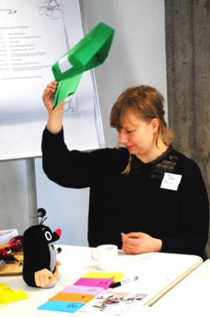
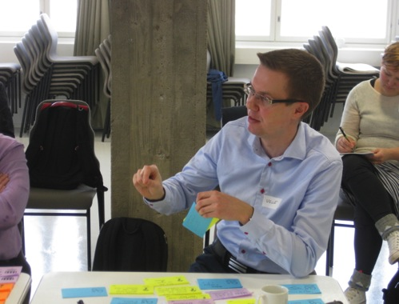
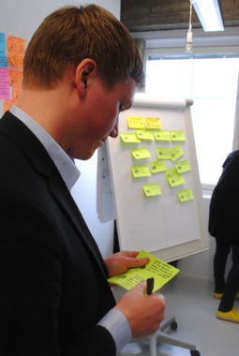
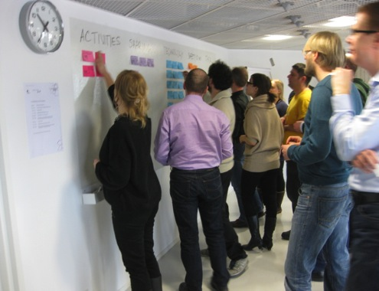
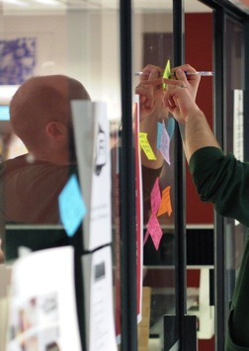
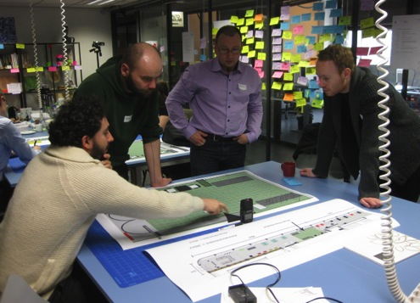

Slide 17
Materials List
Stickers for name tags (PH, SM)
Post-its: 8 colors (PH, SM)
Stickers: 8 stamps (PH, SM)
Star stickers (PH, SM)
Pens 40 (PH, SM)
Flip charts: 5 (CK)
Whiteboard markers for charts and board (PH, SM)
Signs to show the way (CK)
  ask Virve for visual guidelines/logo to be used
Program & Exercise posters A2 (CK)
Sub program posters: instructions A2 (CK)
Floor plans of kaupunkiverstas (VM, KL)
Props for warm-up: Hats, tools, digital things, “people”, self-built stuff (All, SH checks)
Funny bell for Cindy (CK)
Refreshments
  Coffee & Tea x 2 (Amica, CK)
  Fruits and small nibbly bits (Amica, CK)
  Water and soft drinks (Amica, CK)
6 audio recorders; 5 recorders + SH&CK iPhones
  Sampsa 3, Cindy 1, Pia 1
  string for ceiling attachments(SH)
  tape for ceiling attachments (PH, SM)
2 video cameras ;
  One camera+tripod (Cindy)
  One camera+tripod+possibly a separate mic (Samuli & Pia from ADF)
  One from library
Stickers to write one’s name to: 30 pieces

Slide 18
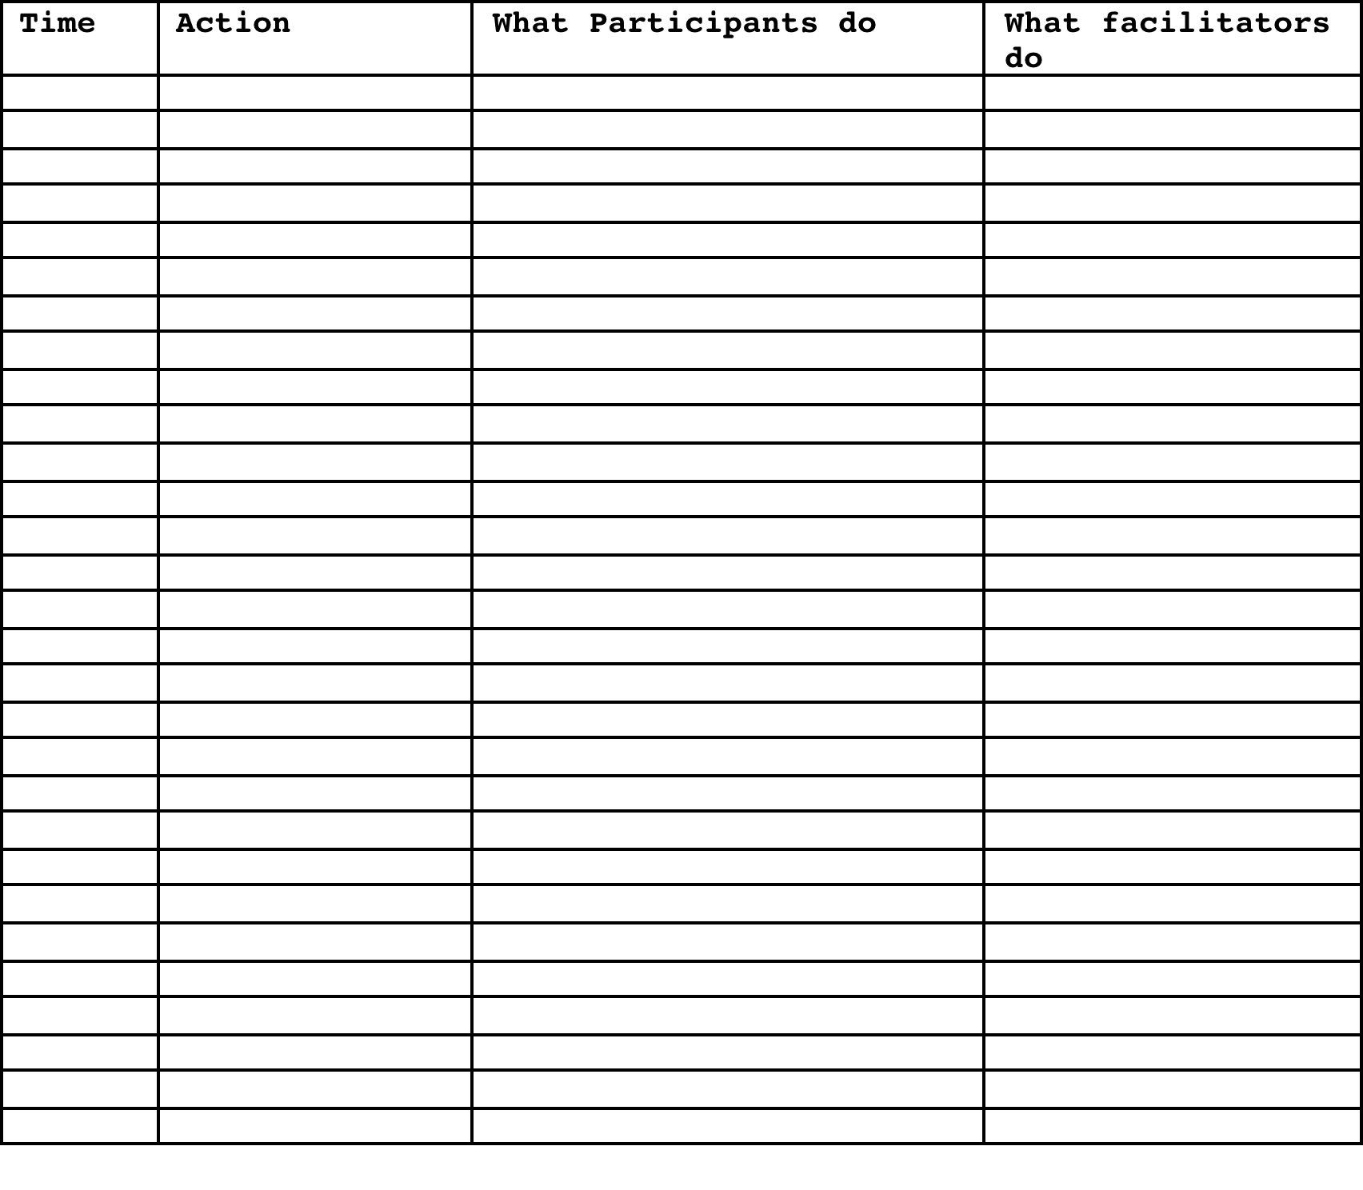

Slide 19
How would you document it?

Slide 20
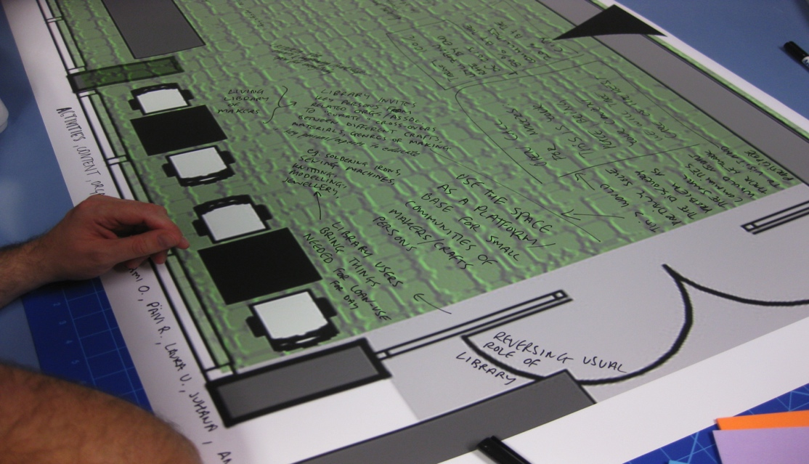
Direct drawing on floor charts
Three floor charts for lasipalatsi maker space; written on extensively by participants

