Slide 1
DfSC-Codesgin themes
Design within/for SOCIOTECHNICAL change, becoming aware and learning to assess soc-tech-org-inst structuration and what it takes to change it
Recognizing when it is necessary and/or beneficial to involve the impacted peoples (aka ‘users’, ‘partners’, and ‘stakeholders’)
Learning to design for collaboration and in collaboration
Learning the (considerable) differences that result from different ways of designing and organizing collaborative design
  With 5 cu, unfortunately, no possibility to rehearse codesign … but if its any consolation, most modes of codesign in social change cannot be duly rehearsed within 5 week periods either.

Slide 2
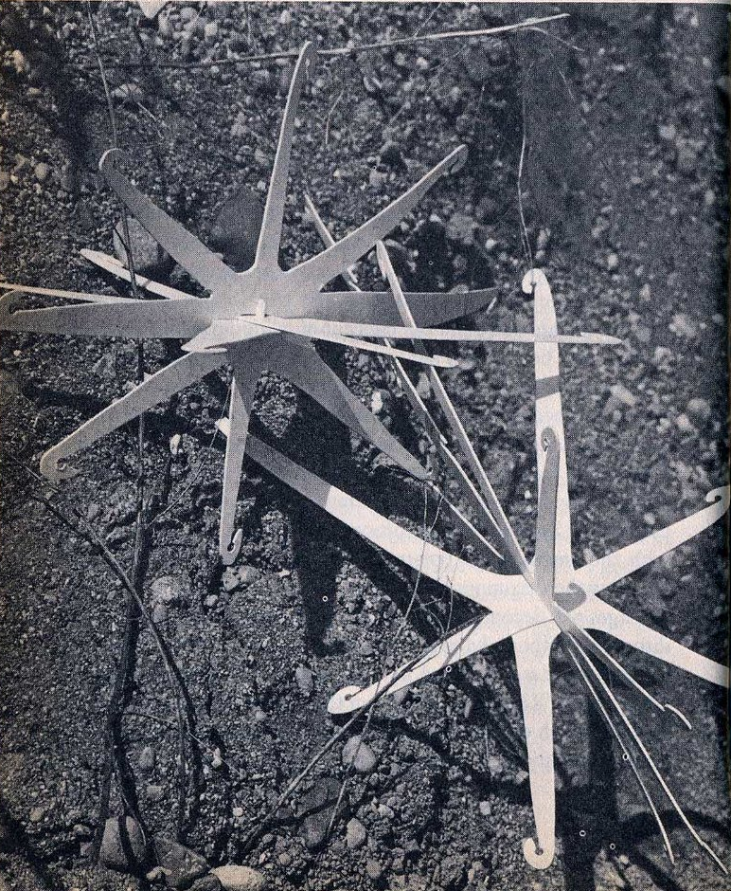
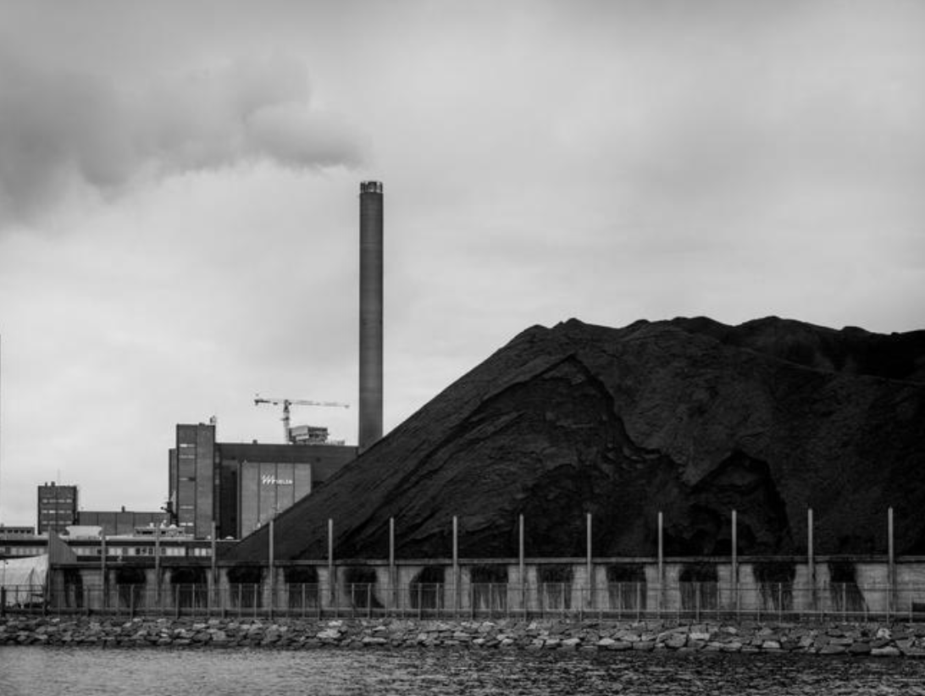
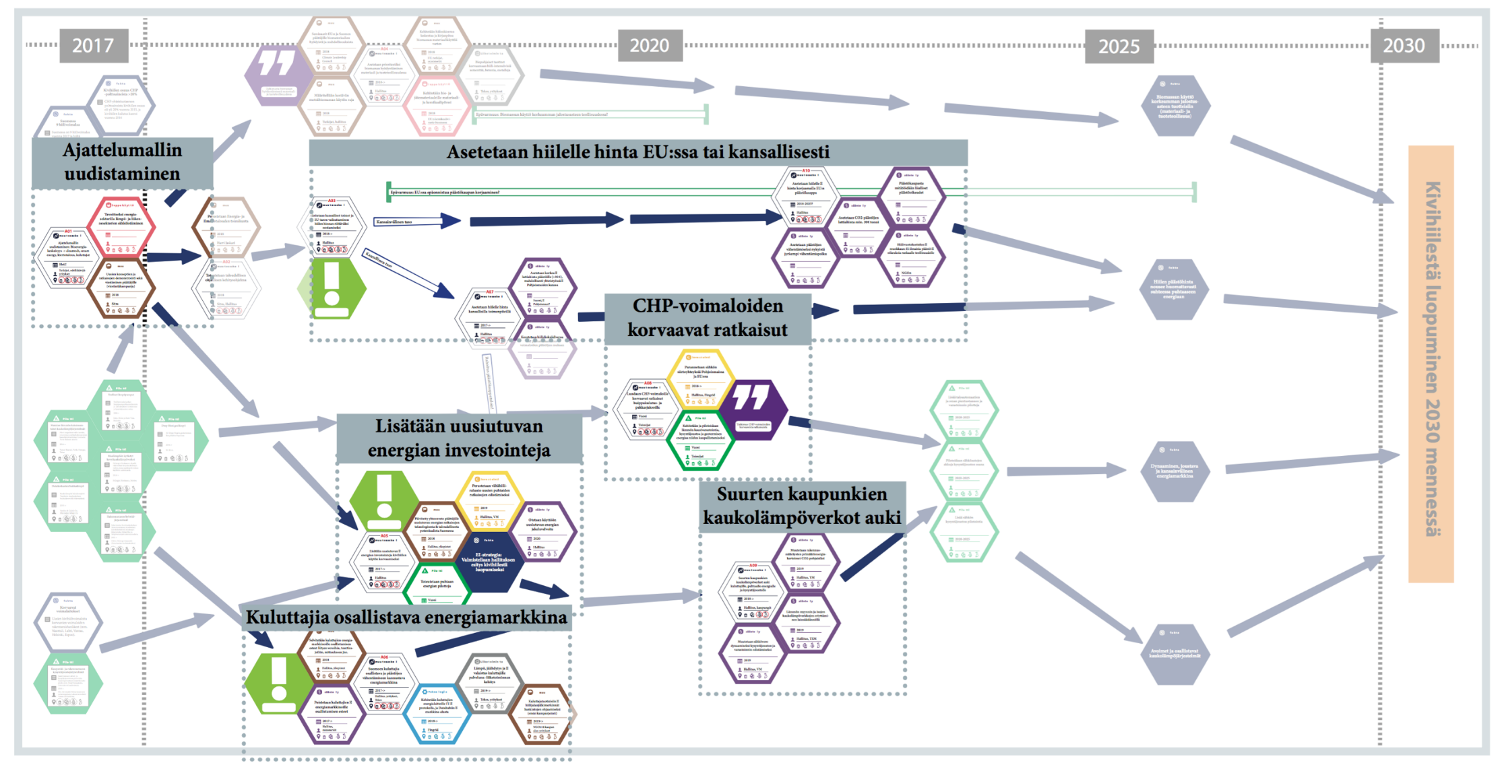
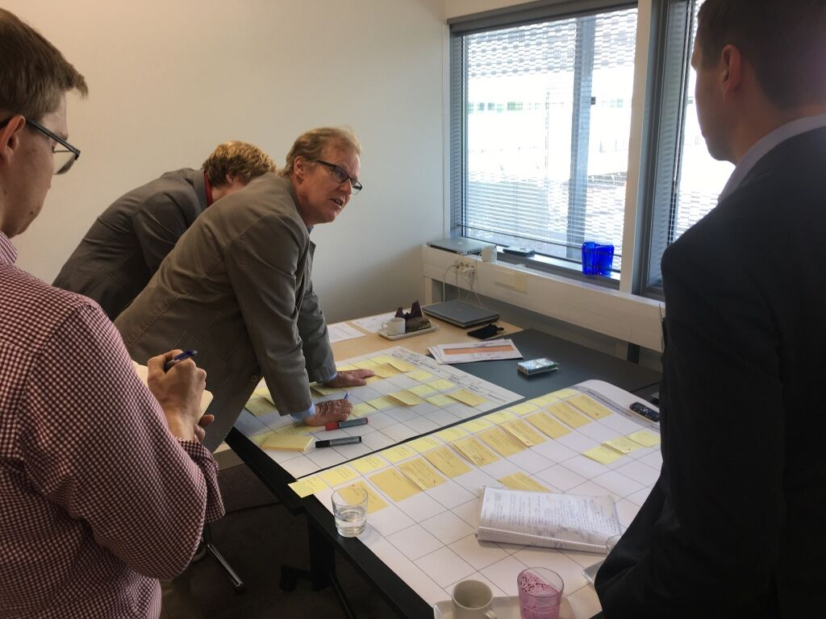
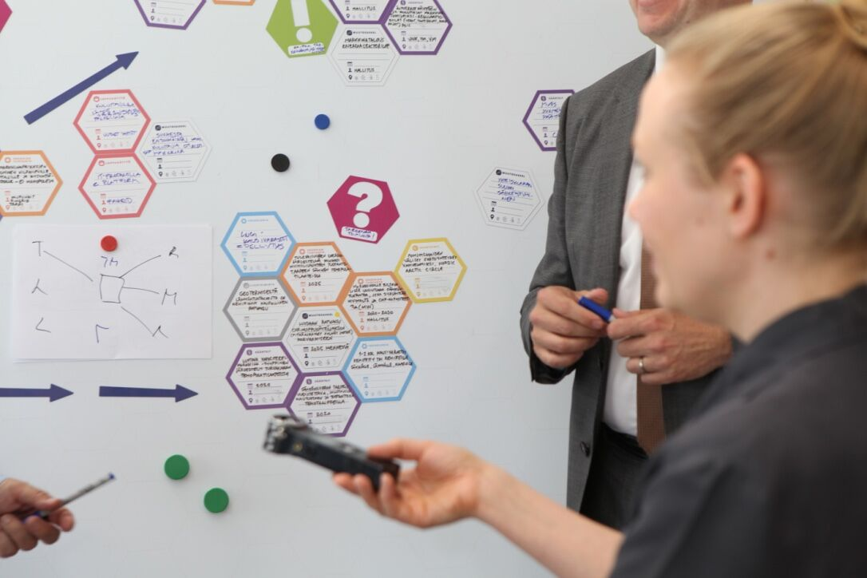
Papanek vs climate change
V. Papanek: design for the real world, 1981 pp., 83. Artificial Burrs for revegetating arid areas by J.Herold and J.Truan
Multi-actor mid-range pathways for energy transition: end of coal use 2030 in Finland.
Eds. Hyysalo, Lovio et al. 2017

Slide 3
Why design social change with and by users
Brings new and new types of resources: development effort, marketing, new ideas, value clarification …
Creates more and different knowledge: what to include in the design, how, what value it has for different peoples, when, how and which contexts?
Increaces ownership of solutions and commitment to future directions (for those who get to participate in solution decisions), adds legitimacy
Reduces risk in design and decision making: helps know what the involved peoples want and what they need
Can be used to improve social image /brand value through having a more responsive, customer oriented and democratic appearance
Notes:
scope which appears unclear to many academics and practitioners

Slide 4
Exercises
1 Designing a solution workshop
2 Designing a mid-range envisioning workshop
3 Designing a participatory design portfolio
4 Designing a chagne management series
5 Own project in small groups: graded

