Slide 1
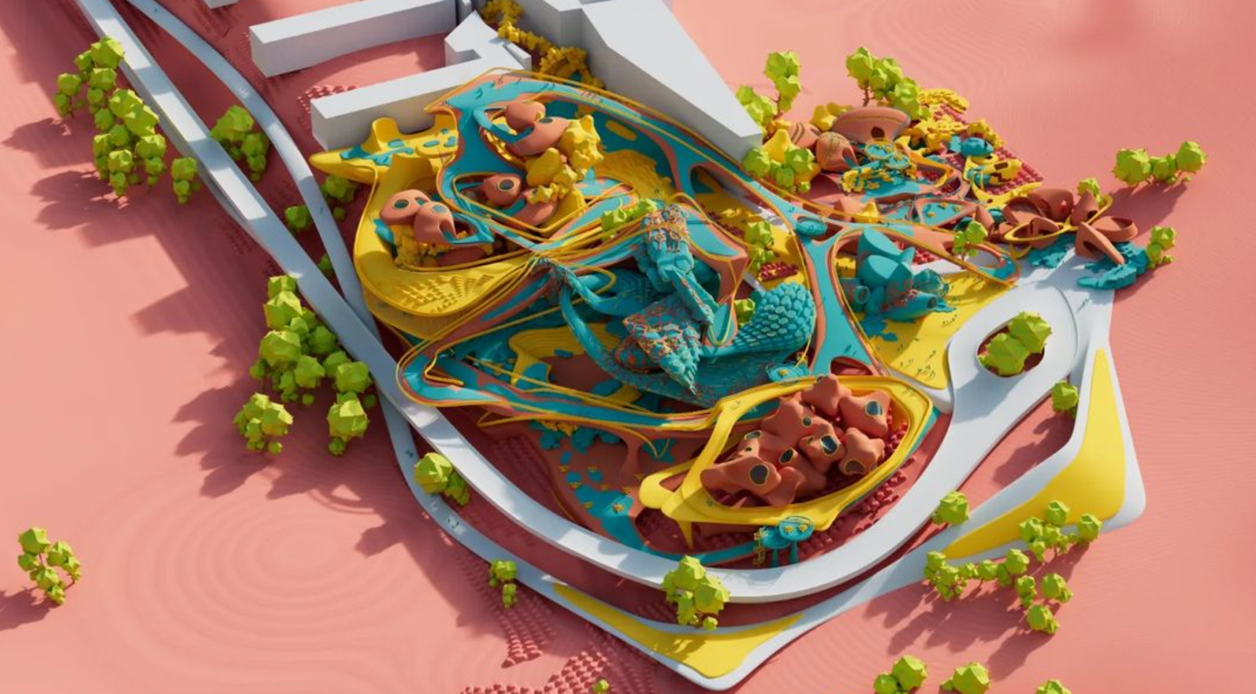
Aalto-SIT workshop
SITE RELATIONSHIPS
28/2-11/3/2022
11/02/2022

Slide 2
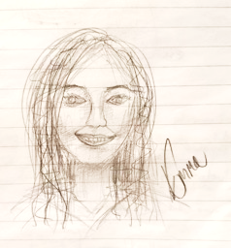
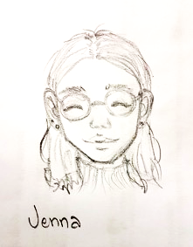
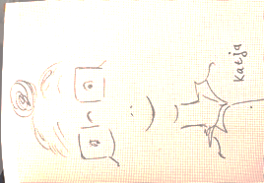
15.2. LIVE 10-13 Finnish time
(17-20 Tokyo)
Introductions on teachers and students
Introduction to the workshop task (Areal plan).
Make six mixed groups
SIT students will later support finding the site information for Aalto students in their group. Aalto students can ask their SIT partners to answer questions or gather / give any local information.
The students will be in contact to their group colleagues and work together outside the official tutoring times. The student groups review the group members’ work also internally.
If the programme commences fast and there is spare time before 13, Aalto students can get tutoring.
23.2. NOTE! NO teaching!

Slide 3
28.2.-11.3. Workshop (online)
1–2.3. 9:15-12 (FI) 16:15-19 (JP) Joint review with SIT people in sub-groups (Zoom breakout rooms – permanent Aalto link). Aalto review: Concept design. SIT review: their work this far.
1.3. teachers’ review
2.3. students comment each other.
7.3. 9:15-12 (FI) 16:15-19 (JP) Joint review with SIT in sub-groups (Zoom breakout rooms): students comment each other.
10.3. Workshop's final review with teachers in sub-groups (Zoom breakout rooms). Aalto: AA, EL, SA
15.3. (for Aalto students) 9:15-10 lecture Selina Anttinen, review 10:05-13: (workshop post-production), introduction to Schematic Design task

Slide 4
Workshop Groups
Toyosu Workshop 2021
research group | review group | Aalto Student |  | SIT Student
1 | Ahlava, Yamashiro | Balanche | Elodie Marilou | Yuri | Takamatsu
 |  | Diao | Xuanyu | Chihiro | Oshima
 |  | Zinno | Laëtitia Lucienne Josette
2 |  | Doan | The Phuong | Sei | Suzuki
 |  | Hukkinen | Jenna Kaisa | Chiho | Ishihara
3 | Anttinen, Suzuki | Guo | Xinghe | Airi | Yamamoto
 |  | Tuerxun | Zulunankaer
 |  | Xu | Peiyao
4 |  | Aarnio | Amalia Aleksandra | Ayane | Suzuki
 |  | Koivisto | Jenna Emilia | Aoi | Sugawara
 |  | Mannila | Emma Amanda Linnea
5 | Lunden, Matsushita | Feng | Yanqi | Taiga | Takehara
 |  | Qi | Qi "Queenie"
 |  | Zhang | Yue "Luna"
6 |  | Mäkinen | Raisa
 |  | Phan | Thanh Tu Tuan | Ann | Kikuchi
 |  | Pushkina | Ekaterina | Lina | Hirai

Slide 5
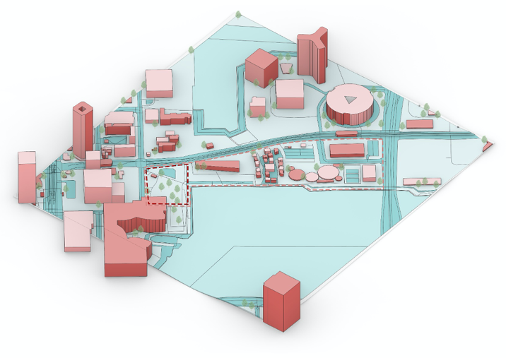
Workshop task
SITE RELATIONSHIP CONSIDERATIONS
March 1: review of work done this far. After that:
Establish the concept and design relationships between the site and existing and forthcoming buildings on the Toyosu area. There can be also other new buildings on the site.
1. The focus of work should be first on the site plan. Concentrate most of all on the relationship between your building complex and the site.
positioning of the buildings and their massing
boundaries of interior and exterior (in-between spaces)
2. The students are recommended to continue the design of the whole building, based on the effects of the modified site plan to the building design:
the input from external considerations to the interior of the building
continue working on plans, sections, facades and perspective images
Submission
Developed site plan and consequently further architectural design for the building complex as an Acrobat / Powerpoint presentation.

