Slide 1
Videos for the 7th lecture
Self, Identity and Gender

Slide 2

Notes:
Different ways? Do you prefer one over the other?

Slide 4
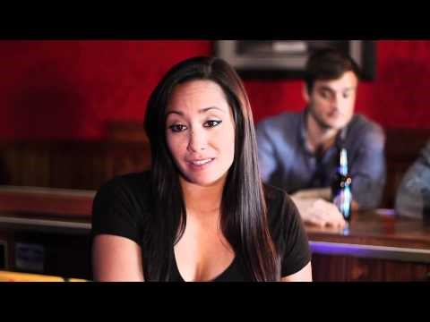
Performing malehood – what is malehood?

Slide 5


