Slide 1
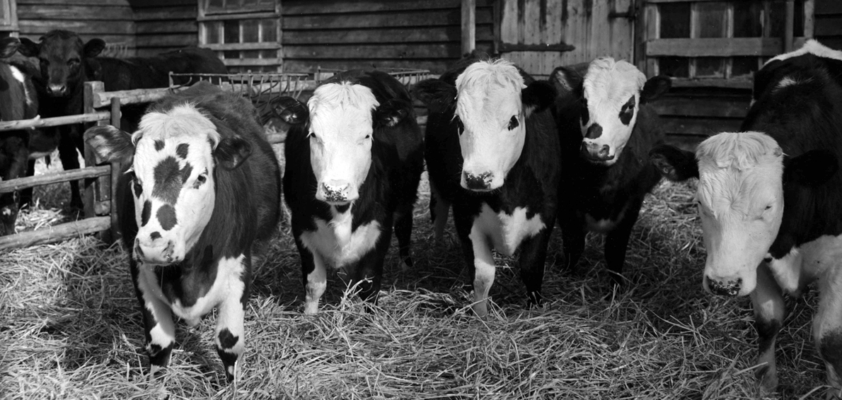
NEWHALL
a new neighbourhood for Harlow

Slide 2
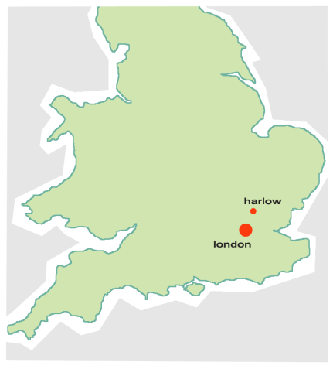
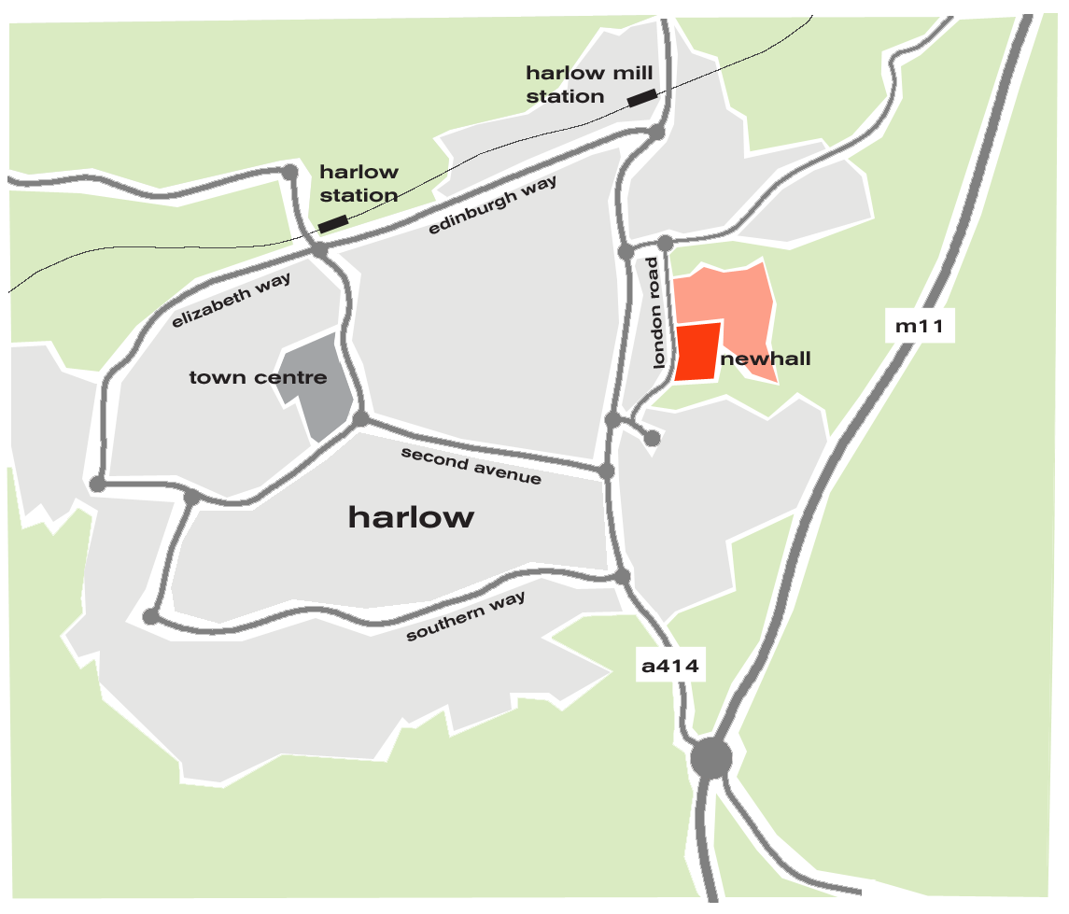
Location

Slide 3
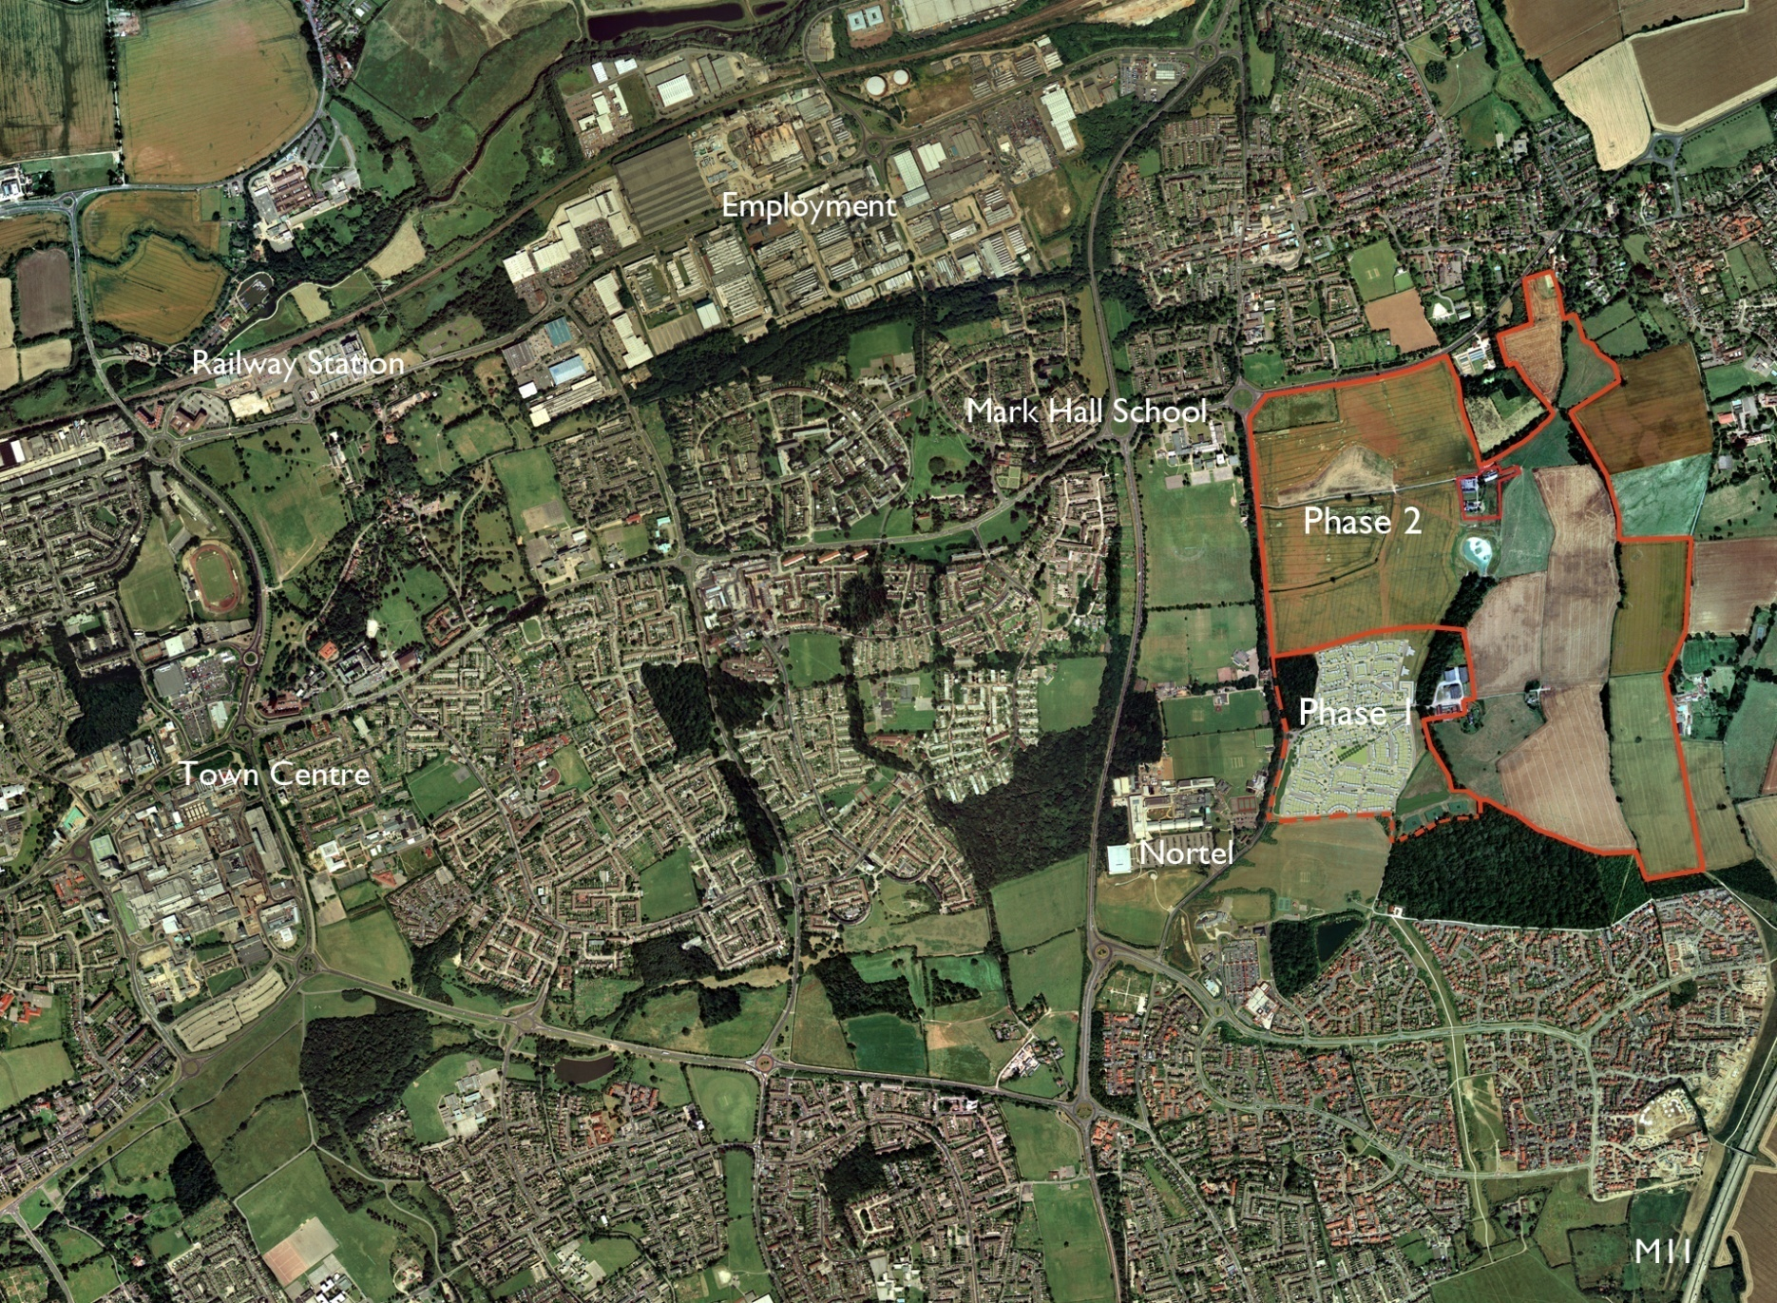
Location
SRA LAND

Slide 4
‘why can’t we build the places that we’d like to visit?’
‘places which attract people also attract investment’

Slide 5
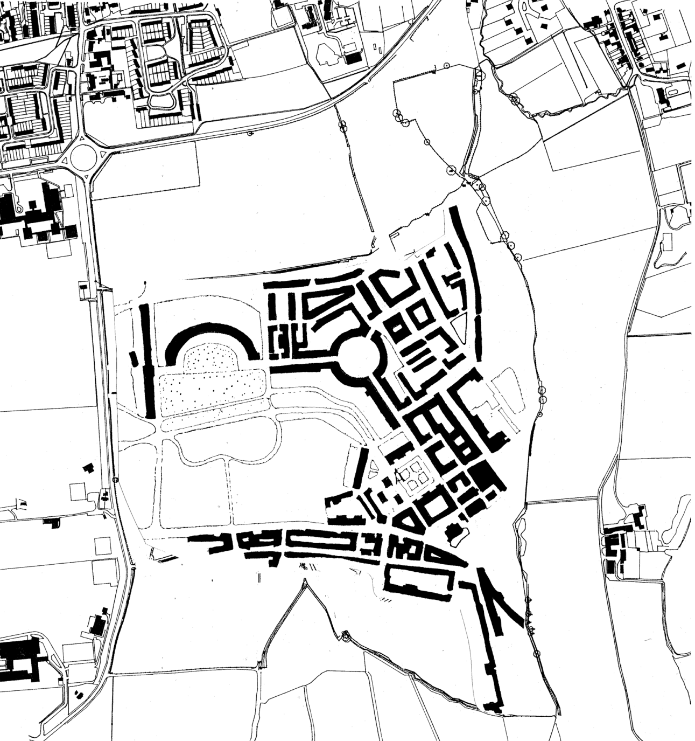

Slide 6
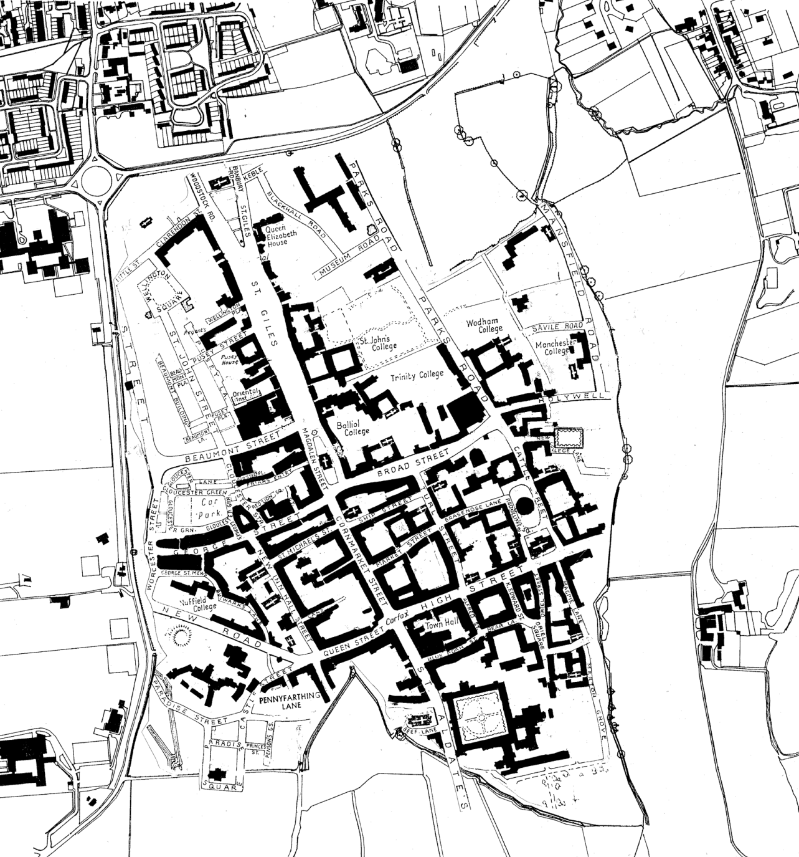

Slide 7
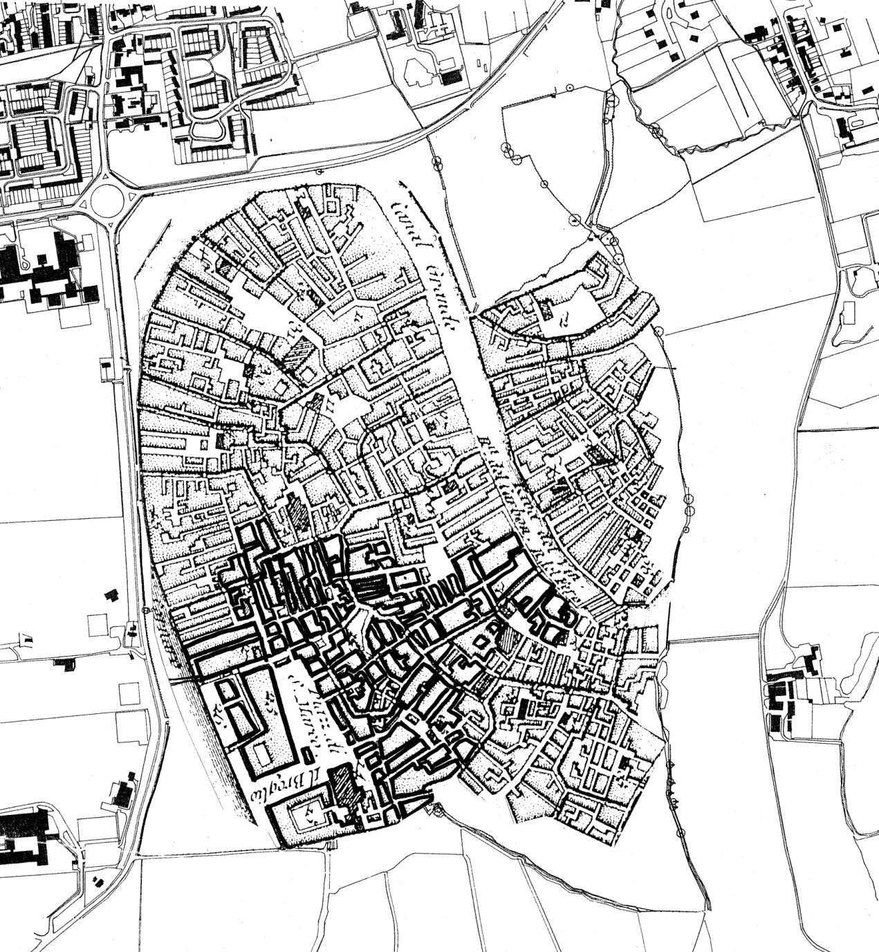

Slide 8
Seven Key Criteria:
Respect natural environments (40% of land undeveloped)
Develop remainder of land at higher densities
Maximise linkages - semi-lattice street structure
People on foot take priority over people in cars
Masterplan built out with contemporary architecture
Set higher standards for ‘sustainability’ than current regulations
Implement using urban design guides / briefs / codes

