Slide 1
Sectoral analysis of the Russian economy
Svetlana Ledyaeva
Aalto University
School of Business

Slide 2
Learning outcomes of this lecture
Transformation of Russian industrial structure in recent three decades.
Industrial aspects of privatization and ownership in Russia.
Concept of Dutch disease – fundamental theoretical concept of Russian economic development.
Dutch disease in Russia.

Slide 3
Role of industries in Soviet Economy
One of the world's three top manufacturers of heavy industrial products (including aviation and arms) + richness in natural resources.
Unbalanced economic structure (agriculture, light industries and services were neglected).
Plan allocation of industries. 5-year central plans: First plan 1928-1933; Last plan (12th) 1986-1990.
Prices were determined by government: Soviet enterprises obtained raw materials such as oil, gas, and coal at prices below world market levels, encouraging waste.
Transportation costs were heavily subsidised, so it encouraged inefficient allocation of some industries.

Slide 4
Industrial structure of Soviet Russia
Russia’s deviations from “normal” structures of market economies were substantial:
the greater shares of heavy industry;
the low shares of services;
the high shares of food, consumption;
the underutilization of foreign trade.
These structural distortions contributed to the stagnation and decline of the planned economies.

Slide 5
Restructuring process of the Russian economy (Yasin 1996)
I – production of goods which are not demanded.
II – production of goods which are demanded plus comparative advantage.
Volume of GDP
Stabilization
Passive phase
Active phase
Equillibrium in the low point of crisis
Time

Slide 6
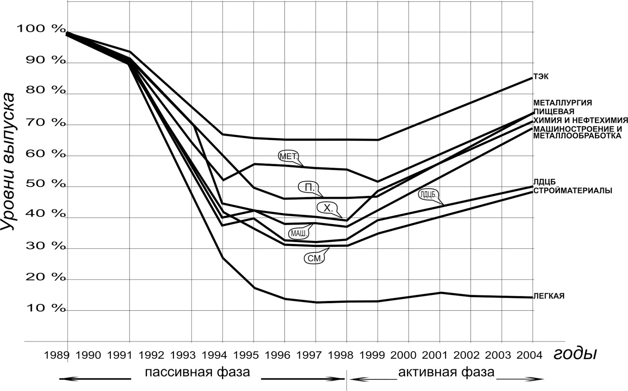
Restructuring process and dynamics of output of main idustrial sectors in Russia (Yasin 2013)
Fuel and energy
Level of output
Metallurgy
Food
Chemistry&petrochemistry
Machine and metal processing
Met.
Food
Forest processing
Forestry
Construction materials
Chem.
Mach.
Constr.mat.
Consumer goods
Years
Passive phase
Active phase

Slide 7
Principal changes in industrial structure during transition: Summary
1992-1994: The output of natural resource-based sectors fell by 30-40%, other sectors – 50-60%: ➔
The weight of natural resources - based sectors (versus processing industries) in the economy increased.
A significant shift from goods production towards the service sector: Service sector of Former SU in 2003 accounted for about 46% of GDP versus 30% in 1991.

Slide 8
Indices of industrial production, % to 1991

Slide 9
Indices of industrial production, processing industries; % to 1991

Slide 10
Industrial output change between 1990 and 2016
Metal fabrication is the process of building machines and structures from raw metal materials.

Slide 11
Total output change between 1989 and 2020, Russia

Slide 12
GDP structure in Russia over time, based on value added

Slide 13
Country | Agriculture, forestry, and fishing, value added (% of GDP) | Manufacturing, value added (% of GDP) | Industry (including construction), value added (% of GDP) | Services, value added (% of GDP)
Africa Western and Central | 21,1 | 12,1 | 27,4 | 47,5
Belarus | 6,8 | 21,6 | 31,7 | 48,4
Brazil | 4,4 | 10,1 | 18,4 | 63,2
China | 7,1 | 26,8 | 38,6 | 54,3
Lower middle income | 14,8 | 14,9 | 29,1 | 50,0
Low & middle income | 8,3 | 18,1 | 31,2 | 54,6
Russian Federation | 3,5 | 13,0 | 32,3 | 54,0
Estonia | 2,5 | 12,8 | 22,0 | 62,5
Germany | 0,7 | 19,1 | 26,7 | 62,6
Finland | 2,5 | 14,5 | 23,9 | 60,1
France | 1,6 | 9,8 | 17,1 | 70,2
European Union | 1,6 | 14,4 | 22,1 | 65,6
United States | 0,9 | 10,9 | 18,2 | 77,3
2019

Slide 14
Industrial patterns of privatization and efficiency changes
Nominal privatisation by insiders (i.e., forestry), State control (i.e. gas) ➔ not so much changes in efficiency/productivity/ investments
New private owners (i.e., oil, machinery, metals) who got their shares through vouchers/loans for shares/auctions ➔ positive changes in management, investments, markets
Foreign/mixed ownership (i.e., food industry) ➔ likely successful changes (FDI, management practices, corporate governance).

Slide 15
Industrial aspects of privatization
Mandatory privatization (light, food industries; smaller firms)
Privatization with the permission of the privatization ministry (larger firms, yet not operating in any of the important strategic industries)
Requiring government approval for privatization (natural resources and defense) – in fact could not be privatized.
Prohibited privatization (space exploration, health, and education)

Slide 16
Industrial aspects of firm-level ownership in transition Russia (Dolgopyatova 2010)
Growth of ownership concentration irrespective sector or size of company: Share of dominant shareholder in the beginning of 21st century - 25-40%; by 2010 – higher than 60%.
Corporate governance: main player – a majority (dominant) shareholder.
High ownership concentration – not only a Russian phenomena. The same – in some developed countries; in all transition economies.
Why? Bad institutions and availability of highly profitable assets for which businessmen are ready to fight.

Slide 17
Shleifer and Vishny (1997) on ownership concentration in transition economies
“… Ownership concentration can serve as a substitute for weak investor protection rights. Therefore, ownership concentration can be positively related to corporate performance especially in environments of weak legal systems.”

Slide 18
Ownership distribution and concentration
Concentration of ownership in the hands of a few major players:
“+” Can reduce inefficiencies due to suboptimal firm size and cost duplication.
“—”Can also result in collusion, create barriers to entry and eliminate healthy competition.

Slide 19
Industrial patterns of ownership distribution and concentration in the 90`s
23 largest private owners control at least 36-38% of output and employment (Guriev and Rachinsky, 2004).
The largest owners are much more strongly represented in energy, natural resources and the automotive industry.
The sectors that produce consumer goods are mostly controlled by other private domestic owners and foreigners.
Smaller domestic owners also tend to dominate manufacturing sectors.
Mid 90s: trend for industry consolidation -expansion of financial-industrial groups. These groups built mostly around natural resource industries.

Slide 20
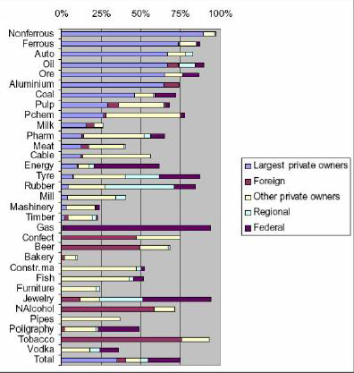
Shares of different categories of owners in sales of respective sectors, beginning of 21st century
(data from
Guriev
and
Rachinsky , 2004;
for the sample that
covers 60% of Russian
industry)

Slide 21
Breakdown of Russian industry by ownership categories in the beginning of 21st century (Guriev and Rachinsky, 2004/2005)

Slide 22
Current tendencies of ownership concentration in industries
Intensifying state ownership and control over the key industrial sectors and strategic industries.
Leading vehicle for the consolidation of state ownership in Russia’s industry is a giant industrial holding Russian Technologies (Rostechnologies) that was set in 2007 and comprises 700 enterprises ➔ 14 holdings, 11 of which in defense industry.
Oil and gas are dominant and big: containing no more than 12 of the 100 largest companies, the oil and gas sector is responsible for almost 40% of the aggregate turnover of the top-100 Russian enterprises (many already state owned, largest state-owned Gasprom and Rosneft).

Slide 23
Opinions on firm-level ownership patterns in Russia from recent literature
State-controlled firms represent around 41 percent of the market value of all listed Russian firms (Deloitte, 2015).
Djankov (2015) comments that the Russian state since 2003 has turned its privatization policy around and increased its control of sectors considered to be of strategic importance, such as finance, energy, transportation and media.
According to Chernykh (2008), the control by the Russian state is often opaque, as only direct ownership is typically reported. Indirect ownership through pyramids can be inferred but requires much work.

Slide 24
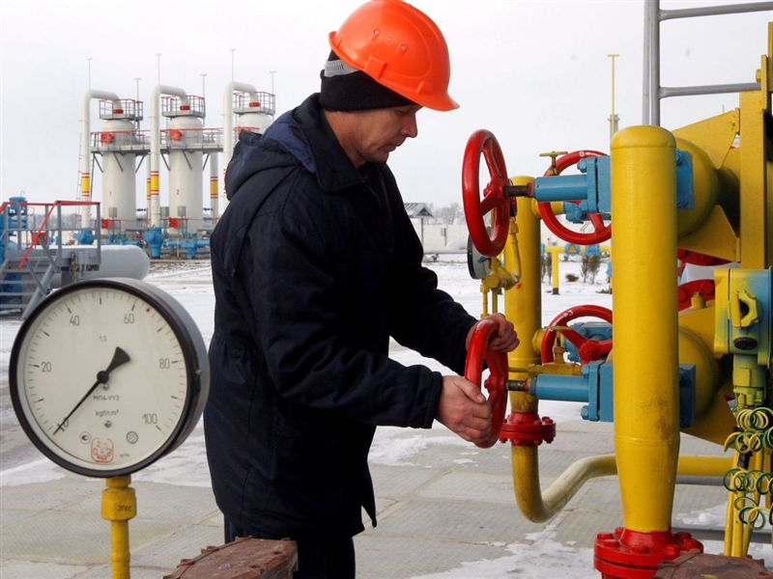
Part 2: Dutch disease and Russia

Slide 25
Dutch disease
Is the apparent relationship between the increase in exploitation of natural resources and a decline in the manufacturing sector (or agriculture).
The term was coined in 1977 by The Economist :
  the decline of the manufacturing sector in the Netherlands after the discovery of a large natural gas field in 1959.
Bad institutions: prerequisite for Dutch disease.

Slide 26
Dutch disease vs. resource curse
are often used interchangeable;
But:
Resource curse refers to the political and social consequences of country`s high dependence on resources` export. Sociopolitical concept!
Dutch disease refers only to the effects of the resulting currency appreciation and changes in the cost of factors of production.
Economic concept!

Slide 27
Dutch disease
(Bruno and Sachs (1982); Corden and Neary (1982))
Spending effect
Tradable resource (oil) sector
Tradable (manufacturing) sector
Non-traded sector (services)
The resource movement effect
What happens when world oil price goes up?
The spending effect;
The resource movement effect.

Slide 28
Dutch disease
A result:
A fall in the output share of non-natural resource tradables (manufacturing sector)
relative to non-tradables (mostly service sector) and resource tradables (e.g. oil industry).

Slide 29
Question for points
When oil/resource export of a country increases, foreign currency supply increases in a country and country`s currency appreciates.
How this affects manufacturing sector. Any guesses?

Slide 30
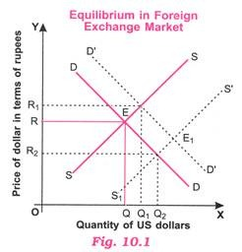
What happens in exchange market?
roubles

Slide 31
Dutch disease and currency appreciation
Export revenues increase in the resource sector:
➔Supply of US dollars / Euros increases.
The nation's currency becomes stronger (appreciates) compared to currencies of other nations.
The nation's other exports becoming more expensive for other countries to buy, and imports becoming cheaper, making those sectors less competitive.

Slide 32
Example (abstract)
Russian sells a car to Czech Republic for 100 Euros.
Exchange rate is 60 roubles per Euro.
Russian company gets 6000 roubles for one car exported to Sweden.
Oil price goes up. Export oil revenues in Russia increase.
ER becomes 40 roubles per Euro.
The car prices in Czech Republic is still 100 Euros.
Russian company gets 4000 roubles for one car exported to Sweden.

Slide 33
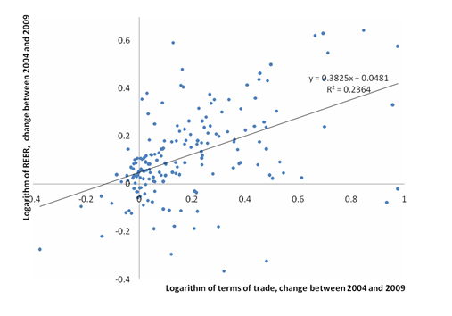
Is there any empirical evidence of Dutch Disease?
Relatively robust evidence: Terms of trade increases cause real exchange rate appreciation in natural-resource-rich countries:
Terms of trade: export value divided to import value.
Vostroknutova, Brahmbhatt, Canuto, VoxEU 2010.

Slide 34
Is there any empirical evidence of Dutch Disease?
The shrinking of the manufacturing sector in response to terms of trade: mixed evidence (Sala-i-Martin and Subramanian 2003).
Ismail (2010) finds strong evidence for Dutch Disease effects, with a 10% increase in an oil windfall/income associated with a 3.4% fall in value added across manufacturing sectors.
On average in resource rich countries the tradables sector (manufacturing plus agriculture) is around 15% of GDP lower than the norm (Vostroknutova, Brahmbhatt, Canuto, VoxEU 2010).

Slide 35
Dutch Disease is good or bad for growth?
Positive:
-higher incomes and consumption of both non-tradables and tradables;
-increased resources for investment in public goods.
Negative: For Manufacturing
-M possess specific long-term, growth-enhancing qualities: positive technological spillovers, learning by doing effects, or increasing returns to scale in production.
-M is more labour intensive than natural resource industries: implications for employment.
The effect for economic growth is inconlslusive. Negative: bad institutions.

Slide 36
Dutch disease in Russia
Mironov and Petronevich, 2015, Discovering the signs of Dutch disease in Russia. Resources Policy
Main arguments:
Eruptive flows of export revenues have resulted in significant appreciation of the real effective exchange rate.
The manufacturing sector tends to shrink and is relatively small.
The mining and service sectors have expanded.
Positive significant impact of the real effective exchange rate on employment rates in the services sector.

Slide 37
Resource curse
Resource curse refers to the political and social consequences of country`s high dependence on resources` export.
Sociopolitical concept!

Slide 38

Democracy: Oversight incentives in resource-rich and resource-poor countries

Slide 39
Conflict
Natural resources can, and often do, provoke and sustain internal conflicts as different groups fight for control of the resources or use natural resources to finance their fighting.
The tendency of oil-rich states to instigate or be targets of international conflict, has been observed in some cases, such as with Iraq’s invasion of Iran and Kuwait.

Slide 40
Weaker institutional development
Institutions can be weaker in resource-rich countries because it is easy for elites to capture or take large sums of cash.
Rent-seeking and rent-seizing ➔
Corruption and week institutions.

Slide 41
Total natural resources rents (% of GDP)
Total natural resources rents are the sum of oil rents, natural gas rents, coal rents (hard and soft), mineral rents, and forest rents.
Country Name | 1990 | 2000 | 2010 | 2013 | 2018 | 2019
Africa Eastern and Southern | 8,1 | 6,6 | 12,4 | 11,0 | 7,4 | 6,2
Africa Western and Central | 17,4 | 18,2 | 15,1 | 13,7 | 11,1 | 8,9
Arab World | 24,7 | 26,1 | 29,3 | 32,2 | 22,7 | 20,2
United Arab Emirates | 36,7 | 21,9 | 22,7 | 27,1 | 17,3 | 16,8
Argentina | 2,6 | 2,3 | 3,3 | 3,0 | 2,1 | 2,1
Armenia | 0,0 | 0,3 | 2,7 | 1,1 | 1,1 | 2,1
Australia | 3,5 | 2,9 | 8,1 | 5,3 | 5,5 | 5,4
Austria | 0,3 | 0,2 | 0,2 | 0,2 | 0,2 | 0,1
Bulgaria | 1,1 | 0,7 | 1,7 | 1,1 | 0,7 | 0,4
Belarus | 1,2 | 2,5 | 1,3 | 1,5 | 1,7 | 1,8
Brazil | 2,3 | 2,2 | 3,7 | 3,8 | 3,8 | 3,5
Central African Republic | 6,4 | 11,2 | 7,9 | 12,9 | 10,8 | 8,3
Switzerland | 0,0 | 0,0 | 0,0 | 0,0 | 0,0 | 0,0
China | 8,3 | 2,6 | 6,3 | 3,0 | 1,5 | 1,3
Germany | 0,2 | 0,1 | 0,2 | 0,1 | 0,1 | 0,1
Euro area | 0,2 | 0,1 | 0,2 | 0,2 | 0,1 | 0,1
Finland | 0,5 | 0,4 | 0,5 | 0,4 | 0,5 | 0,4
France | 0,1 | 0,1 | 0,1 | 0,0 | 0,0 | 0,0
India | 3,4 | 2,4 | 4,4 | 3,6 | 2,2 | 2,0
Japan | 0,0 | 0,0 | 0,0 | 0,0 | 0,0 | 0,1
Kazakhstan | 15,7 | 25,8 | 24,2 | 19,2 | 21,8 | 17,6
Mexico | 7,4 | 3,5 | 4,9 | 5,5 | 3,0 | 2,2
Norway | 7,7 | 11,9 | 8,9 | 8,8 | 8,1 | 7,0
New Zealand | 2,1 | 2,0 | 2,0 | 1,5 | 1,7 | 1,6
Russian Federation | 12,9 | 22,0 | 15,5 | 13,7 | 15,3 | 13,1
Ukraine | 3,4 | 3,8 | 7,6 | 4,4 | 2,6 | 1,8
United States | 1,3 | 1,0 | 0,9 | 0,8 | 0,7 | 0,6
Uzbekistan | 9,9 | 17,6 | 16,8 | 17,1 | 18,0 | 8,8
Yemen, Rep. | 29,8 | 42,3 | 23,3 | 13,6 | 4,4 | 5,4
South Africa | 5,8 | 3,4 | 6,6 | 5,5 | 3,6 | 3,9
Zambia | 21,0 | 9,1 | 18,7 | 12,0 | 11,3 | 6,4
Zimbabwe | 4,2 | 3,9 | 7,1 | 5,0 | 4,4 | 2,5

Slide 44
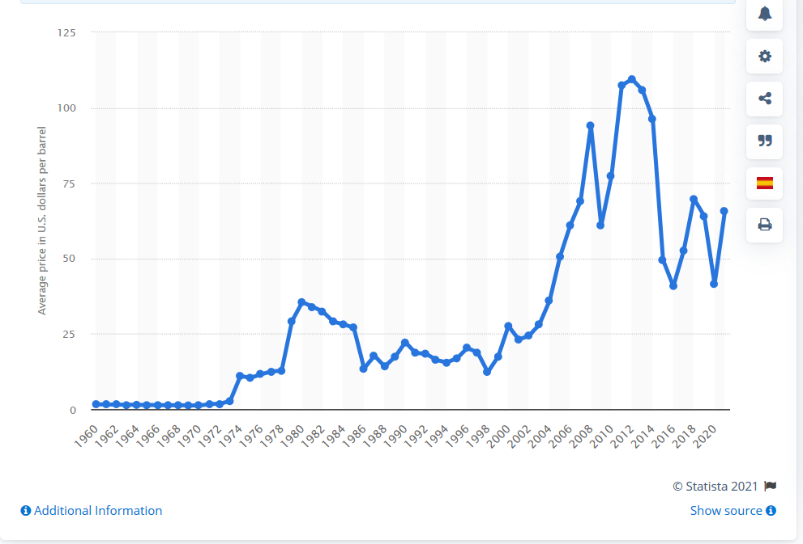
Average annual OPEC crude oil price from 1960 to 2021 (in U.S. dollars per barrel)

Slide 45
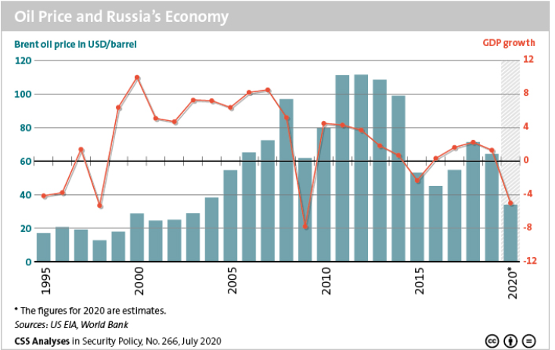

Slide 46
Russia`s export: Industrial structure, million USD

Slide 47
Russia`s export: Industrial structure, %

