Slide 1
Jean Baudrillard: Consumer society - a simulacrum of the gift? Søren Askegaard, Dept. of Business & Management, SDU Odense
Søren Askegaard

Slide 2
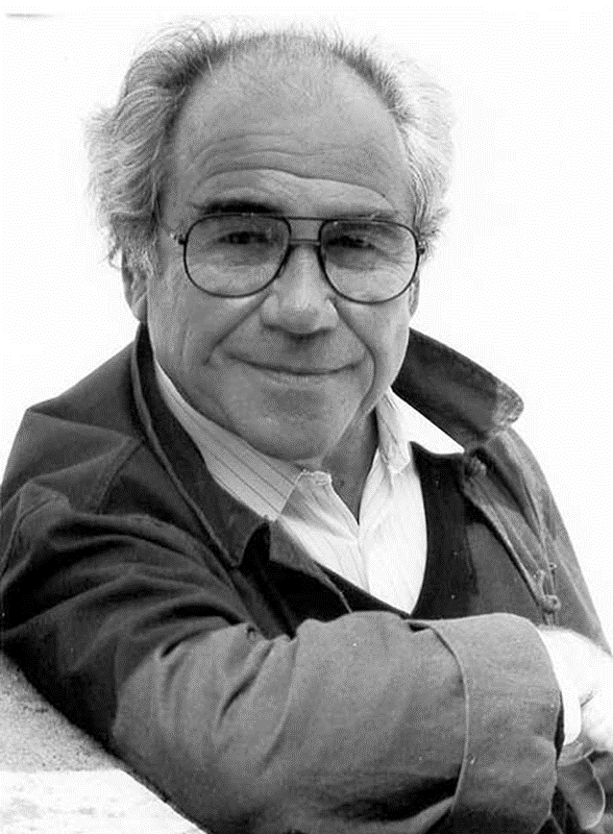
Jean Baudrillard (1929-2007)
Postmodernist?
Sociologist?
Theorist?
Being is not the same as inspiring (as Marx knew)
Søren Askegaard

Slide 3
Genealogy
Claude Lévi-Strauss
Henri Lefèbvre
Roland Barthes
Pierre Bourdieu
Jean Baudrillard

Slide 4
Some influencers/”-cees”
Nietzsche: “Aphorismic writing”, “nihilism”, “we do not believe that that the truth remains truth when we unveil it”
Kojève’s reading of Hegel (the centrality of desire)
Mauss’ The Gift (non-economic exchange)
Bataille’s The Accursed Share (excess, waste,..)
Boorstin’s The Image (the contemporary world of ”pseudo-”)
Sahlins’ Stone Age Economics (original abundance)
Galbraith & Packard’s critique of consumerism
”postmodernists” - Barthes, Foucault, (Deleuze, Derrida, Lyotard, …)

Slide 5
Making sense?
”challenging meaning and reality, seducing them and playing with them” (JB)
“Everywhere one seeks to produce meaning, to make the world signify, to render it visible. We are not, however, in danger of lacking meaning; quite the contrary, we are gorged with meaning and it is killing us.”
So… making sense it NOT the point….
The problem of representation
”Poetry is when two words meet for the first time”
Baudrillard as “a social essayist of heuristics”

Slide 6
Periodization of works
The problem of consumption
”the first five” (1968-1976)
System of objects, consumption society, political economy of the sign, mirror of production, SED
The problem of representation,
From ”Symbolic Exchange and Death” (1976)
On Seduction (1979)
In the Shadow of the Silent Majorities (1982)
Fatal Strategies (1983)
The problem of (conceiving) reality (1985 onwards)
The Transparency of Evil (1990)
The Perfect Crime (1994)

Slide 7
Baudrillard’s beginnings
Marxism
Structuralism
Class structure(s)
Commercial objects and commercial imagery
Everyday lives
Spaces (of consumption)
Durkheim (the predominance of the symbolic)
Mauss (the significance of exchange, the gift, the ”total prestation”)
Bataille (the importance of waste and excess)
Anti-utilitarianism and an (ever-increasing) anti-rationalism

Slide 8
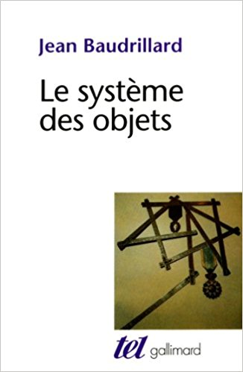
The System of Objects (1968)
Baudrillard’s dissertation
A structural semiotic analysis of the world of consumer goods
Saussure
Barthes
Key terms: ”models and series”, style(s), limits of ”functionalism”

Slide 9
The Ideological Genesis of Needs
First attack against the idea of a positive economy
Growth, accumulation,
Consumption as a productive force
Following Marx
The myth of the primary needs
The anthropological minimum… does not exist!
The threshold of survival is never defined from below but from above
Bataille’s ”accursed share”
”Need” as ”mana”
A degree of social constructivism not sufficient

Slide 10
The Ideological Genesis of Needs 2
”There can be no theory of needs, only a theory of the ideological concept of needs”
Defining consumption not only structurally as a system of exhange and signs but also strategically as a power mechanism
Unfolding the logics behind the sign-object

Slide 11
Ideological genesis + For a Critique of the Political Economy of the Sign (1972)
A formal theory of value based on four logics
Functional logic of use value (VU) (utility)
Practicality
Economic logic of exchange value (VEEc) (economicity)
Equivalence
(Semiotic) Logic of sign value (VESg) (the code)
Difference
(Social) Logic of symbolic exchange (ESb) (Maussian gift)
Ambivalence

Slide 12
Examples of value transitions
VEEc → VU - consumption from the economic perspective
VEEc → VESg - consumption in the political economy of the sign
VESg → VEEc - ?
VESg → VU - ?
ESb → VU, VEEc, VESg - ?

Slide 13
Symbolic exchange ?
Jean Baudrillard:
Symbolic exchange
Georges Bataille
General economy
Marcel Mauss
Reciprocal gift exchange
Jean Baudrillard:
Political economy
Georges Bataille
Restricted (bourgeois) economics
Marcel Mauss
Alientaed commodity exchange

Slide 14
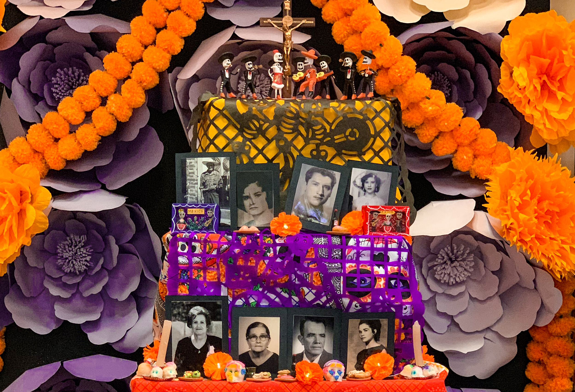
Symbolic exchange
Mauss establishes the gift exchange as an obligatory and central part of social life
Baudrillard extends this logic to…
Simple conversations via
Sacred sacrifices to
Relations between the living and the dead
Baudrillard’s later work can be seen as a search for the ”rules” (not the ”laws”) of symbolic order

Slide 15
The Mirror of Production (1973)
The decisive break with Marxism
A fundamental critique of historical materialism
”materialist orthodoxy against the heresy of primitive societies”
The neglect of ”discharge, waste, sacrifice, prodigality, play and symbolism [...] the gratuitous festive energizing of the body’s powers, a game with death, or the acting out of desire”
A positive versus a negative economy.

Slide 16
The mirror of production – the key argument
At the level of all political economy there is something of what Lacan describes in the mirror stage : through this scheme of production, this mirror of production, the human species comes to consciousness [ la prise de conscience] in the imaginary. Production, labor , value, everything through which an objective world emerges and through which man recognizes himself objectively- this is the imaginary. Here man is embarked on a continual deciphering of himself through his works, finalized by his shadow (his own end), reflected by this operational mirror, this sort of ideal of a productivist ego. This process occurs not only in the materialized form of an economic obsession with efficiency determined by the system of exchange value, but more profoundly in this overdetermination by the code , by the mirror of political economy : in the identity that man dons with his own eyes when he can think of himself only as something to produce, to transform, or bring about as value. (MP, pp 19-20)

Slide 17
Consumer Society (1970)
More correctly: consumption society
Which society produces and is reproduced by consumption logic?
An ”anthropology of the system of objects”
How does the system of objects reproduce (a particular type of) society?
Provocative statements:
Use value has nothing to do with ”consumption”
Consumer society: the opposite of a society of abundance
Key terms: object-sign, means of consumption, (tyranny of the) code

Slide 18
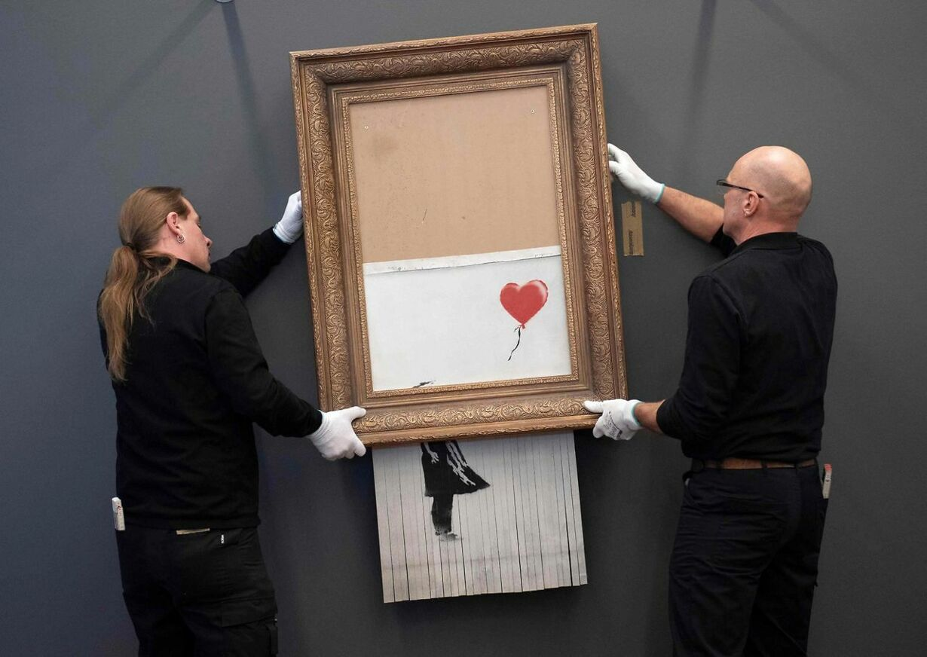
Tyranny of the code
The subsuming of an increasing number of exchange relationships under the interlocking networks of use value, exchange value and sign value
… with particular attention to conversion of sign value to exchange value and of exchange value to sign value

Slide 19
Symbolic Exchange and Death (1976)
The (sort of) last socio-anthropological work
Unfolding the notion of “symbolic exchange”
Reflecting on the “destiny of death”
“it is not normal to be dead, and this is new” (SED p 126)
Marking the transition of interest in “production/consumption” to a focus on “signification” and “representation”
Unfolding the notion of simulation
Notes:
Examples: The tasaday in India
Our own model – COKE is the real thing
The caves in Lescaux
“all of Los Angeles and America”… ? What does he mean?
“Hyperreal is that which is always already reproduced”
The outside world emulatingf the REAL Disneyland
TV emulating USA Topday emulating TV
Santorini, GTI clubbers, “emulating the model”
The Cupido paradox
Counterfeits of originals
Indistnguiishable copies
Endless reproduction of signs (ecstacy of communication)
The end of difference – the age of “trans-” complete relativism
Full positivity and no negativity (cosmetic surgery, jogging..)
Evil – the natural disorder (transparency of Evil)
“We welcome catastrophes”

Slide 20
Symbolic exchange and death
A history of simulation in three (+ 1) periods
Historical orders of simulacra
The order of imitation (or counterfeit)
Based on the natural law of value (use value)
The order of production
Based on the market law of value (exchange value)
The order of simulation
Based on the structural law of value (sign value, the code)
The map precedes the territory
Logics of: Representation, equivalence, differentiation

Slide 21
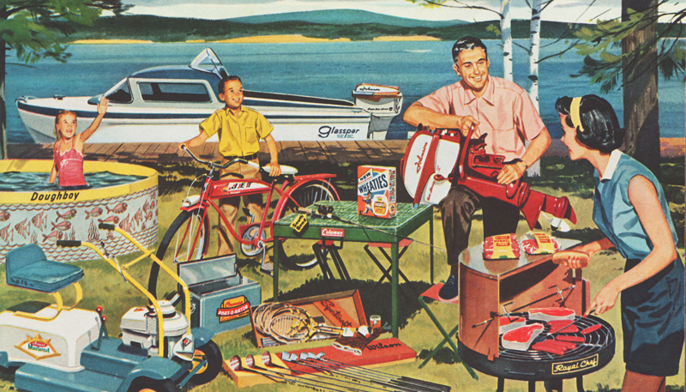
Consumer society as the simulation of the gift
Marx: “an immense accumulation of commodities,”
A permanent party
”The liturgy of the object”
”Objects”, not commodities
”the object is ‘created’, not fabricated
The excess and the imagery of ”gifts”

Slide 22
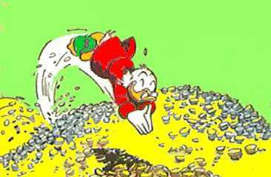
Credit
Money (cash) has a scent of the sweat of the worker and the greed of the capitalist
Not so with credit
”free” access – from class to global issue
False abundance
Real waste
Individual and social

Slide 23
A luxurious and spectacular shortage
”Is growth egalitarian or inegalitarian?
We would say that it is growth in itself
which is a function of inequality. Growth is a necessity for the reproduction of the unequal social order, for the social structure of privilege and it produces and reproduces growth as a strategic
element” (SC p 92, orig.)

Slide 24
A simulation of the gift
In a growth society it is the needs for growth that causes an endless insurrection of needs (SC p. 109)
What is simulated is both the abundance and the (consumer) freedom
But…
The consumer fiest is only a decor but as such it is real, neither more nor less than its opposite

Slide 25
A few key terms from the later Baudrillard
Seduction
Ecstacy
Scene and obscene
The transparency of evil

Slide 26
On Seduction (1979)
Seduction represents the mastering of the symbolic universe as opposed to power which represents the mastering of the real”
The immanent power of seduction is exactly the removal of everything from its truth and throw it back into play, the pure Schein of play, which is directly linked to the strategy of appearances
Seduction – the opposite of production
The ironic destiny of the seducer – the first victim of seduction (from Kierkegaard)
The degradation of game to function – the ”cold” seduction of contemproary markets/fashions

Slide 27
Ecstacies
Utilization – the age of economization
Commodification – the age of industrialization
Communication – the age of marketization
Fashion is the ecstacy of the beautiful
The simulation is the ecstasy of the real
Marketing and consumption as the ecstacy of the sign (the brand)

Slide 28
Scene and obscene…
”Or, la culture n’a jamais été que cela: le partage collectif des simulacres, auquel s’oppose aujourd’hui pour nous le partage forcé du réel et du sens. La seule souveraineté est dans la maîtrise des apparences, la seule complicité est dans le partage collectif de l’illusion et du secret.
Tout ce qui oublie cette scène et cette maîtrise de l’illusion pour verser dans la simple hypothèse et maîtrise du réel tombe dans l’obscène. Le mode d’apparition de l’illusion est celui de la scène, le mode d’apparition du réel est celui de l’obscène.” (55-56)
(FS)
…means abandoning the real! Anything else is obscene!

Slide 29
The transparency of evil
The evil of transparency
The era of the transpolitical, transsexual, transaesthetic
Everything is… hence nothing is..
In the perfect crime, perfection is the crime (The perfect crime 1994)
Cf. Leonard Cohen
”Absolute evil” : ”the unchecked proliferation of good”
(The Agony of Power 2010)
The elimination of negatives - ”Total prophylaxis is lethal”

Slide 30
Baudrillard in the French tradition
”displacing science from the field of knowledge”
Science and creativity
The importance of politics
The point of departure in Marxism
A critique of the critique
Rethinking the modernization of philosophy
(creation of) different kinds of ”socialities”
The gravity of the social is seduction, not production

Slide 31
Our Baudrillardian moments
Anything by Stephen Brown – or any of his pseudonyms
Fitchett and Saren (2003) museum and the forms of value
Østergaard & Fitchett (2012) on relationship marketing and simulation
Hietanen and Ahlberg (2020) on brand simulation
Other than that…
Firat & Venkatesh’s hyperrealities … but beware
Belk, Ger & Askegaard (2003) on desire
Askegaard et al. (2014, 2020) on the hidden moralities in TCR
Askegaard & Fitchett (in process) – on seduction…

Slide 32
Thank your for your attention… Questions?

