Slide 1
Bourdieu
At home with the canon of classics
Dannie Kjeldgaard

Slide 3
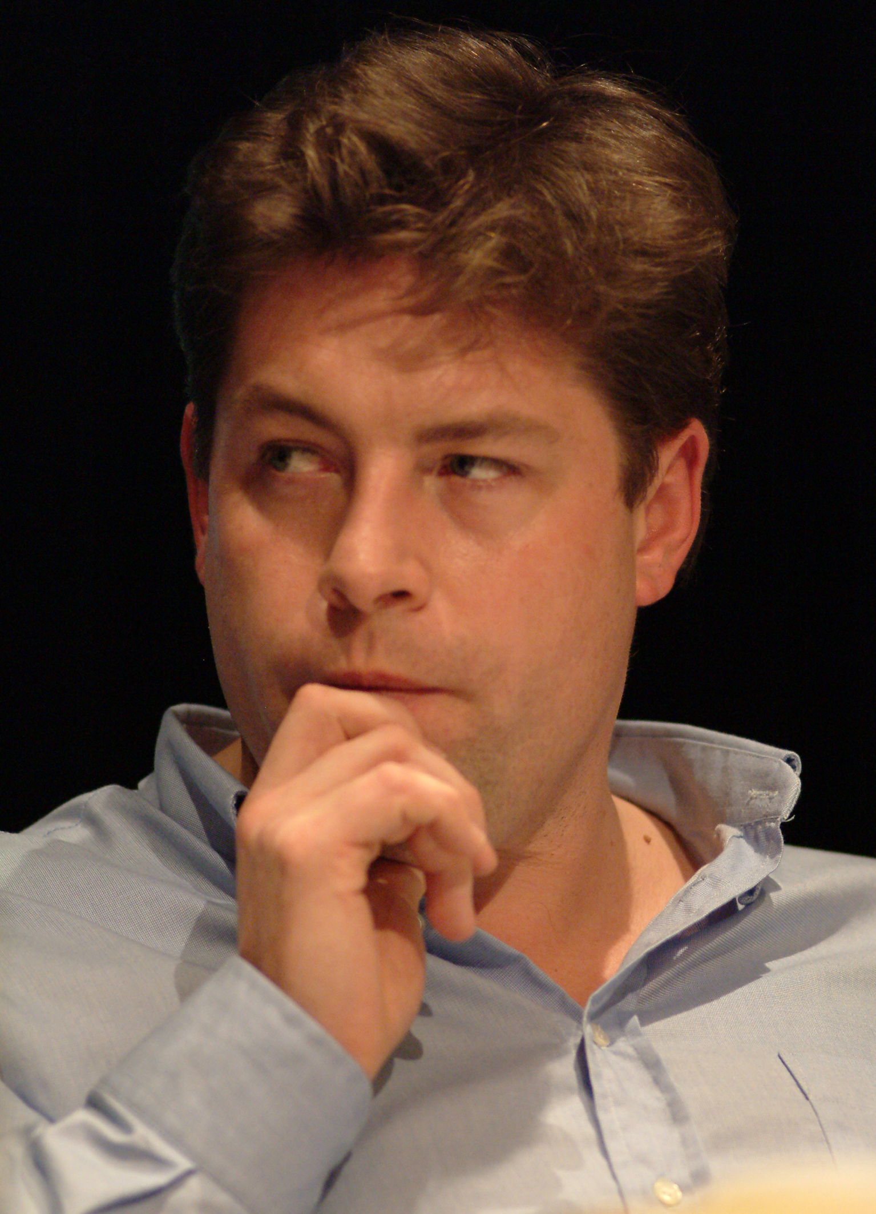
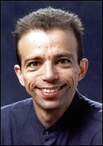
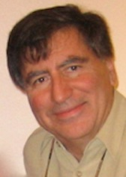
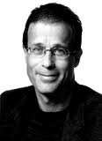
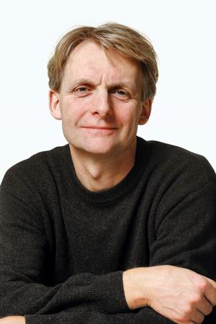
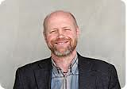
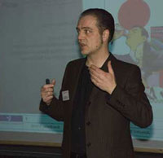
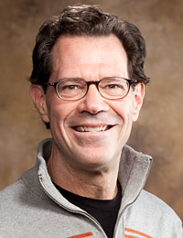
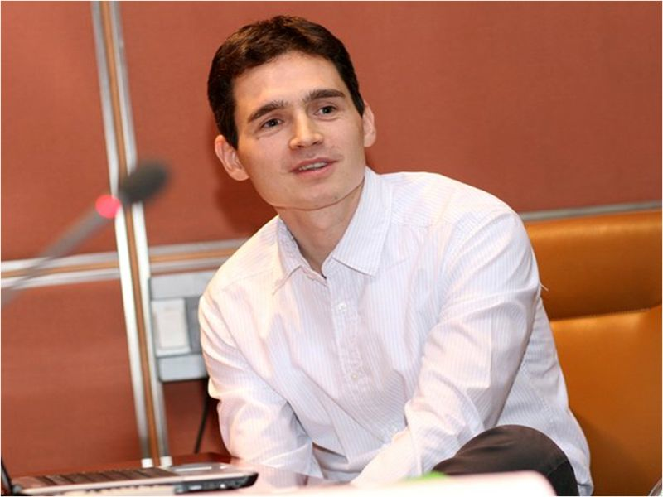
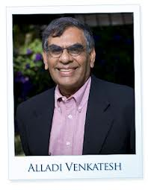
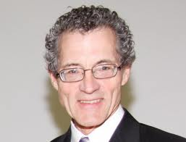

Slide 4
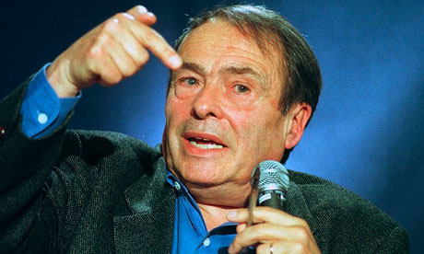
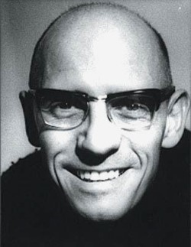
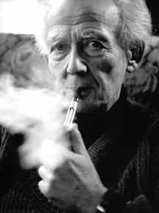

Slide 6
Structure
Bourdieu in my (academic) life
Bourdieu – biography and authorship
The overall project – a ”site ontologist”
Key concepts
Taste and Consumption – applications
Bourdieu and markets – example from global branding
A Reflexive Sociology

Slide 7
Learning to live with Bourdieu
Encountering Bourdieu:
taste (food, clothes, education, marriage partner) constituted by a set of dispositions shaped from your upbringing
Becomes a personal reflection

Slide 8
Conatus and B.’s sociological imagination
Sparse biographical information – only late published an ”auto-socio-analysis”
1930-2002
From Southern France, son of a postal worker (orginally agricultural worker)
Moved to elitist boarding school around age 10
Feeling of alienation and betrayal –social background is embodied and determinate of life chances (contrary to ideals of his father)
Trained in Ecole Normale Superieur - Canguilheim, Aron
Military service in Algeria (1955) – later stayed and studied Algerian agricultural and tribal life
Part of establishing sociology as academic discipline in France, influenced by Raymond Aron, an early critic of marxist existentialists - + Bachelard + Canguilheim (ENS)
Took Aron’s chair as head of Centre de Sociologie Européenne
Founder of journal, Actes de la Recherche en Sciences Sociale (1975)
Professor at College de France (1981)

Slide 9
Conatus …2
Feeling ”sociologically improbable” became driving force for academic venture:
"I never feel myself fully justified in being an intellectual, I don't feel at home, I have the feeling of having to justify (to whom? I have no idea) what seems to me an unjustifiable privilege." Bourdieu, SIQ, p. 47

Slide 10
Authorship
Four waves (Järvinen)
1) Philospher turns ethnographer (1950s-1970s)– life among the Kabyle, Algeria and marriage strategies in Béarn, France
Symbolic capital – social life organized around optimizing honour and prestige – more than one type of economy
Practical sense (Le sens pratique) – knowing what to do, internalized, embodied
2) Sociological: Distinction and theory of taste (1960s to early 1980s – Distinction 1979)
3) Education and social reproduction (1980s) –
4) Cultural production (1990s)– shift in interest from habitus to fields
5) Social structures of the economy (1990s)
E.g. The role of the state in forming markets, eg, real estate
+politically active

Slide 11
”I didn’t make the rules, right?” Key tenets of Bourdieu’s approach
Puzzle: feeling and observation of agency and change, yet most action can be structurally explained
Objects versus practices
Marriage strategies, gift economies, time, space, photography, scientific production, cultural production, museum visits, litterature, interior decoration, politics, fashion, religion, language, gender …
Beyond the structuralist legacy
Beyond existentialism
Beyond rational choice

Slide 12
Eclectic theory building
Weber – class more than economic differences, belief in class as the natural ’order of things’, status and communities
Marx – society as social relations
Phenomenology – embodiment, dispositions
Durkheim, cognitive structures reflect social structures (though more agency than D)
Mauss – technique of the body, habitus
Levi-Strauss – a ’structural’ thinking – and back to Jakobsen
Whole before the parts
Relative and relational thinking
…..

Slide 13
B’s project
To make people aware of the processes that make them act the way they do

Slide 14
Metaphors
The game – ”fight”, ”compete”, ”fields”, ”strategies”, ”tactic”
The economy – ”interest”, investment, capital
Natural science – ”field forces”, ”gravitation” …
Not rational, not conscious

Slide 15
Adversity to professorial definitions:
Concepts are realized in their application in particular (empirical) contexts
Thinking relationally
Anti-elitist

Slide 16
Basic concepts
A structured structure (past/present circumstances, family upbringing, education)
[(habitus) (capital)] + field = practice
A structuring structure (shaping present and future practices)

Slide 17
Status and Taste
Kantian notions of judgement of taste: some are innately capable of judging beauty
Taste is socially constituted: ”good taste is always bad taste”
A study in preference-formation
Non-utilitarian/anti-rational choice, yet experienced as meaningful
Demand, markets and choice
Taste, i.e. Differences in the consumption of cultural goods, determined by the composition of particular kinds of capital

Slide 18
Aesthetic judgements
CC-
”She must have worked hard” ´”look how they are all knotted”, ”perhaps she’s got arthritis” …
”Poor old thing, she must have worked hard”, ”Could be really beautiful as a painting”
”The sort of hands you see in early Van Gogh’s”
”Those are the hands of someone who has worked too much …”
”I find this a very beautiful photograph. It’s the very symbol of toil. It puts me in mind of Flaubert’s old servant-woman …”
CC+

Slide 19
Taste, consumption and class
”Taste classifies, and it classifies the classifier. Social subjects, classified by their classifications, distinguish themselves by the distinctions they make, between the beautiful and the ugly, the distinguished and the vulgar, in which their position in the objective classifications is expressed or betrayed.” (Bourdieu 1984, p. 6)

Slide 20
Habitus
A set of dispositions to act in a certain way in given situations
Integrates past, present and future
Relatively durable and transposable
Cognitive, corporeal
Potential choice to make: current context and experience → frame what we see as visible, possible, suitable
”It is a virtue made of necessity which continuously transforms necessity into virtue by inducing ’choices’ which correspond to the condition of which it is the product” (Distinction, p. 175)
A structuring structure and a structured structure

Slide 21
Habitus
”feel of the game” ”second nature”
Set of dispositions that govern which selection of actions that seems sensible and reasonable
sense of place and out-of-place
Beyond dichotomies
Subjective vs objective -> internalization of the external and externalization of the internal
Structure vs agency – individuals act to their own accord and with a sense of agency within socio-historically produced structures
Rules versus Freedom – social practices don’t operate according to rules but generate regularities

Slide 22
Habitus & Fields
Habitus is enacted contextually in social fields
Field as social space
Education, culture, television, science, housing, burecreaucy ... And sub-felds in-between
Fields are defined by agreement that 1) something is at stake and 2) the stakes which are at stake
cultural goods (life-style), housing, intellectual distinction (education), employment, land, power (politics), social class, prestige or whatever—and may be of differing degrees of specificity and concreteness

Slide 23
Field
A structured system of social positions – structured by individuals or institutions, structures ’the game’
A system of forces, structured internally by power relations (domination, subordination, equivalence)
Nature of position depends on capital volume/composition vis a vis what is deemed valuable
Competitive games (not fair): accumulation of capital

Slide 24
Field 2
Doxa
“a set of fundamental beliefs which does not even need to be asserted in the form of a self-conscious dogma” (PB. 1977),
“Tradition is silent, not least about itself as a tradition” (PB. 1977)
“How we do things around here” (DK 2016)
Illusio
interest and value - -> preference
Interest and habitus
Historically constituted
Habitus and Field
Relational
Relation between these relational structures allows to understand practice
Homologous
Mutually constitutive
Habitus determines perspective of field; engagement in field structures habitus and vice versa
Hysterisis – when habitus and field are ’out of sync’

Slide 25
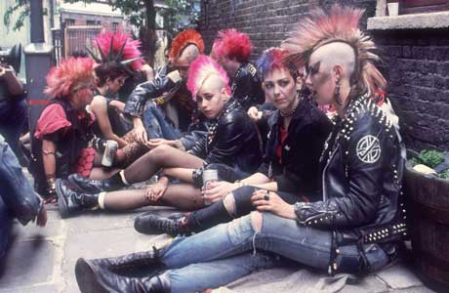
The field of style, historically
CCCS/Birmingham school: subculture’s stylistic representation of working class marginalization
Hebdige:
Communicative intent
Bricolage
Homology
Signifying practice
Market incorporation – the coolhunt
Neotribal
Individualization

Slide 26
The fields of style and youth education in Denmark
Business high school | Ordinary high school
Values: Goal achievement | Values: Authenticity
Outer | The inner (depth ontology)
The individual | The social
Competition | Tolerance
Instrumental relation to education | Autotelic relation
Embrace brands as status markers | Distance from consumption and brands
Style characteristic: Expensive Mature / ’adult’ | Style charateristic: Personality Not expensive or conspicuous

Slide 27
Positions in the field
In my surroundings I would say there are – there’s the typical pop-girl […] tight trousers a bit wide at the legs and tight shirts so that the breasts almost jump in your face. That kind of look. That Britney Spears look. And then I guess there are the techno-types, you know, wide trousers with traffic-safe colours and so on. Who likes to party at In [a Copenhagen night-club well-known for it’s techno and drug scene]. And then there’s the typical pop-boy, a bit trendy … how can I explain it … maybe a tight t-shirt and – nice clothes but, well, maybe a knitted sweater with a zip and then the collar is hanging loose in some funny kind of way and … the typical pop-trendy type. And … yeah then I guess there’s skater-look. A bit like hip-hop it’s just, I would say more earth-colours. Dark green and brown and so on. And the characteristic skater shoes […] (Tim, male, age 18, Copenhagen)

Slide 28
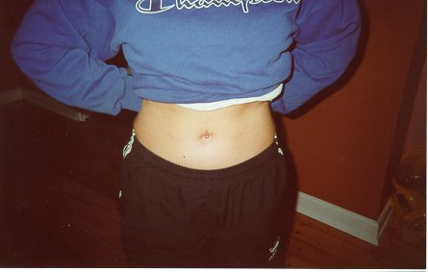
At the centre of style: Showing your Self
R: […] I think everybody strives to be, like, themselves, right. And that’s also what some of these pop-girls are saying, that they are trying to create their own personality and so on. Then I just can’t help saying to them, like ‘but you look just like the one standing over there’, right, ‘so how can you be your self?´, right. But I think it’s like … not so much setting yourself apart, I think it’s more like showing yourself, right. And then obviously you get to stand out because no-one is the same.

Slide 29
Being in a field
R: Yes, because there’s something symbolic in clothes – I mean you signal something about what kind of person you are from the clothes you wear, and I don’t want to be stamped a pop-girl. I: Why is that? R: I’m not really afraid what people were to think of me but it’s – I mean, I didn’t make the rules, right. But there are these categories so that people … when people see someone in pop-clothes they think ‘oh, there’s a pop-girl’. I don’t like that. I don’t’ want to be stamped as a pop-girl. (Fatima, age 17, Copenhagen))

Slide 30
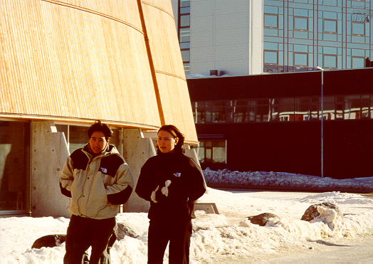
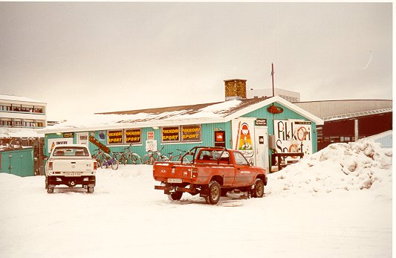

Slide 31
Capital
as the medium for field operation: positioning and effecting change
Economic capital: instrumental, means to an end
Social capital (relationships, networks, organizational affiliations)
Cultural capital (tastes, skills, knowledge, practices)
objectified: things
embodied: body language, intonation, lifestyle choices
institutionalized

Slide 32
Symbolic capital (cultural, social, linguistic, scientific, literary) actually also instrumental, means to an end but deny and suppress their instrumentalism by proclaiming to be disinterested and of intrinsic worth
Generalized and field dependent (late Bourdieu)
Transformations of forms of capital

Slide 33
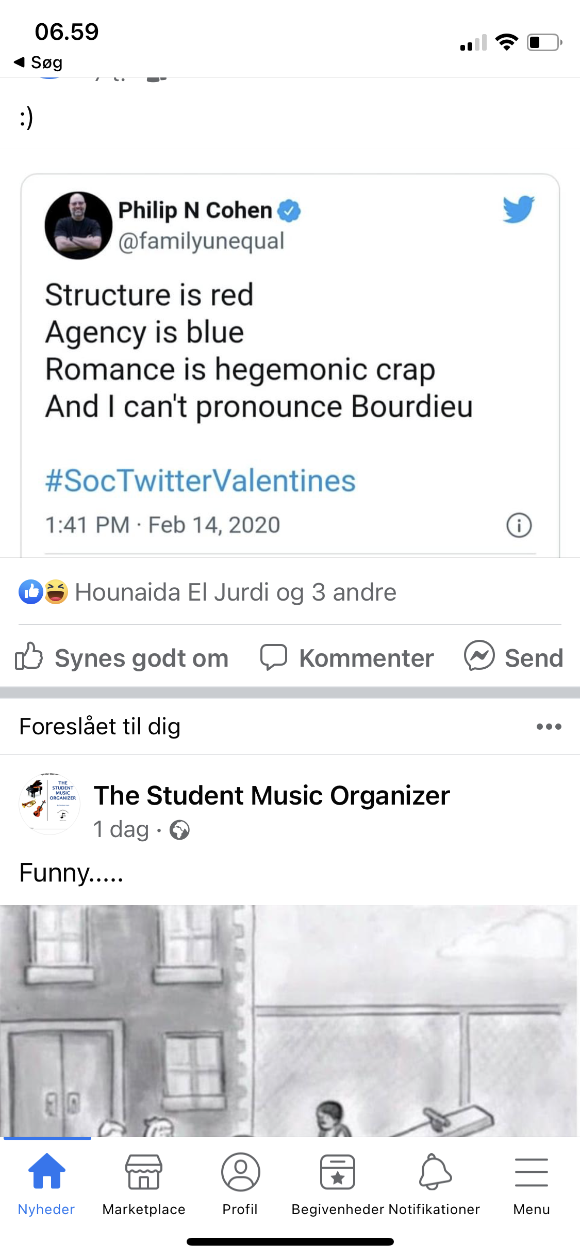
Serendipity?

Slide 34
Practice
A structured structure (past/present circumstances, family upbringing, education)
[(habitus) (capital)] + field = practice
A structuring structure (shaping present and future practices)

Slide 35
Practices
Not actions but the pattern of choice of actions in particular situations
Practice = relation of one’s dispositions (habitus) and one’s position in a field (capital), within a current state of play in that social arena (field)
Practice is not just a function of habitus, but a relation between habitus and one’s current circumstances
Choice of sensible actions and objects from different fields
Choice not necessarily conscious – more a result of the logic of differentiation than emulation or self-orchestration.

Slide 36
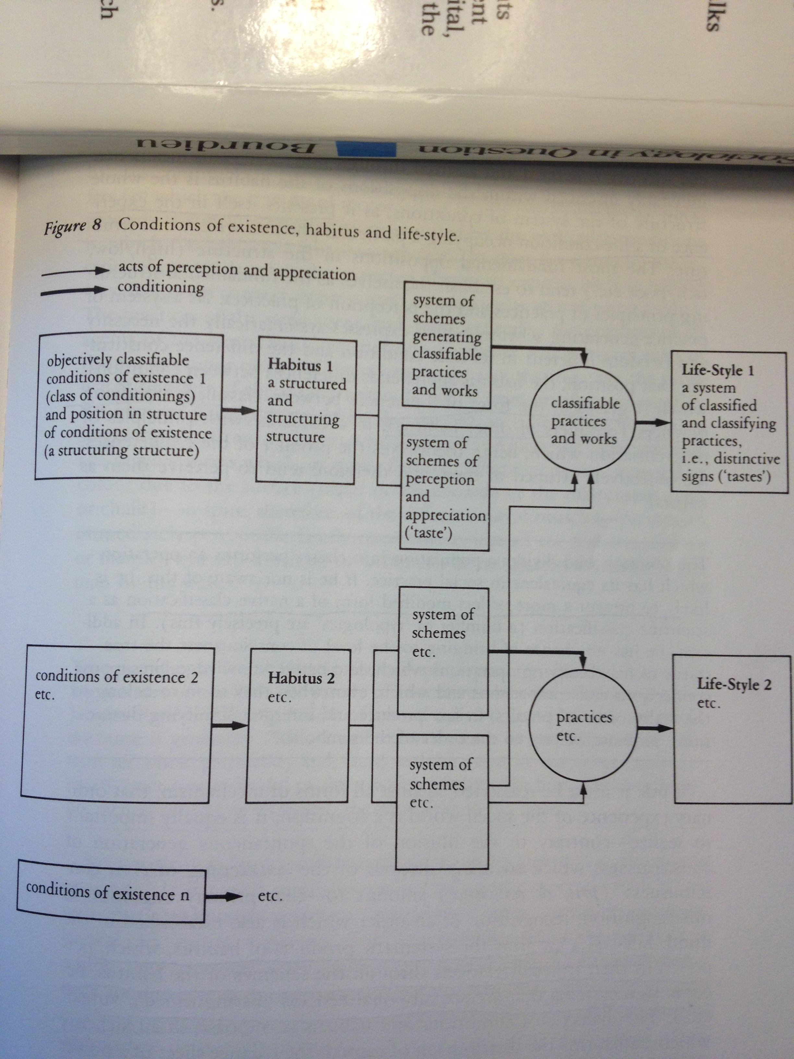

Slide 37
Strategy of analysis and method
Analyse the positions of the field vis-à vis the field of power
Structure of relations between positions of social agents/institutions that compete for the legitimate forms of specific authority
Analyse the habitus of social agents, the different systems of dispositions they have acquired by internalizing the determinate type of social and economic condition, and which find in a definite trajectory within the field …
Method: multi-method. Correspondence analysis

Slide 38
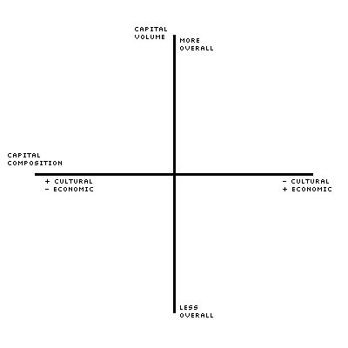
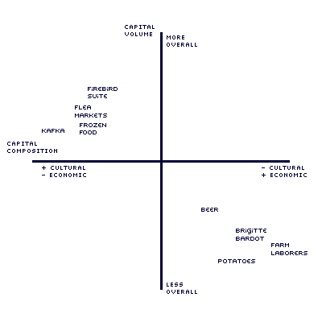
Capital

Slide 39
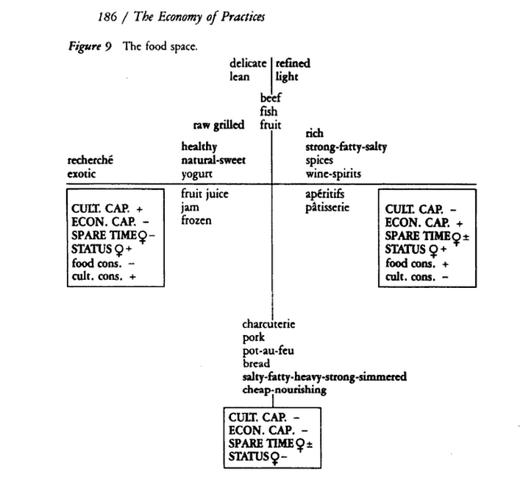

Slide 40
Symbolic struggles for distinction as class struggles
How to establish superiorities in our peculiarities and gaining an official sanction for them: legitimation
Misrecognition & symbolic violence Reproducing the fundamental structure of social inequality
Practical mastery of classification vs reflexive mastery - also situating the analyst vis a vis fields and habitus
- the heroification of the intellectual free thinker outside of structures, habitus, power (particularly damning critique of Sartre, e.g. Distinction p. 472)

Slide 41
Bourdieu and markets
”In the cultural market – and no doubt elsewhere – the matching of supply and demand is neither the simple effect of production imposing itself on consumption nor the effect of a conscious endeavor to serve the consumers’ needs, but the result of the objective orchestration of two relatively independent logics, that of the fields of production and that of the field of consumption”. (Distinction 1984, 230)
”Thus the tastes actually realized depend on the state of the system of goods offered; every change in tastes resulting from a transformation of the conditions of existence and of the corresponding dispositions will tend to induce, directly or indirectly, a transformation of the field of production, by favouring the success, within the struggle constituting the field, of the producers best able to produce the needs corresponding to the new dispositions”, (Distinction, 231)

Slide 42
Fields of production
Firms operate
in fields
as fields
Capital: Technical, scientific, social, commercial, symbolic …
”Symbolic capital resides in the mastery of symbolic resources based on knowledge and a power which functions as a form of credit, it presupposes the trust or belief of thise upon whom it bears because they are disposed to grant it credence” (The Social Structures of the Economy 2005, 195)
”The dominant [firm] is the one that occupies a position in the structure such that the structure acts on its behalf” (The Social Structures of the Economy 2005, 195)
From the national to the international

Slide 43
Contextual to France late 1960’s?
Cultural capital: - family upbringing - formal education - occupational culture
HCC (high cultural capital)
LCC (low cultural capital)

Slide 44
Social class and Bourdieu
HCC | LCC
Formal aesthetics | Material aesthetics
Critical reception | Referential reception
Idealism | Materialism
Cosmopolitan | Local
Consumer subjectivity as individuality | Consumer subjectivity as local identity
Leisure as self actualization | Autotelic sociality

Slide 45
Social class and Bourdieu
Formal aesthetics | Material aesthetics
Visually appealing, style | Comfortable, functional, durable
HCC
LCC

Slide 46
FLAG
”FLAG choice acknowledges the unassailable fact that choices are made most often in contexts irreducible to an inidividual’s psychological mechanisms and a predetermined set of alternatives represented by abstract attribute ratings or information […] consumer choices are experienced in the flow of a person’s life experiences and social relationships with others , which in turn are nested within social collectivities adn historical contexts.”
(Allen 2002, p. 528)

Slide 47
A reflexive sociology
Academy reproduces social differences – e.g. Grading ’refined’ versus ’vulgar’ texts
Systematicity of perspective rather than the social world (result of scholastic training)
Reflexivity of the sociologist vis a vis background an academic thinking
No total intellectuals

Slide 48
Criticism
Overly deterministic despite intention of ’site ontologist’?
Sociological explanation for outliers, non-explained cases (including B. Himself?)
Pragmatic vs vague and elusive?
Too focused on viscosity of the reproduction of structures rather than change, opposition etc (however, must map reproduction to change it?)?

Slide 49
Some further readings
Grenfell (ed): Bourdieu. Key Concepts
Bourdieu and Wacquant, An Invitation to Reflexive Sociology
Bourdieu, Sketch for a self-analysis

