Slide 1
From Mauss to Mushrooms: Non-Utilitarian Social Thought
The point of departure lies elsewhere,
Mauss 1990/1925, p.46
Economics, as constituted, is an anti-anthropology.
Sahlins 2013
Eric Arnould
Aalto University
Canonical Readings in Social Science
October 2021

Slide 2
Mauss as exemplary ancestor

Slide 3
Mauss’ creative genius
Comparative method
Ethnological imagination => Synrectic constructs
Collective representations (see Foucault on penal codes & justice; Graeber on the formation of armies & specie money; Lutheran piety & the Nordic social compact)
Holism: All interpretation must draw a coherent link between the objectivity of historical or comparative analysis with the subjectivity of lived experience
Sacrifice, magic, the gift (i.e., the imaginary construction of society) , the self, habitus & techniques of the body
Notes:
His published works include articles on sacrifice, magic, the notion of food in Vedic literature, the origin of money, law, prayer, the self, various aspects of psychology, the body, Bolshevism, suicide among the Celts, an immense number of “review articles,” as well as sociological theory and ethnological method, and of course, gift exchange.
(Partly out of despair of the West) Begins with native terms and categories and explicating them in the total context; indigenous cultures are partners in developing ideas.
Mauss’ method is always comparative – a number of societies are surveyed; the institution being studied is compared and its similarities in the various societies are noted. The institution is defined. Then an attempt is made to find some general concept upon which the institution is based – mana is taken to be the source of magical beliefs, the idea of sacré the source of sacrifice, potlatch is the exemplar of agonistic exchange.
Mauss offers up examples to enable readers to pursue matters at issue. Alternative ways of thinking are demonstrated, not imagined. Mauss thereby rejects, reverse, or transforms distinctions, theories and principles.
the psychic is simultaneously a simple element of significance of a symbolic system that overwhelms (encompasses) it, and the only means of verification of a reality whose multiples aspects cannot be understood except through a synthesis beyond the self. (Levi‘-Strauss, Introduction to the work of Mauss)

Slide 4
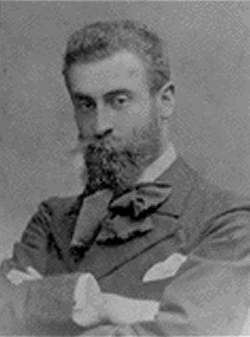
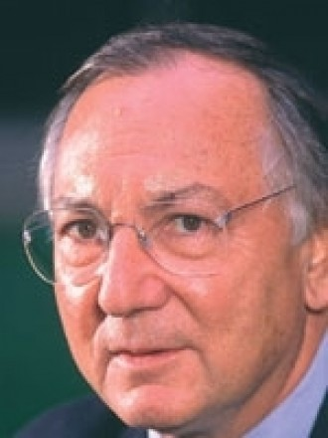
Mauss and his heirs

Slide 5
Mauss’ heritage: conceptions of the gift as an example
The gift is about ritual obligation
The gift (agonistic) is about the quest for glory (hierarchy)
The gift (donation) is about the desire to belong (alliance)
The gift is above all about generativity (liberty)
Notes:
Alain Caille, 2000.

Slide 6
What’s all this to do with marketing and consumer society?

Slide 7
The self is a social product
The consumer self
The responsabilized self

Slide 8
The non-contractual organization of consumer culture
Sherry, Belk, Otnes, Fischer, interpersonal gifting
Mick & DeMoss, self gifting
Curasi, Arnould & Price’s, inalienable possessions
Kozinets and Sherry’s, Burning Man’s intermediate modes of exchange
Giesler’s, Gift systems
Marcoux’s, escape from the gift
Bradford’s, intergenerational giving
Weinberger and Wallendorf, Mardi Gras potlatch
Figueirdo and Scaraboto
Circulation of geo-caching tokens
Tiny altars
Arnould, Arsel, Karababa, Kjeldgaard : constitution of value

Slide 9
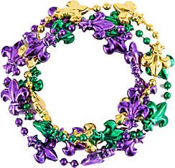
Intra-community Gifting
Class & Other Divisions
Stratified « we »
Uplift & attraction
Collective « we »
A circle of
joined elements
anonymous, categorical, intensifying
Notes:
Krewe members – chiefly potlatch givers – kula representatives, note interplay of vertical and horizontal ties
Ritual Disrobement at Mardi Gras: Ceremonial Exchange and Moral Order
Wesley Shrum, John Kilburn
Social Forces, Vol. 75, No. 2 (Dec., 1996), pp. 423-458
The sacred, according to Durkheim ([1912] 1965), is found in the emotional-ism of collective gatherings. Balcony disrobement is a public ritual in which an archaic, even elemental fascination with breasts and fertility is concentrated on strangers who reveal secrets but not the self. Such gatherings do not prevent conflicts or promote solidarity outside the ritual context. The emotions produced are as temporary as the rite.

Slide 10
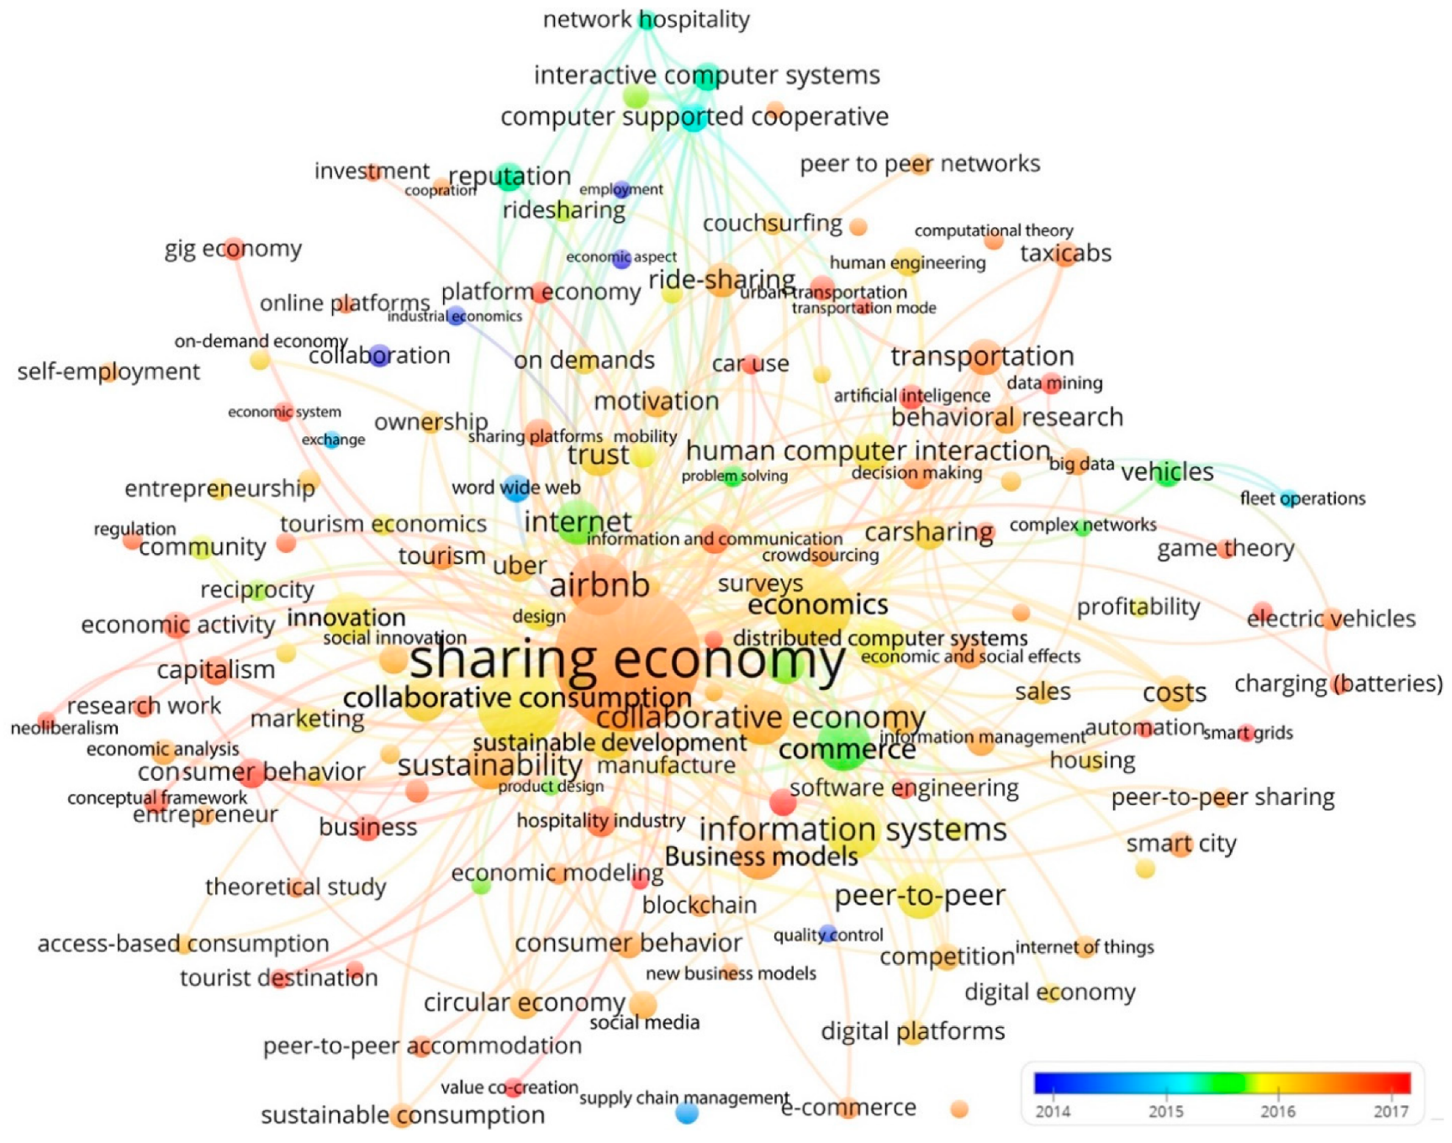

Slide 11
The gift and organizational performance
Probably always the “economic basis of primitive politics is chiefly generosity—at one stroke an act of positive morality and a laying of indebtedness upon the commonality…the entire political order is sustained by a pivotal flow of goods, up and down the social hierarchy, with each gift not merely connoting a status relation, but as a generalized gift not directly required, compelling a loyalty (Sahlins, On the Sociology of Primitive Exchange, 1965).
What makes firms function and enlivens markets is not the universal and abstract law of supply and demand, it is the chain of inter-dependencies and relationships of trust/commitment that weave the network together (Alain Caillé, Anthropologie du Don, 2000, p.57)

Slide 12
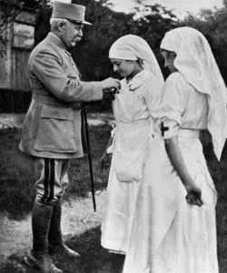
Habitus: Bourdieu mentioned in 104 JCR texts; 59 AMR; 66 AMJ
”La Parisienne”

Slide 13
The body & affect
Joy and Sherry, 2003
Dion, Sitz & Remy, 2011
Embodied experiences Day-to-day experiences grounded in the body
Experiential ethnicity
Embodied imaginary Multi-sensorial and kinesthetic imaginary
Virtual ethnicity
Embodied interactions Shared body techniques and imaginary
Melted bodies

Slide 14
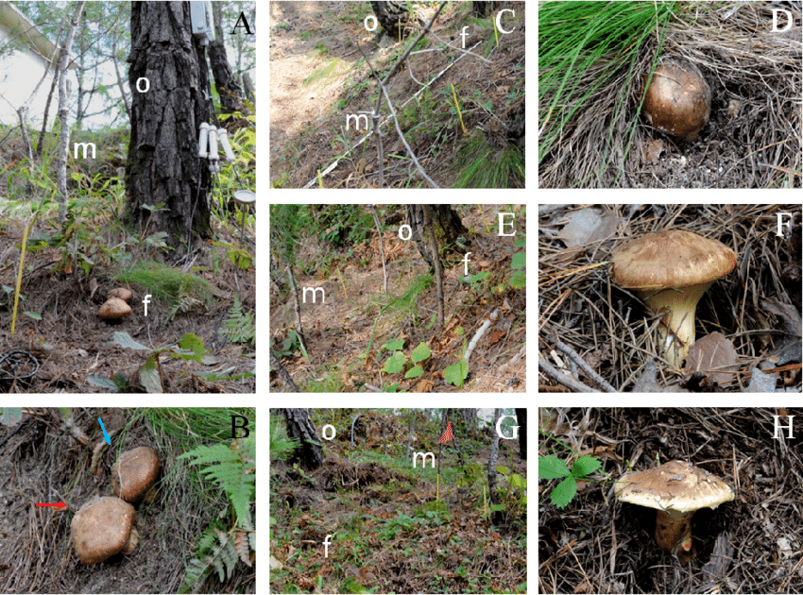
A Living Example of Neo-animist Exchange: the World- Wide Matsutuke Network, Tsing 2015
Pine trees and mushroom hyphae engage in symbiosis
Gathered in forests in North America, Finland, and China by unpaid specialists
PREDATION
EXCHANGE
GIFTING
Source: Tsing 2015
Selected for giving as tokens of respect rather than purchased for own consumption
Rapidly sorted, bulked and expedited through face to face exchange networks

Slide 15
Mauss’ projects (& indeed Sahlins’)
Legitimize sociology: neither determinism nor utilitarianism; an open-ended, critical elucidation of the symbolic nature of society
Extend Durkheim’s work: the determinacy of collective representations (i.e., cultural templates for action and interpretation).
Foster a holistic human science, the total social fact
The self is a bio-psycho-cultural entity: identity (Strathern on gender!)
The body is a bio-psycho-cultural entity: habitus
Working out the social contract
Sacrifice is a symbolic contract between man and gods, creates the divine
Magic is a symbolic technology for managing auratic power
The Gift is a social (symbolic) contract between men, absent the State
Contribute to the creation of the European social democratic contract, the social safety net, “l’etat providentiel”

Slide 16
Collective Representations and Method
The social for Mauss: The proof of the social must also be mental, or put another way, we can never be sure we have understood the sense and function of an institution if we are not able to relive its effects through an individual consciousness. Since these effects are an integral part of the institution, all interpretation must draw a coherent link between the objectivity of historical or comparative analysis with the subjectivity of lived experience…the psychic is simultaneously a simple element of significance of a symbolic system that overwhelms (encompasses) it, and the only means of verification of a reality whose multiples aspects cannot be understood except through a synthesis beyond the self. (Levi‘-Strauss, Introduction to the work of Mauss)
Derived from Bataille’s departure from Mauss.

Slide 17
The form of and rationale for (making sense of) exchange in archaic societies
An Essay (Assay) on the gift

Slide 18
Economic organization w/o economy!
What is the problem Mauss addresses?
The (social) contract, order, organized cooperation
A third paradigm (Caillé)
Neither determinism
Nor utilitarianism
Neither Hobbes nor Machiavelli
But also, in direct response to Lenin’s New Economic Policy
Göbekli Tepe, ca. 10000, BCE

Slide 19
A Relational Paradigm: The Three Obligations
the obligation to give gifts (by giving, one shows oneself as generous, and thus as deserving of respect),
the obligation to receive them (by receiving the gift, one shows respect to the giver, and concomitantly proves one's own generosity), and
the obligation to return the gift (thus demonstrating that one's honor is - at least - equivalent to that of the original giver).*
Watercolor by James G. Swan depicting the Klallam people of
chief Chetzemoka at Port Townsend, with one of Chetzemoka's
wives distributing potlatch

Slide 20
Positive social endebtedness (Godbout)
The tripartite gift
Collective, everything is exchanged, voluntary obligation, mutual indebtedness
From one generation to the next, everyone has the sentiment of receiving more than they have given
Matrilateral cross-cousin marriage

Slide 21
The inalienability of the gift
The persons/things given are not alienated
The person/thing is given again, never ”given back”
Only rights are ceded

Slide 22
Sahlins typology of reciprocities, is it of use?
Immediacy of returns
Equivalence of returns - sidedness
Material dimensions of exchange
Mechanical dimensions of exchange
The span of social distance between partners
Rank, relative wealth, need, type of goods
We have “abstract moral standards”, but not only abstract ones

Slide 23
Potlatch: a system of antagonistic exchange
Willie Seaweed with Galgatu (left), 1955, Photo by Wilson Duff
Notes:
Blankets, the dominant potlatch item in late nineteenth-century Kwakiutl potlatching, are shown piled high in preparation for giving

Slide 24
Potlatch
The potlatch is an example of a total system of giving. Spelt out it means that each gift is part of a system of reciprocity in which the honour of giver and recipient are engaged.
It is a total system in that every item of status or of spiritual or material possession is implicated for everyone in the whole community.
The rule that every gift has to be reciprocated in some specified way sets up a perpetual cycle of exchanges within and between generations across the society
Where does the system get its energy? In each case from
Individuals as representatives of groups who accrue status through loss (giving)
Individuals who are due to lose from receiving, and even worse, default and
Beliefs that the non-human beings from whom worldly resources derive would punish them if they did not reciprocate

Slide 25
Bataille: The Gift is foundational to the Social Order
In the gift, Mauss proposes that we might see as basic excess rather than scarcity, expenditure rather than saving, consumption rather than production, the group rather than the individual, desire for honor rather than biological need, deferred obligation rather than an instant striking of accounts. In short, the generous gift, rather than calculated exchange provides a better clue to the intelligibility of human societies.

Slide 26
Contemporary Theoretical Significance of Potlatch
In potlatch... The gratuitous, unlimited destruction of accumulated wealth, we must, in his view, see a stinging denial of that assumption which guides classical economic theory, that ‘flat and untenable conception of existence’ (Bataille 1985: 117), according to which individuals are motivated by the pursuit of maximum utility, by which is meant the rational activity that leads one to obtain for oneself all the pleasure possible within the restrictions imposed on everyone by limited resources (in money, information, time etc.). In this way ethnology supplies the proof that man is not naturally a homo oeconomicus preoccupied with saving and exchange…
Marcel, Jean-Christophe (2003) Bataille and Mauss:a dialogue of the deaf? Economy and Society, 32:1, 141-152

Slide 27
To summarize….
Mauss’ essential discovery is that in what one can call the first society the social bond is not built on the basis of contract, barter, higgling-haggling or market exchange, but through obeying the obligation of rivalry through displayed generosity.
Primitive gift indeed has nothing to do with charity.
Pervaded with aggression and ambivalence, it is an agonistic gift.
It is not through economizing but in spending and even dilapidating or in accepting to lose his most precious goods that one can make his name grow and acquire prestige.
This discovery represents of course a huge challenge to the central postulates of economic theory and of rational-actor theory… Alain Caillé, editor of Revue MAUSS; http://www.revuedumauss.com.fr/media/ACstake.pdf

Slide 28
Sahlins’ codification of gift relationships
Create normative obligations
Transfers that affirm or reaffirm the giver’s desire for future relationship with the recipient.
Symbolize social identities
Transmit already articulated social values or structure a new set of expectations
Material supports for relationships
Gifts create, maintain, modify & terminate
Communicate inner states of persons

Slide 29
The question of the mana of the hau
Mauss and Hubert pose another question: “What force is there in the thing which one gives which forces the receiver to return it?” (1925: 33, emphasis added)
Behind this lies the Durkheimian question, “since people create things with their hands and construe the world…with their minds, why then do their products…compel them rather than vice versa?” Jenkins 1998
Hence, their interest in the sacred, in mana (force), in the hau (anima)

Slide 30
Fame, keeping while giving, time, debt and kula
The authentification of fame legitmates a persons right to win over others’ loses and to be ranked a winner in a coterie of equals.
Fame in kula also enables a player to demonstrate difference by holding valuables for a long time without having to give them up to relatives for use in internal exchanges.
Keeping a kula shell out of exchange because it is promised allows a person to store wealth in the face of other obligations
However, unless the promised shell or another as famous finally enters a path, the owner’s eminence diminishes
Rare old mwali

Slide 31
Vaygu’a from the Melanesian Kula System
Soulava
Mwali
Notes:
Kitoum, inalienable objects, useful to the owners purposes; but once embarked on keda only exchangeable for other kitoum, i:e:; soulava or mwali
Keda is a kula circuit

Slide 32
Partial answer: Personified Objects, Objectified Persons
In total prestations between clan and clan, said Mauss, things are related in some degree as persons and persons in some degree as things (Strathern 1992: 189).
Thus, exchange of equivalent goods always entails the difference associated with their origin
Notes:
In a commodity economy persons and things are reified (Jolly 1991: 45)

Slide 33
Kula Vaygu’a: the question of ownership
Mauss: it is indeed ownership that one obtains with the gift that one receives. But it is ownership of a certain kind. One could say that it partakes of all kinds of legal principles that we, more modern, have carefully isolated from one another. It is ownership and possession, a pledge and something hired out, a thing sold and bought, and at the same time deposited, mandated, and bequeathed In order to be passed on to another. For it is only given you on condition that you make use of it for another or pass it on to a third person, the ‘distant partner’, the murimuri.
Mauss misunderstands that ownership is separated from possession

Slide 34
Parial answer from Godelier: Reject the dyadic conception of gift and counter-gift
It is essential to visualize the maze of plays and strategies as layers of exchanges, which one must constantly build up over time and then keep track of.
There can be no dependency on one gift for one return.
Giving a vayuga shell and quickly receiving a return denotes an end to further advances; no kula path for a large shell has been opened

Slide 35
The source of value

Slide 36
Partial answer from Weiner: The social force of the Gift
The objects and services exchanged in "primitive" gift-giving are, as Mauss points out, laden with "power" (the Polynesian words mana and hau are used to refer to this "power in the gift").
Though a similar "power" is present to a certain extent in modern gifts as well, Mauss shows that gifts in traditional societies are more complex and multivalent than anything we know from modern society.
The basic force that gives momentum to the processes of human interaction is control over the circulation of goods, over workpower, and over the final regeneration of persons through social arid cosmic time (Weiner 1976, 221).
The gift is economic, political, kinship-oriented, legal, mythological, religious, magical, practical, personal and social. By moving such an object through the social landscape, the gift-giver so to speak rearranges the fabric of sociality - and it is this that forms the basis of the gift's power.

Slide 37
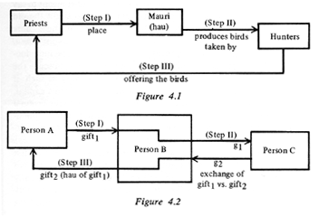
Partial answer: Sahlins’ explication of the hau
Time
Note where the hau appears
Hau is a product of, yield; an increase power; return on; it travels through gifts.
The hau of the taonga of C to B is the product (hau) of A’s original gift.
Reciprocity between A & C, not A & B or B & C

Slide 38
Sahlins explication of the hau
Sahlins rejects the notion of the hau as the spirit of the giver, arguing that Mauss has mis-translated the word ‘hau'.
Hau means the interest or increase accumulated by the gift which must go back to original giver. Even if this is the case it does not negate Mauss' point.
There is still pressure to return and that pressure to return is the result of the fact that the receiver and giver know of the former's obligation: that is embodied in the gift itself. The gift contains fecundity.
Further, we are dealing with a type of society in which individual gain at others’ expense is not envisioned; one gains through others’ failure of expenditure.

Slide 39
Partial answer: An animist reinterpretation of the hau
Largesse
Birds taken
by hunters
Feathers given
by hunters
A. The birds (hau of the forest)
B. The hunters
C. Kin
D. Priests
Nephrite adze
given to hunter
“Sacrifice” to
the forest hau
A share given
to priests
Debt
In fact, the hau of the taonga of B/C to D is the productive property (hau) of A’s original gift.. Moreover, the forest cedes rights but not ownership in its products..

Slide 40
Partial answer: Godelier’s reinterpretation of the gift
Largesse
gift
gift
gift
gift
A. A scarce object
Recipient B
Recipient C
Recipient D
E. A scarce object
Repayment
gift
gift
gift
Debt

Slide 41
Weiner’s critical reformulation
The concept of reproduction rather than reciprocity illuminates the regenerative cycle of social relations maintained by the circulation of persons and things.
And this depends upon that face that somethings must not be exchanged, those that affirm deep- seated identities and differences of identity

Slide 42
Weiner’s insight: Keeping-while- giving
The oldest and most pervasive economic classification…distinguishes alienable and inalienable possessions. The physical uniqueness of inalienable objects iconically conveys the uniqueness of those who possess them.
When such objects conjure up illustrious histories and cosmological powers, they confer glory on their owners and difference is converted into rank.
Valuable objects such as these are hard to protect and, to counter the expenditures of those who want them, great effort is invested by those who have them.
Herein lie the origins of circulation: the need to expend in order to retain, the paradox of 'keeping-while- giving .
Rare old mwali

Slide 43
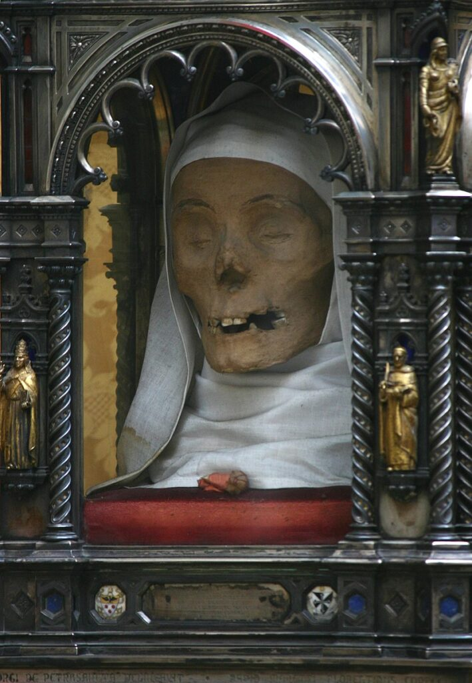
Inalienable wealth
Polynesian fine mat
Danish Crown jewels
The authenticity lodged in these possessions denies intergenerational difference whereas their (uninterrupted) owner­ship continually justifies difference in the present. Therefore, inalienable possessions are the material confirmations of these endeavours, con­trolled [in the Trobirands] through the productive and reproductive exchange relations between women and men (Weiner 1976, p.48)
St. Catherine of Siena

Slide 44
Taonga: Conduits for the hau
An individual’s role in social life is fragmentary unless attached to something of permanence.
The history of the past, equally fragmentary, is concentrated in an object that, with age,
becomes incresingly valuable. In the Maori case, a person’s life force, the hau, also
penetrates these possessions. And among high-ranking people, mana the source of
reproductive potentency and cosmological power contributes its sacred efficiency.
The dynamics surrounding keeping-while-giving are attempts, paradoxical though
they may be, to give the fragmentary nature of social life a wholeness, thereby
strengthening each new generation with the fame of past generations. But these
possessions do more than replicate the past. Their fame and power pervade all
exchange events for giving and the status that ensues is measured by what has
been kept.

Slide 45
The ”origin” of ”inalienable wealth”
Women’s exchange in mortuary rituals occupied a central role in the total Trobriand system of social organization through which subclans reproduced themselves. They did so, she showed by reclaiming subclan valuables that men had ”given” to their sons and daughters, who were not members of the matrilineal subclan. Such reclamation was a central political moment in the subclan’s reconstitution, a show of its strengths and durability.
The need to secure permanence in an entropic world is met through the reproduction of kinship, legitimated each generation by the transmission and retention of inalienable possession within groups, not by reciprocal exchange between groups.
Thus, in distinction to Mauss and Sahlins, for Weiner the Gift is the solution to the problem of social precarity, not of Warre.

Slide 46
Bonsu and Belk: Ashante funerals redistribute inalienable wealth

Slide 47
The origin of (inalienable) wealth
Predation
From elsewhere
Institutes artificial scarcity
Constructs difference and integration
Demonstrates and instantiates power

Slide 48
Taonga, mana & the spirit of the gift
Not only Maori valuables (taonga) and Trobriand kula shells, but Samoan fine mats and Northwest Coast coppers remain attached to their original owners even when they circulate among other people
It is in the rituals surrounding human reproduction and cloth production where women gain control over mana, which in turn, gives them a domain of power and authority in their own right. And here also we locate the source of ”the spirit of the gift”
The highest cosmological authentication attributed to inalienable possessions occurs through the authority of famous ancestors…and their mana
The hau of each person is activitated in a naming ceremony as a sign of each person’s vitality knowedge and ability

Slide 49
Consequently….
The market is a way of instituting a specific cultural-historical conjuncture rather than determining it.
The market is one way among others of objectifying the cultural-historical order, in this case on a large and impersonal scale by competitive pecuniary transactions.
Material rationality is thus a representation in monetary terms of a subjacent set of meaningful relationships among persons and the objects of their existence.
The market is thus a medium and mediator of cultural order.

Slide 50
But also….
3 bases and 3 principles to produce the social order
Selling: completely separating the thing from the person; objects are alienable and alienated
Giving: maintaining something of the person in the thing given; objects are inalienable and alienated
Keeping: in the union of person and thing reside an affirmation of historial identity that must be passed on; objects are inablienable and unalienated

Slide 51
Thank you! Questions?

