Slide 1
Information Retrieval
Eila Rämö
15th Nov. 2021, 9.15-12

Slide 2
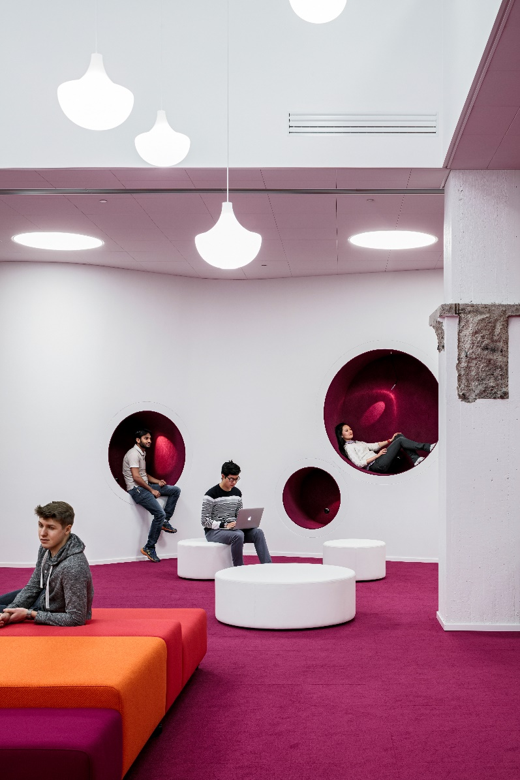
Course content
The information retrieval process
Conceptualising the research topic
Retrieval techniques
Information sources
Learning Centre’s information sources
(e.g. Aalto-Primo,
Research Guides, databases)
Other information sources

Slide 3
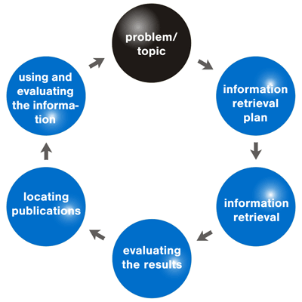

Slide 4
Conceptualising the research topic
Free text: any word in natural language, and their synonyms, other language equivalents etc.
fashion design, sustainability
Use dictionaries and general thesauri on the web for ideas and definitions of terms (Thesaurus.com, Oxford English Dictionary, RedFox dictionaries).
Controlled terms: a term originating from a controlled vocabulary or thesaurus, e.g. General Finnish Ontology http://finto.fi/yso/en/
design management

Slide 5
Conceptualising the research topic
This is the most important phase in the search process.
Concepts are defined into search terms to be used in the search.
Useful concepts are terms which are specific to the discipline and research subject.
Use mindmap or a concept map
(FreeMind, CmapTools etc)
MindJet on Aalto-university computers

Slide 6
Keywords in a concept map

Slide 7
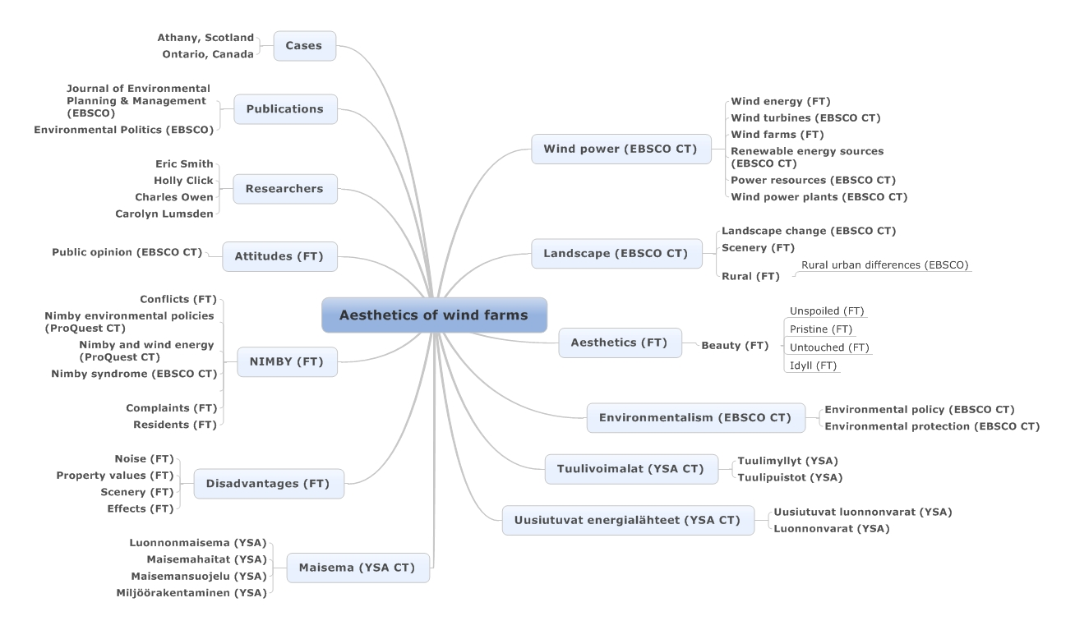

Slide 8
Search techniques
Limit to particular field
- e.g. author, title, keyword, ISBN number etc.
- narrows search results
Phrase search
“fashion design”

Slide 9
Search techniques
Free text search
any word in natural language, and their synonyms, other language equivalents etc.
Use truncation (*, ?, #) of terms and wild cards:
sustainab* (sustainable, sustainability etc.)
wom?n (woman, women), colo?r (color, colour)

Slide 10
Search techniques
Subject term or Keyword searching
A subject term search gives more accurate results than a free-text search and limits the search to the subject term field.
When you find an interesting book or article, check the subject terms, and use those for further searching.
YSO (General Finnish ontology) is used in Finnish university library databases, when books are described into a database.
finto.fi/yso/fi
Commercial databases use they own vocabularies (thesauruses/describtors/subjec terms)

Slide 11
Combining concepts, Boolean searching
AND ”textile design”
AND sustainab*
OR ”fashion design”
OR cloth*
NOT ”textile design”
NOT industrial*

Slide 12
Boolean logic in planning a search
A search plan typically contains combinations of search terms (in different languages) and their synonyms.
“fashion design” AND sustainab*
Search terms are used in databases in combination with their search functions.
Search functions: term truncation, boolean operators, phrases, thesaurus terms.

Slide 13
Information management
Reference management software:
Zotero
Mendelay
EndNote
etc.
Many different output styles for citing:
Havard (American and British)
APA (American Psychological Association)
Chicago
etc.

Slide 14
Information sources at Aalto University
Learning Centre website is a good starting point: learningcentre.aalto.fi
Aalto-Primo (https://primo.aalto.fi/discovery/search?vid=358AALTO_INST:VU1&lang=en
Resource guides identify essential databases and learn information skills
- Design guide: http://libguides.aalto.fi/design
Visual Resources Centre guide for image databases and copyright info
Aaltodoc contains theses and dissertations
Research information portal https://research.aalto.fi

Slide 15
Aalto-Primo
Printed books and e-books in Aalto University Learning Centre collections
Theses and dissertations
Printed journals and e-journals
Articles from international journals
Remote access to all databases
Primo log-in:
- Renewals
- Reservations
- Fees

Slide 16
Other information sources
National Finna: Collections of Finnish archives, libraries and museums: https://www.finna.fi/?lng=en-gb
The National Repository Library (NRL): https://vaari.finna.fi/?lng=en-gb
University of the Arts Library: https://www.uniarts.fi/en
Helsinki University, Library collections : https://helsinki.primo.exlibrisgroup.com/discovery/search?vid=358UOH_INST:VU1&lang=en
WorldCat https://www.worldcat.org/
Google Scholar

Slide 17
Google Scholar will not answer all your needs
Pros of Google Scholar | Cons of Google Scholar
Familiar and relatively simple to use, much like Google. | Does not allow users to limit results to peer reviewed or full text materials or by discipline.
Variety of materials including articles, books, conference proceedings. | Coverage is wide-ranging but not comprehensive and high scholarly quality is not guaranteed.
Can display links to articles and books held through Aalto University Learning Centre. | Weeding through results not held at Aalto is time-consuming.
See how many times an article has been cited and by whom. | Citation information is not as reliable as Scopus or Web of Science information.

Slide 18
References – Why to cite
Successful information retrieval is a central basis of academic writing.
Include essential background literature in your research/thesis.
Use academic information resources.
Choose the best and most relevant sources.
Study the bibliographies of good sources.
Check the reliability of the sources you are going to use.
The accuracy and correctness of referencing are part of a well-written publication and add credibility and reliability to your work.

Slide 19
References – why to cite
References support a research statement, are an expression of the research process, and can be used to criticise opposing views.
The functions of references are:
To give credit to other authors whose materials have been used in the research.
To illustrate the kind of previous research and existing information the research draws and builds upon.
To give further information when useful and necessary for the reader.
Citing is a foundation pillar of scientific communication.

Slide 20
References – How to cite?
Information resources are mainly used in two ways in research: to summarise and to quote.
The readers of the work must always be able to tell whether the information they are reading is the creator's own thought, a summary of, or direct quotation from another work.
When summarising, the writer of the work presents relevant information from the resource in her/his own words. Quotation marks are not used.
e.g. As Herrera states …, or According to Davis …. Appropriate
reference mark is also required.

Slide 21
References – How to cite?
Short quotations must always be presented in quotation marks. Avoid long quotations. Quotations can also be added to the text as indented paragraphs with smaller spacing and without quotation marks.
Quotations have to be presented exactly as they are in the original resource. If you only wish to cite some of the original text, you can point out where you have omitted a part of the text by adding [.] in the quotation. If you leave out the end of a sentence in a quotation, you should express this by adding three commas at the end, followed by the punctuation mark that ends the sentence in the original text.

Slide 22
References – How to cite?
Be consistent – use always the same style in your text references and bibliographic references.
Ask you theses supervisor about the style
Use guides for making the references.
Don’t copy ready-made references as such.
The references give an overview of the quality and reliability of the research.

Slide 23
References – Plagiarism
Plagiarism is the act of presenting another author's work as your own. The work can be a text or a part of it, data, an image, a translation and so on.
Plagiarism includes also copying an academic or an artistic work of another author without permission.
Turnitin is used in Aalto University to prevent plagiarism.

Slide 24
Copyright – right to cite
According to § 22 of the Copyright Act, it is permissible to use citation from disseminated works to the extent required by the specific purpose and in accordance with fair practice.
A separate permission from the author is not necessary. A work is considered disseminated when it has been made available to the public with the author's permission.
The manner, in which the work is made public, is not significant.

Slide 25
Copyright – right to cite images
Images (illustration, photograph or photograph of an artwork) may be cited in a scientific presentation (theses, dissertations, articles).
Images used, must come from legal source and images should be used as a whole work of art or as a whole photograph.
Images must be related to the text; they must illustrate and clarify the text.
In case images have been cited according to copyright law, theses, dissertation etc. may be distributed and shared together with images on the open access repository (Aaltodoc).

Slide 26
Reference – citation
There are two components to referencing:
In-text citation is inserted in the text directly after the information being sourced from the scientific literature.
Bibliographic reference appears at the end of the work and contains sufficient information of the source.
The bibliography contains only those bibliographic references which have been cited in the text.

Slide 27
Placing in-text citation
Incide a sentence – refers to the word ord words in front of the quotation.
After comma – refers to the previous sentence.
In the end of the sentence, before dot – refers to previos sentences.
In the end of the sentence, after dot – refers to entire paragraph.

Slide 28
Placing in-text citation - example
Another remark or claim has been that from shareholders’ perspective, “good design is good business” (Borja de Mozota 2006, 270-273), implying that well-designed products indirectly attract investors by leading to increased sales and better margins, more brand value, greater market share, and higher return on investment (ROI). Some consultants have also seen this to manifest in above-average stock market returns of “good-design” companies (Rich 2004, 30-35).

Slide 29
Reference systems
Name-year system (Harvard, APA …)
In-text citation
the author's last name, publication year and page numbers
Bibliography
bibliographic references in alphabetical order
publication year directly after author's name
if there are several works published by the same author in the same year, they should be differentiated by adding letters a, b, c (in in-text citations and in the bibliography)

Slide 30
Bibliography - examples
Book (Harvard)
Milton, A. & Rodgers, P. 2011. Product Design. London: Laurence King Publishing. 307 p. ISBN 9781780670850 [ebook]. ISBN 9781856697514 [print]. [Cited 7th Feb 2020]. Retrieved from ProQuest Academic Complete.
Journal article (Harvard)
Tao, F., Sui, F., Liu, A., Qi, Q., Zhang, M., Song, B., Guo, Z., Lu, S.C.-. & Nee, A.Y.C. 2019, Digital twin-driven product design framework. International Journal of Production Research, vol. 57, no. 12. P. 3935-3953. [Cited 7th Feb 2020]. Retrieved from Taylor & Frances Online.
Journal article (APA style)
Tao, F., Sui, F., Liu, A., . . . Nee, A. Y. C. (2019). Digital twin-driven product design framework. International Journal of Production Research, 57(12), 3935-3953. Doi:10.1080/00207543.2018.1443229
[Cited 7th Feb 2020]. Retreived from Taylor & Frances Online.

Slide 31
Reference systems
Number reference system (Vancouver)
In-text citation
a number is added in parentheses or square brackets in the appropriate place in the text, starting the numbering from 1
Bibliography
references in chronological order i. e. the same order as they appear in the text
year after the publication information

Slide 32
Bibliography - examples
Book
[1] Milton, A. & Rodgers, Product Design. London: Laurence King Publishing, 2011. 307 p. ISBN 9781780670850 (ebook). ISBN 9781856697514 (print). [Cited 7 Feb 2020]. Retrieved from ProQuest Academic Complete.
E-journal article
[2] Tao, F., Sui, F., Liu, A., Qi, Q., Zhang, M., Song, B., Guo, Z., Lu, S.C.-. & Nee, A.Y.C. Digital twin-driven product design framework. International Journal of Production Research. 2019, vol. 57, no. 12. P. 3935-3953. [Cited 7 Feb 2020]. Retrieved from Taylor & Frances Online.

Slide 33
Reference systems
Footnote reference system
In-text citation
A number called a superscript is added at the end of the cited or summarised information. Normally the numbering runs consistently throughout the work.
Footnote
The superscript numbers correspond with notes either at the end of the page (footnote) or at the end of the text (endnote). The notes state at least the author's name, the name of the publication and page numbers where the citation is from.
Bibliography
bibliographic references arranged in alphabetical order
year after the publication information

Slide 34
Footnote system
The benefit of using footnotes is that the system does not break the structure of the text.
You can also include additional information that supports the main text in the footnotes. For example, you can use a footnote to justify an argument, point towards important differences between different resources, explain an abbreviation or expression in the text, etc.
Footnotes are normally written in a smaller font than the main text and separated from the text by a horizontal line.

Slide 35
Bibliography - examples
Book
Milton, A. & Rodgers, P. Product Design. London: Laurence King Publishing. 2011. 307 p. ISBN 9781780670850 [ebook]. ISBN 9781856697514 [print]. [Cited 7th Feb 2020]. Retrieved from ProQuest Academic Complete.
Journal article
Tao, F., Sui, F., Liu, A., Qi, Q., Zhang, M., Song, B., Guo, Z., Lu, S.C.-. & Nee, A.Y.C. Digital twin-driven product design framework. International Journal of Production Research. 2019, vol. 57, no. 12. P. 3935-3953. [Cited 7th Feb 2020]. Retrieved fromTaylor & Frances Online.

Slide 36
Assessing search results
It is usual that first searches do not deliver the best results, and search terms may need to be rethought.
Typical scenarios:
search terms are too broad; too many references that are irrelevant
search terms are too specific; too little references or no results
search terms are too ambiguous; too many irrelevant results

Slide 37
If your received too many results …
Combine search terms with AND-operator.
Don’t truncate search terms.
Don’t expand the search with synonyms and related terms with OR-operator.
Try more specific terminology.
Use faceted search functions to refine the search by publication year, publication title, subject etc.
Limit the search to academic publications or peer reviewed documents.
Set a time limit.

Slide 38
If your received too few results …
Think around the subject; related research areas and topics.
Find more synonyms and related terms and combine these with OR-operator.
Find more general concepts and terms to replace some of the more specific terms.
Use free text searching (search from all fields) and truncation of search terms.
Are you using the correct databases for the subject?
Browse references used in other articles and books for new search terms.

Slide 39
If your search results are irrelevant to your subject…
Find more terms to describe the subject: synonyms, more narrow and specific terms.
Are you familiar with the jargon?
Are you familiar with all relevant databases to the subject?
Use databases’ internal thesauri to find more specific terms.
Limit your search to academic publications and peer reviewed documents.

Slide 40
Assessing information sources
Source criticism means the assessment of the reliability, relevance and originality of the source.
Presentation
Is the information well presented?
Pay attention to the language, layout and structure.
Relevance
Does the resource meet your research subject or answer questions around the subject? Does it take you to different directions?
Scan the introduction and conclusions sections.
What is the main subject and argument of the resource?

Slide 41
Assessing information sources
Impartiality
Is the subject presented from all relevant viewpoints?
Pay attention to the introduction and conclusion; how do author(s) argue a standpoint?
Is the language emotive or neutral?
Is the author biased or looking after their own interest?
Research methods
What is the information and argumentation based on?
Does the research method support the subject?
Do you trust the information and opinions presented to you?

Slide 42
Assessing information sources
Sources
What is the origin and source of the information presented?
Are the names of authors and / or organisations behind the information explicitly available?
How was the information published?
How authoritative and well-known is the author?
Have you consulted a second-hand source, should you consult the primary source to confirm its validity?
Timeliness
When was the information first published?
Is the information still current for your subject?
How much of the information is out of date?

Slide 43
Thank you! eila.ramo@aalto.fi

