Slide 1
Biomolecules
ELEC-E3260
11th January
Introduction

Slide 2
Today’s schedule
Presentation of the teachers
Course introduction
Short presentation of yourself
Course schedule and workload
Break (15 min)
Communication in science:
  how to read an article...
  how to present an article
  how to review an article/presentation

Slide 3
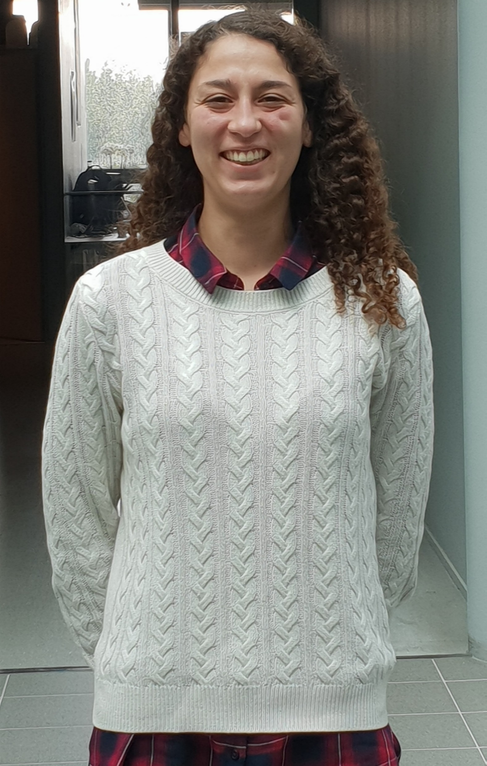
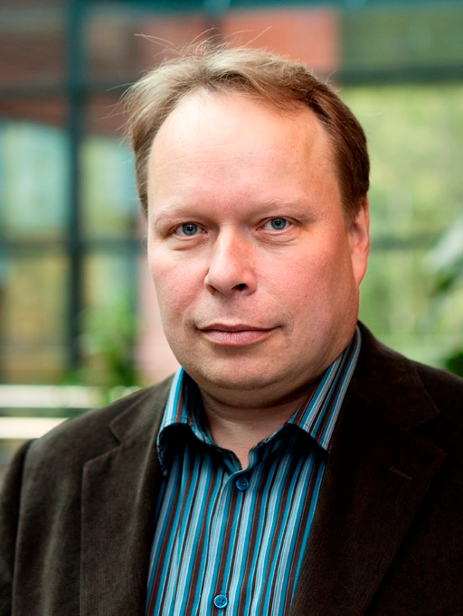
Presentation of the Teachers
Ornella Laouadi, PhD student in the group of Pr. Ilkka Tittonen; Physics of Micro and Quantum Systems in the Department of Electronics and Nanoengineering
Dr. Caterina Soldano, Assistant Professor of Organic Electronics in the Department of Electronics and Nanoengineering
.

Slide 4
Course content
Lectures
Spectroscopy and Microscopy: General Introduction
Microscopy
Raman and InfraRed Spectroscopy
UV-visible and Fluorescence Spectroscopy
Mass Spectrometry
Articles
Articles related to the topics seen during the course.

Slide 5
What you should already know
Basics knowledge on a Bachelor level in Mathematics (integral, exponential, logarithm...), Physics (photon, forces, Hamiltonian …) and in Chemistry (Ionic, covalent, hydrogen … bonds and solvents). And high school knowledge in Biology is useful (structure of the cell, DNA and chromosomes...).

Slide 6
What we expect you to learn
Knowledge
Skills
Molecular Physics
Molecular Quantum Mechanics
Physical insight into biological systems
Microscopy & Spectroscopy techniques
Presentation of a scientific article
Peer-Review
Teamwork
Writing a (scientific) essay

Slide 7
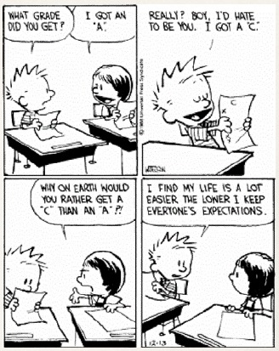
What are your expectations?
Short Introduction of yourself
Who are you?
Where do you come from?
What is your background?
What is your hobby?

Slide 8
Course schedule (tentative)
Date | Lecture topic
11th Jan | Introduction of the course
13th Jan | Spectroscopy-Microscopy: General Introduction
18th Jan | Microscopy techniques
20st Jan | Raman/Infrared Spectroscopy
25th Jan | UV-visible/Fluorescence Spectroscopy
27th Jan | Mass Spectrometry
1st – 15th Feb | Students’ presentations & review
17th Feb | Group work
THERE IS NO EXAM FOR THIS COURSE.

Slide 9
Lecture structure
Topic of the day (45-60 min)
10-15 min break
In-class activity (break-out room for about 25-30 minutes)

Slide 10
Assignment: Presentations & Peer Review
Presentation: Each student will prepare a 25-30 minutes presentation based on an article (list of the articles on MC page/Materials). Have a look on MC about available scientific papers for your individual presentation. Please express your preferences for:
  date (several dates available),
  papers (list available on MyCourses with corresponding link for download)
Please allow multiple preferences. Scheduler is available in the Materials section on MC. If you don’t express your preference, you’ll be assigned one.
Peer-Review: each student will act as reviewer for one of his/her colleagues for their individual presentation. Assignment includes critical reading of the paper, questions/comments during the presentation and a review form to be submitted in MC.

Slide 11
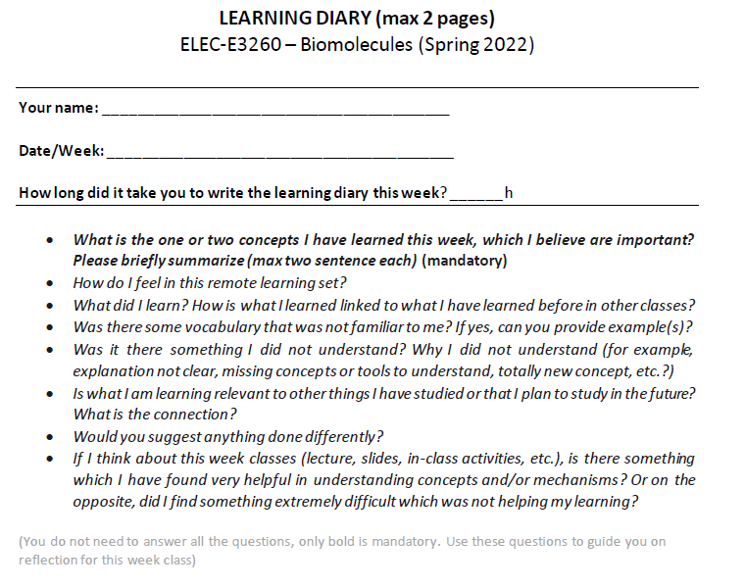
Assignment: Learning Diary
Weekly learning diary on:
lecture content
final reflection on overall course content

Slide 12
Assignment: Essay & Group Work
Group Work: students will be divided in groups (3-4) and is expected to present to the class about relevant aspects of the bio-molecule. Group and molecule assignment will be announced soon.
Each student can retrieve as many scientific publication as needed. Each group will present its work to other groups on 17.02.2022. Presentations, posters, videos are examples of acceptable workgroup output. If you have other ideas, please do not hesitate to discuss with us, especially if you require some special support. Please note that everyone is expected to be present on this day.
Maximum time available is 30 minutes (including Q&A, comments).
Essay The essay focuses on one bio-molecule (very similar way as for group work). You can choose a biomolecule (but different from the one assigned to your group). Template available on MC.

Slide 13
ELEC-E3260 Resources
Lectures will be recorded and published on MyCourses
Slides will be uploaded on MC before the class, so you can take notes during sessions). Many slides contain reference to peer-reviewed scientific papers. All materials is referenced so you can retrieve the paper if looking forward for more detailed readings.

Slide 14
Workload and grades
Assignment​ | Workload​ | Points​
Lectures | 24​ | -​
Group Work​ | 20​ | 20​
(4) Learning Diary | 8 ​ | 10
Presentation​ | 30​ | 25​
Peer-review​ | 4​ | 10
Essay​ | 40​ | 35​
Total​ | 126​ | 100​
Extra points​ | ​ | ​
Attendance​ | -​ | 0.5pts/lecture* ​ (max 5 points)​
* day of peer-review, group work and your presentation" do not count​

Slide 15
Workload and grades
Number of points | Grade
>50 | Fail
50-59 | 1
60-69 | 2
70-79 | 3
80-89 | 4
90-100 | 5

Slide 16
Deadlines
Assignment | Deadline – @6PM
Learning Diary 1 | 14th Jan
Learning Diary 2 | 21st Jan
Learning Diary 3 | 28th Jan
Group work (first draft) | 4th Feb
Essay (draft for feedback) | 11th Feb
Article presentation | Friday of the week in which you have presented
Article Peer-Review | Friday of the week in which you have reviewed
Learning Diary 4 (wk 6, final) | 18th Feb
Group work (final version) | 18th Feb
Essay (final version) | 25th Feb
ALL DEADLINES ARE AT 6PM

Slide 17
Break!

Slide 18

Communicating in Science

Slide 19
When Communicating…
engagement
Tell an interesting story
Know your topic
precision
clarity
rigorous information & sources
fact-check
objective delivery (facts, not opinions)
coherence in the topic
emotion
interaction
respect/trust
connection with society/environment/reality
Know your audience
sufficient information
accurate, specific, well-defined vocabulary
coherence in vocabulary and level

Slide 20
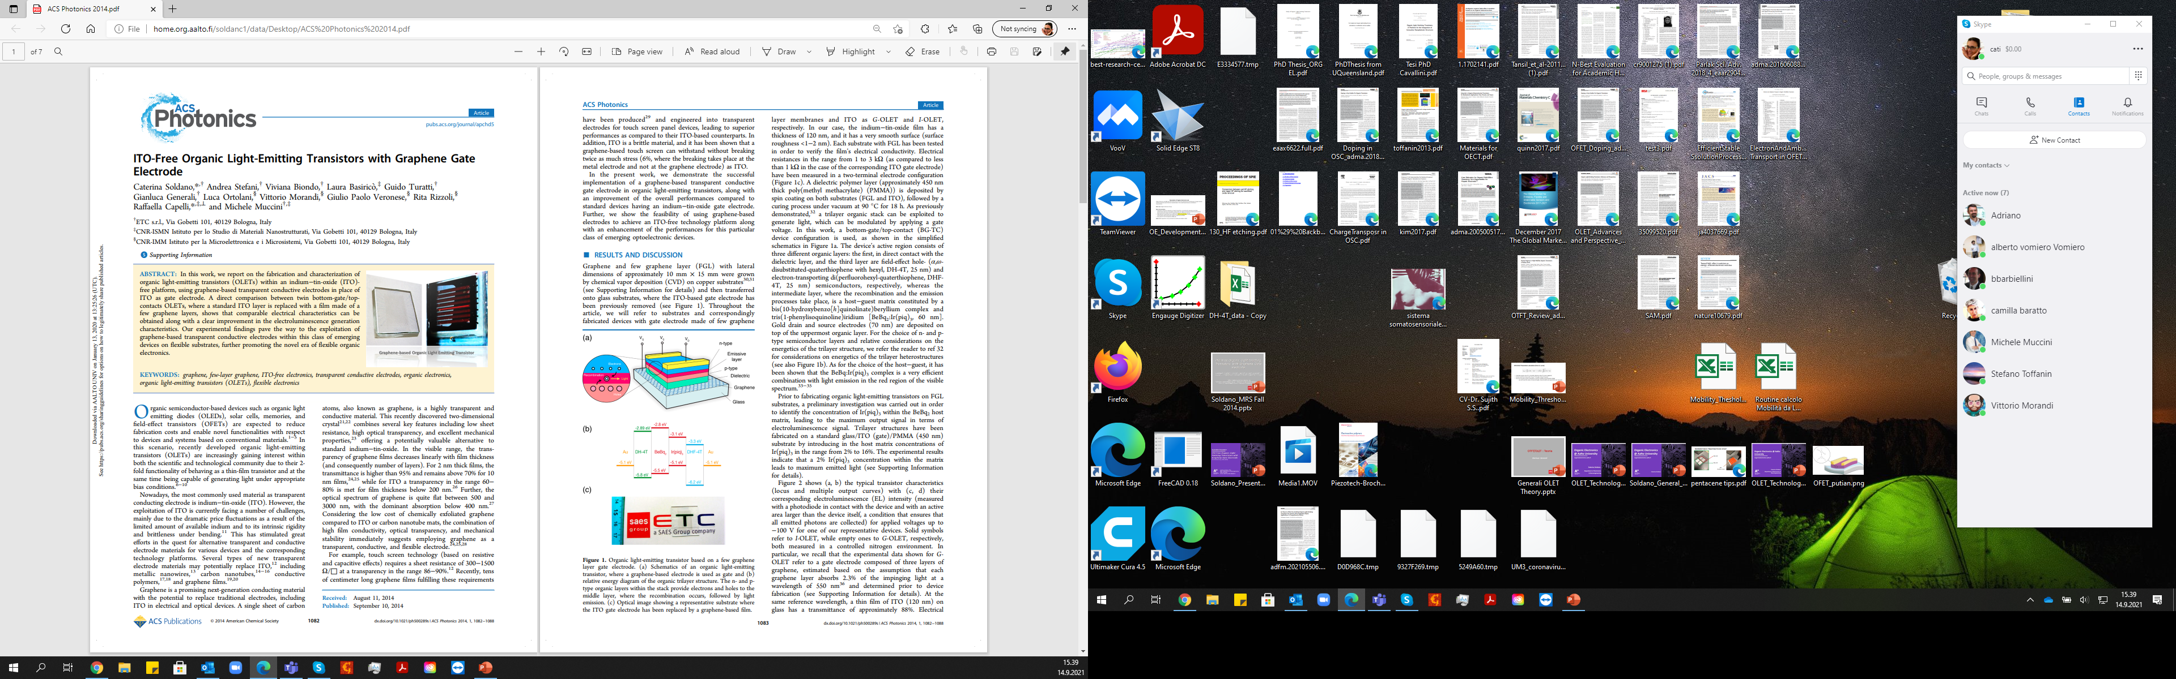
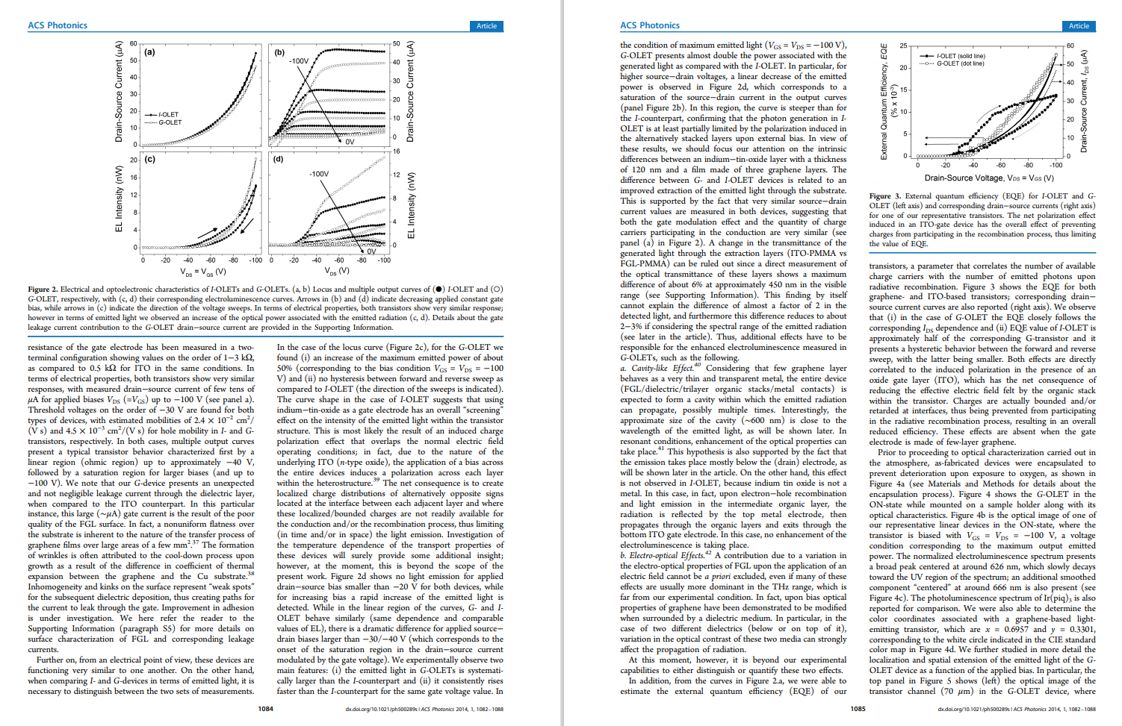
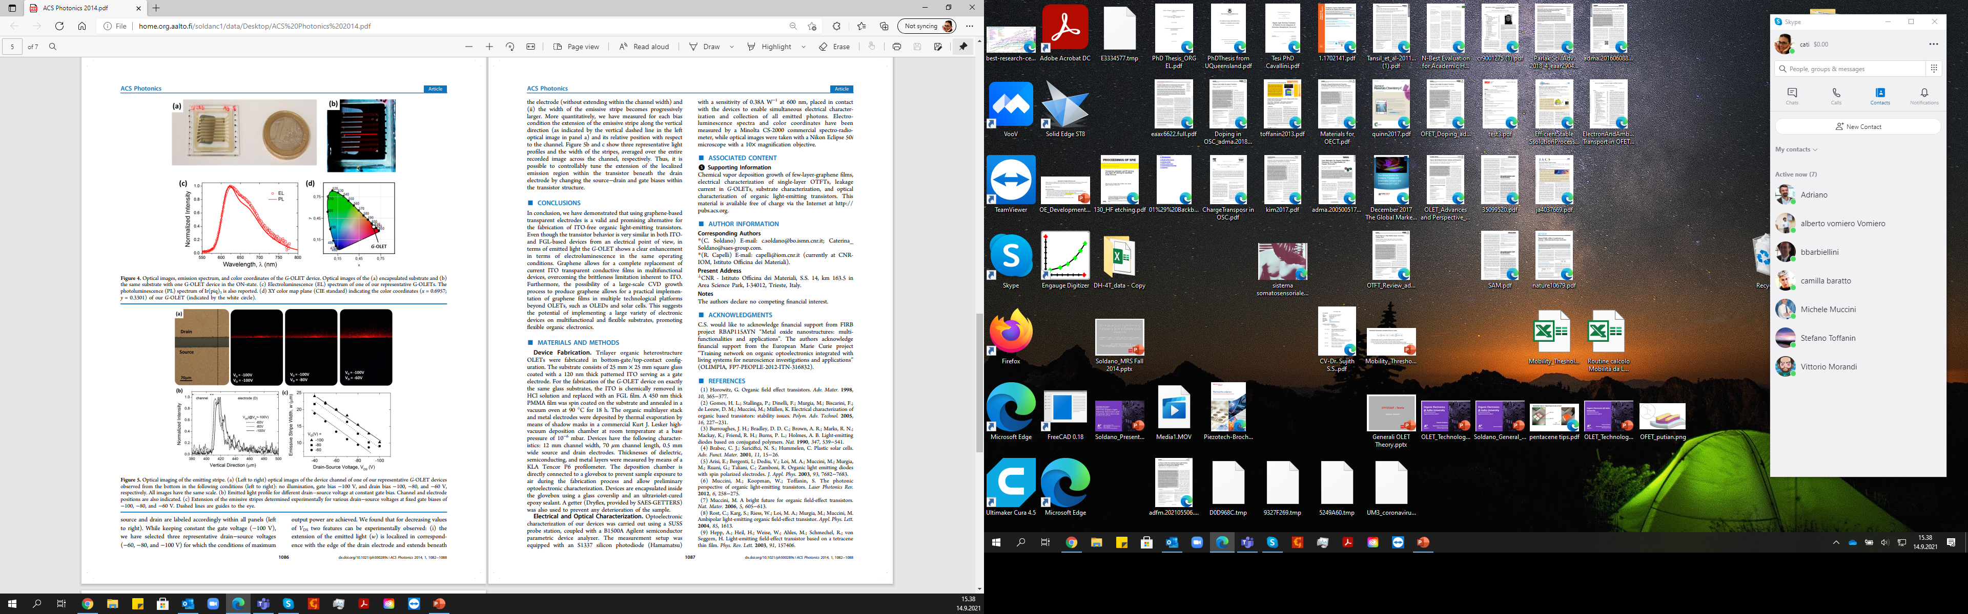
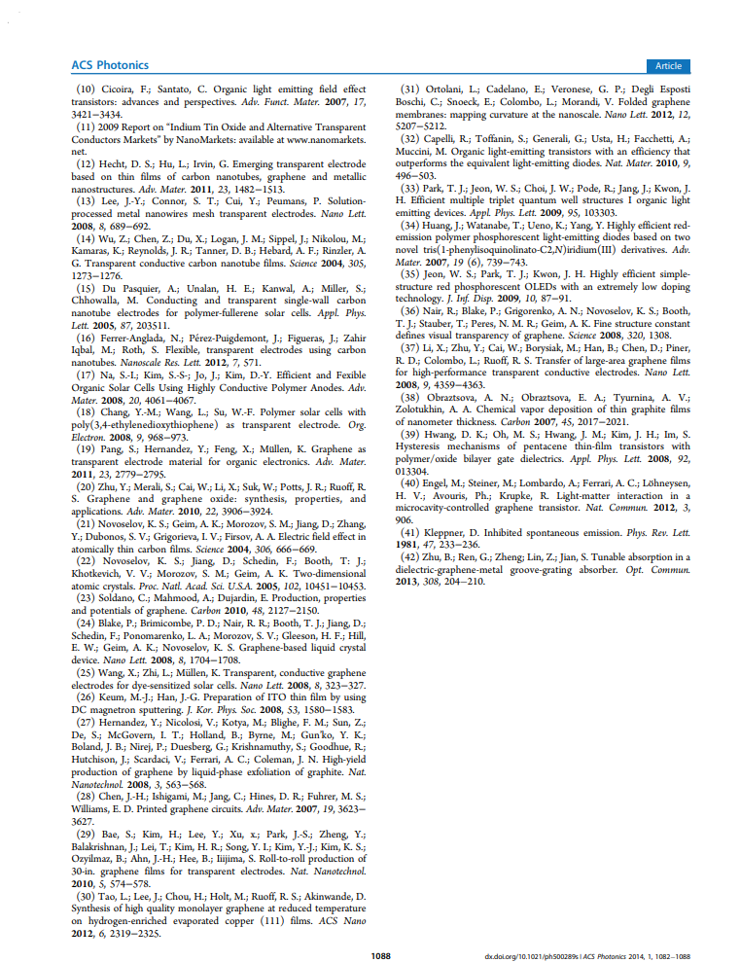
Article Structure
title, authors, paper info
title
keywords, hints on main result
abstract
introduction and
state-of-the-art
which current issue in the state-of-the-art field is the paper trying to solve?
presentation & discussion of results
“In this paper, Authors will address XXX in the following way to demonstrate YYY…”
results and findings to support Author´s claim
figure, graph, tables, schematics, reaction scheme
conclusion: Authors have successfully addressed the initial question!
conclusion/summary of results
references
other content (SI, author info, acknowledgment)
Materials & methods
example available on MC

Slide 21
Article Structure
Introduction: describes the general field and one of the open questions the paper will address (Why)
Materials & Methods: experimental/computational procedure (How)
Results & Discussion: description and explanation of results (What)
Conclusions: summary of results and initial question addressed (What & Why)
Introduction often has links to review article, which are great for the general understanding the topic
M&M have the instructions for repeating the results yourself
Check if reading the conclusions just after the intro is making sense; if it doesn't, it's not a very well-written paper

Slide 22
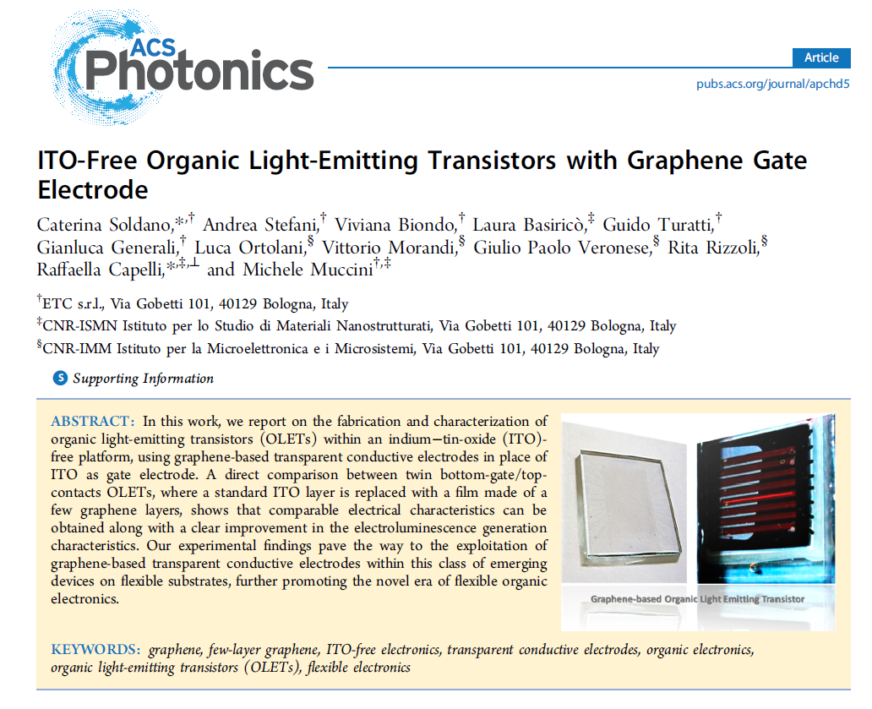
How to choose the article
ACS Photonics 1, 1082-1088 (2014)
Title contain information about the topic and/or main result(s)
What is the paper about?
What is the main results?
Why is it important?

Slide 23
Article Reading & Reviewing
(CS approach)
First reading of the paper for a general understanding
take notes, write comments and questions on the paper
read Supporting Information (even if are not peer-reviewed)
Let it sit for a couple of days
Second reading & collecting notes
easier understanding the second time
check for relevant comments
write notes and comments (main findings, results, relevance of data and their clarity)
Prepare the presentation
typically follow the structure of the paper
identify the main results (worth of showing)
for each result: main outcome and its possible explanation
write outline/intro/conclusion
Write the review file
fill it the review form (according to guidelines and notes)
commenting on my colleague presentation (content and delivery of presentation) after the presentation

Slide 24
How to give a good presentation
Content
Provide context/niche for the topic, keeping in mind that the audience is your peers
Outline helps the audience for what will be presented (and helps presenter too)
Ensure that figures can convery the message (without words).
Don't write too much text.
Write conclusions, not descriptions.
Explain everything that appears on your slides: if you will not comment on a figure, remove it.
Sources and references are mandatory.

Slide 25
How to give a good presentation
Format
Prepare clear definitions (even if only for yourself) and stick to them (e.g. pick one between "valence band" and "HOMO")
Practice your speech (so to become familiar with slides, time required, etc.)
1 slide = 1.5-2.5 minutes of presentation (depending on content and your speed)
Be flexible in your speach (e.g. alternate long and short sentences as you telling a story)
Repeat yourself if necessary
Camera on (best: stand-up and far enough from the camera that your hands are visible)

Slide 26
How to review an article
Comprehension
Summarize the topic/goal of the paper
Identify the background/research questions that the authors are addressing
Identify the main and most important results of the paper (graphical abstract), and justify them.
Does the paper present supporting information?
Critical reading
Is the article clear, well explained?
Did the authors provide enough experimental evidence?
Did the authors provide a thorough explanation of the results?
Are the references up-to-date and supportive of the topic?

Slide 27
How to review a presentation
Content
Is the structure the presentation clear and logical?
Does the presentation reflect the paper accurately?
Is it easy to follow? Is there a good balance between figures, text and dialogue?
Is the bibliography complete and appropriate?
Delivery
Is there a good contact with the audience? (questions, interaction, camera on.)
Has the presenter maintained my interest of the audience?
Is the presentation within time limits?
Is the language clear and precise?

