Slide 1
MUO-E1044 Knowledge Making in Fashion and Textiles
Other ways of knowing: Ethnography in knowledge making
Marium Durrani
07.02.2022

Slide 2
Aims
What is ethnography?
Where does it come from?
Features of ethnography
Examine relations between ethnography, fashion and design
Group discussion + task

Slide 3
What is ethnography?

Slide 4
Definition
‘Ethno’ refers to people and ‘graph’ refers to picture. Ethnography is a study of a group of people, phenomenon or culture
The research practice of writing, describing or painting a picture about particular people, practices, and/or phenomenon
(Wolcott, 1999)

Slide 5
Ethnography is…
‘…qualitative, descriptive, non-mathematical, naturalistic way to study human beings, their life and their behavior, including the way they dress in their own cultural settings’.
‘...a process, that is, the method of inquiry. It is an investigation process that social scientist, mainly qualitative sociologists and cultural anthropologists, employ in different ways to study how human beings act and why they act in the way that they do’
(Kawamura, 2020, p.45)

Slide 6
Historically
From ‘arm chair’ to field research
Developed in the 1920s in anthropology
Bronislaw Malinowski’s (1922) ground breaking study on Argonauts, Western Pacific

Slide 7
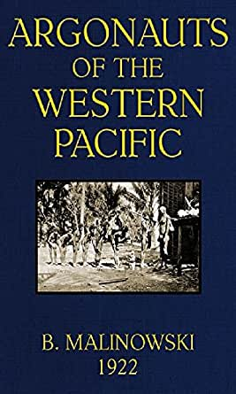
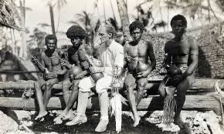

Slide 8
Historically
From ‘arm chair’ to field research
Developed in the 1920s in anthropology
Bronislaw Malinowski’s (1922) ground breaking study on Argonauts, Western Pacific
Shift from studying ‘tribal’ cultures to urban cultures between the 1920s-50s
Spread of ethnography to various disciplines e.g. design, medicine, etc.

Slide 9
Features of ethnography
Field oriented
Cultural interpretation
Size and scope of study
Ethics

Slide 10
Field research
Hallmark of anthropology: move away from labs and closed spaced
Immersion into the field
Information gathered first-hand by observation, listening and talking to participants/informants
Participation in peoples daily lives, routines, for extended period of time
Observing what happens not controlling what happens
Listening to what gets said through formal and informal conversations

Slide 11
Context is everything
Traditionally, data was collected in only natural/real-world setting
Go to the place where the people are not create artificial spaces
When in the field, researcher takes the role of an apprentice
The researcher learns the practices of those being studied
Researcher provides detailed context to the study
Nothing is studied in isolation or independent of its environment e.g. ‘you cannot simply study dress because dress is situated within a cultural context, and the two are inseperable’ (Kawamura, 2020, p.46)

Slide 12
So what is ‘culture’?
‘Culture is an abstraction, a perspective for studying human behaviour that gives attention to acquired/learned social behaviour’
(Wolcott, 1999)
It is an understanding of practice e.g. knitting cultures, repair cultures
Not always the goal but unavoidable
Ethnography helps to look for repeated patterns or divergences in behaviour
Detailed contextualization of cases
Incorporation of the given (social) meaning to a practice with the researchers’ own experiences

Slide 13
Scope
Can be from micro to macro-level
Micro-level: focus on a particular behaviour, practice, phenomenon
single-situation analysis
Macro-level: focus on portraying a cultural system
examine multiple localities and/or societies
Can move between both positions
Holistic but never complete

Slide 14
Ethics
Transparency
Anonymity
Trustworthy
Creating rapport
Sifting data

Slide 15
How is this done?
Observations: participant and non-participant
Informant interviews: structured, semi-structured and unstructured
Web research
Literature review
Artefacts

Slide 16
‘What’ of my research
I studied the practice of garment mending as a sociomaterial practice in 18 self-organized communal repair events in four cities: Helsinki (Finland), Auckland and Wellington (NZ) and Edinburgh (the U.K.)

Slide 17
My influences
Philosophically: Pragmatism (Marriage of practice with theory)
Theoretically: Practice Theories
Methodologically: Multi-sited ethnography

Slide 18
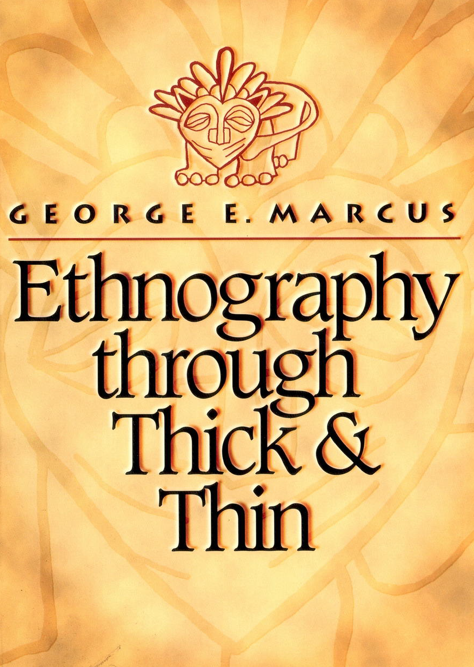
Multi-sited ethnography
Study of ‘ an emergent object’ and ‘whose contours, sites, and relationships are not known beforehand, but are themselves a contribution of making an account that has different, complexly connected real-world sites of investigation’(Marcus, 1995, p. 102).
Mixed-methods
Identify relations b/w people, objects, language/metaphors, narratives or conflicts
Connect local with global
Glocal reflexivity

Slide 19
Iterative research process
Reviewing
Identifying
Sifting
Participating: observing>talking>sensing>reflecting
Writing
(Durrani, 2019)

Slide 20
How did I collect data?
Field & voice notes
Transcriptions
Pictures
Videos
Literature reviews
Map creation

Slide 21
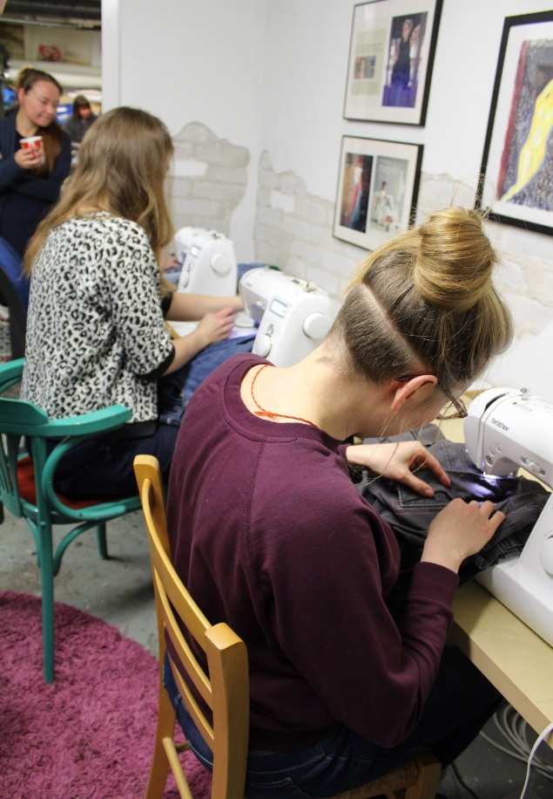
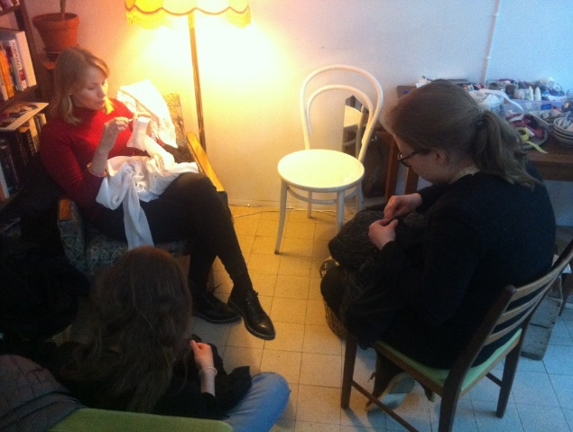
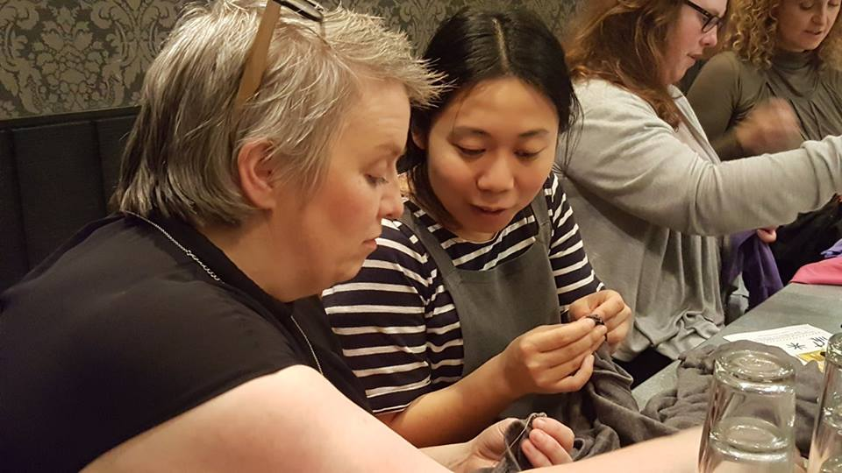

Slide 22
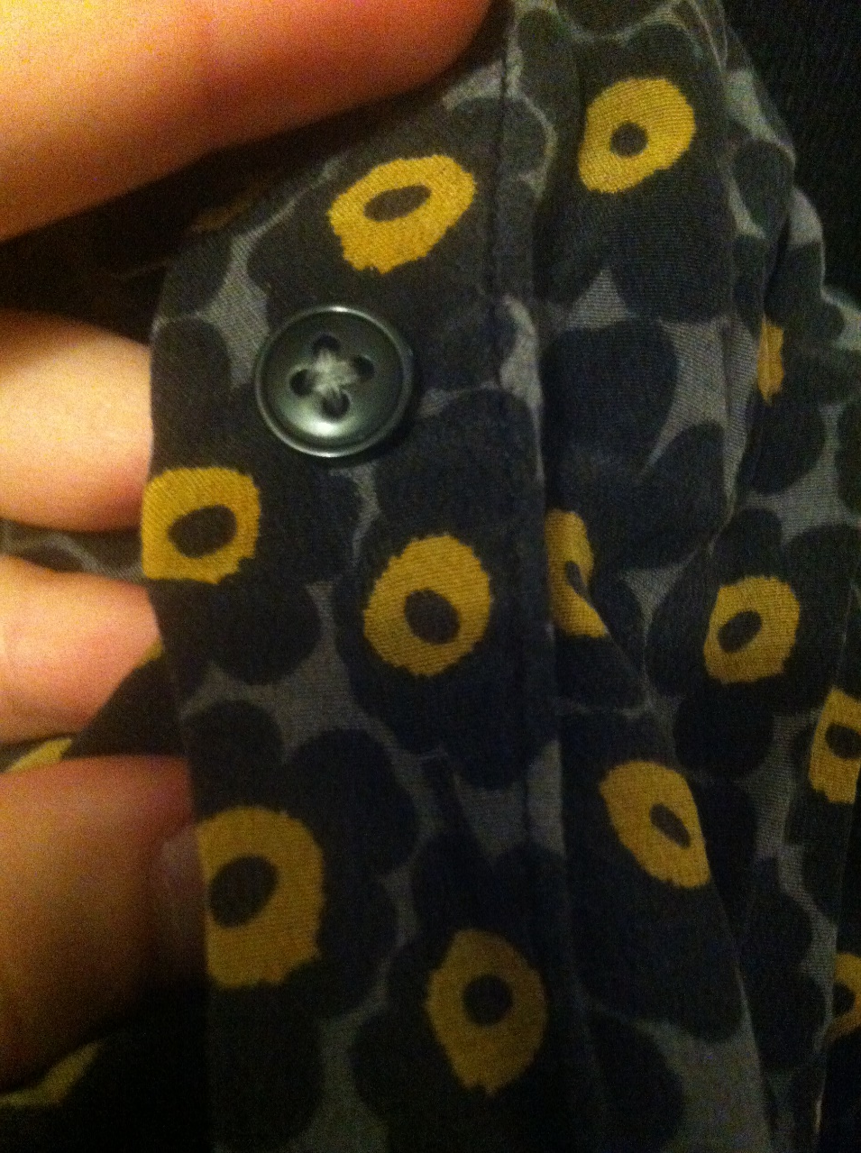
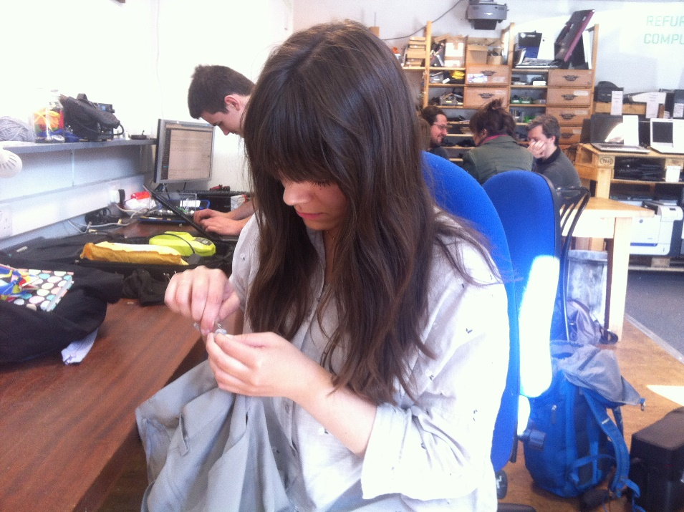
(Durrani, 2019)

Slide 23
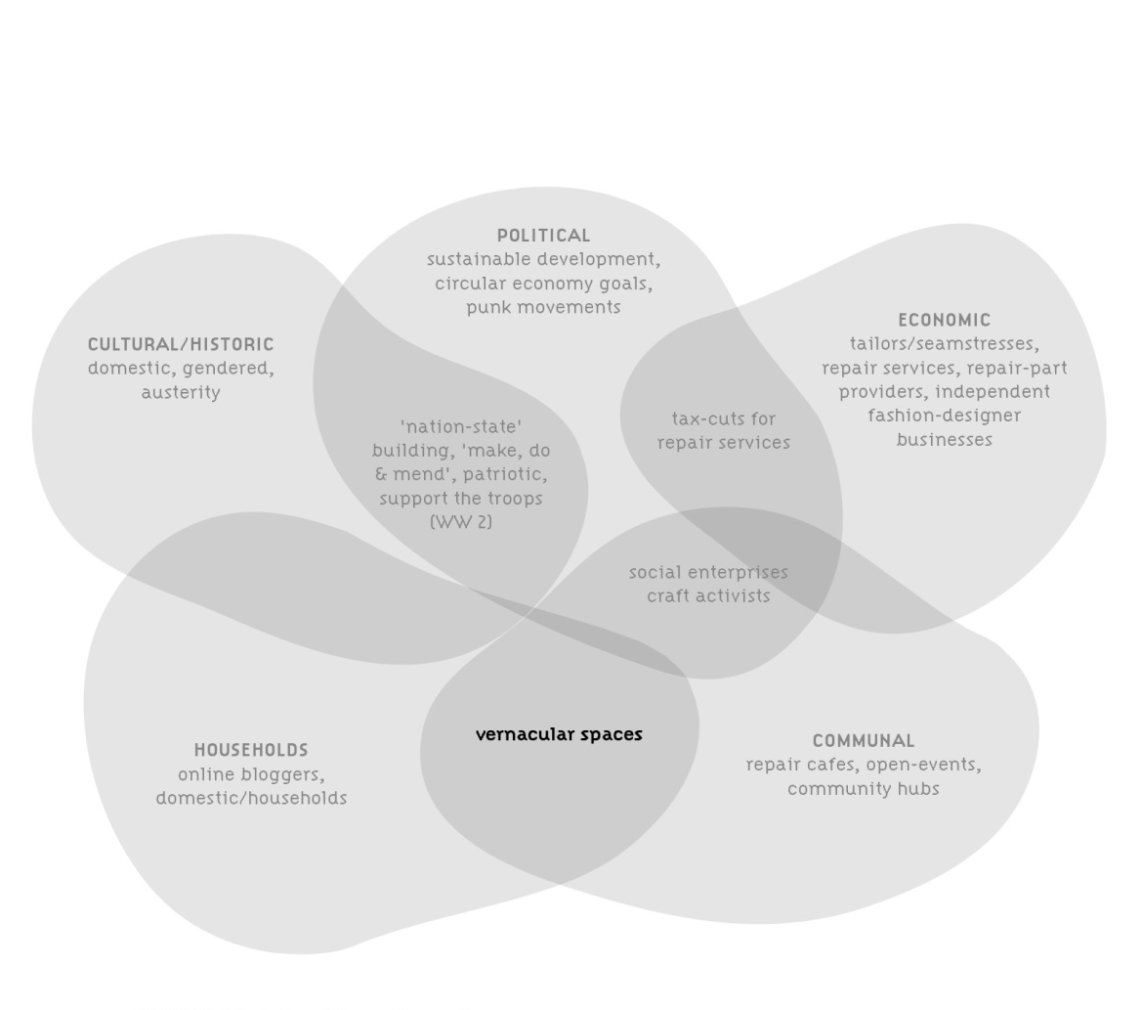
(Durrani, 2019, p.28)

Slide 24
Analysing data
‘search for regularities, that is, things that happen frequently with groups of people. Patterns and regularities are transformed into categories into which subsequent items are sorted. These categories or patterns are discovered from the data. They emerge in a rather systematic, if not totally conscious, application of the processes, and this could potentially lead to building a new theory’ (Kawamura, 2020, p.56)
Combining different perspectives
Depth over breadth
Triangulation

Slide 25
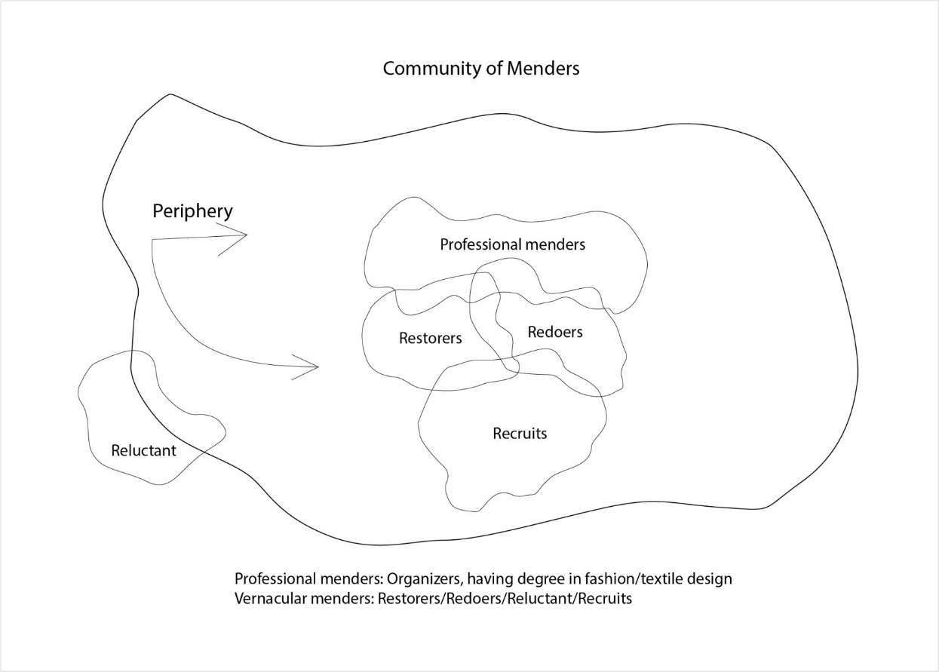
Community of menders: Professional and Vernacular menders’ positions in participation. Source: Durrani (2018 )

Slide 26
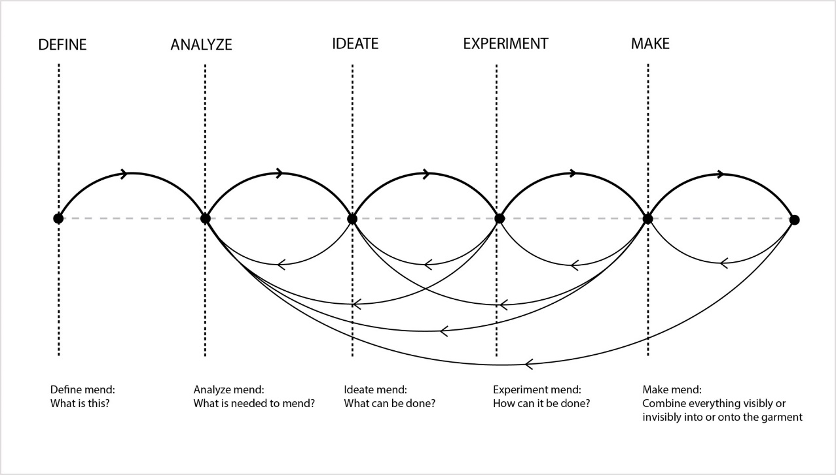
Process of mending: Informal design
(Durrani, 2018)

Slide 27
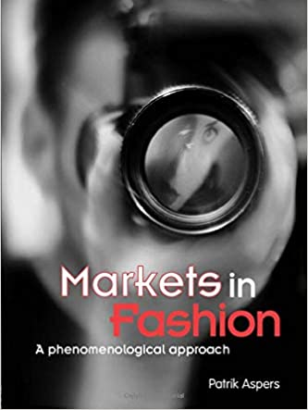
Messy-ness of ethnography
‘As I began the project I knew relatively little about the market for fashion photography, my research agenda was diffuse and the study did not have a clear focus. At this stage informants proved to be especially important. They gave me information I might not have asked for otherwise, and ideas on what to study and how to do so. Simply by talking to them I got a lot of ideas, and further questions arose’ (Aspers, 2001, p.39).

Slide 28
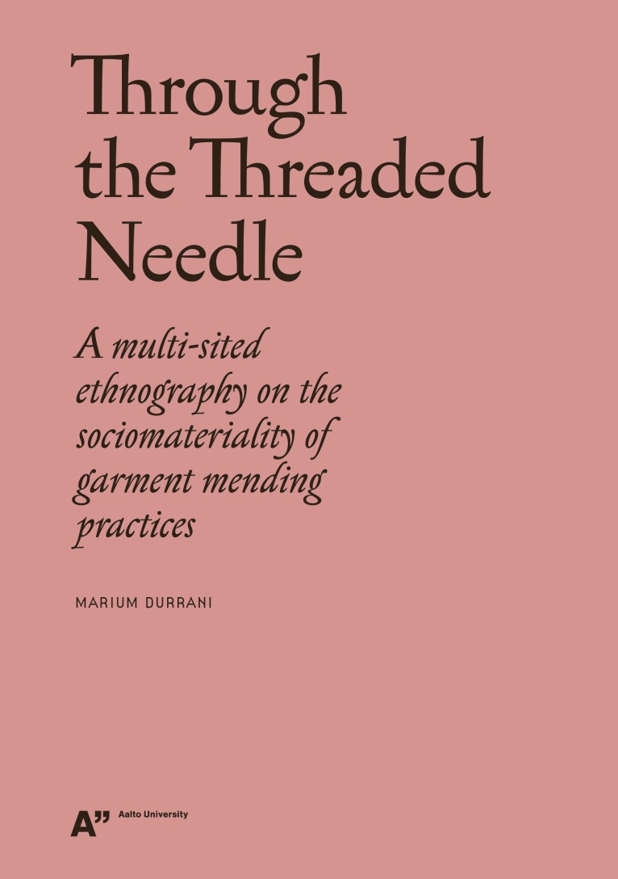
Feeling like an outsider
‘I began to realize that excessive note-taking was not only distracting for the participants but it prevented me from reaching the core of the practice I was conceptualizing, ‘practice’ being the operative word. How could I study a practice that I was not fully engaging in myself ? Therefore, after the first month of my fieldwork I decided to take my own garments with me to the mending events. As I mended together with other menders, both my individual and collective experience was shaped, and further informed my research’(Durrani, 2009, p.89).

Slide 29
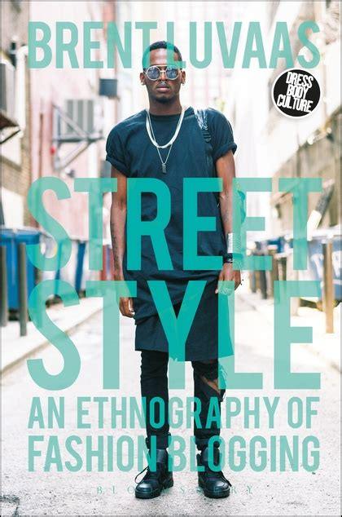
(auto-)Ethnography and self-reflexivity
‘self-reflexivity is a mechanism for creating a more honest, situated, and grounded form of social scientific research. Indeed, after the postmodern critique it became a commonplace of ethnographic work to acknowledge how one’s own background and experience have shaped the account produced. It can be argued that at least since the late 1980s nearly all ethnography has been auto-ethnographic, as it employs the ‘self’ as the vehicle of research’ (Luvaas, 2018)

Slide 30
Link between knowledge and research
How we understand knowledge impacts how we do research
‘Human action is not separate from knowledge’ (Durrani, 2019, p.66)
‘Knowledge is not the end goal; it is an on-going emergent process that is not separate from the researchers’ prior experiences’ (Durrani, 2019, p.8)
Knowledge is created in conjunction with our individual, social and material surroundings

Slide 31
Design and ethnography
Both are a process and deliver a product
Both are focused on research
Both are people-centered
Both incorporate reflexivity

Slide 32
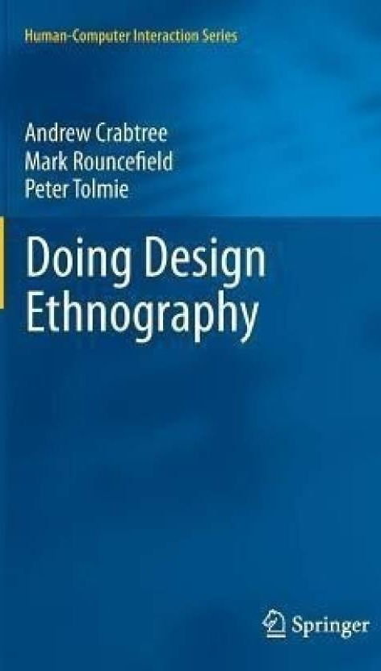
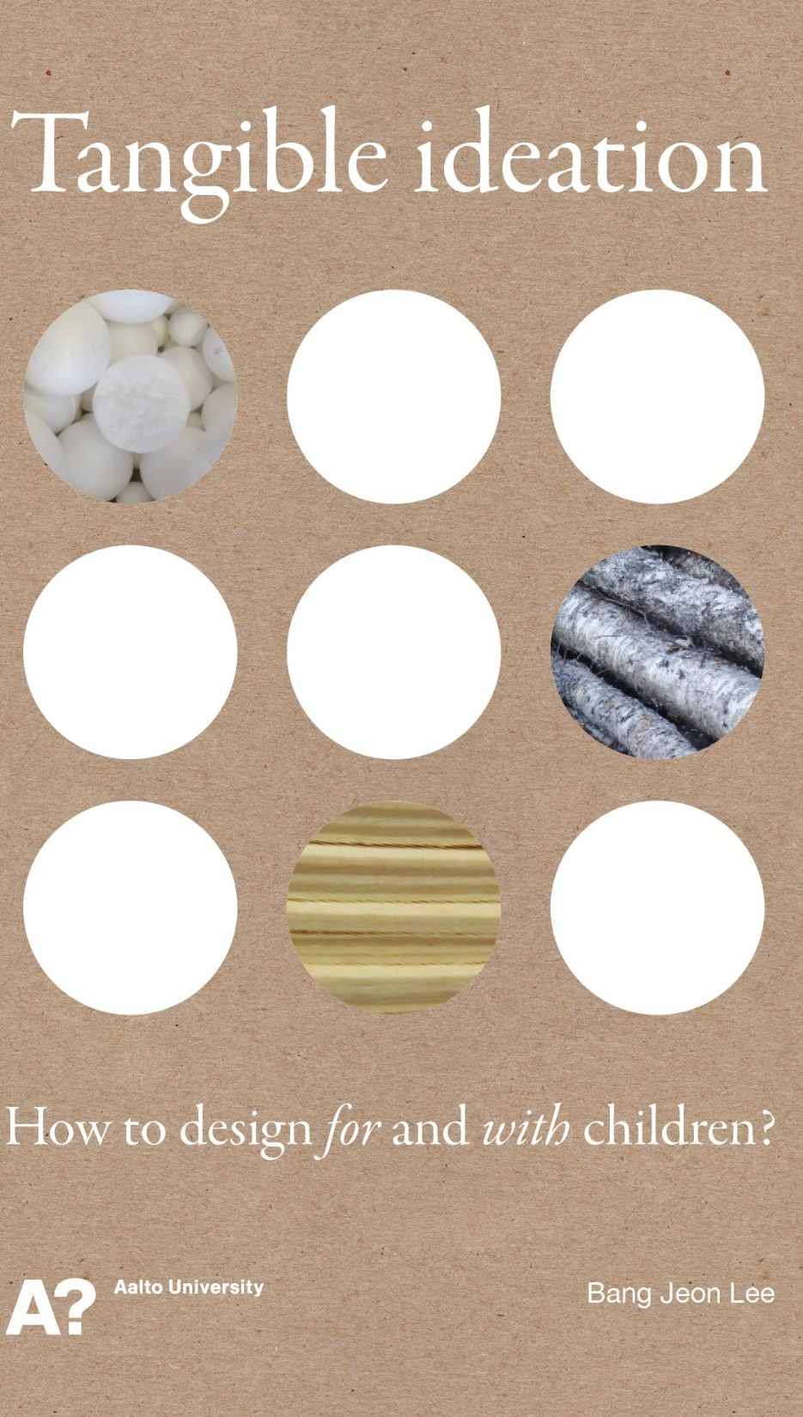
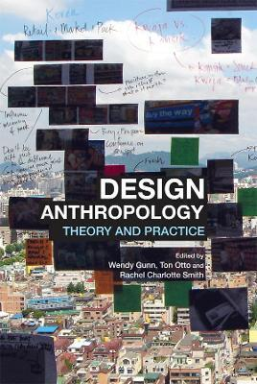

Slide 33
Task (30 minutes)
Select one fashion blogger on any social media platform and:
Make observations of their page, their style, their followers.
What conclusions can be drawn about fashion, culture and society through your quick observations
You can write, sketch, or even create graphs to capture your reflections and observations.

Slide 34
Discussion (30 minutes)
What elements of Luvaa’s (2018) text were most informative?
What did you learn about doing and writing ethnographic accounts that you were not aware of before?

Slide 35
References
Durrani, M. (2018). “People gather for stranger things, so why not this?” Learning sustainable sensibilities through communal garment-mending practices. Sustainability, 10(7), 2218.
Durrani, M. (2019). Through the threaded needle: A multi-sited ethnography on the sociomateriality of garment mending practices. Aalto University.
Kawamura, Y. (2020). Doing research in fashion and dress: An introduction to qualitative methods. Bloomsbury Publishing.
Wolcott. H.F.(1990). Making a study “more ethnographic”. Journal of Contemporary Ethnography. 19,1,pp.44-72.

Slide 36
Thank you! mariumdurrani@gmail.com

