Slide 1
HSK 3-4 Grammar common mistakes
Cheng Jinhua
2022

Slide 2
HSK 3 语法

Slide 3
HSK 3 语法

Slide 4
HSK 3 语法

Slide 5
HSK 3 语法

Slide 6
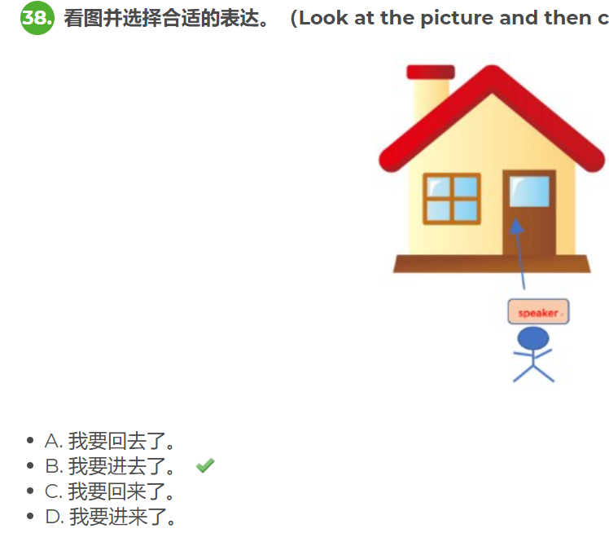
HSK 3 语法

Slide 7
HSK 3 语法

Slide 8
HSK４语法 通过(tōng guò) emphasizes the method or means (of achieving something), while 经过(jīng guò) emphasizes the process.

Slide 9
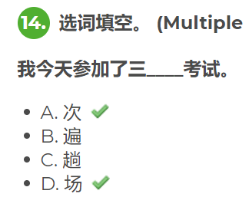
HSK４语法 因为⋯⋯，而⋯⋯ (yīnwèi... ér...) is another structure that can express cause and effect.

Slide 10
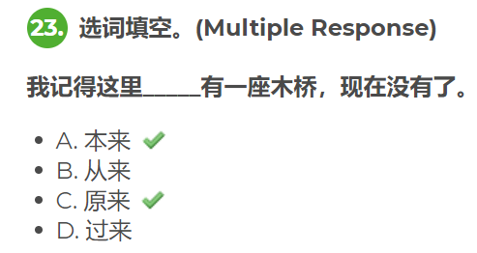
HSK４语法

Slide 11
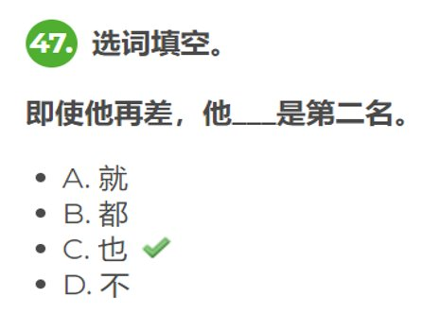
HSK４语法

