Slide 1
Thermodynamics
An Engineering Approach
Lecture 1: Introduction and Basic Concepts
Qiang Cheng (Jonny)

Slide 2
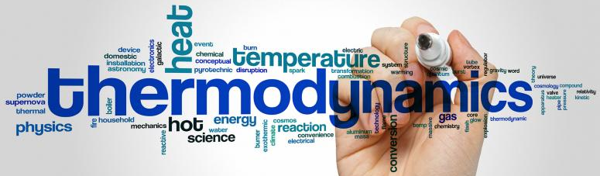
Background
Thermodynamics is a branch of physics that deals with heat, work, and temperature, and their relation to energy, radiation, and physical properties of matter.
The behavior of these quantities is governed by the four laws of thermodynamics which convey a quantitative description using measurable macroscopic physical quantities but may be explained in terms of microscopic constituents by statistical mechanics.
Thermodynamics applies to a wide variety of topics in science and engineering, especially physical chemistry, chemical engineering and mechanical engineering, but also in other complex fields such as meteorology, biology and phylosophy.
https://online.stanford.edu/courses/matsci204-thermodynamics-and-phase-equilibria
Notes:
Heat is energy can be converted from one form to another, or transferred from one object to another. For example, a stove burner converts electrical energy to heat and conducts that energy through the pot to the water. This increases the kinetic energy of the water molecules, causing them to move faster and faster. At a certain temperature (the boiling point), the atoms have gained enough energy to break free of the molecular bonds of the liquid and escape as vapor.

Slide 3
Objective
To cover the basic principles of thermodynamics.
To present a wealth of real-world engineering examples to give students a feel for how thermodynamics is applied in engineering practice.
To develop an intuitive understanding of thermodynamics by emphasizing the physics and physical arguments that underpin the theory.
To present a comprehensive and rigorous treatment of classical thermodynamics while retaining an engineering perspective.
To lay the groundwork for subsequent studies in such fields as fluid mechanics, heat transfer and to prepare the students to effectively use thermodynamics in the practice of engineering.
To gain a better understanding of our life and achieve a higher quality of lift!!!

Slide 4
Philosophy and Goals
In this course you will be introduced to properties of matter (Temperature, Pressure, Enthalpy, Specific Volume, Entropy, etc.) and governing laws which can be used to describe the behavior of matter and its interaction with the surrounding environment.
You will learn how to identify systems and to use thermodynamic analysis to describe the behavior of the system in terms of properties and processes.
Understanding how to apply these concepts is a powerful tool for the engineer, enabling the evaluation of material states (phases) under different conditions and the maximum efficiency achievable with various power cycles.
After completing this course, you should be able to define and describe properties and processes used in thermodynamic analysis and the governing laws.
In addition, you should be able to apply control volume analysis and thermodynamic principles to solve problems involving power and refrigeration cycles.
Communicates directly to the minds of tomorrow’s engineers in a simple yet precise manner.
Leads students toward a clear understanding and firm grasp of the basic principles of thermodynamics.
Encourages creative thinking and development of a deeper understanding and intuitive feel for thermodynamics.

Slide 5
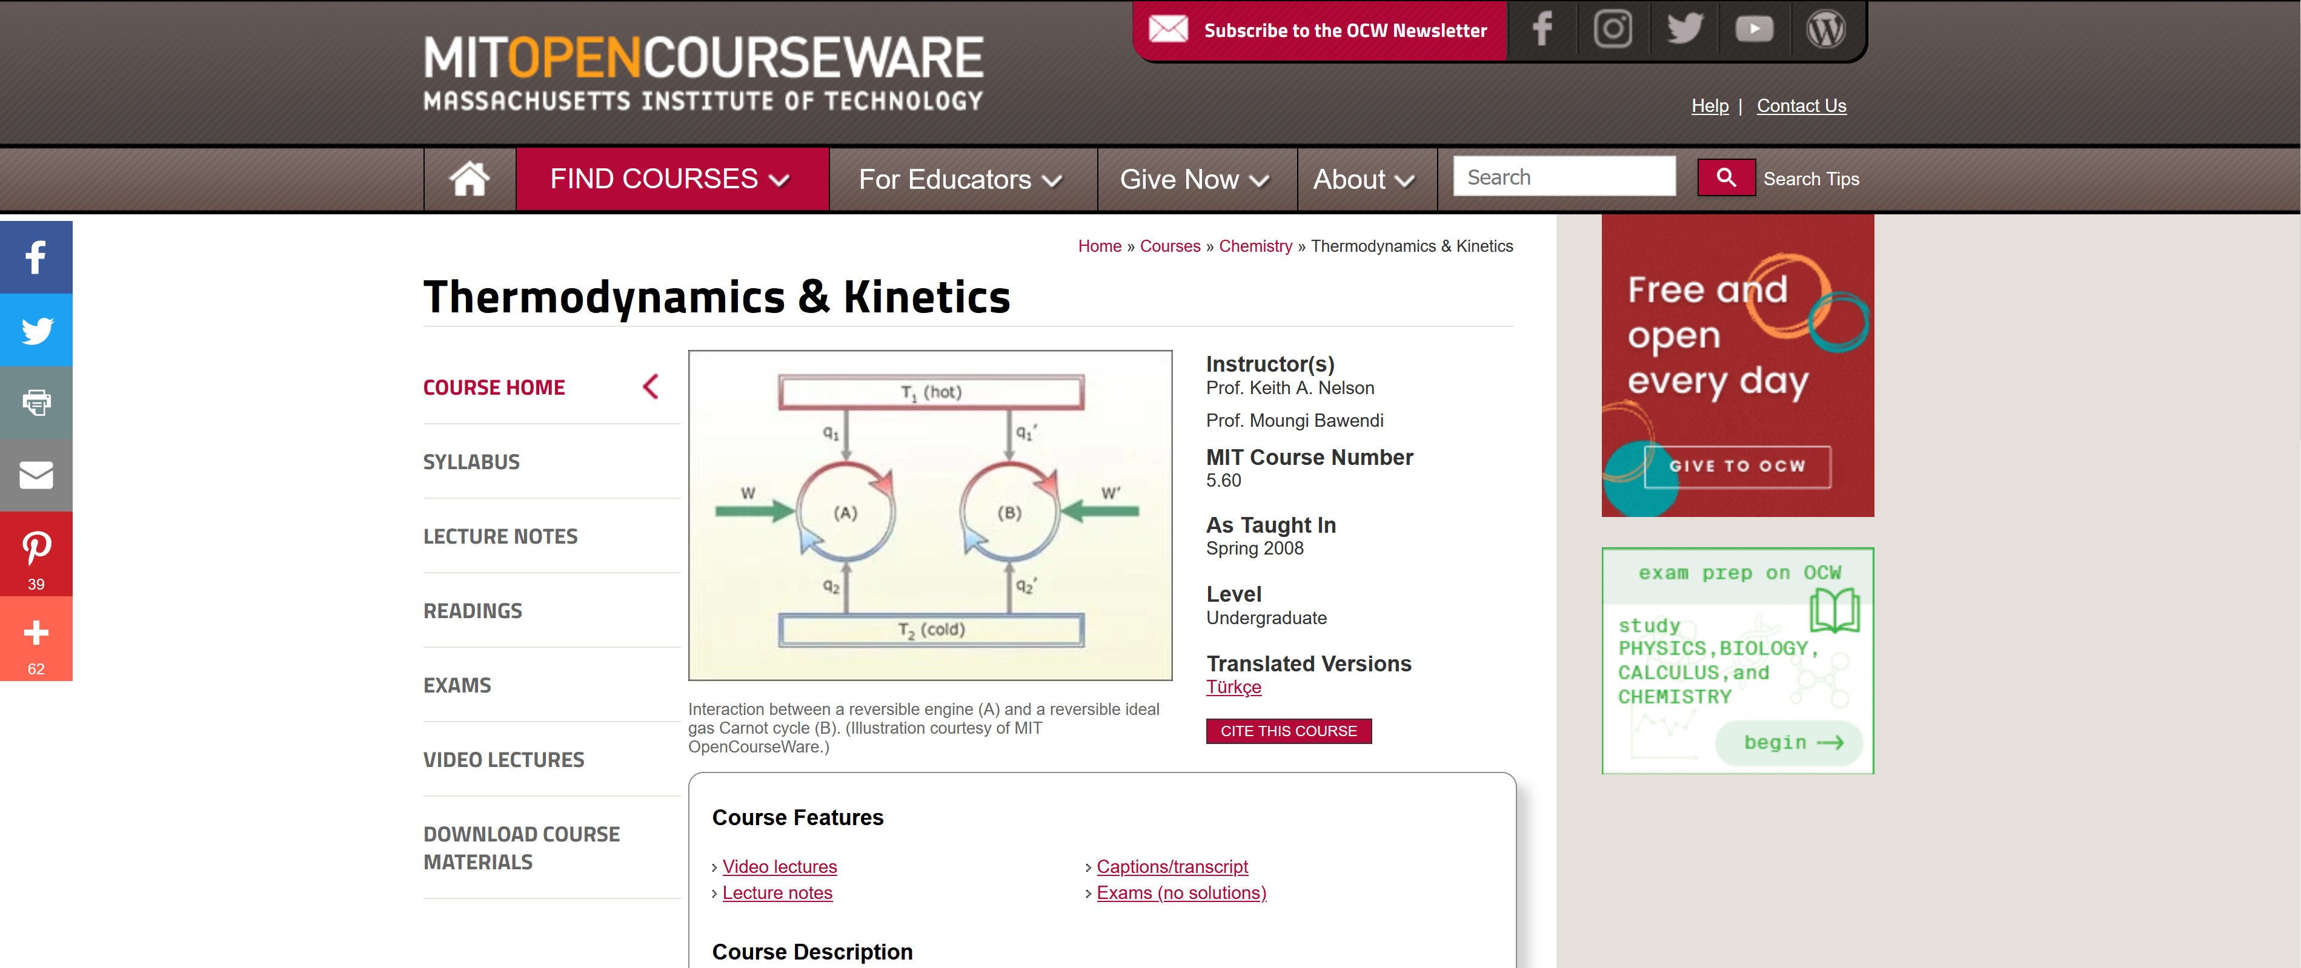
Other Materials and Sources
MITOPENCOURSEWARE:
https://ocw.mit.edu/courses/chemistry/5-60-thermodynamics-kinetics-spring-2008/video-lectures/
NASA
https://www.grc.nasa.gov/www/k-12/airplane/thermo.html
University of Michigan
https://www.coursera.org/learn/thermodynamics-intro

Slide 6
Problem-solving technique
Engineering Software Packages
Step 1: Problem Statement
Step 2: Schematic
Step 3: Assumptions and Approximations
Step 4: Physical Laws
Step 5: Properties
Step 6: Calculations
Step 7: Reasoning, Verification, Conclusion and Discussion

Slide 7
Lecture 1: Introduction and Basic Concepts

Slide 8
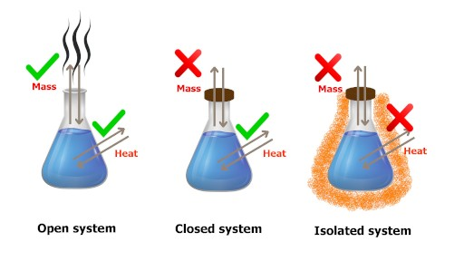
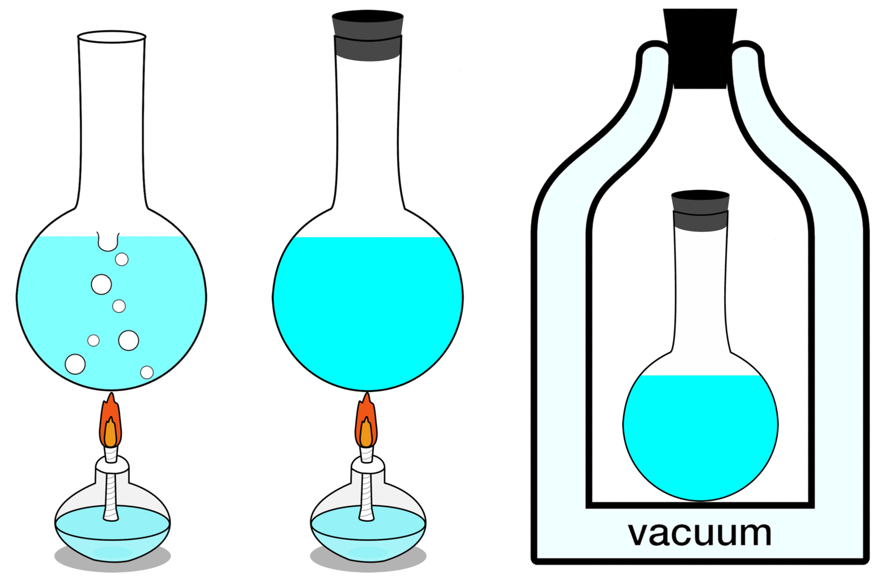
Learning Outcomes
Identify the unique vocabulary associated with thermodynamics through the precise definition of basic concepts to form a sound foundation for the development of the principles of thermodynamics.
Identify SI and English Engineering units, including units for specific volume, pressure, and temperature. Describe the relationship among the Kelvin, Rankine, Celsius, and Fahrenheit temperature scales. Apply appropriate unit conversion factors during calculations.
Discuss properties of a system and define density, specific gravity, and specific weight.
Explain several fundamental concepts used throughout the book, including closed system, control volume, boundary and surroundings, property, state, process, the distinction between extensive and intensive properties, and equilibrium.
Introduce an intuitive systematic problem-solving technique.
Review concepts of temperature, temperature scales, pressure, and absolute and gage pressure.

Slide 9
Using Thermodynamics

Slide 10
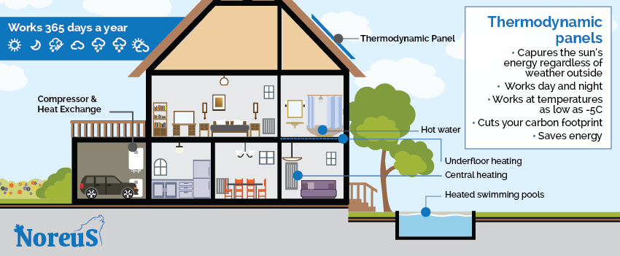
Using Thermodynamics
Predictions of Life in 2050
At home
Homes are constructed better to reduce heating and cooling needs.
Homes have systems for electronically monitoring and regulating energy use.
Appliances and heating and air-conditioning systems are more energy-efficient.
Use of solar energy for space and water heating is common.
More food is produced locally.
Lifestyle
Efficient energy-use practices are utilized throughout society.
Recycling is widely practiced, including recycling of water.
Distance learning is common at most educational levels.
Telecommuting and teleconferencing are the norm.
The Internet is predominately used for consumer and business commerce.
Transportation
Plug-in hybrid vehicles and all-electric vehicles dominate.
Hybrid vehicles mainly use biofuels.
Use of public transportation within and between cities is common.
An expanded passenger railway system is widely used.
Power generation
Electricity plays a greater role throughout society.
Wind, solar, and other renewable technologies contribute significant share of the nation's electricity needs.
A mix of conventional fossil-fueled and nuclear power plants provides a smaller, but still significant, share of the nation's electricity needs.
A smart and secure national power transmission grid is in place.

Slide 11
Defining Systems
In thermodynamics the term system is used to identify the subject of the analysis. Once the system is defined and the relevant interactions with other systems are identified, one or more physical laws or relations are applied.
System
surroundings
boundary
Everything external to the system is considered to be part of the system’s surroundings. The system is distinguished from its surroundings by a specified boundary, which may be at rest or in motion.

Slide 12
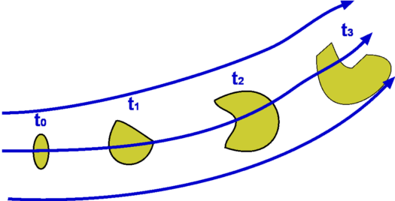
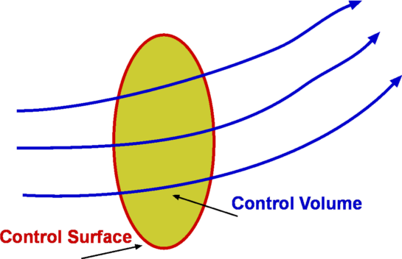
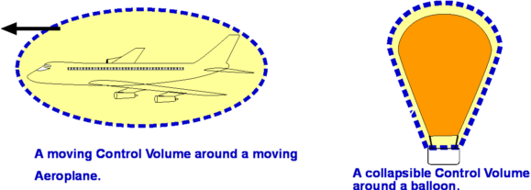
System and Control Volumes
A system is defined as a quantity of matter or a region in space chosen for study.
The mass or region outside the system is called the surroundings.
The real or imaginary surface that separates the system from its surroundings is called the boundary. The boundary of a system can be fixed or movable.
Note that the boundary is the contact surface shared by both the system and the surroundings. Mathematically speaking, the boundary has zero thickness, and thus it can neither contain any mass nor occupy any volume in space.

Slide 13
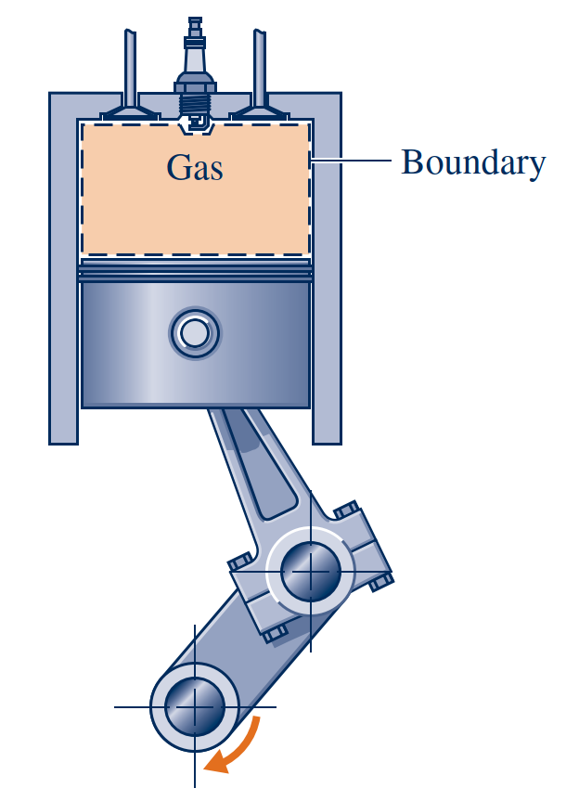
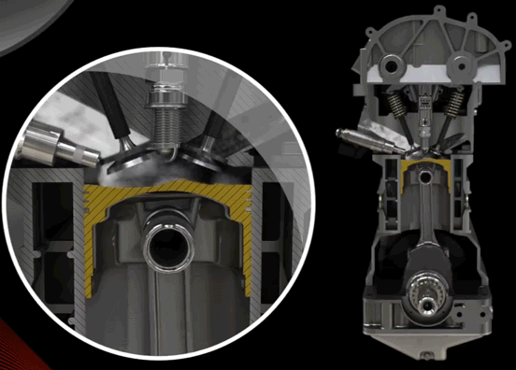
Closed System
Closed Systems
A closed system is defined when a particular quantity of matter is under study. There can be no transfer of mass across its boundary.
Isolated Systems
A special type of closed system that does not interact in any way with its surroundings is called an isolated system.

Slide 14
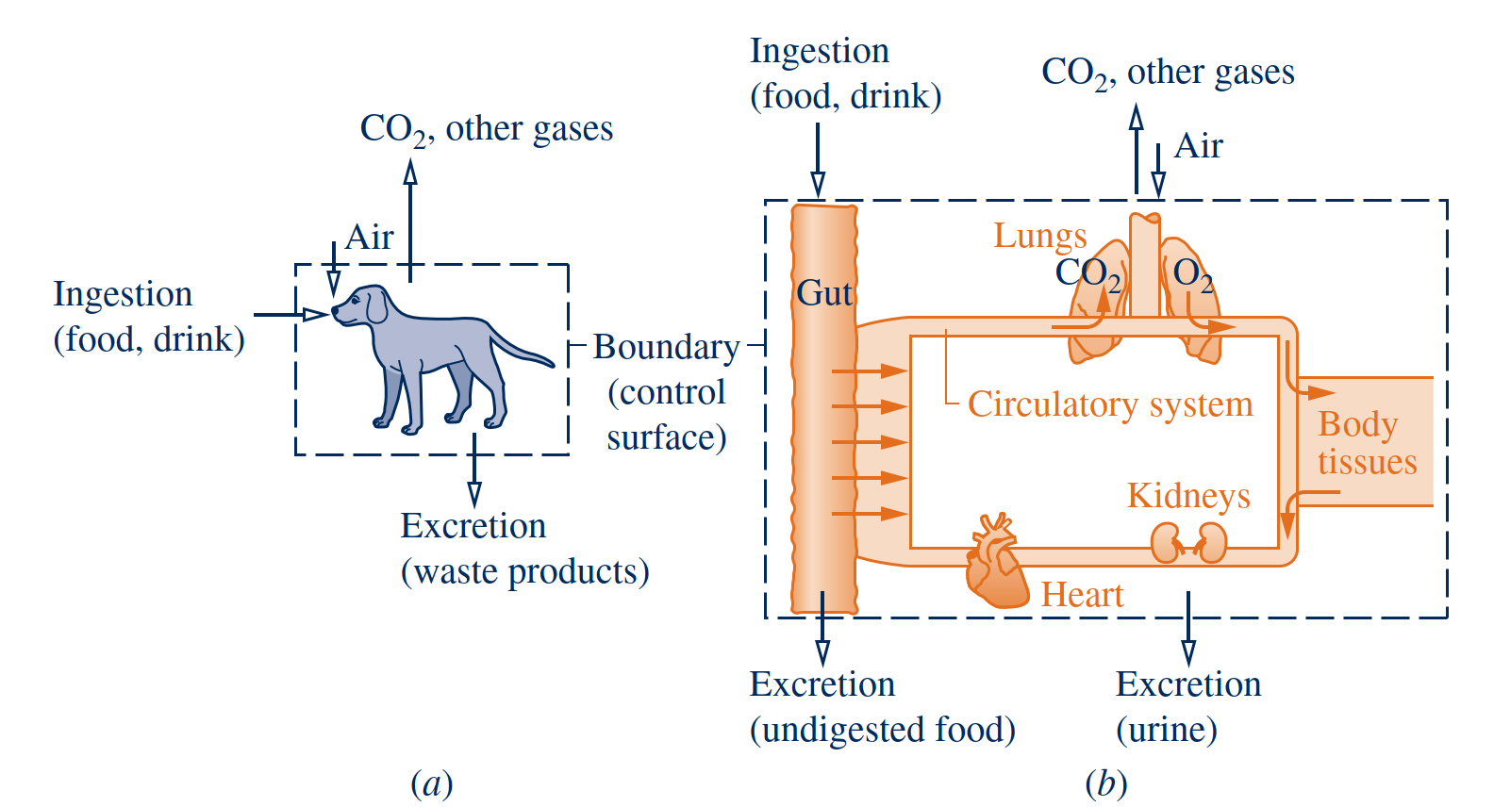
Control Volume Systems
Control Volumes
Mass and heat both cross the boundary of a system
The system boundary should be delineated carefully before proceeding with any thermodynamic analysis. However, the same physical phenomena often can be analyzed in terms of alternative choices of the system, boundary, and surroundings. The choice of a particular boundary defining a particular system depends heavily on the convenience it allows in the subsequent analysis.

Slide 15
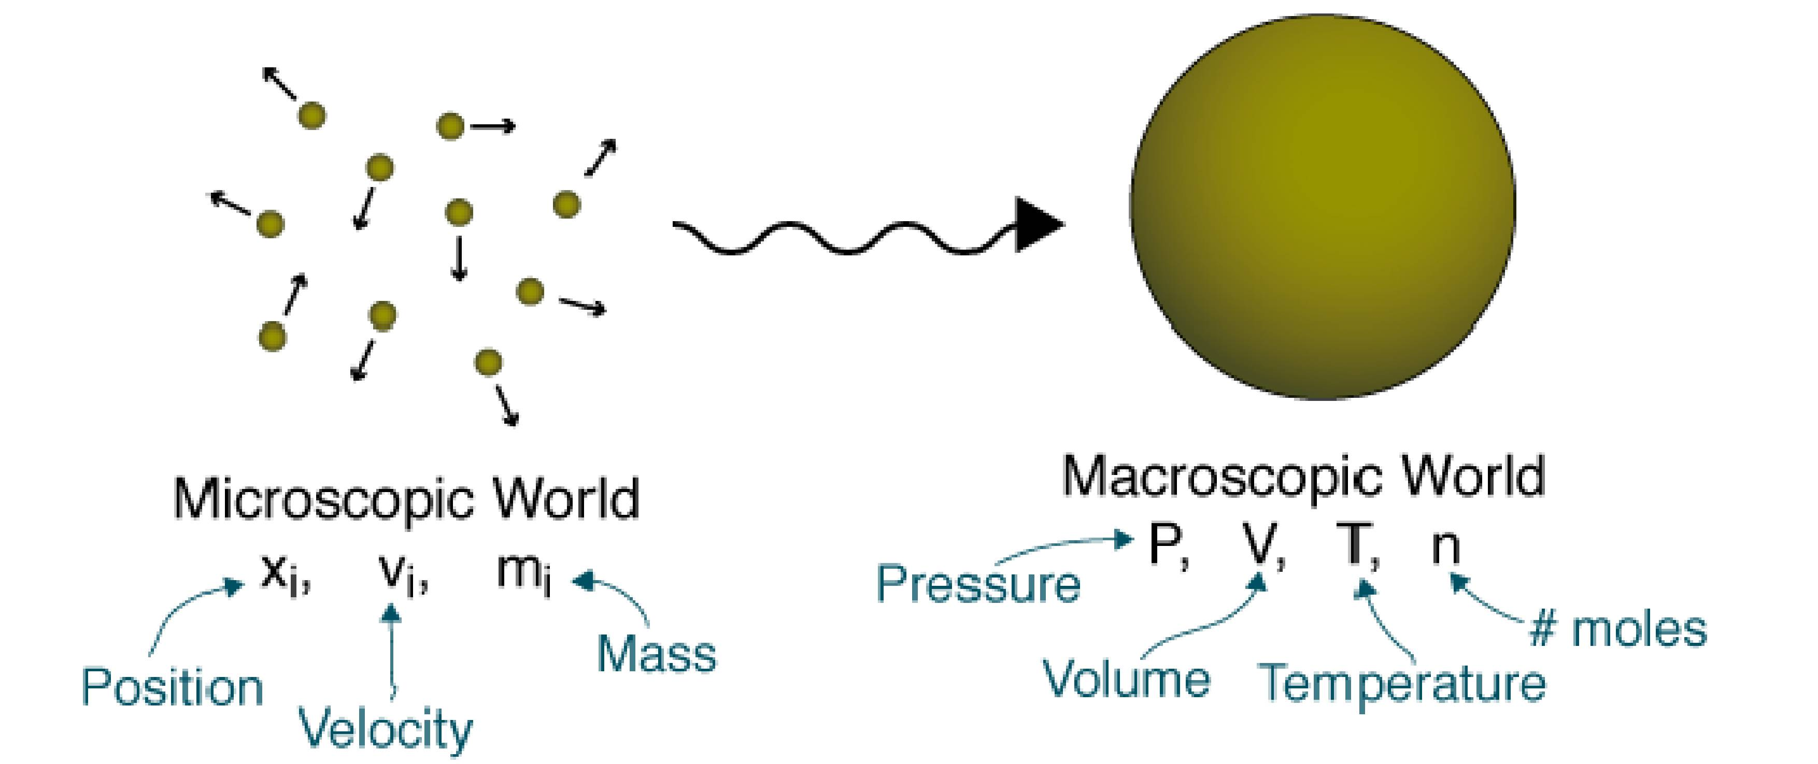
Describing Systems and Their Behavior
Engineers are interested in studying systems and how they interact with their surroundings.
Systems can be studied from a macroscopic or a microscopic point of view.
Macroscopic and Microscopic Views of Thermodynamics
Macroscopic Views
The macroscopic approach to thermodynamics is concerned with the gross or overall behavior. This is sometimes called classical thermodynamics.
The microscopic approach to thermodynamics, known as statistical thermodynamics, is concerned directly with the structure of matter. The objective of statistical thermodynamics is to characterize by statistical means the average behavior of the particles making up a system of interest and relate this information to the observed macroscopic behavior of the system.
Microscopic Views

Slide 16
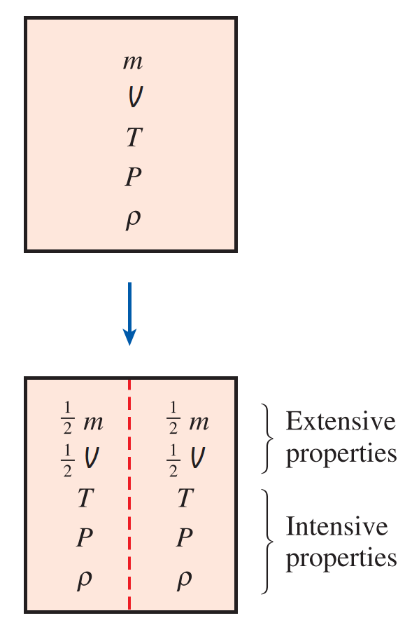
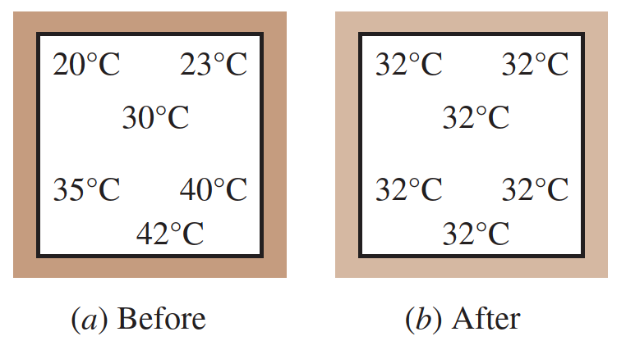
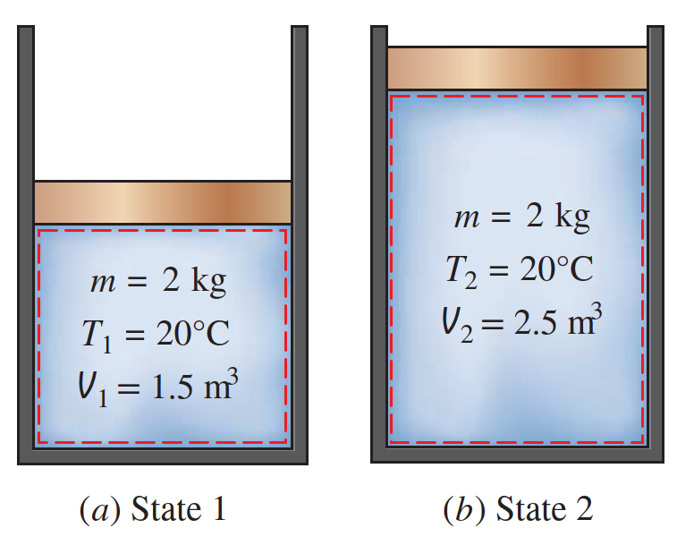
Property, State, and Process
A property is a macroscopic characteristic of a system such as mass, volume, energy, pressure, and temperature to which a numerical value can be assigned at a given time without knowledge of the previous behavior (history) of the system.
property
state
The word state refers to the condition of a system as described by its properties.
When any of the properties of a system changes, the state changes and the system
is said to undergo a process. A system is said to be at steady state if none of its
properties changes with time.
process
extensive properties
A property is called extensive if its value for an overall system is the sum of its values for the parts into which the system is divided. Mass, volume, energy, and several other properties introduced later are extensive.
intensive properties
Intensive properties are not additive in the sense previously considered. Their values are independent of the size or extent of a system and may vary from place to place within the system at any moment.
equilibrium
Classical thermodynamics places primary emphasis on equilibrium states and changes from one equilibrium state to another.
Accordingly, several types of equilibrium must exist individually to fulfill the condition of complete equilibrium; among these are mechanical, thermal, phase, and chemical equilibrium.

Slide 17
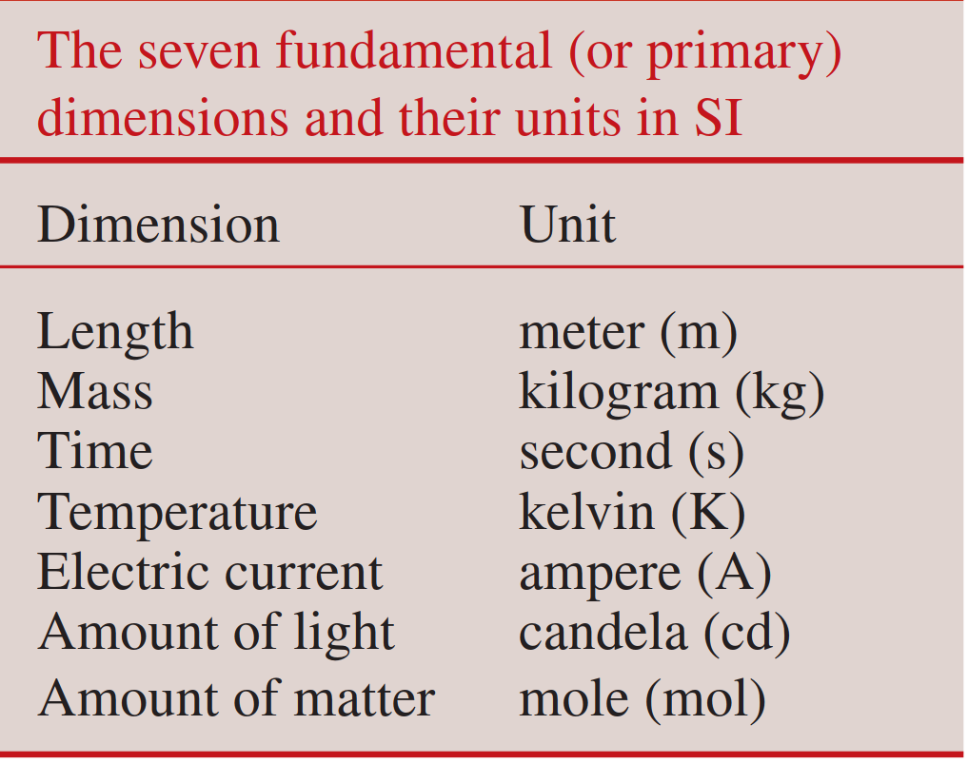
Importance of the Dimensions and Units
units
A unit is any specified amount of a quantity by comparison with which any other quantity of the same kind is measured.
Primary dimensions
Because physical quantities are related by definitions and laws, a relatively small number of physical quantities suffice to conceive of and measure all others. These are
called primary dimensions.
Primary dimensions
Because physical quantities are related by definitions and laws, a relatively small number of physical quantities suffice to conceive of and measure all others. These are
called primary dimensions.
Any physical quantity can be characterized by dimensions. The magnitudes assigned to the dimensions are called units.

Slide 18
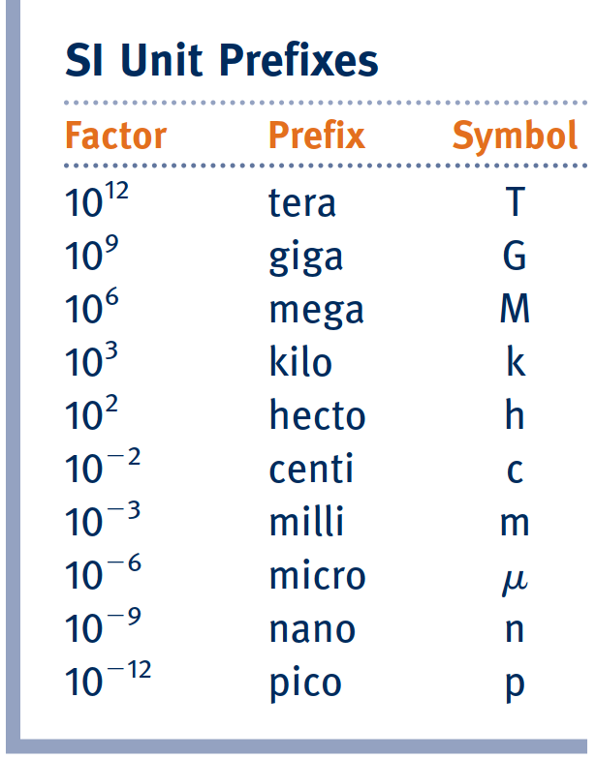
Importance of the Dimensions and Units
Despite strong efforts in the scientific and engineering community to unify the world with a single unit system, two sets of units are still in common use today: the English system, which is also known as the United States Customary System (USCS), and the metric SI (from Le Système International d’Unités), which is also known as the International System. The SI is a simple and logical system based on a decimal relationship between the various units, and it is being used for scientific and engineering work in most of the industrialized nations, including England.
Since it is frequently necessary to work with extremely large or small values when using the SI unit system, a set of standard prefixes is provided in Table 1.4 to simplify matters.

Slide 19
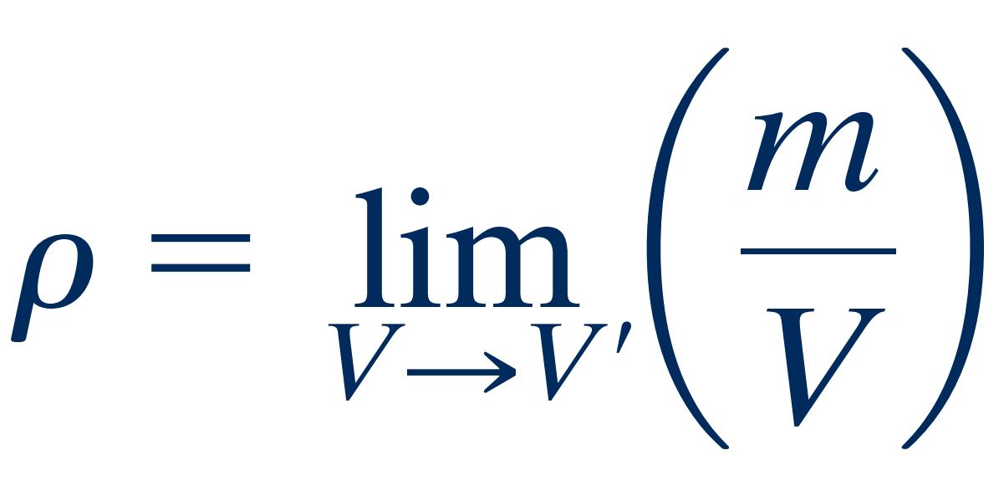
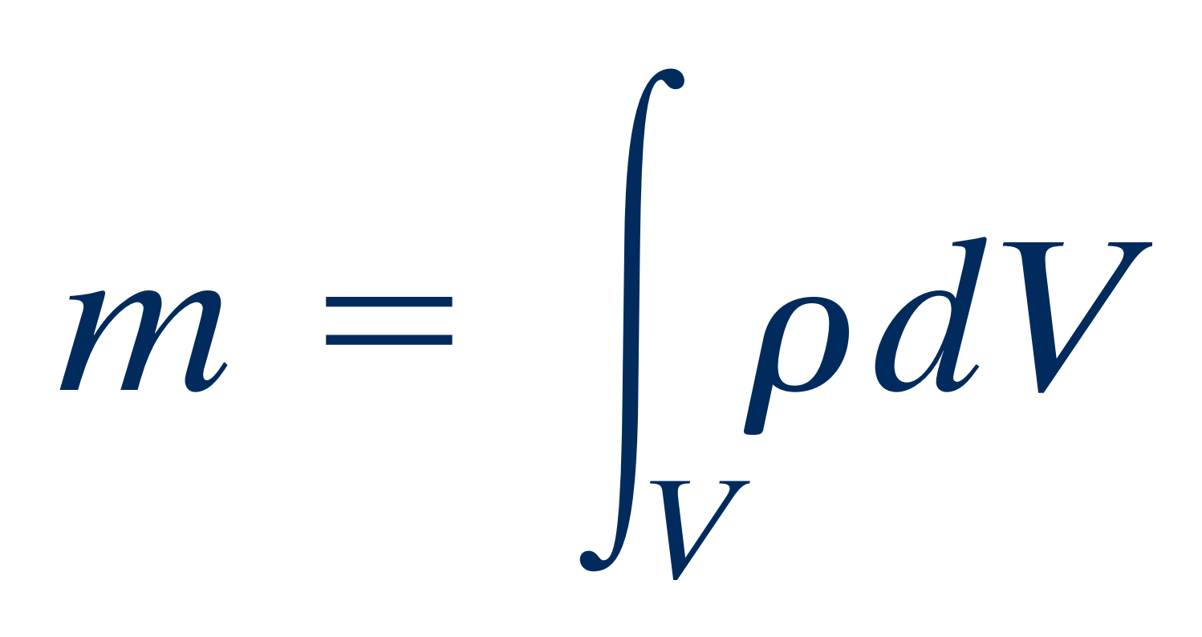
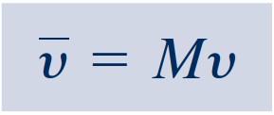
Specific Volume
Three measurable intensive properties that are particularly important in engineering thermodynamics are specific volume, pressure, and temperature.
continuum hypothesis
From the macroscopic perspective, the description of matter is simplified by considering it to be distributed continuously throughout a region.
When substances can be treated as continua, it is possible to speak of their intensive thermodynamic properties “at a point.” Thus, at any instant the density at a point is defined as
specific volume
The specific volume is defined as the reciprocal of the density, 1/ρ. It is the volume per unit mass. Like density, specific volume is an intensive property and may vary from point to point.
The density, or local mass per unit volume, is an intensive property that may vary from point to point within a system. Thus, the mass associated with a particular volume V is determined in principle by integration
$$υ=1/ρ$$
molar basis
In certain applications it is convenient to express properties such as specific volume on a molar basis rather than on a mass basis.

Slide 20
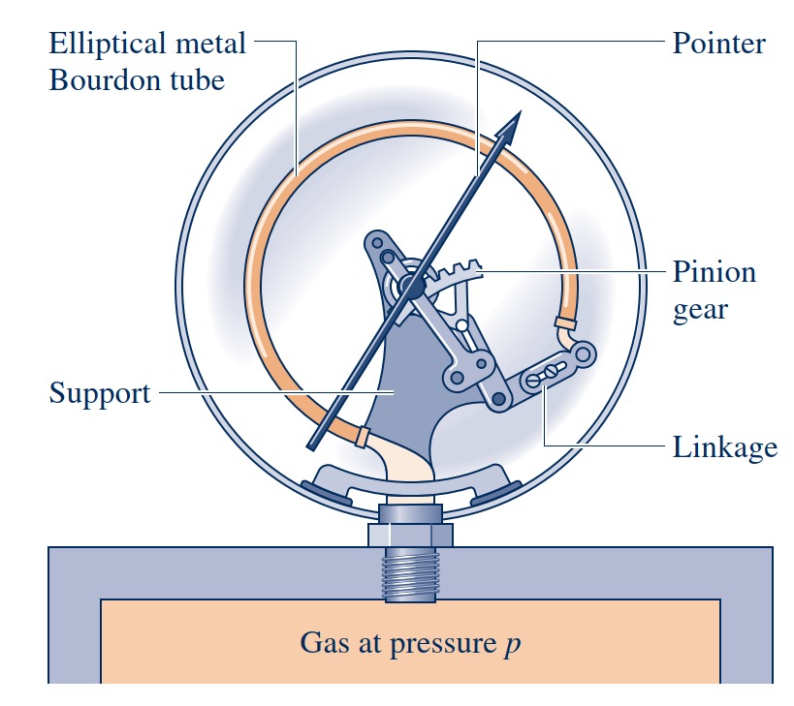
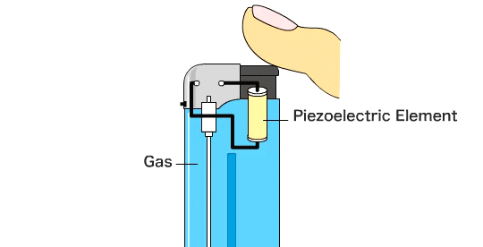
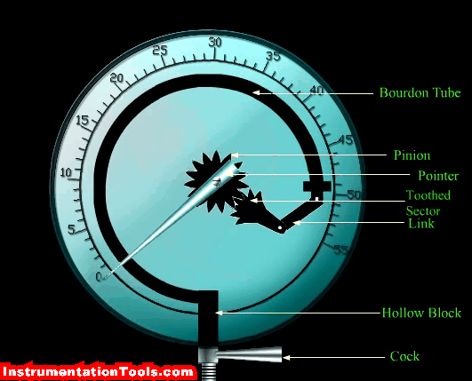
Pressure
Mechanical Pressure Measurements
Electronical Pressure sensor
Piezoelectric Pressure sensor

Slide 21
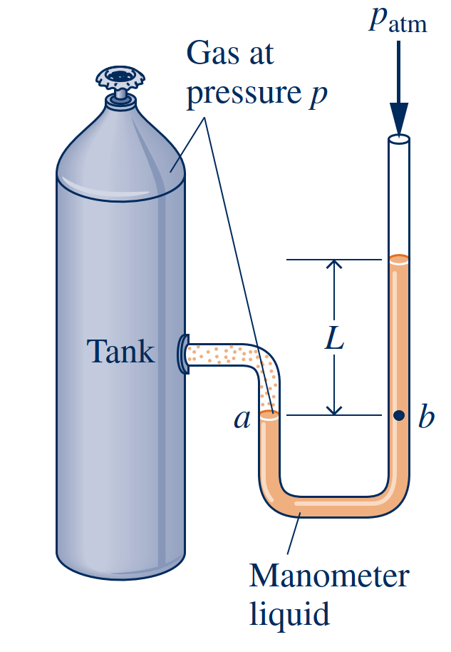
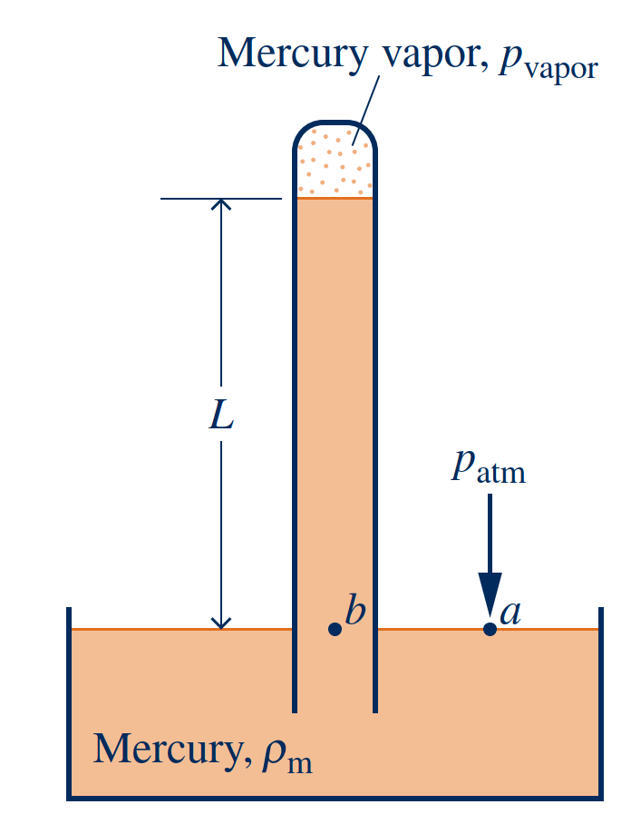
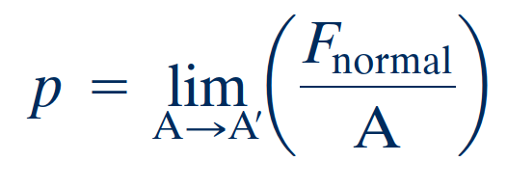
Pressure
Pressure
Manometers and barometers
The pressure, p, at the specified point is defined as the limit
absolute pressure
pressure with respect to the zero pressure of a complete vacuum. The lowest possible value of absolute pressure is zero.
Pressure Measurement
Manometers
barometers

Slide 22
Temperature
A definition of temperature in terms of concepts that are independently defined or accepted as primitive is difficult to give. However, it is possible to arrive at an objective understanding of equality of temperature by using the fact that when the temperature of an object changes, other properties also change.
To illustrate this, consider two copper blocks, and suppose that our senses tell us
that one is warmer than the other. If the blocks were brought into contact and isolated from their surroundings, they would interact in a way that can be described as a thermal (heat) interaction.
thermal (heat) interaction
thermal equilibrium
When all changes in such observable properties cease, the interaction is at an end. The two blocks are then in thermal equilibrium.
Temperature is a physical quantity that expresses hot and cold. It is the manifestation of thermal energy, present in all matter, which is the source of the occurrence of heat, a flow of energy, when a body is in contact with another that is colder or hotter.
temperature
It is a matter of experience that when two objects are in thermal equilibrium with a third object, they are in thermal equilibrium with one another. This statement, which is sometimes called the zeroth law of thermodynamics, is tacitly assumed in every measurement of temperature.
zeroth law of thermodynamics

Slide 23
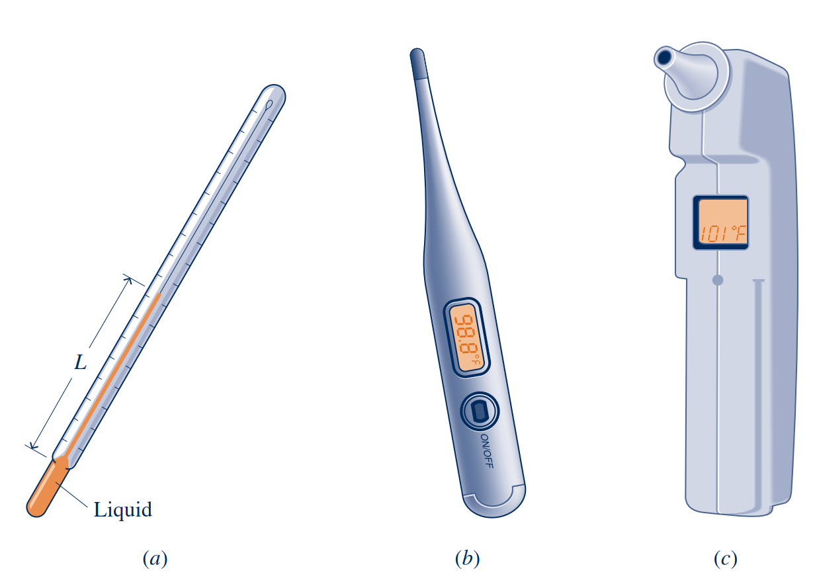
Temperature
Any object with at least one measurable property that changes as its temperature changes can be used as a thermometer. Such a property is called a thermometric property. The particular substance that exhibits changes in the thermometric property is known as a thermometric substance.
thermometric property

Slide 24
Temperature Scales
The Kelvin scale is an absolute thermodynamic temperature scale that provides a continuous definition of temperature, valid over all ranges of temperature. The unit of temperature on the Kelvin scale is the kelvin (K). The kelvin is the SI base unit for temperature.
Kelvin scale
Rankine scale
By definition, the Rankine scale, the unit of which is the degree rankine (8R), is proportional to the Kelvin temperature according to
Celsius scale
The Celsius temperature scale uses the unit degree Celsius (oC), which has the same
magnitude as the kelvin. Thus, temperature differences are identical on both scales.
Fahrenheit scale
A degree of the same size as that on the Rankine scale is used in the Fahrenheit scale, but the zero point is shifted according to the relation

Slide 25
Methodology for Solving
Thermodynamics Problems
❶ Known: State briefly in your own words what is known. This requires that you read the problem carefully and think about it.
❷ Find: State concisely in your own words what is to be determined.
❸ Schematic and Given Data: Draw a sketch of the system to be considered. Label the diagram
with relevant information from the problem statement. Record all property values you are given or anticipate may be required for subsequent calculations. Sketch appropriate property diagrams, locating key state points and indicating, if possible, the processes executed by the system.
❹ Engineering Model: To form a record of how you model the problem, list all simplifying assumptions and
idealizations made to reduce it to one that is manageable. Sometimes this information also can be noted on
the sketches of the previous step. The development of an appropriate model is a key aspect of successful
problem solving.
❺ Analysis: Using your assumptions and idealizations, reduce the appropriate governing equations and relationships to forms that will produce the desired results.

Slide 26
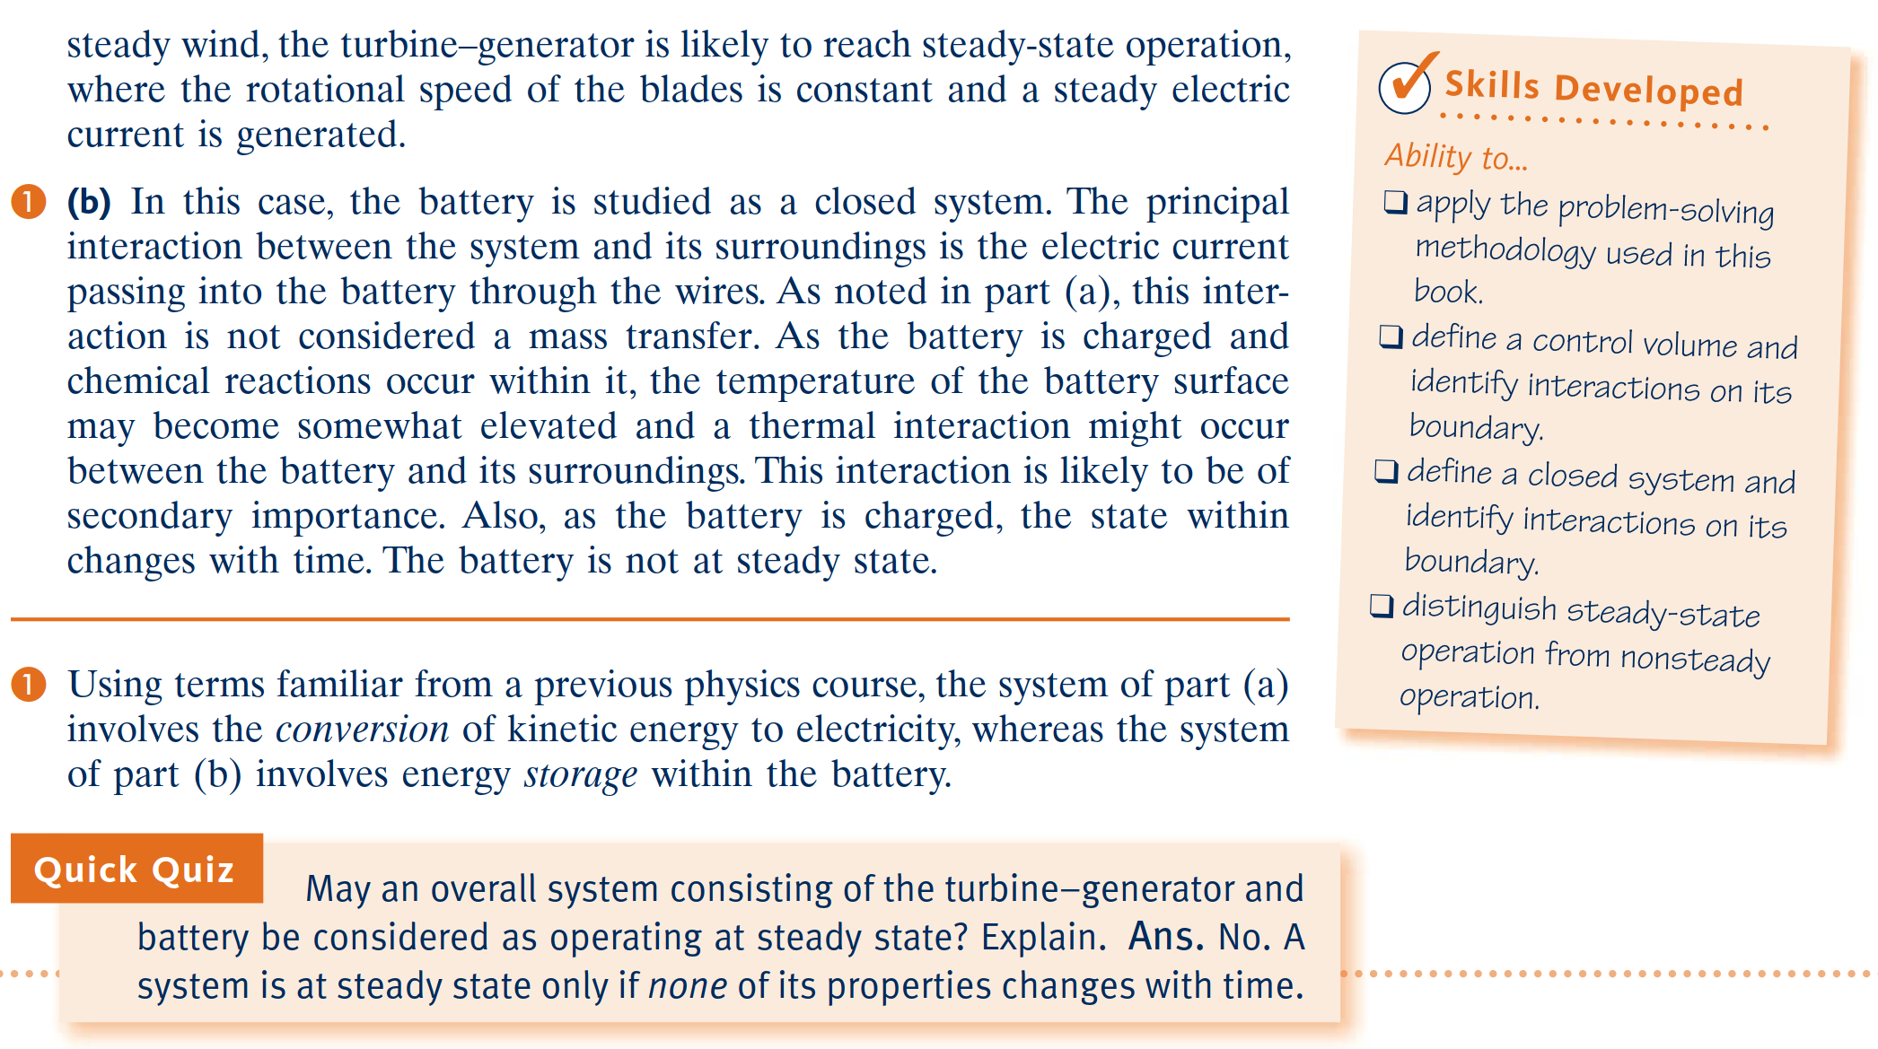
Example

