Slide 1
Responsibility in Business
Lecture starts at 16:15
A couple of minutes before that, there will be some music for you to make a sound check.
Matti Häyry
Aalto University School of Business
51E 00100 Business Ethics
Lecture 1

Slide 2

Responsibility in Business
Music playing so that you can check that
your speakers or headphones are on.
Tim’s Requiem by The Perfct Child from their
Playing God: The Rock Opera – Music by Denny Colt
Matti Häyry
Aalto University School of Business
51E 00100 Business Ethics
Lecture 1

Slide 3
Responsibility in Business
Lecture starting right away
Matti Häyry
Aalto University School of Business
51E 00100 Business Ethics
Lecture 1

Slide 4
Responsibility in Business
Matti Häyry
Aalto University School of Business
51E 00100 Business Ethics
Lecture 1

Slide 5
Responsibility in Business
Keep watching the screen – video coming up.
At some point. ;)
[If you watching this by yourself in MyCourses later, click the link, and return after the video.]
Matti Häyry
Aalto University School of Business
51E 00100 Business Ethics
Lecture 1

Slide 6
Responsibility in Business
Keep watching the screen – video coming up.
At some point. ;)
[If you watching this by yourself in MyCourses later, click the link, and return after the video.]
Matti Häyry
Aalto University School of Business
51E 00100 Business Ethics
Lecture 1

Slide 7
Responsibility in Business
Matti Häyry
Aalto University School of Business
51E 00100 Business Ethics
Lecture 1

Slide 8
Responsibility in Business
Matti Häyry
Aalto University School of Business
51E 00100 Business Ethics
Lecture 1

Slide 9
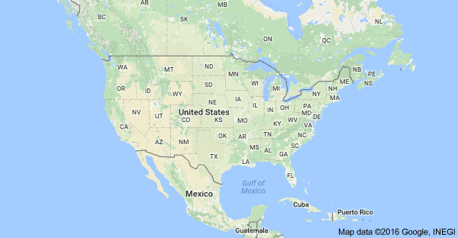
The Dan River Incident

Slide 10
The Dan River Incident

Slide 11

The Dan River Incident

Slide 12
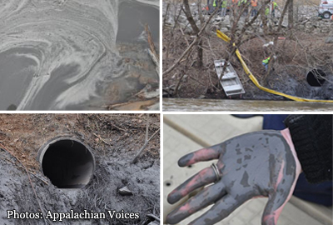
The Dan River Incident
https://www.youtube.com/watch?app=desktop&v=MjV9De4x5e0

Slide 13
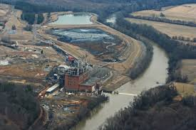
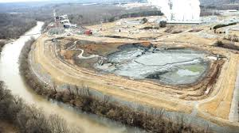
The Dan River Incident
On Sunday 2 February 2014, Duke Energy employees noticed that coal ash waste was spilling from one of the company’s coal ash ponds through a pipe into Dan River in Riverbend, near Eden, North Carolina.
The company delayed reporting this publicly until the next day.
The spillage was stopped in about a week.
Duke estimated that 50.000 to 82.000 tons of coal ash and 27 million gallons of contaminated water had been released into the Dan River.
http://www.catawbariverkeeper.org/issues/coal-ash-1/duke-energy-dan-river-coal-ash-spill-what-do-we-currently-know-what-do-we-need-to-know/?searchterm=None

Slide 14
The Dan River Incident
The Riverbend ash pond was an unlined high hazard coal ash waste pond which had been left untreated since the closure of the Duke Energy coal power plant in April 2013.
According to the operation permit, Duke was required to have the ash pond closed 1 year before closing the plant.
After the spill, Duke representatives said that this would be dealt with “eventually”.
Similarly toxic ash ponds remain in many closed coal power plant sites along rivers.
http://www.catawbariverkeeper.org/issues/coal-ash-1/duke-energy-dan-river-coal-ash-spill-what-do-we-currently-know-what-do-we-need-to-know/?searchterm=None

Slide 15
The Dan River Incident
The coal ash spill affected c. 70 miles of Dan River downstream Eden.
The coal ash settled mostly on the river bottom sediments.
Some of it has been removed, but not all of it can or ever will be.
The US Environmental Protection Agency (EPA) reports that there are no serious health hazards.
The financial damage to society has been estimated at > $ 300 million
https://www.epa.gov/dukeenergy-coalash/frequently-asked-questions-faqs-about-duke-energy-coal-ash-spill-eden-nc

Slide 16
So who is to blame?

Slide 17
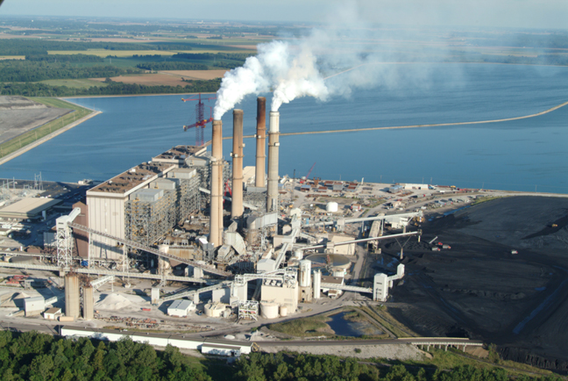

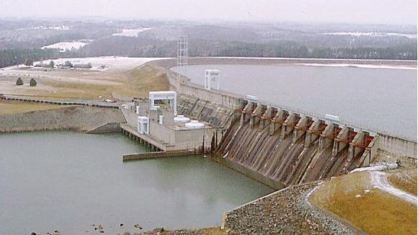
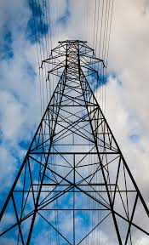

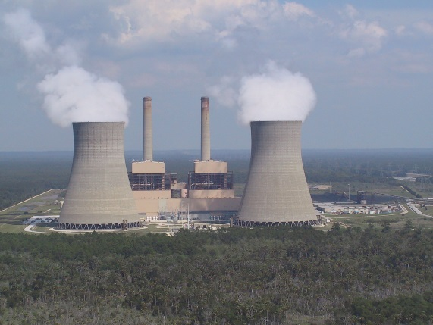
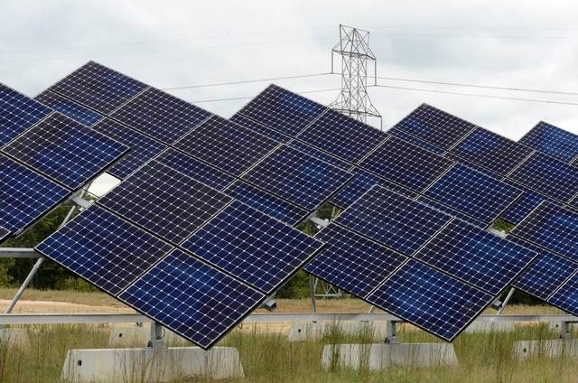
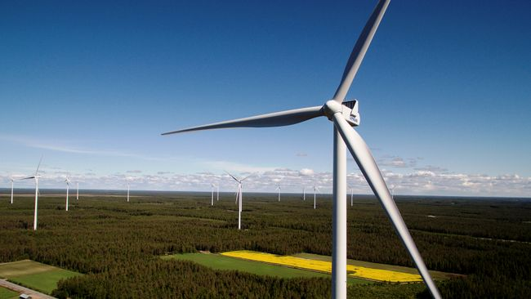

Slide 18
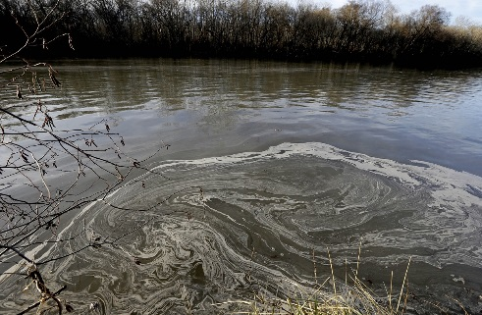
Duke Energy
Is one of the biggest US energy companies.
Has 7.4 million electricity retail customers in the South East and Mid West parts of the US.
Covers a population of about 24 million people.
Has 7 nuclear power plants, 18 coal-fired power stations, over 20 hydroelectric facilities, 24 oil and gas-fired facilities, 4 solar farms, and one wind farm.
Is doing well business-wise.
Is the 50th best US employer – Business Insider.
Wikipedia and official website

Slide 19
Duke Energy
In 1999, the EPA started an enforcement action against Duke Energy.
Wikipedia and its sources

Slide 20
Duke Energy
In 1999, the EPA started an enforcement action against Duke Energy.
They argued that DE had increased emissions by making unlicensed modifications to some of their old and deteriorating coal power plants.
Wikipedia and its sources

Slide 21
Duke Energy
In 1999, the EPA started an enforcement action against Duke Energy.
They argued that DE had increased emissions by making unlicensed modifications to some of their old and deteriorating coal power plants.
Lower courts supported DE’s view, but in 2007, the Supreme Court ruled in favour of the EPA.
Wikipedia and its sources

Slide 22
Duke Energy
In 1999, the EPA started an enforcement action against Duke Energy.
They argued that DE had increased emissions by making unlicensed modifications to some of their old and deteriorating coal power plants.
Lower courts supported DE’s view, but in 2007, the Supreme Court ruled in favour of the EPA.
In 2002, DE was identified as the 46th-largest corporate producer of air pollution in the US.
After 2005, The Political Economy Research Institute has ranked DE as US Nr 13 air polluter.
Wikipedia and its sources

Slide 23
Duke Energy
In 2014, the Dan River incident at the DE power plant was the third worst coal ash spill to happen in the US.
North Carolina regulators immediately blamed DE for the violation on the river.
It was also observed that DE had similar problems elsewhere in the state.
In May 2015, DE was sentenced to pay $ 102 million for Clean Water Act crimes.
Wikipedia and its sources; https://www.justice.gov/opa/pr/duke-energy-subsidiaries-plead-guilty-and-sentenced-pay-102-million-clean-water-act-crimes; http://www.bizjournals.com/charlotte/news/2016/09/07/arge-duke-energy-investor-to-divest-selling-380m.html

Slide 24
Duke Energy
In 2014, the Dan River incident at the DE power plant was the third worst coal ash spill to happen in the US.
North Carolina regulators immediately blamed DE for the violation on the river.
It was also observed that DE had similar problems elsewhere in the state.
In May 2015, DE was sentenced to pay $ 102 million for Clean Water Act crimes.
In September 2016, the Government Pension Fund of Norway excluded DE on ethical grounds.
Wikipedia and its sources; https://www.justice.gov/opa/pr/duke-energy-subsidiaries-plead-guilty-and-sentenced-pay-102-million-clean-water-act-crimes; http://www.bizjournals.com/charlotte/news/2016/09/07/arge-duke-energy-investor-to-divest-selling-380m.html

Slide 25
The Government Pension Fund of Norway excluded Duke Energy?

Slide 26
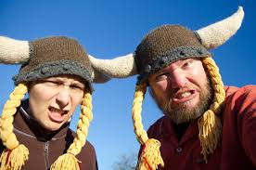
The Government Pension Fund of Norway excluded Duke Energy?

Slide 28
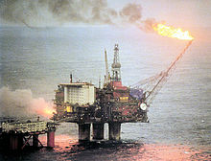
Government Pension Fund of Norway
In the late 1960s, North Sea oil was discovered in Norwegian waters.
Wikipedia and its sources

Slide 29
Government Pension Fund of Norway
In the late 1960s, North Sea oil was discovered in Norwegian waters.
Since then, export of oil and gas has been an important element in the Norwegian economy.
Wikipedia and its sources

Slide 30
Government Pension Fund of Norway
In the late 1960s, North Sea oil was discovered in Norwegian waters.
Since then, export of oil and gas has been an important element in the Norwegian economy.
In 2019, Norway was the world’s
    Nr 15 crude oil exporter (Nr 8 in 2011)
    Nr 9 refined oil exporter (Nr 9 in 2011)
    Nr 3 natural gas exporter (Nr 3 in 2011)
Wikipedia and its sources

Slide 31
Government Pension Fund of Norway
In the late 1960s, North Sea oil was discovered in Norwegian waters.
Since then, export of oil and gas has been an important element in the Norwegian economy.
In 2019, Norway was the world’s
    Nr 15 crude oil exporter (Nr 8 in 2011)
    Nr 9 refined oil exporter (Nr 9 in 2011)
    Nr 3 natural gas exporter (Nr 3 in 2011)
Norway ranks Nr 1-7 in “the world’s richest country” lists – with Luxembourg, Switzerland, Qatar, Singapore, Kuwait, Brunei, U Arab Emir.
Wikipedia and its sources

Slide 32
Government Pension Fund Global
In anticipation of a decline of the oil and gas sector in the future, Norway established in 1990 a national Petroleum Fund.
The point of the Fund is to invest some of the vast surplus generated in order to distribute the gains more evenly between generations.
The name of The Petroleum Fund of Norway was in 2006 changed to Government Pension Fund Global.
It is still commonly referred to as the Oil Fund (Oljefondet).
Wikipedia and its sources

Slide 33
Government Pension Fund Global
At about $ 1 000 000 000 000 (T/B), the GPFG is the largest “pension fund” in Europe and (according to its 2011 evaluation) in the world.
Wikipedia and its sources

Slide 34
Government Pension Fund Global
At about $ 1 000 000 000 000 (T/B), the GPFG is the largest “pension fund” in Europe and (according to its 2011 evaluation) in the world.
The Fund has since 1998 been allowed to invest in the international stock market, first 40% of its portfolio, then 60% (since 2009), and now 70% (since 2014).
Wikipedia and its sources

Slide 35
Government Pension Fund Global
At about $ 1 000 000 000 000 (T/B), the GPFG is the largest “pension fund” in Europe and (according to its 2011 evaluation) in the world.
The Fund has since 1998 been allowed to invest in the international stock market, first 40% of its portfolio, then 60% (since 2009), and now 70% (since 2014).
As a result, it currently holds 1.3 % of global equity markets, and with 2.3 % of European stocks, it is said to be the biggest stock owner in Europe.
Wikipedia and its sources

Slide 36
Government Pension Fund Global
Three criticisms have been levelled at the Fund and its operation:
Wikipedia and its sources

Slide 37
Government Pension Fund Global
Three criticisms have been levelled at the Fund and its operation:
    More of the revenues should go to the state budget now, instead of saving for the future.
Wikipedia and its sources

Slide 38
Government Pension Fund Global
Three criticisms have been levelled at the Fund and its operation:
    More of the revenues should go to the state budget now, instead of saving for the future.
    Exposure to the highly volatile international stock market is not financially safe.
Wikipedia and its sources

Slide 39
Government Pension Fund Global
Three criticisms have been levelled at the Fund and its operation:
    More of the revenues should go to the state budget now, instead of saving for the future.
    Exposure to the highly volatile international stock market is not financially safe.
    The investment policy of the Fund can be unethical.
Wikipedia and its sources

Slide 40
Government Pension Fund Global
Three criticisms have been levelled at the Fund and its operation:
    More of the revenues should go to the state budget now, instead of saving for the future.
    Exposure to the highly volatile international stock market is not financially safe.
    The investment policy of the Fund can be unethical.
A Council on Ethics was established in 2004 to help to counter the last argument.
Wikipedia and its sources

Slide 41
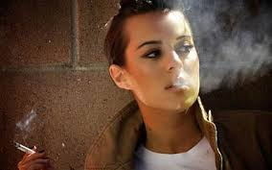
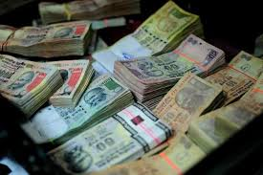
Council on Ethics
For the Norwegian Government Pension Fund Global
http://etikkradet.no/en/

Slide 42
Council on Ethics
For the Norwegian Government Pension Fund Global
The ethical integrity of the Fund’s investments was at the turn of the millennium questioned.
Investments had been made in controversial companies involved in businesses like
    arms production,
    tobacco, and
    fossil fuels.
The Fund’s Advisory Council on Ethics was established 19 November 2004 by royal decree to deal with this.
http://etikkradet.no/en/

Slide 43
Council on Ethics
For the Norwegian Government Pension Fund Global
The general task of the Council is to monitor and evaluate the Fund’s investments and identify those of them that are in conflict with the Fund’s Ethical Guidelines.
http://etikkradet.no/en/

Slide 44
Council on Ethics
For the Norwegian Government Pension Fund Global
The general task of the Council is to monitor and evaluate the Fund’s investments and identify those of them that are in conflict with the Fund’s Ethical Guidelines.
In fact finding the Council relies on external consultants.
Since 2009, the Council has worked with RepRisk ESG Business Intelligence.
RepRisk is a global research firm and provider of environmental, social, and governance risk data.
http://etikkradet.no/en/

Slide 45
Council on Ethics
For the Norwegian Government Pension Fund Global
After receiving data from the consultant (RepRisk) and evaluating cases, the Council can make recommendations to Norges Bank (the central bank of Norway).
http://etikkradet.no/en/

Slide 46
Council on Ethics
For the Norwegian Government Pension Fund Global
After receiving data from the consultant (RepRisk) and evaluating cases, the Council can make recommendations to Norges Bank (the central bank of Norway).
The recommendation can be:
    Exclude – sell the company’s stocks
    Reinstate – lift the ban on a company
    Under observation – use pressure to improve
http://etikkradet.no/en/

Slide 47
Council on Ethics
For the Norwegian Government Pension Fund Global
After receiving data from the consultant (RepRisk) and evaluating cases, the Council can make recommendations to Norges Bank (the central bank of Norway).
The recommendation can be:
    Exclude – sell the company’s stocks
    Reinstate – lift the ban on a company
    Under observation – use pressure to improve
Norges Bank and the Ministry of Finance have made the decisions to divest or use influence.
http://etikkradet.no/en/

Slide 48
Council on Ethics
For the Norwegian Government Pension Fund Global
On Council advice, Norges Bank has excluded:
http://etikkradet.no/en/

Slide 49
Council on Ethics
For the Norwegian Government Pension Fund Global
On Council advice, Norges Bank has excluded:
    5 companies / Production of cluster munitions
    12 companies / Production of nuclear weapons
    21 companies / Production of tobacco
    3 companies / Serious violation of human rights
    21 companies / Severe environmental damage
    1 company / Gross corruption
    3 companies / Serious violations of individuals’ rights in situations of war or conflict
    5 companies / Other particularly serious violations of fundamental ethical norms
http://etikkradet.no/en/

Slide 50
Council on Ethics
For the Norwegian Government Pension Fund Global
In addition, Norges Bank has excluded, based on its own Investment Management rules:
http://etikkradet.no/en/

Slide 51
Council on Ethics
For the Norwegian Government Pension Fund Global
In addition, Norges Bank has excluded, based on its own Investment Management rules:
    51 companies / Production of coal or coal-based energy (so why was DE not excluded earlier?)
Two companies are currently under observation:
    1 company / Risk of severe corruption
    1 company / Risk of severe environmental damage
http://etikkradet.no/en/

Slide 52
Council on Ethics
For the Norwegian Government Pension Fund Global
In addition, Norges Bank has excluded, based on its own Investment Management rules:
    51 companies / Production of coal or coal-based energy (so why was DE not excluded earlier?)
Two companies are currently under observation:
    1 company / Risk of severe corruption
    1 company / Risk of severe environmental damage
Some companies (8 up till 2013) have been reinstated because they have changed their ways.
http://etikkradet.no/en/

Slide 53
What size of investments (and so divestments) are we talking about?

Slide 54
Council on Ethics
For the Norwegian Government Pension Fund Global
Since the Government Pension Fund Global is a big investor, the sums involved are also big.
http://etikkradet.no/en/

Slide 55
Council on Ethics
For the Norwegian Government Pension Fund Global
Since the Government Pension Fund Global is a big investor, the sums involved are also big.
    The leading losers from the policy are tobacco producers – divestment $ 2 billion.
    A close second are companies that are seen to cause environmental damage – $ 1.5 billion.
    And the third are perceived human rights violators – $ 650 million.
    Of the last, $ 372 million divested off Walmart.
http://etikkradet.no/en/

Slide 56
Council on Ethics
For the Norwegian Government Pension Fund Global
Since the Government Pension Fund Global is a big investor, the sums involved are also big.
    The leading losers from the policy are tobacco producers – divestment $ 2 billion.
    A close second are companies that are seen to cause environmental damage – $ 1.5 billion.
    And the third are perceived human rights violators – $ 650 million.
    Of the last, $ 372 million divested off Walmart.
Duke Energy faced an > $ 300 million divestment.
http://etikkradet.no/en/

Slide 57
Council on Ethics
For the Norwegian Government Pension Fund Global
In 2013, the Finance Minister of Norway announced that the Council will be disbanded.
http://etikkradet.no/en/

Slide 58
Council on Ethics
For the Norwegian Government Pension Fund Global
In 2013, the Finance Minister of Norway announced that the Council will be disbanded.
    Its duties would be assumed by Norges Bank, all exclusions would be managed centrally.
    Smooth management was the justification.
http://etikkradet.no/en/

Slide 59
Council on Ethics
For the Norwegian Government Pension Fund Global
In 2013, the Finance Minister of Norway announced that the Council will be disbanded.
    Its duties would be assumed by Norges Bank, all exclusions would be managed centrally.
    Smooth management was the justification.
Objections to this included:
    The ethics watchdog should be independent.
    Too much power would be concentrated.
    Fewer companies would be excluded.
    Investments would become less ethical.
http://etikkradet.no/en/

Slide 60
Council on Ethics
For the Norwegian Government Pension Fund Global
In 2014, the Norwegian Parliament decided to appoint a new Council, under new guidelines.
http://etikkradet.no/en/

Slide 61
Council on Ethics
For the Norwegian Government Pension Fund Global
In 2014, the Norwegian Parliament decided to appoint a new Council, under new guidelines.
    It would now make its recommendations to Norges Bank, not to the Ministry of Finance.
    Distance from policy was the justification.
http://etikkradet.no/en/

Slide 62
Council on Ethics
For the Norwegian Government Pension Fund Global
In 2014, the Norwegian Parliament decided to appoint a new Council, under new guidelines.
    It would now make its recommendations to Norges Bank, not to the Ministry of Finance.
    Distance from policy was the justification.
Objections and counter-objections continue:
    “The Fund excludes too many companies.”
    “Exclusions do not disturb its performance.”
    “The Fund excludes too few companies.”
    “It is supposed to make money, not policy.”
http://etikkradet.no/en/

Slide 63
What do we know so far?

Slide 64
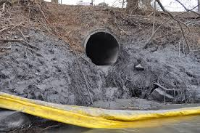
A lot of toxic coal ash was spilled into Dan River in North Carolina in 2014

Slide 65
A lot of toxic coal ash was spilled into Dan River in North Carolina in 2014

Slide 66
A lot of toxic coal ash was spilled into Dan River in North Carolina in 2014
The culprits had to pay $ 102 million + for the estimated $ 300 million damage

Slide 67
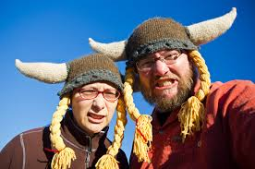
A lot of toxic coal ash was spilled into Dan River in North Carolina in 2014
The culprits had to pay $ 102 million + for the estimated $ 300 million damage
By divesting > $ 300 million, Norwegians told that they do not approve their deed

Slide 68
A lot of toxic coal ash was spilled into Dan River in North Carolina in 2014
The culprits had to pay $ 102 million + for the estimated $ 300 million damage
By divesting > $ 300 million, Norwegians told that they do not approve their deed
Lesson?

Slide 69
A lot of toxic coal ash was spilled into Dan River in North Carolina in 2014
The culprits had to pay $ 102 million + for the estimated $ 300 million damage
By divesting > $ 300 million, Norwegians told that they do not approve their deed
Lesson?
If every investor followed Norway’s example, all unethical companies would be driven out of business?

Slide 70
Let’s take a break.
Back in ten.

Slide 71
Let’s take a break.
Back in ten.

Slide 72
Ding ding ding!
Continuing in a minute.

Slide 73
So what exactly are the grounds on which the Council on Ethics makes its recommendations?

Slide 74
Council on Ethics
For the Norwegian Government Pension Fund Global
Guidelines
https://nettsteder.regjeringen.no/etikkradet3/files/2019/12/guidelines-for-observation-and-exclusion-from-the-gpfg-01.09.2019.pdf
http://etikkradet.no/en/

Slide 75
Council on Ethics
For the Norwegian Government Pension Fund Global
Guidelines
Section 2.
Criteria for product-based observation and exclusion of companies

Slide 76
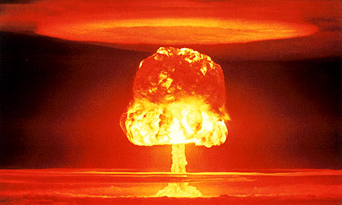
Council on Ethics
For the Norwegian Government Pension Fund Global
Guidelines
Section 2.
Criteria for product-based observation and exclusion of companies
(1) The Fund shall not be invested in companies
which themselves or through entities they control:
      produce weapons that violate fundamental humanitarian principles through their normal use
      produce tobacco
      sell weapons or military material to states that are subject to investment restrictions on government bonds as described in the management mandate for the Fund, section 3-1(2)(c).

Slide 77
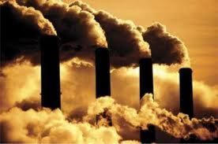
Council on Ethics
For the Norwegian Government Pension Fund Global
Guidelines
Section 2.
Criteria for product-based observation and exclusion of companies
(2) Observation or exclusion may be decided
for mining companies and power producers
which themselves or through entities they
control derive 30 per cent or more of their
income from thermal coal or base 30 per cent
or more of their operations on thermal coal or extract more than 20 million tonnes of thermal coal per year or have a coal power capacity of more than 10 000 MW from thermal coal.

Slide 78
Council on Ethics
For the Norwegian Government Pension Fund Global
?
?
Guidelines
Section 2.
Criteria for product-based observation and exclusion of companies
(3) In assessments pursuant to subsection (2)
above, in addition to the company’s current
share of income or activity from thermal coal,
importance shall also be attached to forward-
looking assessments, including any plans the
company may have that will change the share
of its business based on thermal coal and the
share of its business based on renewable
energy sources.

Slide 79


Council on Ethics
For the Norwegian Government Pension Fund Global
Guidelines
Section 2.
Criteria for product-based observation and exclusion of companies
(4) Recommendations and decisions
on exclusion of companies based on
subsections (2) and (3) above shall not
include a company’s green bonds where
such are recognized through inclusion in
specific indices for green bonds or are
verified by a recognized third party.

Slide 80
Council on Ethics
For the Norwegian Government Pension Fund Global
Guidelines
Section 3.
Criteria for conduct-based observation and exclusion of companies

Slide 81
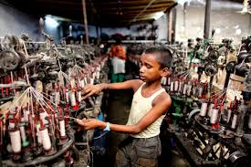
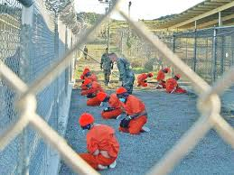
Council on Ethics
For the Norwegian Government Pension Fund Global
Guidelines
Section 3.
Criteria for conduct-based observation and exclusion of companies
Companies may be put under observation or be
excluded if there is an unacceptable risk that the
company contributes to or is responsible for:
1. serious or systematic human rights violations,
such as murder, torture, deprivation of liberty,
forced labour and the worst forms of child labour
2. serious violations of the rights of individuals in
situations of war or conflict

Slide 82
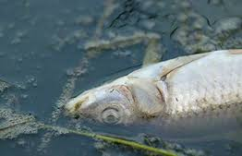
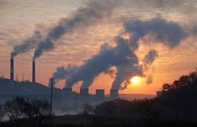
Council on Ethics
For the Norwegian Government Pension Fund Global
Guidelines
Section 3.
Criteria for conduct-based observation and exclusion of companies
Companies may be put under observation or be
excluded if there is an unacceptable risk that the
company contributes to or is responsible for:
3. severe environmental damage
4. acts or omissions that on an aggregate
company level lead to unacceptable
greenhouse gas emissions

Slide 83
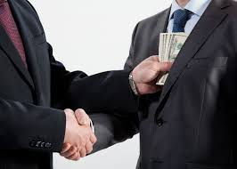

Council on Ethics
For the Norwegian Government Pension Fund Global
Guidelines
Section 3.
Criteria for conduct-based observation and exclusion of companies
Companies may be put under observation or be
excluded if there is an unacceptable risk that the
company contributes to or is responsible for:
5. gross corruption
6. other particularly serious violations of fundamental ethical norms.

Slide 84
What are our questions, then?

Slide 85
Find out and report
What are the reasons given by the CE in particular cases?

Slide 86
Find out and report
What are the reasons given by the CE in particular cases?
What other reasons could be given in particular cases?

Slide 87
Find out and report
What are the reasons given by the CE in particular cases?
What other reasons could be given in particular cases?
CSR (business)
Theories of justice
CSR (critical & political)

Slide 88
Find out and report
What are the reasons given by the CE in particular cases?
What other reasons could be given in particular cases?
CSR (business)
Theories of justice
CSR (critical & political)
Moral theories
Business ethics
Sustainability

Slide 89
Find out and report
What are the reasons given by the CE in particular cases?
What other reasons could be given in particular cases?
CSR (business)
Theories of justice
CSR (critical & political)
Moral theories
Business ethics
Sustainability

Slide 90
Find out and report
What are the reasons given by the CE in particular cases?
What other reasons could be given in particular cases?
CSR (business)
Theories of justice
CSR (critical & political)
Moral theories
Business ethics
Sustainability
The background in the different approaches and theories will be provided by lectures, guest lectures, and reading material.
Everything is geared towards your investigation and reporting.

Slide 91
Course completion
Attend classes!

Slide 92
Course completion
Please attend the scheduled online classes!

Slide 93
Course completion
Please attend the scheduled online classes!
Please complete and send assignments asap!

Slide 94

Course completion
Please attend the scheduled online classes!
Please complete and send assignments asap!
Please start reading the books immediately!

Slide 95
Course completion
Please attend the scheduled online classes!
Please complete and send assignments asap!
Please start reading the books immediately!
Please go to MyCourses and familiarise yourself with all the tabs (on the left) and their content, 3 bars make visible

Slide 96
Personal assignment 1
Cases
Walmart
Imperial Tobacco
Lockheed Martin
Jacobs Engineering
ZTE Corporation
Kosmos Energy
Your case / first name starts with
A, B, C, D
E, F, G
H, I, J, K, L
M, N, O, P
Q, R, S, T, U
V, W, X, Y, Z, Å, Ä, Ö
Or, if you have a special urge to do one of the others, please do.

Slide 97
Find out and report
What are the reasons given by the CE in particular cases?
What other reasons could be given in particular cases?
CSR (business)
Theories of justice
CSR (critical & political)
Moral theories
Business ethics
Sustainability
The background in the different approaches and theories will be provided by lectures, guest lectures, and reading material.
Everything is geared towards your investigation and reporting.

Slide 98
Personal assignment 1
Cases
Walmart
Imperial Tobacco
Lockheed Martin
Jacobs Engineering
ZTE Corporation
Kosmos Energy
Find out and report
What does the company do?
What reasons did the Council on Ethics / Norges Bank give for its exclusion and when?
How much was divested?
Was there a market impact?
How did the company react?
Was there a public reaction?
Has the ban been lifted since?

Slide 99
Personal assignment 1
Cases
Walmart
Imperial Tobacco
Lockheed Martin
Jacobs Engineering
ZTE Corporation
Kosmos Energy
Find out and report
What does the company do?
What reasons did the Council on Ethics / Norges Bank give for its exclusion and when?
How much was divested?
Was there a market impact?
How did the company react?
Was there a public reaction?
Has the ban been lifted since?
http://etikkradet.no/en/ + Google for further details.
= e.g. “Norwegian fund excludes [+ company]”

Slide 100
Personal assignment 1
Cases
Walmart
Imperial Tobacco
Lockheed Martin
Jacobs Engineering
ZTE Corporation
Kosmos Energy
Find out and report
What does the company do?
What reasons did the Council on Ethics / Norges Bank give for its exclusion and when?
How much was divested?
Was there a market impact?
How did the company react?
Was there a public reaction?
Has the ban been lifted since?
http://etikkradet.no/en/ + Google for further details.
= e.g. “Norwegian fund excludes [+ company]”

Slide 101

