Slide 1
Research Data Management at Aalto
Aalto Doctoral Orientation Days
2.6.2022
Lucie Hradecká
Information specialist
Research Services - Open Science and ACRIS

Slide 2
Content
Research data management – brief introduction
  What is RDM?
  Basics of good RDM
  Publishing research data
  Legal and ethical issues
RDM support services at Aalto
  Storage services
  Support services and training
+ RDM resource checklist: contacts and essential information

Slide 3
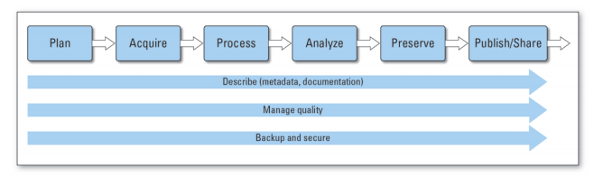
Research Data Management (RDM)
= A set of practices and steps taken to handle and take care of the research data throughout the research life cycle
in a way that ensures the accessibility, understandability, integrity and high quality of research data.
for example: the organisation of data, version control, documentation, backup and digital security, quality control…
Image source: USGS (2014)

Slide 4
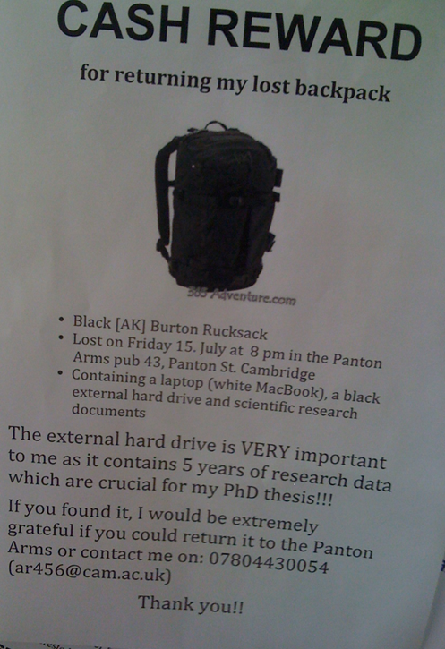
Why is RDM important?
Data are the cornerstone of your results: if peer-reviewers asked to see the data, would it be in a state where others can validate or potentially reproduce your results?
To facilitate data reuse and give your research more visibility
To develop useful skills
To manage risks
  Data loss, flawed/corrupted data, article retractions…
  Mistakes in personal data protection, legal and ethical issues.
Image source: Peter Murray-Rust (2011)

Slide 5
How to approach good RDM?
Data management planning is good practice
“Researchers (incl. doctoral students) and research groups are encouraged to draw up a data management plan (DMP) at the beginning stage of research and update the plan regularly.”
Aalto University Open Science and Research Policy
You can find templates here (e.g. General Finnish DMP template)
Planning saves time, compared to fixing problems afterwards
Most major research funders require a DMP from grant recipients – useful skill for your future career in academia
Notes:
The topics and questions guide you through the most important issues you need to consider

Slide 6
Good RDM Checklist
Before you start collecting data, consider legal and ethical issues: are you working with personal data? Confidential data?
  See our webinars Handling personal data and/or Legal aspects of research data
How are you going to store your data?
  Rule of thumb: don’t store your data only on your laptop or USB drive that can be lost, stolen, or damaged!
  See our webinar How to store research data
What does your data need to make it understandable and reusable? -> standard file formats, documentation/metadata
  Readme files
  Clear descriptions of variables
  Version control
Standard vocabularies, identifiers, schemas, e.g., InChI in chemistry
File naming rules and folder structure
Want to know more? See our webinar Introduction to RDM
Questions: researchdata@aalto.fi
Notes:
Understandable and reusable for yourself later, people in your group, or others? These add to the quality and integrity of your data

Slide 7
Publishing research data
Good practice: provide access to the data to validate your results
This is usually done through data repositories or data journals: see list of recommended options and selection criteria here
You will need to prepare your data for publishing: See this list of practical steps
Published data can get you citations, visibility or new collaborations!
If you publish your dataset, please send us the link or other identifying information to researchdata@aalto.fi – we will add it to ACRIS

Slide 8
Legal and ethical issues
Aalto University recommends publicly funded research data to be openly accessible unless there are ethical or legal issues preventing open access. This is in line with the commonly accepted principle:
“As open as possible, as closed as necessary”
What may be necessary to keep closed?
  Personal or sensitive data which cannot be anonymized,
  Confidential data,
  or when there are plans for commercialization of the research outcomes.
There are options to share data with restricted access, or to only publish a description of the data to showcase your expertise, even if the data cannot be published
When in doubt, talk to your supervisor or contact us at researchdata@aalto.fi

Slide 9
Services for RDM at Aalto
Storage services for research data
Aalto network drives are the recommended file storage space for research data, and cloud file sharing can be useful for collaboration. Use your Aalto account to keep sharing secure.
See more information about services and their suitability for confidential data here (service comparison sheet)
If you need help setting up access to network drive, cloud storage service, or other technical support, contact: servicedesk@aalto.fi
Reading tip for later: Aalto data storage: Best practices

Slide 10
Services for RDM at Aalto
The RDM support network:
Helpdesk: researchdata@aalto.fi
  Coordinated by Data Advisor Antti Rousi
  Broad range of specialists (Open Science, legal, IT) answering all kinds of RDM questions
Data Agents
  A network of researchers and staff who are specialized in RDM
  More discipline-specific RDM support: Data Agents in each School
  You can reach them informally at SciComp garage Data focus day: every Wednesday at 13:00 via Zoom

Slide 11
Services for RDM at Aalto
Trainings
From Introduction to RDM to various specific topics, e.g. making your data and code reproducible or the legal aspects of research data
Live webinars on Zoom, recordings and slides on YouTube
See full list and access previous training recordings here
Final note:
If you are curious about research data management and feel like it is something you would like to focus on more as a researcher, pursue this interest! Not everybody has to be a data management specialist, but if this is your thing, you can choose a career path where it will be an advantage.

Slide 12
RDM Resource Checklist
Contact information:
researchdata@aalto.fi
servicedesk@aalto.fi for storage space issues
Information resources @ Aalto:
RDM and Open Science main page
Research Data Management FAQ
Publishing and reusing research data
RDM training
Aalto Scientific Computing homepage

