Slide 1
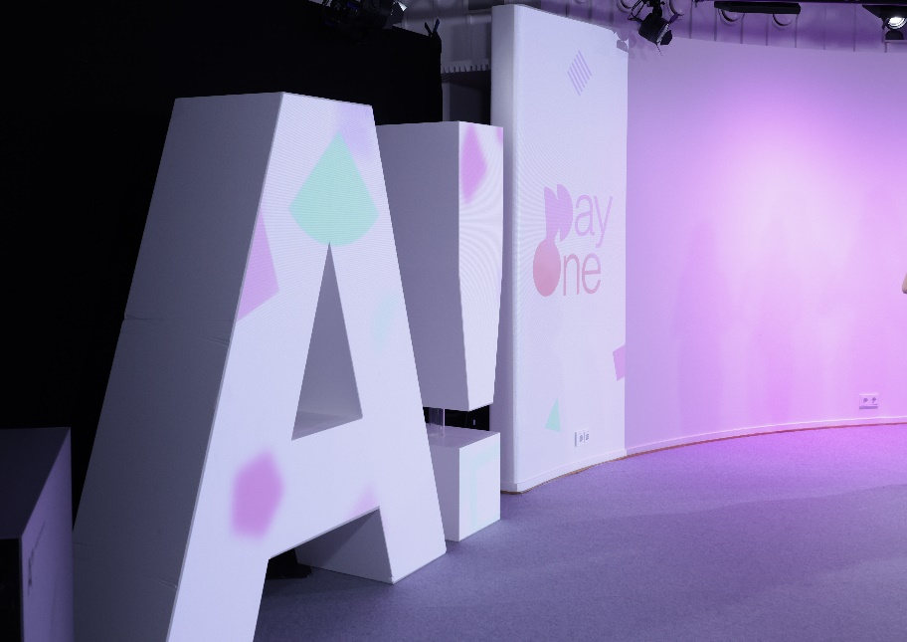
Aalto Doctoral Orientation Days
1-2 June 2022

Slide 2
Aalto Doctoral Orientation Days in a nutshell
Welcome to our doctoral community!
Orientation: Basic knowledge on Aalto doctoral studies and related services & MyCourses site to return to find more information on these issues
Tutor groups: helping you to find our doctoral community especially now in COVID19 times – remember that Aalto is a interdisciplinary university!

Slide 3
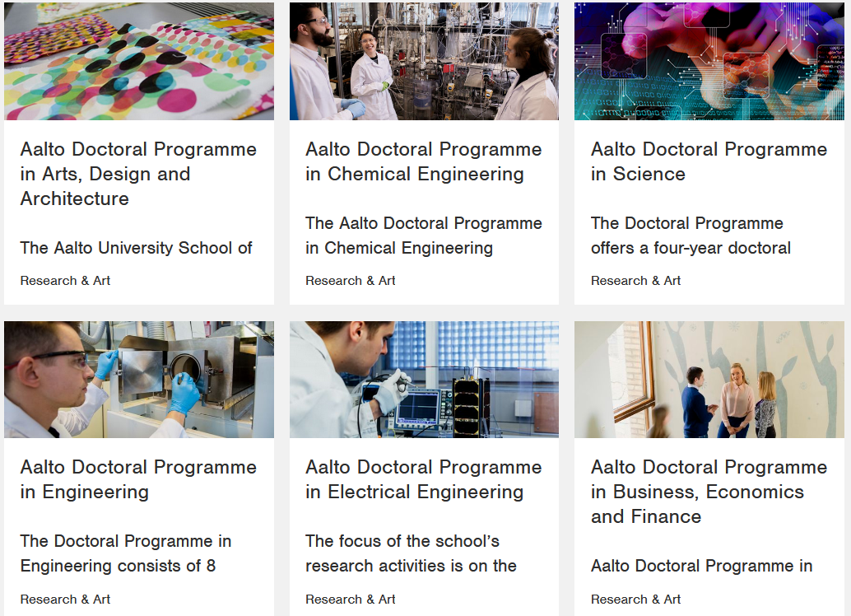
What is your programme?
Six doctoral programmes &
about 3000 doctoral students

Slide 4
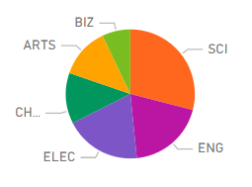
Statistics
Full time students out of all school’s students
ARTS 46%
BIZ 78%
CHEM 59%
ELEC 51%
ENG 37%
SCI 48%
In total 50% of Aalto doctoral students study full time
In total 929 doctoral students are found from Workday, i.e. 33% of Aalto doctoral students are also employees
3021 doctoral students in 6 doctoral programmes

Slide 5
Tutor groups - mixed interdisciplinary groups
Group 1 (Mixed)
Kathrine Gallegos Rosas (ELEC)
Group 2 (Mixed)
Karthekeyan Periasamy (ELEC)
Group 3 (Mixed)
Atiullah Saif (ENG)
Group 4 (Mixed)
Anton Vavilov (SCI)
Group 5 (Mixed)
Farrukh Zeb (ELEC)
53 participants altogether
1 BIZ
13 CHEM
15 ELEC
11 ENG
13 SCI
(ARTS & BIZ main intake for studies starting in the autumn)
Zoom link for the tutor group online meetings on MyCourses under the section Welcome to Orientation Days! (https://mycourses.aalto.fi/course/view.php?id=31038&section=1)

Slide 6
Where it all happens?
Three zoom links: (in your Aalto email and in MyCourses)
One zoom link for all plenary sessions on both days
School zoom links for programme organised by schools
Tutor zoom links for every tutor group
MyCourses full of information: links, slides etc we hope are helpful for you not only during these two days but also afterwards
Doctoral Students – Orientation Days 2021-2022 (https://mycourses.aalto.fi/course/view.php?id=31038)

Slide 7
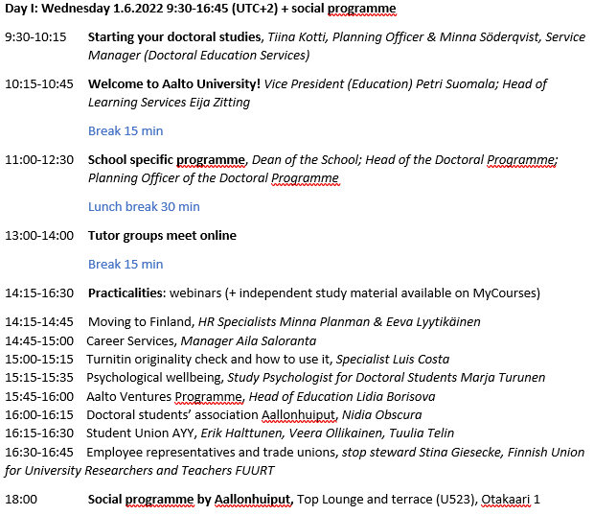
Programme Day I

Slide 8
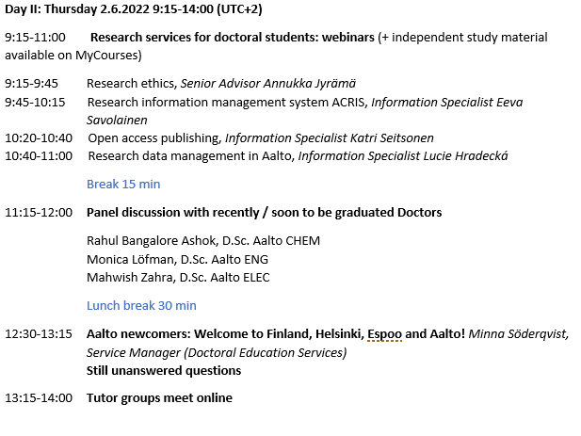
Programme Day II

Slide 9
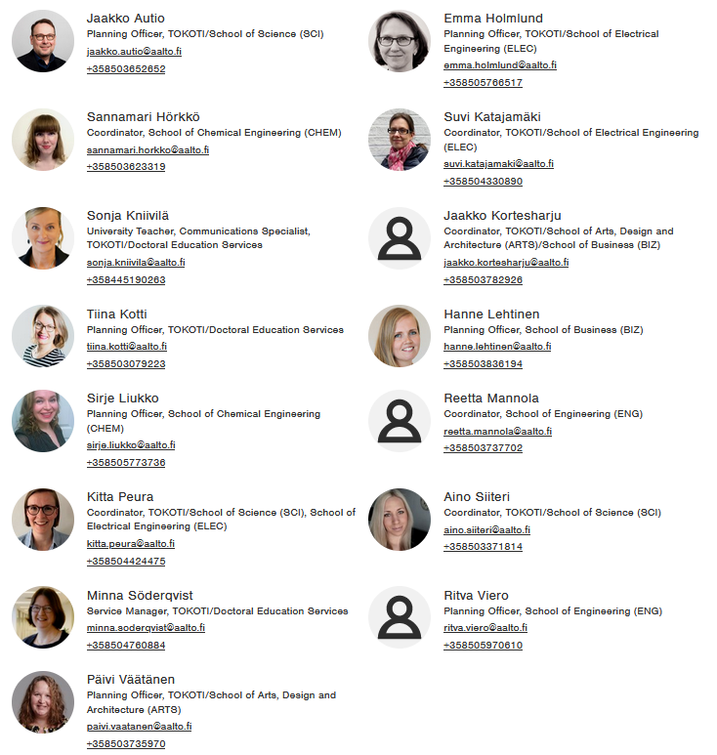
Doctoral Education Services
(part of Learning Services)
Who we are?
Find us: https://www.aalto.fi/en/services/doctoral-education-services

Slide 10
Starting and planning doctoral studies

Slide 11
Study right and studies
Full time doctoral studies take appr. 4 years
Remember to enroll to the university every year in OILI
In case of longer absences, enroll as non-attending
Academic year runs from August to July, teaching usually takes place between September and May
System of 5 teaching periods, but doctoral courses often run with their own schedules

Slide 12
Doctoral studies are decided in/by:
Degree Regulations on Doctoral Education as part of Aalto University General Regulations on Teaching and Studying
Degree structure
2-year Curriculum
Degree requirements, i.e. compulsory & optional courses to be offered / accepted
Course descriptions
Role of your supervising professor and the Doctoral Programme Committee

Slide 13
Doctoral Personal Study Plan
A tool for planning and scheduling your activities and resources in order to complete your studies and research
A tool for preparing for your career after completing your degree
A tool for discussing your plans with your supervising professor
An agreement about supervision and advising
The Sisu credit plan included follows the degree structure of your doctoral programme and is required for registering to courses in Sisu
Should be updated when appropriate

Slide 14
5 parts of the Doctoral Personal Study Plan
Sisu credit plan (in Sisu)
Research plan (see your programme’s instructions)
Supervision plan (Aalto template)
Funding plan (free format, see instructions)
Career plan free format, see instructions)
The plan and all changes discussed with your supervising professor – supervising professor needs to approve your plan (minimum twice: at the beginning of your studies and before pre-examination)​
Autumn 2022: submitted in MyStudies

Slide 15
Degree structure:
40/60* ECTS of studies + thesis
Doctoral thesis
General Research Studies
Research Field Studies
* 40 ECTS in the fields of art and design & technology, 60 ECTS in the field of business

Slide 16
Choosing courses
Compulsory courses of your doctoral programme
Other courses offered by your programme / School for doctoral students
Language and communication courses for doctoral students & Finnish/Swedish courses by Aalto Language Centre
Courses on transferable skills and competences offered at Aalto
Aalto University Pedagogical training
Courses from other Finnish universities, or from our networks like N5T, Cluster, Unite! etc.

Slide 17
Your doctoral programme’s curriculum & courses
ARTS: https://into.aalto.fi/display/endoctoralarts/Studies+and+courses
BIZ: https://into.aalto.fi/display/endoctoralbiz/Studies+and+courses
CHEM: https://into.aalto.fi/display/endoctoralchem/Studies+and+courses
ELEC: https://into.aalto.fi/display/endoctoralelec/Studies+and+courses
ENG: https://into.aalto.fi/display/endoctoraleng/Studies+and+courses
SCI: https://into.aalto.fi/display/endoctoralsci/Studies+and+courses

Slide 18
Language and communication courses for doctoral students & Finnish courses
LC-1350 Writing Doctoral Research for Engineering and Science (w) D (3 ECTS)
LC-1330 Presenting Doctoral Research (o) D (3—5 ECTS)
LC-1335 Preparing for the Doctoral Defence (o), (1 ECTS)
LC-1336 Popularize your Research (o,w) D (2 ECTS
LCA-1030 Writing Doctoral Research (3 ECTS)
LCA 1031 Presenting Doctoral Research (3 ECTS)
LCA-1050 Writing Doctoral Research for Arts (w) D (3 ECTS)
LCB-1350 Writing Doctoral Research for Business and Management (w) D (3 ECTS)
LC-L1017 Asiantuntijaesittämisen valmennus jatko-opiskelijoille D (3 ECTS)
LC-L1018 Tutkimusraportoinnin tekstiretriitit jatko-opiskelijoille (3 op)
LC-L1019 - Tutkimustiedon yleistajuistaminen D (5 op)
Writing Clinic for doctoral students
Tutkivan työn ja tutkimusraportoinnin mentorointi​
Finnish as a foreign language, courses from survival to conversational level (link to Language Centre)

Slide 19
Courses on transferable skills and competences offered at Aalto
LC-L1010 Research ethics for doctoral students (1-2 ECTS)
LC-L1011 Open Science for Doctoral Students (1 ECTS)
LC-L1012 Business Skills for Doctoral Students (1 ECTS)
LC-L1013 Career Course for Doctoral Students (1 ECTS)
LC-L1014 Interactive Leadership Skills for Doctoral Students (1 ECTS)
LC-L1015 Project Management for Doctoral Students (1 ECTS)
LC-L1016 Writing Research Grant Applications for Doctoral Students (1 ECTS)
LC-L1020 Theory of Science (1 ECTS)
Check out: findocnet.fi
To join to course and get an enrolment key for Findocnet platform, contact udes@aalto.fi / minna.soderqvist@aalto.fi

Slide 20
Courses from other Finnish universities, or our networks, e.g. N5T, Cluster, Unite!
Find a suitable course at e.g. https://phdcourses.nordicfivetech.org/
Discuss with your supervising professor & include the course as a study draft in your Sisu credit plan
Apply for the course through the procedure of the University offering the course
If accepted, complete the course and apply for credit transfer in Sisu via the study draft (you’ll need an official transcript of records from the other University)

Slide 21
Pedagogical training
The training is intended for Aalto University faculty, and it is free of charge.
Core courses:​
A! Peda Intro, 5 ects​
Teaching practice, 5 ects, ​
Learning and teaching in higher education, 5 ects,​
Course Design, 5 ects​
More information: https://www.aalto.fi/en/services/pedagogical-training-main-page ​

Slide 22
Tools & information for doctoral students

Slide 23
(Some of) Aalto Information Systems for Doctoral Students
Sisu
MyCourses
ACRIS
Turnitin
Into / aalto.fi
sisu.aalto.fi
Sisu credit plan (study plan)
Registration to courses & course descriptions
Credits, ordering transcripts
HELP: sisu@aalto.fi
mycourses.aalto.fi
Course webpage: course syllabus & materials, course assignments
HELP: mycourses@aalto.fi
Internal: acris.aalto.fi
Public: research.aalto.fi
Contains university’s up-to-date research and artistic activity.
Enter your research and artistic outputs
HELP: acris@aalto.fi
Tool for enhancing skillful writing and preventing plagiarism
Check your texts against comparison databases for similarity and getting a similarity report.
https://wiki.aalto.fi/display/turnitin/Turnitin+for+students
into.aalto.fi / aalto.fi
Website for Aalto students, including study guides, instructions, application forms etc.
MyStudies (available autumn 2022)
OILI
https://oili.csc.fi
Annual enrollment
National system
For storing DPSP & doctoral thesis & supervision –related materials

Slide 24
Aalto IT
aalto.fi/it – IT services and instructions
servicedesk@aalto.fi – send service request or ask a question
https://www.aalto.fi/en/services/it-services-for-research
https://www.aalto.fi/en/services/microsoft-office-package-installation-on-students-and-employees-own-devices
https://www.aalto.fi/en/services/printing-at-aalto-university

Slide 25
Stay connected
Use your Aalto email OR if you are a part-time student, you may also redirect your incoming emails from Aalto mailbox to your other email address (not allowed if you have a work contract with Aalto): https://www.aalto.fi/en/services/redirecting-emails-outside-of-aalto-university-students-only
Note: you need your Aalto login for entering e.g. Sisu, Findocnet, MyCourses, certain information at aalto.fi etc.
Mailing list for doctoral students: Aalto-doctoral-students@list.aalto.fi - doctoral students automatically joined
Doctoral Education Newsletter, published once per period

Slide 26
New communication media
Doctoral education newsletter
In the end of every period
Meant to doctoral students
Delivered also to supervising professors, thesis advisors and other stakeholders
Doctoral education supervision newsletter
Delivered to supervising professors and thesis advisors + some stakeholders
Please inform on changes in supervision roles

Slide 27
New websites
https://www.aalto.fi/en/service-entities/doctoral-education-services - to find our contact information and what we do
https://www.aalto.fi/en/study-at-aalto/being-a-doctoral-student-at-aalto - to give basic info to students
https://www.aalto.fi/en/study-at-aalto/support-for-challenges-during-your-doctoral-studies - in case of troubles for students
https://www.aalto.fi/en/study-at-aalto/doctoral-student-well-being-and-welfare
https://www.aalto.fi/en/collaboration/doctoral-graduates-of-aalto-university-in-working-life
https://www.aalto.fi/en/study-at-aalto/career-services-for-doctoral-students
https://www.aalto.fi/en/research-art/doctoral-programmes
https://www.aalto.fi/en/services/publishing-doctoral-theses

Slide 28
New services
Psychologist for doctoral students
Ombudspersons nominated
National Findocnet.fi- courses for doctoral students on transferable skills

Slide 29
New in the updated degree regulations
Electronic display of doctoral thesis for 10 days before the oral public defence
Doctoral personal study plan (to be done in MyStudies)
Research plan
Credit plan (done in SISU)
Supervision plan (Super important to keep updated!)
Financial plan
Career plan

Slide 30
Updated degree regulations since 1st August 2021
Educational objectives and learning outcomes of the doctoral programme said in their curricula
Curriculum consists of modules called
General research studies
Research field studies
Doctoral thesis
-

Slide 31
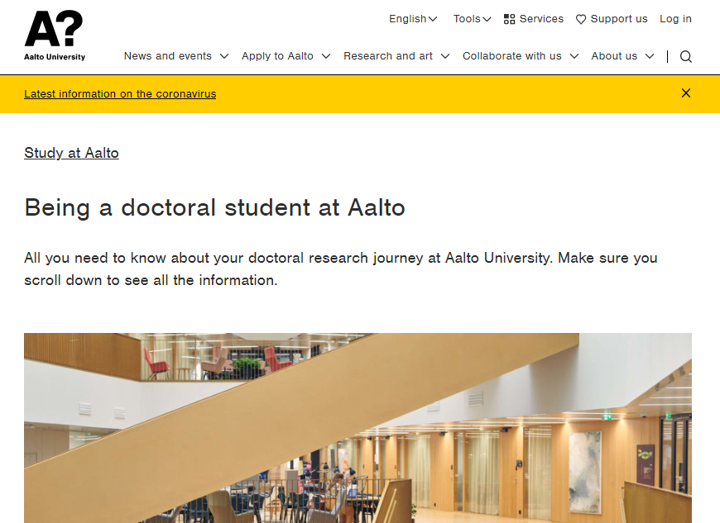

Slide 32
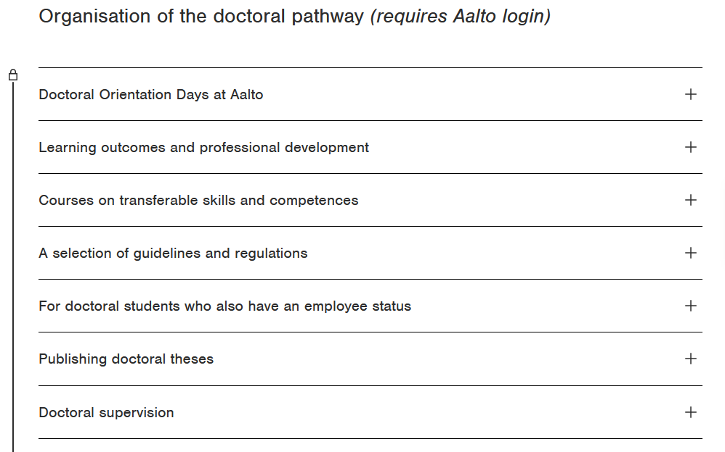
https://www.aalto.fi/en/study-at-aalto/being-a-doctoral-student-at-aalto

Slide 33
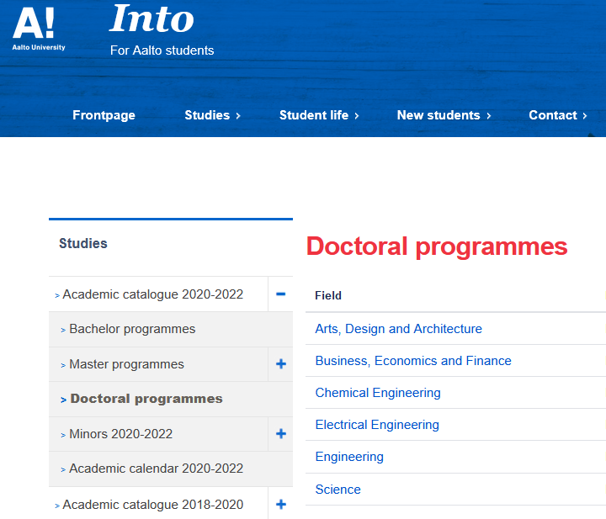
Doctoral programmes in Into:
https://into.aalto.fi/display/enopinnot/Doctoral+programmes

Slide 34
We encourage you to be active:
Search for information
Make friends
Be part of Aalto community and Aallonhuiput
Keep your contacts
Enjoy Aalto possibilities
Stay in touch
Make whatsapps or other communication groups
Use the zoom links created

Slide 35
Questions, comments proposal?
udes@aalto.fi
(+ School DES personnel)

