Slide 1
Day 1: Introduction and Purpose of Course
Project Management
Aalto University, Winter 2022
Patrick Simek, PhD

Slide 3
Course Structure and work style
Course Structure
Work Style
21 hours of work in class +
7.5 hours of work outside of class each day (including weekends)

Slide 4
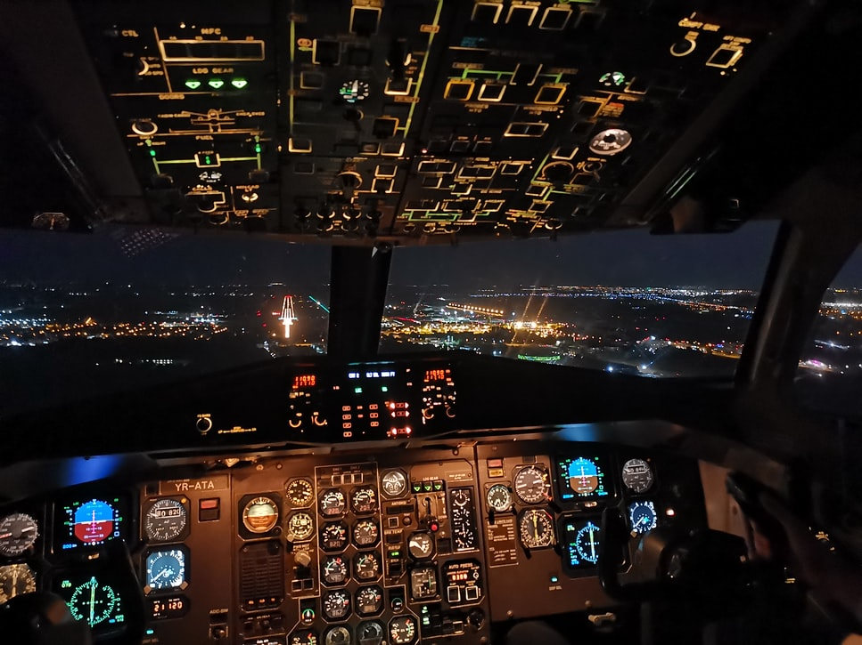
purpose of this course
Understand special features of projects
Learn common tools and methods - “processes” - to successfully manage projects
Become aware of and refine important social “people” skills to manage and participate in projects
“Is project management for me?”

Slide 5
Course Focus and Skill Development
Critical factors for project success
Skills in planning and implementing projects
Communicating in various project stages
Communicating to various audiences
Time management

Slide 6
Breaks, Prep for each day and Graded assignments
Two 15-minute breaks
Participate actively in class discussions and in your team
Submit all assignments when they’re due
Do the out of class readings and on-line assessments

Slide 7
Grades
4 team assignments (of which one is a project presentation
Individual presentation grade
Exam in class on Day 7 – 30 points (multiple choice)

Slide 8
Reading
Reading: Project Management for the Unofficial Project Manager
Articles
Templates for some assignments
YouTube videos
Personal Assessments
Links on MyCourses

Slide 9
Office Hours and email
Monday – Thursday: right after class (stay online)
Friday: right after class (stay online)
Email: patrick.simek@yahoo.ca

Slide 10
This Photo by Unknown Author is licensed under CC BY-SA
This Photo by Unknown Author is licensed under CC BY-NC

Slide 11
Project management is important in the 21st century because all knowledge workers will manage projects
* Most jobs today are 60-80% project-based
* Most employees have no project management training
* Average cost of failed projects = 1/3 of project budget
* < 8% of organizations perform well on projects

Slide 12
Poor project management leads to…
45% of projects - overdue or canceled
55% - don’t meet goals
ROI suffers
US stats - $13.50 net loss on every $100 spent on projects
Poor morale and high job turnover

Slide 13
Why blend project management and communication?
Projects often take place “outside” of the normal hierarchy
Lateral leading
Therefore: 3 top skills project managers need
Communication
Empathy
Conflict resolution

Slide 14
What do we mean by a project
Goal - create a unique product, service or result
Time frame - Temporary
Definite beginning and end
End = objectives are met
(or can’t be met and the project is cancelled)

Slide 15
FEATURE | REGULAR OPERATION | PROJECT
Task | Familiar | Unfamiliar
Staff | Full-time, Permanent | Part-time, temporary
Roles & Duties | Established patterns | Uncertain, variable
Culture | Set by role or power | Task-driven
Momentum or pace | Maintained by system | Threatened by system
From David Boddy, Managing Projects, Building and Leading the Team, Pearson Education, 2002, p 7

Slide 16
FEATURE | REGULAR OPERATION | PROJECT
Working Relationships | Established cooperation | Negotiable, need to create cooperation
Authority | Clear. Set by employee’s jobs/titles | Ambiguous, determined by project
Coordination | Hierarchical | Network/matrix
Information Sources | Established, routine | New, uncertain

Slide 17
What kind of communicator are you?
Answer 12 question survey
Add your scores on page 3
Read about the type of communicator you are
Why could this knowledge be helpful when working on a team

Slide 18
project team Roles
Leader – guides and helps the team, clears hurdles, communicates clearly, provides resources, is empathetic, encouraging, motivating
Subject matter expert(s) – know the industry or activity, have experience and know-how
Financial guru – good with accounting, finance, cash flow management
Strategist – big picture thinker, watches for changes in stakeholder or end-user behavior
Executor – good at scheduling, checklists, research, making sure things get done

Slide 19
Characteristics of successful teams
Share a clear purpose
Technically and personally competent
Creative thinkers and problem solvers
Effective communicators
Collaborative
Disciplined
Mutual respect
Notes:
Let’s look at the characteristics of successful teams before you choose a project and form teams,
Based on research from the Project Management Institute, successful teams have all of these characteristics. Let’s look at each of these elements a bit more closely.
Strong Sense of Purpose
A project must begin with a clearly defined and approved mission need that your team understands. Failure to secure an approved mission statement may lead to poor use of limited resources and may put your project at risk of inconsistency with organizational goals.
Summary
Building an effective team is the most important thing a project manager can do to ensure the success of a project. A project team can fail to accomplish its objectives for many different reasons; however, by understanding the nurturing attributes that make a team work well together — and acting on those attributes — you will help set your project team up for success.
Effective teams are not born: they are created and often go on to accomplish great things.
As a team leader, provide and nurture the above, and you will watch your team thrive.

Slide 20
a clear purpose
Project has a clearly defined and approved mission
Team members understand and are committed to finding a solution
Team creates a team charter –
scope
desired outcomes
overall collaboration approach
Notes:
Share a Clear Sense of Purpose
Until you can define the problem in need of a solution, you will not have a legitimate cause for committing resources. Can it be said that the only thing worse than a rebel without a clue is a project without a cause?
Also, a project will likely suffer an early death if your management doubts the team’s commitment to the purpose. A team charter that has been reviewed and endorsed by management clearly expresses the recognized need for a project team, its scope, desired outcomes, and overall management approach.
The combination of an approved mission and a formal team charter establishes an early foundation for a strong sense of purpose, both from the perspectives of management and from the integrated project team members assigned to support your project.

Slide 21
Technically and personally competent
Technical skills
Personal skills
communication
conflict resolution
negotiation
creative problem solving
strategic thinking
team working
persuasion
Notes:
All members of the team are technically and personally competent. It’s not just the team leader or project manager who needs communication skills, is able to resolve conflicts and negotiate, is good at problem solving and strategic thinking, it’s every member doing their best to use these skills. Yes, we discussed earlier that it’s important for teams to have a financial guru and a strategic thinker, but when everyone does their best in all of these areas, the project has a much greater likelihood of being completed on-time, on-budget, meets stakeholder and end user expectations, and is overall a quality job.
Competent
Competent team members have suitable and/or sufficient skills, knowledge, and experience for your specific project’s purpose; they are properly qualified to tackle the topic and develop a winning approach and successful solution.
But who would select incompetent team members? All project managers know that competent people create a competent team, because team competence is merely the aggregate competence of the individual players.
Teams typically exhibit two types of competencies: technical and personal. The combination of the two helps a team function well.
Technical competencies relate to the technical skill levels of the individual team members. When recommending team members, two questions should be asked:
What critical technical skills are needed?
What balance of these skills is needed to round out the team?
Rather than opting for each team member to have identical skills, select a balance of people with varying types and degrees of relevant technical skills.
Personal competencies— the qualities, skills, and abilities of team members allow individuals to function effectively as a team. Interpersonal skills (i.e., soft skills or people skills) enhance an individual’s interactions, job performance, and career prospects. They include communication skills, conflict resolution and negotiation, creative problem solving, strategic thinking, team building, and persuasive skills. Interpersonal skills help a person interact effectively with coworkers and stakeholders and are broadly applicable both in and outside the workplace. It’s often said that hard skills will get you an interview, but you need soft skills to get (and keep) the job. One can say that its basis is the genuine concern for the feelings of others, particularly those on your team.
Desirable personal competencies include:
Active listening (listen more, talk less, and consider others’ perspectives)
Constructive criticism (give it cheerfully; receive it likewise)
Conflict mitigation (assume that your team members have the best intentions in mind; pick your battles)
When recommending team members, consider individuals singularly and how each would work with the team as a whole.

Slide 22
What does a creative thinking and problem solving team look like?
Uses abstract and non-linear thinking – pinball machine like
Is diverse – ethnic, cultural, political, philosophical and generational
Encourages creativity
Avoids idea-killing phrases:
“That won’t work.” “We’re not ready for that” “We tried that.”
Encourages debate
Discourage ridicule
Notes:
Creative problem-solving teams are not homogeneous and often don’t think alike. Sometimes they disagree, and that’s a good thing. They value their differences and build on them. When they disagree, though, they do so with respect.
Creative
A technically and personally competent team with a strong sense of purpose can still be success limited if it lacks creative energy from both leader and members.
Creative thought is often abstract and non-linear, as our brains attempt to make associations and build links where none existed before. We all do this instinctively when pressed to solve a problem or scheming for a desired outcome. Try to provide a diverse team environment (e.g., ethnically, culturally, politically, philosophically, and generationally) in which creativity is encouraged and avoid saying any of the following idea-killing phrases (adapted from www.dummies.com/how-to/content/inspiring-team-creativity-for-business.html):
It won’t work.
We’re not ready for that. It isn’t practical. It’s already been done. Write a white paper for me on that.
Do any of these phrases sound familiar? Have you used any of them?
In addition, creativity has a better chance of taking root and thriving if the team rejects the notions that:
Creativity is limited to artistic types. Failure will be punished. Crazy ideas will be ridiculed. Creativity can get out of hand.
All ideas should have immediate practical applications.
Instead, encourage healthy debate, which can lead to an increase of high-quality ideas.

Slide 23
What helps teams be Collaborative?
Shared sense of the purpose and communication
Trust
Tools to promote communication
* Face to Face Meetings * Videoconferences
* Telephone * Text Messages
* Email * Social Media
* Skype * “War Rooms”
Notes:
This slide is actually about communication from the standpoint of trust and choosing the best type of communication.
Trust is a key element here. Think for a minute, who in your life do you trust? Why do you trust them?
Right. People you trust tell you the truth, do what they say they’ll do, and they have your back. They don’t criticize you to others behind your back, and if they have a problem with you, they respect you enough to discuss it one-on-one.
That’s how I hope your teams will work in this class.
As for tools to promote communication, fact to face meetings are the best. Why? Do I say that? (Let students answer)
It’s because when you are face to face, you can hear words, see body language, and sense if you are on the same page or not. That’s why modes of communication that use as many of the senses other than words yield better results.
How many of you have ever had a misunderstanding with a friend or person you were dating when texting? Did it seem silly later after you figured out what the other person really meant? Right. So to avoid wasting time with straightening things out, have meetings that are as personal as possible.
In case you’re wondering, War Rooms mean having a special work space where the team meets to brainstorm and work together for extended periods of time. Teams that work in war rooms develop close bonds with each other and often come up with extremely creative solutions to problems.
Successful collaboration happens when your team works together toward a common goal. A competent team with a common sense of purpose is helpful in this regard. Collaboration looks a lot like “teamwork,” which further suggests an environment conducive to effective communication. Because communication is the key to collaboration, the project manager must foster a project environment that encourages open communication and trust among team members and provides an infrastructure to make each form of communication as effective as possible.
As the leader of the project team, the project manager can use many different methods and tools to facilitate a highly collaborative environment. Here are some effective methods of communication:
Face-to-face interaction (single or group meetings)
Videoconference
Telephone
Collaboration software (e.g., Microsoft® SharePoint®, GoToMeeting™)
Social media
Email
Text messages
U.S. Postal Service
For long-duration or high-visibility projects, collocation of team members, or a ”war room,” tends to heighten collaboration between team members by facilitating the free and impromptu flow of ideas and information.

Slide 24
Discipline starts and ends with the team leader
Establish group process agreement and mutual expectations
Emphasize meeting attendance
Plan the next work week’s activities ahead of time
Conduct regular status reviews
Be accountable - keep commitments
Avoid wasting time
Communicate with stakeholders regularly
Connect with your team daily
Notes:
If you put on your paper that you want to be the leader of a team, here are some additional things to consider. The leader needs to be ready to put in as much if not more time than other team members to make sure that the things on this slide are accomplished and accomplished well. Over achievers – step right up!
Disciplined
Team discipline is one of the most important elements of structure and organization for potential team members and starts and ends with the team leader. Discipline sets the tone for the team over the course of the project; it determines how and when meetings are run and impacts team dynamics and, ultimately, the success of the project. It can make solving problems easy and help avoid other problems altogether.
You must be a disciplined leader to get the most out of your project team. Discipline (e.g., at home, in school, or in the army) is key to helping you follow your processes and accomplish what needs to be done for successful projects. Needless to say, your team will not be disciplined if you are not a disciplined leader.
The following considerations concern the project manager’s role in team discipline:
Establish a group process agreement up front to set mutual expectations for the team members
Emphasize the importance of meeting attendance
Plan the next work week’s activities ahead of time
Conduct regular (weekly or daily) reviews of what you did and did not accomplish
Follow through on your commitments
Avoid time wasters
Communicate with stakeholders regularly, regardless of results
Take the time to connect with your team each day
Of course, if you’re a team member, encourage your leader from time to time with helpful feedback on his or her or the team’s performance, and fully participate in and contribute to the team’s efforts.

Slide 25
Create Mutual respect
Insist that everyone treat others as they would want to be treated
All team members ask themselves, Am I …
Reasonable? Consistent? Open to others’ ideas?
Sensitive to the needs of others? Willing to admit mistakes?
Free from a hidden agenda?
Notes:
Being part of a project team can be a growth experience and it is definitely an exercise in understanding yourself as well as learning how you interact with others. I realize that all of the things on this list don’t come naturally to all cultures and even if you are like this most of the time, when the deadline slips, when team members aren’t getting along well, when your budget just got reduced, or when a stakeholder just announced a major change, stress can make the most respectful of us lose it.
After you form your teams, I challenge you to ask yourself these questions every day. That will help remind all of us of the components of mutual respect.
OK. Any questions about the characteristics of successful project teams? All right. Let’s proceed to choosing a project and forming our teams.
Mutual Respect
In a team environment, mutual respect among team members is a good starting point on the road leading to trust. We may respect our project managers, elected officials, or other leaders, but they all must earn our trust. Respecting others does not necessarily mean that you trust them to do what’s in your best interest, but heartfelt trust is rooted in the evidence that you can depend on another person. Although we can respect a person we don’t trust, can we truly trust a person we don’t respect?
One simple way to begin building an effective team is to insist that members of your project team treat others as they would want to be treated. It’s a simple lesson from grade school, yet sometimes neglected in the workplace. Mutual respect, which starts with the process of building trust and goodwill, requires some effort from all parties.
A simple way to help gauge whether your attitude about your project and your role and behavior within it are conducive to building trust and goodwill is to ask yourself:
“Am I”—
Reasonable?
Consistent?
Open to others’ ideas?
Sensitive to the needs of others?
Willing to admit mistakes?
Free from a hidden agenda?
If everyone on the team pursues honest answers to these questions and makes the necessary adjustments to his or her attitude and behavior, the team will enjoy the benefits of mutual respect and perhaps team trust.

Slide 26
Project Team Formation
Read project choice handout
Add suggestions for own projects
Form teams based on interests, skills, strengths and experience

Slide 27
For Class tomorrow…
Required readings- Text chapters 1-3
Team Task 1:
Team Charter
Project scope statement
List of stakeholders for your project

Slide 28
Team kick-off meeting
Introduce yourselves – why you chose this project, skills, strengths, experience, interests you bring to the project
Choose a team name and team leader
Decide when you will meet to complete the team kick-off meeting and Team Task 1

Slide 29
In class or after class:
Review sample team charter
Discuss how you will work together and write your Team Charter
Review links to diversity resources on MyCourses
Talk about the considerations your team will have in working together given your Cultural/Gender/Political/Age backgrounds
Start to think about the scope of this project (consider me (Patrick) to be the project sponsor)
Discuss your project and write a List of Stakeholders (There should be some real people and some may be fictitious people)

