Slide 1
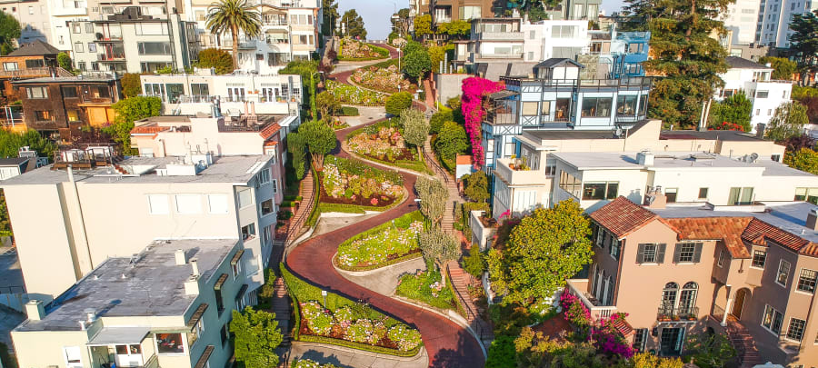
Aesthetic Experiences
18.1.2022
Ahola, Eeti
Chen, Yiqi
Hakumäki, Matilda
Ihalainen, Emilia
Kajander, Atte
Kousa, Janne
Raunio, Kirsi-Maria
Tajalli, Mahsa

Slide 2
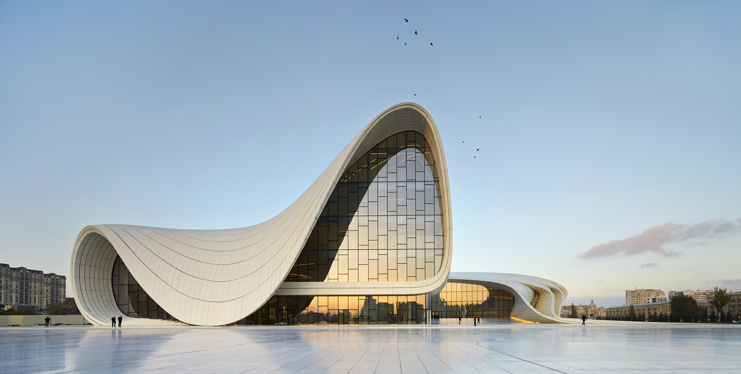
Architectural Aesthetic Features:
Architecture is counted as visual art since it uses sensory elements such as color, size, shape, balance, texture, unity, contrast, context… to be created. But what does aesthetic architecture mean and how can it be evaluated?

Slide 3
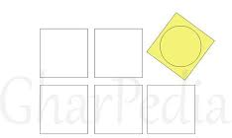
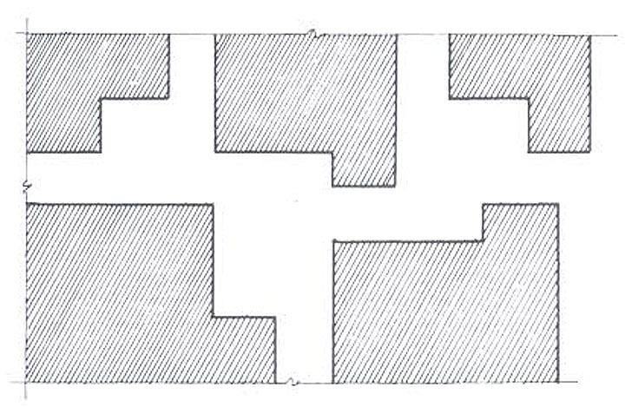
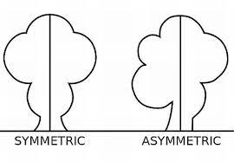
Architectural Aesthetic Features:
Architects use principles and creative processing to put various elements together in creating a unified whole. Such as Mass and Space, Symmetry and asymmetry, contrast, hierarchy, balance, unity and rhythm
Hierarchy
Mass and space
Rhythm

Slide 4
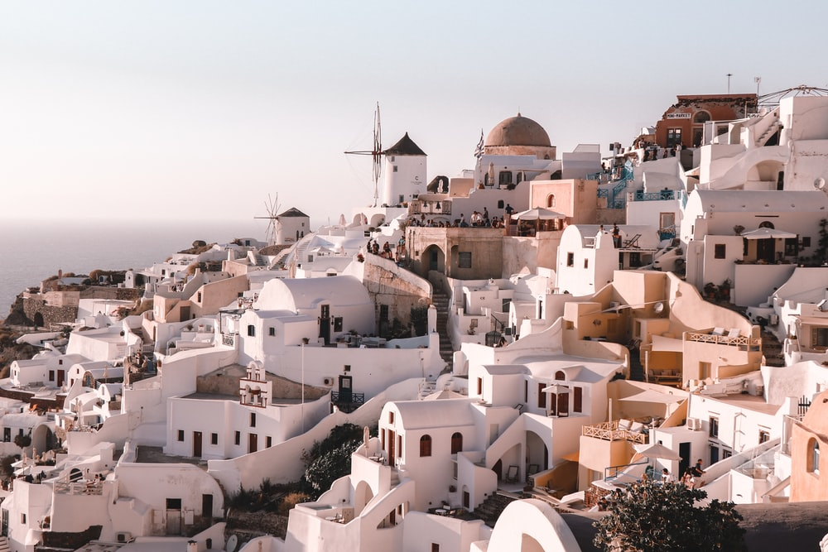
Architectural Aesthetic Features:
Architecture and buildings are part of objects in Urbanism. Exterior of a single building cannot matter alone but in comparison with other buildings and their surroundings alongside with their relation to streets, plaza,...

Slide 5
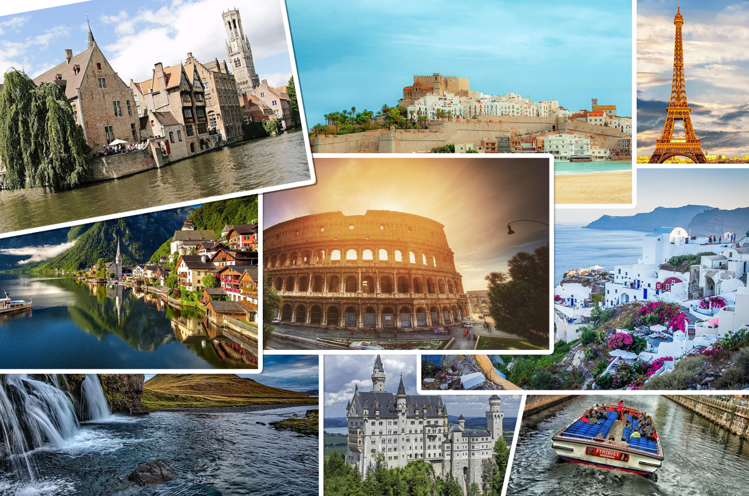

Slide 6
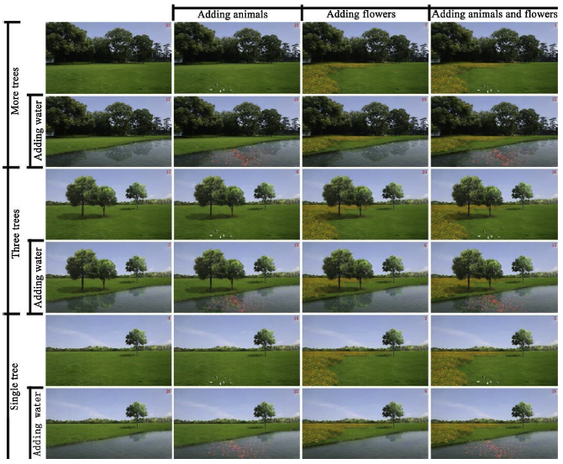
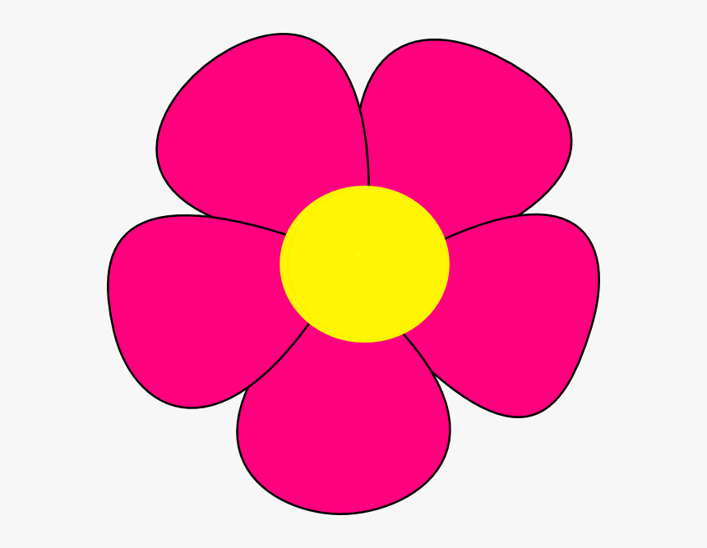
Urban green spaces and aesthetics
Nasar (1998):
“closeness to nature” is one of the six most important factors defining visual pleasantness in cities
Biophilia Hypothesis (Wilson, 1984)
Environmental preference and restoration are closely related (Van den Berg et al, 2003)
Photomontage study in China:
Strong positive correlation between aesthetic preference & restorative potential
Number of trees, water elements, flowers and fish increase aesthetic experience (Wang et. al 2019)
Characteristics of urban green spaces in relation to aesthetic preference and stress recovery (Wang et al 2019)
Notes:
Next I’m going to talk about urban green spaces and aesthetics. As we all remember from Marke’s lecture,
Biophilia hypothesis = human beings prefer for natural environments due to an innate human attraction to biological things

Slide 7
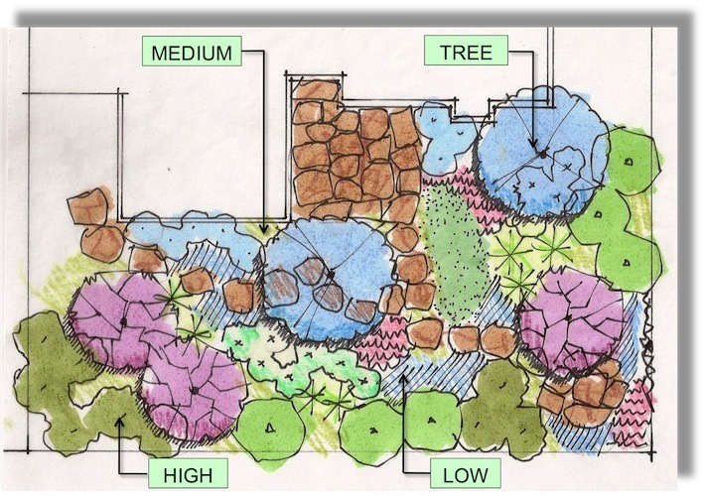
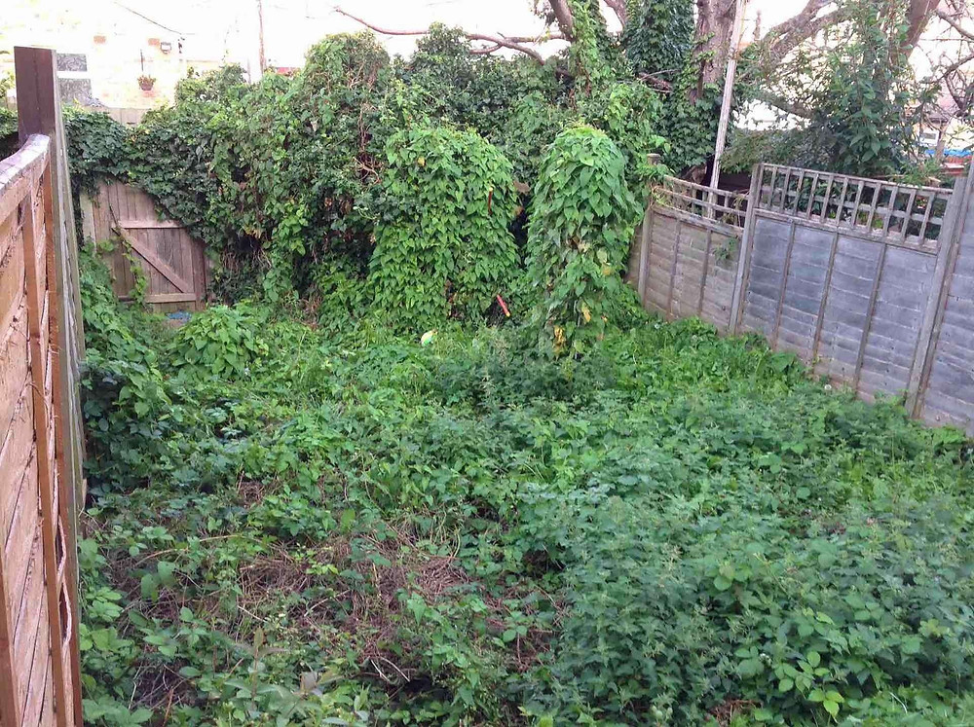
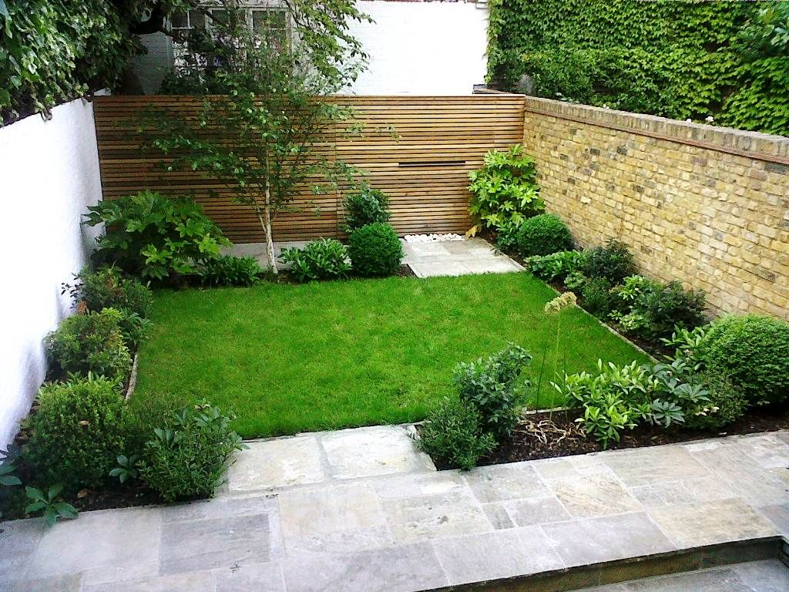
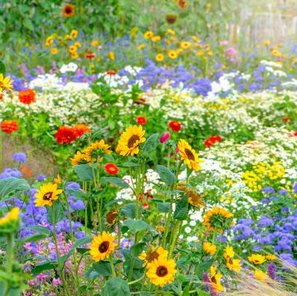
Booth and Hiss (1991)
Planting Design
Visual composition
forming a landscape,
place setting, connectivity
Scattered Coherent
Too much Too little
Volume/variety
Properties of plants
Species
Color
Purpose
Texture
Height
Chaotic
Uncoordinated
Visually Disturbing
Too simple, boring
Less attractive
Visually Unpleasant
Notes:
Different settings have different planting compositions
Booth and Hiss (1991): Residential Landscape Architecture, Design Process for Private Residence
Too much: too much variety / too little: “too similar”
People prefer coherency and color to natural/bushy/scattered, and plants with flowers
Trees are also preferred (Wang, Zhao, Meitner, Hu, Xu)
https://www.finegardening.com/article/design-like-a-pro-sure-tips-for-great-plant-composition

Slide 8
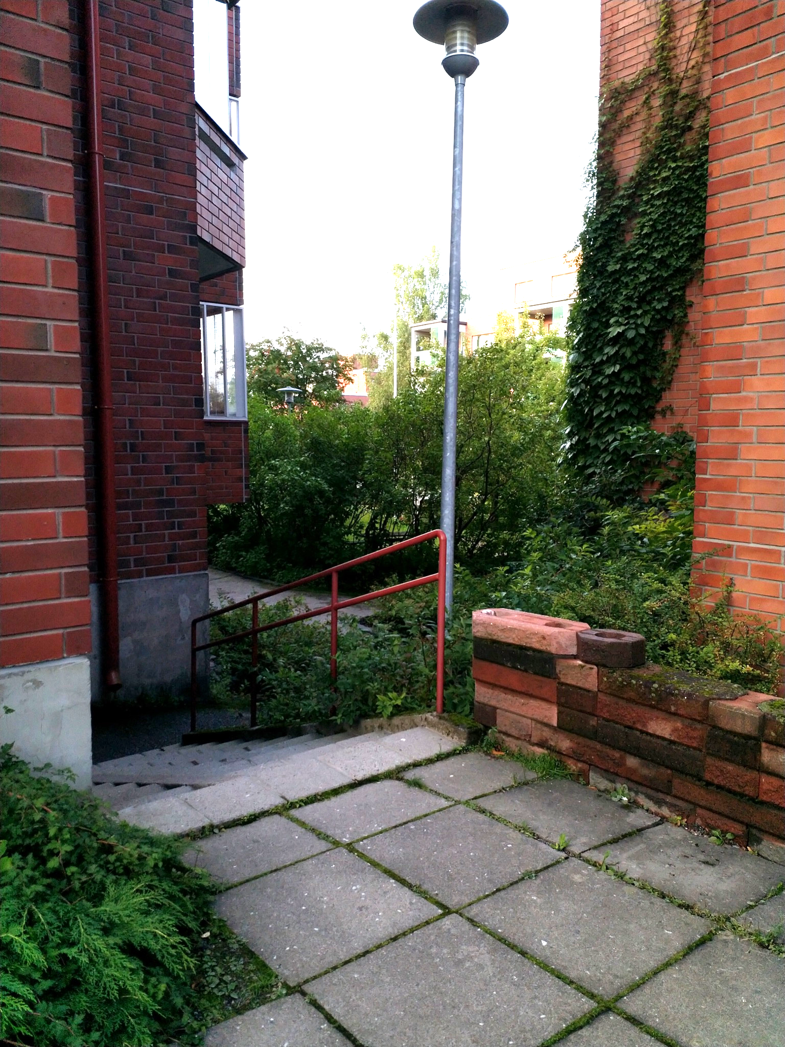
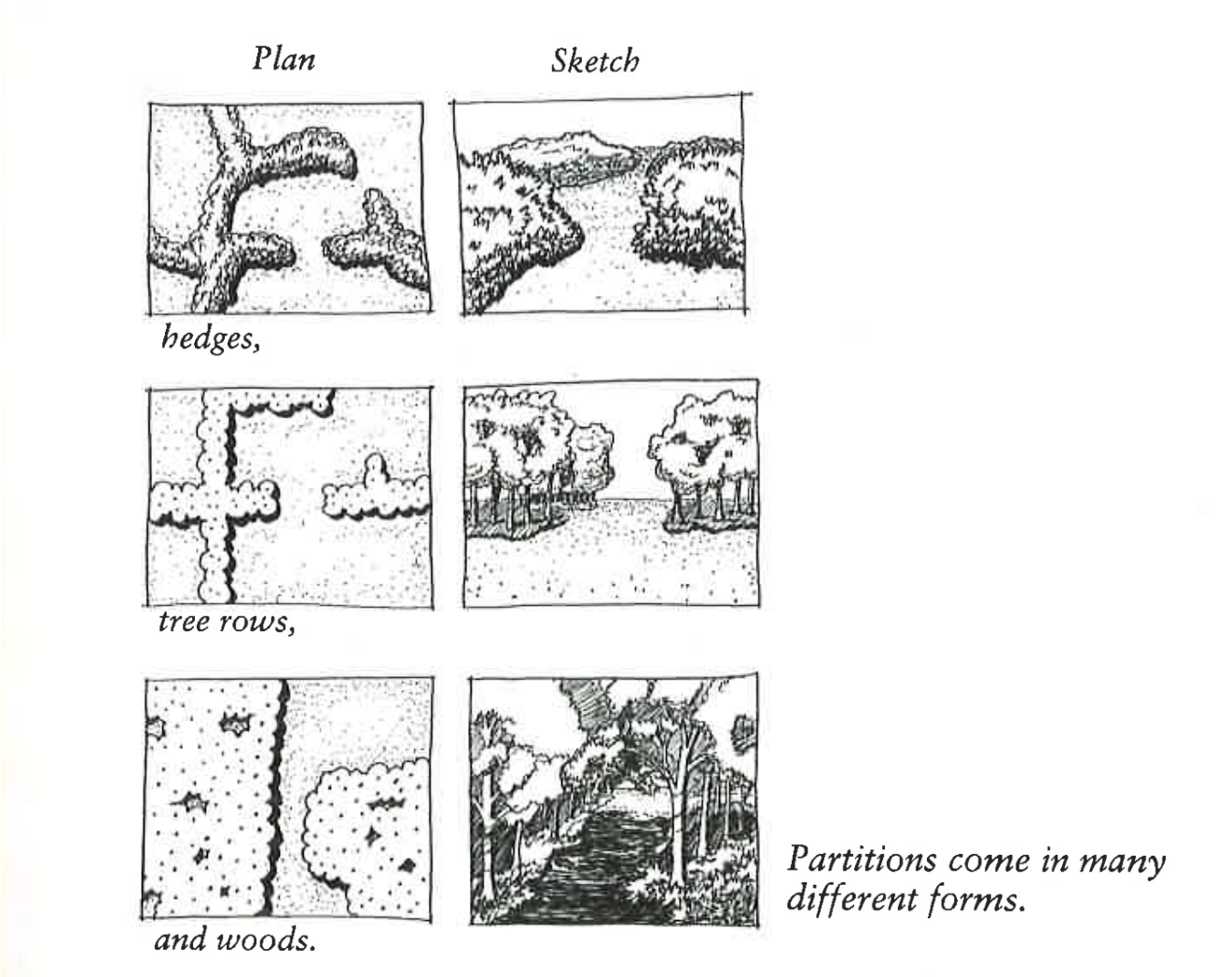
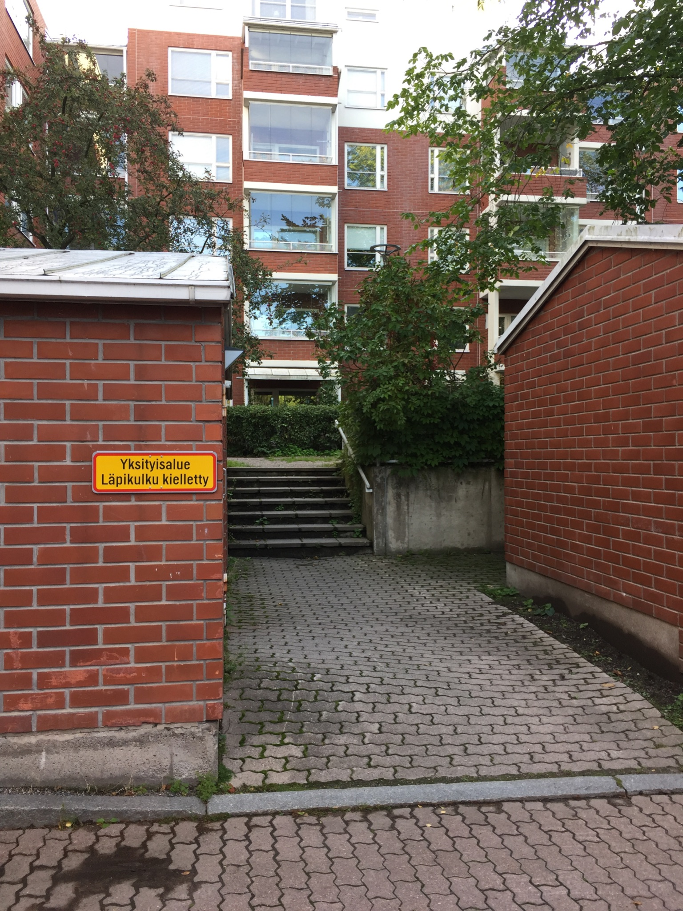
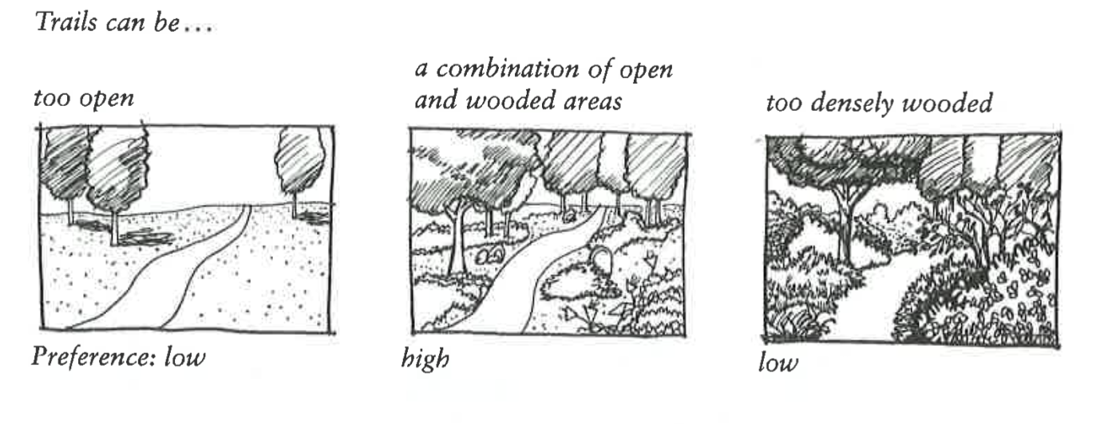
Gateways and partitions
Understanding | Exploration
Coherence | Complexity
Legibility | Mystery
Trails and locomotion
People are attracted to a curving path rather than a straight path. Trail should curve to follow the lay of the land.
Notes:
Kaplan, R. Kaplan, S. Ryan, R. (1998) With people in mind : design and management of everyday nature. Island press.
These design elements are mainly for natural setting, but they can be applied to urban environments as well.
Gateways:
Signal transition between spaces, help to orient to an area
A well designed gateway can provide both legibility and mystery (Kaplans’ matrix)
Trails and locomotion:
Trails enhance a sense of security (legibility, coherence). If there is no path, it may be less clear that the venturing forward is appropriate (especially in nature setting).
Curving trail attracts more than a straight trail (more mystery, whats behind the corner?).
Aesthetic locomotive experience is a balanced combination of understanding and exploration

Slide 9
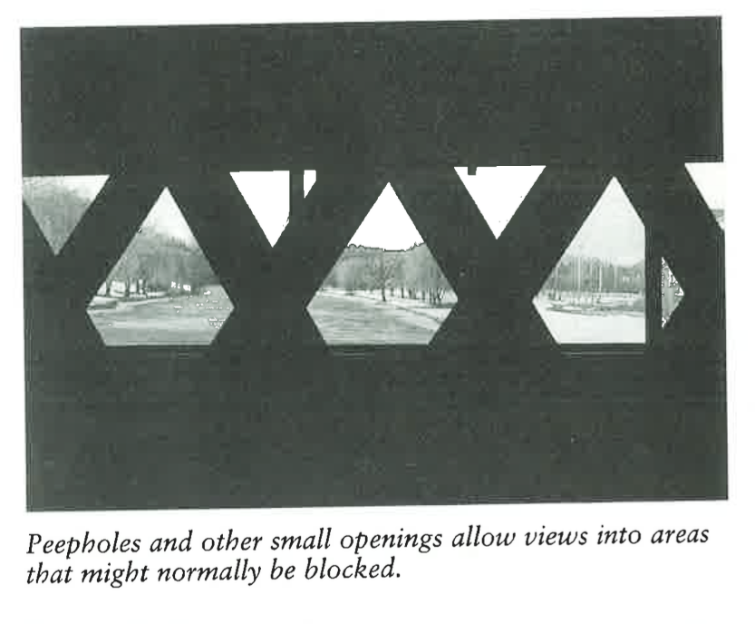
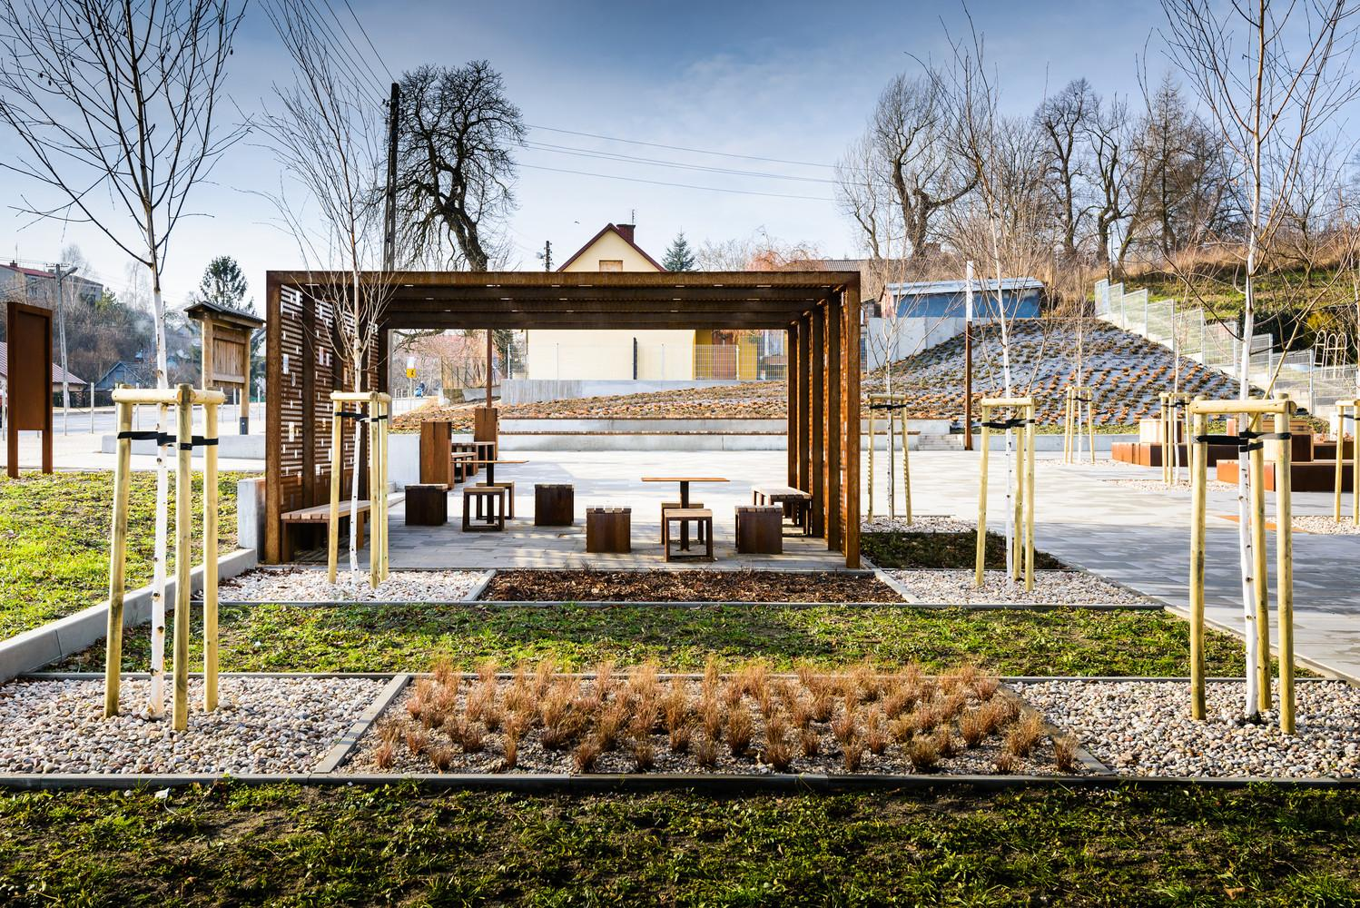
Views
Understanding | Exploration
Coherence | Complexity
Legibility | Mystery
Places
Notes:
Kaplan, R. Kaplan, S. Ryan, R. (1998) With people in mind : design and management of everyday nature. Island press. CHAPTER 10 Engaging people.
Views and vistas
Views need focus points (where to look at? What path does the eye follow?)
For example trees, tree rows, rivers
Peepholes/windows lure to look at a surprising view (again, mystery)
Places
Natural elements attract people, especially trees and water
Well defined waterscapes with a natural form are usually favored (rarely straight edges). Eroded or overgrown banks are generally disliked.
Open and poorly defined spaces become more interesting if they are divided. Spaces with more private feel (sense of enclosure) tend to attract people. For example a pergola in a park can create a sense of own place when being in there.

Slide 10
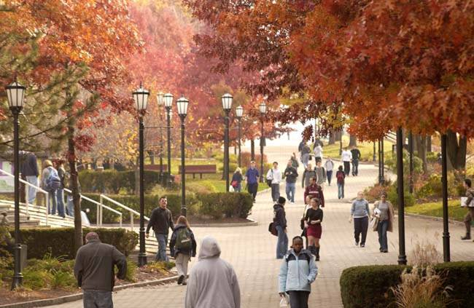
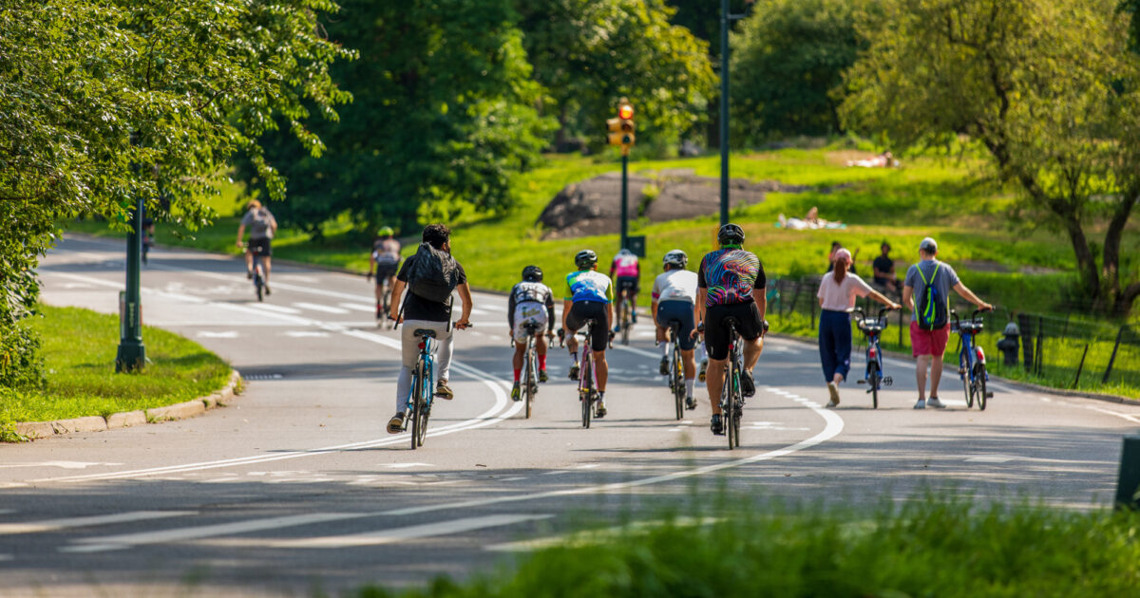
Urban aesthetics and physical activity
Can an aesthetically pleasant environment contribute to walking and cycling?
Commonly studied aesthetical factors include urban green such as parks, trees and gardens, diversity of architecture, natural sights, cleanliness (Pikora et al. 2003)
Significant positive effect on walking for exercise and recreation (Ball et al. 2001; Owen et al. 2004)
Aesthetical environments can also attract cyclists, as long as the infrastructure is in shape (Mertens et al. 2016)

Slide 11
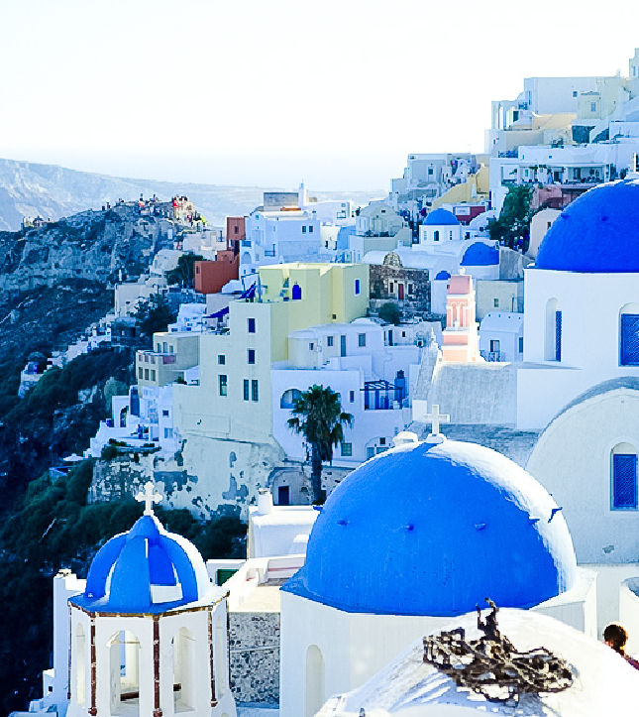
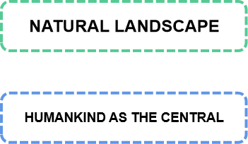
Rural Environmental Aesthetics
Carlson put forward the ecological aesthetic principles of "nature as complete beauty" and "life community", and believed that natural aesthetics is displayed step by step through its characteristics until the natural environment itself.

Slide 12
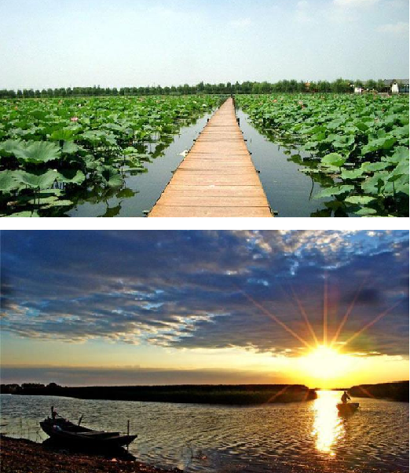
SYMBIOSIS
Reflecting the harmonious coexistence of production, life and ecology, only when the unity of the three can produce better aesthetic effect.
SUSTAINABLE
The sustainable concept of coexistence between man and nature forms the harmonious atmosphere of rural environment.
HABITABLE
Rural environment is the living place of locals, so its aesthetic experience is based on locals' living experience.
PRODUCTIVE
When the rural environment is productive, it can meet the development needs of locals and provide them with material basis.
Rural landscape of Guangdian village

Slide 13
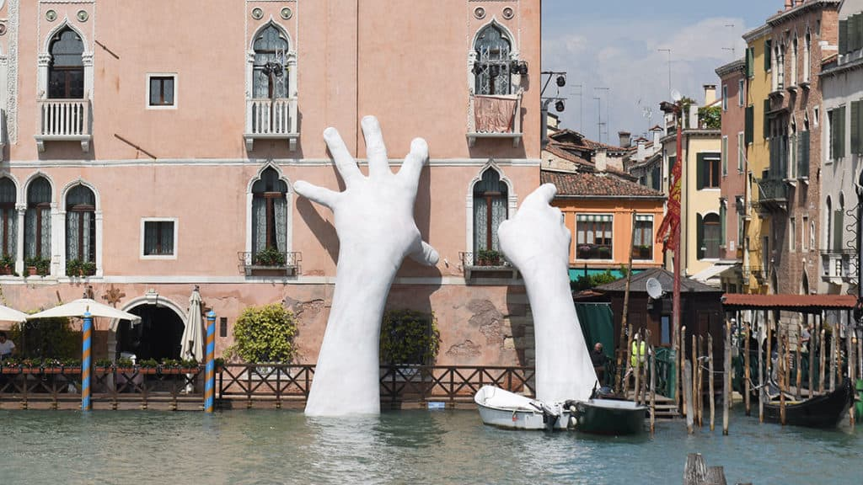
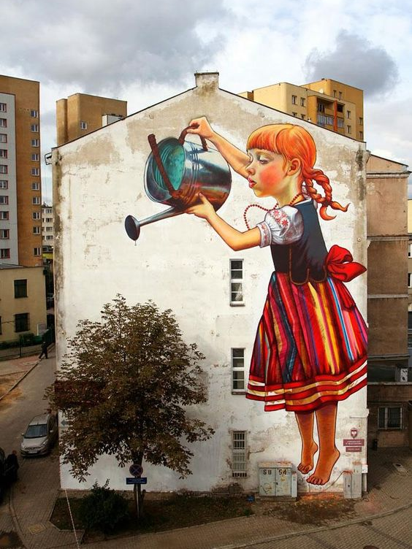
Public Art and Aesthetics
‘The aim of art is to represent not the outward appearance of things,
but their inward significance’ (Aristotle)
Support (2017) Artist: Lorenzo Quinn, Venice, Italy
‘The Legend of Giants’ by Natalia Rak

Slide 14
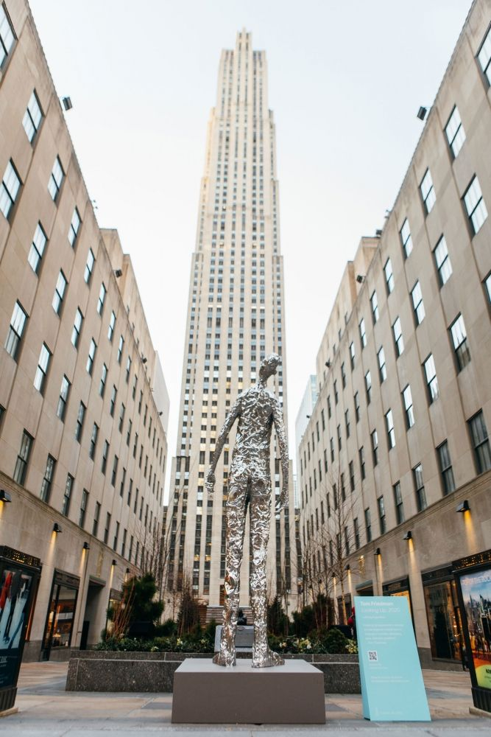
from monumentality to function
“site specific … in the public domain” McCarthy (2006)
Questionnaire of Taike 2020
Majority (72%) 15-79 years old Finns want art to their everyday environment
The percent for art principle
increase the aesthetic value of state-owned public buildings and places
Art and design contribute to the attractiveness of a place among businesses, investors, taxpayers and tourists - enhance the quality of city life (cultural and economic value)
The education value
communication, dialogue and exchange
Tom Friedman ‘Looking up’ 2020
https://www.luhringaugustine.com

Slide 15
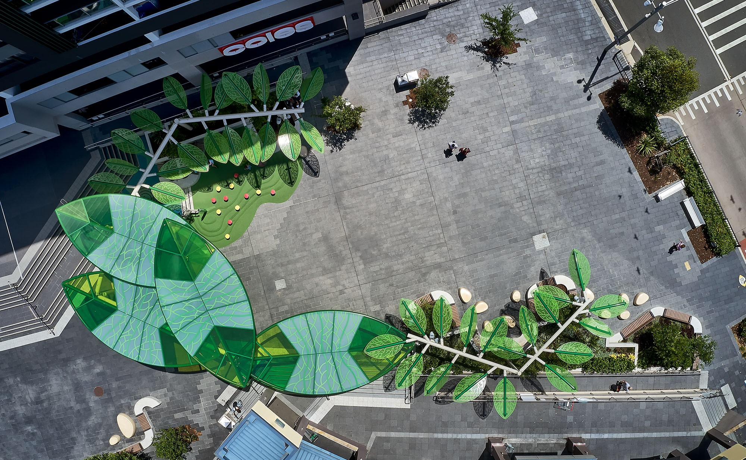
Tom Friedman ‘Looking up’ 2020
https://www.luhringaugustine.com
Landezine: Artistic Shade Structure 2021

Slide 16
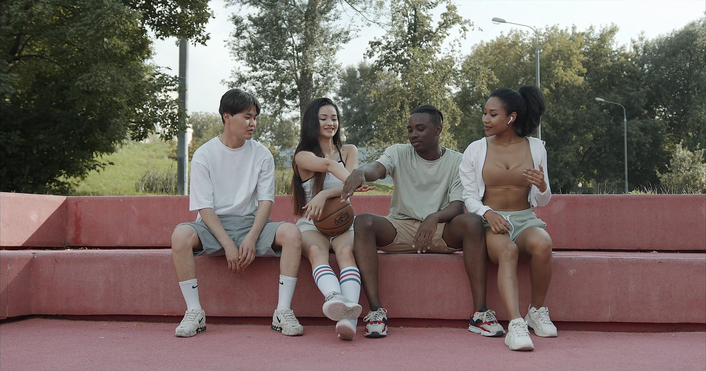
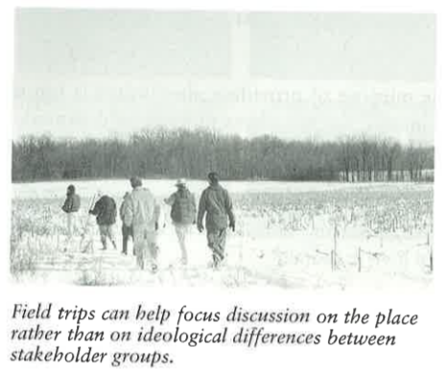
Aesthetics and participation
There are different knowledges and understanding - between experts and the public.
The public is not homogenous - there is multiple "publics".
Why participation?
To increase "good aesthetics" the feeling of the place and possibility make a difference is relevant
Impact of participation extends even among those who does not participate directly
Design or planning fits to the local context and create unique solutions
Increases sense of ownership, stewardship, and community
Notes:
Aesthetic Preference as Starting Point for Citizen Dialogues on Urban Design: Stories from Hammarkullen, Gothenburg (Brita Fladvad Nielsen, Ruth Woods and Wenche Lerme) → file:///C:/Users/emili/Downloads/UP%204(1)%20-%20Aesthetic%20Preference%20as%20Starting%20Point%20for%20Citizen%20Dialogues%20on%20Urban%20Design_%20Stories%20from%20Hammarkullen,%20Gothenburg%20(1).pdf
Kaplan, R. Kaplan, S. Ryan, R. (1998) With people in mind : design and management of everyday nature. Island press. CHAPTER 10 Engaging people.

Slide 17
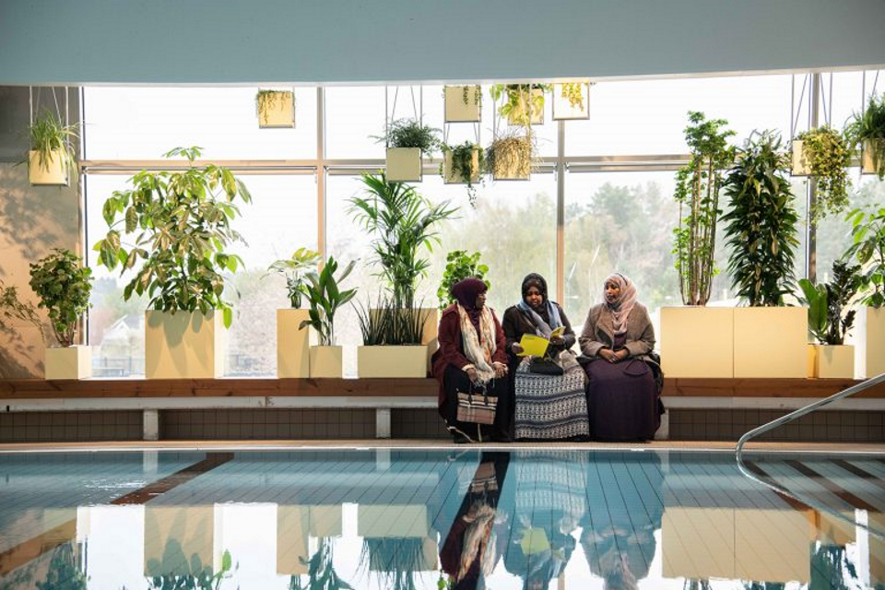
Aesthetics and participation
Case study in Hammarkullen, Gothenburg
Not all experts were included in early participation
Experts did not provide always clear information
The matter of different knowledges created at some level barriers
How to engage?
Start early, include many
Understandable information
Provide alternatives
Inviting feedback
Opportunities for participation
Attractiveness of engagement - why should I read this?
Small experiments
https://statenskonstrad.se/konst/moving-plants/
Notes:
Aesthetic Preference as Starting Point for Citizen Dialogues on Urban Design: Stories from Hammarkullen, Gothenburg (Brita Fladvad Nielsen, Ruth Woods and Wenche Lerme) → file:///C:/Users/emili/Downloads/UP%204(1)%20-%20Aesthetic%20Preference%20as%20Starting%20Point%20for%20Citizen%20Dialogues%20on%20Urban%20Design_%20Stories%20from%20Hammarkullen,%20Gothenburg%20(1).pdf
Kaplan, R. Kaplan, S. Ryan, R. (1998) With people in mind : design and management of everyday nature. Island press. CHAPTER 10 Engaging people.

Slide 18
Thank you!

Slide 19
Literature
Tom Friedman ‘Looking up’ https://www.luhringaugustine.com/highlights/tom-friedman-looking-up
https://www.ornamo.fi/projekti/taidekayttoon/
https://brill.com/view/book/edcoll/9789460911224/BP000011.xml
The handbook of the percent for art principle in Finland
WANG CHENHUI ‘Public art has more than aesthetic value’ | 2020-06-16 http://www.csstoday.com/Item/7966.aspx
https://www.researchgate.net/publication/344986936_Shifting_Sensibilities_Architecture_and_the_Aesthetics_of_the_City
https://www.designingbuildings.co.uk/wiki/Aesthetics_and_architecture
https://www.ripublication.com/irph/ijert_spl17/ijertv10n1spl_33.pdf
Paetzold, Heinz- Diogenes (English ed.), 2012-02, Vol.59 (1-2), p.63-72
Ball, K. et al. (2001). Perceived Environmental Aesthetics and Convenience and Company Are Associated with Walking for Exercise among Australian Adults. Preventive Medicine 33(5) 434-440.
Kaplan, R. Kaplan, S. Ryan, R. (1998) With people in mind : design and management of everyday nature. Island press.
Aesthetic Preference as Starting Point for Citizen Dialogues on Urban Design: Stories from Hammarkullen, Gothenburg (Brita Fladvad Nielsen, Ruth Woods and Wenche Lerme)
Booth and Hiss (1991): Residential Landscape Architecture, Design Process for Private Residence
Akhir, Sakip, Abbas,Othman (2018). Literature Survey on How Planting Composition Influence Visual Preferences: A Campus Landscape Setting. The Journal of Social Sciences Research. Special Issue, 6, pp: 783-790, 2018. ISSN(e): 2411-9458, ISSN(p): 2431-6670
Nasar J.L. (1998) The Evaluative Image of the City. Thousand Oaks, California: Sage Publications, Inc.
Noriah, O., Mohamed, N., Ariffin, M. H., Mohd, A. W. R. (2015). Landscape visual studies in urban setting and its relationship in motivational theory. Procedia - Social and Behavioral Sciences, 170: 442-51.
Owen, N. et al. (2004). Understanding environmental influences on walking: Review and research agenda. American Journal of Preventive Medicine 27(1): 67-76.
Pikora, T. et al. (2003). Developing a framework for assessment of the environmental determinants of walking and cycling. Social Science & Medicine 56(8): 1693-1703
Mertens, L., Van Dyck, D., Ghekiere, A. et al. (2016). Which environmental factors most strongly influence a street’s appeal for bicycle transport among adults? A conjoint study using manipulated photographs. International Journal of Health Geographics 15, 31.
Wang, R., Zhao, J., Meitner M. J., Hu Y., Xu, X. (2019). Characteristics of urban green spaces in relation to aesthetic preference and stress recovery. Urban Forestry & Urban Greening 41 (2019) p. 6-13.
Van der Berg, A.E., Jorgensen, A., Wilson, E.R (2014). Evaluating restoration in urban green spaces: does setting type make a difference? Landsc. Urban Plan 127, 173-181.
Wilson, E. O. (1984). Biophilia. Harvard University Press, Cambridge, USA.

