Slide 1
Functional environments
Group task 1
Liisa Amperla, Kaius Kiiras, Ville Leppänen, Markus Suominen, Tommi Toikkanen
18.1.2022
Content
1. Good quality built environments
2. Suitability for user groups
3. Walkability
4. Enjoyable streets
5. Functional public transport

Slide 2
Determining quality – context
Environmental determinism leaves out the human element
Possibilism and probabilism should not be only understood through individual agency – social elements
We cannot assess what is the quality and how functional the neighborhood is without understanding both the physical and the subjective dimensions
For example, in the case of walkability – social interactions
Dempsey (2009) Are good quality environments socially cohesive? Measuring quality and cohesion in urban neighbourhoods. Town Planning Review, 80(3),315-345.

Slide 3
Suitability for user groups
The functional quality of the environment consist of various settings and various user groups while only groups of people can define functional quality --> need for surveys (e.g., PPGIS data)
--> need to define the group to be asked the questions
--> functional quality of the environment (e.g. experienced functional problems) is usually revealed only through the lived everyday life (Ihmisystävällinen elinympäristö, Kyttä 2004)

Slide 6
Walkability as a functionality of environment
Walkability enables several areas of benefits (defined by ARUP) that can be interpreted as functionality of environment
Perspectives: social, environmental, economic, and political

Slide 7
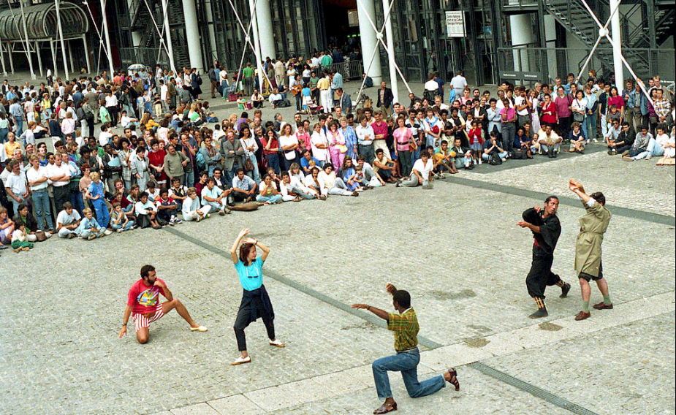
Social benefits of walkability
health and wellbeing (active lifestyles, reduced diseases)
- traffic safety and reducing crimes
placemaking
social cohesion and equality (accessibility, social interaction, inclusiveness, community identity)
Photo: by P. Capper (Wikipedia)
Photo: Vienna, by Bwag (Wikipedia)

Slide 8
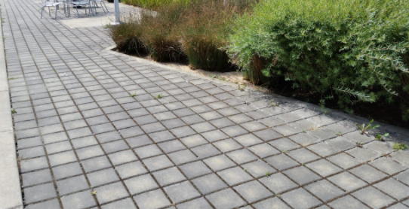
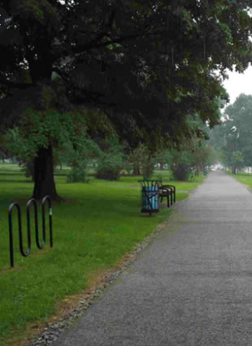
Environmental benefits of walkability
Photo: stormwater.cob.org
decreasing dependency on non-renewable resources
more compact infrastructure compared to motor vehicles
better air quality (more trees and vegetation, less vehicle emissions) + less noise + livability of streets and public space
improved urban microclimate (robust vegetation and shaded canopies) + increasing permeable surface for water drainage
Photo: epa.gov
Photo: Think Sustainability

Slide 9
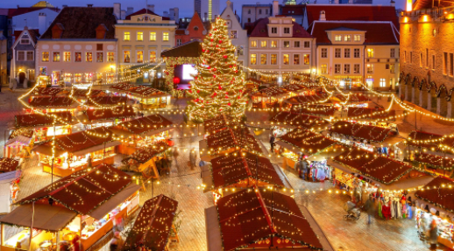
Economic benefits of walkability
local services and businesses (local social and economic vitality)
higher levels of productivity and creative thinking because of physical exercise
city attractiveness (branding, identity, tourism, creative class)
urban regeneration (increasing land and property values, active street facades) + cost savings (e.g., maintenance, healthcare costs)
Photo: Tallinn (metro.co.uk)
Photo: Stockholm (Culture Trip)

Slide 10
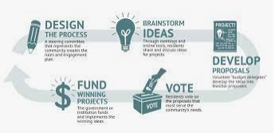
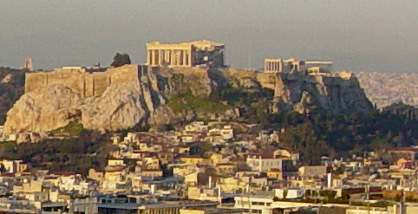
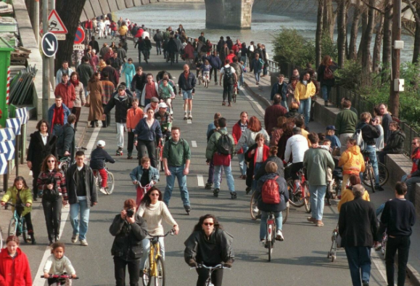
Political benefits of walkability
fostering competitiveness in the global network of cities
citizens may appreciate pedestrianization eventually
walking promotes increased feelings of attachment that may cause citizen empowerment (e.g., participatory budget in Paris)
correlation between community involvement and walkability (more innovative solutions)
sustainable development + urban regeneration + cultural heritage
Photo: Acropolis, by Leonard G (Wikipedia)
Photo: participatorybudgeting.org
Photo: Paris (france24.com)
Photo: High Line Park (newyork.fi)

Slide 11
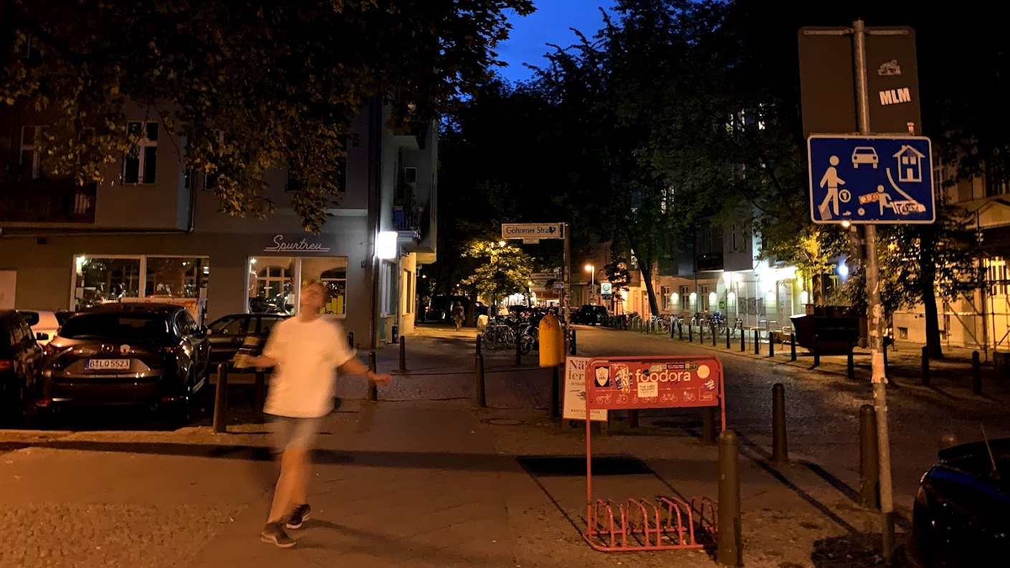
Functional environments, case designing enjoyable streets
Why enjoyable streets?
They are the core reason for the enjoyability of the urban life itself.
They include the mixed uses, the closeness to services, the interestingness to just slow down while walking –
to enjoy the environment and the people around.
A street is functional if it is enjoyable for all groups. Is it possible?

Slide 12
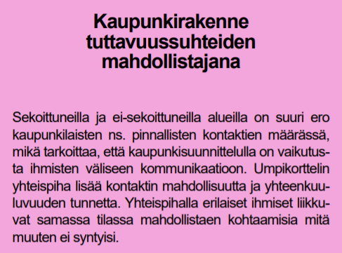
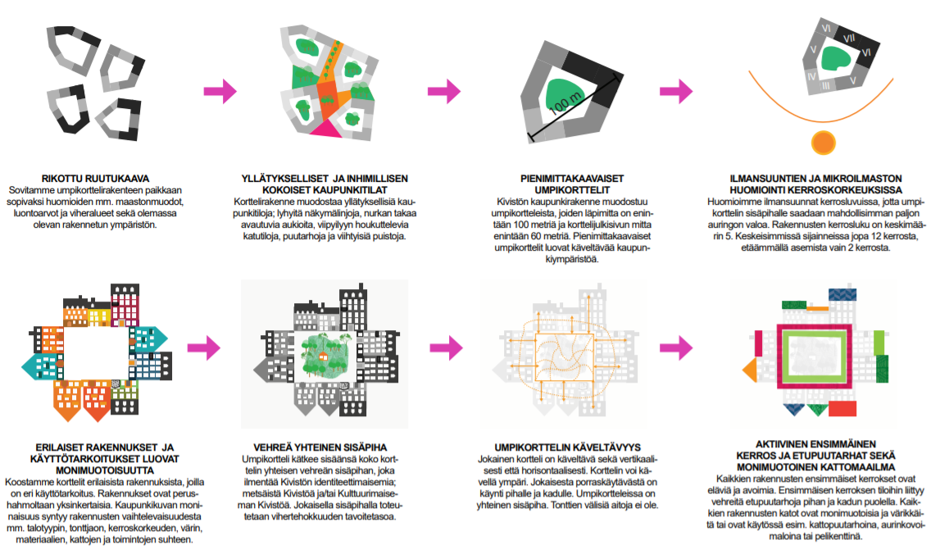
What to think when trying to create functional enjoyable urban environments? ...WHERE THE OPTIONAL ACTIVITIES HAPPEN! :)
Design no ”useless” spaces that have no purpose, "just to be on the safe side" – that creates the emptinesses we can see everywhere in modern functionalistic environments
Promote the interaction between the building and the street by allowing the building’s ground floor activities to flood into the street
An outdoor seating are for a cafe, or a small front yard of an apartment, or something else
The green spaces shall be active as well
A 2-meter-wide grass lane is not an active urban space
Design the street in a way that car drivers instinctively slow down – a sign doesn’t help
Make sure that the spaces are easily distinguishable; private, semi-private, public?
The built environment plays a crucial role in creating acquaintance relationships in the neighbourhood – which in turn makes the enjoyable urban life possible
…and thousands of other things – these are just some random examples!
Holmqvist, E. (2009). Politik och planering för ett blandat boende och minskad boendesegregation - Ett mål utan medel? Uppsala universitet.

Slide 13
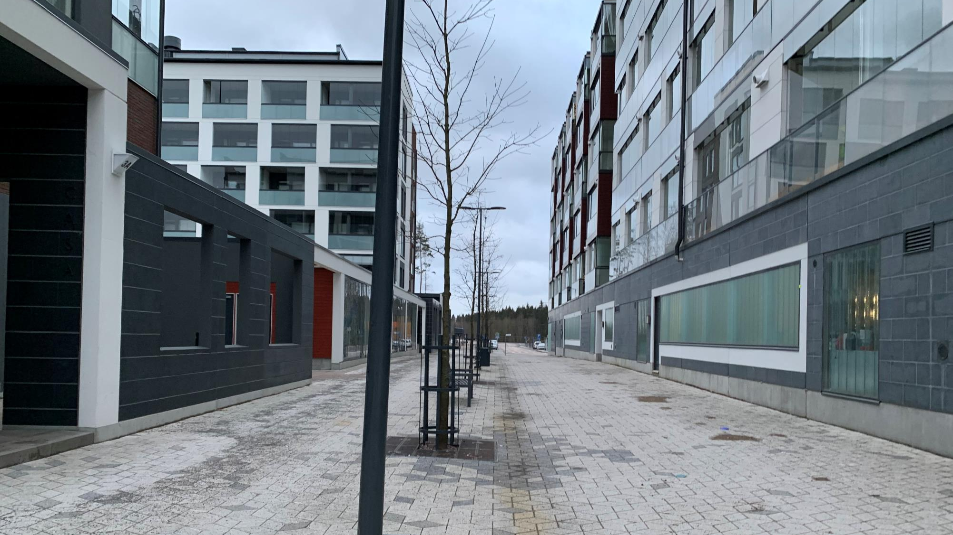
The buildings ”turn their backs” to the street!
Kivistö, Vantaa
Notes:
The fucken bench, and lots of money used for this street – if the plan doesnt require the buildings to take contact, they will not…

Slide 14
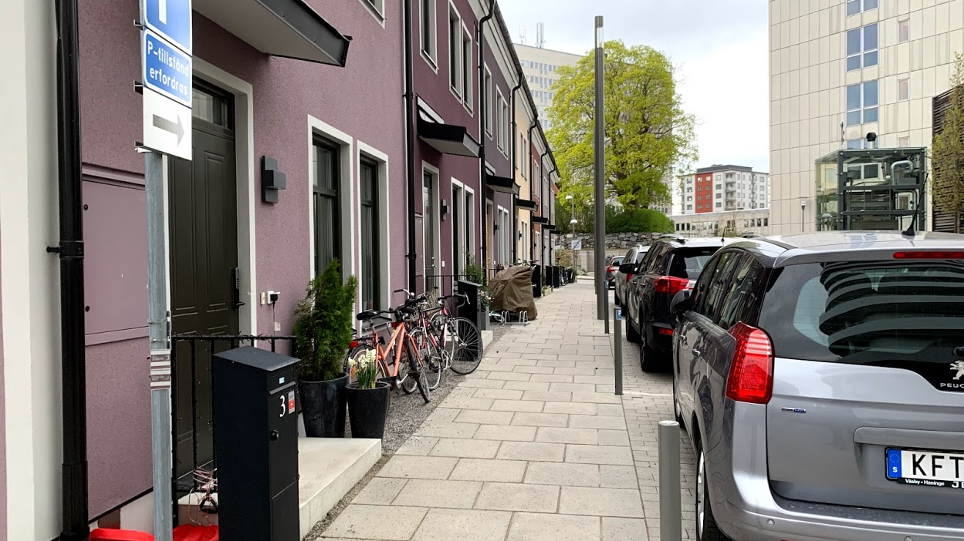
The buildings open up to the street, the edge is ”soft”, annexed by residents
Råcksta, Stockholm
Notes:
Here it is more likely that aquaintances develop

Slide 15
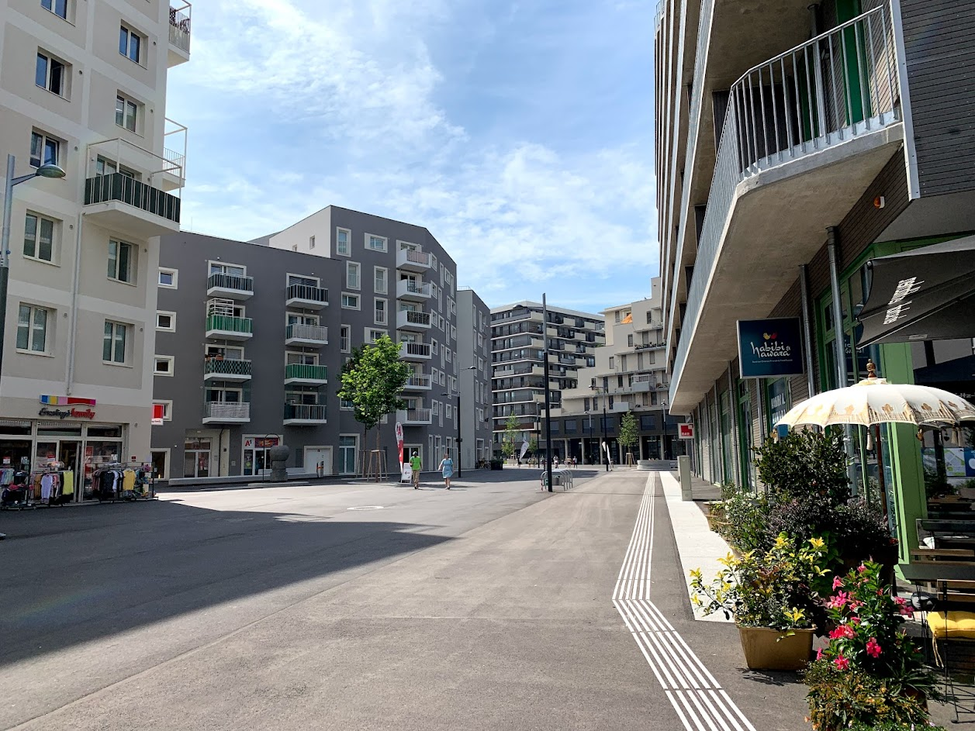
Active ground floors in an otherwise quite dull and basic environment – but they make the difference!
Notes:
Imagine this very basic, very boring, no colour area without the active ground floors – they make the difference!

Slide 16
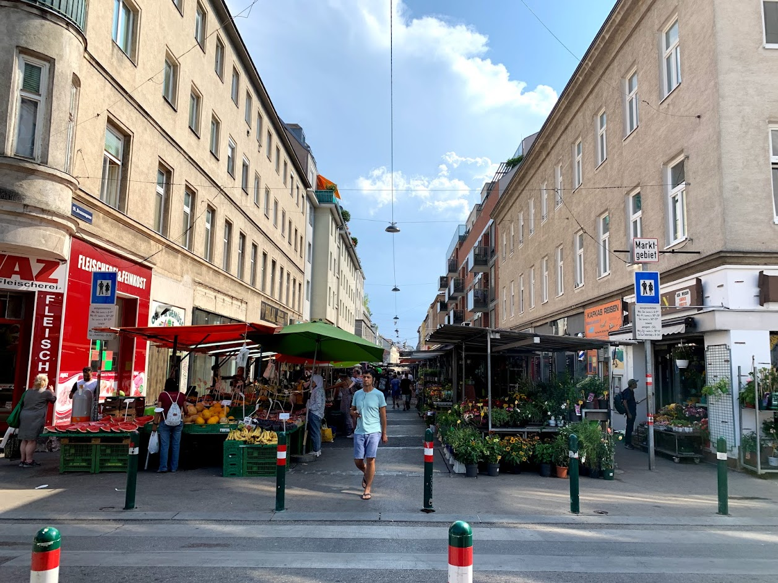
An active street, created by the market activities happening in the street

Slide 17
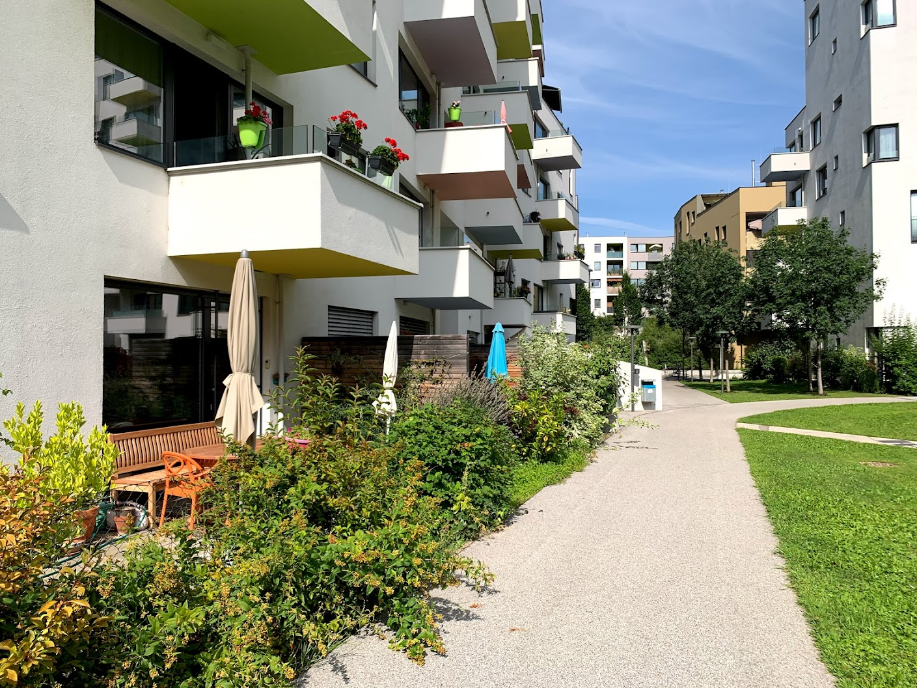
An active front, created by front yards

Slide 18
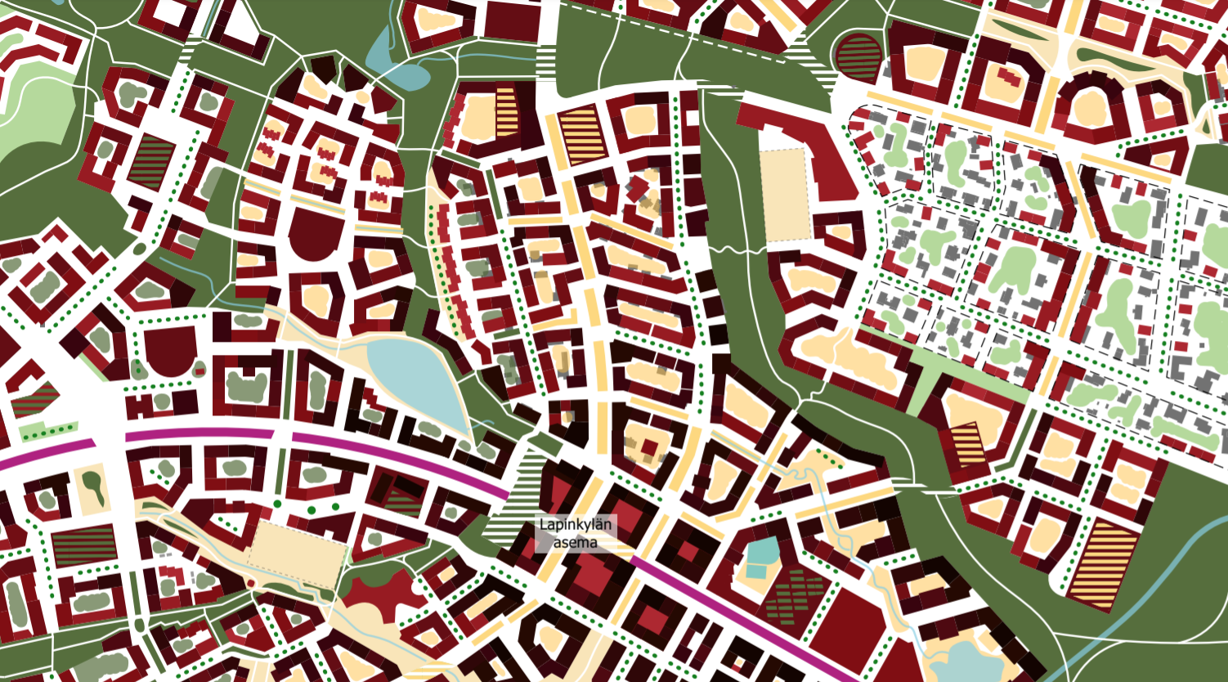
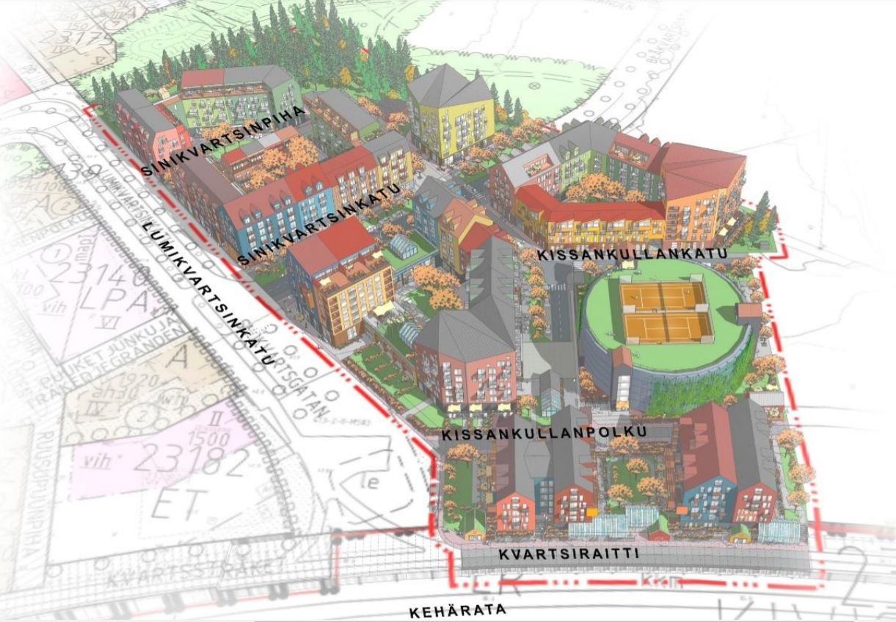
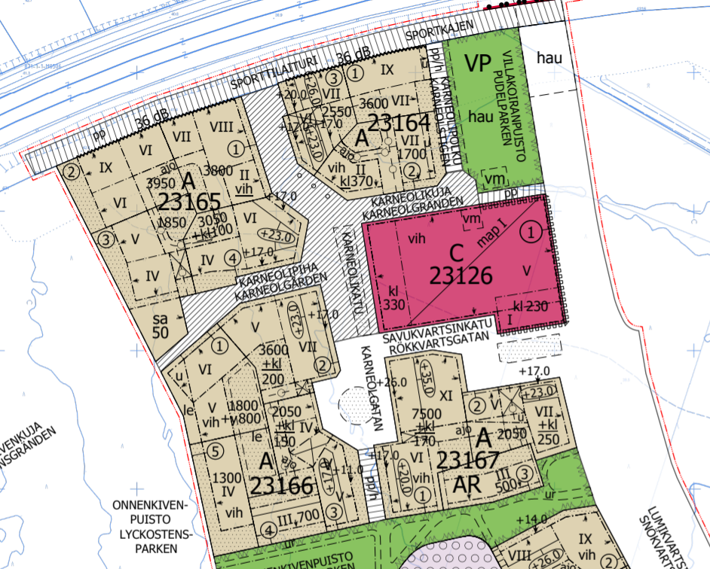
Advertisement !!!!!!!!!!!
https://www.vantaa.fi/instancedata/prime_product_julkaisu/vantaa/embeds/vantaawwwstructure/156762_Kiviston_keskustan_kaavarunko_kh22032021_II.pdf
A new planning guideline document based on creating functional environments that are enjoyable to spend time in ☺
in Finnish ☹
Notes:
https://www.vantaa.fi/instancedata/prime_product_julkaisu/vantaa/embeds/vantaawwwstructure/156762_Kiviston_keskustan_kaavarunko_kh22032021_II.pdf

Slide 19
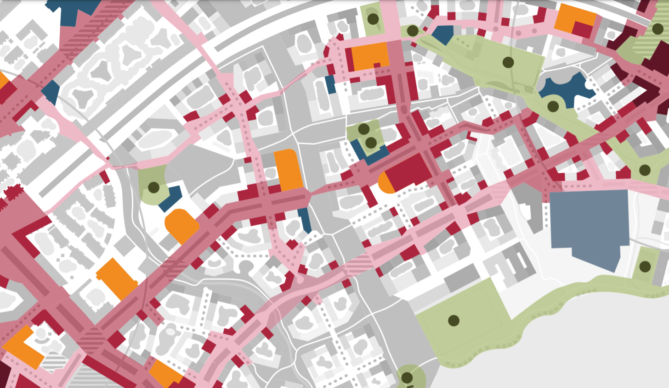
The goal: to create an environment where the urban spaces are active, mix-use, and enjoyable – as in a truly urban ”Jacobsian” environment that we have lost during in the post-WWII era
… lots of challenges … lots of mindsets to be re-thought in the process …
The functionality of the urban life is the core question!
The most crucial and easy evaluation question:
Do you want to spend time in that street/place?
In today’s Kivistö: not so much…
but there are some delightful things that have proceeded forward during the last five years – there is a revolution in thinking going on!

Slide 20
Functional public transportation design
Although the essential function of public transportation is a constant, differing circumstances in disparate places lead to divergent priorities in design.
Human-centered design and efficiency typically at odds with each other, as concessions made for comfort and space come at the cost of passenger capacity.
Public transportation infrastructure must be considered in its totality, from vehicles to stations and roads and pathways to stations.

Slide 21
Functional public transportation design
Although the essential function of public transportation is a constant, differing circumstances in disparate places lead to divergent priorities in design.
Human-centered design and efficiency typically at odds with each other, as concessions made for comfort and space come at the cost of passenger capacity.
Public transportation infrastructure must be considered in its totality, from vehicles to stations and roads and pathways to stations.

Slide 22
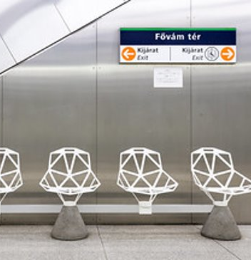
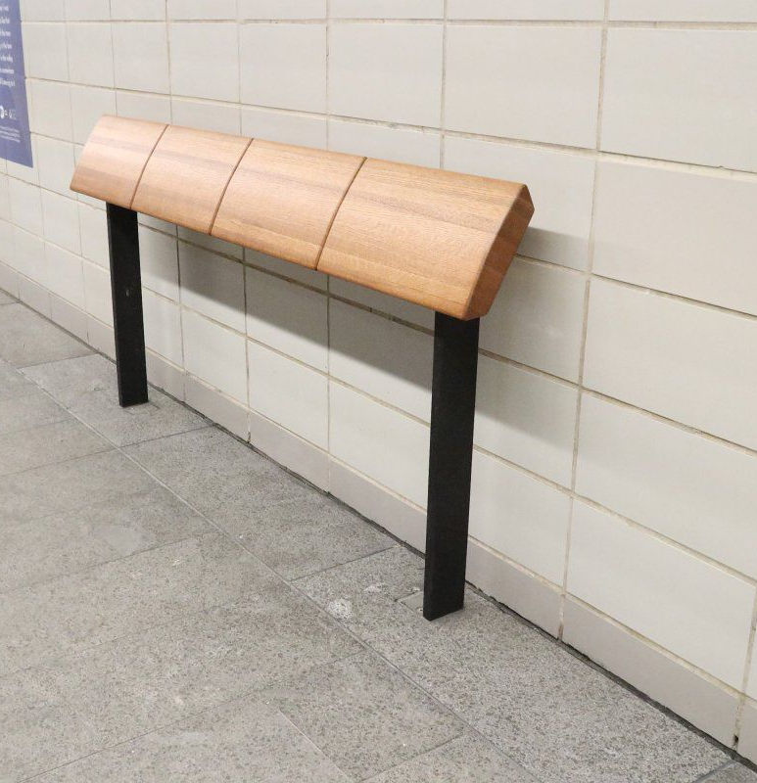
Functional public transportation design
Capacity
Simple
Personal space
Aesthetics
Space-efficient
Simple
Anti-human

Slide 23
Thank you!

