Slide 1
Place attachment
Dymskaia, Julia
Hernandez, Euridice
Huangfu, Mengyuan
Huomo, Timo
Kuntsi, Juho
Moinel, Caroline
Mori, Kazuki
@Urban Experience D Peer Teaching

Slide 2
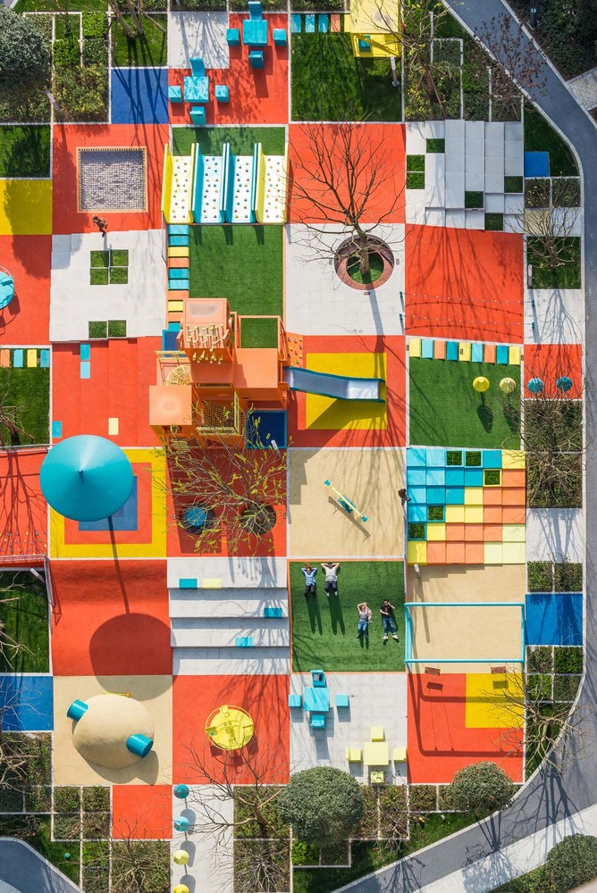
Contents
Theoretical part
Place attachment
Placemaking
Case studies-Different continents
Europe
Africa
Asia
Latin America
Conclusion part

Slide 3
Place attachment - how to define?
Place attachment - can be measured, mapped, but how to define?
Simply: bonds between humans and places
Lack of longitudinal studies (Hernández et al. 2014, Kyttä 2012)
We focus on place making
Examples of planning and actions that foster place attachment
Focus on physical qualities of places
Role of design and planning: create physical settings that foster place attachment
urban identity
rootedness
place dependence
community attachment
Image: pixabay.com
Notes:
What term to use to refer to the bond between humans and places?
According to Hernandez et al (2014) and Kyttä (2012), there is a lack of longitudinal studies on place attachment. Interesting - place attachment of individuals usually evolves over time.
Not only physical (social too), but physical are important: quiet areas, aesthetically pleasant buildings, presence of green areas for example.
Attached to people rather than the place itself, for example? Live long enough in the area -> get friends -> get attached to them and to the place.
Why place attachment important? Enhances the quality of life of individuals.

Slide 4
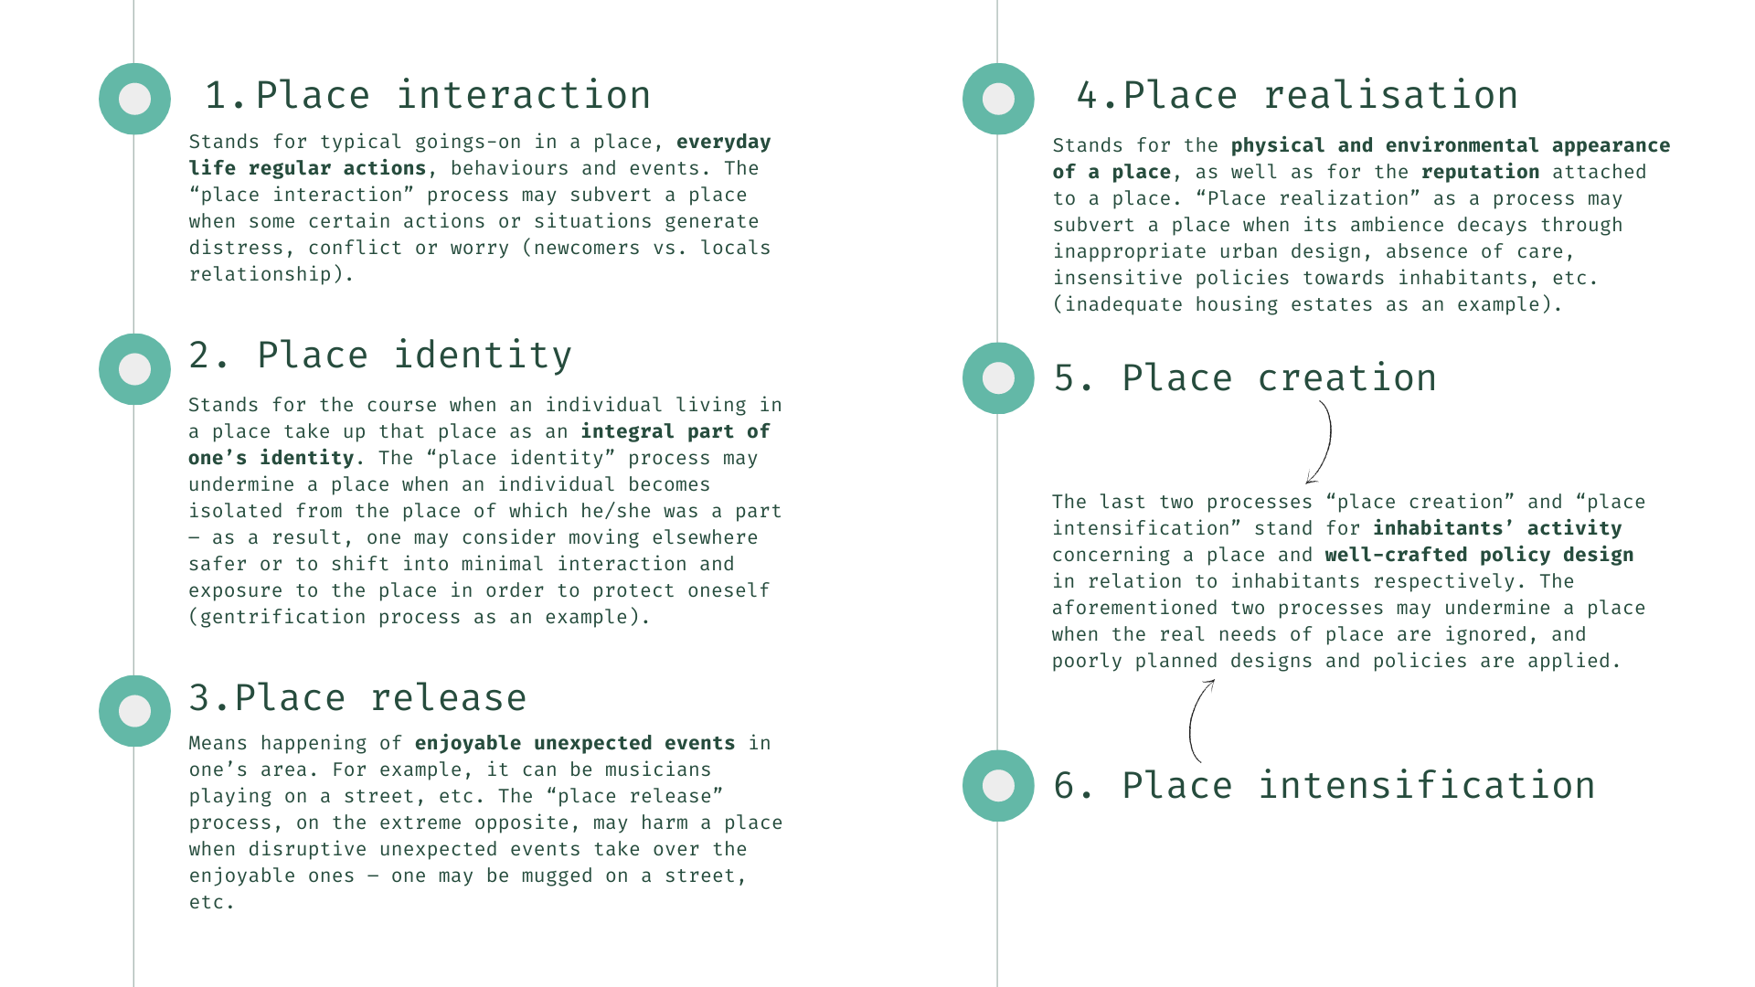
Seamon (2014): six processes of place attachment

Slide 5
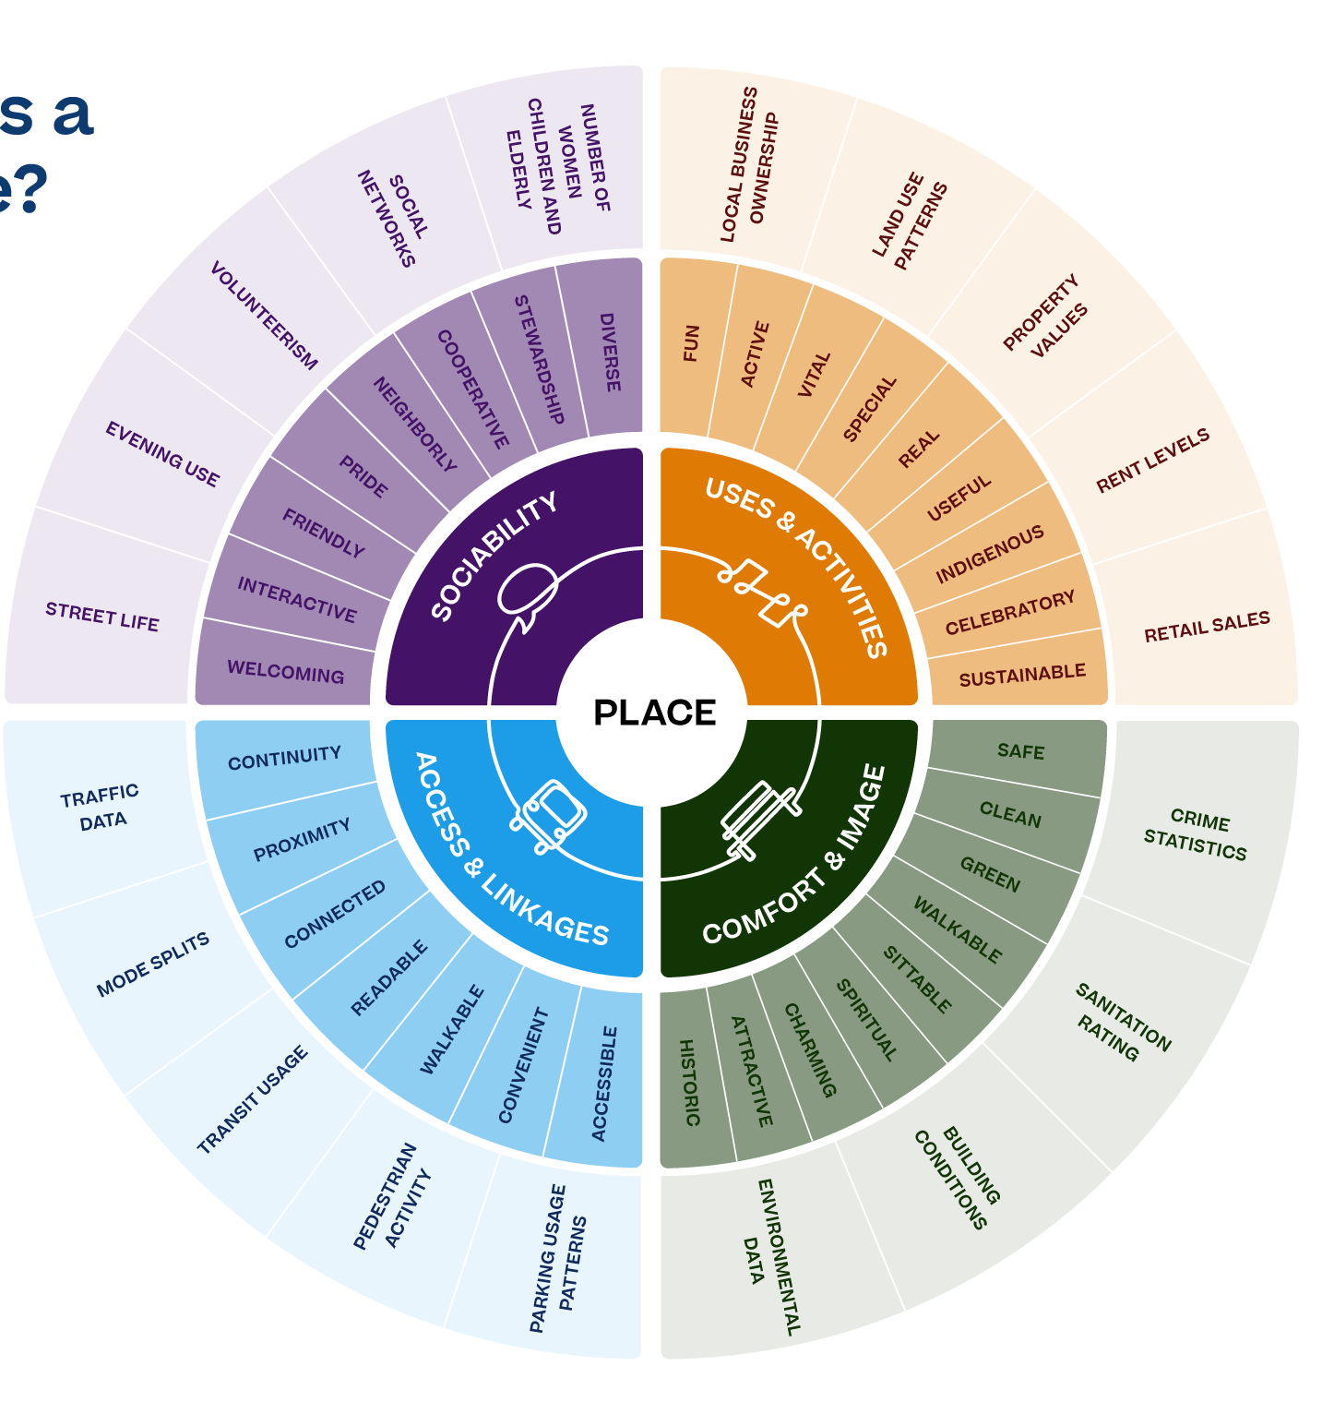
Place making
・Collaborative process by which people and communities can shape public spaces to maximize shared value.
・Place making is not a new idea. Concept of designing cities for people formulated by urban pioneers Jane Jacobs and William H. Whyte in the 1960s.
・Community participation and input are essential for place making practices together with a common understanding on how places foster social interactions,variety of activities, inclusivity and positive experiences.
・According to Project for Public Spaces, there are four key elements to take into account:
Sociability
Uses and activities
Access and linkages
Comfort and image
Place Diagram tool developed by Project for Public Spaces.

Slide 6
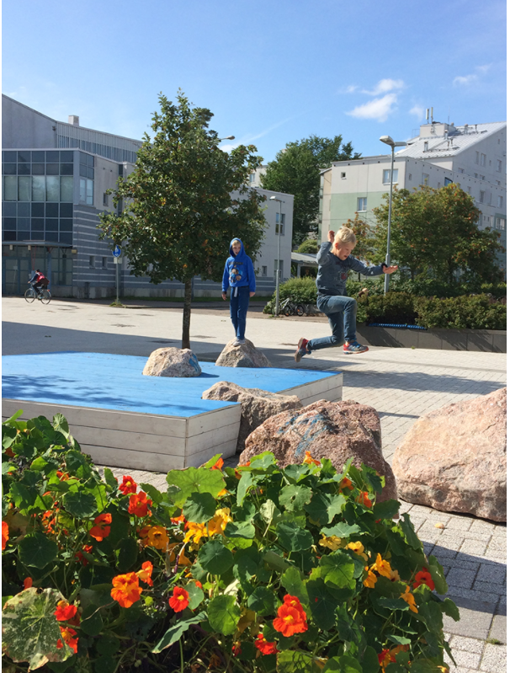
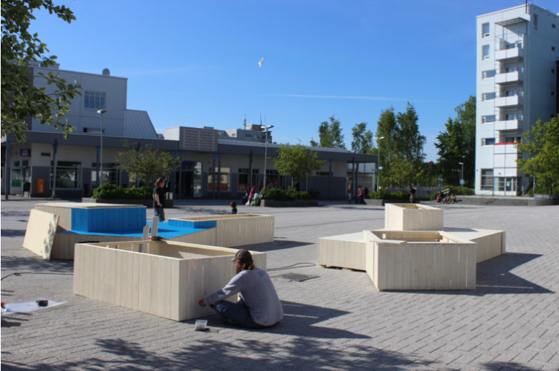
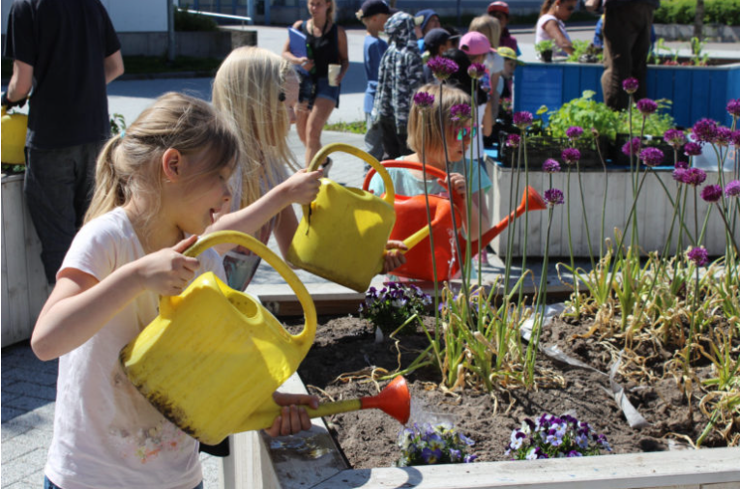
Case studies-1: Meri-Rastila, Helsinki
Europe-Finland
“Our Meri-Rastila”
The urban gardens
The Meri-Rastila square
Interventions
Päivi Raivio
Päivi Raivio
Päivi Raivio

Slide 7
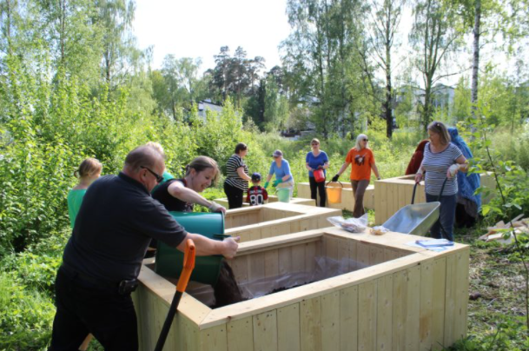
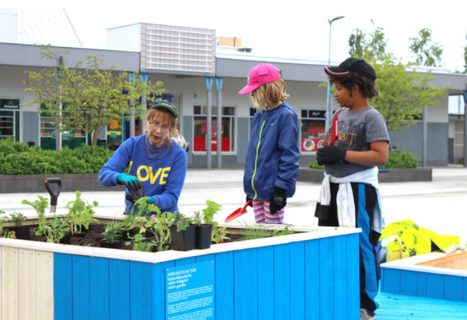
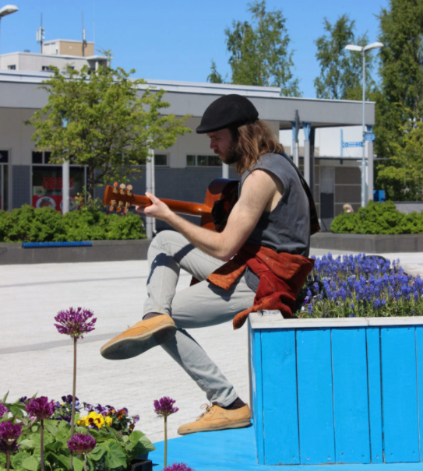
Päivi Raivio
Päivi Raivio
Success factors:
Working on Site
Engaging with kids and youth
Päivi Raivio

Slide 8
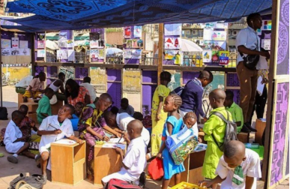
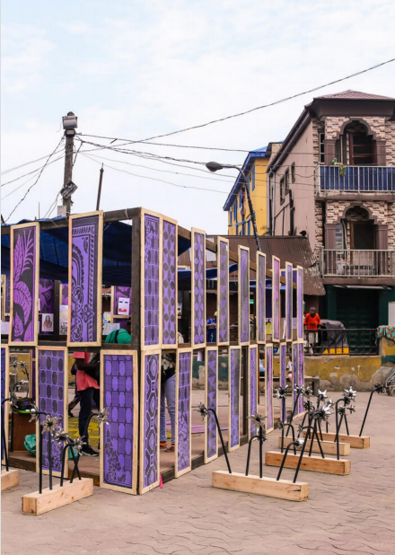
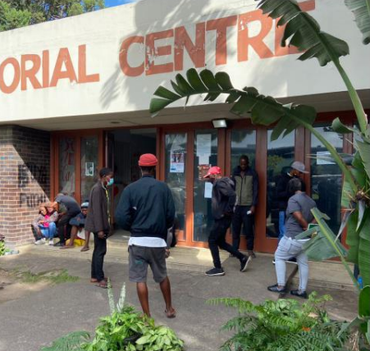
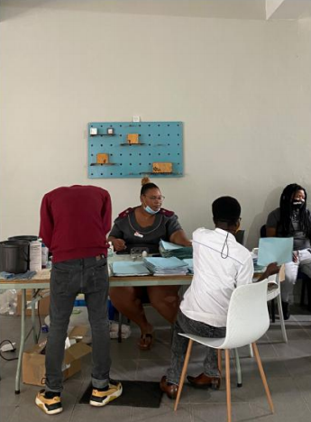
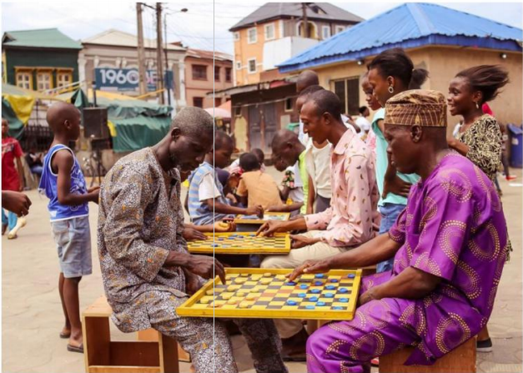
Case studies-2
Photo from:
A New Placemaking Agenda for African Cities
https://issuu.com/futurecapetown/docs/ofc_placemaking_magazine
Africa-Nigeria
Africa-Durban
Bellhaven is an evidence-based harm reduction center in Durban serving low-income and homeless individuals suffering from substance use disorders.
Meet At The Square show how placemaking actions and interventions can be experimental and transient with the potential for prototype and scalable solutions.

Slide 9
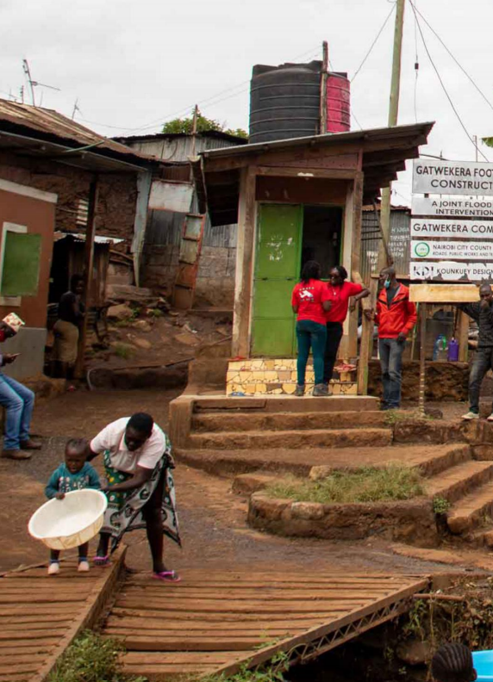
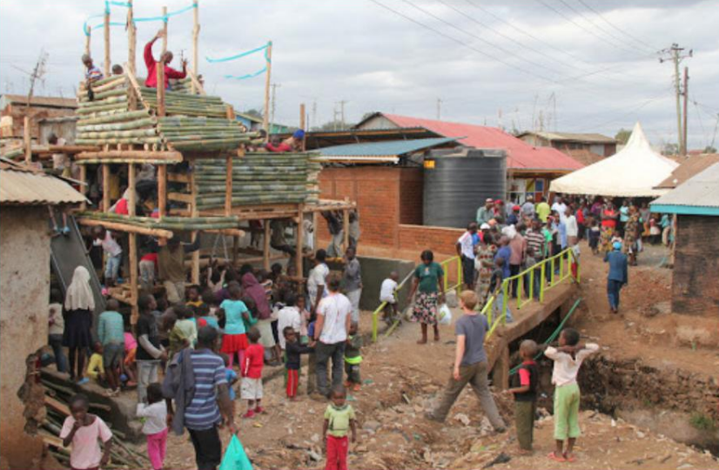
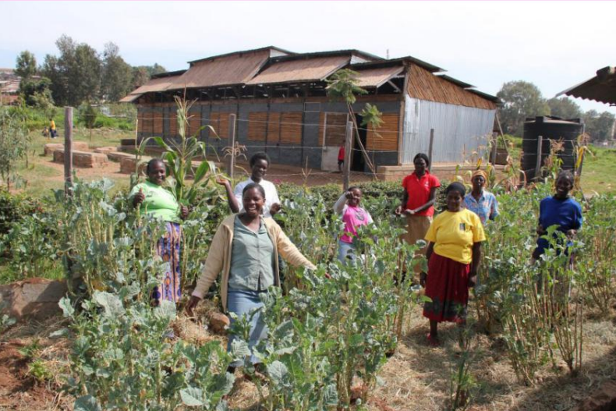
“ We all need to find our own word for placemaking, because wherever we go it is going to change meaning and form” — Malaika Toyo
Photo from:
A New Placemaking Agenda for African Cities
https://issuu.com/futurecapetown/docs/ofc_placemaking_magazine
Interventions should recognise that communities are dynamic spaces.
Placemaking demands that all parties involved learn by doing and in doing to transform the everyday places we encounter.
Placemaking initiative should build the confidence of the community by capturing their visions for interventions through communication.
Build community ownership through each phase of the process.

Slide 10
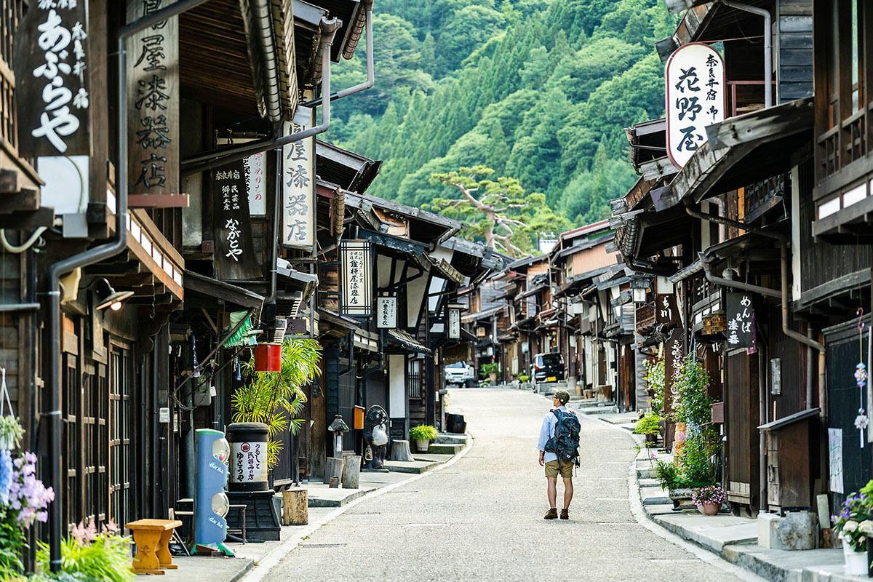
Case studies-3: Tsumago-Juku (妻籠宿), Kiso Valley
Asian-Japan ・Approach: Preservation ・Level: Townscape
an old town where travellers stay.
The remained traditional townscape has attracted 400,000 tourists[1] per year, compared to the 600 dwellers[2].
Here is one of the first cities in Japan where a townscape preservation movement occurred.
Photo cited from https://www.go-nagano.net/theme/id=19053 [1] https://www.bunka.go.jp/seisaku/bunkazai/shokai/hozonchiku/pdf/r1392257_038.pdf [2] http://www.town.nagiso.nagano.jp/data/open/cnt/3/13622/1/03_jinkousangyou.pdf?20210806151635

Slide 11
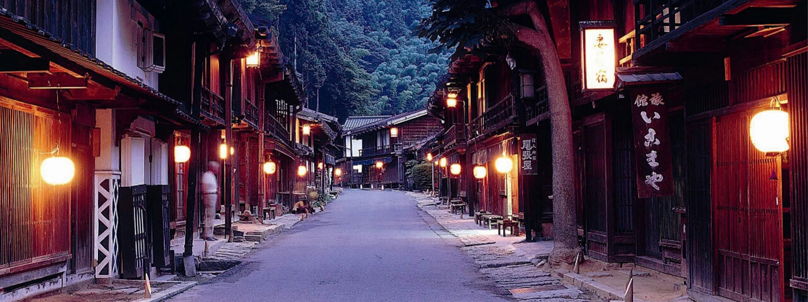
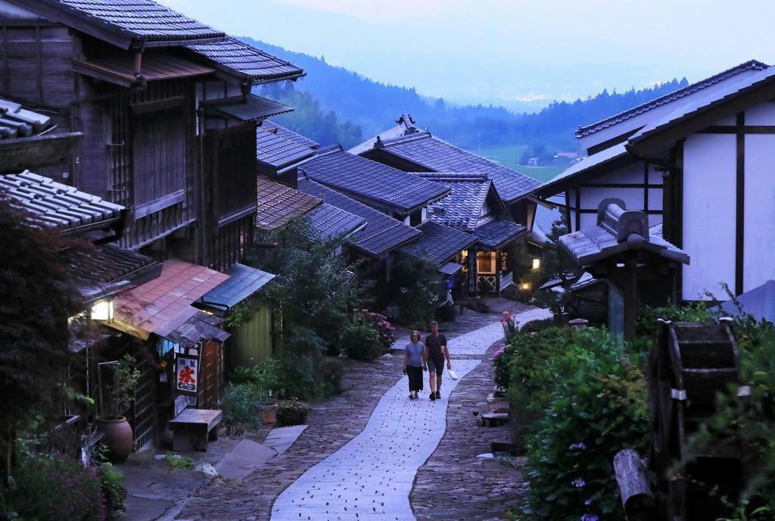
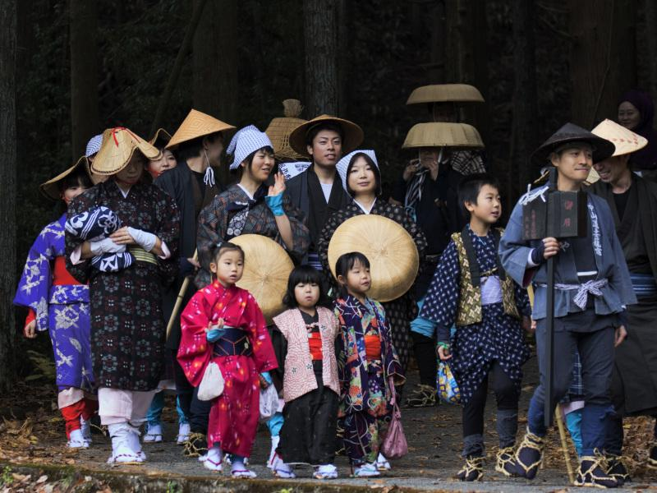
[Background] ・Narrow land →less development →population decline in 1950s[3] ・As a result, one of the first cities of conservation movements.
[Point] ・Long-term movement valuing the preversation and consensus. ・Involving everyone to establish the organisation and the charter. ・Prioritising everyday lives rather than economic rationality.
[Result] ・Civic Pride/Trust ・Development of Tourism Industry ・Political Impact: enactment of “Preservation District” system
“Fifty years ago, I said to people. ‘Imagine, at dusk, a light goes on in the upstairs of an inn, and a traveller will walk under it.’ Everyone asked me if it was really going to happen so I couldn’t do anything than telling a lie ‘of course, it absolutely will!’.” – Kobayashi Toshihiko [3]
Photo: https://www.ana.co.jp/ja/jp/japan-travel-planner/nagano/0000009.html Photo2: https://www.sankei.com/article/20190714-WL354RCX5VMDLF6Z3OIQVHNQ7U/ Photo3: https://kuniokina.exblog.jp/24992457/ [3] https://www.bunka.go.jp/seisaku/bunkazai/shokai/hozonchiku/pdf/r1392257_038.pdf

Slide 12
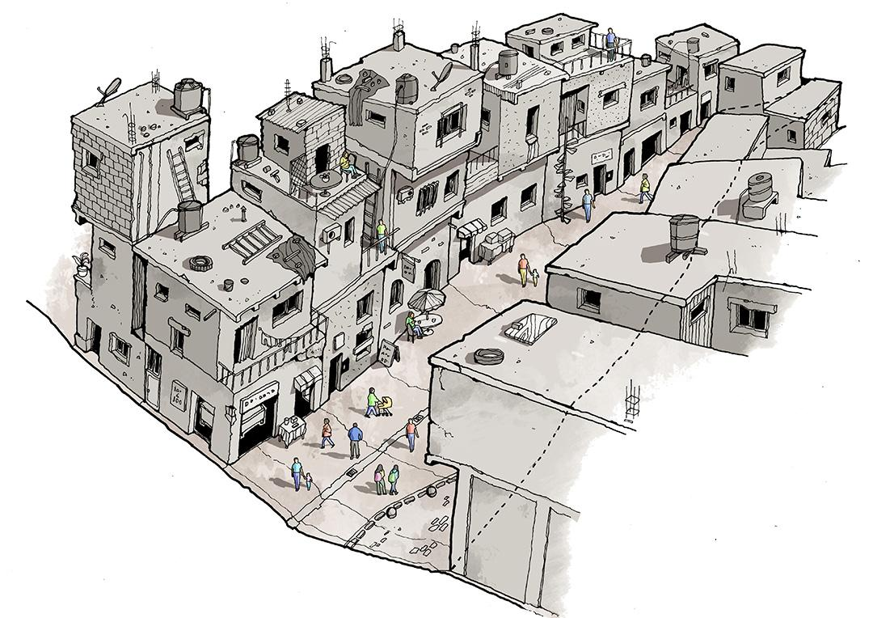
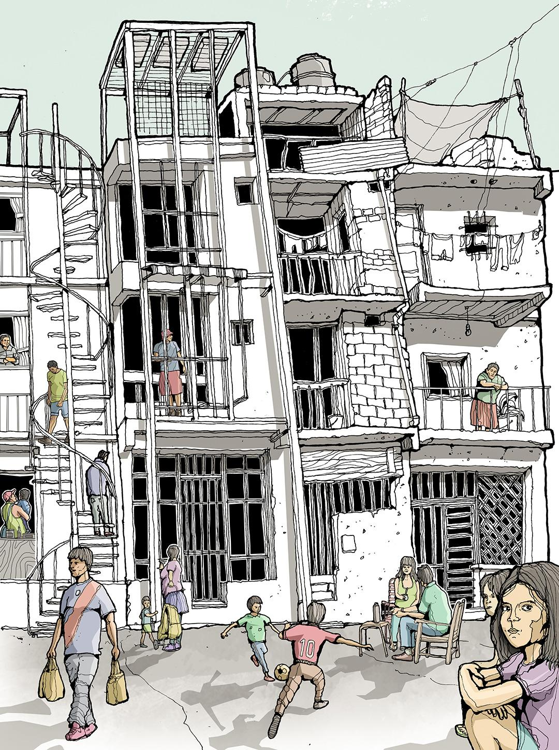
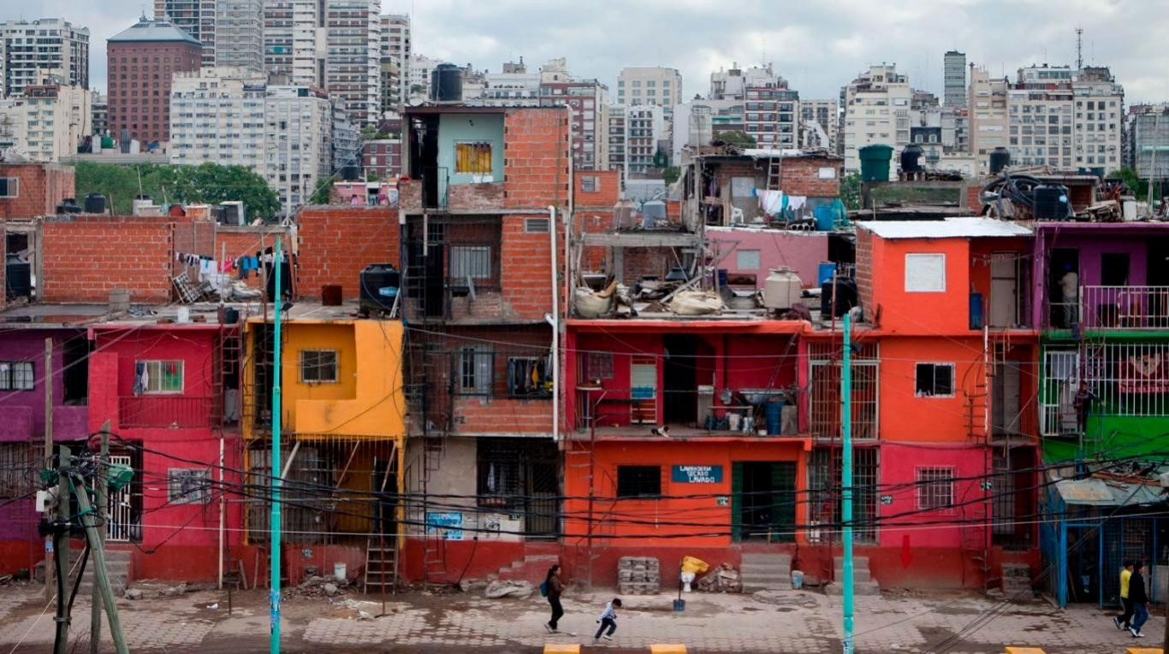
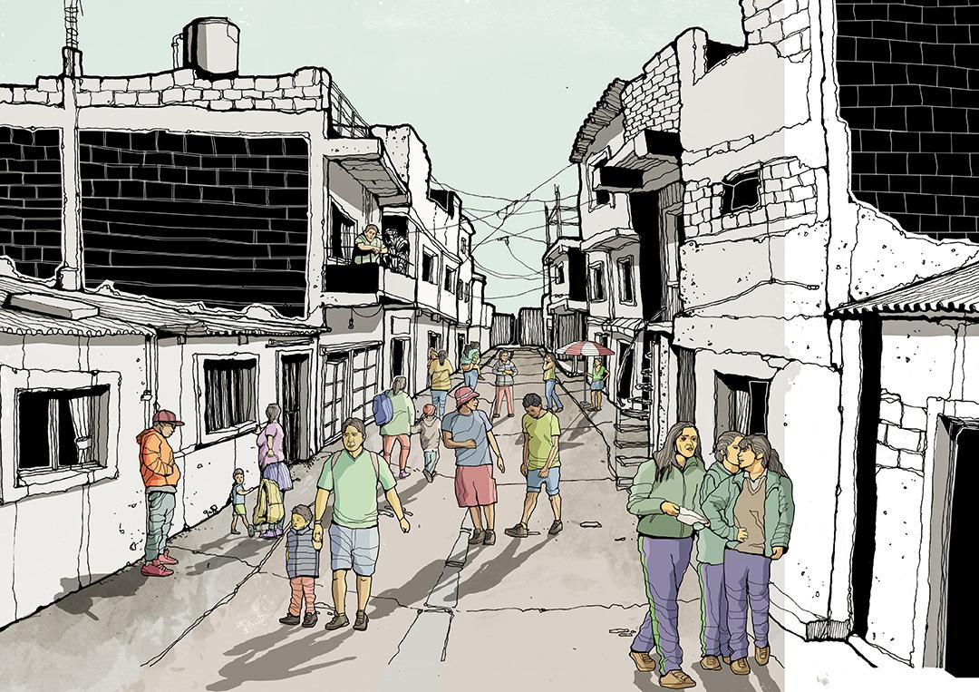
Case studies-4: Barrio Mugica
Latin America- Buenos Aires
Proximity matters
Video about the open collaborative map created: https://vimeo.com/115102630?embedded=true&source=vimeo_logo&owner=6431167
Density and human scale
Personality shapes the place
(Gehl blog, 2018)
Notes:
https://gehlpeople.com/blog/embracing-the-paradox-of-planning-for-informality-2/
But is not only improving the physical space that we can increase place attachment, in latin America we can see in poor communities already a strong emotional feeling with the place. One example of this is Barrio Mugica, Former Villa 31 in the center of Buenos Aires.
As Jean Gehl team that worked in the area, it is a place where you see people walking, cycling and spending time socializing, playing and people-watching in the streets and spaces of Villa 3. People feel connected to the area, they even created a project where with the kids from the neighborhood they created an open collaborative map.
Of course that the area needed improvements in urbanization and better urban qualities, however those improvements could not jeopardize the place attachment already existent in the area-
As Jean Gehl team stated “as our designs developed, we realized the risks of redevelopment. Adhering to modern buildings standards would mean widening streets, restricting entrepreneurialism and possibly increasing construction costs. The community would have to give up some of its most powerful attributes in order to meet code.”

Slide 13
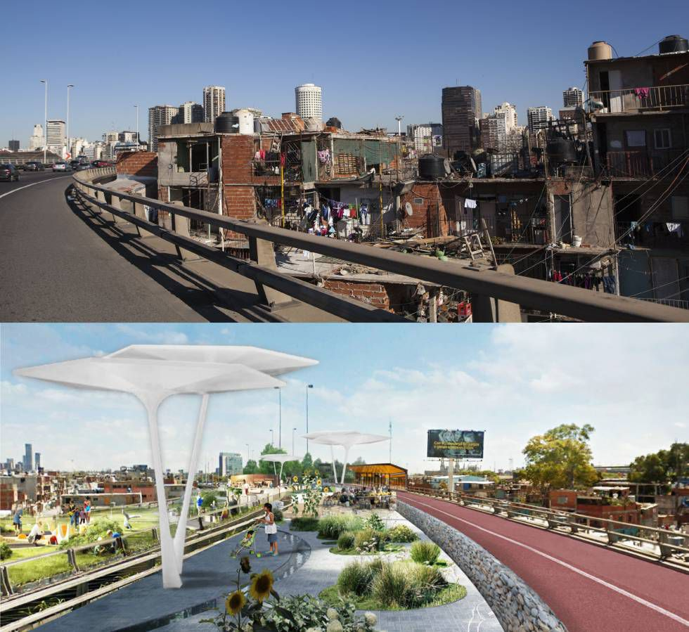
Place making is welcome, the revitalization is needed, but the community must be involved in the process
Photo from: https://brasil.elpais.com/brasil/2016/08/30/internacional/1472565308_299661.html
Notes:
And then this concern actually came into reality with the revitalization project conducted by the municipality (it is on going since 2016). The project wanted to integrate the villa as part of the city. and included the construction of infrastructure (sewages, drainages, drinking water and electrical connections, paving of streets and public lighting), renovation of public spaces, construction of more than 1,200 new houses, improvement of existing houses as well as the construction of schools, health centers and strategies to boost social and economic development. However, this process fail in incorporating the community approach, it did not included properly the community as part process of building the place vision. They were altering peoples place without consulting them: "Many residents feel they weren't included in the decision-making process. This level of uncertainty generated a lot of problems, fear and distrust. Many say this has been a lost opportunity," said Pablo Vitale, co-director of the Civil Association for Equality and Justice, an Argentine human rights group. They offered new homes for people, but they were not in the place, so people refused they did want to leave their place. They invited people to help with the painting but then removed the kids signature because they were signs of vandalization.
So this case study emphasizes that when thinking about place making and bringing better physical conditions to a space, it is necessary to respect the place and the emotional connection that people have with the space. Of course the improvements are necessary and people from the place support the urbanization process but emphasize the necessity of cooperation with those who leave and are connected with the place. Interventions must preserve those meaningful places emerge in a social context and through social relations, spaces geographically located and at the same time related to their social, economic, cultural etc. surroundings, and they give individuals a sense of place, a `subjective territorial identity' (Agnew, 1987).

Slide 14
Conclusions
Image sources listed in previous slides
Many terms used for describing emotional bonds between humans and places - place attachment perhaps the most prominent one
Community involvement crucial in placemaking - Planners don’t have all the answers, so let the community participate
As our case studies show - it is possible to start small, no need for a lot of money!

Slide 15
References
A New Placemaking Agenda for African Cities,(2022).[Online] Available at: https://issuu.com/futurecapetown/docs/ofc_placemaking_magazine [Accessed 24 January 2022].
El país (2016). A Villa 31, de favela a novo bairro de Buenos Aires. Available at: https://brasil.elpais.com/brasil/2016/08/30/internacional/1472565308_299661.html
Gehl, J. (2018). Embracing the paradox of planning for informality. Available at: https://gehlpeople.com/blog/embracing-the-paradox-of-planning-for-informality-2/
Hernández, B., Hidalgo, M. C. & Ruiz, C. (2014). Theoretical and Methodological aspects of Research on Place Attachment. In Place attachment: advances in theory, methods and applications. New York: Routledge.
Kyttä, M. (2012). Kulttuuriympäristö ihmisten arkiympäristönä. Museoviraston tilaama selvitystyö. (in Finnish!)
Project for Public spaces (2022). What is Place Making? [online] Available at: https://www.pps.org/article/what-is-placemaking [Accessed 24 Jan. 2022].
Raivio, P. (2020). Meri-Rastila, Helsinki: From a troubled square to a green and playful hangout for all. Our City? Helsinki.
Seamon, D. (2014). Place attachment and phenomenology. In Place attachment: advances in theory, methods and applications. New York: Routledge.
The Guardian (2019). Should a notorious Buenos Aires slum become an official neighbourhood? https://www.theguardian.com/cities/2019/aug/07/should-a-notorious-buenos-aires-slum-become-an-official-neighbourhood

