Slide 1
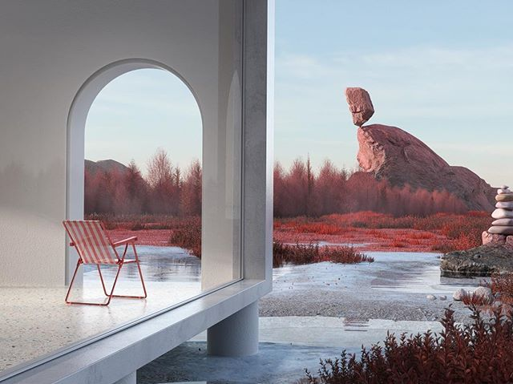
RESTORATIVE ENVIRONMENTS
Urban Experience 2022
Group:
Golovine, Daniel
Koskela, Vieno
Kuittinen, Fanni
Laczik, Dorottya
Lehtola, Lotta
Mäkiniemelä, Maija
Nikkinen, Juuso
Stevens, Emily

Slide 2
Definition of restorative
adjective
“making you feel better or more energetic if you are feeling tired or ill”
https://dictionary.cambridge.org/dictionary/english/restorative

Slide 3
slido.com/120096
Which places do you go to to restore – to relax and charge your batteries?
Notes:
📣 This is Slido interaction slide, please don't delete it. ✅ Click on 'Present with Slido' and the poll will launch automatically when you get to this slide.

Slide 4
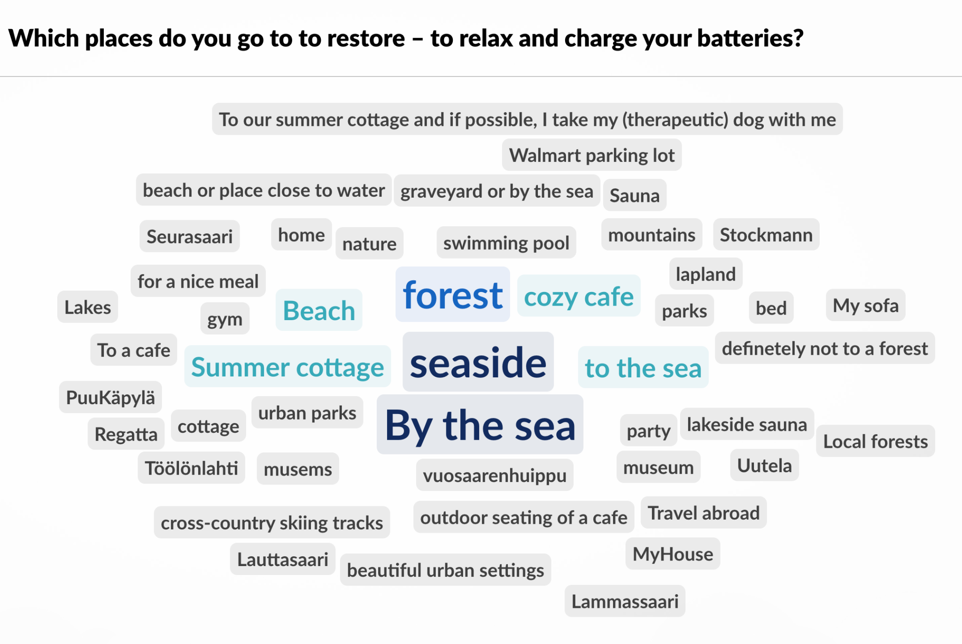
Word cloud from the lecture on 25.01.22

Slide 5
slido.com/120096
What qualities make the places you mentioned restorative?

Slide 6
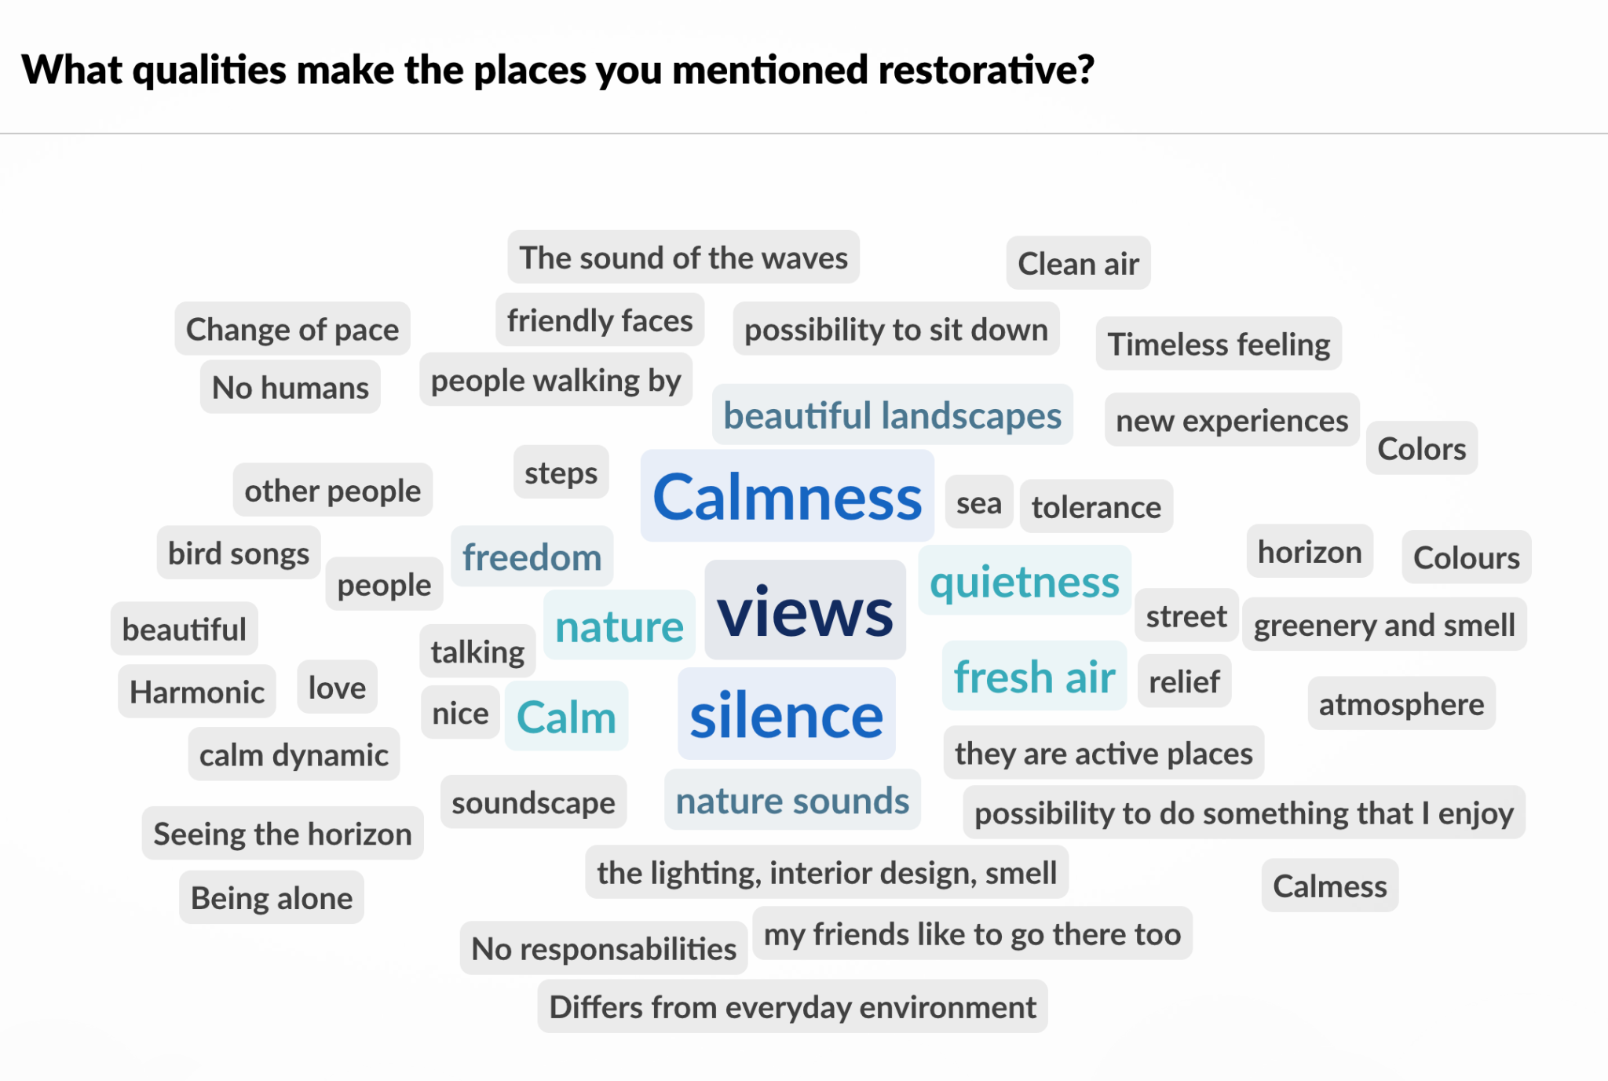
Word cloud from the lecture on 25.01.22

Slide 7
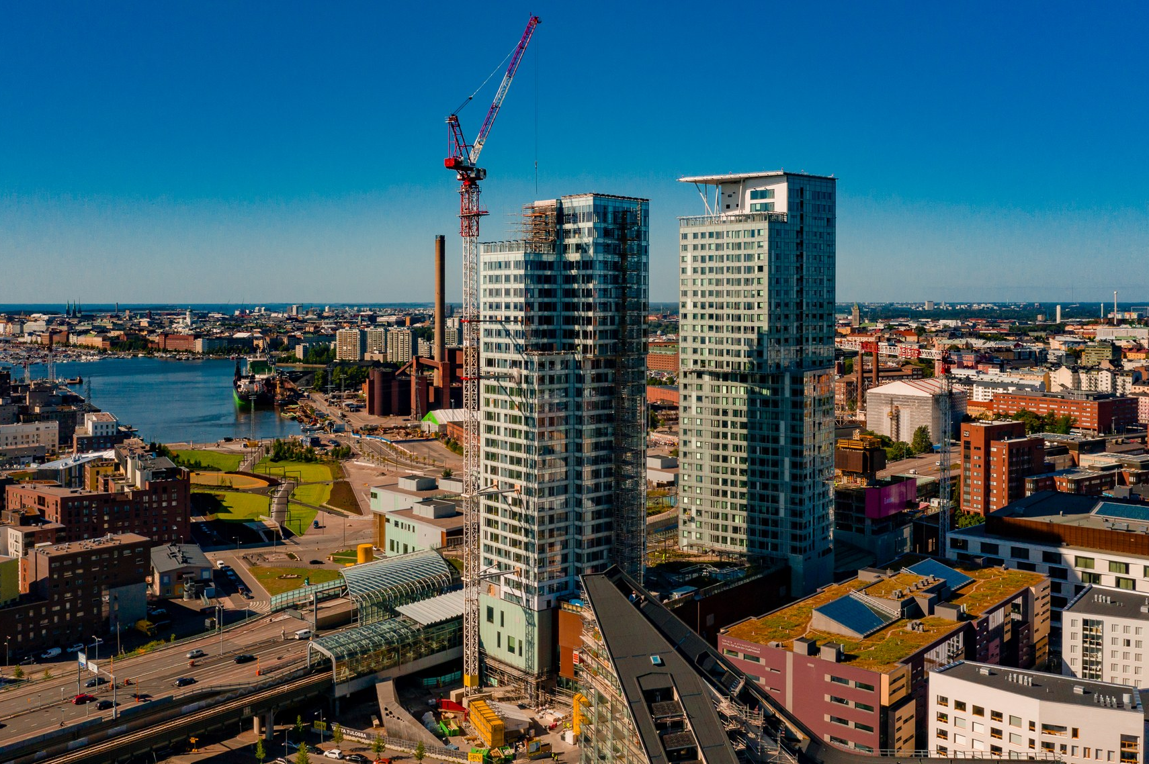
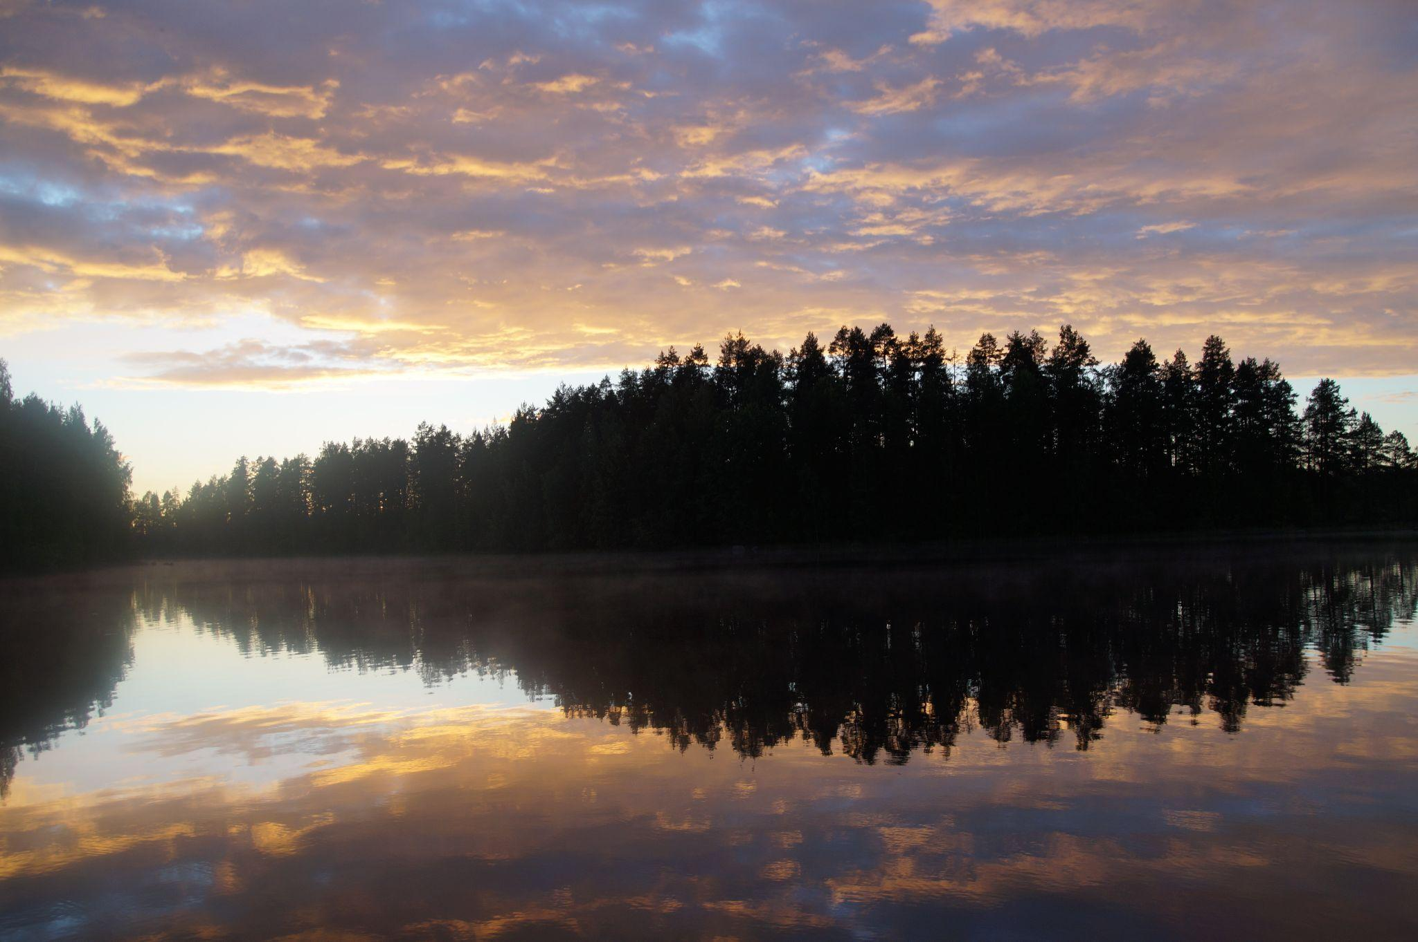
Nature as a restorative environment

Slide 8
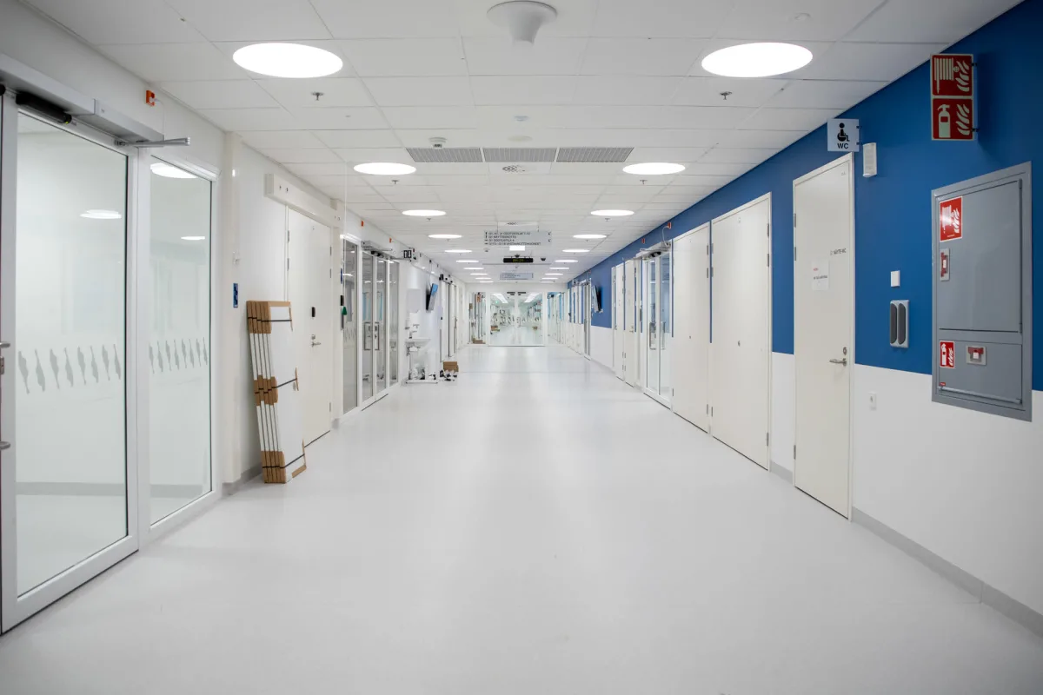
Nature as a restorative environment

Slide 9
Nature as a restorative environment
+

Slide 10
Notes:
I will address the question of whether built environments have restorative qualities beyond greenness based on Subiza-Peréz et al. case study of two public squares in Tampere
- --- overall, the rate of greenness is lower in built environment
- -- Therefore, it is important to understand, which other qualities of built environment contribute to restorative experiences
- In previous studies of the restorative quality of built environment, size, openness, cultural value of urban settings like national landscapes were associated with higher restorative quality – the researchers used this information to select the squares in Tampere
-- for example, Hämeenpuisto (in the picture) has historic value although the statue erected after the 1918 war has been criticised for being too aggressive
- In addition, individual characteristics such as place attachment and extensive time spent in urban environments and urban-orientedness – that is the personal preference for urban environments increase the rated sense of restoration
In the study, the researchers asked 34 volunteers to spend 10 minutes walking + 10 min sitting in each the site
- They found out that time spent in urban squares can increase attentional performance and decrease negative affect
- --- However, the visits did not increase positive affect --- researchers suggest that this could be due to the participants’ low need for restoration or small sample size?
- The authors mention a particular challenge for planners in Finland: people often spend their free-time in nature, not in urban squares
- --- yet, planners can foster qualities, such as aesthetic appeal or connect smaller urban squares to increase the useability of squares -- this helps generate positive place attachment increasing the restorative qualities of built environment

Slide 11
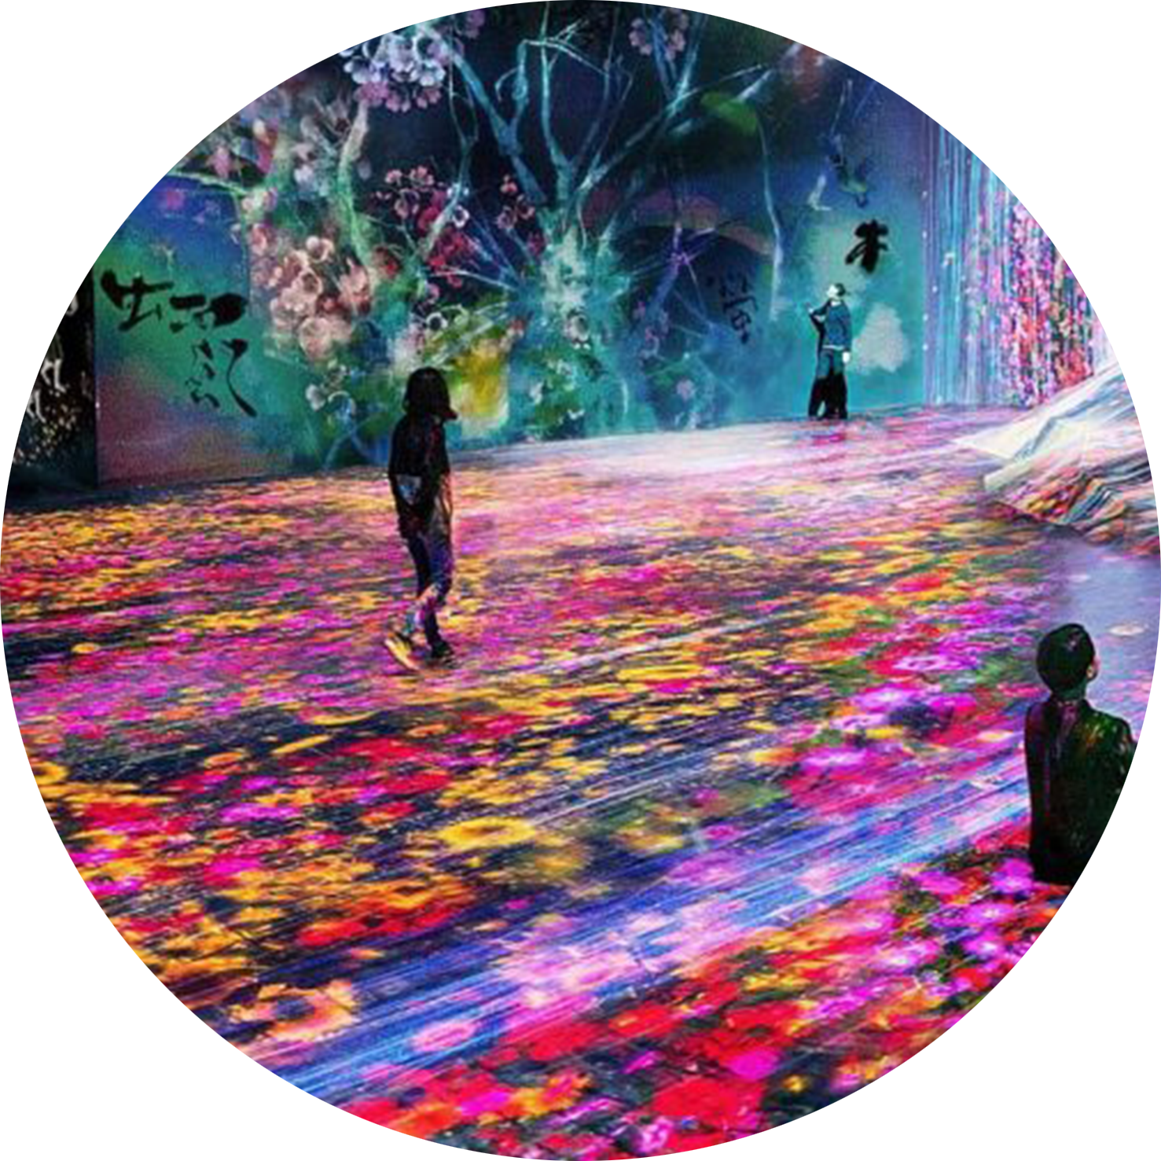
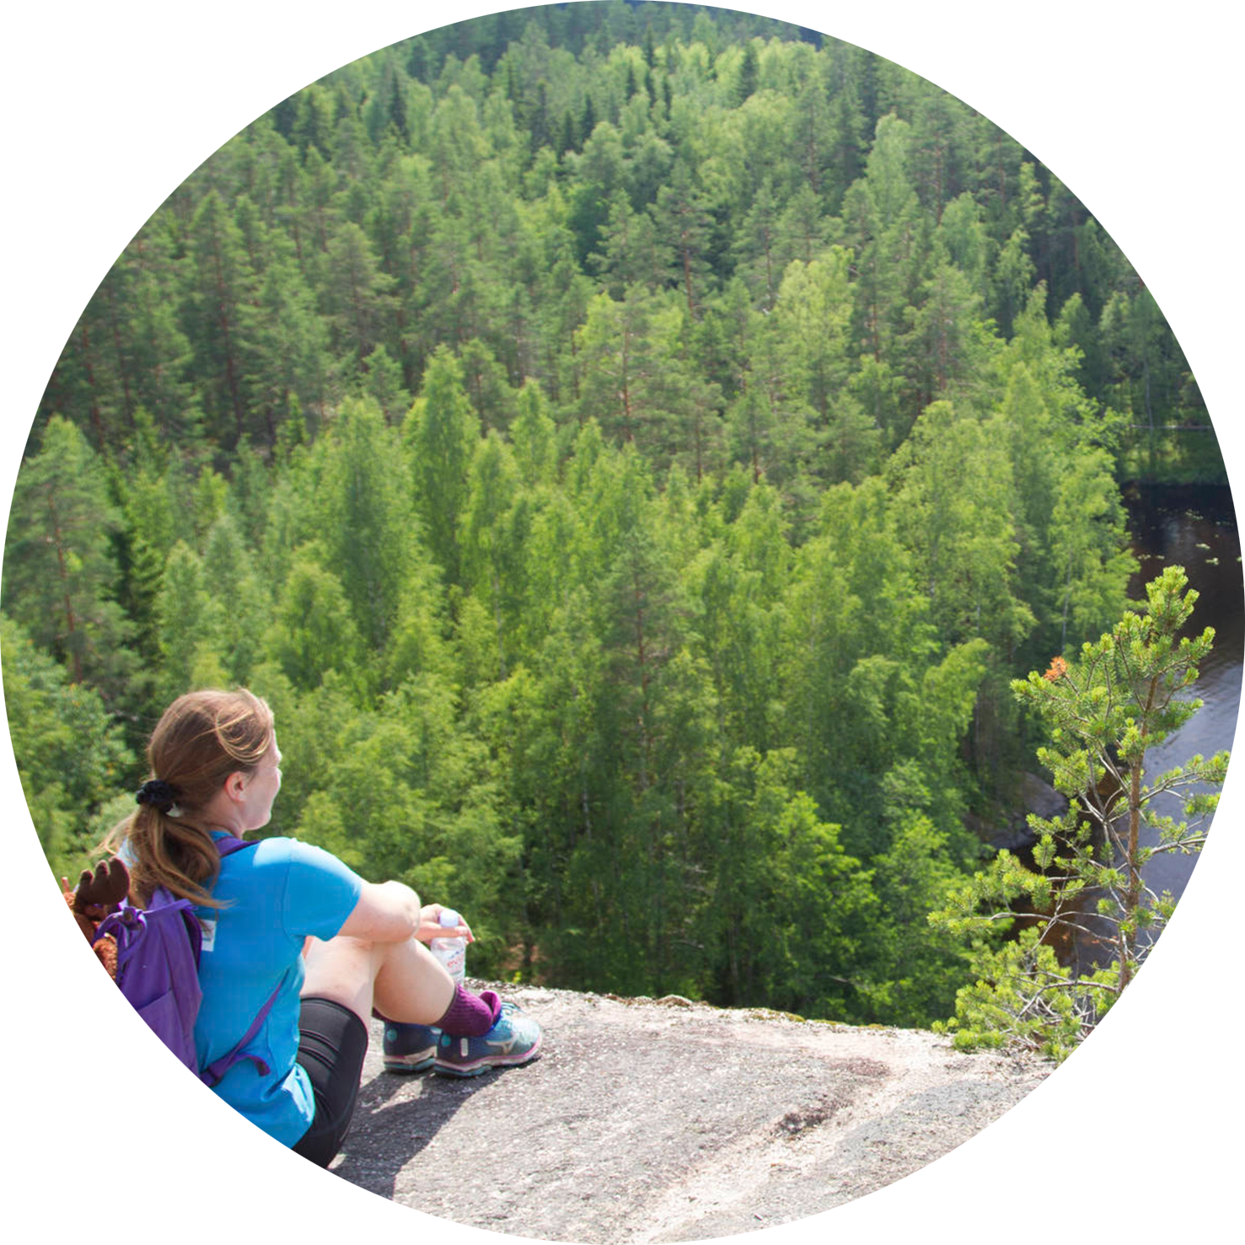
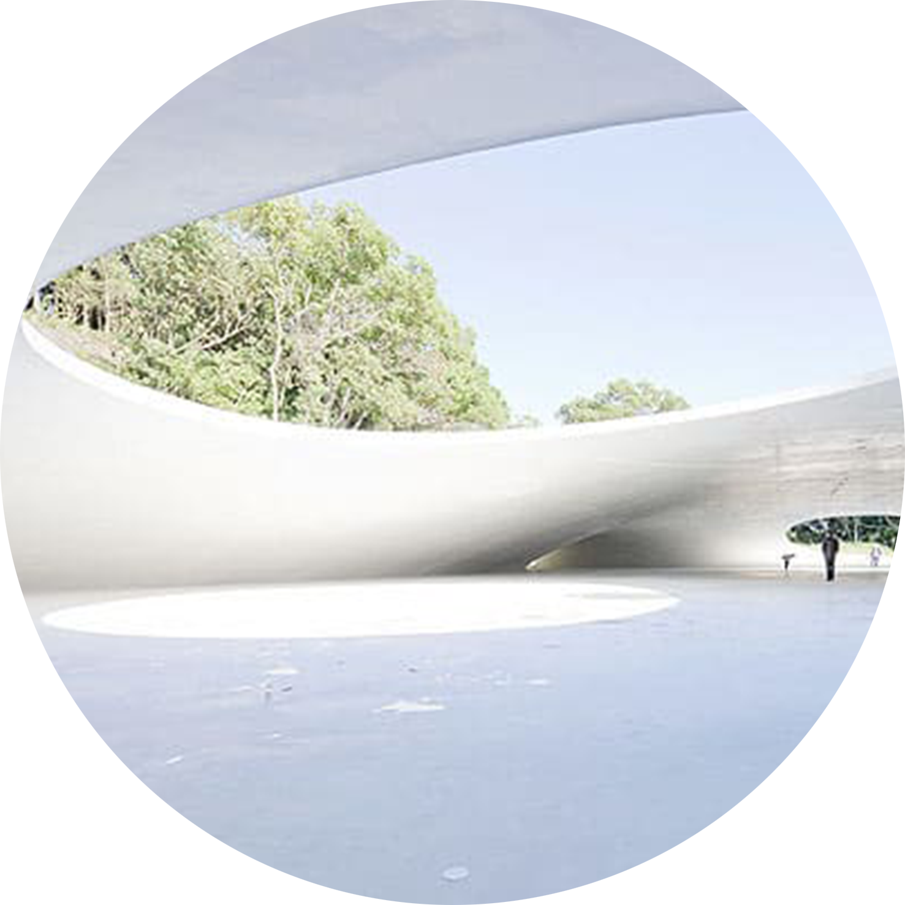
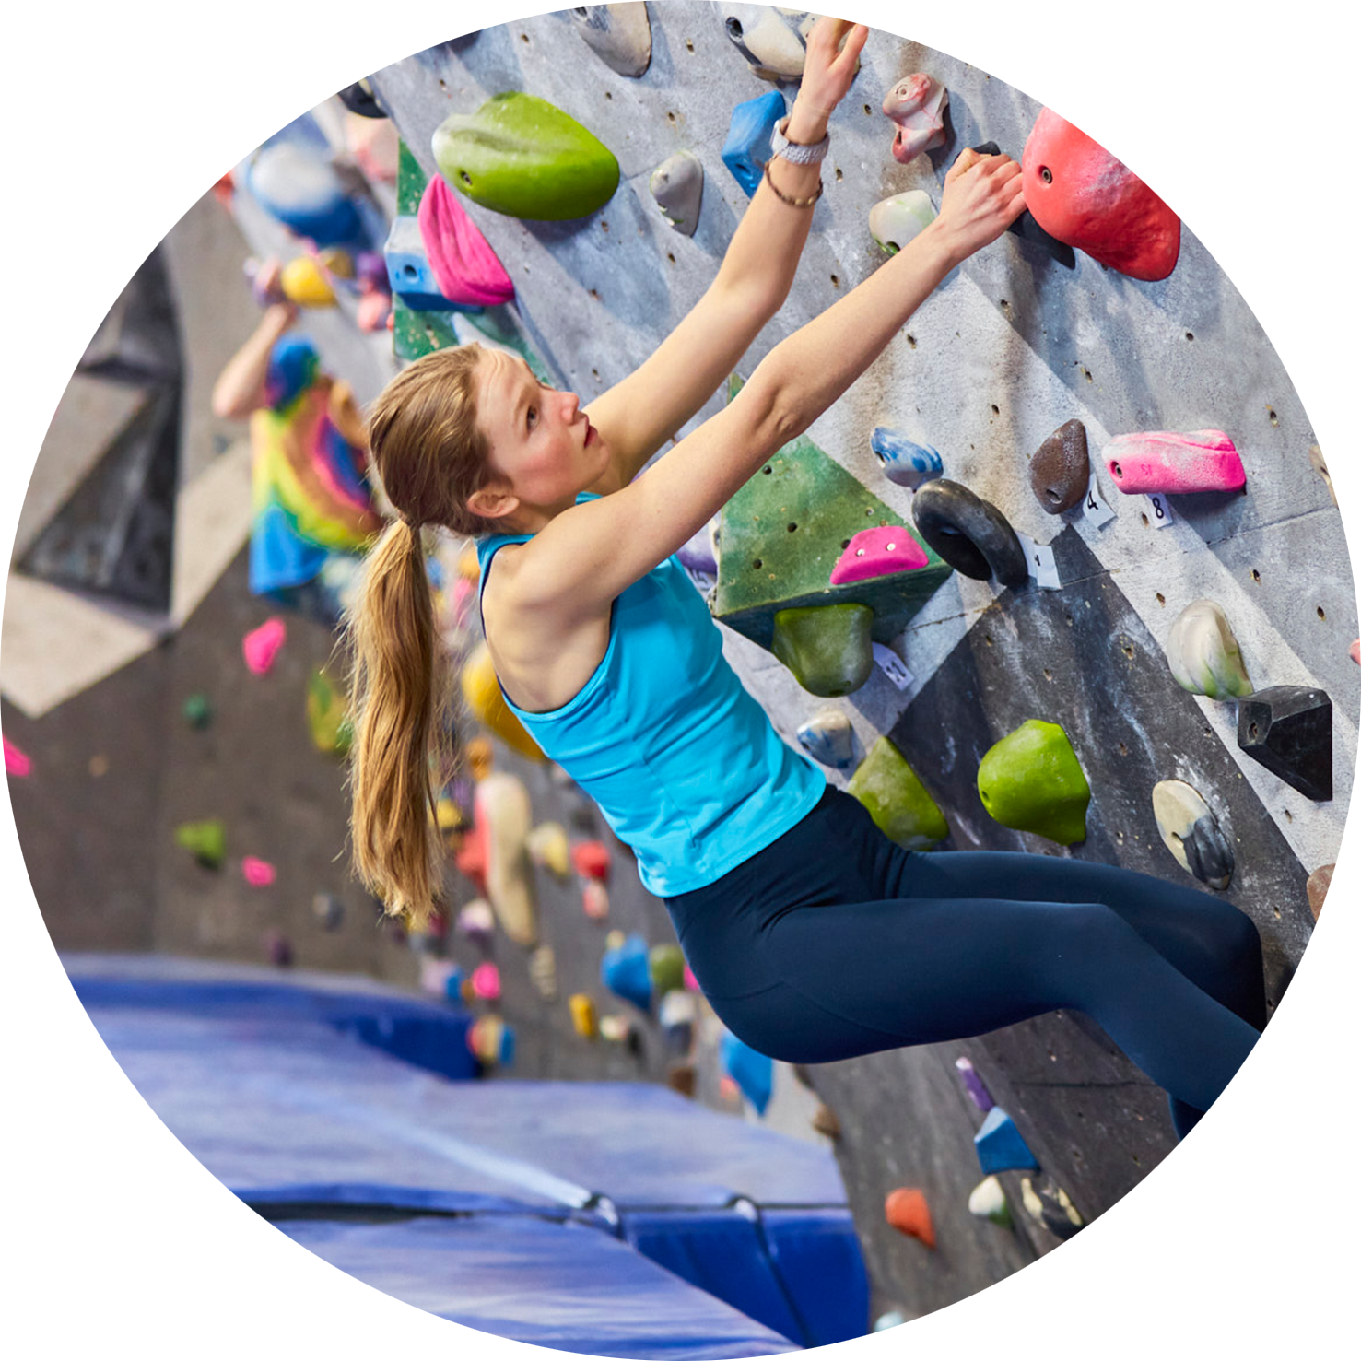
Attention Restoration Theory (ART)
Qualities
Fascination
Extent
Being Away
Compatibility

Slide 12
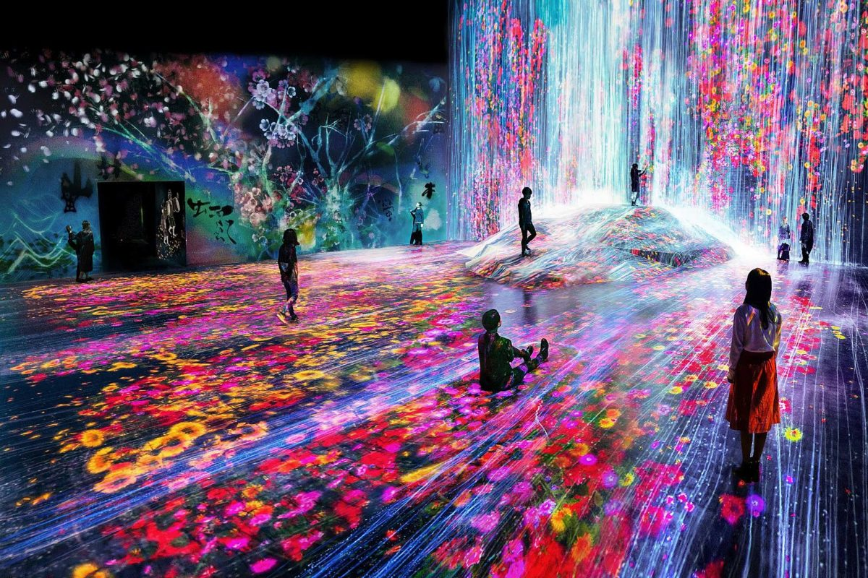
Fascination
Extent
Being Away
Compatibility
Notes:
-setting draws attention without cognitive effort
-e.g. museums

Slide 13
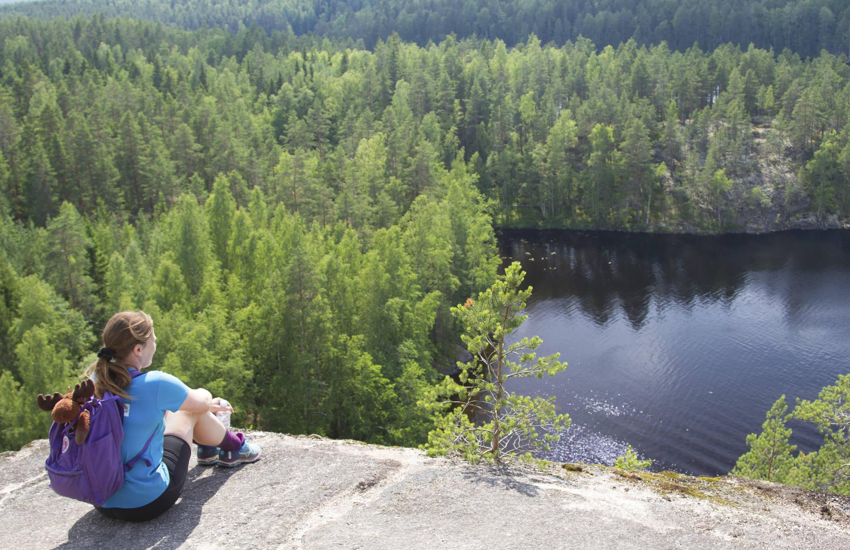
Fascination
Extent
Being Away
Compatibility
Notes:
-setting somehow mind-engaging, promotes exploration
-travelling, hiking, exploring

Slide 14
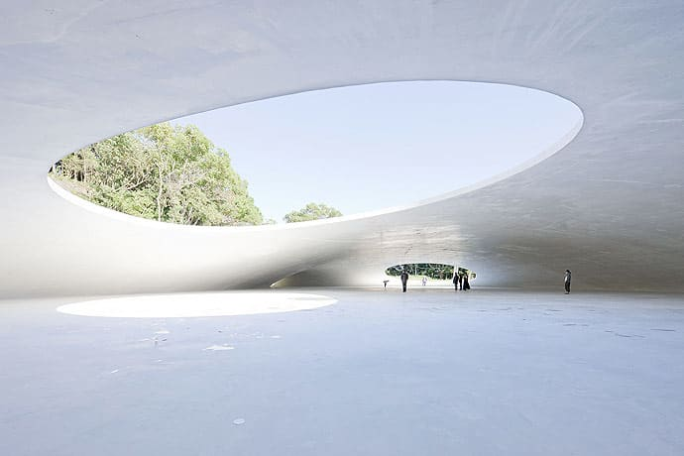
Fascination
Extent
Being Away
Compatibility
Notes:
-different from person’s typical environment
-e.g. Teshima Art Museum, artwork of James Turrell

Slide 15
Fascination
Extent
Being Away
Compatibility
Notes:
-about individual’s interest, how they match with the environment
-e.g. hobbies and activities

Slide 16
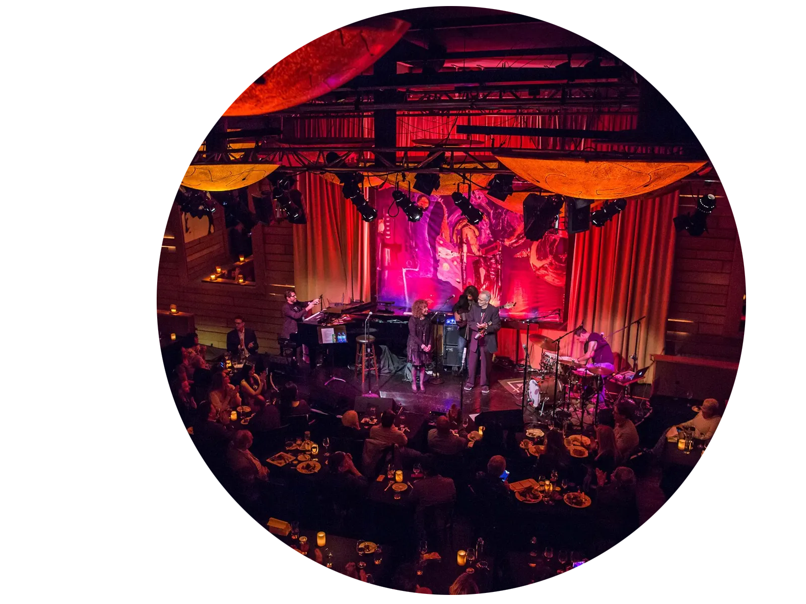
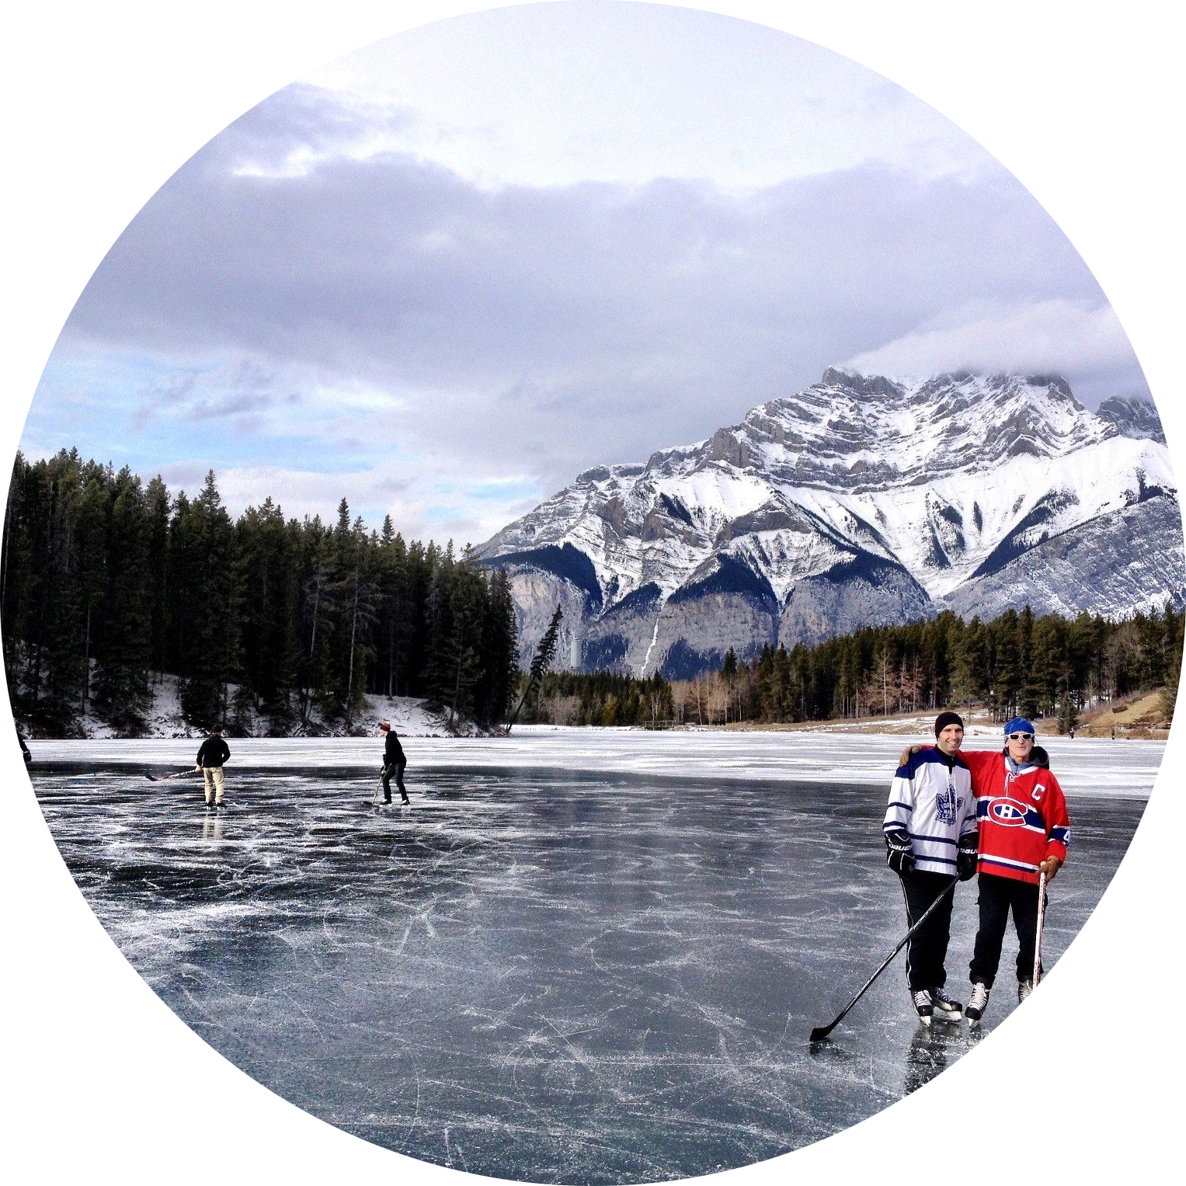
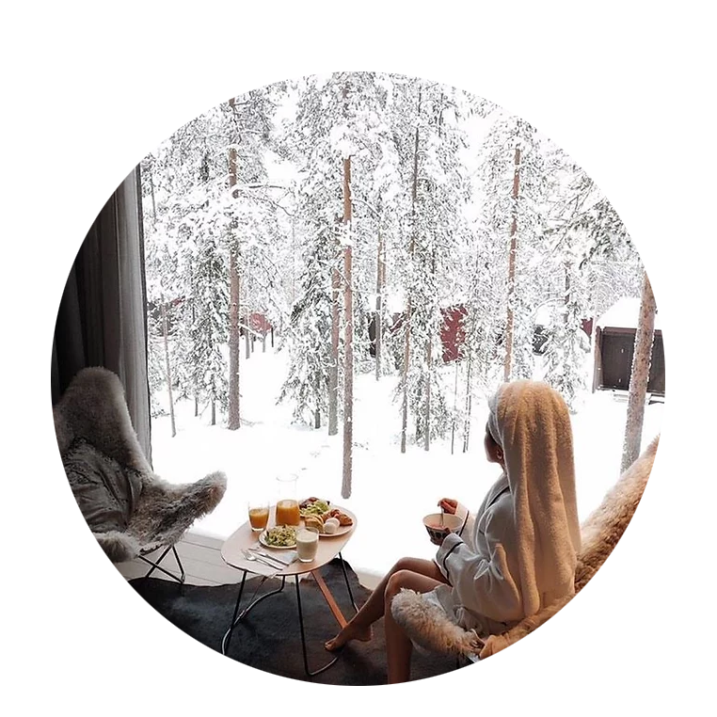
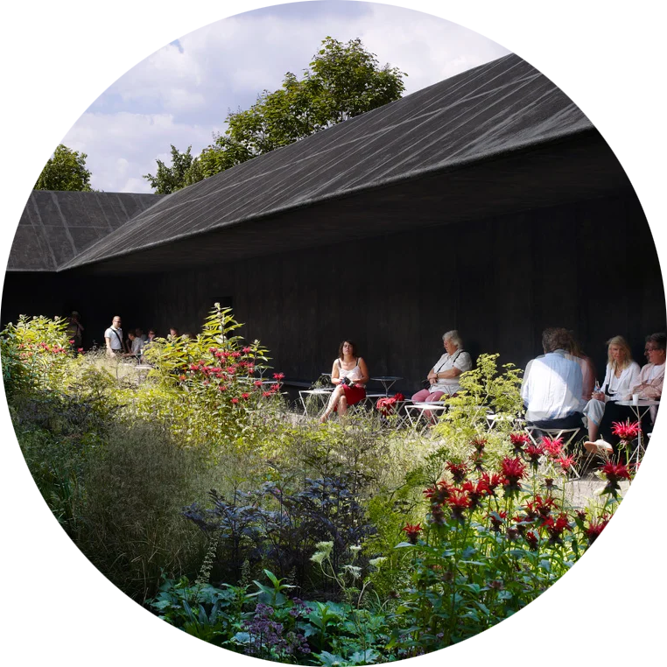
Notes:
-often bound together, often two or more characteristics present at once

Slide 17
Taking all the senses into account
VISION
HEARING
MULTI-
SENSORITY
TOUCH
OLFACTION

Slide 18
The significance of the senses
We sense our environment with all of our body
A restorative environment nourishes all the senses
What is most essential is to strive to remove negative sensory stimulus and, in right amounts, increase positive sensory stimulus

Slide 19
The relations between the senses
Nature is naturally a multisensory environment
An environment that is designed with multisensority in mind serves all of its users in the best possible way, also those who have some of their senses impaired
A space can and should be experienced multisensorily, rather than only visually, as is usual
This provides both opportunities and creates challenges to planning/design

Slide 20
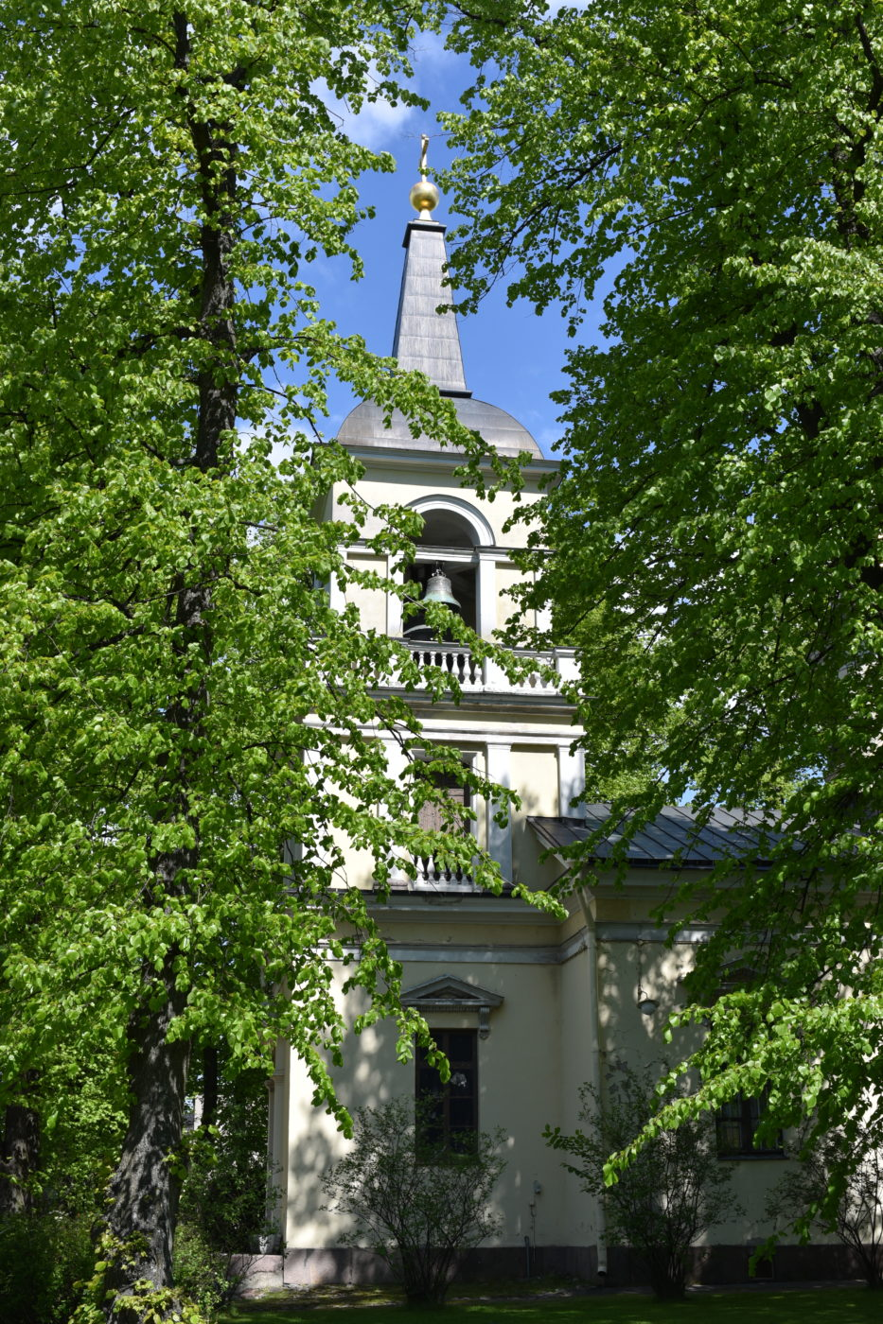
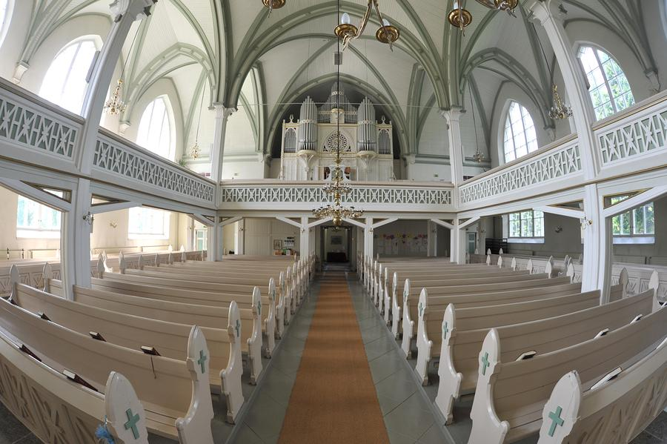
Places of Worship As Restorative Environments
Notes:
As I was reading The book on restorative environment design I realised that places of worship quite often fulfill many of the ideas laid out in the book.
Not only are they often surrounded by beautiful natural environments, they also one of the few built environment experiences that take all the senses, even taste into account, through the act of communion for example. They are often historic and beautiful environments that are often surrounded by nature.
According to a study by Thomas R. Herzog et al. Places of worship do function as restorative environments for religious people, the restorative effects of places of worship are greatly amplified during prayer and especially when the devotees pray for help with their problems.
The effects on non-religious people are however less strong, but still noticeable, probably due to the historic nature and the beautiful architecture.

Slide 21
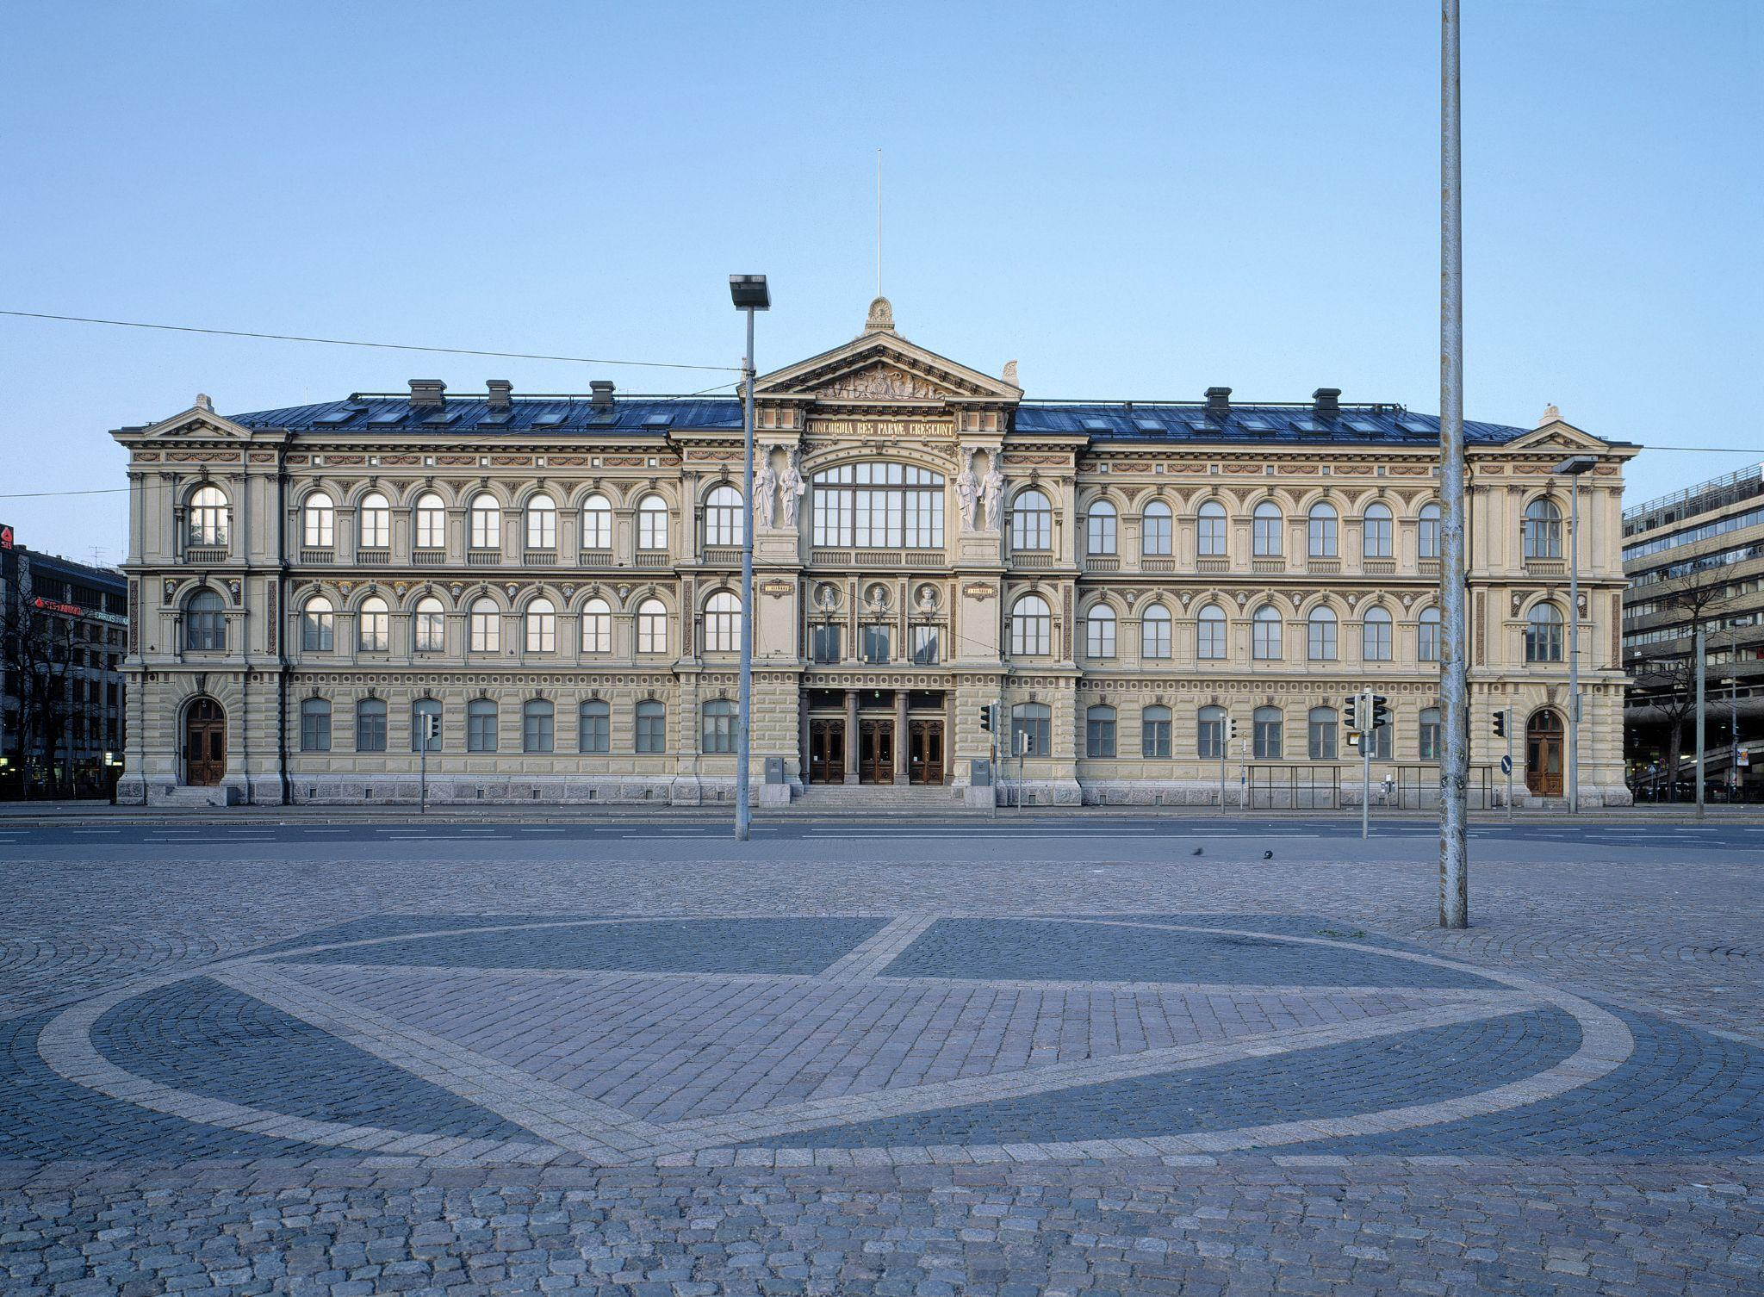
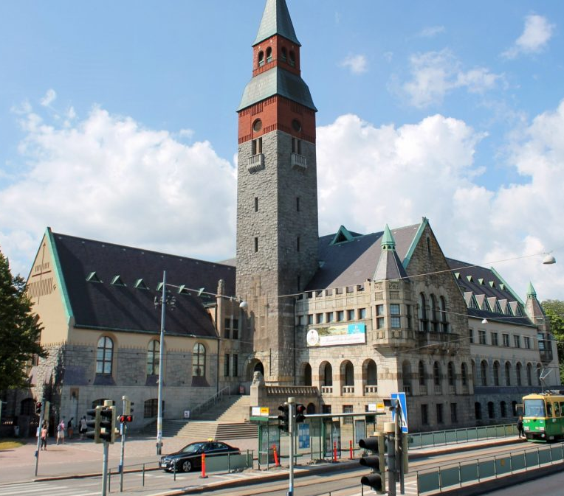
Museums as Restorative Environments
Notes:
According to another study by Stephen Kaplan et al, Museums are also quite effective restorative environments, especially for people who like to visit museums such as myself. They are often filled with fascinating objects and beautiful art. The biggest detraction from the museum experience is the unclear layout, which can lower or eliminate the restorative effects for people unfamiliar with museums.

Slide 22
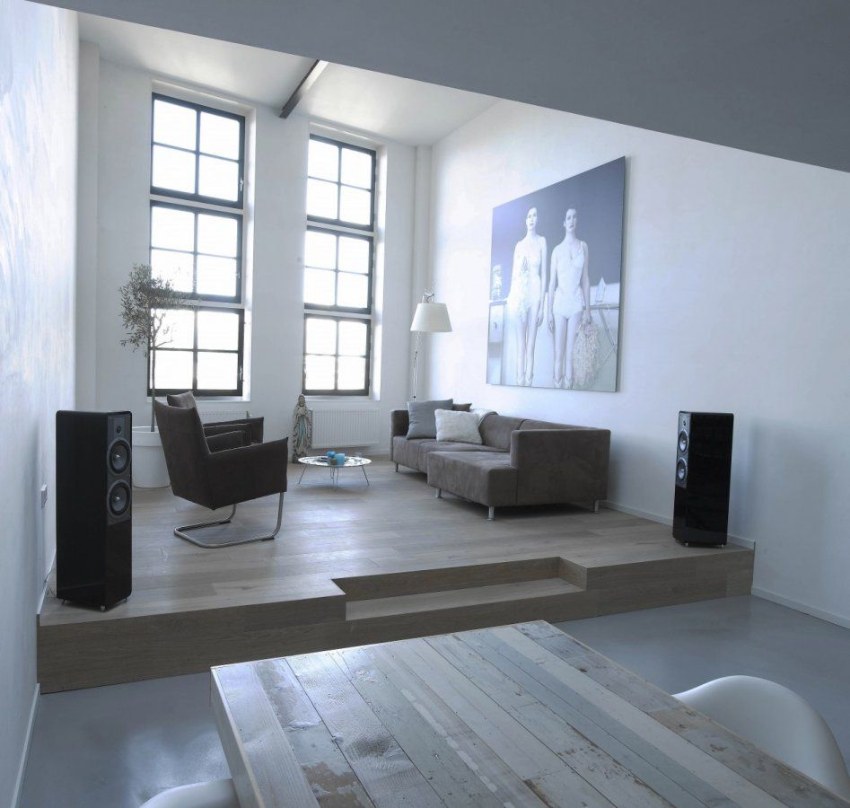
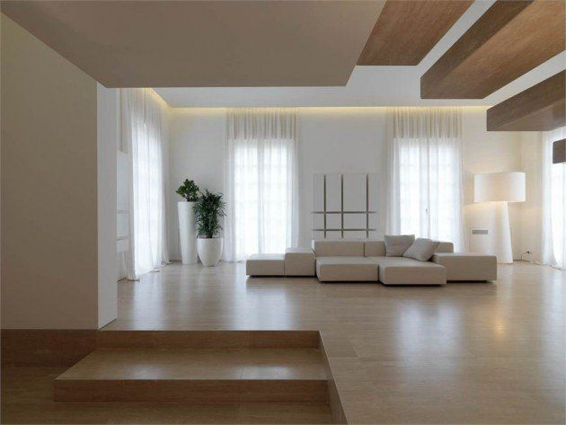
Materials in Restorative Environments I.
Notes:
As Lotta has already mentioned previously, pleasing the senses plays and important role in creating a restorative environment.
And for that pleasant feeling and to nourish all the senses also materials have a vital part.
When choosing materials, there are some main surfaces, that should be considered carefully when choosing their materials;
Such surfaces are: floor, wall, ceiling
Source: Restorative Environment Design, Nousiainen, Marjut Lindroos, Heikki Heino, Petri Kymenlaakso University of Applied Sciences, 2016 Restorative Environment Design by Restoratiiviset Ympäristöt - Issuu

Slide 23
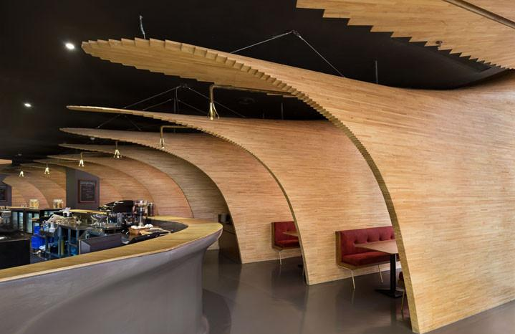
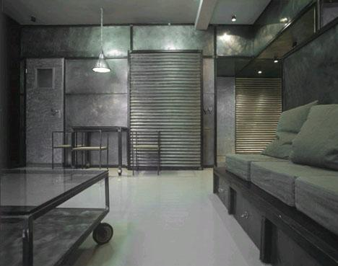
Materials in Restorative Environments II.
Natural
Artificial
Notes:
When talking about materials, there are two main types to take into account.
Artificial: such as glass, concrete, metal
they deliver often only one-sided sensory experience – and as mentioned previously, a RE shall be multisensory
Natural: wood, stones
They not only visually engaging, but they also feel, sound and smell plesant; (also offer a perfect reflective surface for light)
Also they become more beautiful as they age
Architecture of natural materials require maintenance, it is NOT eternal and that what makes them so human.
When considering natural materials for restorative environments, we talk about also ecological materials. Their properties are among other things renewability, recyclability. It can be said, that restorativness and sustainability goes hand in hand;
(AGAIN: Materials are considered form the point of their impact on restorative environment, not necessarily from design – of course restoratively positive materials can be stylish as well)

Slide 24
Materials in Restorative Environments III.
Acoustic properties
Contribution to pleasant room air
Enjoyable for the senses
CO₂ reduction
Ecological material
Light and strong material
Notes:
And such an ecological material is wood. It is the most commonly used material when creating restorative AND sustainable environments.
Properties: its most important properties are that
Its usage can considerably reduce carbon dioxide emissions, since its transportation and refinement costs are significantly less compared to other, non natural materials (regarding to Finland)
Additionally, In the direction of its grain it is very strong and at the same time light material - appropriate to use it for in-and outdoor spaces
Evens out moisture and retains a pleasant room air in winter and summer as well; its smell also considered enjoyable
Acoustic properties: impermeable wood surfaces does not mute a sound 🡪 ideal for concert halls/auditoriums
(Wood is maintained from forests; in general European forests are certified and quantitatively sustainably managed 🡪 it is continuously improved. Regarding Finland, two thirds of the country is covered in forests, it is a land of wood construction.
There are several studies that show the restorative effects of wood: environments with wooden interiors are experienced as relaxing and stress reducing)
Wood can be also used in a variety of different forms; a woodshed, a doghouse, interior elements, terrace, or nowadays facades are made more and more out of wood.

Slide 25
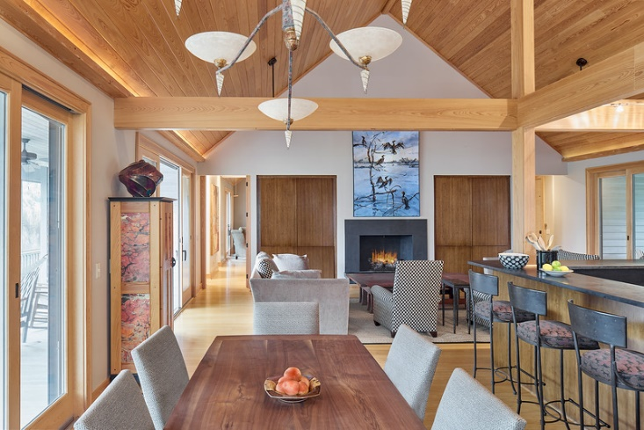
Materials in Restorative Environments IV.
Notes:
Less is more: a moderately wooden interior decoration is considered as more pleasant than a completely white or wooden decor

Slide 26
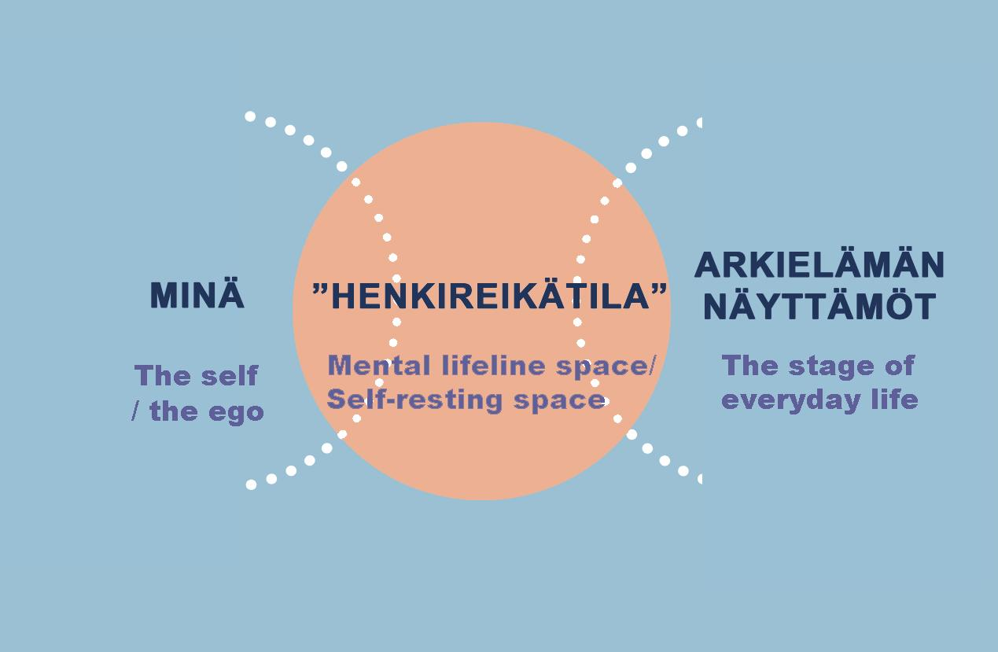
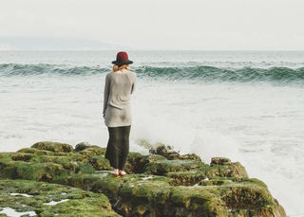
Liisa Horelli-Kukkonen
HENKIREIKÄTILAT

Slide 27
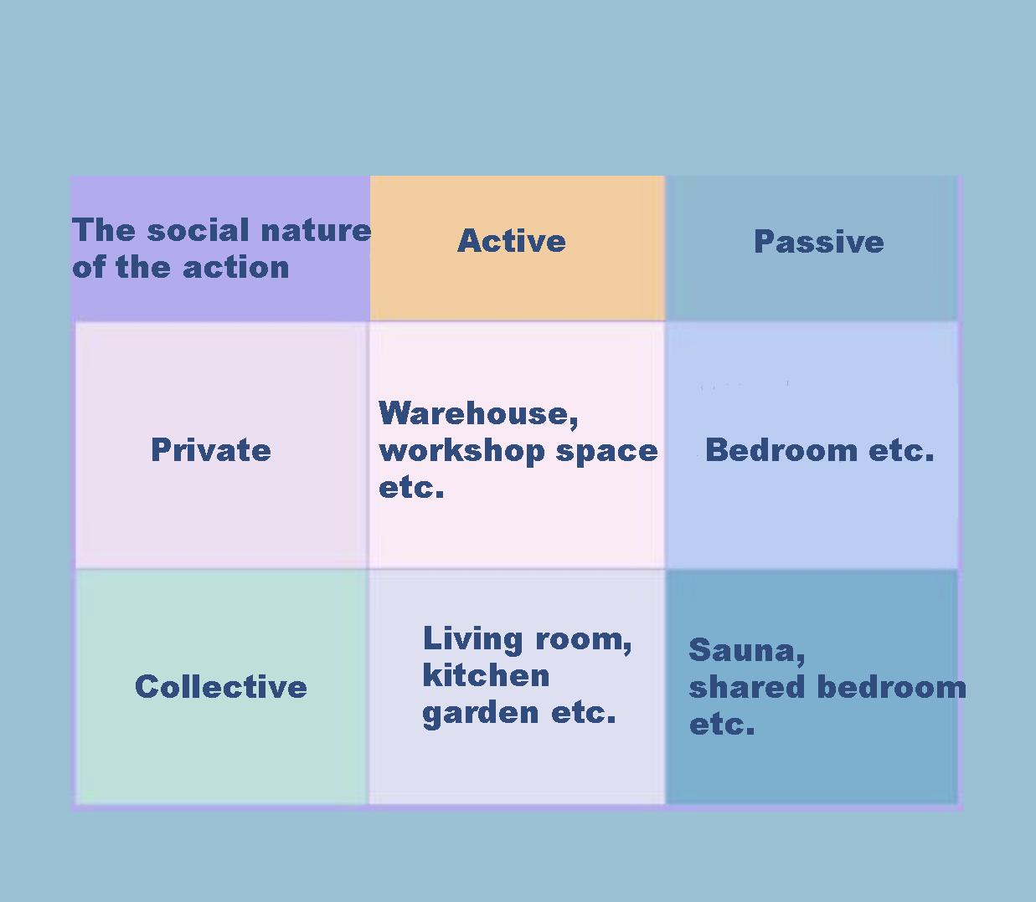
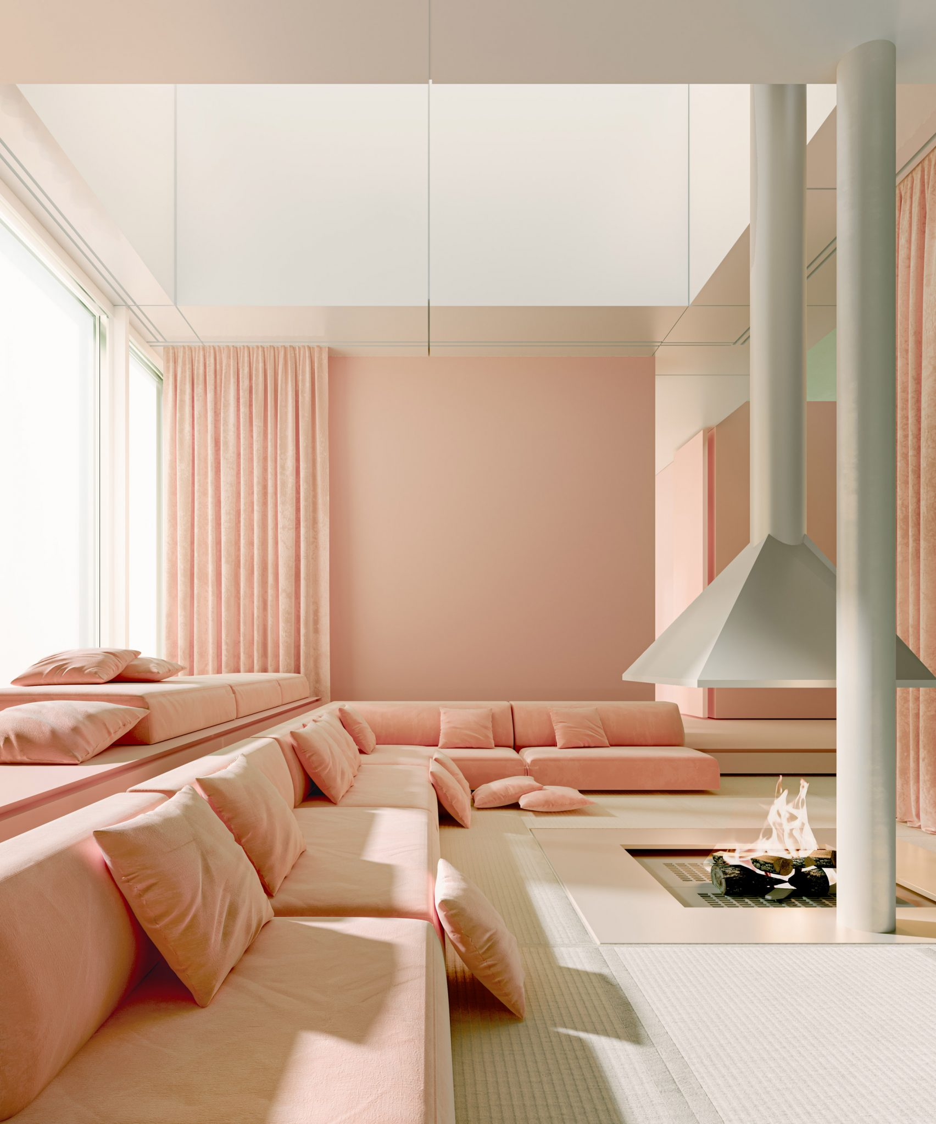
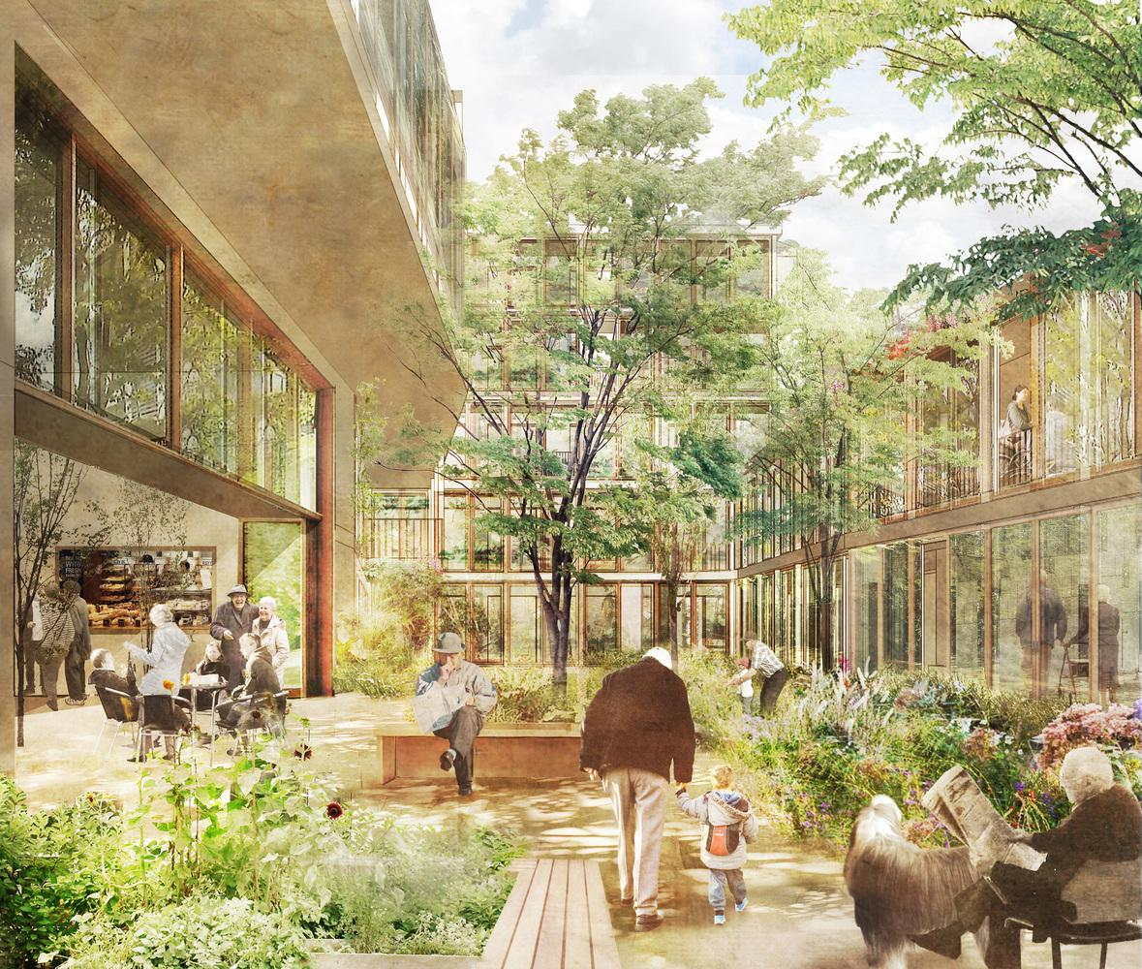
Four different types of spaces by social spatial functions

Slide 28
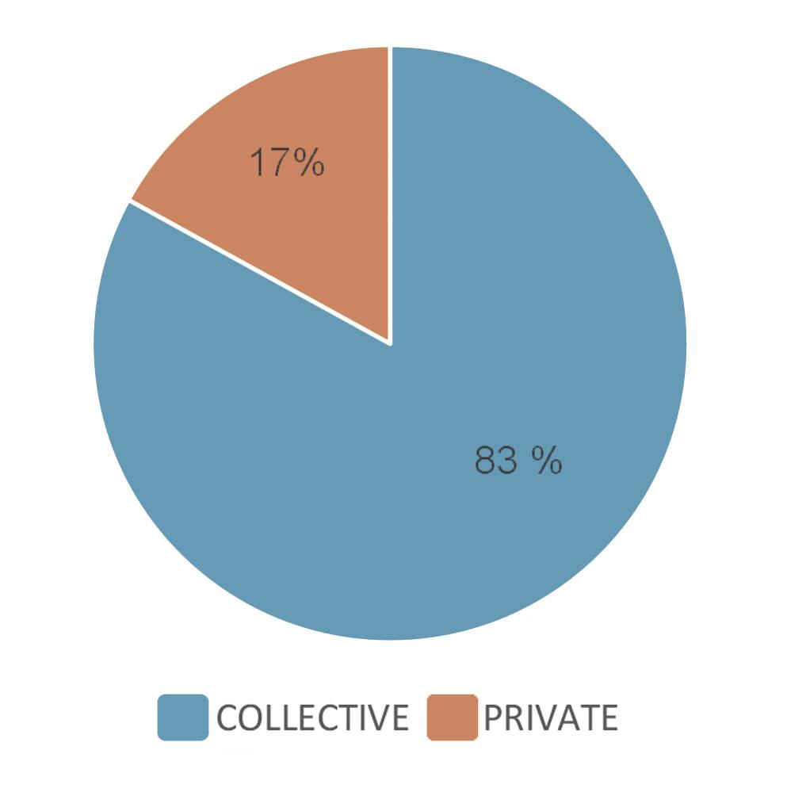
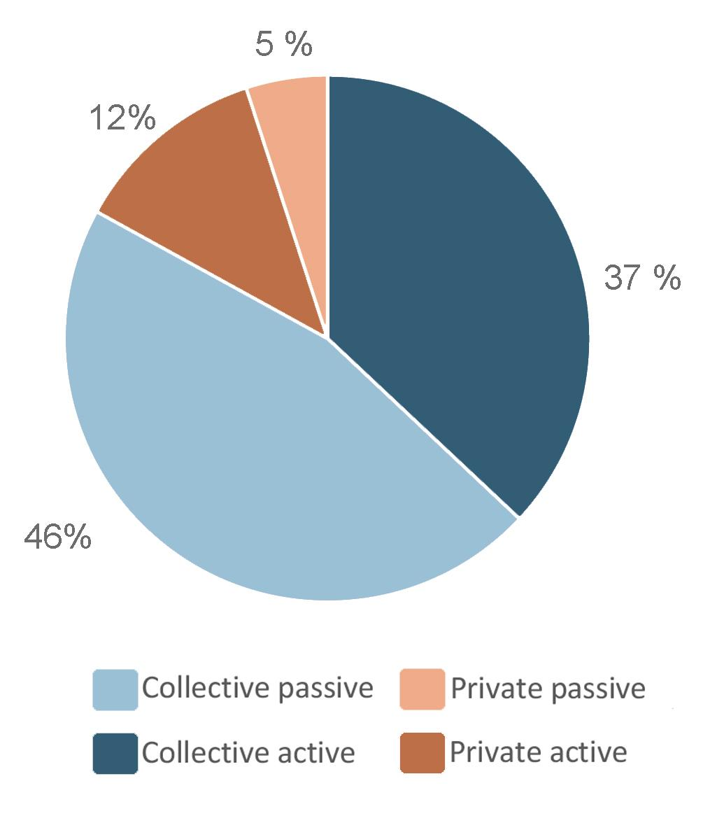
SURVEY, Horelli-Kukkonen

Slide 30
Sources
Nousiainen, M., Lindroos, H., Heino, P. Restorative Environment Design, Kymenlaakso University of Applied Sciences. 2016. Restorative Environment Design by Restoratiiviset Ympäristöt - Issuu Accessed on 20.01.2022
Aura,S., Horelli, L. & Korpela, K. 1997. Ympäristöpsykologian perusteet. 1. painos. Porvoo: WSOY
Horelli-Kukkonen, Liisa. 1993. Asunto psykologisena ympäristönä. Asujan ja asunnon vuorovaikutusta koskeva tutkimus pientalojen itsesuunnittelukokeilun valossa. Teknillisen korkeakoulun arkkitehtiosaston julkaisuja 3, Espoo.
Herzog TR, Ouellette P, Rolens JR, Koenigs AM. Houses of Worship as Restorative Environments. Environment and Behavior. 2010;42(4):395-419.
Kaplan S, Bardwell LV, Slakter DB. The Museum as a Restorative Environment. Environment and Behavior. 1993;25(6):725-742.

