Slide 1
Session 3
Project Management
Aalto University, Winter 2022
Patrick Simek, PhD

Slide 3
Comments about Team Task 1
Issues with Assignments?

Slide 4
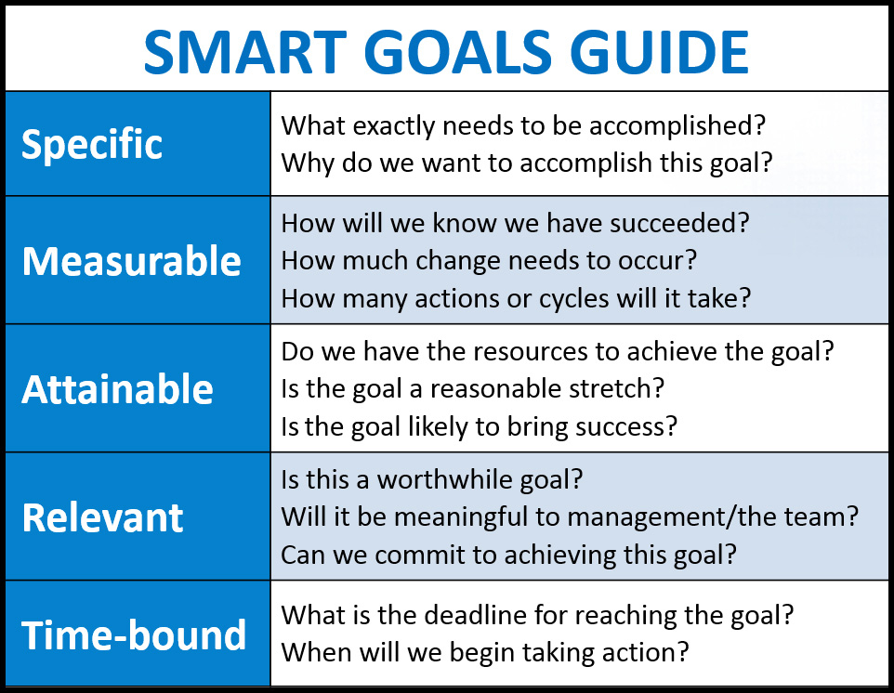

Slide 5
Project Scope Statements
A Project Scope Statement is to a project like a compass is to a hiker –
It tells you which direction to go
Notes:
Just a quick comment about the Project Scope Statements. Because this class is so short, I know it might be difficult to feel confident about the completeness of your Scope Statements. These really are important to make sure that you and your key stakeholders have the same expectations from your project. As you go along through the process of executing the project, it is your compass – guiding you I the right direction.
If you refer to the scope statement whenever a suggested change or deviation comes up and if you revise and get the revised scope statement approved by the Key Stakeholder, you will likely avoid Scope Creep, the stress creator and killer of many projects.
After grading scope statements, add text to the slide. Read and discuss with students
Next, Let’s talk about your Emotional Intelligence quizzes.

Slide 6
Situational case: “Project Scope”
Your boss is giving you a rough outline of the scope, constraints, and risks involved in a prospective client's project. The project is highly similar to another project you are currently closing.
The sponsor wants to know how long this project would take your team to complete.
You think your team may need two months, but what should your answer be?
Notes:
EI or EQ as it is also called, is how each we manage our behavior, interact socially, and make personal decisions that enable us to achieve positive results.
Understanding your own emotional intelligence will help boost your people skills, a vital part of success in business.
High emotional intelligence helps you stay calm and positive in the face of adversity. We all know people who are in full control of their emotions. They're calm in a crisis, and they make decisions sensitively, however stressful the situation.
We also know people who can read the emotions of others. They understand what to say to make people feel better, and they know how to inspire them to take action.
People like this have high emotional intelligence (or EI). They have strong relationships, and they manage difficult situations calmly and effectively. They're also likely to be resilient in the face of adversity.
Who do you know who has high EI?
Who in this class do you think has high Emotional Intelligence?

Slide 7
Emotional Intelligence (or EQ) defined
How we manage our behavior
How we interact socially
How we make personal decisions that allow us to achieve positive results

Slide 8
Intelligence Quotient vs Emotional Quotient IQ vs EQ
People with average IQs outperform those with the highest IQs 70% of the time
90% of top performers in business have high EQ’s
Why is EQ more important in today’s business world than IQ?
Notes:
As you read before doing the Emotional Intelligence quiz, when emotional intelligence (EQ) was first introduced to the business world, it explained why people with average IQs outperform those with the highest IQs 70% of the time. This awareness changed the widely-held belief that IQ was the most important characteristic in business success, which triggered extensive research as to why individuals with the highest IQs were often not the top corporate performers.
Research findings revealed that emotional intelligence is the factor that differentiates top performers from the others, regardless of IQ. In fact, 90% of top performers have high emotional intelligence. You’re all really smart people. By a quick show of hands, Were you surprised at those facts?
Why would you say that EQ is a more reliable indicator of business and project success than IQ?
Yes, it helps teams work together, leaders with high EQ can read other people which allows them to know when to ask for things, when to wait, how to resolve problems that arise, which people to assign to work together and which to put on different teams. How to tap into the creativity of employees and motivate them. For example, leaders with High EQ understand that different things motivate different people – how you communicate, is it money, job satisfaction, or recognition that motivates someone?

Slide 9
Signs of low EI
Get stressed easily
Difficult to assert oneself
Challenging to identify and explain emotions
Assume quickly and defend assumptions strongly
Notes:
Let’s take a look at the flip side of the Emotional Intelligence coin, low EI. People with low EI
People get stressed easily? When you keep your feelings inside, they can quickly build into the uncomfortable sensations of tension, stress, and anxiety. Unaddressed emotions strain the mind and body. Your emotional intelligence skills help you manage stress more easily by enabling you to spot and tackle tough situations before things escalate. People who fail to use their emotional intelligence skills are more likely to turn to other, less effective means of managing their mood. They are twice as likely to experience anxiety, depression, substance abuse, and even thoughts of suicide.
2. Is it difficult for them to assert themselves. People with high EQs balance good manners, empathy, and kindness with the ability to assert themselves and establish boundaries. This is important because you can’t say YES all the time. Knowing when to agree to extra work and situations that you weren’t planning on will help you be happier with your work, accomplish it well, and maintain work/life balance.
This tactful combination is ideal for handling conflict. When most people are crossed, they default to passive or aggressive behavior. Emotionally intelligent people remain balanced and assertive by steering themselves away from unfiltered emotional reactions. This enables them to neutralize difficult and toxic people without creating enemies.
3. Do you find it challenging to identify and explain emotions that you are feeling? We all experience emotions, but only a few can accurately identify them while they are occurring. Research shows that only 36% of people can do this, which is problematic because unlabeled emotions often go misunderstood, which leads to irrational choices and counterproductive actions. People with high EQs master their emotions because they understand them, and they use an extensive vocabulary of feelings to do so. While many people might describe themselves as simply feeling “bad,” emotionally intelligent people can pinpoint whether they feel “irritable,” “frustrated,” “downtrodden,” or “anxious.” The more specific your word choice, the better insight you have into exactly how you are feeling, what caused it, and what you should do about it.
4. Do you make assumptions quickly and defend them strongly? People who lack EQ form an opinion quickly and then gather evidence that supports their opinion and ignore any evidence to the contrary. (The president of a large country may come to mind.) More often than not, they argue fiercely to support their assumptions. This is especially dangerous for leaders, as their under-thought-out ideas become the entire team’s strategy. Emotionally intelligent people let their thoughts marinate, because they know that initial reactions are driven by emotions. They give their thoughts time to develop and consider the possible consequences and counter-arguments. Then, they communicate their developed idea in the most effective way possible, taking into account the needs and opinions of their audience.

Slide 10
Hold grudges = a stress response
Replay mistakes too much leads to anxiety and fear of failure
Feel others don’t understand them and they can’t fix it
Not aware of emotional triggers & can’t sidestep them
Stuff emotions – not genuine or productive
Blame others for how they make them feel
Get offended easily
Narcissists have an extremely low level of EI
Notes:
5. Do you hold grudges? The negative emotions that come with holding on to a grudge are actually a stress response. Just thinking about the event sends your body into fight-or-flight mode, a survival mechanism that forces you to stand up and fight or run for the hills when faced with a threat. When a threat is imminent, this reaction is essential to your survival, but when a threat is ancient history, holding on to that stress wreaks havoc on your body and can have devastating health consequences over time. In fact, researchers at Emory University have shown that holding on to stress contributes to high blood pressure and heart disease. Holding on to a grudge means you’re holding on to stress, and emotionally intelligent people know to avoid this at all costs. Letting go of a grudge not only makes you feel better now but can also improve your health.
6. Do you keep replaying your mistakes. Emotionally intelligent people distance themselves from their mistakes, but they do so without forgetting them. By keeping their mistakes at a safe distance, yet still handy enough to refer to, they are able to adapt and adjust for future success. It takes refined self-awareness to walk this tightrope between dwelling and remembering. Dwelling too long on your mistakes makes you anxious and gun shy, while forgetting about them completely makes you bound to repeat them. The key to balance lies in your ability to transform failures into nuggets of improvement. This creates the tendency to get right back up every time you fall down.
7. Do you often feel that others don’t understand you? When you lack emotional intelligence, it’s hard to understand how you come across to others. You feel misunderstood because you don’t deliver your message in a way that people can understand. Even with practice, emotionally intelligent people know that they don’t communicate every idea perfectly. They catch on when people don’t understand what they are saying, adjust their approach, and re-communicate their idea in a way that can be understood.
8. Are you unaware of what triggers emotional outbursts? Everyone has triggers—situations and people that push their buttons and cause them to act impulsively. Emotionally intelligent people study their triggers and use this knowledge to sidestep situations and people before they get the best of them.
9. Do you refrain from ever getting angry? Emotional intelligence is not about being nice; it’s about managing your emotions to achieve the best possible outcomes. Sometimes this means showing people that you’re upset, sad, or frustrated. Constantly masking your emotions with happiness and positivity isn’t genuine or productive. Emotionally intelligent people employ negative and positive emotions intentionally in the appropriate situations.
10. Do you blame other people for how they make you feel? Emotions come from within. It’s tempting to attribute how you feel to the actions of others, but you must take responsibility for your emotions. No one can make you feel anything that you don’t want to. Thinking otherwise only holds you back.
11. Do you get offended easily? If you have a firm grasp of who you are, it’s difficult for someone to say or do something that gets your goat. Emotionally intelligent people are self-confident and open-minded, which create a pretty thick skin. You may even poke fun at yourself or let other people make jokes about you because you are able to mentally draw the line between humor and degradation

Slide 11
4 Skills that comprise emotional intelligence
Personal Competence | Self-awareness | Self-management
Social Competence | Social awareness | Relationship management
Notes:
This chart shows the 4 skills that make up emotional intelligence. These are all critical for success on teams, success overall at work, and for healthy, long-lasting relationships.

Slide 12
What people with a strong sense of self-awareness look like
Can perceive emotions immediately
Understand behavioral tendencies
Know what they do well
Know what satisfies them
Know what annoys them
Helps them make correct choices
Notes:
According to the reading about Emotional Intelligence, here’s what people with high levels of EQ in the Self-awareness realm look like.
They can accurately perceive their own emotions IN THE MOMENT and understanding their tendencies in various situations.
This helps a person know what they do well, what motivates them, what satisfies them and which people and situations push their buttons
Only 2% lf low performers in job situations are strongly self-aware
To be generally happy with your work and life, it’s worth developing a high sense of self-awareness.
Each of the 4 skills of emotional intelligence were outlined like this and had short vignettes showing how people with high, low, and medium emotional intelligence experienced life and what others had to say about them.
Please make sure to read this and on your final presentation in class 7, one aspect will be to honestly and realistically assess the emotional intelligence quotients of the members of your team.

Slide 13
HINT: EI is an element of your final project presentation
Remember what you read
Be aware of your own and your team mates EI during this week
Include an EI assessment of your team in your final presentation on Day 7
Notes:
Since you will need to include an assessment of your team’s emotional intelligence as part of your team presentation on Day 7, please be sure to read this extract from Emotional Intelligence 2.0, keep some notes about your own and your team mates emotional intelligence, and be prepared to discuss and prepare a comment on why high EI helped your team to do well on your project initiation and planning or what hindered you.

Slide 14
Discuss your EI assessment results with someone you trust in this room
Pair up with one or two people you trust in this room
Talk about your EI assessment results
Did anything surprise you?
How might you be able to use this new insight?
How could EI play a part in team functionality?
Notes:
Since EI is an important characteristic for all of us to develop, will you please discuss your results with a person you trust in our class?
This might be one or more people with whom you feel comfortable. Please talk for about 5 minutes about the questions on the screen.
Without disclosing your EI score, who would share with you discussed just now.

Slide 15
Project Planning Tools
Risk Management Plan
Project Schedule
Project Communication Plan
Notes:
Thank you for taking the assessment, for thinking about it, and for discussing the questions openly with others in our class. For a team to be high functioning, Developing EI is valuable. Even if some results said that EI isn’t high, being aware of what it is, how it affects your interactions with others and choosing to approach or think about things differently will increase your EI over time.
Now, let’s shift gears and talk work on more of the required tools for planning projects that were discussed in Chapter 4.
These 4 plans are critical to understand and know how to use: the Risk Mgt Plan, Project Scheduel, Budget and Project Communication Plan. Some additional tools were presented in Chapter 4 to help us build each of these and the proper mindset is also necessary.

Slide 16
A plan is to a project as a roadmap is to a group on a trip … it tells you how to get to your destination
Having a risk management plan prepares a team for Murphy’s Law
“If anything can go wrong, it will”
A risk management plan will help you move smoothly and quickly if a risk becomes reality
Notes:
By planning for possible risks that could affect your project, you are thinking smart and avoiding the panic that can totally derail a project where the risks haven’t been considered in advance.

Slide 17
Risk Management Plan Step 1: Brainstorm a list of possible problems
Notes:
The first step of creating a risk management plan is to brainstorm all of the possible things that could go wrong with a project.
Did you all participate in O-Week? I was assuming that you did. So think back to the activities and then talk about in your team for 1 minute about some of the risks there might be in hosting O-Week.
Can I have a volunteer come forward and write these risks on the board that people are going to shout out? Thank you.
If you were planning O-Week, what are some of the things that could go wrong?
Airline strike and students flying to Finland don’t arrive
There is a fire or other disaster that makes the campus unoccupiable
(Get other ideas from Joan before class)
___________
___________

Slide 18
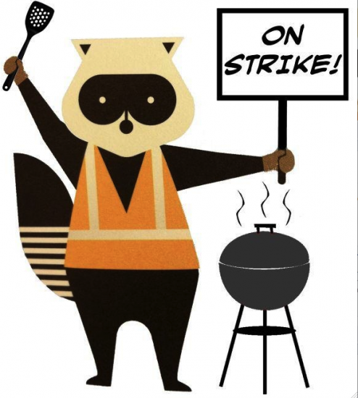
Risk Management Plan Step 1: Brainstorm a list of possible problems
Notes:
The first step of creating a risk management plan is to brainstorm all of the possible things that could go wrong with a project.
Did you all participate in O-Week? I was assuming that you did. So think back to the activities and then talk about in your team for 1 minute about some of the risks there might be in hosting O-Week.
Can I have a volunteer come forward and write these risks on the board that people are going to shout out? Thank you.
If you were planning O-Week, what are some of the things that could go wrong?
Airline strike and students flying to Finland don’t arrive
There is a fire or other disaster that makes the campus unoccupiable
(Get other ideas from Joan before class)
___________
___________

Slide 19
Situational case “Cheap office furniture”
Scenario
Your company is expanding and for the new departments cheap office furniture is supposed to be procured. Since you have good relations with countries in Eastern Europe, you are asked to find nice desks and office chairs and – if you find suitable ones – order 150 each.
What do you need to consider from a risk management point of view?

Slide 20
Risk Management Plan Step 2: Assess each risk factor
Impact x Probability = Actual Risk
Impact
Worst-case scenario = 5
Relatively important impact = 4
Minimal impact = 2
Notes:
After making your list of possible risks, weigh them. First think about how much impact each of the risks would have on the project if they occurred. Assign an impact factor to each risk using a scale of 0 to 5.

Slide 21
Risk Management Step 3: Assign a probability factor
Probability
1 = slight possibility
2 = it could happen
3 = 50-50 chance it will happen
4 = a greater than 50% chance it will happen
5 = a high likelihood it will happen
Notes:
Next determine the probability of each risk occurring and assign a probability factor to each one. In some cases, you have to use your best guestimate. In other cases, you may want to research weather trends, what’s happening in the transportation sector currently, how responsive is the fire department and is the building up to date on it’s fire detection and protection systems, etc.

Slide 22
Risk Management Step 4: Create a risk matrix
RISK | IMPACT | PROBABILITY | SCORE
Airline worker strike | 5 | 2 | 10
Building burns to the ground | 5 | 2 | 10
Audio/visual equipment failure | 4 | 3 | 12
Notes:
Lay out the risks on a chart, determine the impact of the risk if it happened, determine what the probability of that occurring is, and then multiple the impact x the probability to get a risk score. For any risk that scores above 12, take time to check into alternatives, preventive steps and mitigation.
This is the first step In creating a risk management strategy that you can communicate to the stakeholders and project sponsor.

Slide 23
Risk Management Step 5: T.A.M.E. the risks
Transfer to a third party
Accept risk - deal with it if it occurs
Mitigate risk - reduce the probability or impact
Eliminate risk - make it go away
Notes:
After assessing the risks, you are now ready to decide how you would deal with each risk if it became reality. In this step, you can use the tame tool.
What examples can you think of where these risk strategies have been applied?
Transfer risk – Insurance - a specified risk of loss is passed from the policyholder to the insurer. A fashion company outsources a number of its information technology capabilities to transfer technology risks to outsource vendors. If systems go down, the vendor may have to pay penalties.
Risk Acceptance - VV
An investor buys stock in an innovative company with a high valuation. They accept the risk that it could go down significantly because they feel the reward could also be large.
Mitigate the risk – mitigates the risk of being late by assigning more resources to a critical task that has many dependencies.
Eliminate the risk - it should attack the source of the hazard, not its outward signs e.g. the noise, vibration, fumes, exhaust, etc. that it produces. For example, it is better to replace, redesign, isolate or quiet a noisy machine than it is to provide workers with hearing protection.

Slide 24
Risk Management Step 6: Create the Risk Management Plan
RISK | SCORE | STRATEGY | WHO
Airline Employee Strike | 10 | Have select an alternate date to hold O-Week | Student Body President? Joan? Someone else?
Audio/visual equipment failure | 12 | Rent back-up equipment | Sauli?
Notes:
After you have that information, you’re ready to create your Risk Management Plan.
I don’t know who the decision-makers are for these risks, so I have question marks after their names. In your plan, however, you’d have researched this thoroughly and you would know without a doubt who would be responsible. AND you would have shared the Risk Management Plan with them so they know what to expect on their end.

Slide 25
Benefits of communicating risk management plans
Team members’ stress level will be lower
Project sponsor will feel confident
Stakeholders will be pleased, more supportive and less demanding

Slide 26
The Project Schedule – what for?
Shows all key tasks
Shows milestones
Shows if the project is on track or not
Notes:
The project schedule not only tells you all of the key tasks and milestones to complete a project, it tells you if you’re on track or not.
It should be visible, constantly updated and open for every team member to see

Slide 27
5 Steps to create a Project Schedule include…
Prepare a Work Breakdown Structure (WBS)
Sequence all activities
Assign responsibilities for who is preparing what
Shows an estimate of the duration of each task
Identifies the critical path to completion
Notes:
These 5 steps are necessary to create a workable and accurate project schedule

Slide 28
WBS shows the project deliverables and the components in each deliverable
Brainstorm deliverables using
mind maps or
linear lists or
Post-it note method
Notes:
As you prepare the WBS for your projects, refer to pages 90-93 in your text. Take time to brainstorm with your whole team to be sure you don’t miss any steps. If you do, your whole schedule and budget could be negatively impacted

Slide 29
Make a working chart after brainstorming to start the process
Sequence # | % Done | Deliverable/Activity/Component
1 |  | Promotion
1.1 | 100% | Create publicity plan
1.2 | 50% | Design O-week theme
Notes:
After brainstorming a list of deliverables, activities, and components, group them and sequence each activity and component of a deliverable to determine the flow of what must occur first, second, third, etc.
After preparing the chart, keep updating the % complete to make sure no component is falling behind schedule.

Slide 30
Three types of dependencies
Logical relationships between activities = dependencies
Determine if each relationship is
Finish to Start – when one activity concludes it triggers the start of another
Concurrent – both can start at the same time and run simultaneously
Finish to Finish – Some activities cannot be completed until another activity is also completed
Notes:
Map this out either using computer project planning software or a simple excel spreadsheet. You can also use yellow stickies on a white board or a desk while your planning

Slide 31
Identify additional team members if required to complete the project
Consider each activity
What skills, strengths, experience, work orientation and possibly communication style is required for each activity
Consider all of your options – existing team members, other people at Aalto or external vendors
Review and get approval from project sponsor before acting
Revise if necessary
Notes:
After completing your team planning, review it with the project sponsor or key stakeholder to be sure you can get the cooperation of these individuals. Remember, this is one of the special features of project work – you’re working with volunteer team members, not hiring permanent staff. Often the ideal team member you’ve identified is not available and you need to revise your choices

Slide 32
Estimate the time required to do the work and the duration required
WORK is not equal to DURATION
16 hours 2 weeks @ 1/hr per day
Work = hours required to Number of days the work
do the work will be spread over
Underestimate = Project late Overestimate = Project is over budget
Notes:
As your preparing your Project schedule, keep in mind this critical concept: Work is not equal to Duration.
Because projects are short-term, operate with volunteer labor for the most part who have other jobs and responsibilities, and there is a specific start and end date, you have to think realistically how much time each person can put into the project and over what period of time. If you under-estimate this, your project will be late. Over estimate it and your project may be over budget.
Where as in an operational work environment an employee may be able to devote 2 solid days to a task, on projects, usually the amount of time that an employee can give each day is small, therefore, the duration to complete the activity is much longer. Be sure to factor this in when making project schedules

Slide 33
Caution: when determining number of hours to complete work
Consider amount of time from various sources
List the optimistic, most likely and pessimistic
Use PERT formula to calculate amount of time for each task
Expected Time = ((Optimistic + 4 x Most Likely + Pessimistic)/6)
Notes:
Refer to page 106 for more information on calculating the PERT formula

Slide 34
Enter sequence, work, duration, start and end dates on your planning chart
Sequence # | Status | % Done | Deliverable/Activity/Component | Work Hours | Duration | Start Date | End Date
1 |  |  | Promotion
1.1 | Complete | 100 | Create publicity plan | 3 hours | 3 days | 1/12/18 | 1/15/18
1.2 | On-track | 50 | Design O-Week Theme | 12 hours | 6 days | 1/15/18 | 1/20/18
Notes:
Once you have identified all of the details, you can put them on a chart like this prior to making your completed schedule.

Slide 35
Project Schedule See format on page 114

Slide 36
Establish Milestones and Critical Path
Milestones – important but somewhat arbitrary
Identify the Critical Path
The longest sequence of activities that must start and end as scheduled.
These activities determine the duration of the project.
If any activity on the critical path is late, the entire project will be late
Notes:
Wise project leaders and project teams understand the importance of identifying the critical path.
Look at your schedule carefully, identify the critical path, and if possible add more resources to the activities here. Better to finish the critical path activities early to ensure meeting overall project timeline.
Refer to pages 112-116 to review two methods for calculating the Critical Path. Are all of you familiar with Gantt charts? I think that’s the preferable method for calculating the Critical Path. Take a look at the Gantt chart on page 114 when you get to this part of your project planning.

Slide 37
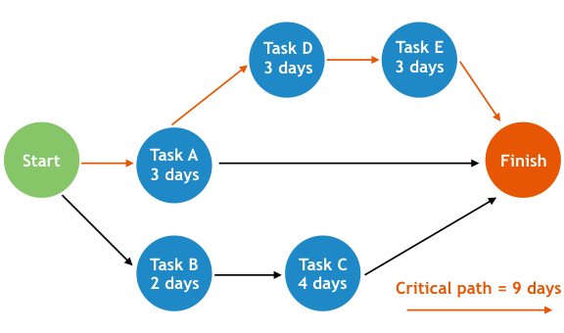
Since not every task is dependent on those preceding it, not every task will be on the critical path
The sequence of tasks on the critical path are so connected that if one task is delayed, it will set back the entire project

Slide 38
Creating the Project Budget
Line Item | Calculation | Total | Internal Aalto Expense | External Expense
Materials
Labor
Promotion
Insurance
Notes:
And now for those financial gurus who love numbers … it’s time to prepare the project budget.
There are many formats to choose from. On large projects, they are incredibly elaborate. For this project, let’s keep it simple.
All that’s really necessary for our project budgets are 5 columns: the line item, the calculation, total, and whether it’s an internal expense and external expense.
The handout shows a simple project budget laid out in categories. You are welcome to create any format for your budget that you wish.
How many of you are familiar with preparing budget docs? That’s what I thought. If you have questions, ask me, but otherwise go to it!

Slide 39
The Communication Plan keeps the project leader sane
Communication plan helps her/him know who to communicate with when
Communicate to: team, stakeholders, project sponsor, executives, vendors, the media and sometimes the general public
Mediums of communication: meetings, conference calls, email, text, reports, website and sometimes social media
Notes:
The last part of the project plan is the Communication Plan. This part of the project is so important because 90% of the Project leader’s job is communication.
You reviewed a professional real-world communication plan from the Project Management Institute in the homework reading. That was much more detailed that what I want you to put together for your project, but when you begin working in your dream career job in a couple of years, you may need to make one like that

Slide 40
Project Communication Plan
Project Name: Date: |  | Prepared by:
WHAT | WHO |  | HOW | WHEN
Communication Type | Initiator | Audience | Method/ Channel | Time/ Frequency
Project Scope Statement | Project Leader | Project Sponsor | Face-to-face | Before project approval/ 1 time
Research Update | C, D, E | Team | Email | Daily/Until launch
Status Report | Project Leader | Project Sponsor, Key Stakeholder | Meeting | Weekly/Until completion
Notes:
For our projects in this class, however, feel free to use the simple 5 column one like this (also on page 122 in your text). Think about and write down the What, Who, How and When, and you’ll have it. It’s not rocket science, but it does require careful thought and consistent follow-through after it’s prepared to keep the project moving smoothly towards completion.

Slide 41
Time to plan your projects
Risk Management Plan
Project Schedule
Budget
Project Communication Plan
Notes:
Who has a question about anything we’ve covered on the planning documents?
Ok then, It’s time for you to prepare project planning documents for your projects. In your teams, I’d like you to work to decide how to prepare these four documents for your project and then begin preparing them. Take your 15-min break whenever you need one. Then, come back and work. Complete as much of your assigned tool as possible during. At 3:25, and then discuss your experiences using these planning tools.
I’m here as your resource person, so ask me any questions you have. I’ll also be the time keeper and let you know when it’s time to begin wrap up and prepare a status report to the class.
If you want to submit the plan you’ve been working on for 2 Participation points, please email me by 23:55 tonight.

Slide 42
Discussion Time about your experiences
project initiation process
project planning process
team communication and interaction
awareness of emotional intelligence
Notes:
Let’s take a break from your team work. I’d like to have a status report from each team about your experiences of these four aspects of project work. You can also ask me questions about the project planning documents you’re working on now.
Will you take 7 minutes, jot down some notes about what you’d like to say about each of these experiences you’ve had so far on your project, and talk with me team by team? Think of this as reporting to your Project Sponsor. Let’s allow 3 minutes per team (3x8=24)

Slide 43
Tomorrow in class
Conduct a performance conversation with a team mate
Talk about accountability issues on your team.
team member not participating
doing substandard work
not coming to team meetings
If there are none, create a hypothetical situation
Notes:
Part of keeping a project on track is being willing to talk straight about what’s going well and what is not. Sometimes a project leader has to have a heart-to-heart talk with a team member who isn’t pulling their weight. This is called a performance conversation. This is one of the most difficult types of conversations to have, and many teams just avoid them and take on more work themselves.
From a project management standpoint, this is the wrong approach to take. To help you get comfortable with this process, we’ll imagine that someone on your team isn’t pulling their weight.

Slide 44
Before you leave today…
Give me a list of who on your team will have a performance conversation with whom, and who the observer will be
Again, if there are no performance issues on this team, think back to other team experiences and use one from there or make one up!

Slide 45
Tonight…
Read chapter 5, Executing and Controlling the Project
Take the on-line empathy quiz and print your results
Skim “Cultivating empathy in business leaders” and “the Kanban Board”
Complete Graded Task 2 until tomorrow, 18.1.2021 22:00 (Finnish Time)

