Slide 1
Thermodynamics
An Engineering Approach
Lecture 6: Using Entropy
Qiang Cheng (Jonny)

Slide 2
Learning Outcomes
When you complete your study of this chapter, you will be able to…
explain key concepts related to entropy and the second law, including entropy transfer, entropy production, and the increase in entropy principle.
evaluate entropy, evaluate entropy change between two states, and analyze isentropic processes, using appropriate property data.
represent heat transfer in an internally reversible process as an area on a temperature–entropy diagram.
analyze closed systems and control volumes, including applying entropy balances.
use isentropic efficiencies for turbines, nozzles, compressors, and pumps for second law analysis.
Notes:
Heat is energy can be converted from one form to another, or transferred from one object to another. For example, a stove burner converts electrical energy to heat and conducts that energy through the pot to the water. This increases the kinetic energy of the water molecules, causing them to move faster and faster. At a certain temperature (the boiling point), the atoms have gained enough energy to break free of the molecular bonds of the liquid and escape as vapor.

Slide 3
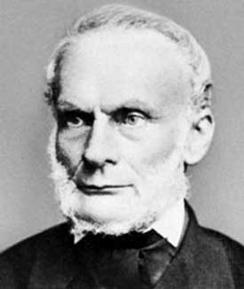
Background
Entropy is a scientific concept, as well as a measurable physical property that is most commonly associated with a state of disorder, randomness, or uncertainty. The term and the concept are used in diverse fields, from classical thermodynamics, where it was first recognized, to the microscopic description of nature in statistical physics, and to the principles of information theory. It has found far-ranging applications in chemistry and physics, biological systems and their relation to life, cosmology, economics, sociology, weather science and climate change, and information systems and the transmission of information in telecommunication.
Clausius realized in 1865 that he had discovered a new thermodynamic property, and he chose to name this property entropy. It is designated S and is defined as
Rudolf Clausius (1822–1888), originator of the concept of entropy

Slide 4
What is Entropy

Slide 5
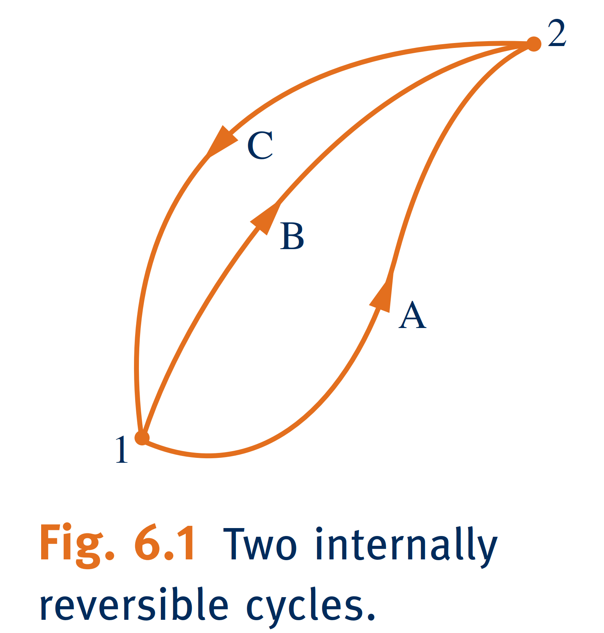
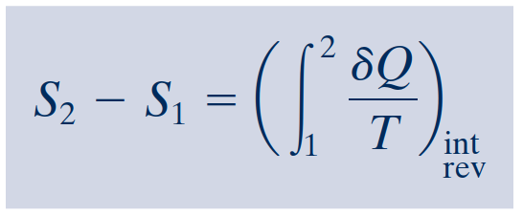
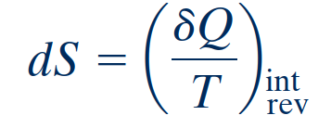
Entropy–A System Property
For the first cycle
For the second cycle
definition of entropy change
On a differential basis
Entropy is an extensive property.
Evaluating Entropy

Slide 6
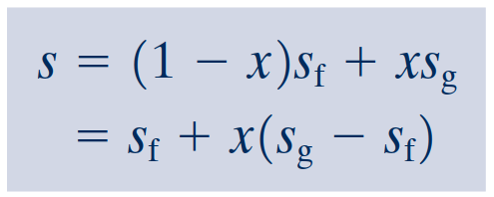
Retrieving Entropy Data
The specific entropy values given in Tables A-2 through A-18 are relative to the following reference states and values. For water, the entropy of saturated liquid at 0.01ºC (32.02ºF) is set to zero. For the refrigerants, the entropy of the saturated liquid at -40ºC (-40ºF) is assigned a value of zero.
Vapor Data
Saturation Data
Liquid Data

Slide 7
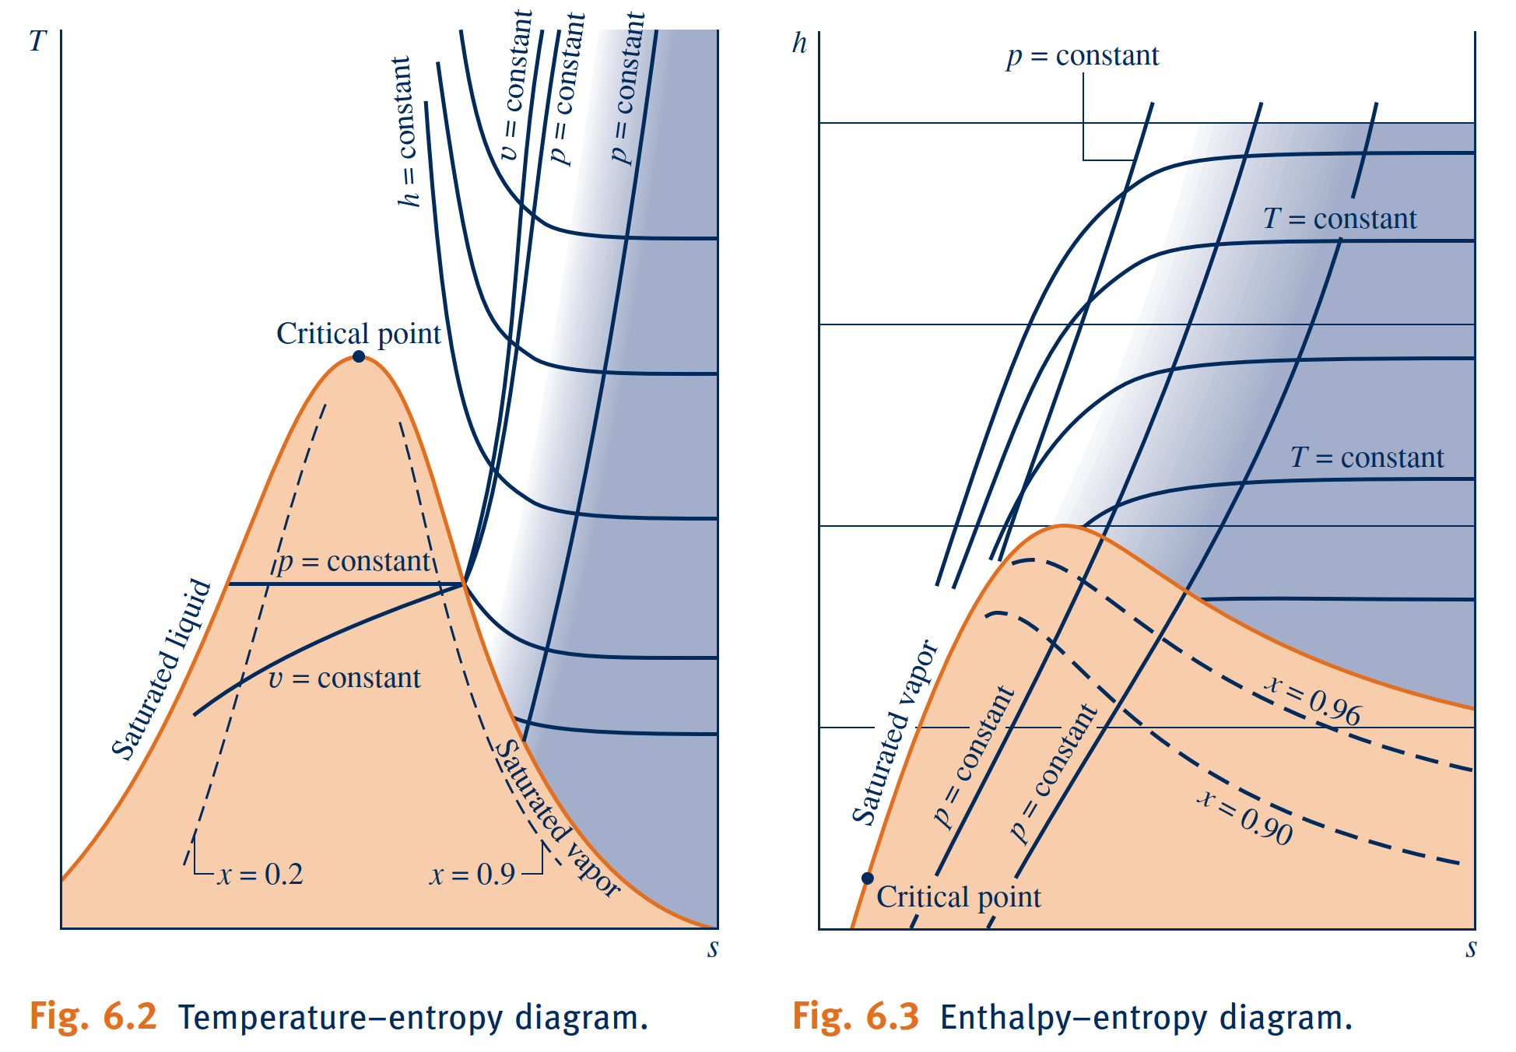
Temperature–Entropy Diagram
The essential features of an enthalpy–entropy diagram, commonly known as a Mollier diagram, are shown in Fig. 6.3.

Slide 8
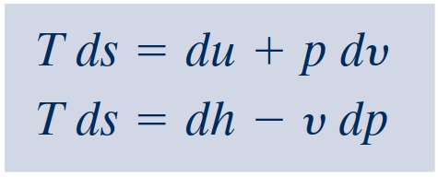
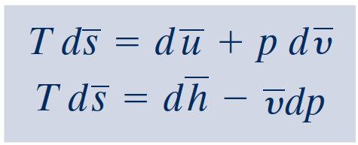
Introducing the T dS Equations
In the absence of overall system motion and the effects of gravity, an energy balance in differential form is
By definition of simple compressible system, the work is
On rearrangement, the heat transfer is
the first T dS equation results
The second T dS equation is obtained from Eq. 6.8 using H=U+pV. Forming the differential
the second T dS equation

Slide 9
Entropy Change of an Incompressible
Substance
The incompressible substance model introduced in Lecture 3 assumes that the specific volume (density) is constant, and the specific internal energy depends solely on temperature. Thus, $du=c\left(T\right) dT$, where $c$
denotes the specific heat of the substance,
On integration, the change in specific entropy is
When the specific heat is constant, this becomes

Slide 10
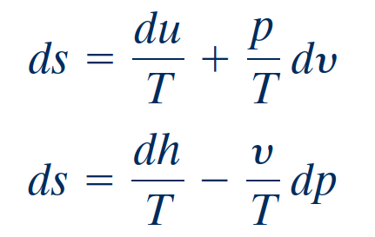
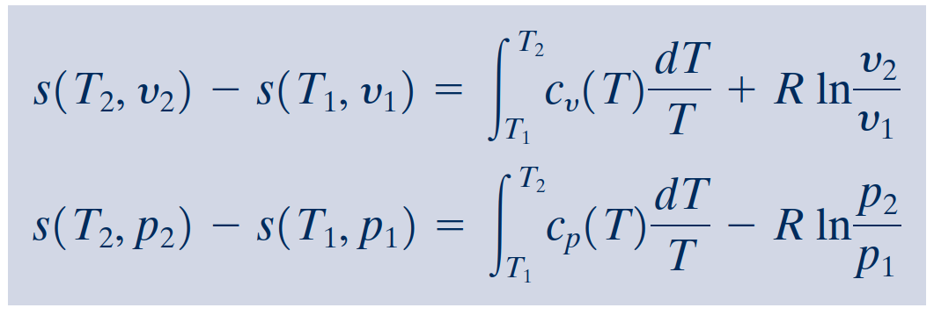
Entropy Change of an Ideal Gas
It is convenient to begin with
For an ideal gas, $du= c_{v} (T) dT$, $dh=c_{p} (T) dT$, and $pv=RT$. With these relations,
On integration,

Slide 11
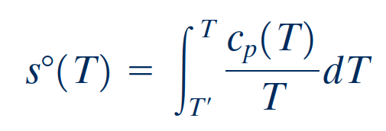
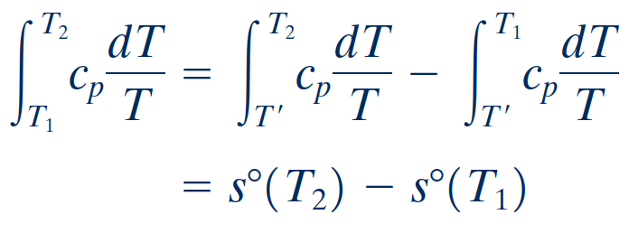
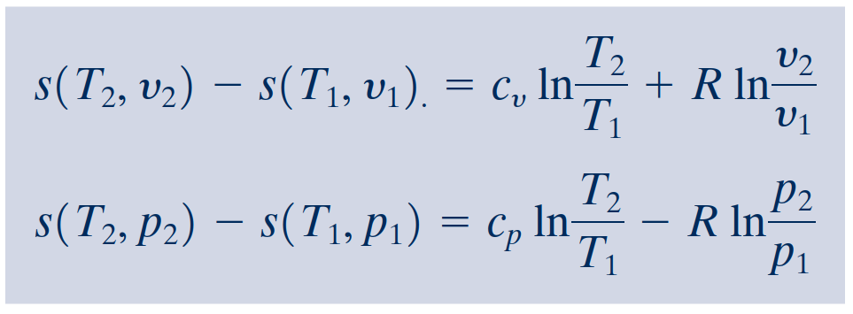
Using Ideal Gas Tables
As for internal energy and enthalpy changes of ideal gases, the evaluation of entropy changes for ideal gases can be reduced to a convenient tabular approach. We begin by introducing a new variable $s^{o}(T)$ as
where $T^{′}$ is an arbitrary reference temperature.
On integration,
When the specific heats $c_{v}$ and $c_{p}$ are taken as constants,

Slide 12
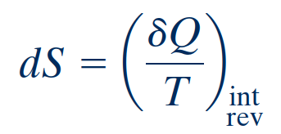
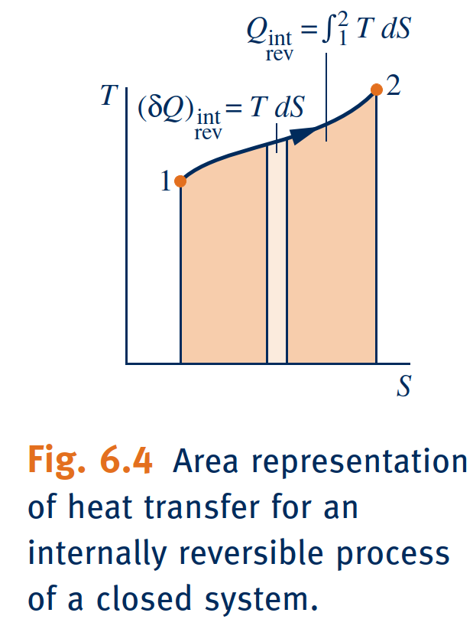
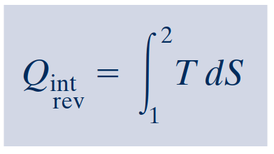
Entropy Change in Internally Reversible
Processes of Closed Systems
As a closed system undergoes an internally reversible process, its entropy can increase, decrease, or remain constant. This can be brought out using
which indicates that when a closed system undergoing an internally reversible process receives energy by heat transfer, the system experiences an increase in entropy.
Conversely, when energy is removed from the system by heat transfer, the entropy of the system decreases.
This can be interpreted to mean that an entropy transfer accompanies heat transfer.
The direction of the entropy transfer is the same as that of the heat transfer. In an adiabatic internally reversible process, entropy remains constant.
isentropic process
A constant-entropy process is called an isentropic process.
On rearrangement

Slide 13
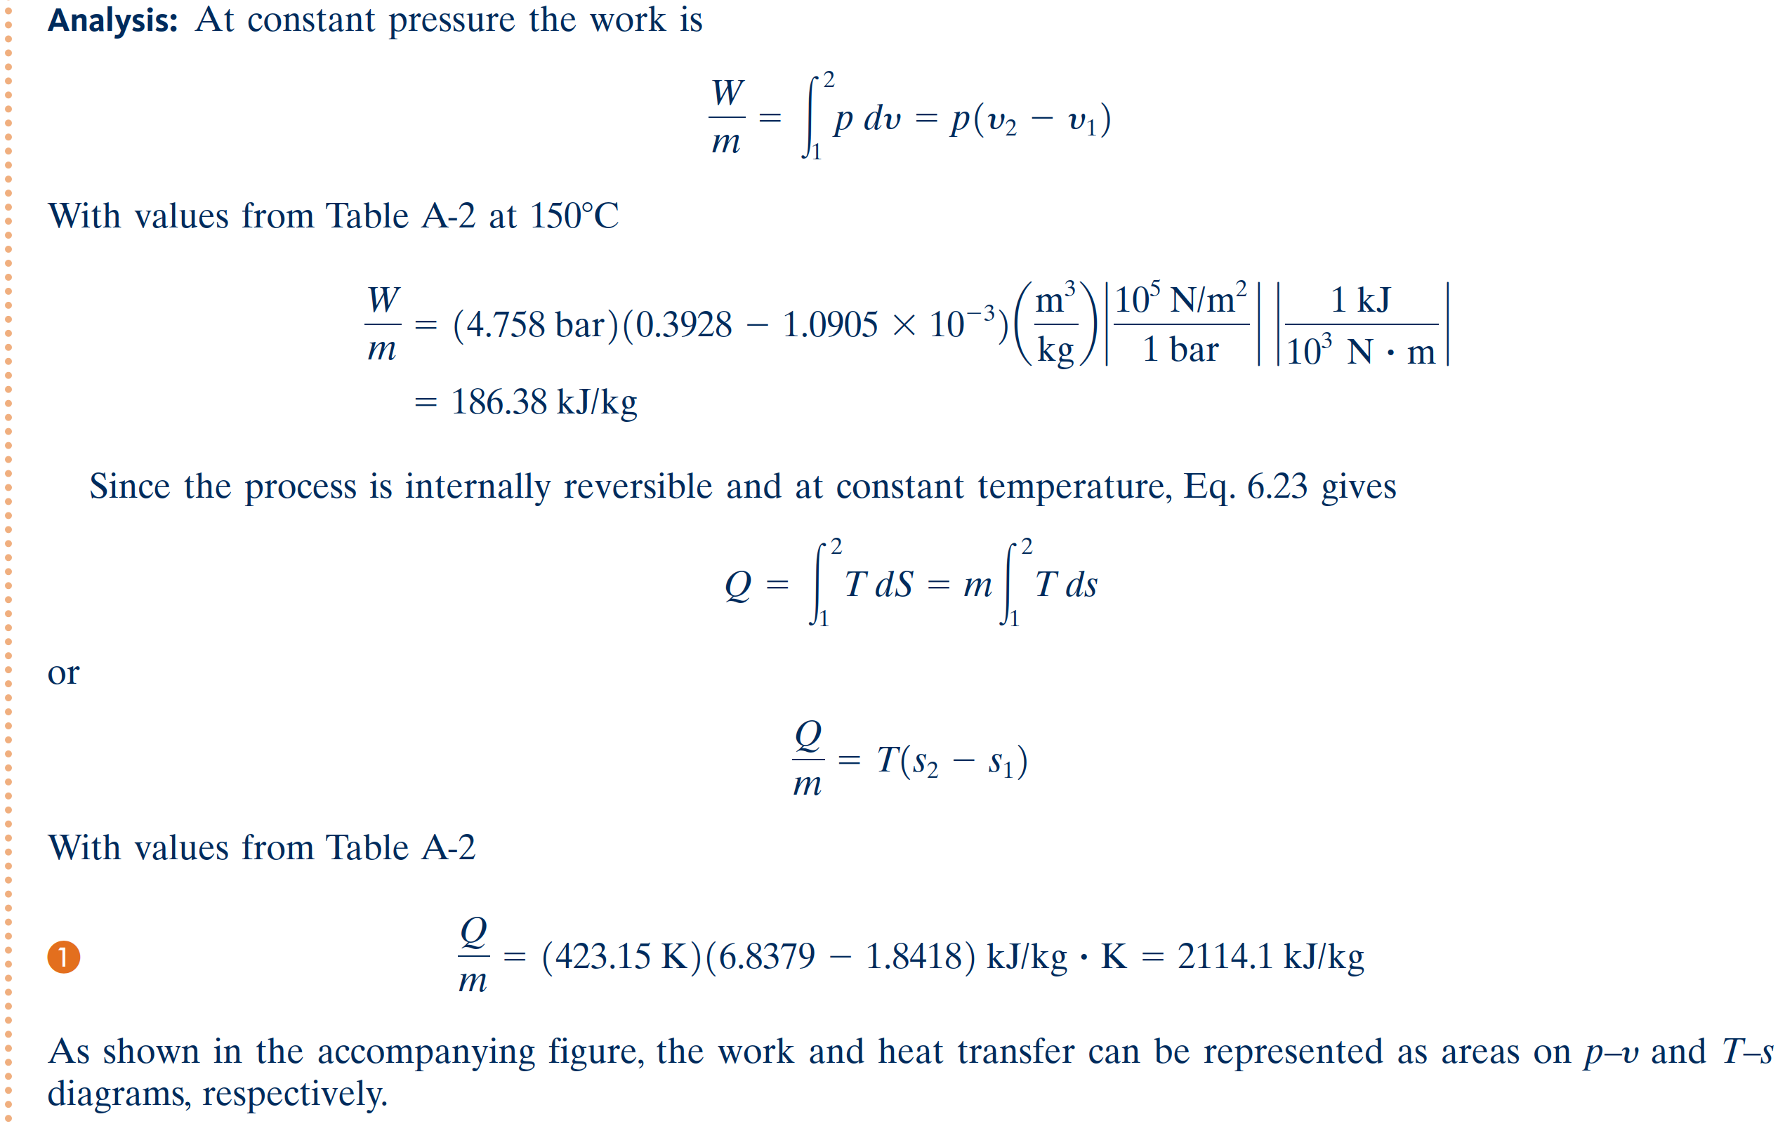
Work and Heat Transfer in an Internally
Reversible Process of Water

Slide 14
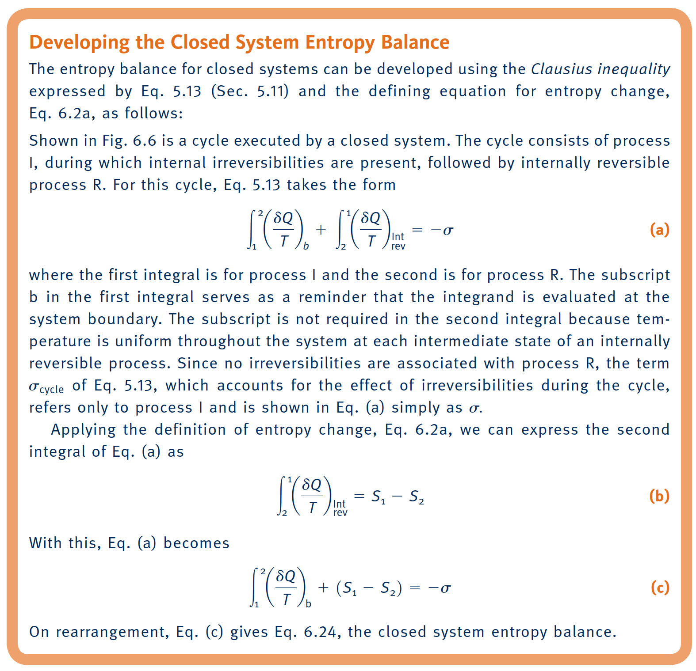
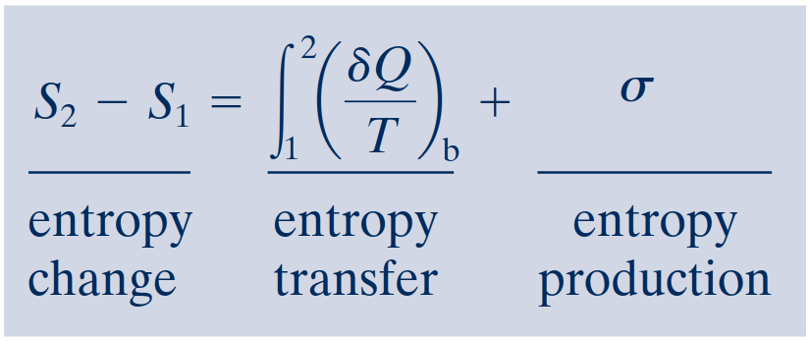
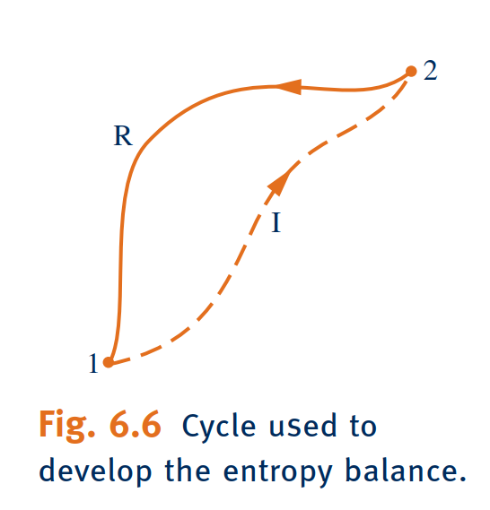
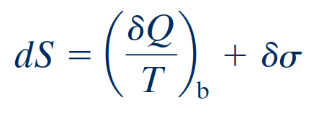
Entropy Balance for Closed Systems
entropy balance
The entropy balance is an expression of the second law that is particularly effective for thermodynamic analysis.
closed system entropy balance
It is sometimes convenient to use the entropy balance expressed in differential form

Slide 15
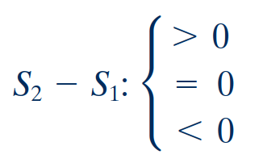
Interpreting the Closed System Entropy Balance
If the end states are fixed, the entropy change on the left side can be evaluated independently of the details of the process. However, the two terms on the right side depend explicitly on the nature of the process and cannot be determined solely from knowledge of the end states. The first term on the right side is associated with heat transfer to or from the system during the process. This term can be interpreted as the entropy transfer accompanying heat transfer.
entropy transfer accompanying heat transfer
The entropy change of a system is not accounted for solely by the entropy transfer but also is due in part to the second term on the right side of denoted by. The term is positive when internal irreversibilities are present during the process and vanishes when no internal irreversibilities are present. This can be described by saying that entropy is produced (or generated) within the system by the action of irreversibilities.
entropy production

Slide 16
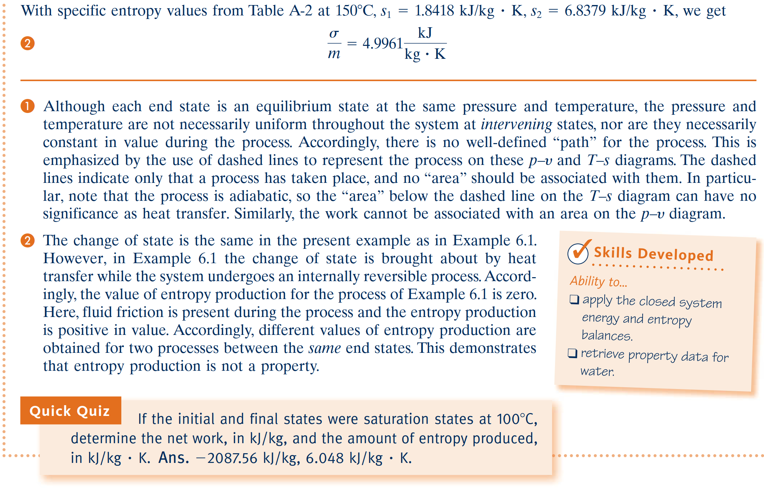
Applications of the Closed System Entropy Balance

Slide 17
Directionality of Processes
An energy balance for the isolated system reduces to
An entropy balance for the isolated system reduces to
Since entropy is produced in all actual processes, the only processes that can occur are those for which the entropy of the isolated system increases. This is known as the increase of entropy principle. The increase of entropy principle is some-times considered an alternative statement of the second law.
increase of entropy principle

Slide 18
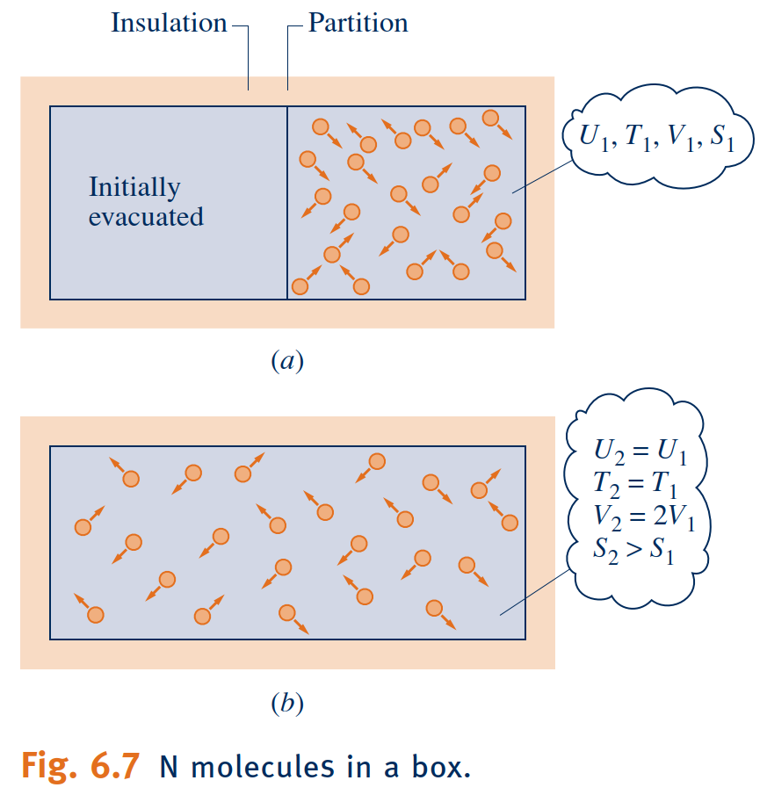
Statistical Interpretation of Entropy
Building on the increase of entropy principle, in this section we introduce an interpretation of entropy from a microscopic perspective based on probability.
In statistical thermodynamics, entropy is associated with the notion of microscopic disorder.
We can evaluate the change in entropy for the process of Fig. 6.7 by applying Eq. 6.17, expressed in terms of volumes and on a molar basis. The entropy change for the constant-temperature process is
Through more complete molecular modeling and statistical analysis, the total number of positions and velocities-microstates-available to a single molecule can be calculated. This total is called the thermodynamic probability, $w$.
Microstates
thermodynamic probability
Boltzmann relation

Slide 19
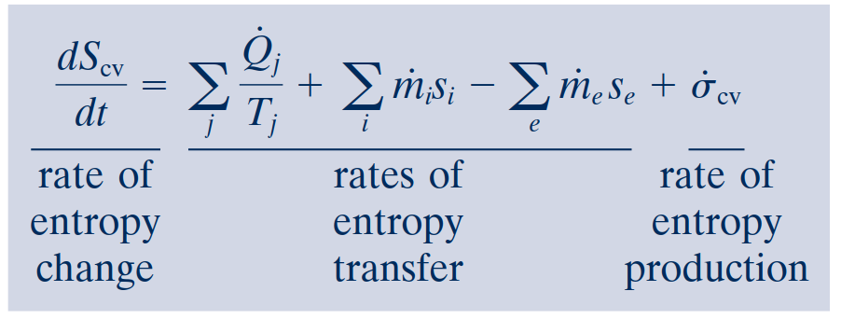
Entropy Rate Balance for Control Volumes
control volume entropy rate balance
Integral Form of the Entropy Rate Balance
The rate of entropy transfer accompanying heat transfer can be expressed more generally as an integral over the surface of the control volume
In addition, the terms accounting for entropy transfer accompanying mass flow can be expressed as integrals over the inlet and exit flow areas, resulting in the following form of the entropy rate balance

Slide 20
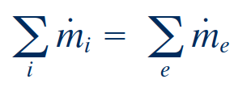
Rate Balances for Control Volumes at
Steady State
At steady state, the conservation of mass principle takes the form
The energy rate balance at steady state is
steady-state entropy rate balance
One-Inlet, One-Exit Control Volumes at Steady State

Slide 21
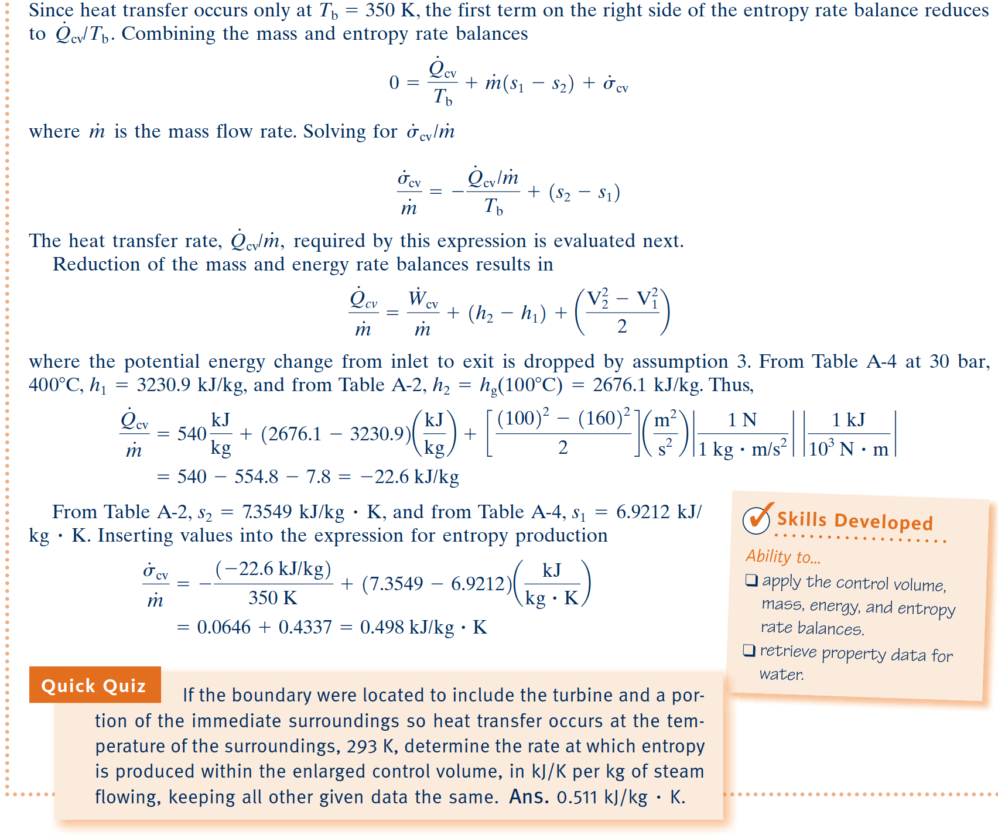
Applications of the Rate Balances to Control Volumes at Steady State

Slide 22
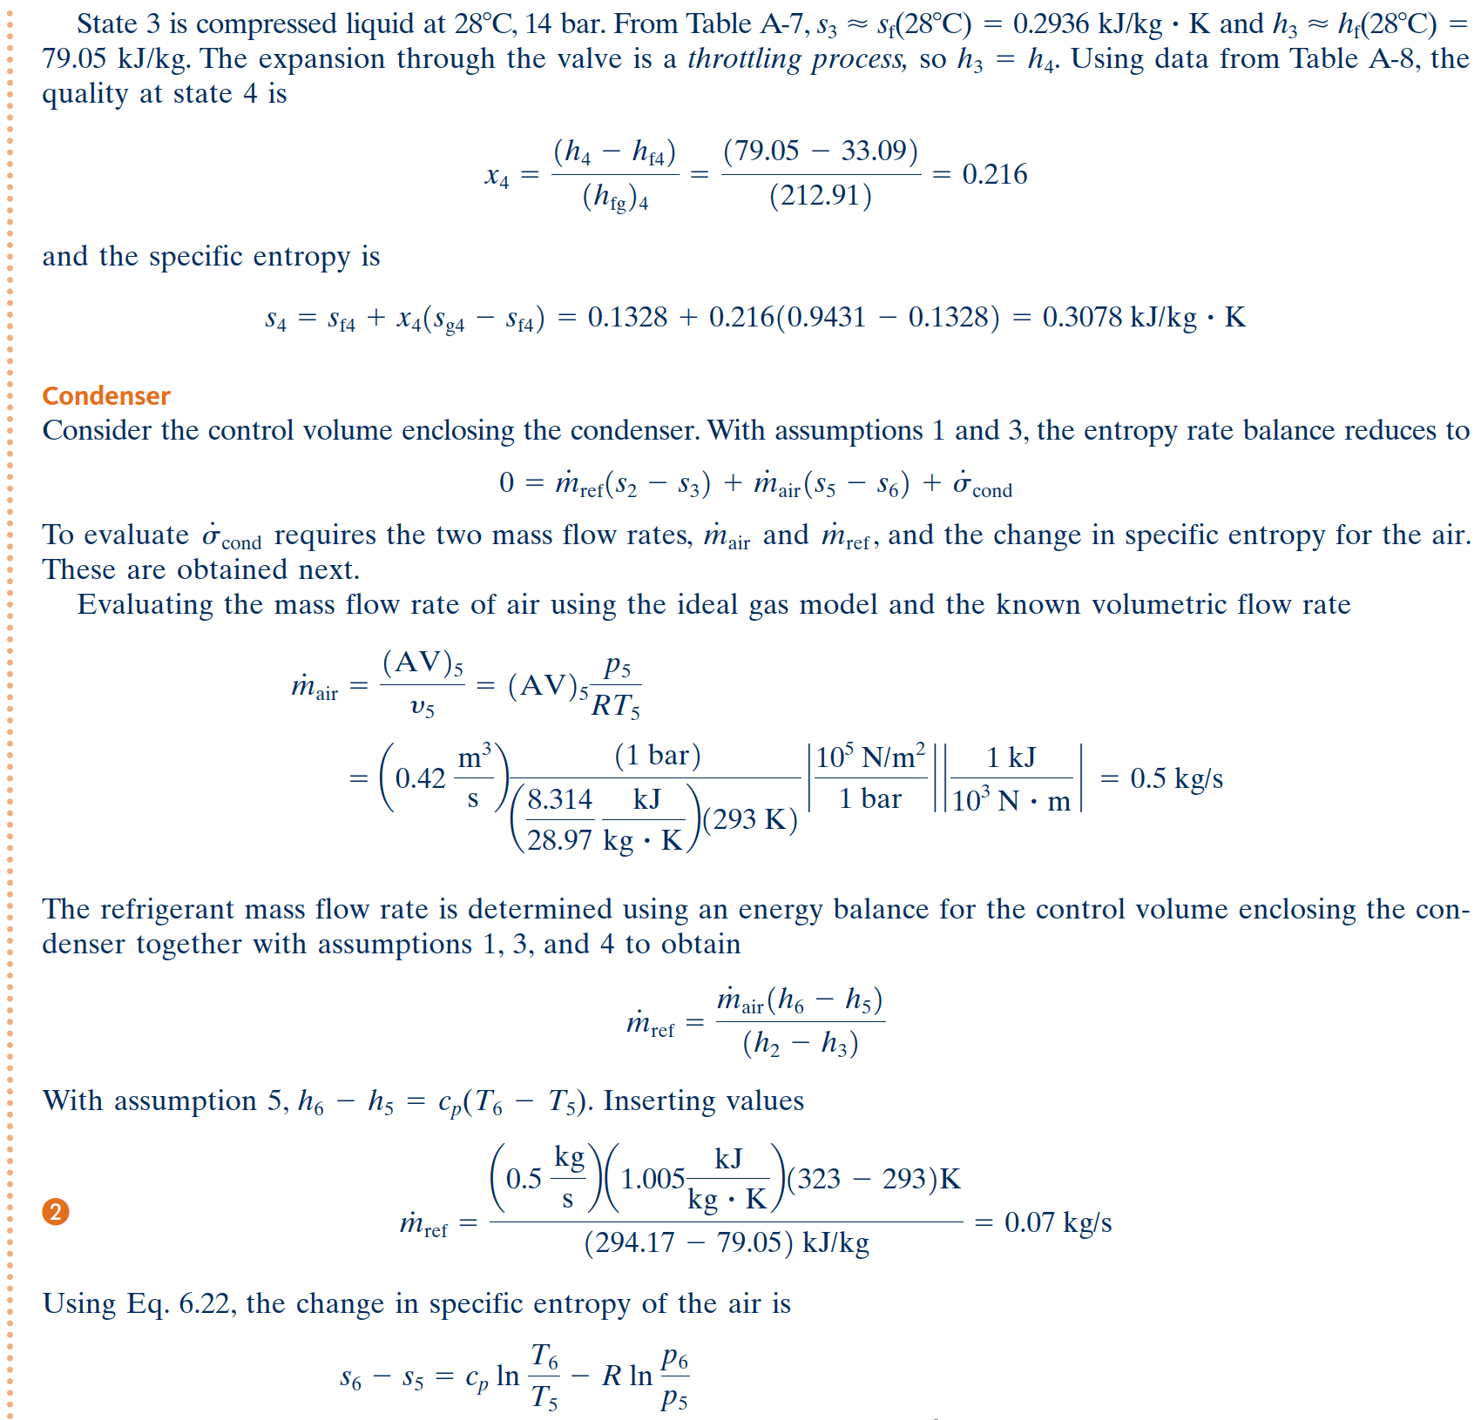
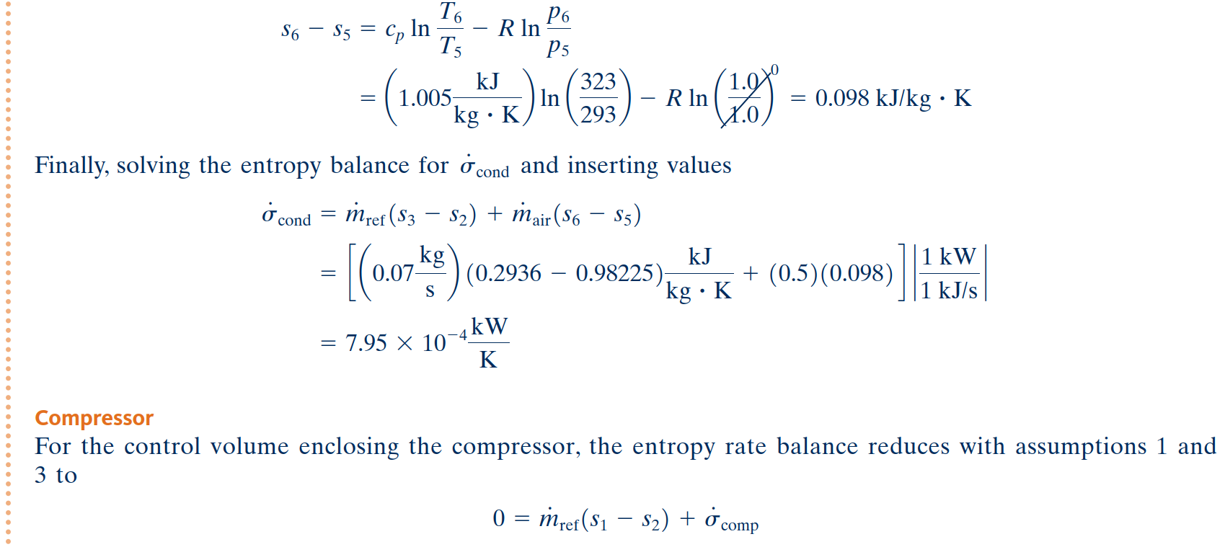
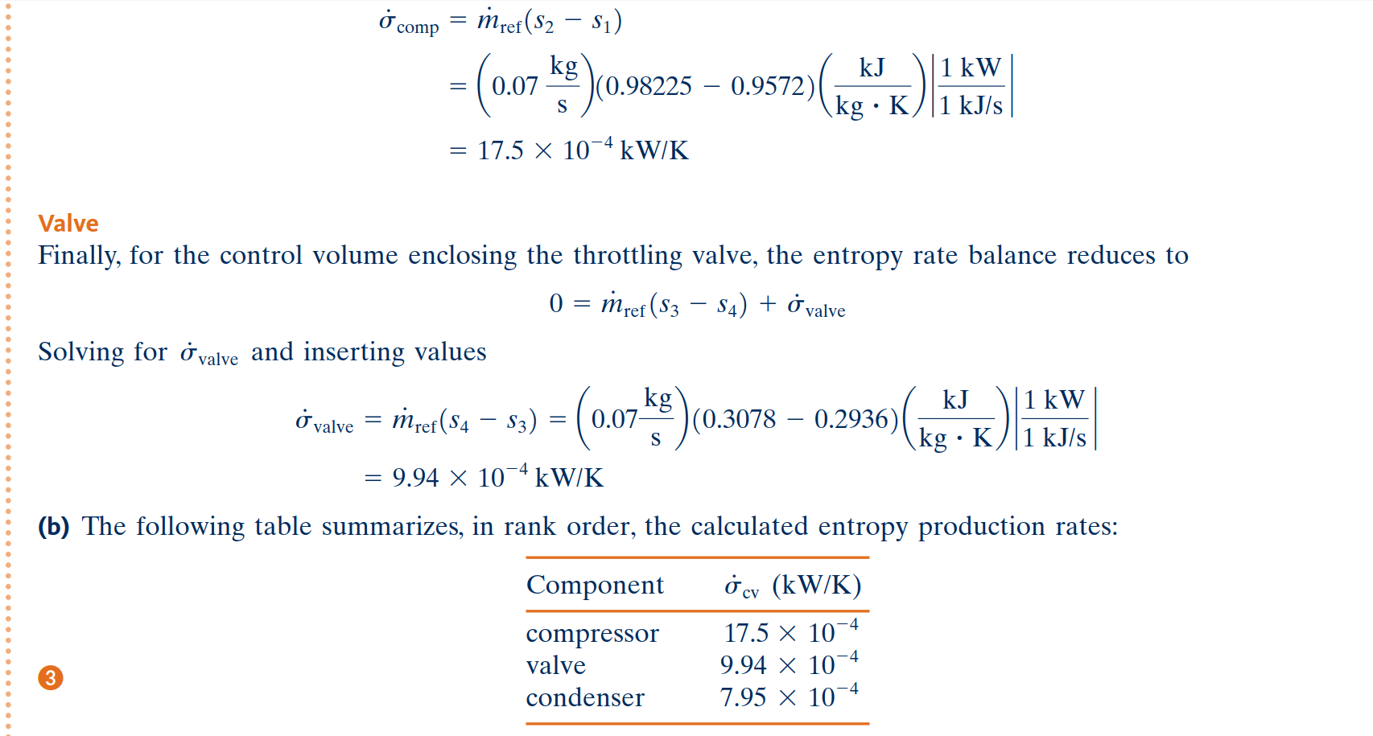

Slide 23
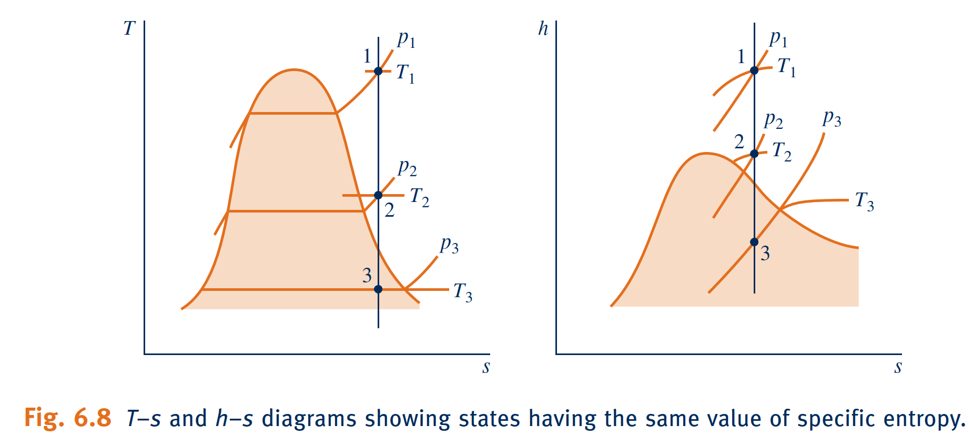
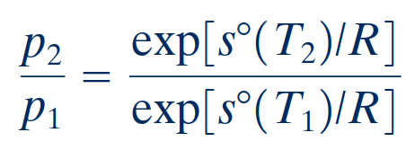
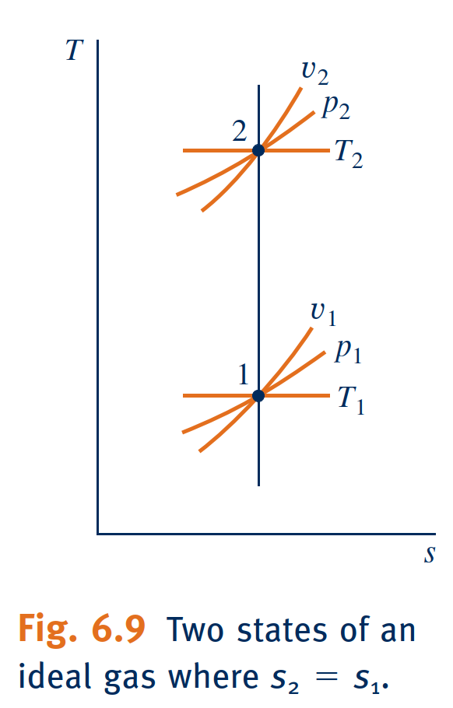
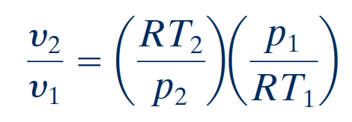
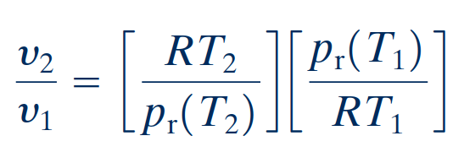
Isentropic Processes
Ideal Gas Tables
For the special case of air modeled as an ideal gas
With the ideal gas equation of state, $v={RT}/p$, the ratio of the specific volumes is

Slide 24
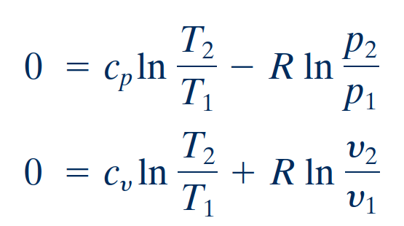
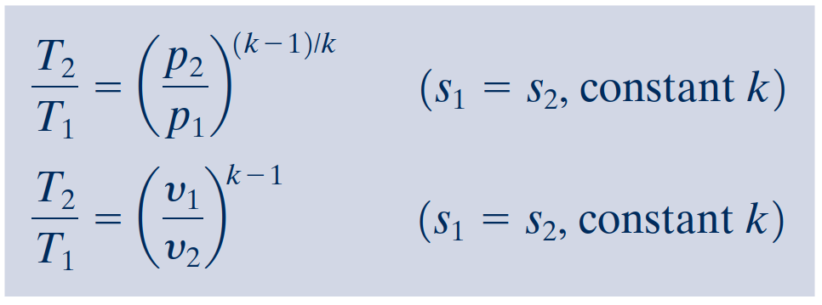
Isentropic Processes
Assuming Constant Specific Heats
Introducing the ideal gas relations

Slide 26
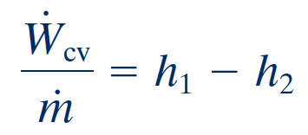
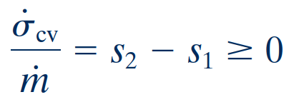
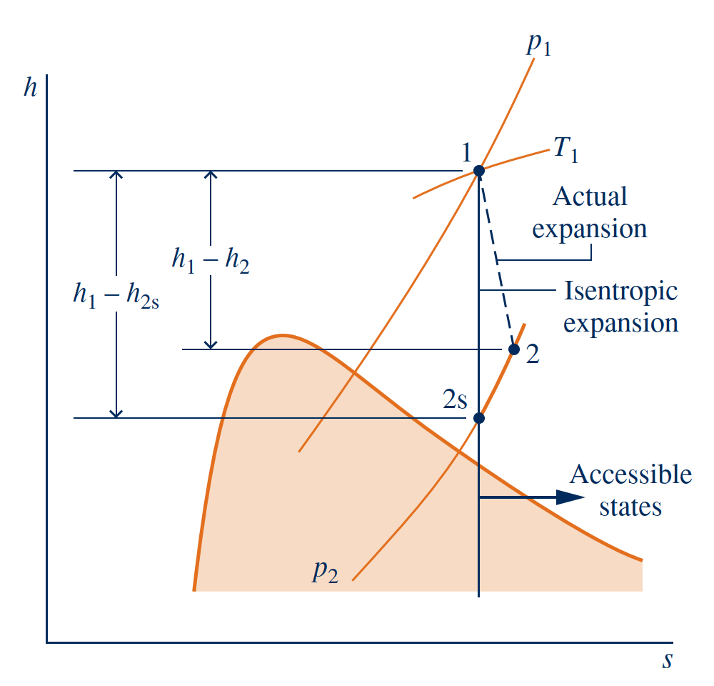
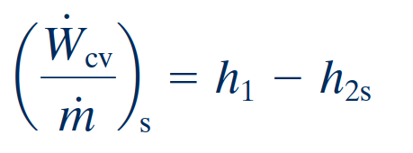
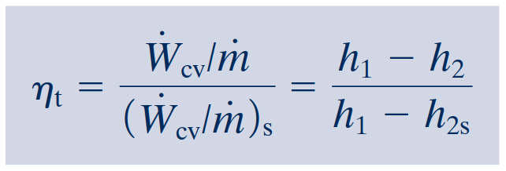
Isentropic Turbine Efficiency
With these assumptions, the mass and energy rate balances reduce, at steady state, to give the work developed per unit of mass flowing through the turbine
Since there is no heat transfer, the allowed exit states are constrained by
Therefore, the smallest allowed value for h2 corresponds to state 2s, and the maximum value for the turbine work is
In an actual expansion through the turbine h2 . h2s, and thus less work than the maximum would be developed. This difference can be gauged by the isentropic turbine efficiency defined by

Slide 29
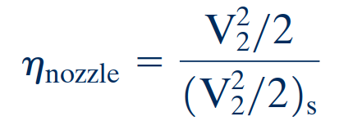
Isentropic Nozzle Efficiency
A similar approach to that for turbines can be used to introduce the isentropic efficiency of nozzles operating at steady state. The isentropic nozzle efficiency is defined as the ratio of the actual specific kinetic energy of the gas leaving the nozzle, V222, to the kinetic energy at the exit that would be achieved in an isentropic expansion between the same inlet state and the same exit pressure, 1V2222s . That is,
isentropic nozzle efficiency
Nozzle efficiencies of 95% or more are common, indicating that well-designed nozzles are nearly free of internal irreversibilities.

Slide 30
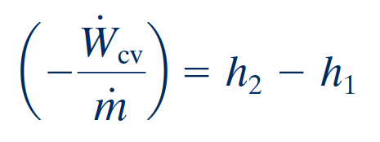
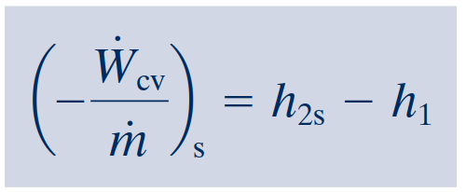
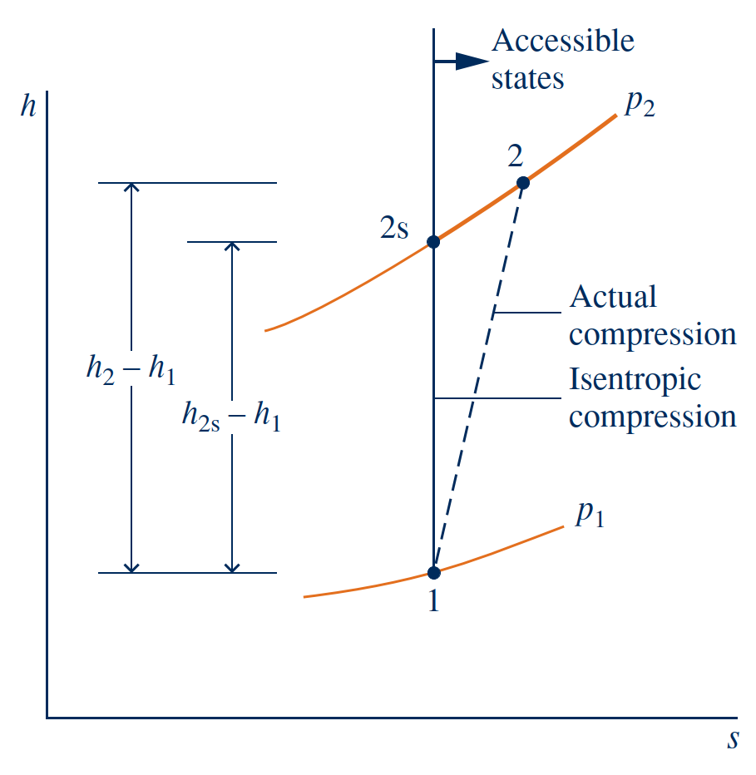
Isentropic Compressor and Pump Efficiencies
For negligible
heat transfer with the surroundings and no appreciable kinetic and potential energy
effects, the work input per unit of mass flowing through the compressor is
The minimum work input is given by
isentropic compressor
efficiency

Slide 31
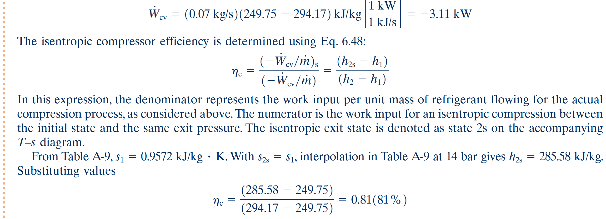

Slide 32
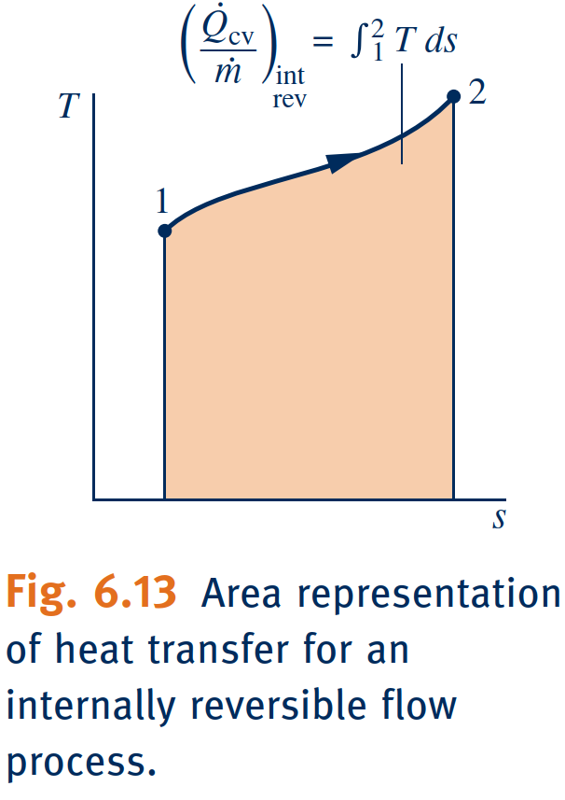
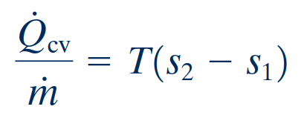
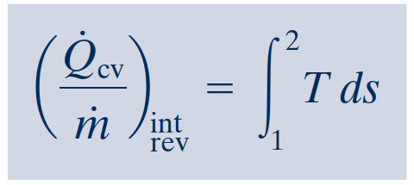
Heat Transfer and Work in Internally
Reversible, Steady-State Flow Processes
For a control volume at steady state in which the flow is both isothermal at tempera-
ture T and internally reversible, the appropriate form of the entropy rate balance is
Heat Transfer
Work

Slide 33
Work in Polytropic Processes
IDEAL GAS CASE.
For a polytropic process of an ideal gas,
For the case of an ideal gas,

Slide 35
Enthalpy Vs. Entropy
Enthalpy, denoted by the symbol ‘H’, refers to the measure of total heat content in a thermodynamic system under constant pressure. Enthalpy is calculated in terms of change, i.e., ∆H = ∆E + P∆V(where E is the internal energy). The SI unit of enthalpy is joules (J).
Entropy, denoted by the symbol ‘S’, refers to the measure of the level of disorder in a thermodynamic system. It is measured as joules per kelvin (J/K). Entropy is calculated in terms of change, i.e., ∆S = ∆Q/T (where Q is the heat content and T is the temperature).
Entropy and Entropy Generation in Daily Life
https://www.youtube.com/watch?v=YM-uykVfq_E
Notes:
https://sciencestruck.com/difference-between-entropy-enthalpy-in-thermodynamics

Slide 36
Summary
Entropy is a quantitative measure of microscopic disorder for a system.
The increase of entropy principle
The entropy-change and isentropic relations for a process can be summarized as follows: 1. Pure substances: 2. Incompressible substances: 3. Ideal gases:
The work done during a steady-flow process is proportional to the specific volume. Therefore, v should be kept as small as possible during a compression process to minimize the work input and as large as possible during an expansion process to maximize the work output.
The reversible work inputs to a compressor compressing an ideal gas from T1, P1 to P2 in an isentropic (Pv^{k} = constant), polytropic (Pv^{n} = constant), or isothermal (Pv = constant) manner, are determined by integration for each case with the following results:
The work input to a compressor can be reduced by using multistage compression with intercooling.
Most steady-flow devices operate under adiabatic conditions, and the ideal process for these devices is the isentropic process.
The parameter that describes how efficiently a device approximates a corresponding isentropic device is called isentropic or adiabatic efficiency.
Entropy balance

