Slide 1
Engineering Equation Solver (EES)
Ali Khosravi
Aalto University

Slide 2
Overview
EES (pronounced 'ease') is a general equation-solving program that can numerically solve thousands of coupled non-linear algebraic and differential equations. The program can also be used to solve differential and integral equations, do optimization, provide uncertainty analyses, perform linear and non-linear regression, convert units, check unit consistency, and generate publication-quality plots. A major feature of EES is the high accuracy thermodynamic and transport property database that is provided for hundreds of substances in a manner that allows it to be used with the equation solving capability.

Slide 3
Basic Features
Operates on all Microsoft Windows operating systems (XP, 7, 8, and 10)
Solves up to 6,000 simultaneous non-linear equations (Commercial version). The 32-bit Professional version can solve 12,000 simultaneous equations. The 64-bit version increases this limit to 24,000.
Equations can be entered in any order
Extremely fast computational speed
High accuracy thermodynamic and transport functions for 100's of fluids.
Unit conversion and automatic unit consistency checking
Parametric studies with spreadsheet-like table
Single and multi-variable optimization capability
Uncertainty analysis and regression capability
Professional plotting (2-D, contour, and 3-D) with automatic updating
LaTeX, PDF, as well as printed output
Graphical user input/output capabilities with Diagram window
Heat transfer library functions for conduction, convection, and radiation
Link to Fortran, C/C++, Python, Excel, and MATLAB

Slide 4
An introduction of EES
More tutorials: https://www.youtube.com/channel/UCVMYHyofqjvkUsrgdXvV4lw/videos
Video credit: https://youtu.be/IAsYyiaPECw?list=PLD7kPnQWgv397NkfHikfps9h5cZLyAODc

Slide 5
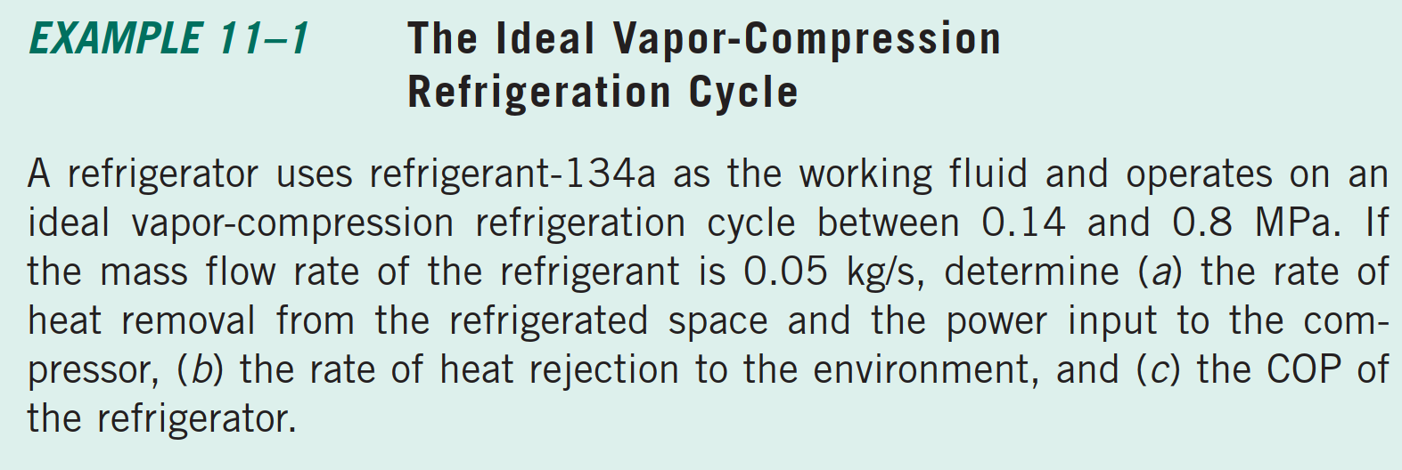
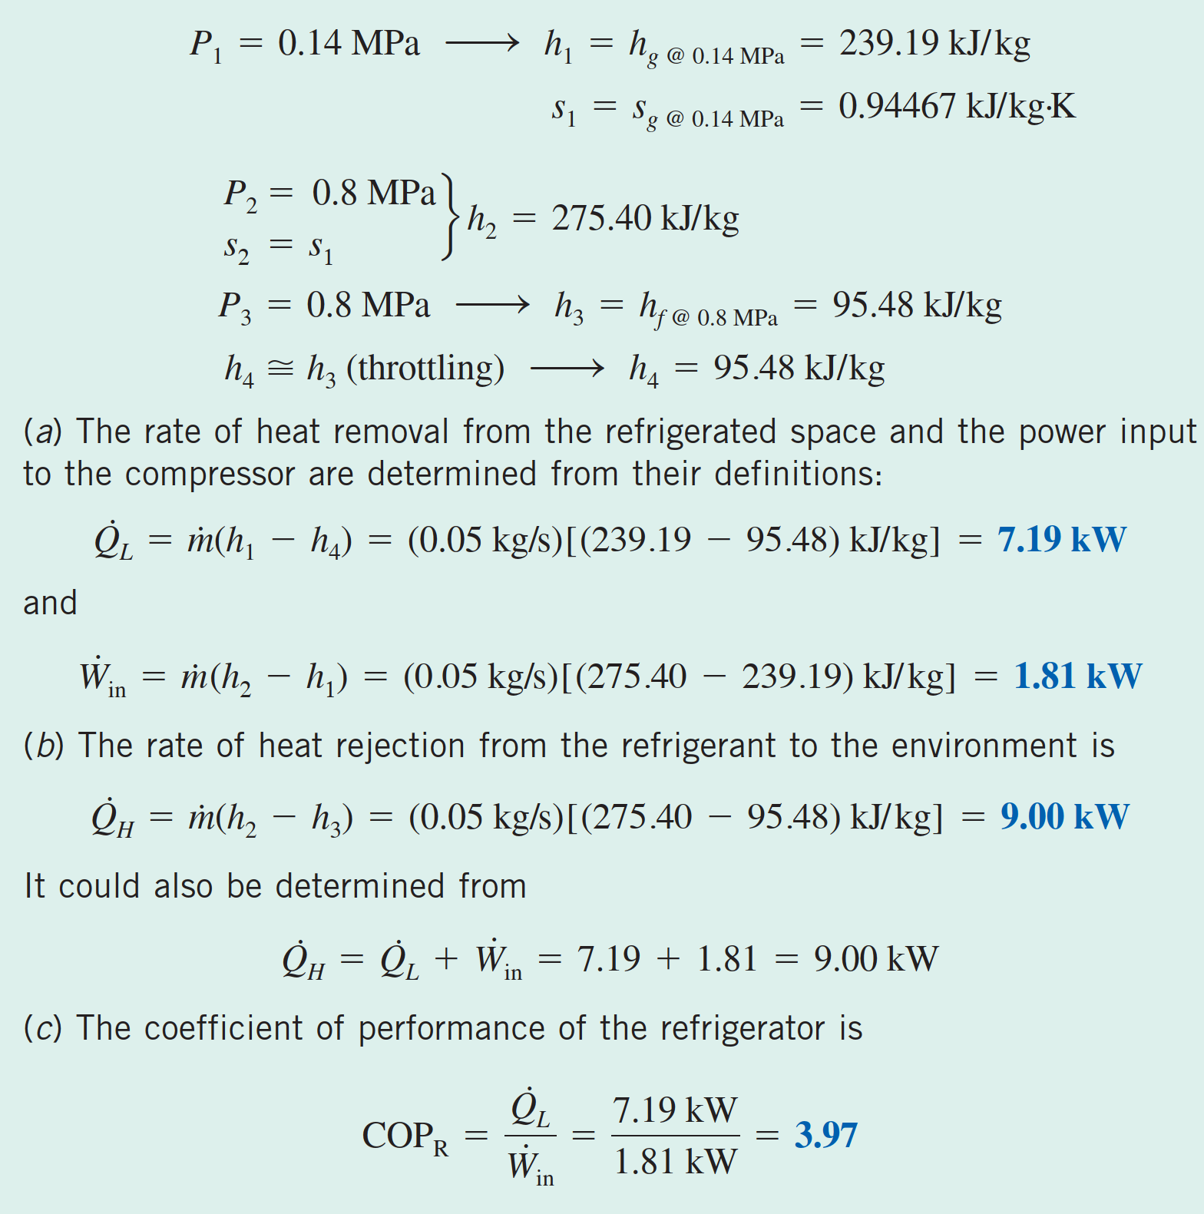
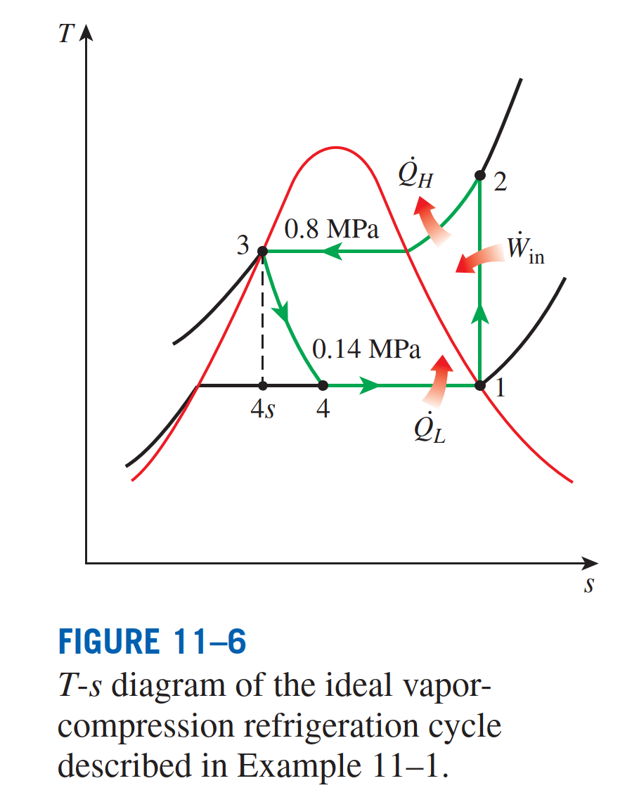

Slide 7
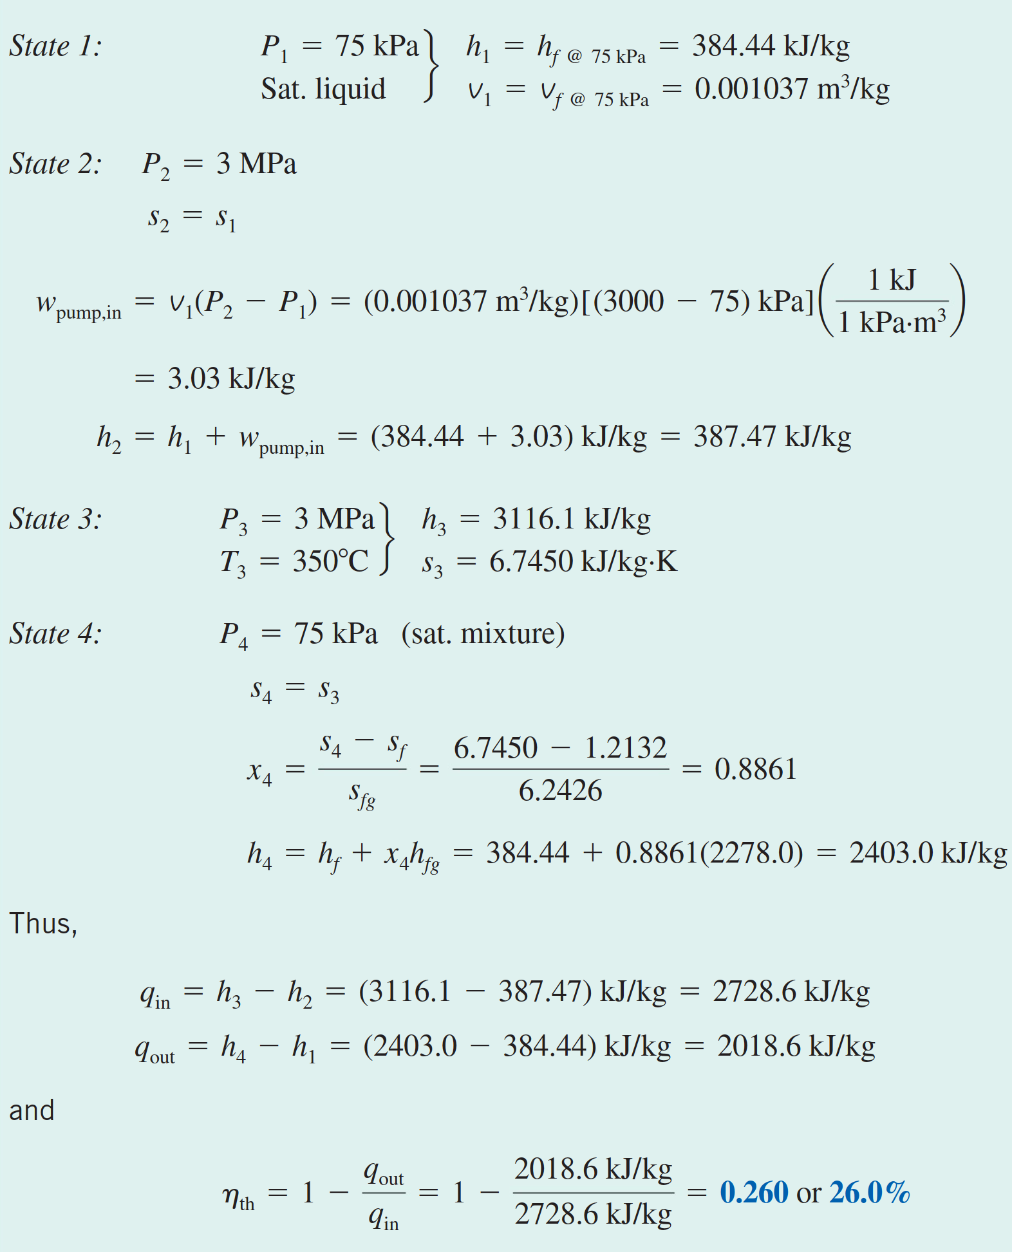
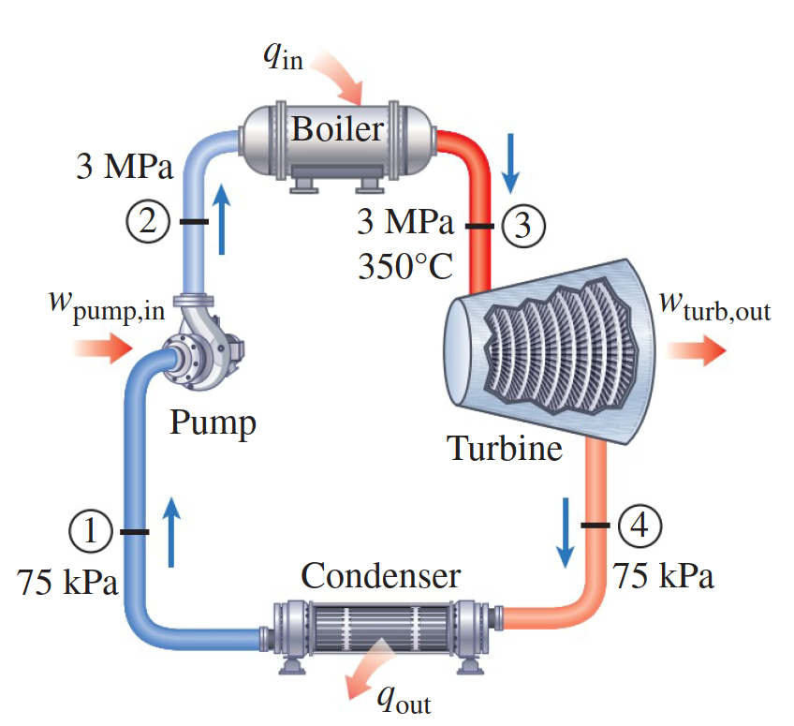
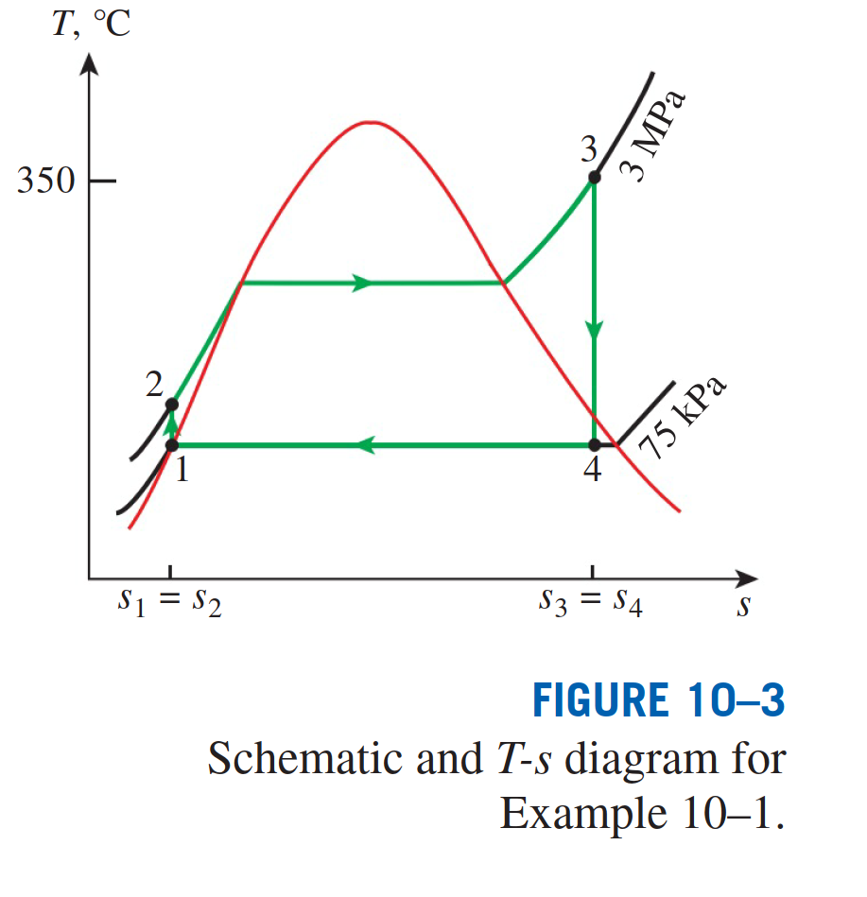

Slide 10
