Slide 1
Fundamentals of Corporate Finance
Chapter 3
Time Value of Money: An Introduction
Copyright © 2018, 2015, 2012 Pearson Education, Inc. All Rights Reserved.
Notes:
If this PowerPoint presentation contains mathematical equations, you may need to check that your computer has the following installed:
1) MathType Plugin
2) Math Player (free versions available)
3) NVDA Reader (free versions available)

Slide 2
Content
Course outline
Map of corporate finance
The law of one price
Compounding
Discounting

Slide 3
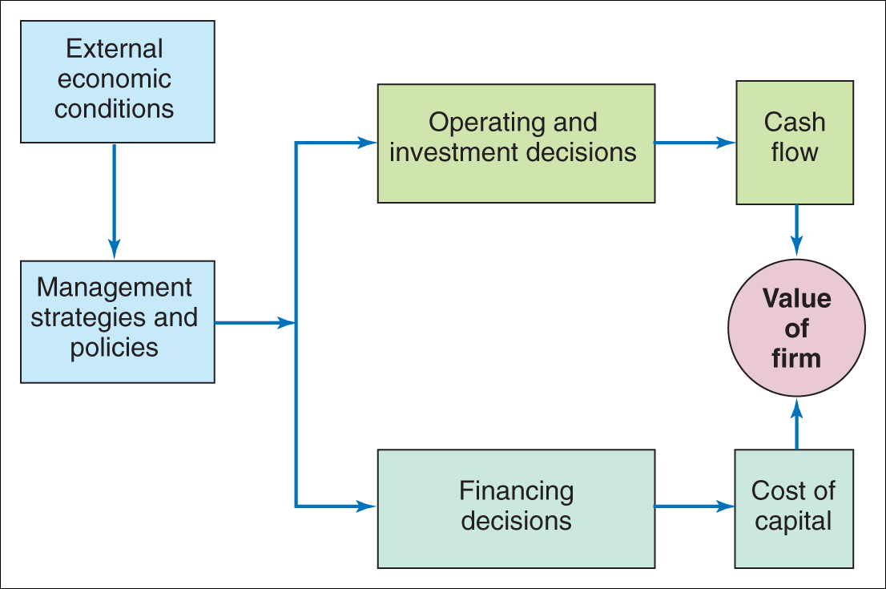
Corporate Finance

Slide 4
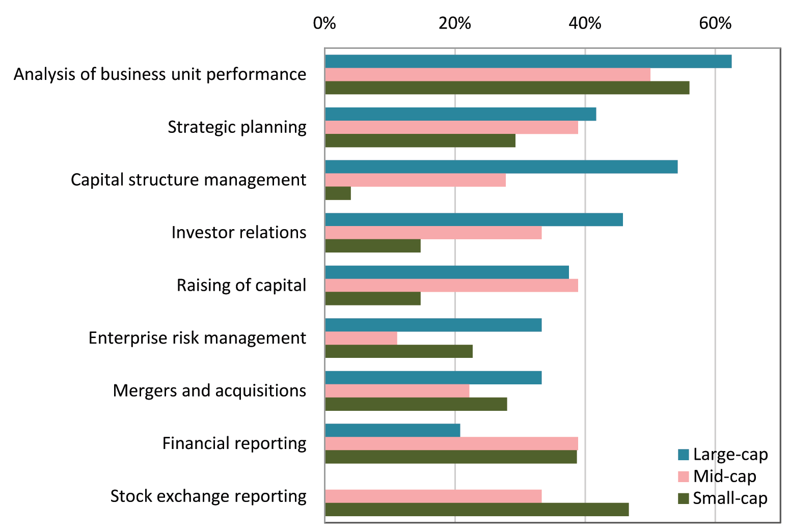
Functions which occupy the most attention and time of the Modern CFO?

Slide 5
Operating and Investment Decisions
Role of the Financial Manager
Make decisions on behalf of the firm’s investors
For good decisions, the benefits exceed the costs

Slide 6
Cost-Benefit Analysis
Quantifying Costs and Benefits
Role of Competitive Market Prices
A competitive market is one in which a good can be bought and sold at the same price
In a competitive market, the price determines the value of the good
Personal opinion of the “fair” price is irrelevant

Slide 7
Market Prices and the Valuation Principle
The Valuation Principle
The value of a commodity or an asset to the firm or its investors is determined by its competitive market price
The benefits and costs of a decision should be evaluated using those market prices
When the value of the benefits exceeds the value of the costs, the decision will increase the market value of the firm

Slide 8
Market Prices and the Valuation Principle
Why There Can Be Only One Competitive Price for a Good
Law of One Price
In competitive markets, securities that produce exactly the same cash flows must have the same price

Slide 9
Market Prices and the Valuation Principle
Why There Can Be Only One Competitive Price for a Good
Arbitrage
The practice of buying and selling equivalent goods to take advantage of a price difference
Arbitrage Opportunity
Any situation in which it is possible to make a profit without taking any risk or making any investment
So, what would you do if the Arbitrage did persistently exist?
https://www.economist.com/news/2019/01/10/the-big-mac-index

Slide 10
The Time Value of Money and Interest Rates
The Time Value of Money
In general, a dollar today is worth more than a dollar in one year
If you have $1 today and you can deposit it in a bank at 10%, you will have $1.10 at the end of one year
The difference in value between money today and money in the future the time value of money.

Slide 11
The Time Value of Money and Interest Rates
The Time Value of Money
Consider a firm's investment opportunity with a cost of $100,000 today and a benefit of $105,000 at the end of one year.

Slide 12
The Time Value of Money and Interest Rates
The Interest Rate: Converting Cash Across Time
Interest Rate (r), sometimes (i)
The rate at which money can be borrowed or lent over a given period
Interest Rate Factor (1 + r)
It is the rate of exchange between dollars today and dollars in the future
It has units of “$ in one year/$ today”

Slide 13
The Time Value of Money and Interest Rates
The Interest Rate: Converting Cash Across Time
Value of $100,000 Investment in One Year
$110,000 is the opportunity cost of spending $100,000 today
The firm gives up the $110,000 it would have had in one year if it had left the money in the bank
Alternatively, by borrowing the $100,000 from the same bank, the firm would owe $110,000 in one year.

Slide 14
The Time Value of Money and Interest Rates
The Interest Rate: Converting Cash Across Time
Value of $100,000 Investment in One Year
The investment’s net value is difference between the cost of the investment and the benefit in one year: $105,000 − $110,000 = − $5,000 in one year

Slide 15
The Time Value of Money and Interest Rates
The Interest Rate: Converting Cash Across Time
Value of $100,000 Investment Today
How much would we need to have in the bank today so that we would end up with $105,000 in the bank in one year?
This is calculated by dividing by the interest rate factor:

Slide 16
The Time Value of Money and Interest Rates
The Interest Rate: Converting Cash Across Time
Value of $100,000 Investment Today
The investment’s net value today is the difference between the cost of the investment and the benefit in one year: $95,454.55 − $100,000 = − $4,545.55 today

Slide 17
The Time Value of Money and Interest Rates
The Interest Rate: Converting Cash Across Time
Present Versus Future Value
Present Value
The value of a cost or benefit computed in terms of cash today
(−$4,545.45)
Future Value
The value of a cash flow that is moved forward in time
($5,000) (-$4,545.45 today) × (1.10 $ in one year/$ today) = −$5,000 in one year

Slide 18
The Time Value of Money and Interest Rates
The Interest Rate: Converting Cash Across Time
Discount Factors and Rates
Money in the future is worth less today so its price reflects a discount
Discount Rate
The appropriate rate to discount a cash flow to determine its value at an earlier time
Discount Factor
The value today of a dollar received in the future
The one-year discount factor is expressed as:

Slide 19
The Time Value of Money and Interest Rates
Timelines
Constructing a Timeline
Identifying Dates on a Timeline
Date 0 is today, the beginning of the first year
Date 1 is the end of the first year

Slide 20
The Time Value of Money and Interest Rates
Timelines
Distinguishing Cash Inflows from Outflows
Representing Various Time Periods
Just change the label from “Year” to “Month” if monthly

Slide 21
Valuing Cash Flows at Different Points in Time
Rule 1: Comparing and Combining Values
It is only possible to compare or combine values at the same point in time

Slide 22
Valuing Cash Flows at Different Points in Time
Rule 2: Compounding
To calculate a cash flow’s future value, you must compound it

Slide 23
Valuing Cash Flows at Different Points in Time
Rule 2: Compounding
Compound Interest
The effect of earning “interest on interest”

Slide 24
Valuing Cash Flows at Different Points in Time
Rule 3: Discounting
To calculate the value of a future cash flow at an earlier point in time, we must discount it.

Slide 25
Valuing Cash Flows at Different Points in Time
Rule 3: Discounting
If $826.45 is invested today for two years at 10% interest, the future value will be $1000

Slide 26
Valuing Cash Flows at Different Points in Time
Rule 3: Discounting
If $1000 were three years away, the present value, if the interest rate is 10%, will be $751.31

Slide 27
The Three Rules of Valuing Cash Flows
Table 3.1 The Three Rules of Valuing Cash Flows
Rule | Formula
1: Only values at the same point in time can be compared or combined. | None
2: To calculate a cash flow’s future value, we must compound it. | Future value of a cash flow:
3: To calculate the present value of a future cash flow, we must discount it. | Present value of a cash flow:

Slide 28
Which investment would you prefer?

Slide 29
Exercises
Chapter 3 exercises 9-26

