Slide 1
Mergers and Acquisitions

Slide 2
Aims and Objectives:
To recap some of the basic M&A terminology, but quickly move onto the three core areas of M&A research; Antecedents (what motives?), Moderators (how is it done?) & Outcomes (what happened?).
To use extensive real world examples to highlight how these factors, issues and concerns manifest in International M&A deals.
To highlight the roles of regulators and regulation.
To address the core question; “does M&A create value for shareholders?”

Slide 3
Reading this Week:
Arnold (2013) Corporate Financial Management, Chapter 20
Suggested Further Readings From this Lecture:
Haleblian, J., Devers, C. E., McNamara, G., Carpenter, M. A., & Davison, R. B. (2009). Taking stock of what we know about mergers and acquisitions: A review and research agenda. Journal of Management.
Malmendier, U., & Tate, G. (2008). Who makes acquisitions? CEO overconfidence and the market's reaction. Journal of Financial Economics, 89(1), 20-43.
Fischer, M. (2017). The source of financing in mergers and acquisitions. The Quarterly Review of Economics and Finance, 65, 227-239.

Slide 4
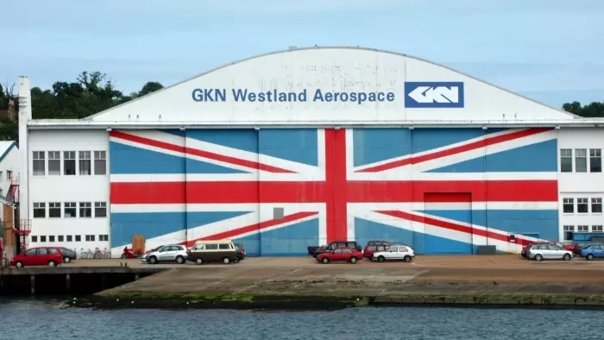
M&A Basics: M&A Terminology
Merger
Negotiated deals
Mutuality of negotiations
Mostly friendly
Acquisition
Obtaining more than 50% ownership in a target company
Tender offers
Offer made directly to the shareholders
Hostile when offer made without approval of the board (see note right)
Restructuring
Usually a major part of post- M&A
Changes to improve operations, policies, and strategies
FT.com: Biggest UK Hostile bid in a decade Melrose/GKN
If GKN, the 259-year-old engineering group, left it late to think about its future, then the same can be said of its shareholders. Many waited until the very last minute to make up their minds on Melrose’s £8bn bid.
With acceptances coming in right up to Thursday’s 1pm cut-off point, it took until 4pm — just an hour before the deadline — for the result to be announced.
And the winner, after 80 days of the most fiercely fought takeover battle in recent memory, is . . . Melrose. But only by a the width of the window coatings that GKN provides for Airbus jets.
Melrose’s bid has won the support of 52.4 per cent of GKN investors, just above the 50 per cent plus one share threshold it set for acceptances.
They have won the argument that GKN will be better run and more highly valued under their lean and disciplined approach
Further Reading:
Vincent, M. (2018) Winners and losers in the Melrose-GKN bid battle, Financial Times, 29th March 2018

Slide 5
M&A Basics: Types of Mergers
FT.com: Vertical media mergers are just so 19th century
Media companies are falling over themselves to merge with one another right now. AT&T took the US to court over the right to buy TimeWarner, and Comcast and Disney are engaged in a bidding war for some of 21st Century Fox.
AT&T and Comcast are communications companies that are attempting to go vertical and control every layer of a media empire from underground cables to the creation of content. It all seems very last century, if not 19th century. Back then, Andrew Carnegie was determined to own coal mines and railroads as well as steel mills. The goal was control from top to bottom, closed access and economies of scale.
So why would vertical integration make sense in media? AT&T has said it plans to use “robust content” to drive “viewer engagement to new levels” and micro-target customers and advertisers through data analysis.
AT&T-Time Warner does have one final advantage: a massive 5G wireless and fibre network. Now that the US has stopped requiring “net neutrality”, at least for now, network providers could leverage their market power to charge out-of-network content streamers more, just as Andrew Carnegie charged higher prices to rival steel companies who wanted to use his railroad. Back to the 19th century indeed.
Further Reading:
Slaughter, A-M, (2018) Vertical media mergers are just so 19th century, Financial Times, 21st June 2018
Horizontal mergers
Between firms in same business activity
Rationale
Economies of scale and scope
Synergies (ex. combining of best practices)
Government regulation due to potential anticompetitive effects
Vertical mergers
Combinations between firms at different stages
Goal is information and transaction efficiency
Possible “market power” advantages through combination (see sidebar)

Slide 6
M&A Basics: Types of Mergers
Conglomerate mergers
Firms in unrelated business activities (see sidebar)
Distinctions between conglomerate and non-conglomerate firms
Investment companies – diversify to reduce portfolio risk
Financial diversified – provide funds and expertise on generic management functions of planning and control
Concentric diversified – combine with firms in less related activities to broaden potential markets
FT.com: US hedge funds join chorus for change at Europe’s conglomerates
Sprawling entities comprised of eclectic and often unrelated businesses have been going out of fashion for more than two decades. Among those in the crosshairs are the Swiss engineering group ABB, which makes electricity transmission equipment to factory robots, its compatriot confectionery maker Nestlé, and German steel-to-submarines manufacturer ThyssenKrupp. Carmakers Daimler and VW have, meanwhile, faced calls to split off their trucks divisions, while Fiat-Chrysler is in the process of spinning off its components arm into a separate listed entity.
Further Reading:
Pooler, M. and McGee P. (2018) US hedge funds join chorus for change at Europe’s conglomerates, Financial Times, 21st August 2018

Slide 7
M&A Basics: Change Forces Driving Mergers
Technological change (see sidebar)
Efficiency of operations
Globalization and freer trade
Changes in industry organization
New industries
Deregulation and regulation
Favorable economic and financial conditions
Negative trends in industries and economies
High valuation of equities
FT.com: Japan’s Shiseido touches up its M&A strategy
Having spent decades selling their products at department stores and specialised shops, companies from Estée Lauder and L’Oréal to Shiseido are turning to start-ups to enable cosmetics to become connected and customised.
Beauty companies are increasingly using artificial intelligence and smartphone apps to provide personalised skincare, to stand out from their rivals.
The Japanese company has purchased three start-ups in the US in the past two years — MatchCo, Giaran and Olivo Laboratories — for undisclosed sums to acquire technologies in artificial skin, customised make-up and artificial intelligence.
In March, French cosmetics giant L’Oréal bought ModiFace, a Canadian beauty tech company focused on augmented reality and AI.
“If we keep on doing things in the traditional way, our business will face decline,” Yoichi Shimatani, Shiseido’s chief research and development officer, said in an interview. “Customers now want personalised beauty.”
Further Reading:
Pooler, M. and McGee P. (2018) US hedge funds join chorus for change at Europe’s conglomerates, Financial Times, 21st August 2018

Slide 8
What academic research tells us about M&A:
Key Paper
Haleblian, J., Devers, C. E., McNamara, G., Carpenter, M. A., & Davison, R. B. (2009). Taking stock of what we know about mergers and acquisitions: A review and research agenda. Journal of Management.
Three key research areas:
Antecedents (what motives?)
Moderators (how is it done?)
Outcomes (what happened?)

Slide 9
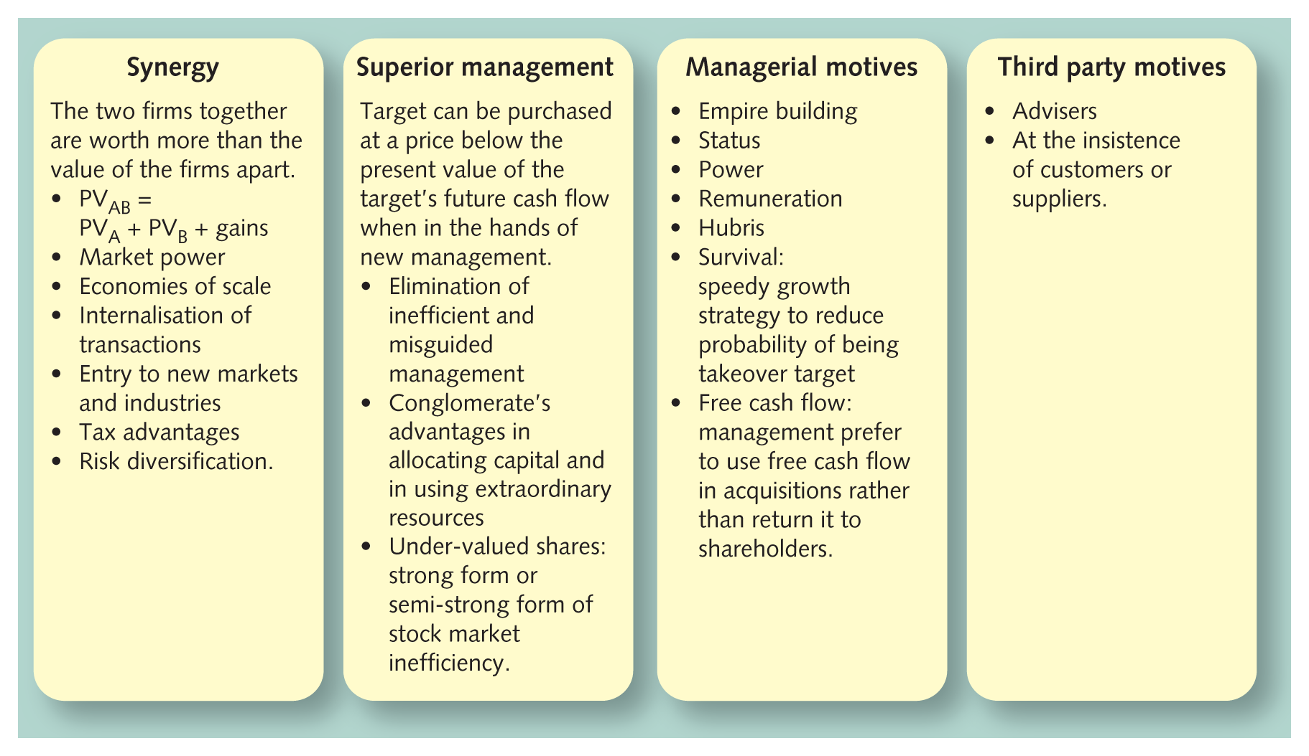
Antecedents: Merger motives

Slide 10
Synergy
The combined entity will have a value greater than the sum of its parts
PV_{AB} = PV_{A} + PV_{B} + gains
Value is created from a merger when the gain is greater than the transaction costs
Assume A and B as separate entities have present values of £20m and £10m, the transaction costs total £2m and the value of the merged firms is £40m then the net (after costs) gain from merger is £10m:
£40m = £20m + £10m + gain
But who is going to receive this extra value?
acquisition premium
winner’s curse

Slide 11
Business Case: Shopping for Synergies
FT.com: Unibail-Rodamco sees €100m annual synergies in $24.7bn Westfield takeover
Unibail-Rodamco, the largest commercial property company in Europe, is buying Westfield Corporation in a deal that values the Australian-headquartered shopping centre group at $24.7bn.
Under an agreement announced on Tuesday, the Paris-based company said it would pay Westfield shareholders the equivalent of $7.55 per security in a mix of cash and shares – an 18 per cent premium to Monday’s closing share price.
Unibail-Rodamco said it had identified synergies worth €100m per year and it expects the deal to be accretive to earnings per share in the first full year.
Further Reading:
Smyth, J. (2017) Unibail-Rodamco sees €100m annual synergies in $24.7bn Westfield takeover, Financial Times, 12th December 2017
Consider with the person sitting next to you:
Unibail-Rodamco paid a 18% premium to acquire Westfield, and expects to create £100m in synergies between the two combined companies. The 18% acquisition premium is roughly around £3.8bn in “overpayment”.
What difficulties and challenges might Unibail-Rodamco’s management team encounter after paying such a high premium to creating those synergies, and making this purchase a success?
Considering as an investor how you might view “bricks and mortar” physical retail at the moment, what might worry you about this investment?

Slide 12
Market power
To exercise some control over the price of the product
a monopoly, oligopoly or dominant producer positions
b collusion or de facto cooperation
A motivator in vertical as well as horizontal mergers
Even conglomerate mergers can enhance market power
We will examine the counter-balances to Market Power motives when we examine the role of regulators later.

Slide 13
FT.com: Worries of market power
FT.com: Probe of supermarket deal ‘must consider suppliers’
Business secretary Greg Clark has written to the UK competition regulator to insist that its inquiry into J Sainsbury’s proposed takeover of Asda look at the implications for supermarket suppliers.
Sainsbury’s proposed £7.3bn acquisition of Asda, currently owned by Walmart of the US, would create a new UK market leader, overtaking Tesco.
At present, Sainsbury has a 15.8 per cent share of the market, while Asda has 15.6 per cent.Mr Clark said in his letter to the CMA that it should take account of both the “horizontal and vertical competition issues”, including the possible impact on the supply chain as well as competitors.
He added that a combination of Sainsbury’s and Asda could create the UK’s largest supermarket retailer, with a corresponding level of market power over suppliers.
“As part of my engagement with the sector, the effect of this potential increased market power has been highlighted as a potential concern with regard to existing suppliers,” Mr Clark said.
Further Reading:
Pickard, J. (2018) Probe of supermarket deal ‘must consider suppliers’, Financial Times, 17th May 2018
Consider with the person sitting next to you:
Can you think of three ways in which this deal may lead to “horizontal and vertical competition issues”? Why could there be such alarm from regulators? Should you as a customer be worried?

Slide 14
Economies of scale
Larger size often leads to lower cost per unit of output
Economies in manufacturing, marketing, administration, research and development and purchasing
Savings from the sharing of central services
Development of executives
Financial economies
Economies of scope
FT.com: UTC and Rockwell eye economies of scale from $30bn deal
Greg Hayes, UTC’s chief executive, says the combined company would have the “scale to do things we couldn’t do on our own”.
Boeing and Airbus have used the lure of substantially higher volumes — on the back of a decade of booming orders — to win steep price concessions from equipment suppliers who have traditionally enjoyed higher margins than the aircraft makers.
As production now begins to accelerate, suppliers are bulking up — both to win a wider range of higher margin work on each aircraft, and also to achieve greater negotiating power in the face of pricing pressure.
Further Reading:
Hollinger, P. (2017) UTC and Rockwell eye economies of scale from $30bn deal, Financial Times, 5th September 2017

Slide 15
Internalisation of transactions
For Vertical Mergers this is seen as possibly beneficial in that it can effect:
Costs of communication
The costs of bargaining
The costs of monitoring contract compliance
The costs of contract enforcement
Reduces the uncertainty of supply or the prospect of finding an outlet
Avoids the problems of having to deal with a supplier or customer in a strong bargaining position
Savings have to be compared with the extra costs due to the loss of competition between suppliers

Slide 16
Entry to new markets and industries
Know-how
Critical size
Over-supply and excessive competition
Chance to apply general managerial skills and experience to a cutting-edge technology through a deal with the technologically literate enthusiasts

Slide 17
Other M&A benefits
Tax advantages
Risk diversification
Eliminating inefficient management
Targeting undervalued shares/companies

Slide 18
Managerial motives
The managers have to be paid a lot more money
Status
Putting together an empire
The excitement of the merger process itself
Managerial motives

Slide 19
The wit and wisdom of Warren Buffett on M&A
‘The acquisition problem is often compounded by a biological bias: many CEOs attain their positions in part because they possess an abundance of animal spirits and ego. If an executive is heavily endowed with these qualities – which, it should be acknowledged, sometimes have their advantages – they won’t disappear when he reaches the top. When such a CEO is encouraged by his advisors to make deals, he responds much as would a teenage boy who is encouraged by his father to have a normal sex life. It’s not a push he needs.’
Managerial motives

Slide 20
The wit and wisdom of Warren Buffett on M&A
‘Many managements apparently were overexposed in impressionable childhood years to the story in which the imprisoned, handsome prince is released from the toad’s body by a kiss from the beautiful princess. Consequently, they are certain that the managerial kiss will do wonders for the profitability of Company T(arget). Such optimism is essential. Absent that rosy view, why else should the shareholders of Company A(cquisitor) want to own an interest in T at the 2X takeover cost rather than at the X market price they would pay if they made direct purchases on their own? In other words, investors can always buy toads at the going price for toads. If investors instead bankroll princesses who wish to pay double for the right to kiss a toad, those kisses had better pack some real dynamite. We’ve observed many kisses, but very few miracles.
Nevertheless, many managerial princesses remain serenely confident about the future potency of their kisses – even after their corporate backyards are knee-deep in unresponsive toads.’
Managerial motives

Slide 21
What academic research tells us about Overconfidence issues in M&A :
Malmedier and Tate (2008) found that overconfident CEOs over-estimate their ability to generate returns.
As a result, they overpay for target companies and undertake value-destroying mergers.
The effects are strongest if they have access to internal financing.
Found that the odds of making an acquisition are 65% higher if the CEO is classified as overconfident.
key contribution of paper is to directly measure which CEOs are prone to overconfidence (or hubris) and to show that those CEOs, in particular, destroy value for their shareholders through acquisitions
Further Reading:
Malmendier, U., & Tate, G. (2008). Who makes acquisitions? CEO overconfidence and the market's reaction. Journal of Financial Economics, 89(1), 20-43.

Slide 22
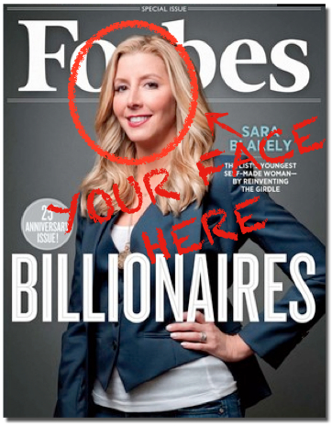
John Kay on M&A
“For the modern manager, only acquisition reproduces the thrill of the chase, the adventures of military strategy. There is the buzz that comes from the late-night meetings in merchant banks, the morning conference calls with advisers to plan your strategy. Nothing else puts your picture and your pronouncements on the front page, nothing else offers so easy a way to expand your empire and emphasise your role.”
Managerial motives

Slide 23
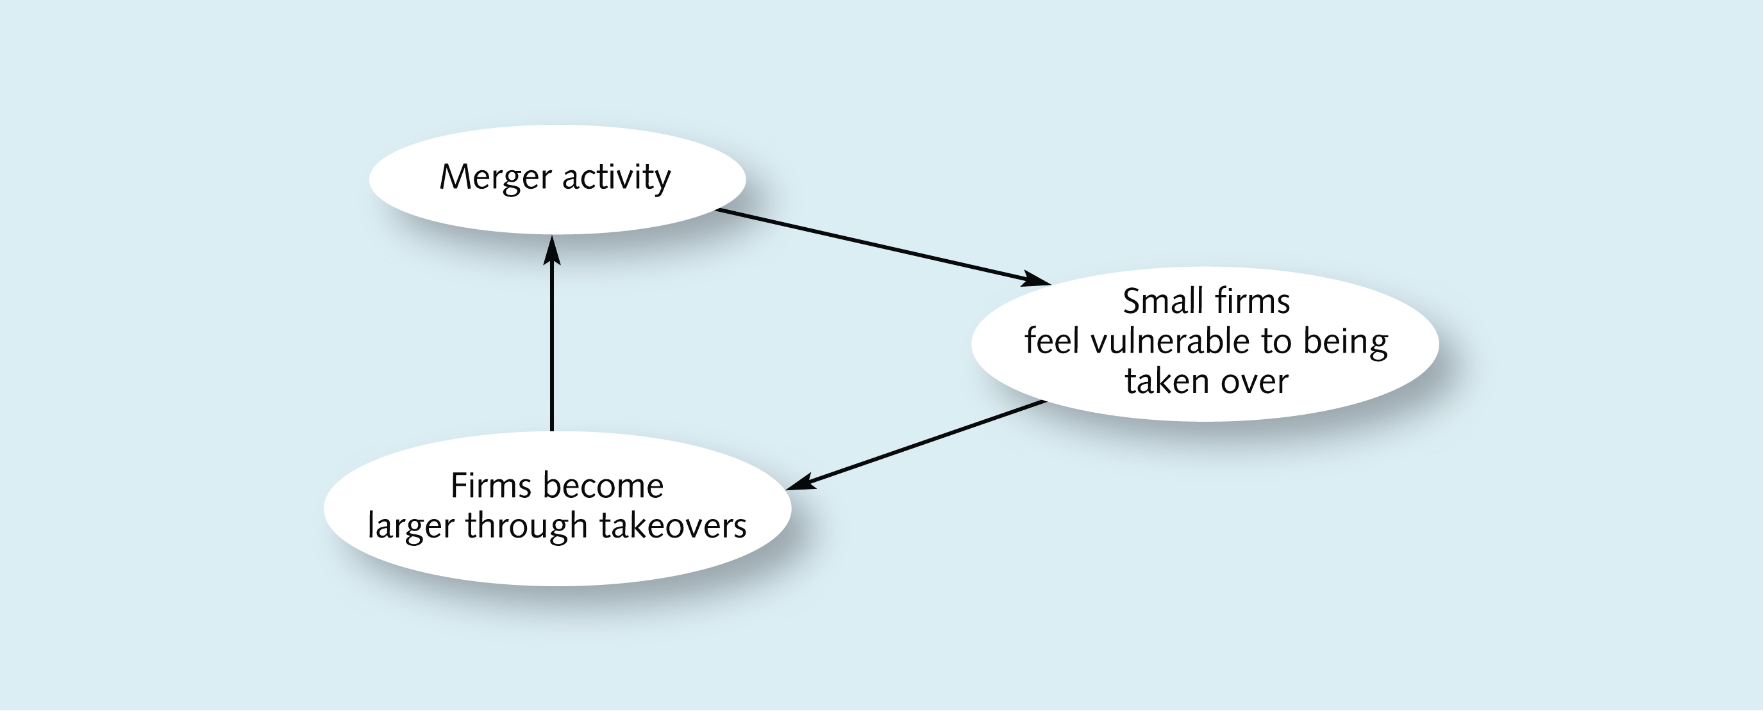
Other managerial motives
Survival - The self-reinforcement effect of mergers

Slide 24
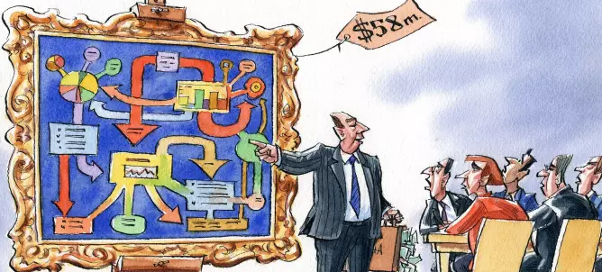
Third party motives
FT.com: It is a mystery why bankers earn so much
But what exactly do they do for the money? When asked this question, they turn sheepish and talk vaguely about the art of persuasion rather than the science of valuation. The secret to a bulging “success fee” is less to obtain the best possible deal than to make the chief executive and the board believe they got it. That is not the same thing, particularly in the long term.
…the stakes are very high. One former banker compares it to a surgeon explaining his or her charges as a patient is being wheeled into the operating theatre. The latter needs to have the best possible professional and is in no position to quibble. Going through an M&A auction can feel like being operated upon for directors who have not experienced it before. Shareholders and the media lurk, ready to condemn any slip-up (the latter risk is why public relations consultants get paid so much as well).
Further Reading:
Gapper, J. (2018) It is a mystery why bankers earn so much, Financial Times, July 4th 2018
Advisers
Investment bankers
Accountants
Lawyers
PR/Image consultants
Suppliers and customers

Slide 25
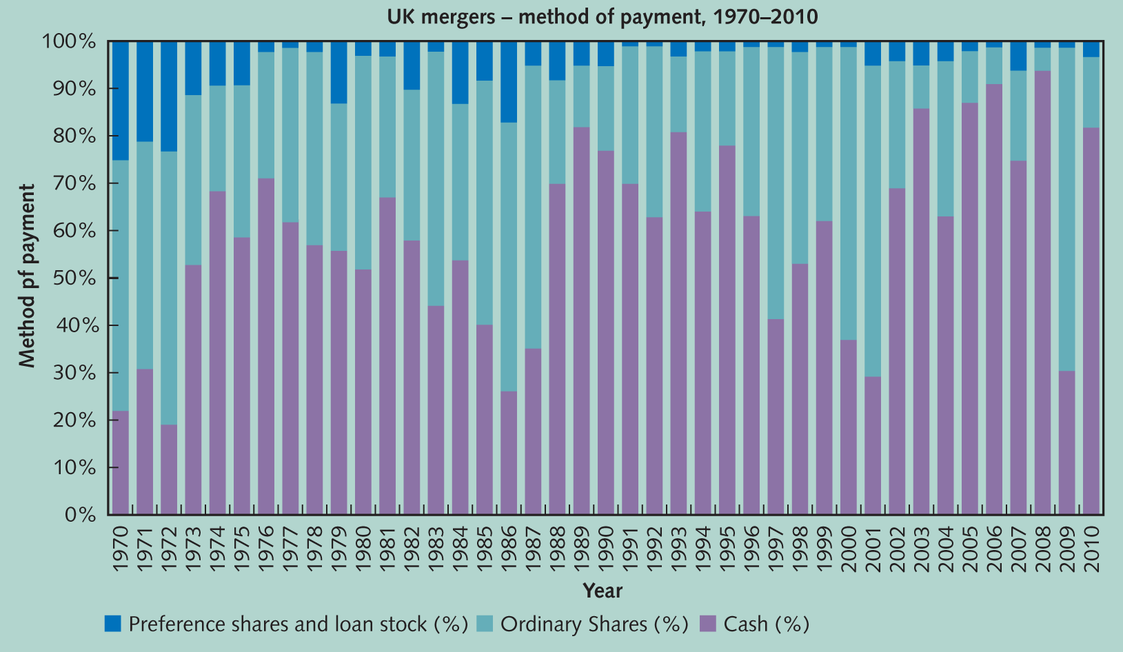
Financing mergers
“Even though there exists overwhelming empirical evidence suggesting that cash payment outperforms stock payment in takeovers, the economic rationale for this outperformance is still up for discussion.” Fischer (2017, p.227)
Fischer (2017) finds in his study compelling evidence to conclude that:
The acquirers and targets characteristics are what influence the financing source of a takeover. Though this particularism doesn’t necessarily prevent sector or industry wide tends, patterns and waves forming (see graph above)
On announcement, share based takeovers underperform, and in the long run (3 years) share based takeovers underperform. “In case of competing bids, common stock financing seems to be less attractive.” (p.238) (Disney vs Comcast and Fox 2018 deal)
Further Reading:
Fischer, M. (2017). The source of financing in mergers and acquisitions. The Quarterly Review of Economics and Finance, 65, 227-239.

Slide 26
Financing mergers
Cash
Advantages
The acquirer’s shareholders retain the same level of control over their company
Simplicity and preciseness give a greater chance of success
It allows the recipients to spread their investments
A disadvantage of cash to the target shareholders is that they may be liable for capital gains tax (CGT)
Potential cashflow strain on acquirer
A way of adjusting financial gearing

Slide 27
Shares
Advantages to target shareholders of receiving shares in the acquirer
Capital gains tax can be postponed
They maintain an interest in the combined entity
To the acquirer, an advantage of offering shares is that there is no immediate outflow of cash
Consider the effect on the capital structure of the firm and the dilution of existing shareholders’ positions

Slide 28
Mergers: process and integration
The regulatory bodies
Defence tactics
The impact of mergers
Problem areas

Slide 29
The regulatory bodies
The City Code on Takeovers and Mergers (‘the Code’)
Developed in a self-regulatory fashion by City institutions
Administered by the Panel Executive of the Takeover Panel
Statutory law
Sanctions
Public reprimands
Shunning
Legal action under market abuse legislation
Remove share-voting rights

Slide 30
Objective of the Takeover Panel regulation
To ensure fair and equal treatment for all shareholders. The main areas of concern are:
Shareholders being treated differently
Insider dealing
Target management action which is contrary to its shareholders’ best interests
Lack of adequate and timely information released to shareholders
Artificial manipulation of share prices
The bid process dragging on and thus distracting management from their proper tasks

Slide 31
Other regulators
Competition and Markets Authority (CMA)
‘A substantial lessening of competition’
Power to clear a merger
CMA is the ultimate arbiter in deciding if a substantial lessening of competition is likely
Can insist on major changes
A CMA inquiry may take several months to complete
European Commission

Slide 32
Business Case: Regulators, new laws and scale of blocked deals (2018)
FT.com: Toll of scuppered deals this year hits $540bn (2018)
Acquisitions worth more than $540bn have been scuppered so far this year as blockbuster takeovers have come under renewed threat from government scrutiny. Countries are increasingly turning to foreign investment laws to block deals in sensitive industries, including the technology and utility sectors, while antitrust regulators have put up barriers to several multibillion-dollar transactions this year.
Among the casualties was chipmaker Broadcom’s $142bn hostile bid for rival Qualcomm, which was blocked by US president Donald Trump on national security grounds, and the latter’s $44bn pursuit of Netherlands-based NXP Semiconductors, which China refused to approve amid an escalating trade dispute with Mr Trump.
Matthew Herman, co-head of global M&A advisory at law firm Freshfields, said that it was “impossible to decouple” the heightened regulatory scrutiny from politics. Several G7 countries are increasing the power they have to review deals on national security grounds, including the US, Germany and UK. Beijing has in turn sought to broaden its oversight of acquisitions, a retaliation against western efforts to curb Chinese takeovers.
“While pointing to recent transactions such as Broadcom-Qualcomm might make you think that this is solely a recent phenomenon, it is not,” he said. “Governments have used foreign direct investment and antitrust regimes to scrutinise business combinations for decades.”
Further Reading:
Platt, E. and Fontanella-Khan, J. (2018) Toll of scuppered deals this year hits $540bn, Financial Times, 12th August 2018
FT.com: Germany plans further foreign investment curbs (2018)
Germany is to increase its powers to block foreign investments by significantly lowering the threshold for deals that can be subject to ministerial veto, in a further sign of growing protectionist sentiment towards Chinese acquisitions. Berlin can veto deals that involve the purchase of at least 25 per cent of the equity of a German company by an entity from outside the EU, and only if they endanger public order or national security. Ministers now want to reduce that threshold to 15 per cent.
Further Reading:
Chazan, G. (2018) Germany plans further foreign investment curbs, Financial Times, 7th August 2018

Slide 33
Takeover Defenses
Not all mergers are welcome
During the 1980s, a variety of devices were developed to defend firms from unwelcome takeover proposals
Antitakeover considerations are even a factor for recent IPO firms (Field, Karpoff, 2002)
Possible motivations for defense
Target seeks a better price
Management believes the target would perform better as independent firm
Management is seeking to entrench itself

Slide 34
Financial Defensive Measures
One view: efficient firms with favorable market conditions has natural defense from high valuation
Alternative view: above firm is an attractive firm to be associated with (good target)
Financial conditions that make firm vulnerable
Highly liquid balance sheet
Good cash flow to stock price (good P/E ratio)
Subsidiaries that can be sold without significantly impairing cash flow
Small percentage owned by incumbent management

Slide 35
Financial Defensive Measures
Possible financial defenses
Increase debt – use funds to repurchase equity
Increase dividends
Structure loan covenants to force acceleration of repayment in event of takeover
Liquidate securities portfolio
Decrease excess cash
Use excess liquidity to acquire other firms
Divest or spin-off non-essential subsidiaries
Undervalued assets should be sold
Value increased by restructuring

Slide 36
Methods of Resistance
Reorganization of assets
Asset acquisitions may block takeovers (use of equity dilutes bidder’s position, antitrust issues)
“Selling off the crown jewels” – sell assets in which bidder is most interested
Reorganizing financial claims
Debt-for-equity exchanges – increase leverage to levels unacceptable to bidder
Dual-class recaps – increase insider voting
Leveraged recaps – increase debt and insider voting, distribute cash in dividends – “scorched earth” policy
Event studies – Generally positive returns when restructuring to improve efficiency; negative when “scorched earth” policy

Slide 37
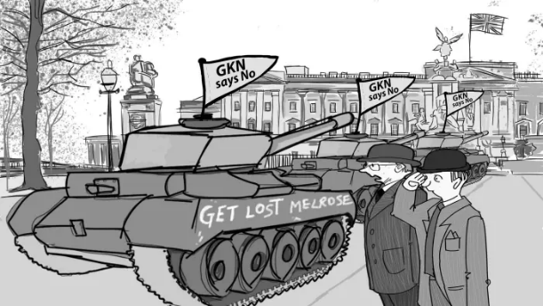
Business Case: GKN fights Melrose
FT.com: GKN pledges £2.5bn to sway investors in Melrose battle (2018)
GKN has promised to return £2.5bn in cash to shareholders over the next three years in an effort to fend off a hostile £7bn approach from turnround specialist Melrose Industries…GKN has not only promised to return cash amounting to 147p a share over the next three years, but to revive flagging margins and boost cash generation in its aerospace and automotive divisions. It also intends to sell non-core businesses, including the US aerostructures business that led to last year’s profit warning, amounting to roughly a quarter of annual turnover.
“This strategy is expected to generate significant cash for shareholders in the short term and meaningful sustainable cash flows over the mid to long term,” said Anne Stevens, the former Ford executive who was appointed chief executive last month in the wake of Melrose’s hostile assault. “We have a plan and we are dedicated to delivering it.”
The aerospace and automotive group’s management is fighting to convince investors to reject Melrose’s offer of 1.49 shares and 81p for every one of GKN’s shares.
It has argued that accepting the offer would leave GKN shareholders with just 57 per cent of the benefit of any turnround, against 100 per cent of the proceeds should they reject the bid.
However, the relatively unknown management of GKN has so far struggled to bridge the credibility gap with Melrose, which also plans to improve and sell the group’s under-performing businesses before returning proceeds to shareholders.
Analysts said the announcement on Wednesday offered “decent detail”, but one said: “The question will always be: why are you just figuring all this out now?”
Further Reading:
Hollinger, P. (2018) GKN pledges £2.5bn to sway investors in Melrose battle, Financial Times, 14th February 2018
Consider with the person sitting next to you:
Ultimately the shareholders of GKN didn’t have enough trust in the management to deliver their “superior” plan and went with turnaround specialist Melrose’s offer on 29th of March 2018.
Consider the proposed defence actions of the GKN management; selling off divisions, giving back cash, etc.
If you were a shareholder, what might you have been considering when mulling your options before the vote?

Slide 38
Methods of Resistance: Research on Value effects
Classic study on the value effects of Takeover defences is Ruback (1987) who concluded (p.65) that:
“…defenses that give incumbent managers the power to veto hostile takeovers seem to be harmful.”
“…defenses that destroy assets are probably bad.”
“…defenses which do not give managers veto power and do not destroy assets, such as antitakeover corporate charter changes, are probably not harmful.”
A more recent meta-analysis (a study of studies, overall looking at very large sample populations) by Gehlen and Lucey (2017) looking at 16,000 cases of anti-takeover defences being adopted failed to really significantly add to Ruback’s 30 year old suggestions
“…it does not matter whether an antitakeover defense is adopted, but in what context this adoption happens.”
In other words there is no “one size fits all” rule for anti-takeover defences. “Context is king” in these matters and the who, what, where, when, how and why matters greatly.
Further Reading:
Ruback, R. S. (1987). An overview of takeover defenses. In Mergers and acquisitions (pp. 49-68). University of Chicago Press. Available at: http://www.nber.org/chapters/c5821.pdf (Accessed: 21st August 2018)
Gehlen, T. and Lucey, B. (2017), The Wealth Effect of Adopting Anti-Takeover Defences: Evidence from a Meta Analysis (February 4, 2017). Available at SSRN: https://ssrn.com/abstract=2911633 or http://dx.doi.org/10.2139/ssrn.2911633

Slide 39
Duty of Directors in a takeover situation
Business judgment rule: Directors must demonstrate to the courts that the best interests of shareholders have been served
Duty of directors to demonstrate sound business reasons to reject offer
Duty of directors to approve only a transaction that is fair to shareholders and is best transaction available
Duty of directors to fully explore independent competitive bids and obtain best offer
Fairness opinion from an investment banking firm not sufficient.
Chapter 19-39

Slide 40
Assessing the evidence of Success In Mergers & Acquisitions
Jensen and Ruback (1983), The Market for Corporate Control, Journal of Financial Economics. Survey based on a number of studies that were made in USA.
Classic Study

Slide 42
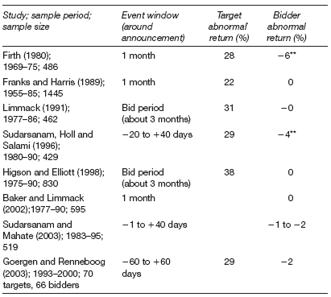
Short Term Studies of Abnormal Returns:

Slide 43
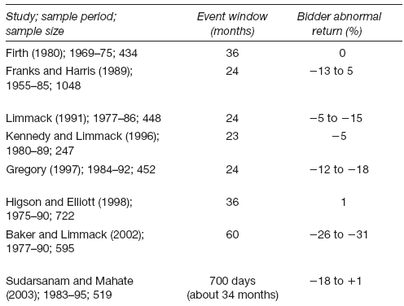
Longer Term Studies of Abnormal Acquirer Returns :

Slide 44
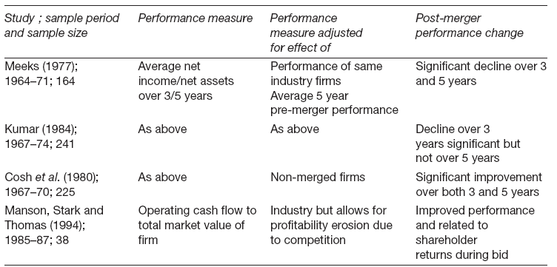
Studies of Post-Merger Profitability:

Slide 45
Student Activity/Discussion
Bloomberg.com: Facebook's/Whatsapp (2018)
“The company acquired WhatsApp for $22 billion in 2014… For years it told Wall Street it was just waiting for the right time to make money off of these properties. Chief Executive Officer Mark Zuckerberg said the company could afford to be patient until those apps reached 1 billion users. Now they are well beyond that level, but Zuckerberg says the company is still experimenting with potential business models.”
Further Reading:
Frier, S. (2018) The End of Facebook's Easy Growth, Bloomberg, 26th July 2018 available at: https://www.bloomberg.com/news/articles/2018-07-26/the-end-of-facebook-s-easy-growth
Consider with the person sitting next to you
Facebook acquired WhatsApp for $22bn in February 2014. Many people questioned the price at the time (and many still do!). Bloomberg in 2018 reported that after 4 years of ownership Facebook is still at the “experimenting” stage of how to create a business model to make their money back (most recently a 2018 “Whatsapp Pay” system in India).
1bn users achieved, but very much struggling to monetarise them.
How long do you think we need to leave this deal before we can start to judge and assess it either a brilliant long term move, or a very expensive wasteful mis-step?

Slide 46
Wit and Wisdom of Warren Buffett on M&A Value
“They are a bonanza for the shareholders of the acquiree; they increase the income and status of the acquirer’s management; and they are a honey pot for the investment bankers and other professionals on both sides. But, alas, they usually reduce the wealth of the acquirer’s shareholders, often to a substantial extent”

Slide 47
Summary of Empirical Research Findings on Value Effects
The economy
Cowling et al. (1980) found efficiency gains neutralised by greater monopoly power, although two cases with benefits were noted.
Research shows acquisitions have, at best, a neutral effect on economy.
Although overall economic wealth may not increase, wealth redistribution can occur.
The shareholders
Accounting studies indicate that acquisitions are unprofitable to the acquirer.
Event studies (before and after comparisons) show that target company shareholders get significant gains while acquiring company shareholders get no gains or even a loss.
Bidders may earn gains prior to the bid.

Slide 48
Summary of Empirical Research Findings on Value Effects
The shareholders (Cont.)
Gain of target company shareholders’ likely to be a result of bid premium.
Acquiring company shareholders’ lack of gain may be due to anticipation of acquisition by efficient market.
Many surveys conclude that acquisitions transfer rather than create wealth.
Managers and employees
Acquiring company managers benefit from:
increased power and status
increased financial rewards
increased job security
Managers of target companies tend to lose their jobs following an acquisition, while their employees also face uncertain futures.

Slide 49
Outcomes:
At the end of this weeks lecture and seminar the student should be able to:
Place merger and acquisitions within a real world business context in which shareholders value should have primacy but research shows that often value is hard to find.
Understand that not all Merger and acquisition activity is welcomed, and be able to discuss some of the possible defences giving real world examples.

