Slide 1
Fundamentals of Corporate Finance
Chapter 8
Investment Decision Rules
Copyright © 2018, 2015, 2012 Pearson Education, Inc. All Rights Reserved.
Notes:
If this PowerPoint presentation contains mathematical equations, you may need to check that your computer has the following installed:
1) MathType Plugin
2) Math Player (free versions available)
3) NVDA Reader (free versions available)

Slide 2
Content
- Accounting rate of return
- Payback method
- NPV
- IRR
- Profitability index

Slide 3
Accounting rate of return
Average annual accounting profit x 100%
Initial amount of the investment to
earn that profit
Average annual accounting profit x 100%
Average amount of the investment (at the mid-point)
to earn that profit*
* Average investment = Initial Inv. + scrap value
2
Accept or reject
ARR > predetermined target
Mutually exclusive
Highest ARR

Slide 4
Payback method
How quickly the company can recover its initial capital investment from future net cash flows arising from the project.
Accept or reject
Choose projects that repay the initial capital invested within a predetermined period of time.
Mutually exclusive projects
Choose the project that pays back in the quickest time.

Slide 5
The NPV Decision Rule
Net Present Value
Most firms measure values in terms of Net Present Value – that is, in terms of cash today
NPV = PV (Benefits) – PV (Costs)

Slide 6
The NPV Decision Rule
The NPV decision rule implies that we should:
Accept positive-NPV projects; accepting them is equivalent to receiving their NPV in cash today, and
Reject negative-NPV projects; accepting them would reduce the value of the firm, whereas rejecting them has no cost (NPV = 0)

Slide 7
Using the NPV Rule
Organizing the Cash Flows and Computing the NPV:
A take-it-or-leave-it decision
A fertilizer company can create a new environmentally friendly fertilizer at a large savings over the company’s existing fertilizer
The fertilizer will require a new factory that can be built at a cost of $81.6 million. Estimated return on the new fertilizer will be $28 million after the first year, and will last for four years

Slide 8
Using the NPV Rule
Organizing Cash Flows and Computing NPV
The following timeline shows the estimated cash flows:

Slide 9
Using the NPV Rule
Given a discount rate r, the NPV is:
We can also use the annuity formula:

Slide 10
Using the NPV Rule
Organizing Cash Flows and Computing NPV
If the company’s cost of capital is 10%, the NPV is $7.2 million and they should undertake the investment

Slide 11
Using the NPV Rule
The NPV Profile
The NPV depends on cost of capital
NPV profile graphs the NPV over a range of discount rates
Based on this data the NPV is positive only when the discount rates are less than 14%

Slide 12
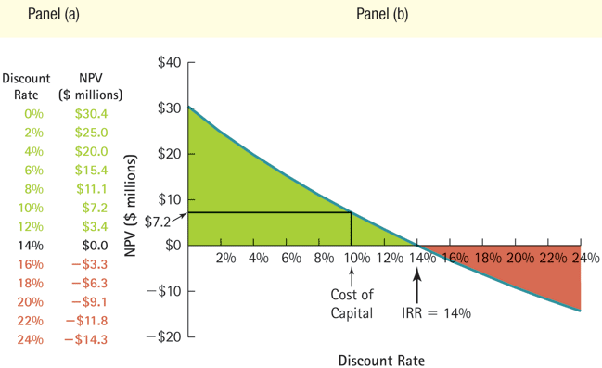
NPV of Project

Slide 13
Using the NPV Rule
Measuring the Sensitivity with IRR
If you are unsure of your cost of capital estimate, it is important to determine how sensitive your analysis is to errors in this estimate
The IRR can provide this information
Alternative Rules Versus the NPV Rule
When evaluating alternative rules for project selection, understand that alternative investment rules may or may not give the same answer as the NPV rule
When the rules conflict, always base your decision on the NPV rule

Slide 14
Alternative Decision Rules
The Internal Rate of Return Rule
Take any investment opportunity where IRR exceeds the opportunity cost of capital

Slide 15
Alternative Decision Rules
Weakness in IRR
In most cases IRR rule agrees with NPV for stand-alone projects if all negative cash flows precede positive cash flows
In other cases the IRR may disagree with NPV

Slide 16
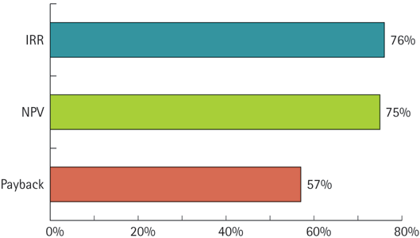
The Most Popular Decision Rules Used by CFOs

Slide 17
Alternative Decision Rules
Delayed Investments
Two competing endorsements:
Offer A: single payment of $1million upfront
Offer B: $500,000 per year at the end of the next three years
Estimated cost of capital is 10%
Opportunity timeline:

Slide 18
Alternative Decision Rules
The NPV is:
Set NPV to zero and solve for r to get IRR.

Slide 19
Alternative Decision Rules
23.38% > the 10% opportunity cost of capital, so according to IRR, Option A best
However, NPV shows that Option B is best
To resolve the conflict we can show an NPV Profile

Slide 20
Alternative Decision Rules
Multiple IRRs
Suppose the cash flows in the previous example change
The company has agreed to make an additional payment of $600,000 in 10 years

Slide 21
Alternative Decision Rules
The new timeline:
The NPV of the new investment opportunity is:
If we plot the NPV profile, we see that it has two IRRs!

Slide 22
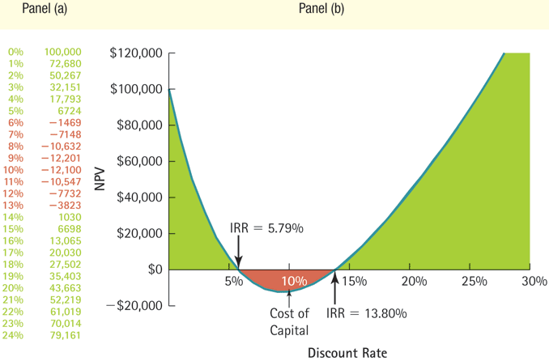
Figure 8.4 NPV with Additional Deferred Payments

Slide 23
Choosing Among Projects
Mutually Exclusive Projects.
Can’t just pick the project with a positive NPV
The projects must be ranked and the best one chosen
Pick the project with the highest NPV

Slide 24
NPV and Mutually Exclusive Projects
Problem:
You own a small piece of commercial land near a university. You are considering what to do with it. You have been approached with an offer to buy it for $220,000. You are also considering three alternative uses yourself: a bar, a coffee shop, and an apparel store. You assume that you would operate your choice indefinitely, eventually leaving the business to your children.

Slide 25
NPV and Mutually Exclusive Projects
Problem:
You have collected the following information about the uses. What should you do?
Blank | Initial Investment | Cash flow in the First Year (CF₁) | Growth rate (g) | Cost of capital (r)
Bar | $400,000 | $60,000 | 3.5% | 12%
Coffee Shop | $200,000 | $40,000 | 3% | 10%
Apparel Store | $500,000 | $75,000 | 3% | 13%

Slide 26
NPV and Mutually Exclusive Projects
Solution:
Plan:
Since you can develop only one project (you only have one piece of land), these are mutually exclusive projects. In order to decide which project is most valuable, you need to rank them by NPV. Each of these projects (except for selling the land) has cash flows that can be valued as a growing perpetuity, so from Chapter 4, the present value of the inflows is
The NPV of each investment will be

Slide 27
NPV and Mutually Exclusive Projects
Execute:
The NPVs are:
Alternative | NPV
Coffee Shop | $371,429
Bar | $305,882
Apparel Store | $250,000
Sell the Land | $220,000
You should choose the coffee shop.

Slide 28
NPV and Mutually Exclusive Projects
Evaluate:
All the alternatives have positive NPVs, but you can take only one of them, so you should choose the one that creates the most value.
Even though the coffee shop has the lowest cash flows, its lower start-up cost coupled with its lower cost of capital (it is less risky) make it the best choice.

Slide 29
NPV and Mutually Exclusive Projects
Problem:
You own a small piece of commercial land near a university. You are considering what to do with it. You have been approached recently with an offer to buy it for $600,000. You are also considering three alternative uses of the land for yourself: a laundromat, a bakery, and a bike shop. You assume that you would operate your choice indefinitely, eventually leaving the business to your children.

Slide 30
NPV and Mutually Exclusive Projects
Problem:
You have collected the following information about the uses. What should you do?
Blank | Initial Investment | Cash flow in the First Year | Growth rate | Cost of capital
Laundromat | $200,000 | $35,000 | 2.0% | 7.0%
Bakery | $750,000 | $45,000 | 3.5% | 6.5%
Bike Shop | $800,000 | $40,000 | 4.5% | 7.0%

Slide 31
NPV and Mutually Exclusive Projects
Solution:
Plan:
Since you can only do one project (you only have one piece of land), these are mutually exclusive projects. In order to decide which project is most valuable, you need to rank them by NPV. Each of these projects (except for selling the land) has cash flows that can be valued as a growing perpetuity, the present value of the inflows is
The NPV of each investment will be

Slide 32
NPV and Mutually Exclusive Projects
Execute:
The NPVs are:
Alternative | NPV
Laundromat | $500,000
Bakery | $750,000
Bike Shop | $800,000
Sell the Land | $600,000
Based on the rankings the bike shop should be chosen.

Slide 33
NPV and Mutually Exclusive Projects
Evaluate:
All of the alternatives have positive NPVs, but you can only take one of them, so you should choose the one that creates the most value.
Even though the Laundromat has the lowest start-up costs, the higher cash flows of the bike shop, along with its higher growth rate, makes it the best choice.

Slide 34
Choosing Among Projects (2 of 8)
Differences in Scale
A 10% IRR can have very different value implications for an initial investment of $1 million vs. an initial investment of $100 million

Slide 35
Choosing Among Projects
The Bottom Line on IRR
Picking the investment opportunity with the largest IRR can lead to a mistake
In general, it is dangerous to use the IRR in choosing between projects
Always rely on NPV

Slide 36
Putting It All Together
Summary of Decision Rules
NPV | Blank
Definition | The difference between the present value of an investment’s benefits and the present value of its costs
Rule | Take any investment opportunity where the NPV is positive; turn down any opportunity where it is negative
Advantages | Corresponds directly to the impact of the project on the firm’s value Direct application of the Valuation Principle
Disadvantages | Relies on an accurate estimate of the discount rate Can be time-consuming to compute

Slide 37
Putting It All Together
IRR | Blank
Definition | The interest rate that sets the net present value of the cash flows equal to zero; the average return of the investment
Rule | Take any investment opportunity where its IRR exceeds the opportunity cost of capital; turn down any opportunity where its IRR is less than the opportunity cost of capital
Advantages | Related to the NPV rule and usually yields the same (correct) decision
Disadvantages | Hard to compute Multiple IRRs lead to ambiguity Cannot be used to choose among projects Can be misleading if inflows come before outflows

Slide 38
Putting It All Together
Payback Period | Blank
Definition | The amount of time it takes to pay back the initial investment
Rule | Accept the project if the payback period is less than a prespecified length of time—usually a few years; otherwise, turn it down
Advantages | Simple to compute Favors liquidity
Disadvantages | No guidance as to correct payback cutoff Ignores cash flows after the cutoff completely Not necessarily consistent with maximizing shareholder wealth

Slide 39
Project typology
Mutually Exclusive
Divisible
Repeatable

Slide 40
Capital rationing
Divide each NPV by its initial investment.
This result is known as a profitability index (PI)
Rank each project from highest to lowest in accordance with their PIs
Look at the requirements of the question –
If projects are both divisible and repeatable – take on the best project as many times as possible; you will typically only be able to take on part of the last project. E.g. if you have £20 to spend and the project costs £8, you could take the project on 2 ½ times, and would be rewarded with 2 ½ times the NPV than if you had taken on the project only once.
If projects are divisible, but not repeatable, you would take on the highest ranked project first, then the second best etc, until you hit the maximum budget you have. You will typically only be able to perform part of the last project you select, in which case the NPV for this project would need to be apportioned as above.
If projects are neither divisible nor repeatable, you would just have to try different combinations of the projects that do not take you over your budget, and choose the combination that gives you the highest overall NPV.

Slide 41
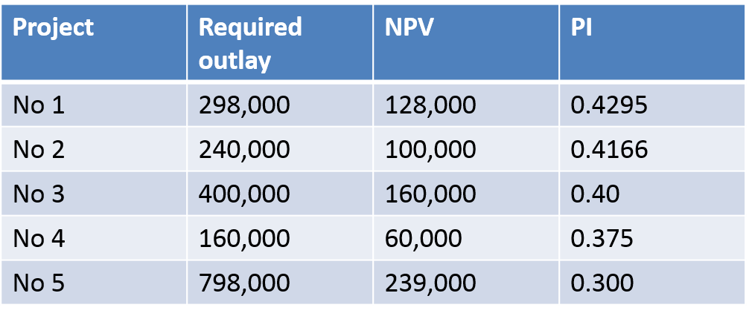
Example

