Slide 1
Fundamentals of Corporate Finance
Chapter 8
Cost of Debt Bonds and Their Valuation
Copyright © 2018, 2015, 2012 Pearson Education, Inc. All Rights Reserved.
Notes:
If this PowerPoint presentation contains mathematical equations, you may need to check that your computer has the following installed:
1) MathType Plugin
2) Math Player (free versions available)
3) NVDA Reader (free versions available)

Slide 2
Introduction to the Weighted Average Cost of Capital
I want to raise £100,000 to buy a piece of equipment that will generate returns over 1 year. I need to raise finance……

Slide 3
Where to raise finance?
Providers of debt finance
Risk?
Why?
Discuss
I raise £60000 at a cost of 6%

Slide 4
Where to get the rest
Providers of equity finance
Risk?
Why?
Discuss
I raise the remaining £40,000 at 16%

Slide 5
One year on….
I have now made 10% return on the investment and need to repay my providers of finance.
Debt £60000 x 1.06 = £63600 (happy as they have been compensated for the risk they have taken but their ‘wealth’ has not been improved).

Slide 6
What about equity holders?
To compensate them for the level of risk they have taken they need
£40000 x 1.16 = £46400
But we have not increased their wealth!

Slide 7
Now I have a new project and need to do an NPV
What discount rate can I use? (cost of capital)
I have raised 60% of finance from debt at 6% and 40% from equity at 16%.
Therefore I can work out a weighted average cost of capital:
0.4 x 16 + 0.6 x 6 = 10
This is my weighted average cost of capital (WACC)

Slide 8
To show NPV
To show that my first project did not increase wealth of my debt or equity providers:
NPV
Year 0 Year 1
-100000 110000
1.00 0.909 (discount factor at 10%)
-100000 100000 = 0 NPV

Slide 9
WACC
Over the next few sessions we will be building up the WACC by looking at each element in turn.
Starting with debt finance….

Slide 10
This lecture…
What are bonds
What are risks associated with bonds
Cash flow of coupon bonds
Valuation
Types of bonds
Ratings
Building a yield curve
Strips

Slide 11
Bond Basics
Bonds are simply long-term IOUs that represent claims against a firm’s assets.
Bonds are a form of debt
Bonds are often referred to as fixed-income security.

Slide 12
Key Features of a Bond
Debt instrument issued by a corporation or government.

Slide 13
Terminology
Par value - face amount of the bond, which is paid back at maturity (assume £100; $1,000).
Coupon rate – stated interest rate (generally fixed) paid by the issuer. Multiply by par to get monetary payment of interest.
Maturity date – when the bond must be repaid in full.
Yield to maturity - rate of return earned on a bond held until maturity (cost of debt).
Market value – current market price of the bond on the secondary market.

Slide 14
Bond Value
Bond Value = PV(coupons) + PV(par)
Bond Value = PV(annuity) + PV(lump sum)
Remember:
As interest rates increase, bond prices decrease
and vice versa. This is an important concept in finance

Slide 15
Yield to Maturity
If bond Sells at a DISCOUNT (less than $1,000) then YTM > Coupon Rate
If bond Sells at a PREMIUM (more than $1,000) then YTM < Coupon Rate

Slide 16
Why?
If you had a 5% bond of $1000. On issue the YTM is 5% (you would get a coupon of $50 which is fixed).
If the price of the bond falls to $900 you would still get $50, so the YTM is now 50/900 = 5.56%
The opposite applies if the opposite happens. If the price rises to $1100 then the return will be 50/1100 = 4.54%

Slide 17
Valuing a Discount Bond with Annual Coupons
Coupon rate = 10%
Annual coupons
Par = $1,000
Maturity = 5 years
YTM = 11%
Price= ?
Notes:
Show on excel:
PV of 5 years coupon

Slide 18
Finding the YTM (cost of debt)
Coupon rate = 10%
Annual coupons
Par = $1,000
Maturity = 4 years
YTM = ?
Price = $920
Now, this is a much more difficult mathematical problem which requires linear approximation

Slide 19
Traded debt
UK bonds are normally issued with a nominal value of £100
P_{D} = _{Σ} –––––– + –––––––
i = annual nominal interest (coupon payment)
R_{n} = amount payable upon redemption
k_{D} = cost of debt capital (pre-tax benefit)
P_{D} = current market price of bond
n
i
R_{n}
t = 1
(1 + k_{D})^{t}
(1 + k_{D})^{n}
Notes:
Slightly different terminology, but this is ok. Want to expose to different ones, just in case.

Slide 20
Cost of traded debt example - Elm plc
Elm plc issued £100m of bonds six years ago carrying an annual coupon rate of 8 per cent
Due to be redeemed in four years for the nominal value of £100 each
The next coupon is payable in one year and the current market price of a bond is £93
Year 0 1 2 3 4 Cash flow +£93 –£8 –£8 –£8 –£108
8 8 8 108
93 = –––––– + –––––––– + –––––––– + ––––––––
1 + k_{D} (1 + k_{D})² (1 + k_{D})³ (1 + k_{D})⁴

Slide 21
What is interest rate risk?
Interest rate risk is the concern that interest rates will change, and that will affect the value/price of a security.

Slide 22
Interest rate risk example
Suppose you just inherited £500,000. You intend to invest the money and live off the interest.

Slide 23
Interest rate risk example
You may invest in either a:
10-year bond
series of ten 1-year bonds
Both bonds currently yield 5%.

Slide 24
If you choose the 1-year bond strategy:
After year 1, you receive £25,000 in income and have £500,000 to reinvest. But, if after 1-year rates fall to 3%, your subsequent annual income would fall to £15,000.
If you choose the 10-year bond strategy:
You can lock in a 5% interest rate, and £25,000 annual income.
Notes:
The reverse situation is possible where the interest rates rise, making the first scenario more profitable.

Slide 25
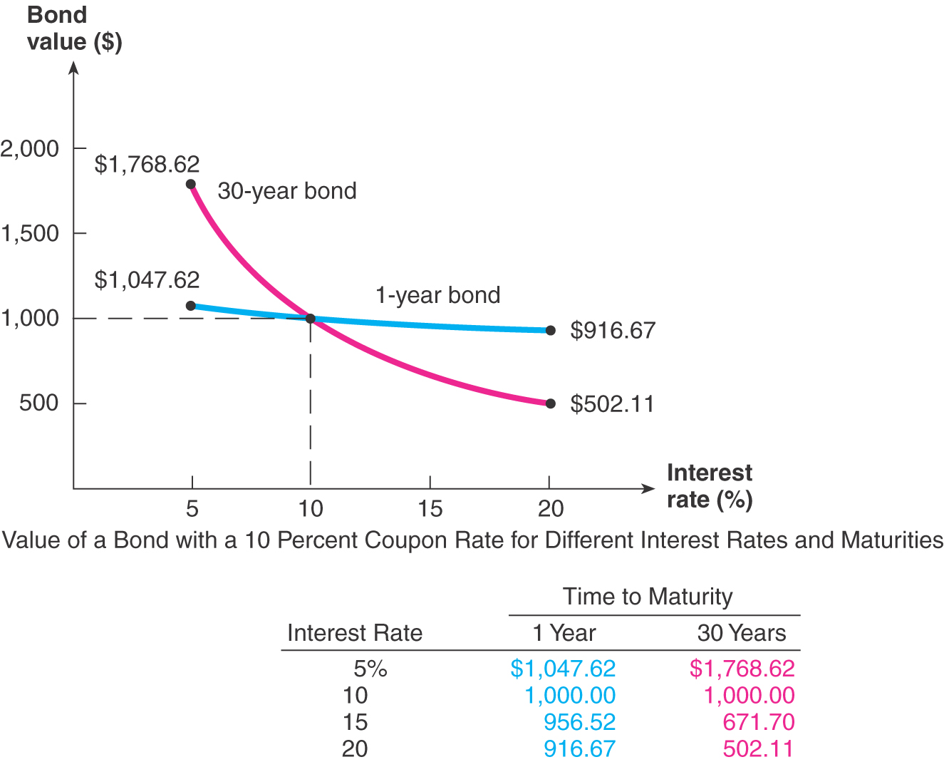

Slide 26
Interest Rate Risk
Price Risk
Change in price due to changes in interest rates
Long-term bonds have more price risk than short-term bonds
Low coupon rate bonds have more price risk than high coupon rate bonds

Slide 27
Elm plc
With k_{D} at 11 per cent the discounted cash flow on the right hand side = -2.31
With k_{D} at 10 per cent the discounted cash flow on the right hand side = 0.66
0.66
k_{D} = 10% + –––––––––––––– ( 11 – 10) = 10.22%
0.66 – -2.31
£93
V_{D} = £100m × ––––– = £93m
£100
It would be wrong to use the coupon rate of 8 per cent on the bond for the cost of debt
k_{DAT} = k_{DAT} (1 – T) k_{DAT} = 10.22 (1 – 0.19) = 8.28%

Slide 28
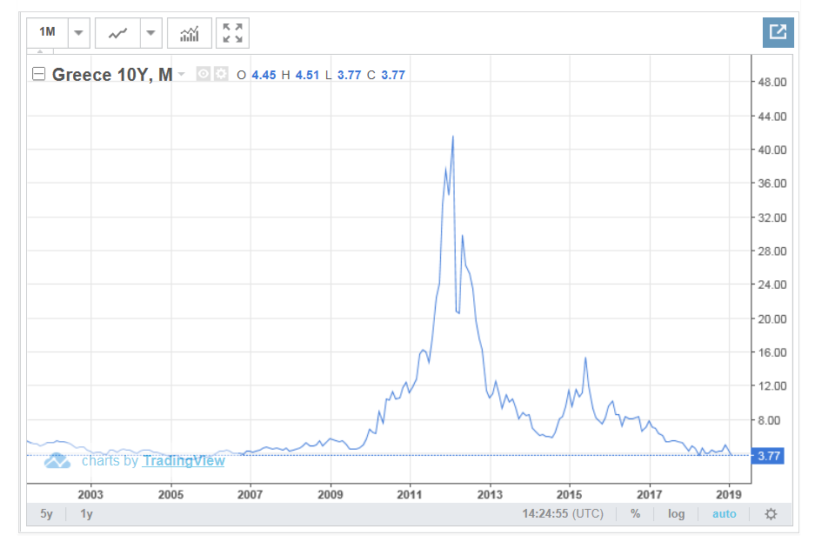
Greek Bond Yields
https://tradingeconomics.com/greece/government-bond-yield

Slide 29
Government Bonds
Treasury Securities = Federal government debt
Treasury Bills (T-bills)
Pure discount bonds
Original maturity of one year or less
Treasury notes (T-notes)
Coupon debt
Original maturity between one and ten years
Treasury bonds (T-bonds)
Coupon debt
Original maturity greater than ten years
Notes:
More on terminology

Slide 30
Tax Consequences
Interest is tax deductible. Therefore there are tax savings for a company when using debt finance.
If the YTM on a bond is 10%, then the cost to the company will be YTM (1-t).
So in this example 10 (1-0.19) = 8.1%

Slide 31
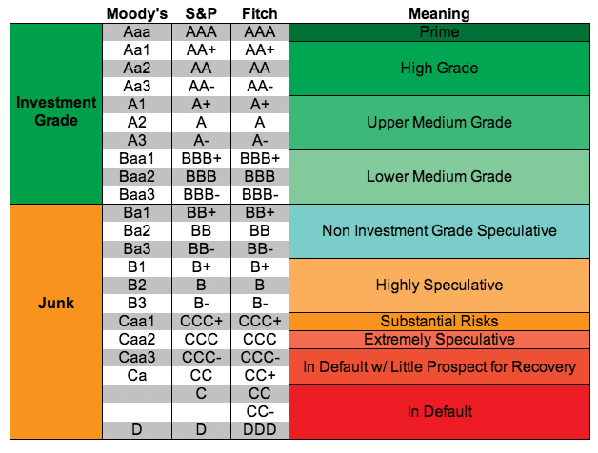

Slide 32
Bond Ratings - Speculative
Low Grade
Moody’s Ba, B, Caa and Ca
S&P BB, B, CCC, CC
Considered speculative with respect to capacity to pay. The “B” ratings are the lowest degree of speculation.
Very Low Grade
Moody’s C and S&P C – income bonds with no interest being paid
Moody’s D and S&P D – in default with principal and interest in arrears

Slide 33
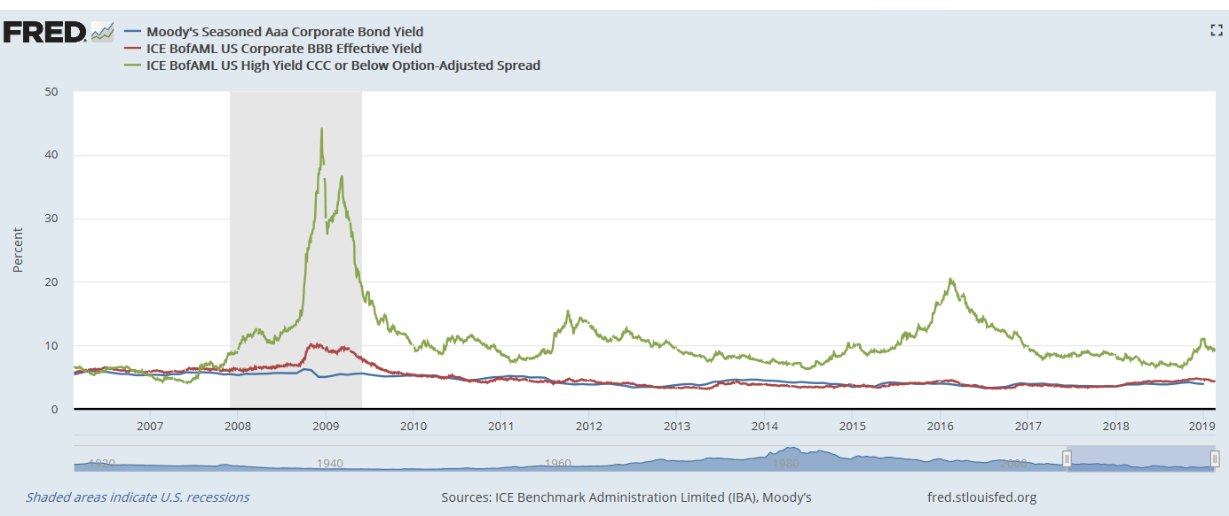
Bond spread

Slide 34
Bond Pricing (Secondary Market)
Hence bond prices will be sensitive to anything which causes the interest rate “r “ to change.
Perceptions of the amount of risk
Riskiness of the firm (for an individual corporate bond)
Uncertainty regarding the economy (will affect all bonds)
Attitudes to risk
An increase in the general level of risk aversion
Central Bank decision to raise official rate, often foreshadowed by:
An increase in inflation
Rapid economic growth
Labour shortages etc….

Slide 35
What is the “term structure of interest rates”? What is a yield curve?
Term structure: the relationship between interest rates (or yields) and maturities.
A graph of the term structure is called the yield curve.

Slide 36
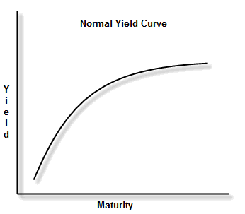
Draw a normal yield curve

Slide 37
Actual US Treasury Yield Curve
https://www.treasury.gov/resource-center/data-chart-center/interest-rates/pages/textview.aspx?data=yield

Slide 38
What factors can explain the shape of this yield curve?
This constructed yield curve is upward sloping.
This is due to increasing expected inflation and an increasing maturity risk premium.

Slide 39
Strips Data (CIBC World Markets)
Maturity 5% 6% 7% 8% 9%
1 9,518 9,426 9,335 9,246 9,157
2 9,060 8,885 8,714 8,548 8,386
3 8,623 8,375 8,135 7,903 7,679
5 7,812 7,441 7,089 6,756 6,439
10 6,103 5,537 5,026 4,564 4,146
15 4,767 4,120 3,563 3,083 2,670
20 3,724 3,066 2,526 2,083 1,719
30 2,273 1,697 1,269 950 713
40 1,383 940 638 433 295

Slide 40
Strips
Strips are a single payment bond/or could be described as a zero coupon bond.
Strips could be used to predict future borrowing rates.
Par $1,000
Maturity | 1 | 2 | 3 | 4 | 5 | 6
Market Price | 991 | 983 | 967 | 927 | 901 | 870
a. If the company plans to borrow money for a year in three years time, what rate should it expect to pay?
b. What assumptions are we making when we rely on these rates?
c. What are the additional risks compared to coupon payment bonds?

