Slide 1
Fundamentals of Corporate Finance
Chapter 16
Capital Structure
Copyright © 2018, 2015, 2012 Pearson Education, Inc. All Rights Reserved.
Notes:
If this PowerPoint presentation contains mathematical equations, you may need to check that your computer has the following installed:
1) MathType Plugin
2) Math Player (free versions available)
3) NVDA Reader (free versions available)

Slide 2
Aims and Objectives:
To introduce the debate surrounding the possibility of an optimal capital structure
To examine in detail M&M conceptual papers, and a main alternative theory of Static Trade-Offs.
To discuss the relationship between levels of gearing and shareholder returns
To introduce the idea of Costs of Financial distress and its effect on levels of debt.

Slide 3
Suggested Further Readings From this Lecture:
Stretcher, R., & Johnson, S. (2011). Capital structure: professional management guidance. Managerial Finance, 37(8), 788-804.
Baker, H. K., Singleton, J. C., & Veit, E. T. (2010). Survey Research in Corporate Finance: Bridging The Gap Between Theory and Practice. Oxford University Press. E-book: http://capitadiscovery.co.uk/northumbria-ac/items/1739210
López-Salido, D., Stein, J. C., & Zakrajšek, E. (2017). Credit-market sentiment and the business cycle. The Quarterly Journal of Economics, 132(3), 1373-1426.
Flanders, J. (2015). It’s not a Minsky moment, It’s a Minsky Era, or: Inevitable instability. Econ Journal Watch, 12(1), 84-105.

Slide 4
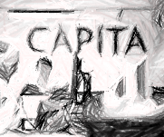
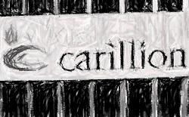
Business Case: Capita & Carillion’s legacy
The sudden collapse of the large outsourcer Carillion on 15th of January 2018 sparked substantial analysis into the balance sheets of some of the UK’s largest outsourcing companies. For the first time in many years questions started to be asked as to exactly why shareholders allowed these types of organisations to have so much debt as a part of their capital structure.
The dangers of balance sheets “stuffed with hard-to-value and illiquid intangibles” like long term contracts, which then had substantial borrowings attached to them, started to weigh heavily on shareholders minds. Outsourcing companies like Capita and Serco saw substantial declines in their share price values as many reconsidered the risks involved.
Companies themselves were equally quick to realise the change in business sentiment towards their highly leveraged ventures. By February 2018 Capita announced a £700m rights issue of new shares to raise further equity finance as its share price plummeted 45%.
FT.com: Outsourcers are facing their own financial crisis
When an outsourcing business writes down the value of contracts, it is rather like a bank writing down a book of loans.
If the decline in anticipated revenues is big enough, it can trigger a run where the spooked lenders demand their capital back.
As contracts are not easy to sell at short notice, that leaves shareholders as the backstop provider of liquidity.
If they say no, as Carillion’s did, and the government won’t provide a bailout (as it shouldn’t), the business can be toast.
Their banklike characteristics mean they need more equity, not less
Further Reading:
Ford, J. (2018) Outsourcers are facing their own Financial Crisis, Financial Times, 24th June 2018

Slide 5
Introduction
Discussions of Capital Structure are effectively about the mixture of sources of capital used by the business and the various costs, risks and rewards of those types of finance. Each has its different costs, generally;
Equity = Higher Risk, thus high returns are demanded
Debt = Lower risk, thus lower cost and cheaper to acquire
Ultimately then Capital Structure is about managing or optimising the overall Cost of Capital, the Weighted Average Cost of Capital, or WACC that a company has to be the most beneficial it can be for the company.
Since WACC is often also the starting point for determining a hurdle rate for Investment Appraisal this is an important figure affecting not only current operations, but all future investments.
Remember if the return on investment is lower than the WACC, the company is not creating value (see sidebar)
FT.com: Saint-Gobain boss defiant after failed takeover
One of France’s largest industrial companies, Saint-Gobain employs 180,000 people worldwide and in 2017 pulled in €40bn in sales… critics say has suffered years of underperformance, poor investment decisions and top-heavy bureaucracy.
Felix Brunotte, an analyst at independent research house AlphaValue argued.... Saint-Gobain’s return on capital employed — a measure of the efficiency of its investment — was below its cost of capital, measured by its weighted average cost of capital, WACC. This would be an indication that the company was not employing its capital effectively or creating value for shareholders.
The chief executive of one of France’s oldest industrial companies is in no mood for criticism. “Honestly, this is bullshit,” Pierre-André de Chalendar, the boss of Saint-Gobain, told the Financial Times in response to accusations the company was too complex. While “it would be foolish for me to say we are perfect”, those who criticise are “sometimes people who have uneducated views”.
Saint-Gobain’s chief financial officer, Guillaume Texier, added that the company’s return on capital employed was 11.2 per cent in 2017, below its recent peak of 12.1 per cent in 2008, but beating its weighted average cost of capital of “approximately” 9.7 per cent.
Further Reading:
Keohane, D. (2018) Saint-Gobain boss defiant after failed takeover, Financial Times, 26th June 2018

Slide 6


Perfect knowledge or imperfect tools?
In the last lecture we looked at the calculation of the Weighted Average Cost of Capital. In the Saint-Gobain example just presented we had two opposing views being discussed. Given Saint-Gobain is a highly acquisitive company, that the return on investment is higher than the WACC is a key figure for the approval of acquisitions.
An independent analyst believes that Saint-Gobain’s returns on investment are lower than it’s weighted average cost of capital.
Saint-Gobain’s chief financial officer believes the company’s returns are marginally above it.
Reflect on what we discussed last week regarding the calculations of this WACC figure.

Slide 7
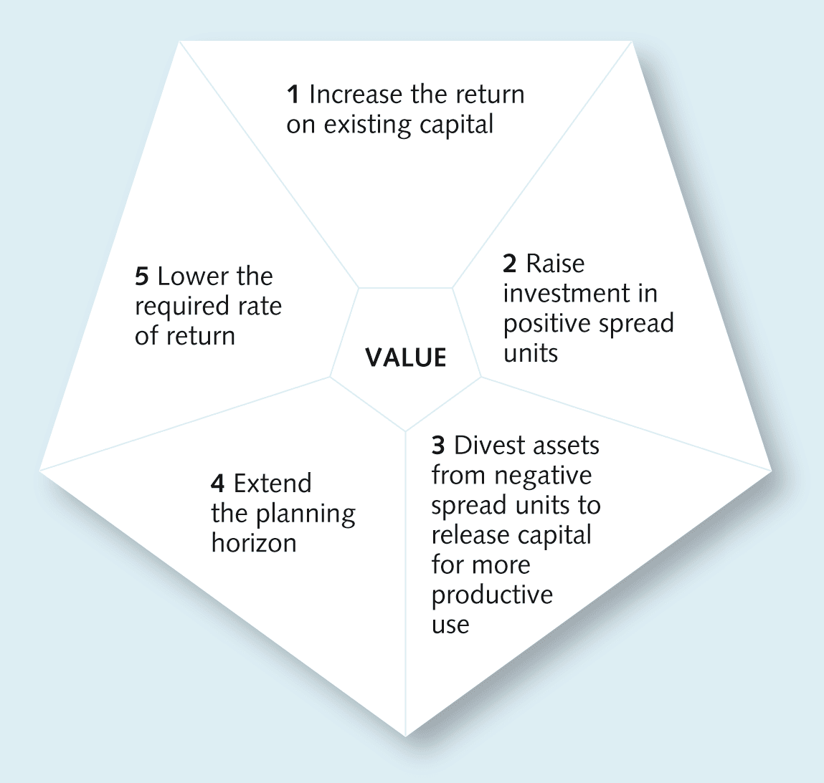
Value pentagon

Slide 8
The current state of Capital Structure research
The current status of Capital Structure research and theory is perhaps best summarised by Baker et al. (2010):
  “The status of our understanding of how managers actually make capital structure decisions does not appear to be anchored by any of the extant academic theories. Despite several decades of theory development and refinement, none of the normative capital structure theories indicating how managers should act seem to fit the survey data.” (p.36)
  - We have many theories developed about how Capital Structure should work conceptually, but when you compare the theory to empirical survey’s of financial managers and companies, few, if any, of the theories seem to fit the observations.
Further Reading:
Baker, H. K., Singleton, J. C., & Veit, E. T. (2010). Survey Research in Corporate Finance: Bridging The Gap Between Theory and Practice. Oxford University Press. E-book: http://capitadiscovery.co.uk/northumbria-ac/items/1739210

Slide 9
The current state of Capital Structure research
The first division in the literature can be drawn between the pre-Modigliani and Millar (1958) article era and post- era. (M&M, 1958). Pre-M&M (1958) article there was no coherent theory of capital structure in academia.
That isn’t to say that the impact of debt in a capital structure wasn’t well understood however, the ability of low cost debt to be beneficial to returns was widely understood (for indeed perhaps hundreds of years by that point!). M&M’s article for example itself cites Keynes and other books from the 1930’s.
There was however a burst of academic research in the early 1950’s (Durand, 1952; Allen, 1954; Morton, 1954; Gordon & Shapiro, 1956), with M&M’s 1958 article creating the first coherent unifying & normative theory. Theory to that point being either a point-of-view theory or illustrative theory. (see Frank & Goyal, 2011, p.139)
Further Reading:
Modigliani, F., & Miller, M. H. (1958). The cost of capital, corporation finance and the theory of investment. The American economic review, 261-297.
Frank, M. & Goyal, V. (2011). "Trade-off and Pecking Order Theories of Debt". Handbook of Empirical Corporate Finance: Empirical Corporate Finance. Elsevier. pp. 135–202

Slide 10
The literature development post-Modigliani and Millar (1958, 1963) article’s which proposed the first unifying theory of capital structure then splits into four main models/theoretical development areas (with many, many others) These are:
Trade-off Models (Kraus & Litzenberger, 1973)
  “…assumes that each firm has a value-maximizing optimal capital structure that minimizes its overall weighted average cost of capital (WACC).”
Pecking Order Models
  “…asserts that when managers possess valuable insider information, they should have a preference for internal over external capital.”
Signalling Models
  “…similar to the pecking-order models in that they invoke information asymmetries; their motivation, however, differs dramatically. In signalling models, potential investors grow accustomed to management presenting news about the company’s prospects in the most flattering light. As a consequence, investors discount every thing disclosed by the company, even when it is truthful, which in turn raises the firm’s cost of capital above what it otherwise would be.”
Agency Cost Models
  “…assume that agency costs are widespread in non-owner-managed firms. These costs arise because management has an incentive to invest in perks, such as a Learjet or expensive office decorations, which benefit management without increasing shareholder wealth.”

Slide 11
Further Reading:
Kraus, A., & Litzenberger, R. H. (1973). A state‐preference model of optimal financial leverage. The journal of finance, 28(4), 911-922.
Modigliani, F., & Miller, M. H. (1958). The cost of capital, corporation finance and the theory of investment. The American economic review, 261-297.
Modigliani, F., & Miller, M. H. (1963). Corporate income taxes and the cost of capital: a correction. The American economic review, 433-443.
Miller, M. H. (1977). DEBT AND TAXES*. the Journal of Finance, 32(2), 261-275.
Myers, S. C. (1984). The capital structure puzzle. The journal of finance, 39(3), 574-592.
Frank, M. & Goyal, V. (2011). "Trade-off and Pecking Order Theories of Debt". Handbook of Empirical Corporate Finance: Empirical Corporate Finance. Elsevier. pp. 135–202

Slide 12
Concept of an Optimal Capital Structure
The WACC calculation suggests a possible optimal structure, Since Debt is a lower cost than Equity it would seem to suggest that you just take on more debt.
Why is debt generally cheaper?
Lenders usually require a lower rate of return than ordinary shareholders in exchange for some kind of security or collateral
Debt interest can be offset against pre-tax profits before the calculation of the corporation tax bill, thus reducing the tax paid
Issuing and transaction costs associated with raising and servicing debt are generally less than for ordinary shares.

Slide 13
So theoretically all you need to do is
Gearing level
Low
High
Increase the gearing level.
And, when you do that…

Slide 14
The overall cost of financing the company should reduce
Gearing level
Low
High
Overall Cost of Finance (If the returns to equity are constant or do not rise much with gearing)
High
Low
But, can this be done without risk?
Risk of Financial Distress?
Lets zoom in on the risk aspect (East Well Example)

Slide 15
Thus at low levels of debt the risks of financial distress are low
Gearing level
Low
High
Overall Cost of Finance
High
Low
Risk of the company becoming Financially distressed
Low
High
But at higher levels, Financial distress costs become very real.

Slide 16
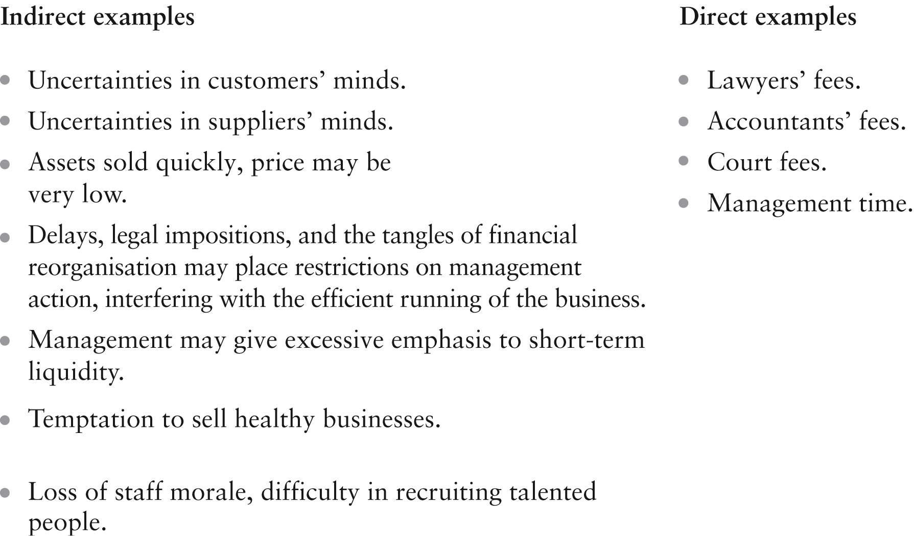
Corporate Financial Distress Costs
Financial distress: where obligations to creditors are not met or are met with difficulty.

Slide 17
Relationship Between Risk & Return
Bankruptcy risk
Required return
Financial risk
of equity (%)
Business risk
Risk-free rate
0
Level of gearing
The determinants of a company's cost of equity finance

Slide 18
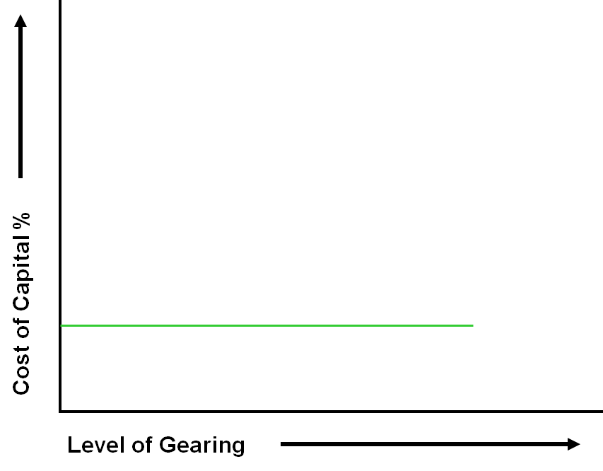
Cost of Debt (Green Line) initially unaffected by a rise in gearing (Risk Insignificant)

Slide 19
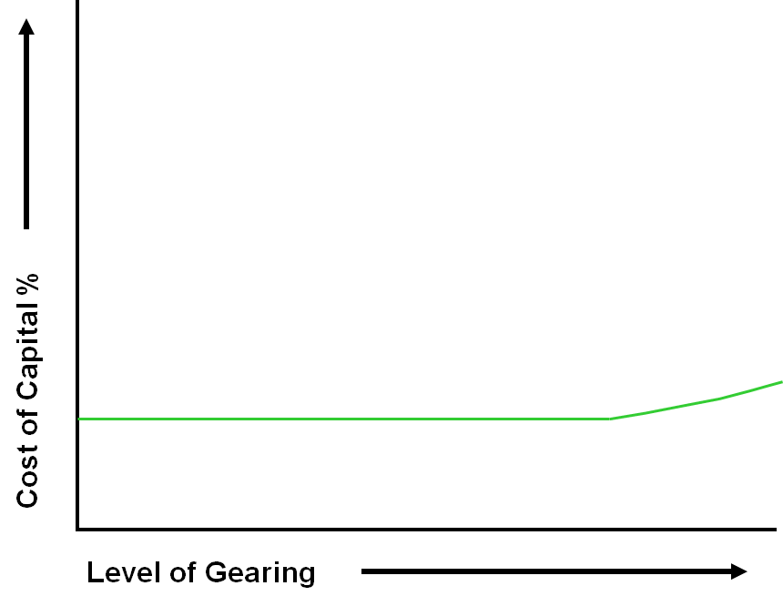
Cost of Debt (Green Line) initially unaffected by a rise in gearing (Risk Insignificant)
However rises more steeply @ higher gearing (Bankruptcy Risk)

Slide 20
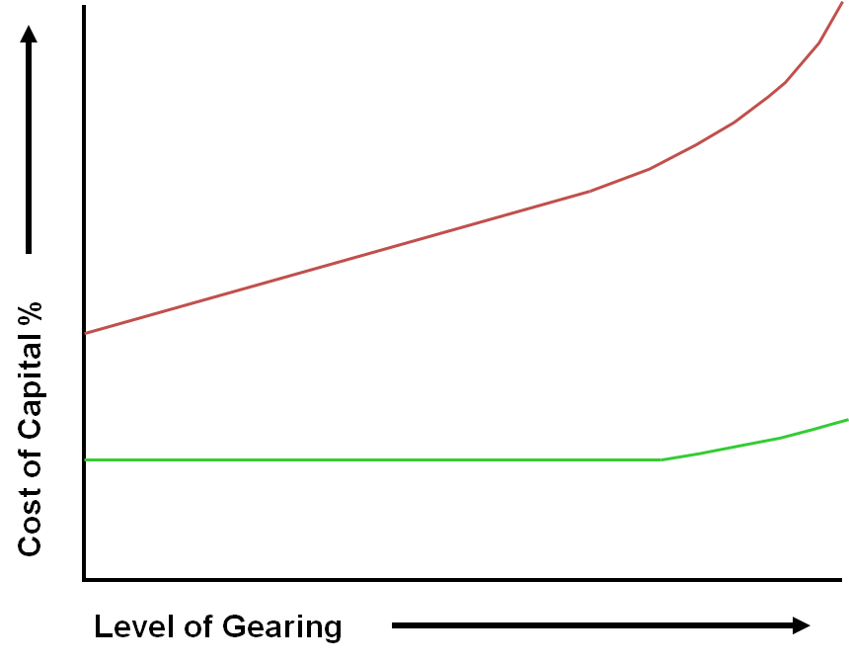
Cost of Equity (Red Line) rises as gearing rises (Financial Risk)
Rises more steeply @ high gearing (Bankruptcy Risk)

Slide 21
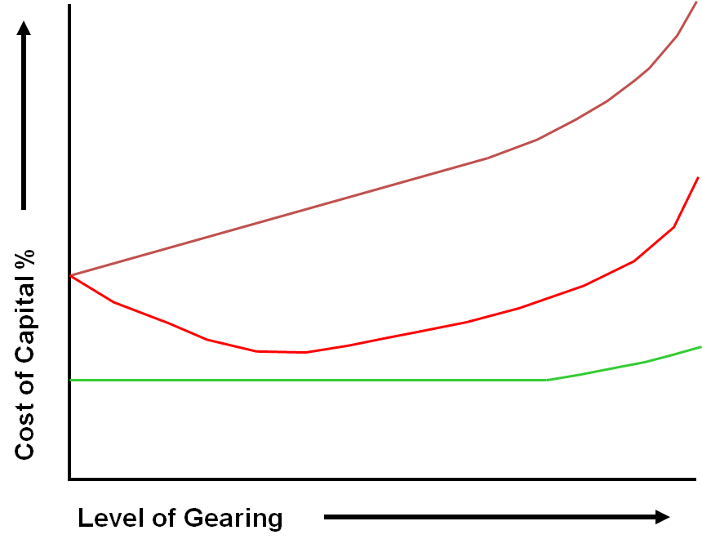
WACC thus, Initially falls

Slide 22

WACC thus, Initially falls
Reaches the lowest WACC
Y = Lowest Cost of Capital
Thus the highest share price & Company Value
And then it rises as Ke sharply increases
But…
…an optimal gearing level X does seem to exist.

Slide 23
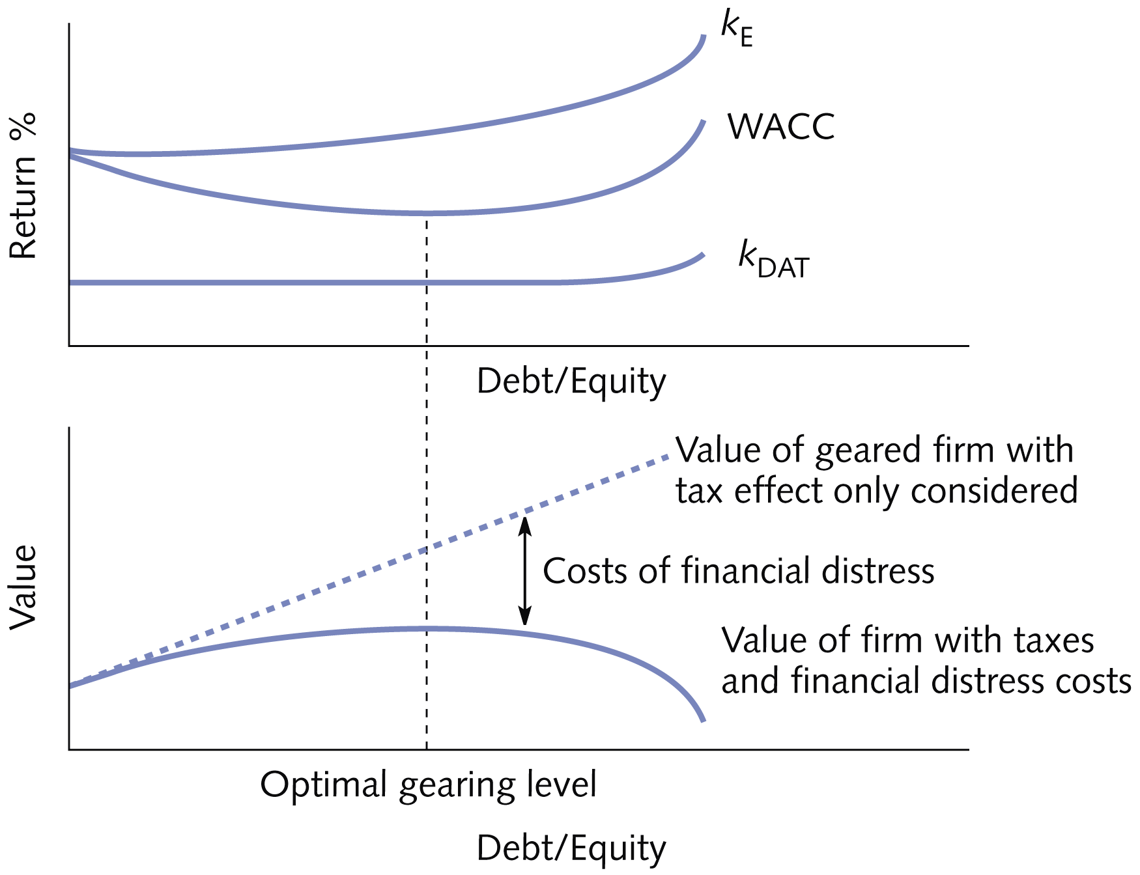

Slide 24
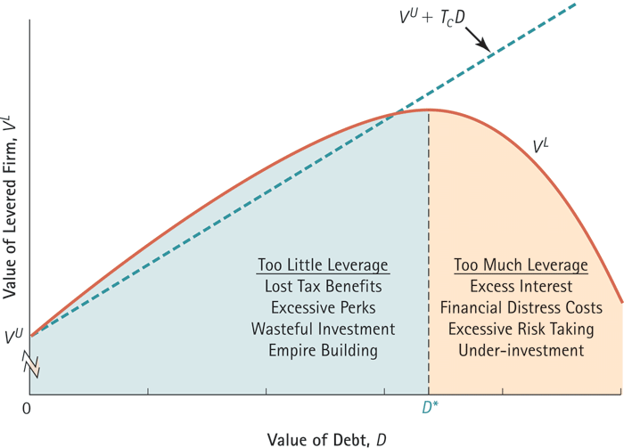
Optimal Leverage with Taxes, Financial Distress, and Agency Costs

Slide 25

Business Case: Carpetright’s financial distress costs
FT.com: Carpetright posts £71m loss as chain’s woes spook suppliers
The company on Tuesday said that “adverse publicity” about its restructuring had affected both suppliers, which had responded by tightening the terms on which they would extend credit for purchases, and customers.
Professional fees associated with the CVA and other restructuring totalled more than £6m.
The result of slower trading and inferior trade credit terms was a sharp increase in year-end net debt. But a £60m share issue in May has since reduced that to about £17m, much of it an expensive loan facility provided by major shareholder Meditor [18% Interest Compound]
Mr Walsh said that suppliers were “coming back on terms” but that trade credit insurers were taking a bit longer. “The indications are that they’d like to see more of a track record. They are a bit nervous of any company in a CVA. But we have paid all suppliers in full and on time.”
Further Reading:
Eley, J. and Novnick, N. (2018) Carpetright posts £71m loss as chain’s woes spook suppliers, Financial Times, 26th June 2018
Carpetright, a UK based flooring and beds retailer, slumped 80% in share price after announcing two profits warnings ending with them posting in June 2018 a £71m loss.
Suddenly creditors were asking for cash in advance, trade credit insurers stopped insuring them, or asked for exorbitant rates. Their immediate cash needs were helped out by an investor, but for the price of 18% interest compounded monthly.
Customers started to worry. Lead times in fitting carpets means weeks can go by for the customer between paying for the carpets and them arriving. Could the company collapse and take their money with it? Would it just be safer to shop elsewhere?
The company complained about “adverse publicity” spooking customers and suppliers.

Slide 26
Trade-offs Models
In conclusion then,
The Trade-Off Model indicates that up to a point, gearing will increase shareholder wealth (as Kd<Ke)
Beyond this point is starts to become too risky.
As the impact of the increase in Ke starts to outweigh the impact of the extra debt
The WACC rises
Share price (and Shareholder Wealth) falls
Thus; We can attain an optimal capital structure!

Slide 27
Modigliani and Millar (1958) Paper
A seminal paper which Franco Modigliani won the Nobel Prize for economics for in 1985 and was part of Millar’s consideration for his 1990 joint win.
Argued in 1958 that a companies capital structure has:
  No impact on the WACC. Therefore, no optimal capital structure exists
Argued that a companies value depends purely on business risk.
M&M Proposition: The total market value of any company is independent of its capital structure.
Is often heavily criticized for the assumptions on which is based on (see sidebar).
Theoretical Assumptions of Modigliani and Millar (1958) Paper
There is no taxation.
There are perfect capital markets, with perfect information available to all economic agents and no transaction costs.
There are no costs of financial distress and liquidation
Firms can be classified into distinct risk classes.
Individuals can borrow as cheaply as corporations.
Further Reading:
Modigliani, F., & Miller, M. H. (1958). The cost of capital, corporation finance and the theory of investment. The American economic review, 261-297.

Slide 28
Modigliani and Millar: Worked Example
Hoteliers Plc invests £1m in a new hotel in Glasgow.
The required return for an all-equity hotel in Glasgow is 15%
The Hotel is expected to provide £150,000 net annually in perpetuity.
This cash flow is paid out each year to the providers of finance

Slide 29
Modigliani and Millar: Worked Example
The company is considering 3 different capital structures:
Structure 1: All equity (1,000,000 shares selling at £1 each).
Structure 2: £500,000 of debt capital giving a return of 10 per cent per annum. Plus £500,000 of equity capital (500,000 shares at £1 each).
Structure 3: £700,000 of debt capital giving a return of 10 per cent per annum. Plus £300,000 of equity capital (300,000 shares at £1 each).

Slide 30
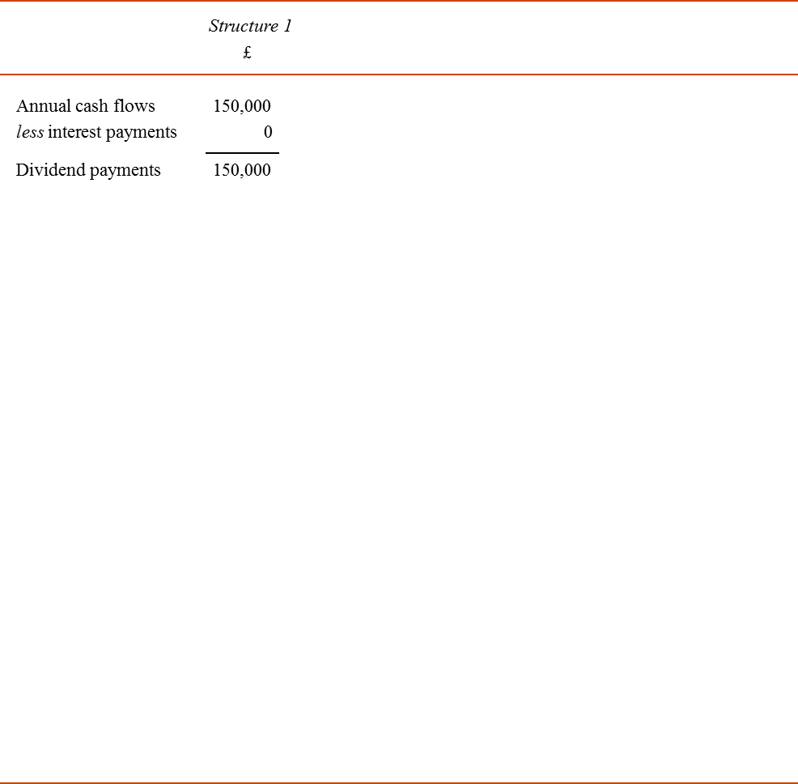
Structure 1 All equity

Slide 31
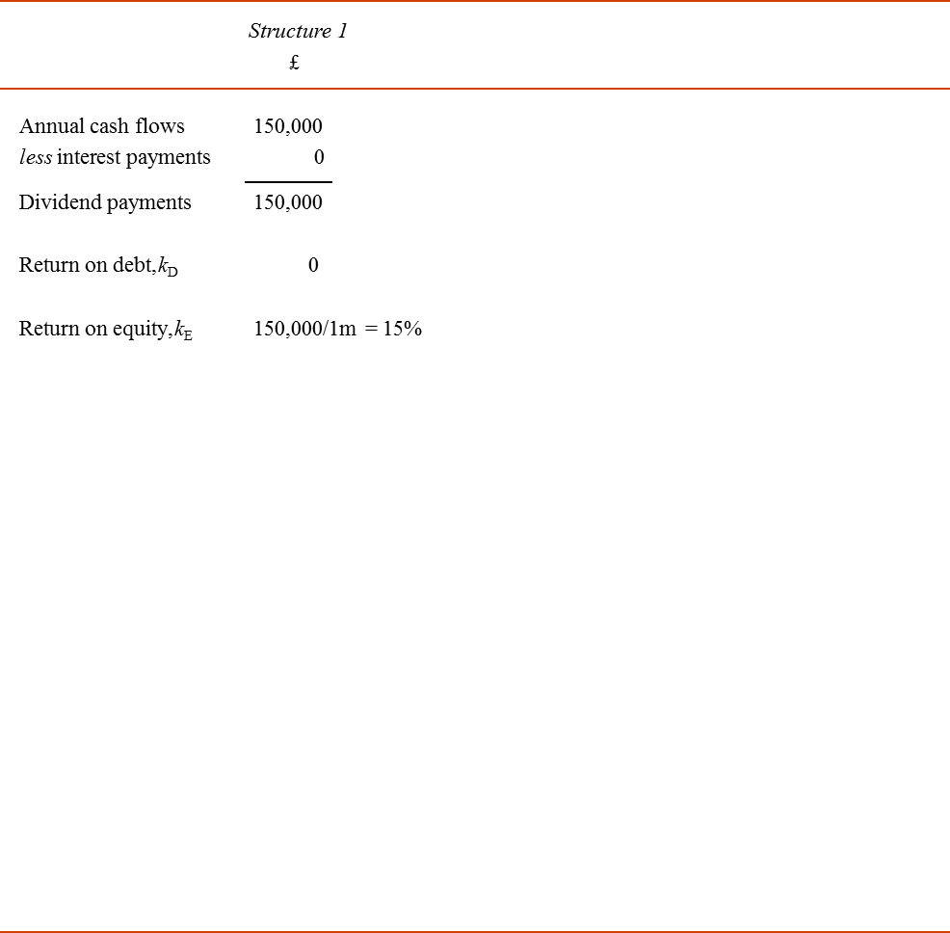
Structure 1 All equity

Slide 32
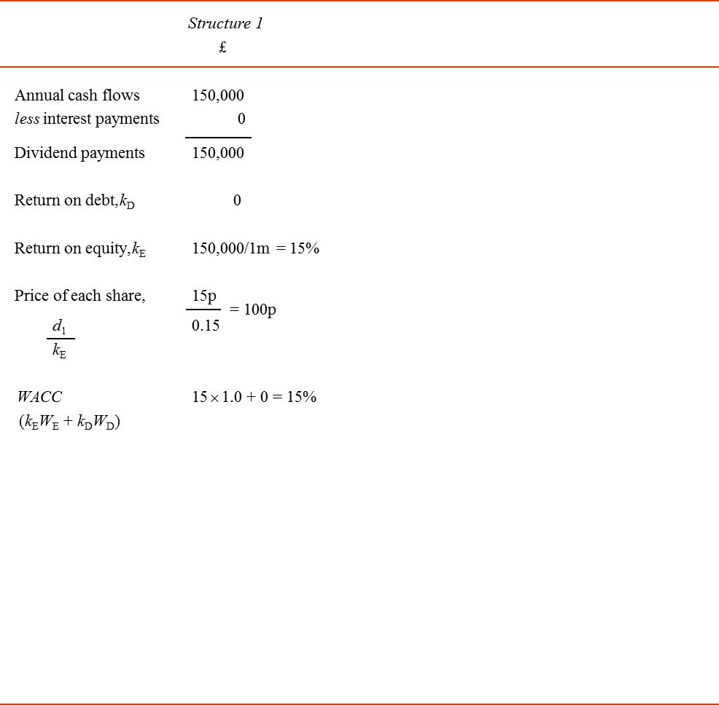
Structure 1 All equity

Slide 33
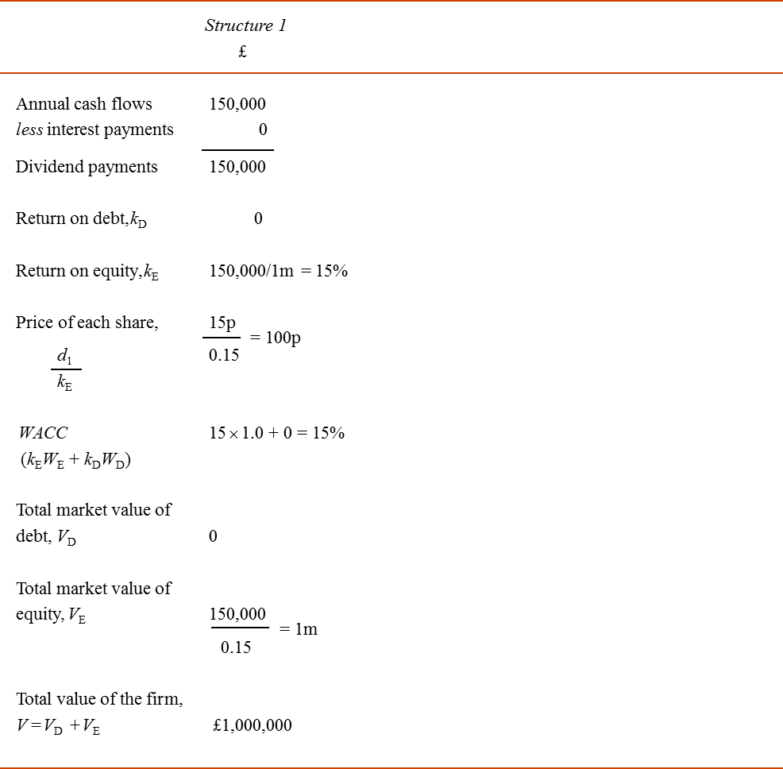
Structure 1 All equity

Slide 34

Structure 1 All equity
Structure 2 50% of debt capital Plus £50% of equity capital

Slide 35
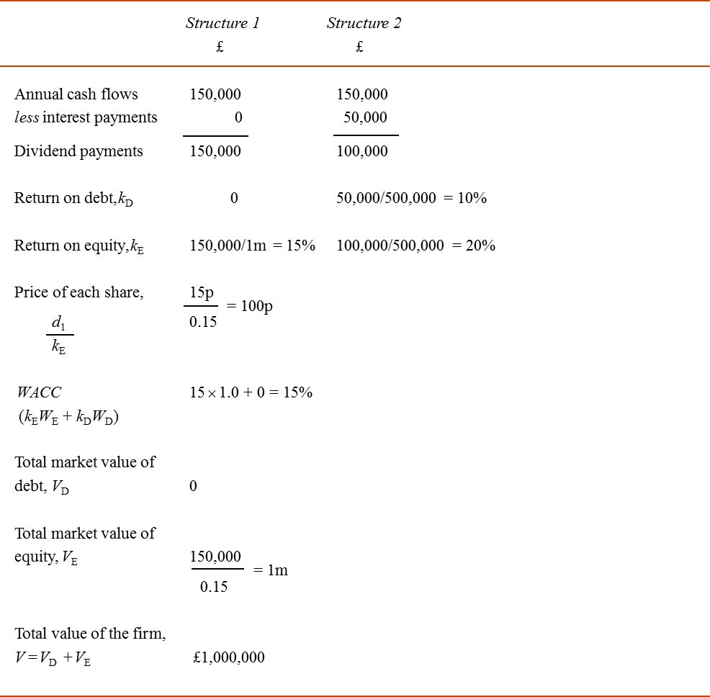
Structure 1 All equity
Structure 2 50% of debt capital Plus £50% of equity capital

Slide 36
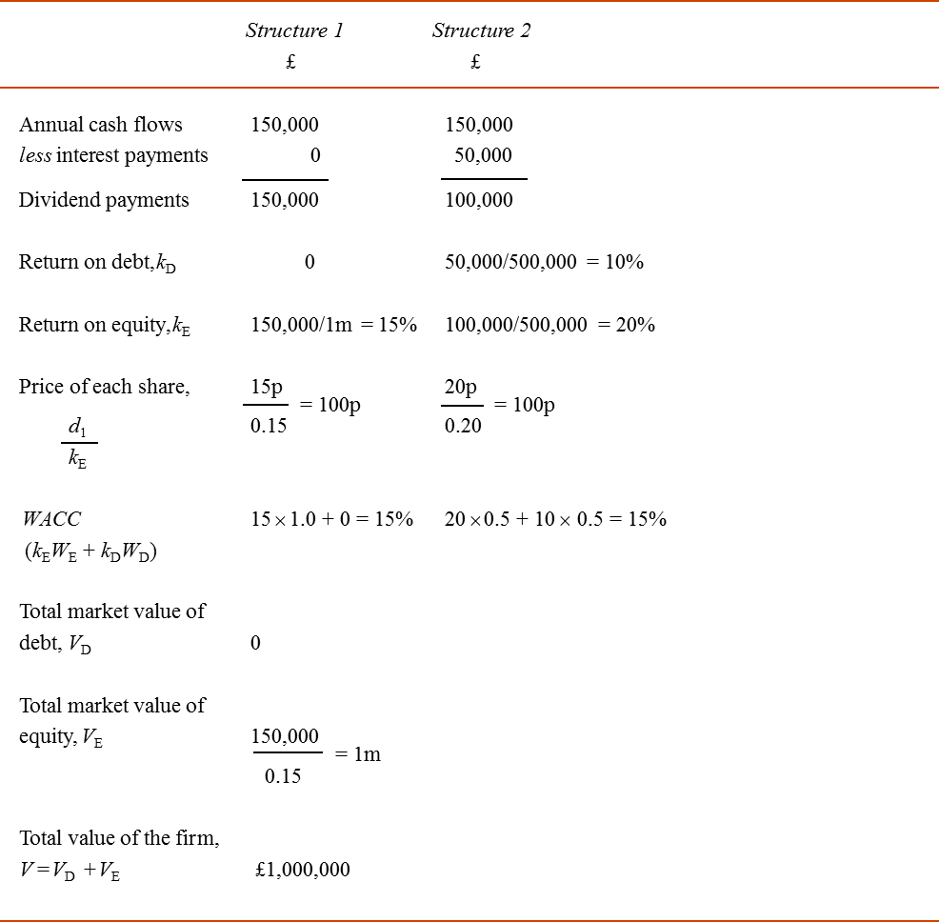
Structure 1 All equity
Structure 2 50% of debt capital Plus £50% of equity capital

Slide 37
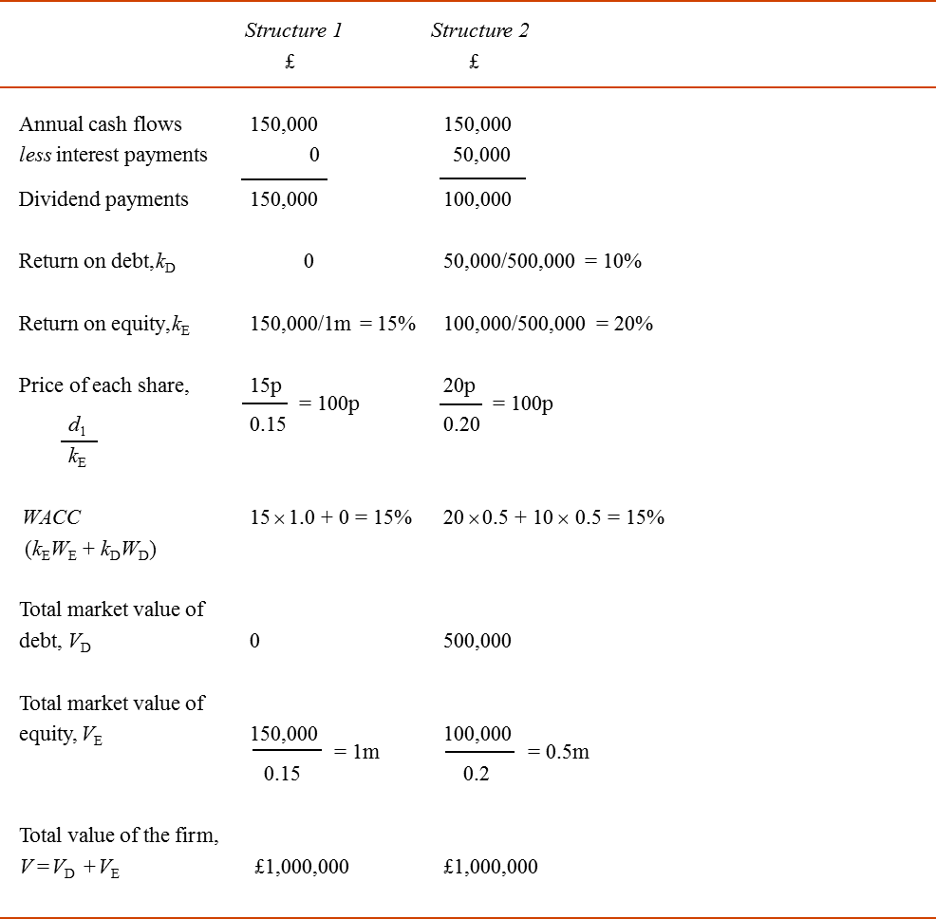
Structure 1 All equity
Structure 2 50% of debt capital Plus £50% of equity capital

Slide 38
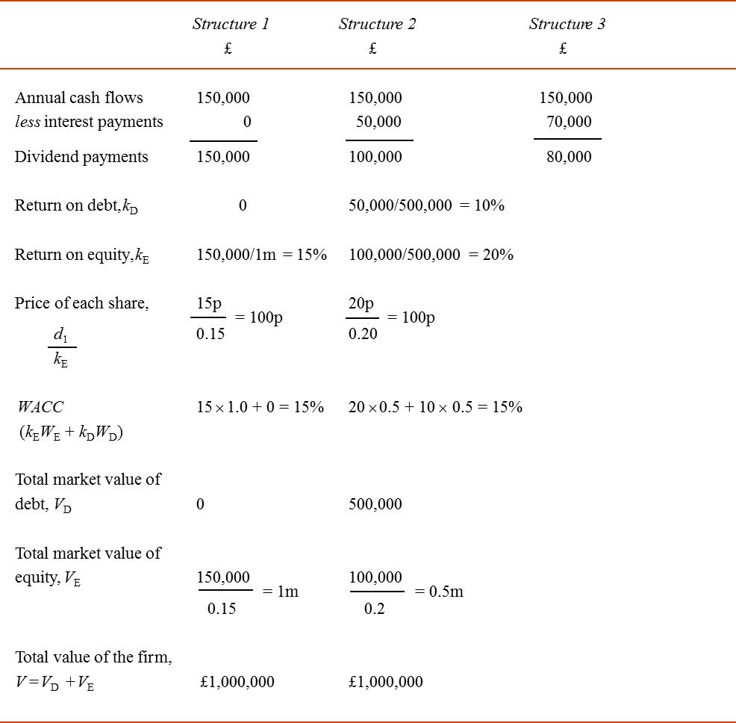
Structure 1 All equity
Structure 2 50% of debt capital Plus £50% of equity capital
Structure 3 70% of debt capital Plus 30% of equity capital

Slide 39
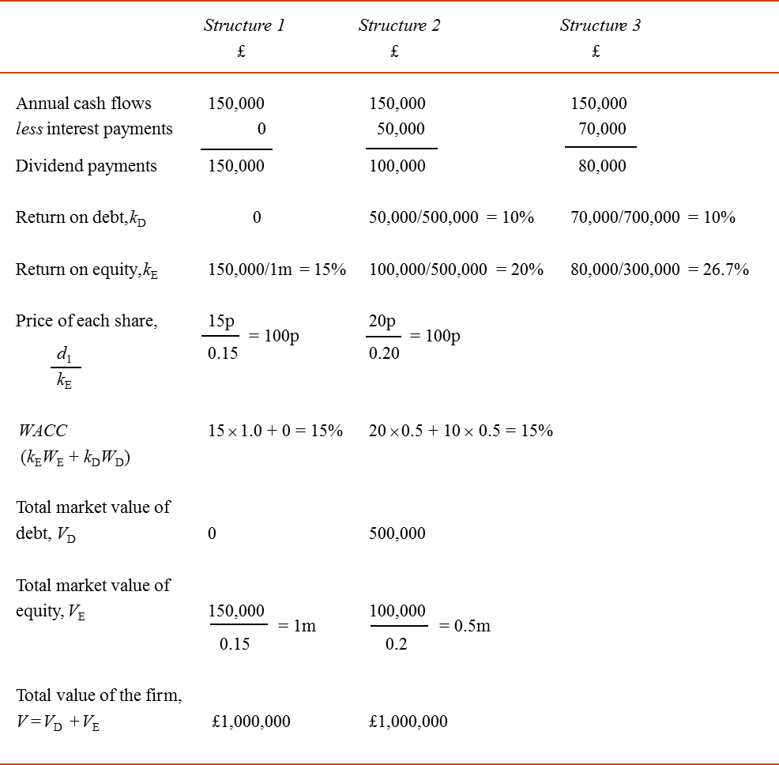
Structure 1 All equity
Structure 2 50% of debt capital Plus £50% of equity capital
Structure 3 70% of debt capital Plus 30% of equity capital

Slide 40
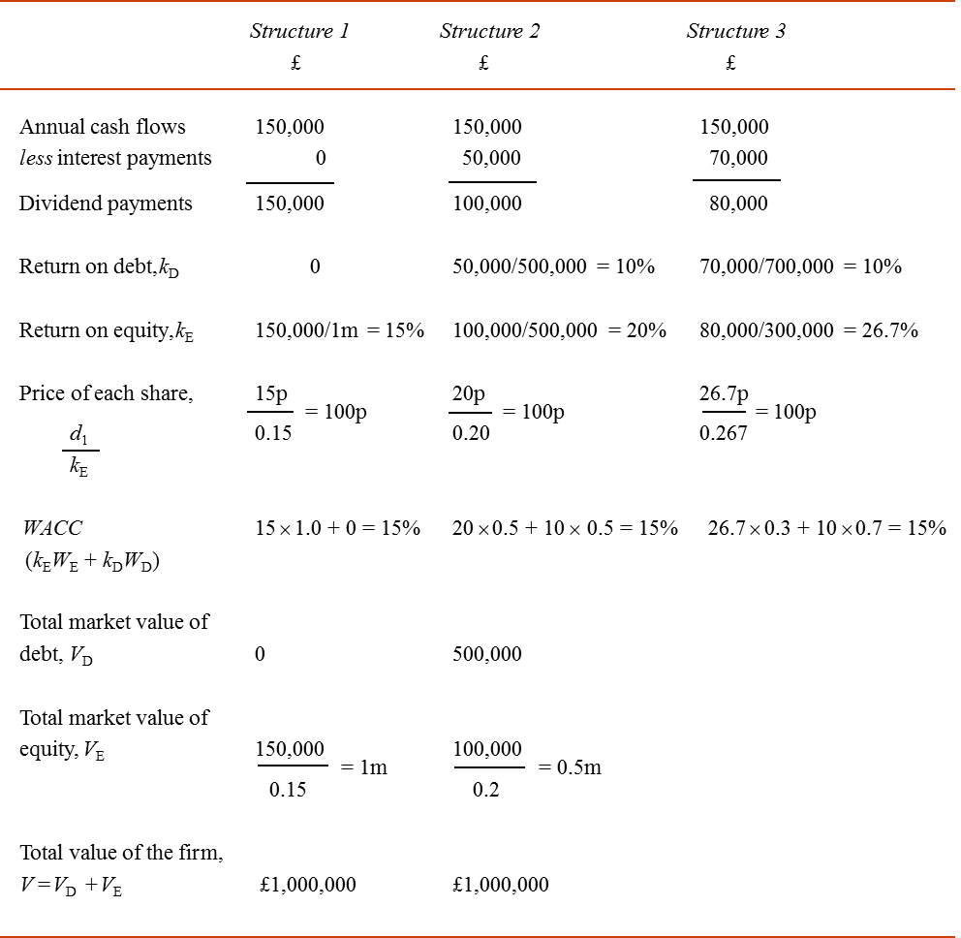
Structure 1 All equity
Structure 2 50% of debt capital Plus £50% of equity capital
Structure 3 70% of debt capital Plus 30% of equity capital

Slide 41
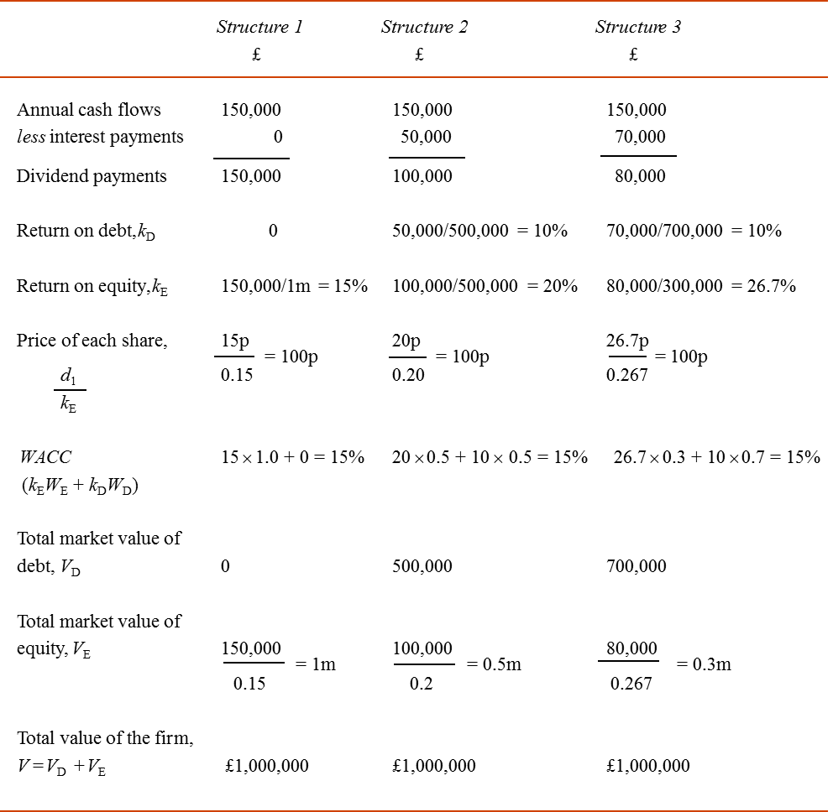
Structure 1 All equity
Structure 2 50% of debt capital Plus £50% of equity capital
Structure 3 70% of debt capital Plus 30% of equity capital

Slide 42
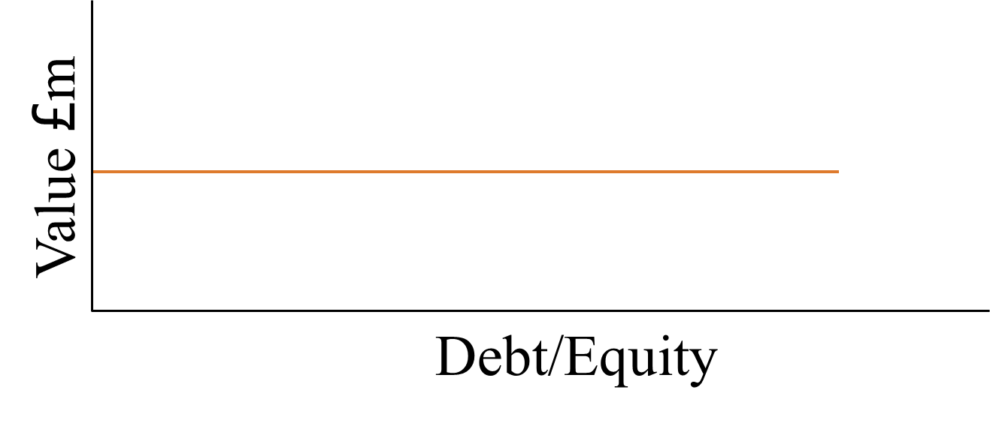
As the cost of equity increases this is exactly offset by the cost of debt being lower, constant and a larger proportion of the capital structure.
Thus, no optimal capital structure exists.
Therefore is doesn’t matter what the gearing is, the firm value isn’t determined by financial risk, only business ones.

Slide 43
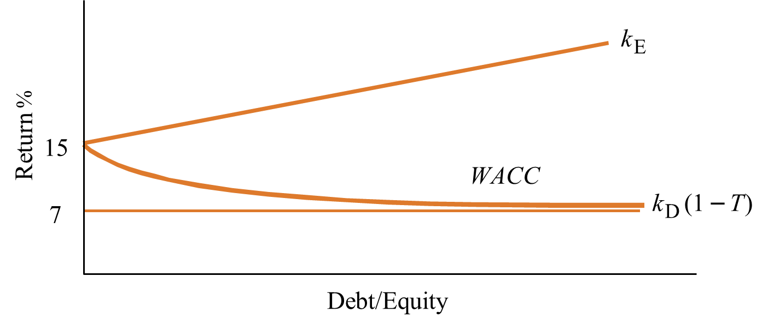
Modigliani and Millar (1963) Paper
In 1963 M&M revised their paper to take tax into account. They were heavily criticised for ignoring tax in their 1958 paper, as taxation has a measurable benefit on using debt in particular to finance an entity.
Debt has the major benefit of being a tax deductible expense which can be offset against profit. Thus, by changing the assumptions to now take tax into account M&M’s theory dramatically changed. So where before Hoteliers Plc borrowed at 10%, effectively in a world with 30% tax, they borrow at 7% (1- Tax rate)
As you increase the Gearing you will reduce the WACC due to the tax benefit of debt.

Slide 44
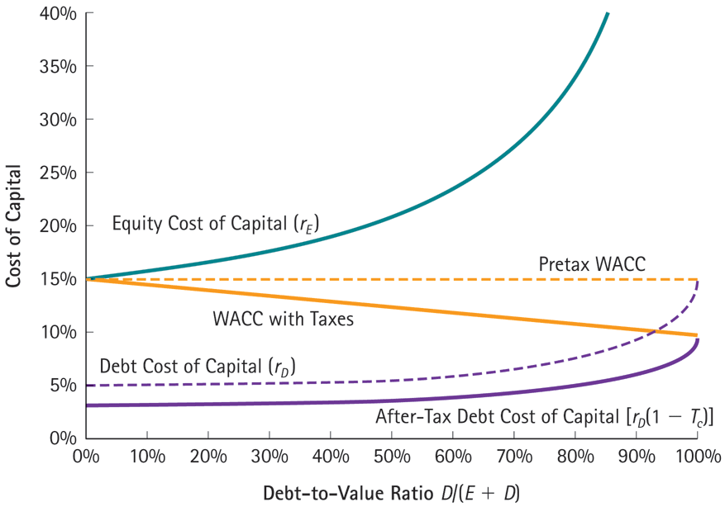
The WACC with and without Corporate Taxes

Slide 45
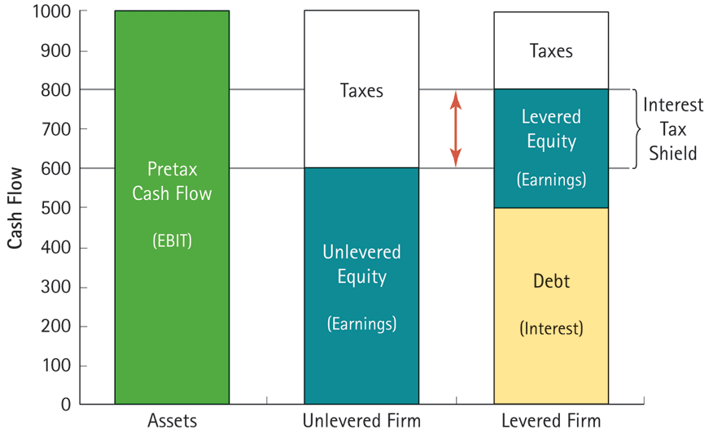
The Cash Flows of the Unlevered and Levered Firm

Slide 46
Modigliani and Millar (1963) Paper
Which will in turn will increase the overall value of the company.

Slide 47
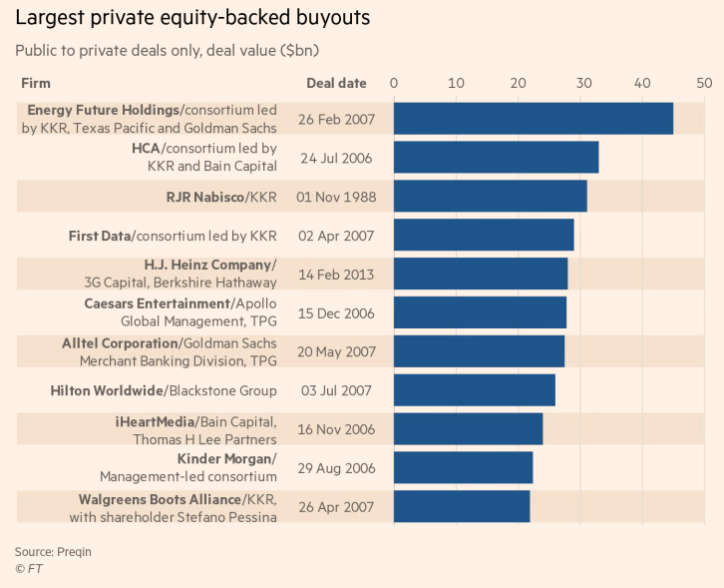
Business Application: Private Equity and M&M (1963)
Classically Private Equity groups are seen as the main practical utiliser of the thoughts behind M&M (1963).
Private Equity groups buy all the shares of a company and “take them private” and off the publicly traded exchanges. Usually for radical restructuring and/or financial re-engineering before setting back to the open market or another buyer. Most PE deals aim for a 7-10 year exit horizon.
Because they have bought all the shares of the company out of the public domain and by definition therefore control completely the Cost of Equity.
This allows them to leverage the company to levels which would be unacceptable to shareholders if it was publicly owned, with 70%+ debt common for some of the largest deals.
Further Reading:
Platt, E., Edgecliffe-Johnson, A. and Fontanella-Khan, J. (2018) Can Paul Jacobs pull of the biggest buyout in history? Qualcomm’s former chairman is trying to find backers for a $100bn bid for chipmaker, Financial Times, May 14th 2018

Slide 48
Trade-Off Models
Trade-Off Models (Kraus & Litzenberger, 1973) accept that in perfect capital markets the firm's market value is independent of its capital structure.
However they argue that market imperfections do exist, and are impossible to ignore.
  “The taxation of corporate profits and the existence of bankruptcy penalties are market imperfections that are central to a positive theory of the effect of leverage on the firm's market value.” (Kraus & Litzenberger, 1973, p.918)
Further Reading:
Kraus, A., & Litzenberger, R. H. (1973). A state‐preference model of optimal financial leverage. The journal of finance, 28(4), 911-922.
Frank, M. & Goyal, V. (2011). "Trade-off and Pecking Order Theories of Debt". Handbook of Empirical Corporate Finance: Empirical Corporate Finance. Elsevier. pp. 135–202

Slide 49
Activity
Sunview Holidays Plc owns a block of apartments in Devon which it hires out to holiday makers.
The business started 3 years ago when shareholders invested £1m into the company receiving 1 million ordinary shares.
Profits are expected to be £140,000 per annum and all profits are distributed to shareholders as Dividends.

Slide 50

Solutions
Return per share =
£140,000 Profit
1,000,000 Shares
= 14 pence per share

Slide 51
Activity
Sunview Holidays Plc proposes to buy an adjacent block of flats for £1m and it expected that these flats will also earn an annual profit of £140,000. This acquisition could be financed by:
The shareholders could subscribe to an additional 1 million shares at £1 each.
Or, the company could issue £1,000,000 of 10% Bonds onto the UK Bond market
Consider with the person sitting next to you:
Can you calculate the return per share for each method?

Slide 52
Solutions
a) All Equity
Return per share = £280,000 Profit
2,000,000 Shares
= 14 pence per share
b) Debt and equity (50% Loan)
Profits = £280,000 – £100,000 (Bond interest payment £1m x 10%)
Return per share = £180,000 Profit
1,000,000 Shares
= 18 pence per share

Slide 53
What’s the probable effect on the share price?
Previous situation
Current share price =£1
Expected returns = 14p (14%)
Therefore Shareholders think 14% return is appropriate for this investment.
Thus 14% is the Required Rate of Return (RRR)
With Debt
If Ke (RRR) = Dividend/ MV then MV =Dividend/RRR
Thus MV of shares = £0.18/0.14 = £1.286
As more people would want shares which gave a high return in an efficient rational market these shares would be bought up.

Slide 54
Thus, this suggests that gearing a company (using debt) will increase returns per share (from 14p to 18p)
And this will increase both the value of the company and shareholders wealth (through increases in both share value and dividends)
All this by merely changing the capital structure of the company
However gearing increases risk to shareholders
As, as already mentioned, while profits can fluctuate, interest payments are constant

Slide 55
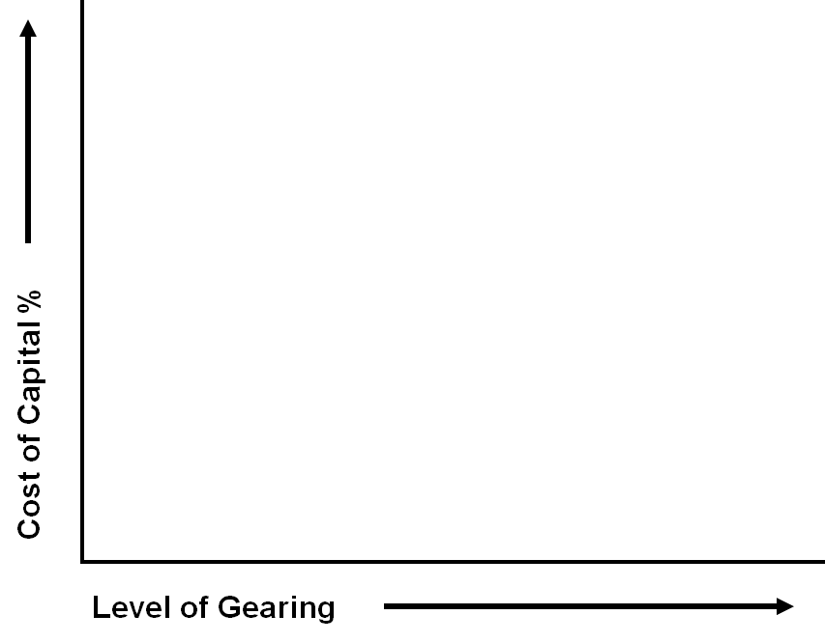

Slide 56
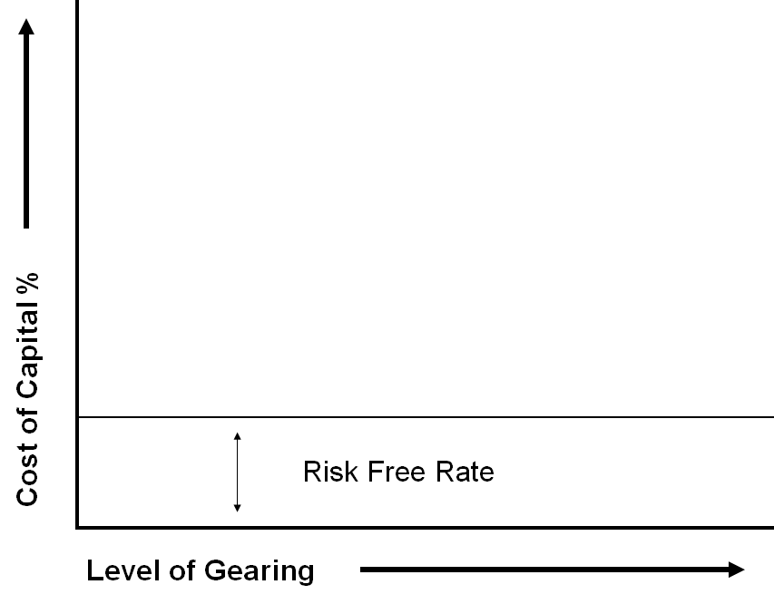
Investors always assume the risk free Rate of Return

Slide 57
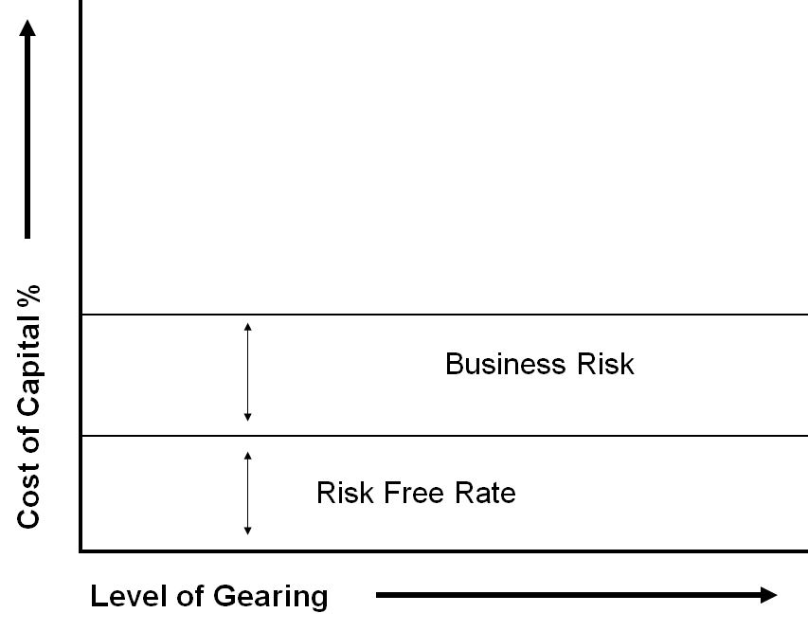
And, they are willing to, (if they invested in the company) take the possibilities of the business risks of the company.

Slide 58
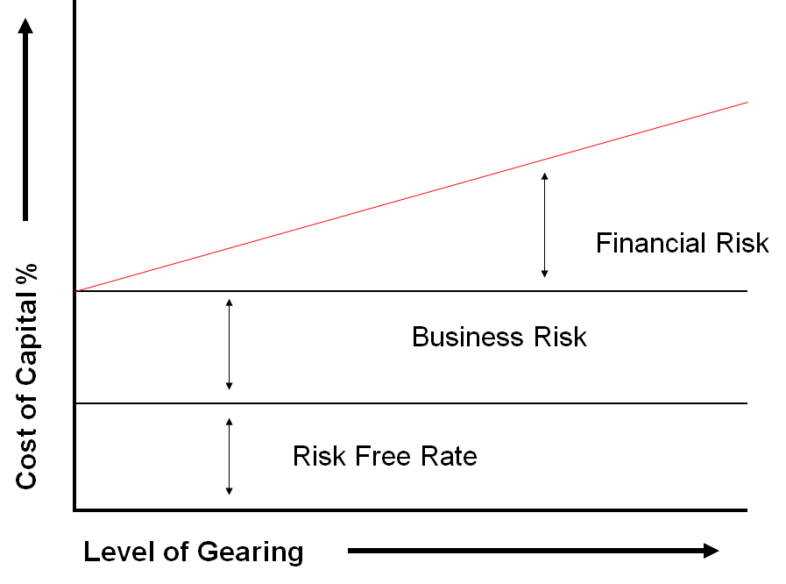
However as Financial Gearing increases it amplifies the financial risks a business faces, thus investors demand a higher rate of return as; profits may fluctuate, but your debt payments won’t, leading to higher levels of enterprise risk.

Slide 59
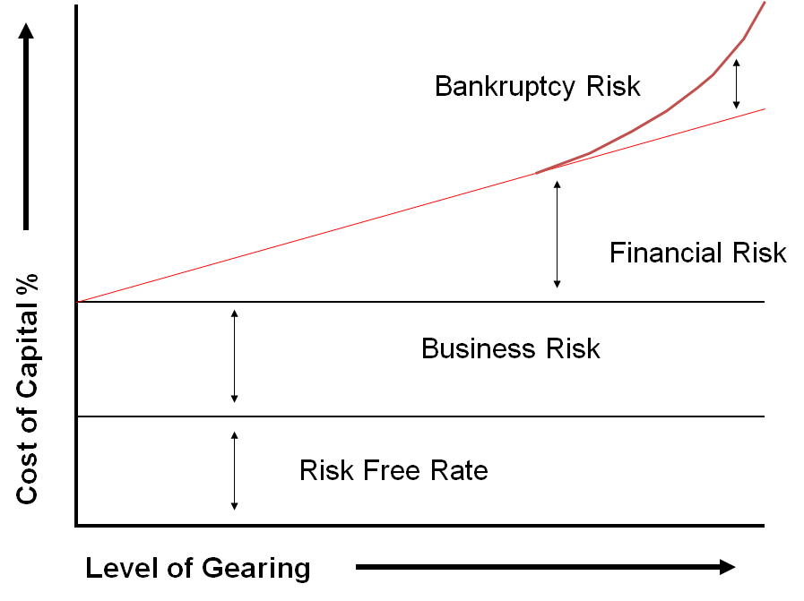
Also at extreme levels of debt equity holders will demand much larger returns as the levels of debt become excessive.

Slide 60
What then, is the impact of Gearing for Sunview?
Increasing debt may have the effect of reducing the WACC
But
Increases the risk for shareholders
So how does the market react to this financial risk?
It could
Ignore the additional risk (Thus RRR still = 14%)
Share price would remain at £ 1.286

Slide 61
b) The RRR could increase to 16% to compensate
If Ke (RRR) = Dividend/ MV then
MV =Dividend/RRR
Then share price = £0.18/16%
Share price = £1.125
Thus
Despite a increase in Shareholders expectations the share price has still risen and shareholders still gained (Originally £1, now £1.125 per share)

Slide 62
c) If Investors want 20% to compensate
If Ke (RRR) = Dividend/ MV then MV =Dividend/RRR
Then share price = £0.18/20%
Share price = £0.90
Thus
The share price has fallen and there has been a destruction of shareholders wealth (from £1 originally to £0.90) despite an overall increase in dividends (increase of 4p which doesn’t compensate for the overall 6p loss)

Slide 63

But what effect will this have on the WACC? Remembering that the WACC is also the hurdle rate for investments, thus a lower hurdle rate makes investments more worthwhile.
Originally the WACC was 14% (all equity). If we add in the debt… again the market could….
Ignore the additional risk (Thus RRR still = 14%)
Share Price = £1.286 thus Market Value= £1.286 x 1m = £1.286m
Debt = £1m
WACC = (We x Ke) + (Wd x Kd)
WACC = {(£1.286m/£2.286m) x 14%} + {(£1m/£2.286m) x 10%)}
WACC = 7.86% + 4.37%
WACC = 12.23%

Slide 64
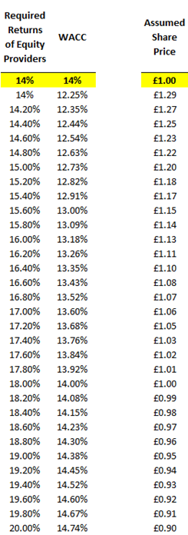
b) The RRR could increase to 16% to compensate
Share Price = £1.125 thus Market Value= £1.125 x 1m = £1.125m
Debt = £1m
WACC = (We x Ke) + (Wd x Kd)
WACC = {(£1.125m/£2.125m) x 16%} + {(£1m/£2.125m) x 10%)}
WACC = 8.47% + 4.71%
WACC = 13.18%

Slide 65
c) If Investors want 20% to compensate
Share Price = £0.90 thus Market Value= £0.90 x 1m = £0.9m
Debt = £1m
WACC = (We x Ke) + (Wd x Kd)
WACC = {(£0.9m/£1.9m) x 20%} + {(£1m/£1.9m) x 10%)}
WACC = 9.47% + 4.71%
WACC = 14.73%

Slide 66

Therefore Shareholder Wealth is affected by market reactions to gearing both through
Share price movements
And, WACC changes.
In conclusion
Increasing Debt has a twofold impact on WACC and Shareholder wealth.
It decreases WACC as a Cheaper source of finance
But, it increases the Cost of Equity as shareholders demand more returns for the risks they are taking.
The question is…
Which has the greater impact?

Slide 67
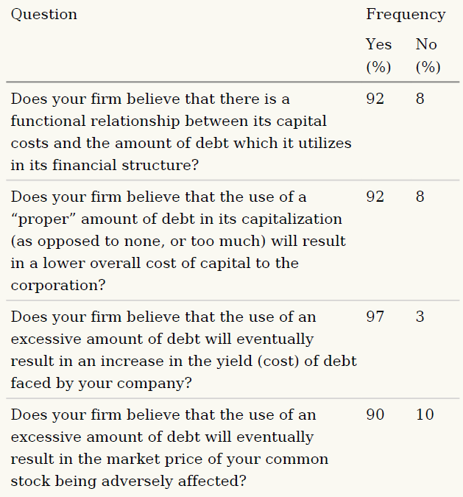
Capital Structure in Practice: Key Research
Seminal Survey
Scott and Johnson (1982)
Surveyed 212 CFO’s of Fortune 1000 Companies
Further Reading:
Scott, D. and Johnson, D. (1982). “Financing Policies and Practices in Large Corporations.” Financial Management, 11:2, 51–59.

Slide 68
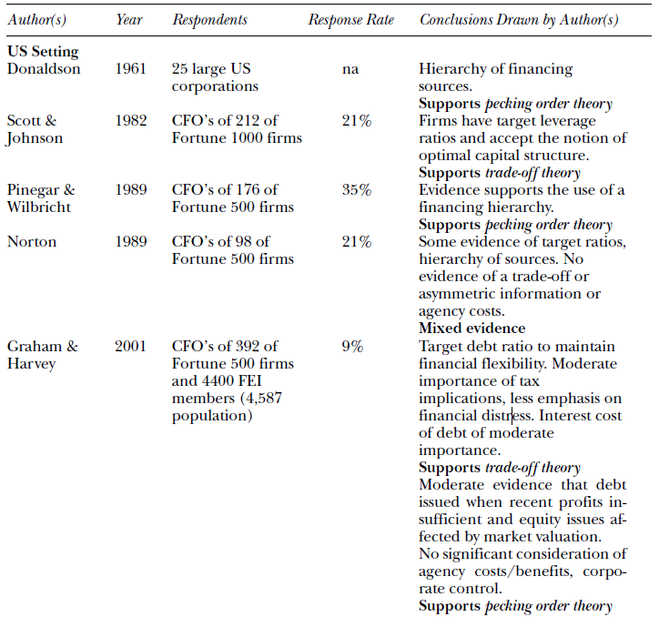
USA Findings
Further Reading:
Beattie, V., Goodacre, A., & Thomson, S. J. (2006). Corporate financing decisions: UK survey evidence. Journal of Business Finance & Accounting, 33(9‐10), 1402-1434.

Slide 69
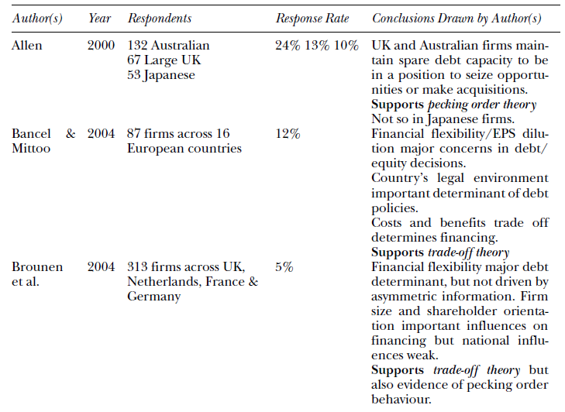
Non-USA Findings
Further Reading:
Beattie, V., Goodacre, A., & Thomson, S. J. (2006). Corporate financing decisions: UK survey evidence. Journal of Business Finance & Accounting, 33(9‐10), 1402-1434.

Slide 70
Gearing in Practice
We have covered some of the main theories in this lecture, this is a very large area of the finance academic literature with a considerable amount of different viewpoints.
This lecture therefore gives you a starting point to leap into that literature, it is not an end-point.
In practice, extreme positions tend to be avoided. For example:
All Equity - You lose the benefit of low cost debt
Highly geared – Financial risk likely to increase Ke & Kd
See Sidebar
FT.com: Debt at UK listed companies soars to record high
Debt at UK listed companies has soared to hit a record high of £390bn as companies have scrambled to maintain dividend payouts in response to shareholder demand despite weak profitability.
UK plc’s net debt has surpassed pre-crisis levels to reach £390.7bn in the 2017-18 financial year, according to analysis from Link Asset Services, which assessed balance sheet data from 440 UK listed companies.
The data for net debt, which is total debt less cash, show that while companies cut their borrowings by a fifth in the two years immediately after the financial crisis, debt levels have jumped 69 per cent since 2010-11.
Most of the increase was used to fund dividends — against a backdrop of low interest rates — at a time of low profitability for UK companies, Link said.
The collective gearing level — debt relative to equity capital — at UK plc shot up in tandem with rising debt levels, peaking at 83 per cent in 2015-16, but has since fallen to 73 per cent, Link said.
Further Reading:
Murphy, H. (2018) Debt at UK listed companies soars to new record high, Financial Times, 2nd July 2018

Slide 71
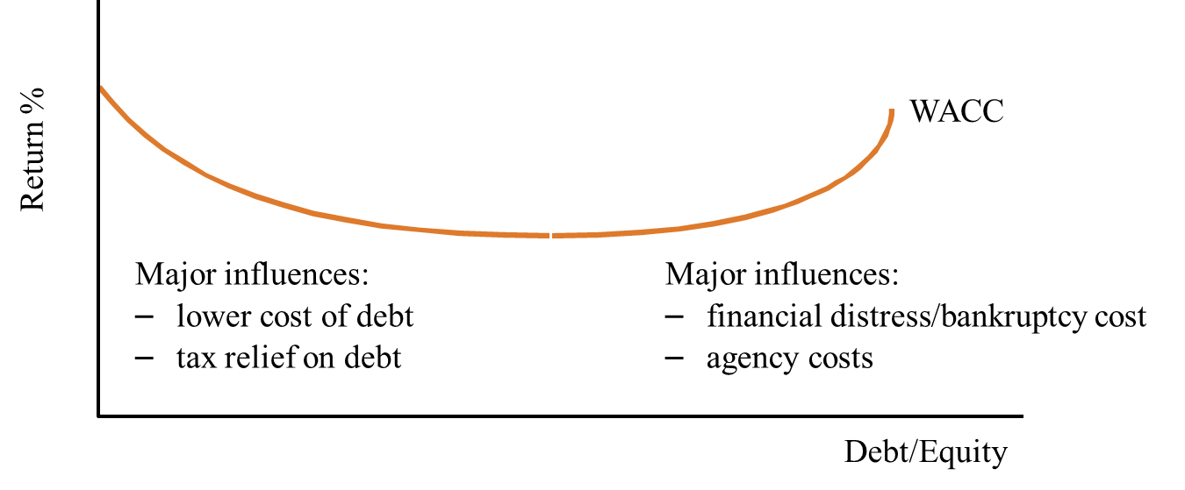
Thus a compromise must be reached by managers.
A company can borrow up to a “reasonable” level.
But… Define “reasonable”… Difficult to judge.
How the equity shareholders react to levels of debt can be very much dependent on market sentiment.
We started this lecture with the business case of Capita after Carrillon’s collapse. Remember up until that event, the market was very happy with the debt levels of large outsourcing companies such as Capita and Serco. It was only after the collapse of Carrillion did market sentiment change.
In July 2018 market sentiment allows us to have record high levels of indebtedness of UK companies. Higher even than pre-crisis 2007 levels.

Slide 72
Minsky and the importance of credit market sentiment
Classically coming from behavioural finance theorists such as Minsky (1977,1986) but more recently Lopez-Salido, Stein and Zakrajsek (2017). Finds investor sentiment in credit markets can be an important driver of economic fluctuations. Interest in the work of Minsky was very niche until the 2008 financial crisis, after which his work posthumously has been thoroughly re-examined and re-evaluated.
Hyman Minsky famously stated: “Stability leads to instability.” High aggregate demand and profits raise confidence and expectations, which in turn increases risk-taking. As these periods of increased risk taking extends (in boom periods), and asset prices increase, in long period growth so does the possibility of a “Minsky Moment” increase.
A “Minsky Moment” is a sudden collapse of asset prices after a long period of growth, sparked by debt or currency pressures. This is a correction like we’ve seen in 2007-08
But Minsky’s theories aren’t about the panic of the correction (to which the “Minsky Moment” is often attributed), they’re about the “virtually inevitably” (Flanders, 2015) of the way in which stability and prosperity themselves lead to exuberances, over-confidence, increased speculative activity and the inevitability of subsequent crashes and corrections.
Further Reading:
Flanders, J. (2015). It’s not a Minsky moment, It’s a Minsky Era, or: Inevitable instability. Econ Journal Watch, 12(1), 84-105.
López-Salido, D., Stein, J. C., & Zakrajšek, E. (2017). Credit-market sentiment and the business cycle. The Quarterly Journal of Economics, 132(3), 1373-1426.

Slide 73
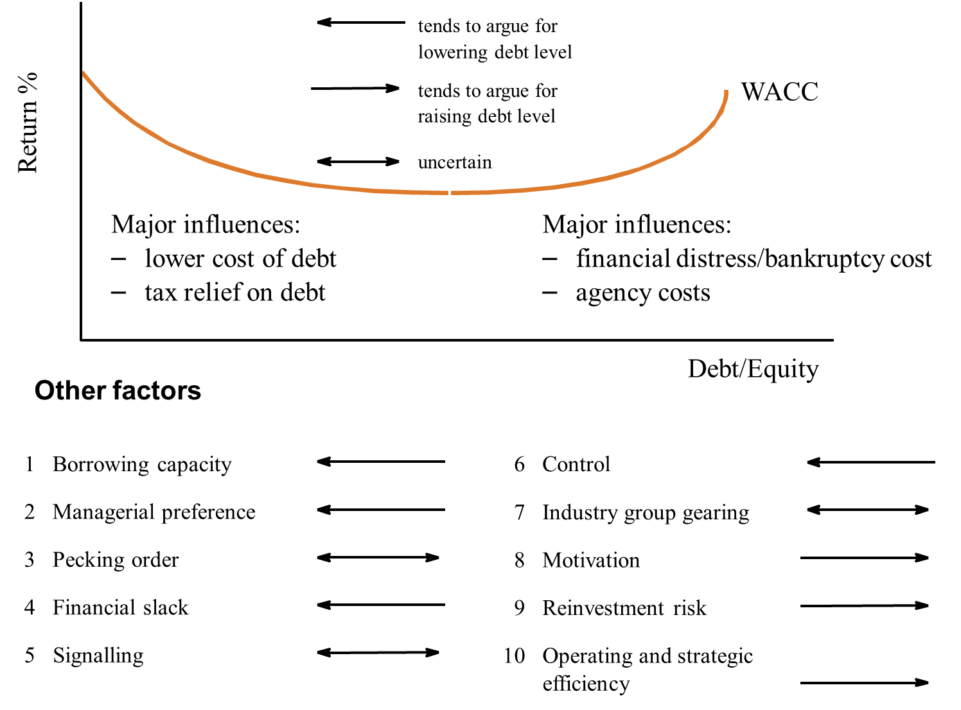
Capital Structure: A Summary

Slide 74
Capital Structure in Practice: Why such a theory-practice gap?
Millar (1977) on Theory-Practice Gap:
  “No corporate treasurer’s office, controller’s staff, or investment banker’s research team that I have ever encountered had, or could remotely be expected to have, enough reliable information about the future course of prices for a firm’s securities to convince even a moderately skeptical outside academic observer that the firm’s value had indeed been maximized by some specific financial decision or strategy.” (p. 272)
Further Reading:
Miller, M. H. (1977). DEBT AND TAXES*. the Journal of Finance, 32(2), 261-275.

Slide 75
Capital Structure in Practice: Why such a theory-practice gap?
Economists develop models because:
  “…rational behavior models generally lead to better predictions and descriptions at the level of the industry, the market and the whole economy than any alternatives available to them. Their experience, at those levels, moreover, need involve no inconsistency with the heuristic, rule-of-thumb, intuitive kinds of decision making they actually observe in firms. It suggests rather that evolutionary mechanisms are at work to give survival value to those heuristics that are compatible with rational market equilibrium, however far from rational they may appear to be when examined up close and in isolation.” (pp. 272–273)
Further Reading:
Miller, M. H. (1977). DEBT AND TAXES*. the Journal of Finance, 32(2), 261-275.

Slide 76
Capital Structure in Practice: Why such a theory-practice gap?
“…theories are designed to suggest how managers should behave and not to describe how they actually behave.”
(Baker et al. 2010)
Further Reading:
Baker, H. K., Singleton, J. C., & Veit, E. T. (2010). Survey Research in Corporate Finance: Bridging The Gap Between Theory and Practice. Oxford University Press. E-book: http://capitadiscovery.co.uk/northumbria-ac/items/1739210

Slide 77
Outcomes:
At the end of this weeks lecture and seminar the student should be able to:
To evaluate the views of Modigliani & Millar regarding an Alternate Theory
To critically discuss the Trade Off Model of Capital Structure.
Discuss how debt can influence a capital structure
Interpret the relationship between levels of gearing and shareholder returns
Consider the idea of Costs of Financial distress and its effect on levels of debt.

Slide 78
Mid term
10 marks for multiple choice questions (designed to check general comprehension of the covered material)
- Time value of money (APR, capital rationing, NPV, IRR)
- Cost of debt
- Cost of equity
- WACC
20 marks for exam level questions
Any two of the previously released exam level questions (sensitivity, WDA, WACC, capital rationing)

