Slide 1
ELEC-E8423 - Smart Grid Electric vehicles and their charging systems
Laura Kaur
Eemeli Kontto
22.03.2022

Slide 2
Introduction
Electric Vehicles
A vehicle that uses one or more electric morots for propulsion
In Europe 5 668 939 PEV’s, exponential growth
EC seeking to have 30 million EV’s by 2030
EU supporting sales and developing infrastructure
In Finland by the end of 2021 99 910 electric cars (44 592 addition in 2021)
Ranges
Batteries up to 280 kWh for city use
Nissan Leaf - 40kWh battery up to 270 km range
Kia e-Niro - 64 kWh battery up to 370 km range
Tesla model S - 100kWh battery up to 652 km range
Sources: [1-4]

Slide 3
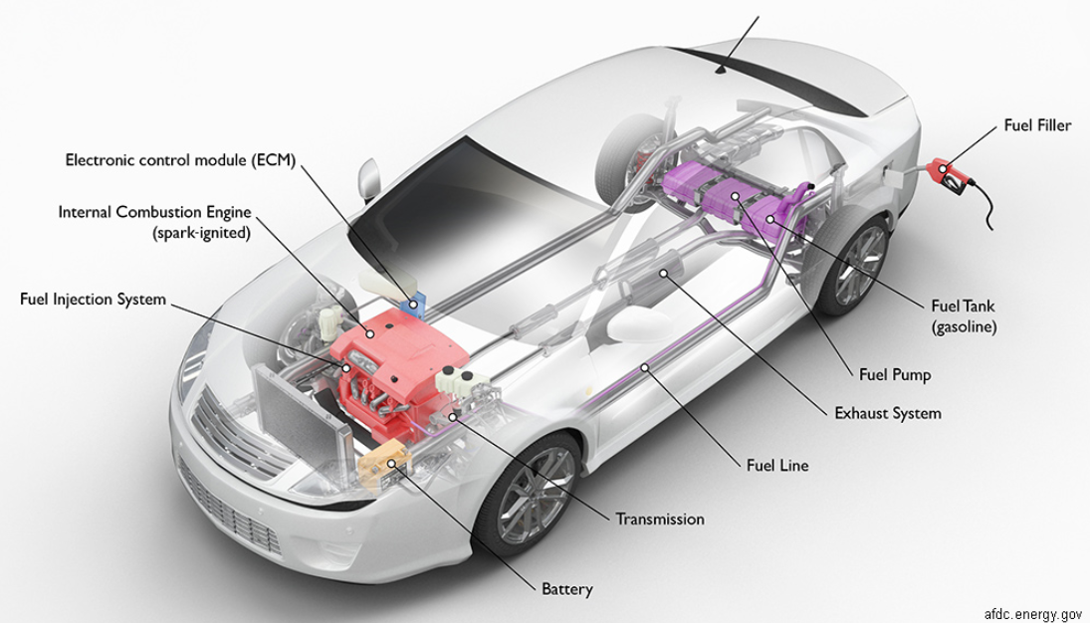
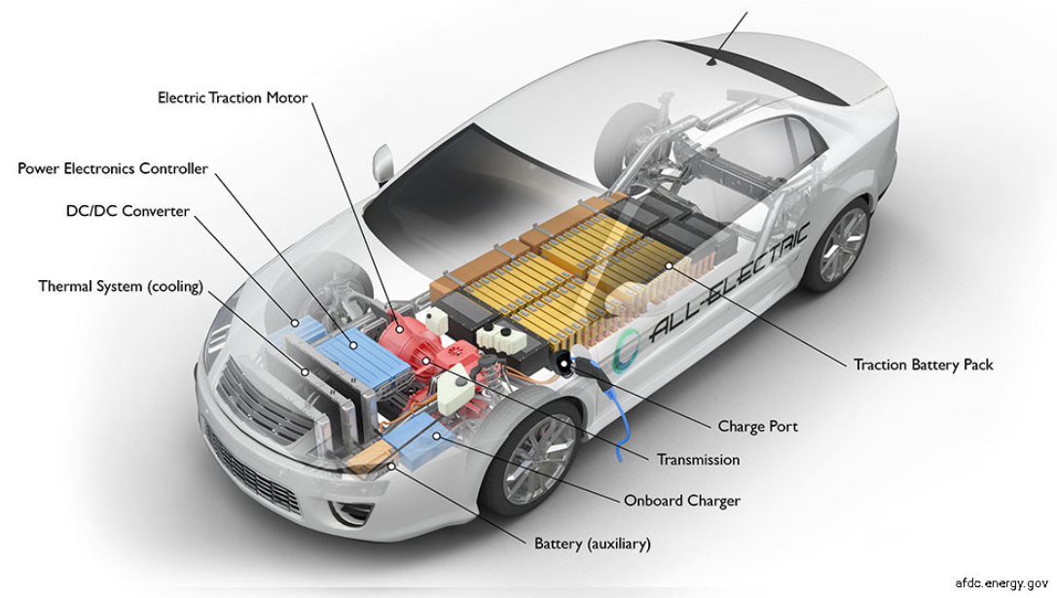
Charging systems
ICE vs EV
Battery, ECM, exhaust system, fuel filler, fuel injection system, fuel line, fuel pump, fuel tank (gasoline), internal combustion engine (spark-ignited), transmission
Battery, charge port, DC/DC converter, electric traction motor, onboard charger, power electronics controller, thermal system (cooling), traction battery pack, transmission (electric
Source: [5]

Slide 4
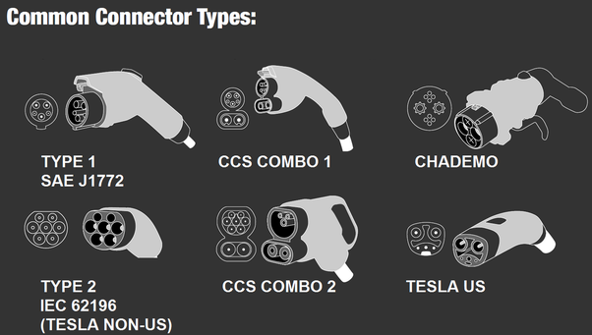
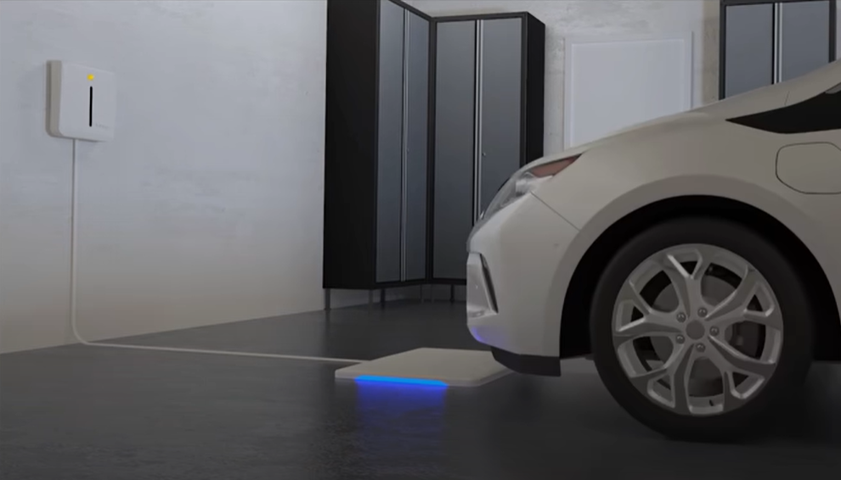
Charging System
Plug-in charging
Europe has its own standardized plugs for EV’s
Slow and basic charging (AC) -> Type 2
Quick charging (DC) -> CSS Combo
Other types are used: Japan (Type-1, CHAdeMO) and US (Type-1, CCS Type-1)
Maximum of 10 EV’s per PCP, 2.9 million PCP by 2030!
Wireless
Efficient only in very short range, energy diminishes fast
New technologies being tested frequently (Hevo, WiTricity)
Pizza-box-sized charging station
Possibility for more efficient charging at all times
Genesis available with at home wireless charging
Sources: [6-9]

Slide 5
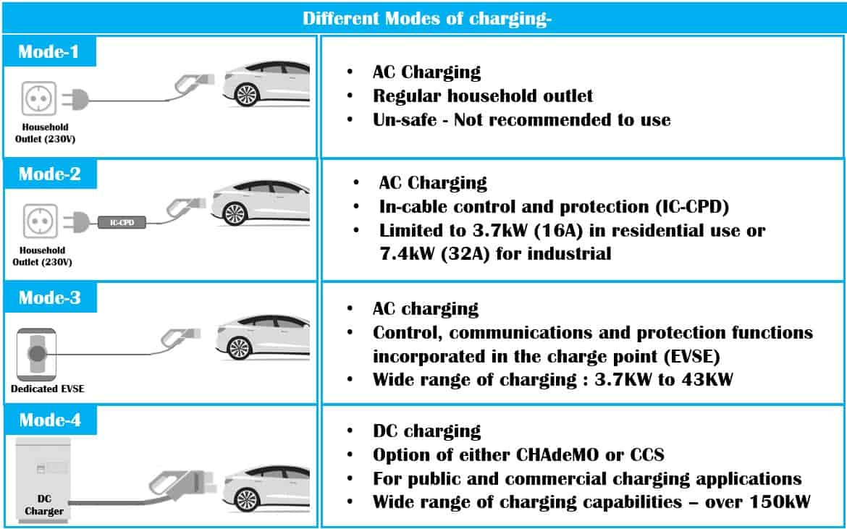
Charging modes of EV’s
Sources: [7]

Slide 6
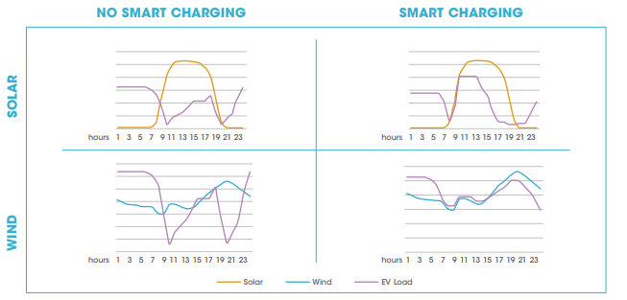
Changes in power grid
Adaptation of EVs will increase the peak demand and change load curves of worlds power grids and.
Increases the risk for grid failures, voltage drops and blackouts.
Smart charging has been established as a solution for this.
Sources: [10]
Notes:
Smart charging allows EV’s to charge their batteries during either high local generation hours or during off-peak ours when electricity prices are lower. This eases the stress that is put on to the power grid and saves users money. Smart charging allows synergies between EV charging, renewable electricity generation and the electricity markets.
With out smart charging, fast adaptation of EVs can cause failures in the existing network or even in worst cases blackouts.
The table illustrates two different scenarios with solar and wind energy: controlled and uncontrolled charging. With controlled charging its possible to move the peak demand in to the peak generation periods.
Source https://www.irena.org/publications/2019/Sep/Electric-vehicle-smart-charging

Slide 7
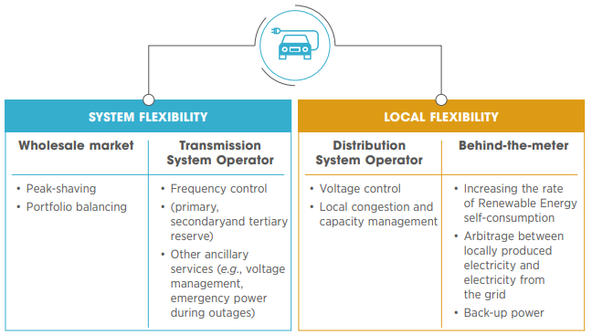
Changes in power grid
When integrated into the smart grid, EVs can provide much more than just clean transportation.
Sources: [10]
Notes:
Source https://www.irena.org/publications/2019/Sep/Electric-vehicle-smart-charging

Slide 8
Future developments for EV sector
Increased focus on the charging network
Charging must be made easily available to everyone. This requires big investments and planning.
New laws and directives are needed to support the growing EV infrastructure
E.g. Tax incentives, The Energy Performance of the Buildings Directive (EPBD), Market Design Directive and Regulation (MDD)
Work on supporting communication protocols to enable smart charging
Shared protocols OCPP and OSCP between the customer and the grid.
Sources: [11-13]
Notes:
Increased focus on the charging network
EV prices have become more competitive and the technology has reached consumers’ expectations (mainly battery capacity). Now the biggest obstacle to tackle is the availability of charging network. With sufficient amount of fast charges consumers would be more interested in buying EV’s. This doesn’t necessarily mean more +250kW chargers but more chargers in the range of 100-150kW.
Source https://www.bcg.com/publications/2021/the-evolution-of-charging-infrastructures-for-electric-vehicles
New laws and directives are needed to support the growing EV infrastructure
E.g. Tax incentives, The Energy Performance of the Buildings Directive (EPBD), Market Design Directive and Regulation (MDD). These are EU directives, but similar trends can be found in other parts of world as well.
EPBD obligates that all new buildings, or existing buildings undergoing major renovations need to install certain number of chargers or have the readiness to retrofit them easily. This of course depends on the building type. This is a important directive, since EVs will move the ‘re-fuelling’ of cars from gas stations into buildings.
MDD encourages countries to enable more smart metering in the electricity grid. This will in the future help with for example using the cars battery as a storage for the building.
For example, EU legislation that all EVs must have the same type of charging port.
Source https://www.virta.global/blog/this-is-how-eu-regulation-accelerates-the-electric-vehicle-revolution
Work on supporting communication protocols to enable smart charging
Shared protocols OCPP and OSCP between the customer and the grid.
OCPP (Open Charge Point Protocol) is the global open communication protocol between charge stations and the back-end systems of charge station operators. This protocol handles the exchange of charging data and can trade information between EVs and the electricity grid.
OSCP (Open Smart Charging Protocol) is an open communication protocol between a charge point management system and an energy management system. This protocol imparts a 24-hour forecast of the accessible capacity of an electricity grid.
Source https://www.greenflux.com/spotlights/open-protocols/

Slide 9
Conclusions
Amount of EVs on the roads grows exponentially.
EU expects 30 million new EVs by 2030
Mass adaptation of EVs require vast charging network.
Biggest hold back for consumers has been range anxiety which can be dealt with by installing more chargers.
Smart charging supports the growing EV-sector by moving peak demand into peak generation hours.

Slide 10
Source material used
[1] Teknologiateollisuus. Visited 19.03.2022. Sähköinen liikenne -tilannekatsaus 2021 Q4. [Link]
[2] Nissan. Visited 20.03.2022. https://www.nissan.fi/ajoneuvot/henkiloautot/leaf.html
[3] Tesla. Visited 20.03.2022. https://www.tesla.com/fi_fi/models
[4] Virta. Visited 21.03.2022. [Link]
[5] Alternative Fuels Data Center. Visited 20.03.2022. [Link]
[6] All The Electric-Car Charging Connectors In One Great Big Poster. Visited 20.03.2022. [Link]
[7] Evexpert. Visited 20.03.2022. [Link]
[8] Virta. Visited 20.03.2022. [Link]
[9] Wireless FULL EV chargng has arrived. Visited 20.03.2022. [Link]

Slide 11
Source material used
[10] IRENA. Electric-vehicle smart charging. [Link]
[11] BCG. Winning the Battle in the EV Charging Ecosystem. [Link]
[12] VIRTA. Here’s how EU legislation accelerates the EV revolution. [Link]
[13] GreenFlux. Open protocols. [Link]

