Slide 1
ELEC-E8423 - Smart Grid Demand response of industrial loads
Lionel Irrmann, Severi Korhonen
18.03.2022

Slide 2
Introduction
Demand Response (DR) is the adjustment of electricity consumption for either lowering energy costs, or for power balance management.
The Industrial sector is a major electricity consumer
Major consumption = major DR potential
Motivation: competitiveness of energy intensive industry competitiveness is tied to electricity prices
Benefit of demand response 2-sided:
Improved competitiveness of industrial products with cheaper energy and additional revenue from market participation
Reduced peak demand due to DR = less investments needed in power system

Slide 3
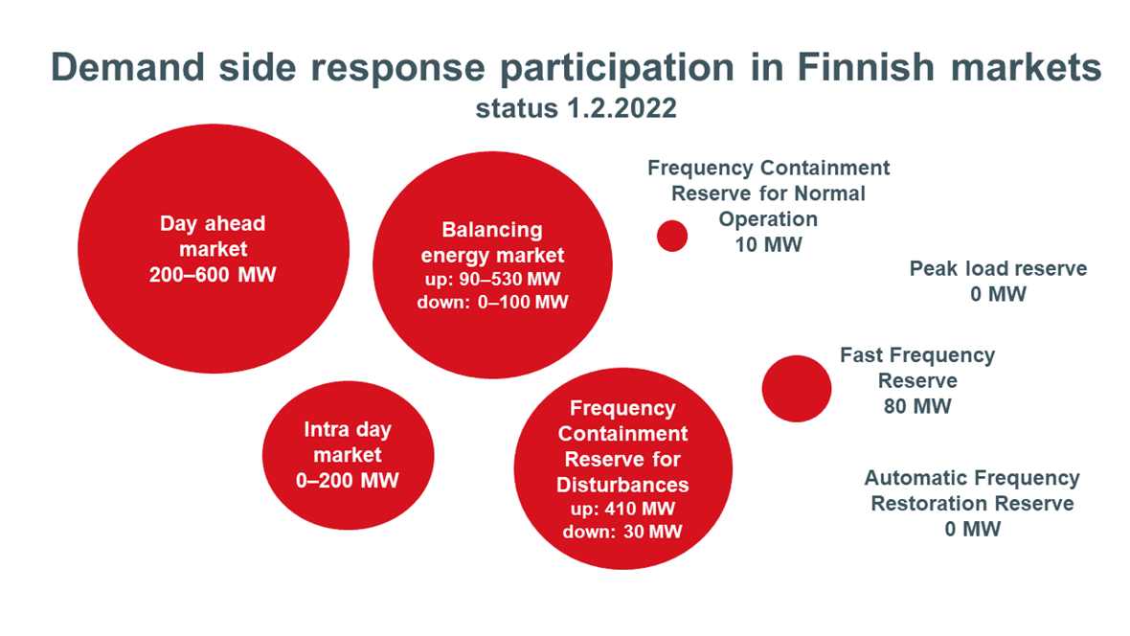
Demand response 101
Users agree to reduce their electricity demand when the grid is under stress
Industry sector has participated in DR for a long time by reducing the use of electricity if the price of electricity rises high
Source: Fingrid

Slide 4
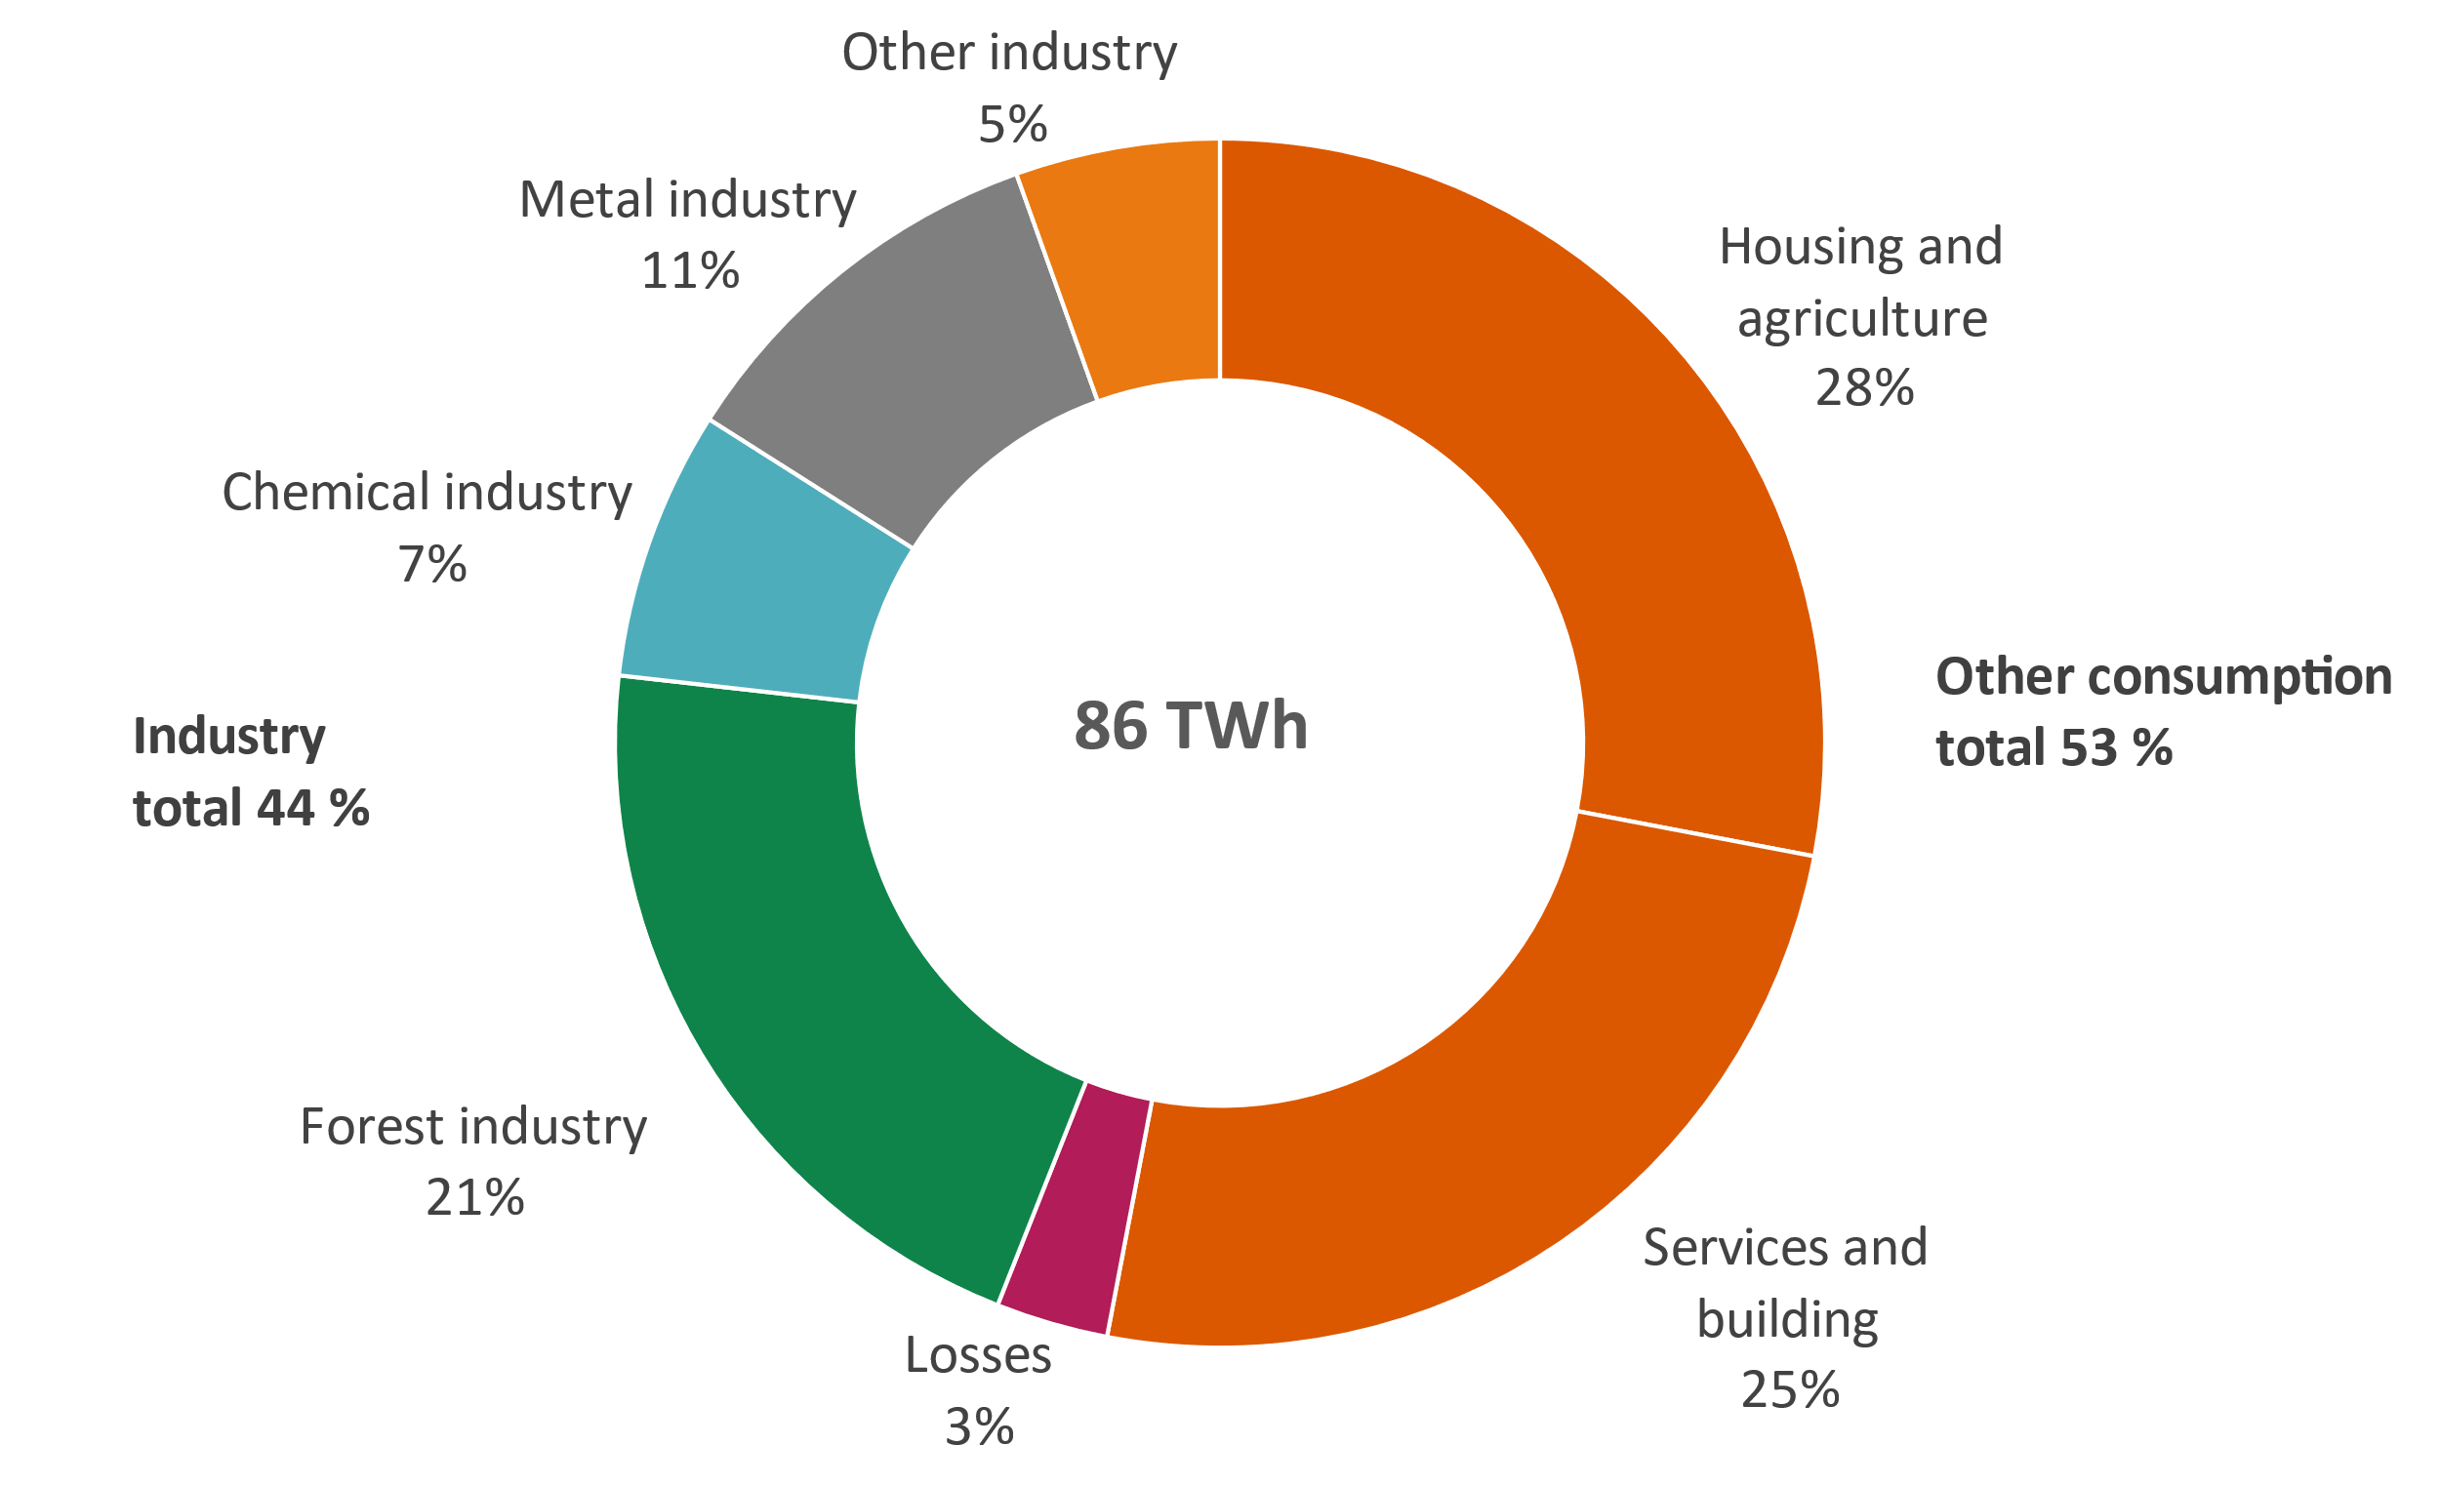
Industry and energy consumption in Finland
Industry amounted to 44% of total Finnish electricity consumption in 2021.
Main sectors in Finland:
Forestry
Metal
Chemical
Source: Finnish Energy ry

Slide 5
Forest industry
Forest industry consists of timber, paper and pulp sectors
Forestry can participate in DR mostly with mechanical pulpwood mills, which can take advantage from temporary storage capacity
Paper and pulp industry has a potential of 790 MW for fast activating electricity demand response (VTT's estimate 2005)

Slide 6
Steel industry
Steel industry consists of for example steel manufacturing etc.
Steel industry's largest potential DR participants are in electrolysis processes and electric arc furnaces
Most of steel industry's demand response is quickly activated without any long preparation times
Steel industry can offer roughly 300 MW of demand response (VTT's estimate 2005)

Slide 7
Chemical industry
Examples of Finnish chemical industry are petrochemicals , fertilizers, plastics, and others
Integrated chemical processes are very inflexible and have low DR potential
Most potential DR participants are processes using heat pumps, electrolyzers, or electrified processes with stockpiles
Future potential: switching from fossile fuels to P2X

Slide 8
Other sectors and future trends
New industry sectors are being created, e.g. data centers, battery factories
New consumption types and industry characteristics
Especially data centers promising for demand response due to on-site storages
Trend of digitalisation and electrification of processes opens new possibilities in providing demand response
Better real-time monitoring and control of loads
More electricity consumption
Aggregators may reduce the threshold to participate in DR
Smaller facilities may not be sufficiently big to market entry or lack resources to do so
Aggregators are companies managing the loads of multiple smaller actors
“Outsource” DR participation to aggregators

Slide 9
Conclusions
In Finland, industry consumes 44% of electricity, and has a strong potential in demand response
Different industry sectors have unique characteristics and capabilities in providing demand response
Some industrial sectors have a long history in DR in Finland, but recent developments and trend indicates the role of DR is growing

Slide 10
Source material used
Finnish Energy, 2022. Energy Year 2021 – Electricity. Available at: https://energia.fi/en/newsroom/publications/energy_year_2021_-_electricity.html#material-view
Motiva, 2021. “Suomen teollisuuden sähköistyminen ja sen vaikutus energiatehokkuuteen ja hukkalämpöjen hyödyntämiseen”. Available at: https://www.motiva.fi/ajankohtaista/julkaisut/kaikki_julkaisut/suomen_teollisuuden_sahkoistyminen_ja_sen_vaikutus_energiatehokkuuteen_ja_hukkalampojen_hyodyntamiseen.9236.shtml
Fingrid, “Demand-side management” [website, accessed 21.03.2022]. Available at: https://www.fingrid.fi/en/electricity-market/market-integration/the-future-of-the-electricity-markets/demand-side-management/
Juuso Jokiniemi, 2014. “Sähkön kysyntäjosutokohteiden mahdollisuudet Suomen teollisuudessa”. Available at: http://urn.fi/URN:NBN:fi:aalto-201410042706
VTT, 2005. Sähkön kysyntäjouston potentiaalikartoitus teollisuudessa. Espoo: Valtion teknillinen tutkimuslaitos. VTT Prosessit PRO3/P3017/05. Julkaistu 31.8.2005. [website, accessed 21.3.2022] Available at: http://www.vtt.fi/inf/julkaisut/muut/2005/PRO3_P3017_05.pdf

