Slide 1
ELEC-E8423 - Smart Grid Different market mechanisms for Smart Grid: bidding, real-time pricing, blockchains
Nusrat Tanny & Niloufar Zarei
05.04.2022

Slide 2
Introduction
Smart Grid – new vision to figure out an efficient way of integrating green & renewable technologies. Also called "Energy internet".
Demand response (DR) has an important role in the future of the electricity market for maintaining the balance between supply and demand by introducing load flexibility
Distributed
Blockchain
DR based on control mechanism
Centralized
Demand Response
Incentive-based
Demand bidding
DR based on offered motivations
DR based on decision variable
Price-based DR
Realtime price

Slide 3
Roles of demand response in the electricity system by timescale
Price-based demand response
Time-of-use pricing
Day-ahead hourly pricing(RTP)
Real-time hourly pricing (RTP)
Step 2
Load curtailment timescales
Years
System planning
Months
Operational planning
Day-ahead
Economic scheduling
Day-of
Economic dispatch
Less than 15
Demand response release
Ancillary service
Demand bidding / buyback
Interruptible programs
Emergency program
Direct load control
Incentive-based demand response
Step 1

Slide 4
Demand Bidding
Demand Bidding (also called Buyback) is a program in which consumers bid on specific load reductions in the electricity wholesale market.
A bid is accepted if it is less than the market price. When a bid is accepted, the customer must curtail his load by the amount specified in the bid or face penalties.
is useful for both the consumers and system operator (SO)
improves market efficiency by providing the opportunity for consumers to change the market clearing price (MCP) in peak hours
Challenges-
- Privacy is the key issue.
- takes time to recruit customers for a demand response program

Slide 5
Realtime Pricing
Real time Pricing (RTP) is a dynamic pricing scheme, with the price updating cycle of 1 hour or less
RTP customers are informed about the prices on a day-ahead (Day-ahead Real-Time Pricing (DA-RTP) or hour-ahead wholesale prices (to ensure that customers have sufficient time to respond to RTP)
RTP is the most direct and efficient demand response program suitable for the future electricity market
RTP brings some advantages for customers, such as increasing their awareness regarding consumption and subsequently decreasing their consumption, especially during the high electricity price
Reaching to reach RTP in the electricity market brings some challenges.

Slide 6
Realtime Pricing (Challenges)
The major challenge faced in the implementation of "real time " is that both the data collection and the decision making must be completed within a minimal time
Due to the minimum time for notification in advance, there is a need for the development of a methodology which is advanced and capable of finding an optimal solution as fast as possible
Hence the computational methodology involves high level of complexity
Because of the computational complexity involved, the methodology must be properly tested during the developmental stages
The development of energy management system can ensure the collection of online data and assist in the decision-making process
The demand management from load or consumer side is expensive and ineffective due to high transaction costs

Slide 7
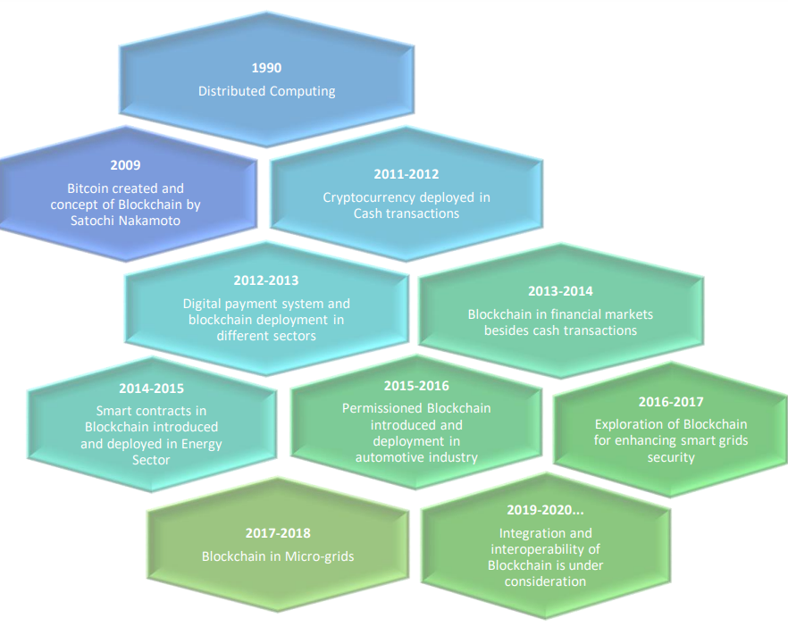
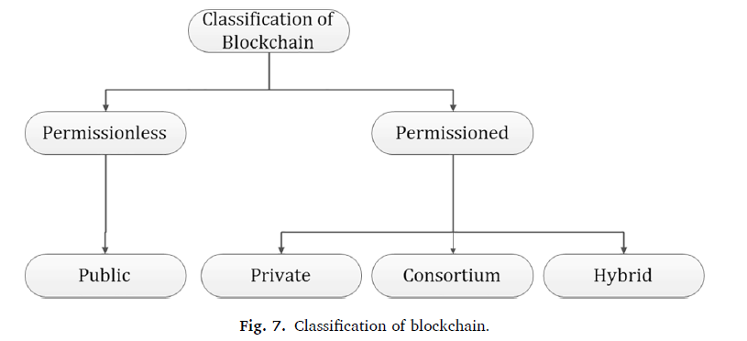
Blockchain for Smart Grid1
- Blockchain as a decentralized and distributed technology provides promising applications in the smart grid infrastructure with its excellent and salient features. The concept of blockchain is to decentralize power to build trust between untrusted parties.
A blockchain consists of blocks with a growing list of records that are linked using cryptography to resist the alteration of the data. The main advantage of this technology is that it maintains all the variations in the blocks as all blocks are connected in the chain and no block can be modified or removed.

Slide 8
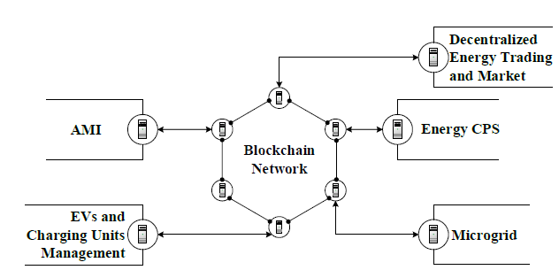
Blockchain for Smart grid2
-main area of application
Opportunities
Moving towards Decentralized Smart Grid System
Use of Blockchain to Monitor, Measure, and Control
has a great impact on energy trading for eradicating
false transaction
scalable in nature
provides a resilient and better fault-tolerant network in which an error or malicious attack can be identified and removed easily.
Challenges
Security and privacy
Standardization
Immature technology
Future direction- Blockchain interoperability

Slide 9
Conclusions
Demand Bidding gives the opportunity for consumers to change the market clearing price and it helps to improve market efficiency but still there has some privacy issue
RTP could serve to improve market efficiency, mitigate market power, dampen wholesale price volatility, and bolster system reliability but more advanced metering systems are needed
RTP would not be expected to deliver short-term results with regard to equipment purchases. But in long term, the cost of electricity saved exceeds the incremental cost of the equipment purchased
Considering security, privacy and trust issue "Blockchain Technology" has attracted the rapid growing attention in smart grid area.
the smart meters or electrical vehicles as well as other parts of the smart grid need a reliable and efficient communication infrastructure.
Deploying appropriate technology in smart grid communication infrastructure is an open problem. There are some challenges in deploying each one of the technologies, e.g., security, performance, and privacy.

Slide 10
List of References
[1] Daiva Stanelyte, N. R. (2022). Overview of demand-response services: A review. Retrieved from Energies: https://www.mdpi.com/1996-1073/15/5/1659/htm
[2] Demand Bidding. (2019). Retrieved from https://userstcp.org/wp-content/uploads/2019/11/3.Task_8_Demand_Side_Bidding_Brochure.pdf
[3] JeffZethmayr, D. ( March, 2018). The costs and benefits of real-time pricing: An empirical investigation into consumer bills using hourly energy data and prices, 50-57.
[4] koliou, E. (2016). DEMAND RESPONSE POLICIES FOR THE IMPLEMENTATION OF SMART GRIDS. Retrieved from https://repositorio.comillas.edu/xmlui/bitstream/handle/11531/7166/TD00195.pdf?isAllowed=y&sequence=1
[5] Li, W.-T., Yuen, C., Hassan, N. U., Tushar, W., Wen, C.-K., Wood, K. L., . . . Liu, X. (n.d.). Demand Response Management for Residential Smart Grid: From Theory to Practice. 2431 - 2440. Retrieved from https://ieeexplore.ieee.org/abstract/document/7336481/authors#authors
[6] M.H.Albadi, E.-S. ( November, 2008). A summary of demand response in electricity markets, 1989-1996.
[7] Muhammad Baqer Mollah, J. Z. (2020). Blockchain for Future Smart Grid: A Comprehensive Survey.
[8] N. Arjomand, H. S. (n.d.). A Review of Blockchain-based Smart Grid: Applications, Opportunities, and Future Directions.
[9] Vardakas, J. S., Zorba, N., & Verikoukis, C. V. (2015). A Survey on Demand Response Programs in Smart Grids: Pricing Methods and Optimization Algorithms, 152-178.
[10] Arun Sekar Rajasekaran a, *. M.-T. (2022). A comprehensive survey on blockchain technology.

Slide 11
Thank you !

