Slide 1
ELEC-E8423 - Smart Grid Concentrating solar power and its comparison to photovoltaics
Suvi Kallio
Nick Nortamo
03.05.2022

Slide 2
Introduction
Technical overview
Potential of CSP
Concentrating solar power plants
Concentrating solar power versus photovoltaics
Cost comparison
Challenges with CSP
Conclusions

Slide 3
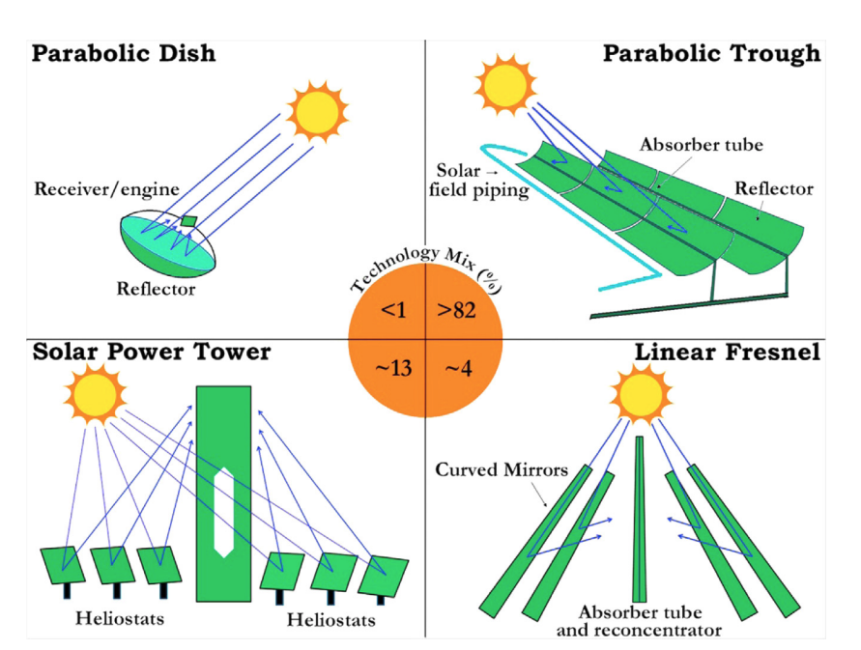
Technical overview of CSP
Consist of solar concentrators (mirrors or lenses), receiver, steam turbine and electrical generator
Main idea: concentrating sunlight onto an absorber to warm up heat transfer fluid → steam turbine → electricity → storage
Used heat transfer fluids are molten salt, thermo oil, air and water
Figure 1. Various CSP technologies and their installed ratios (Islam et al., 2018)

Slide 4
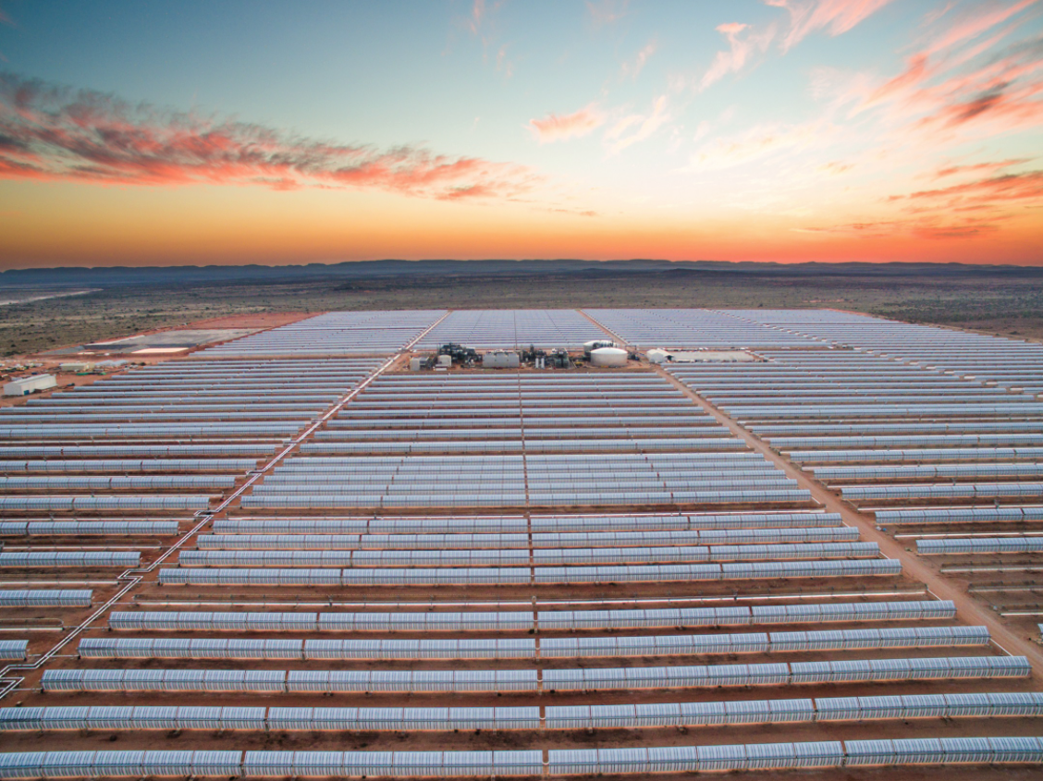
Potential of CSP
Thermal energy storage (TES)
In 2030 could meet up 6% of the world’s power demand and 12% by 2050
Hybrid systems:
CSP-PV
Desalination
Solar Combined Heat and Power (SCHP)
Figure 2. Parabolic through- plant in South Africa (Estela).

Slide 5
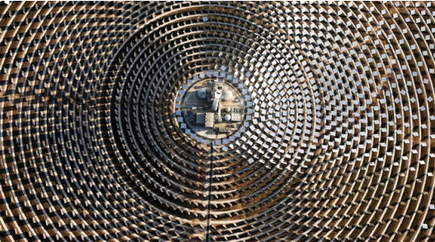
Concentrating solar power plants
Global total installed capacity 6.451 GW (2020)
Over 100 commercial CSP plants
Spain, China, USA, Morocco, South Africa
Gemasolar Thermosolar Plant in Spain
Solar Power Tower, molten salt as heat transfer fluid
95 hectares
Height 140 m
15 hours storage capacity
Figure 3.Gemasolar Thermosolar Plant pictured from above (Helioscsp, 2020).

Slide 6
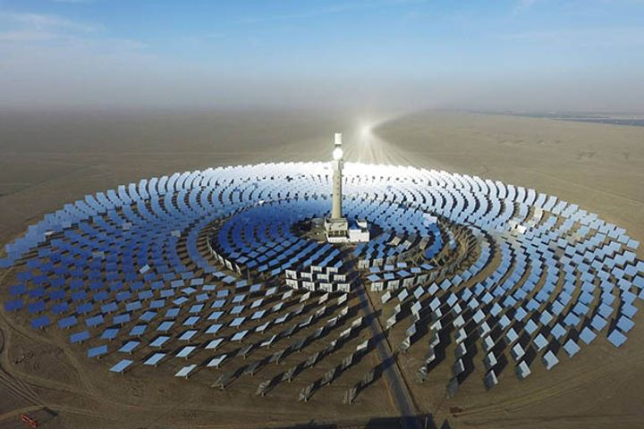
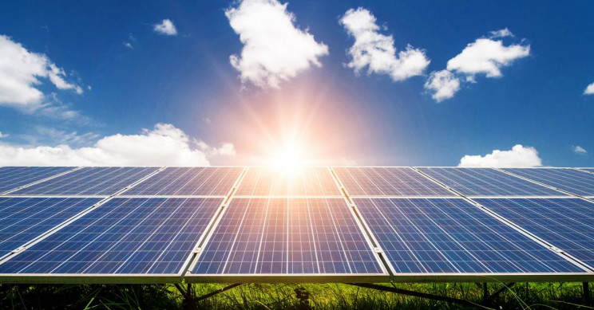
CSP versus PV
CSP systems can store excess energy in thermal energy storages (TES) → cheap convenient flexibility.
PV systems needs a battery to store excess energy → expensive flexibility.
CSP more suitable for larger scale utility plants.
PV more suitable for smaller scale plants, e.g. households.
Notes:
Thermal energy storages provide flexibility and can be utilized to smoothen out load curves.
PV systems needs battery that is expensive to install, especially in larger scale.
CSP has high investment costs and needs large land area, which makes it more efficient in large scale.
PV can be utilized in any scale, but flexible PV systems are more suitable in smaller scale, like households. Due to high battery costs.

Slide 7
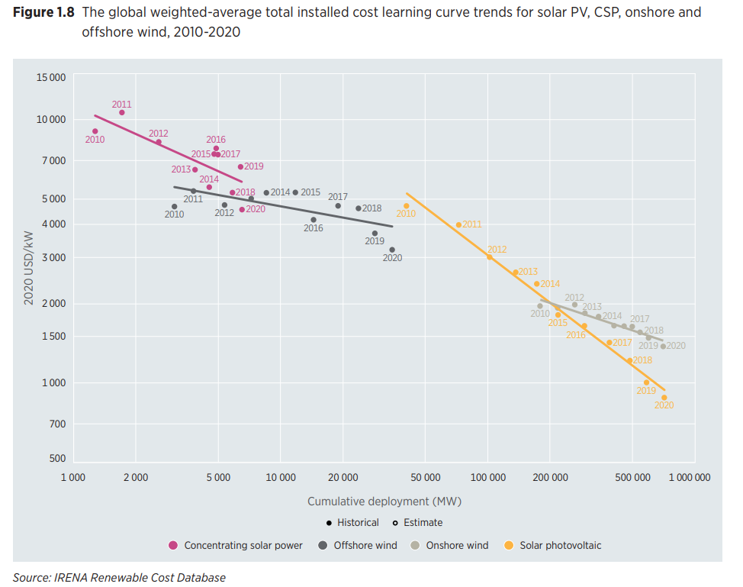
Cost comparison
CSP plants are still around 6 times more expensive than PV plants
PV is much more attractive for investors
Research and development reduces cost trends for both technologies
CSP can be more cost efficient with hybrid systems
Notes:
Y-axis is cost / installed kW and the x axis shows the cumulative deployment of the technologies. Pink is CSP and yellow is solar PV.
Rapid deployment of solar PV makes it constantly more attractive and cost efficient.
CSP plants are more suitable in areas where flexibility is needed. Low cost energy storage.
Hybrid systems, e.g. CHP alternatives makes the CSP competitive in certain locations.

Slide 8
Challenges with CSP
High water consumption for cooling purposes
Dust on mirrors reduce efficiency
Heat transfer fluids have high demand (Molten salt)
Decisions regarding technology and sizing of storages
Environmental aspects. (Hazardous materials, animals)
Commercial viability
Notes:
- Water consumption , can be expensive and the environmental downsides.
- Dust needs to be removed, could be costly to maintain. Picture in the slide.
Popularity of molten salt makes it harder to obtain + more expensive.
Goal is to maximize efficiency and utilization, so the choice of technology and efficient sizing of TES is important
Environmental aspects, such as hazardours materials and animals burning to death like in the picture, mostly birds though.
Commercial viability. Is it worth the high investment costs or is it better to just build a large scale solar PV?

Slide 9
Conclusions
Four different types of CSP technologies, most common parabolic through collector
Can be used in different hybrid systems, such as desalination, CSP-PV or solar combined heat and power
The convenient storage cabaility of CSP provides good flexibility, making it an excellent solar energy system for smart grids.
CSP has high investment costs involved, making it less competitive vs. other technologies.

Slide 10
Source material used
Islam, M. T., Huda, N., Abdullah, A. B., & Saidur, R. (2018). A comprehensive review of state-of-the-art concentrating solar power (CSP) technologies: Current status and research trends. Renewable and Sustainable Energy Reviews, 91, 987–1018. doi:10.1016/j.rser.2018.04.097
Chen, Q., & Wang, Y. (2020). Research Status and Development Trend of Concentrating Solar Power. 2020 9th International Conference on Renewable Energy Research and Application (ICRERA). doi:10.1109/icrera49962.2020.9242893
Beatrice Bedeschi. (2018). Hybrid Concentrated Solar Power – PV gains. Helioscsp. Available at: https://helioscsp.com/hybrid-concentrated-solar-power-pv-gains/
Laissaoui, M., Nehari, D., Bouhalassa, A., Hazmoune, M., Lechehab, S., & Touil, A. (2015). Thermodynamic analysis of combined CSP-MED desalination in Algeria. 2015 3rd International Renewable and Sustainable Energy Conference (IRSEC). doi:10.1109/irsec.2015.7455096
Estela. North and South Africa. Available at: https://estelasolar.org/market/africa/#SA
Gemasolar Thermosolar Plant / Solar TRES CSP Project. NREL. Available at: https://solarpaces.nrel.gov/project/gemasolar-thermosolar-plant-solar-tres
Sener sells three Concentrated Solar Power plants in Seville and Cádiz to the Qualitas fund. Helioscsp. 2020. Available at: https://helioscsp.com/sener-sells-three-concentrated-solar-power-plants-in-seville-and-cadiz-to-the-qualitas-fund/
Estela. European Solar Thermal Electricity Association. Figures and Facts. Available at: https://estelasolar.org/figures-facts/
Irena. Available at: https://www.irena.org/-/media/Files/IRENA/Agency/Publication/2021/Jun/IRENA_Power_Generation_Costs_2020.pdf

