Slide 1
ELEC-E8423 - Smart Grid Deep heat energy wells for ground source heat pump systems
Iiro Hyvönen
Jesse Vähä-Koukkula
15.3.2022

Slide 2
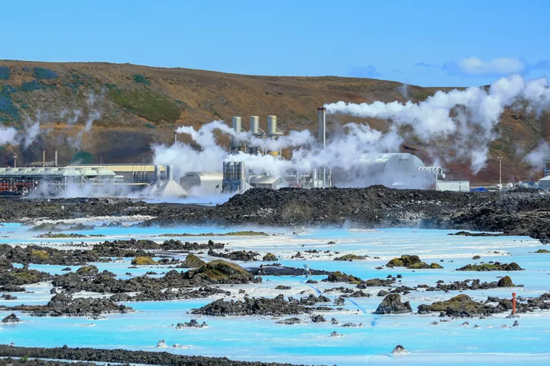
Contents
Introduction
Basic components
Collector systems
Charging and discharging
Smart Grid
Projects in Finland
Conclusion
Geothermal plant in Blue Lagoon, Iceland.
https://www.treehugger.com/what-is-geothermal-energy-5105305

Slide 3
Introduction
-Deep heat energy wells are approximately 1-3 kilometers deep wells, which are used for producing geothermal heat with heat pumps.
-When the usage of fossil fuels is decreasing, new methods for heating and cooling must be found. Deep heat energy wells could provide a solution for carbon free heating and cooling.
- In Finland, buildings produce over 30% of the CO2 emissions. [1] In many cities, district heating is still produced by combustion technologies which produces emissions.
-Heat and cooling is carbon free, depending on the electricity they use. In this power point, we examine deep heat energy wells and ground source heat pumps, and their effects to the grid.
[1] https://www.rakennusteollisuus.fi/Tietoa-alasta/Ilmasto-ymparisto-ja-energia/Materiaalitehokkuus/

Slide 4
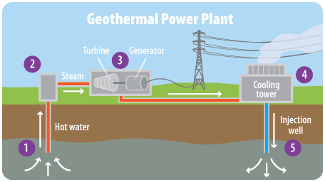
Basic Components
Basic components
Collector pipes
Pumps
Turbine / exchanger
COP-value 3 - 6
Collector pipes
Coaxial (deep)
U-tube (shallow)
Geothermal plant and its components.
https://archive.epa.gov/climatechange/kids/solutions/technologies/geothermal.html
Notes:
The overall efficiency of the plant is really good, the COP value is usually between 3 and 6. The COP value tells us how many units of energy we get out of the plant if we use 1 unit of electricity. In this case the efficiency would be 300 to 600 percent.
The collector pipes are the main ground breaking technology that enables these kinds of plants. Some of you may currently live in ground heated apartment, which has collector pipes somewehere around 300 meters below ground. In deep heating systems they go much further, from 1 to some cases even 10 kilometers deep into the bedrock. The collector pipe diameter is around 15 - 30 cm. There are two main collector types, coaxial and U-tube. Coaxial pipes are usually used in deeper holes, which we are talking about today and u-tube is seen in shallow geothermal projects, where the collector pipes are drilled 300 meters below ground. Iiro Will tell you more about the collector pipers next.

Slide 5
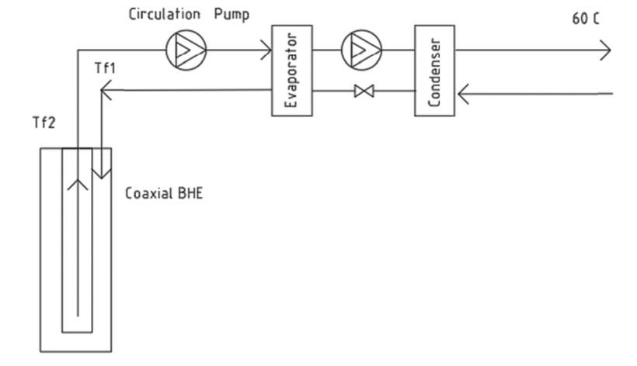
Coaxial deep heat pump system
- Coaxial deep heat pump system has a dual pipe with opposite flows in a circuit.
- Coaxial pipe allows higher mass flow rates than U-pipe system.
- When depth increases, antifreeze solutions can be more useful than water as a fluid
Figure 1: Principle of a DWHP system (Bashir et al, 2020)
https://ieeexplore.ieee.org/document/9262850

Slide 6
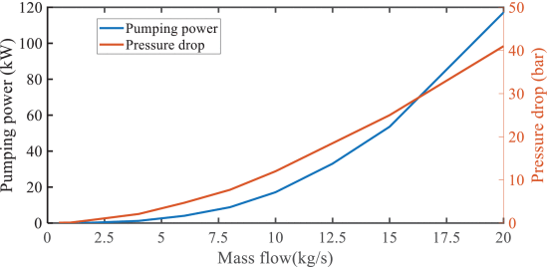
- In figure on the right: Pressure drop and pumping power when mass flow increases
- Vacuum tube in deep wells reduces thermal short-circuiting and therefore offers an interesting possibility
- Thermal conductivity and risk for thermal short-circuiting increases when drilling the well deeper
Figure 2: Pressure drop and mass flow rate (Bashir et al, 2020)

Slide 7
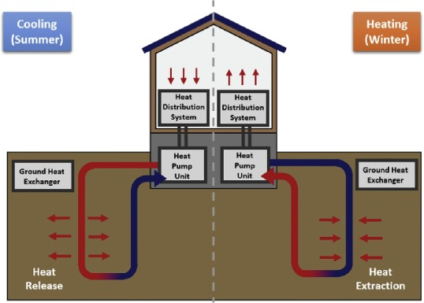
Charge and discharge
Earth works as an energy storage
No transportation costs
No storage costs
Energy wells can be recharged
Heat recovery
Natural charge
Renewable
Cooling
Sustainable
Seasonal cooling and heating.
https://www.ucsusa.org/resources/how-geothermal-energy-works
Rybach, Ladislaus (September 2007). Geothermal Sustainability (PDF). Geo-Heat Centre Quarterly Bulletin. Vol. 28. Klamath Falls, Oregon: Oregon Institute of Technology. pp. 2–7. Retrieved 2009-05-09.
Notes:
The giant storage can also be recharged relatively easily. All newly built residential and commercial buildings must have heat recovery systems installed, which collect the waste heat that would otherwise be lost via ventilation. Usually these systems are in place to increase the overall thermal efficicency of a building and go unutilized during summer time when heating isnt needed. With geothermal solutions the heat recovery can be used to direct the waste heat back into the ground to recharge the ground. This combined with the continous radioactive decay, which heats the ground naturally, makes deep heating renewable.
Lastly, rechargingopens an option to use geothermal to cool down the buildings, which in a way solves 2 problem in once. Cooling can be achieved by switching the direction of the liquid inside the collector pipe during summer.
I want to say a few words about sustainability. Some of you may have a question, if the core of our planet could cool down from excess usage of geothermal solutions. Its a fair point in local sense, as the ground can cool down around the collector pipe faster than the natural heat dissipation and nuclear decay could heat it up. This can be avoided by measurements and planning so we dont build too many collector pipes in one area. Even if the area happens to get depleted from heat, it would be only a problem in a small area, which will eventually heat up again. Globally the heat is regerating at a rate of 30 terawatts, which is more than double the current total energy consumption around the world. Geothermal heating is overall really safe and causes no pollutants during the production of energy, as long as the electricity used in the pumps is produced renewably. For example, the plant can power itself once it is started.

Slide 8
Effects on smart grid
Electricity usage in district heating production increases in the future
Deep heat pumps can provide electricity reserves for grid
Reduced need of peak power plants through renewables
https://www.sciencedirect.com/science/article/pii/S1364032116309418

Slide 9
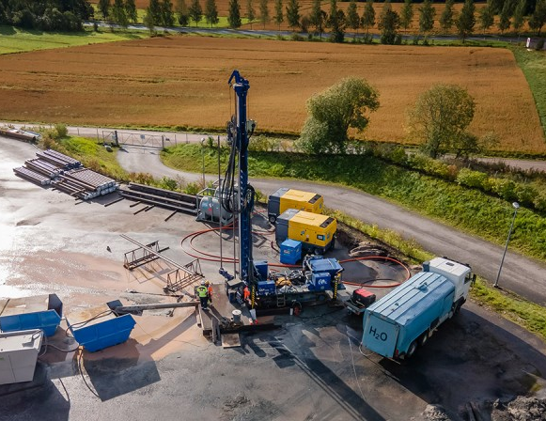
Geothermal projects in Finland
Vantaa Energy’s Varisto (2022)
Helen Ruskeasuo (2022)
ST1 Otaniemi (202?)
Pilot projects
High investment costs
High risks
Low energy costs (0,04€/kWh)
Vantaan Energia’s deep heat project in Varisto.
https://www.vantaanenergia.fi/en/construction-of-vantaa-energys-geothermal-heating-plant-started/
Notes:
Technical difficulties are very likely to happen, as most of the deep heat wells at this point are pilot projects for the respective companies. Pilot project also means that the initial investment costs are high and the risks even higher. This is the reason why relatively few palnts are being built at the moment. On the bright side, the cost of energy is relatively low, around 4 cents a kWh. Compare this to district heating’s 10 cents per kWh and electricity’s 12 cents per kWh.

Slide 10
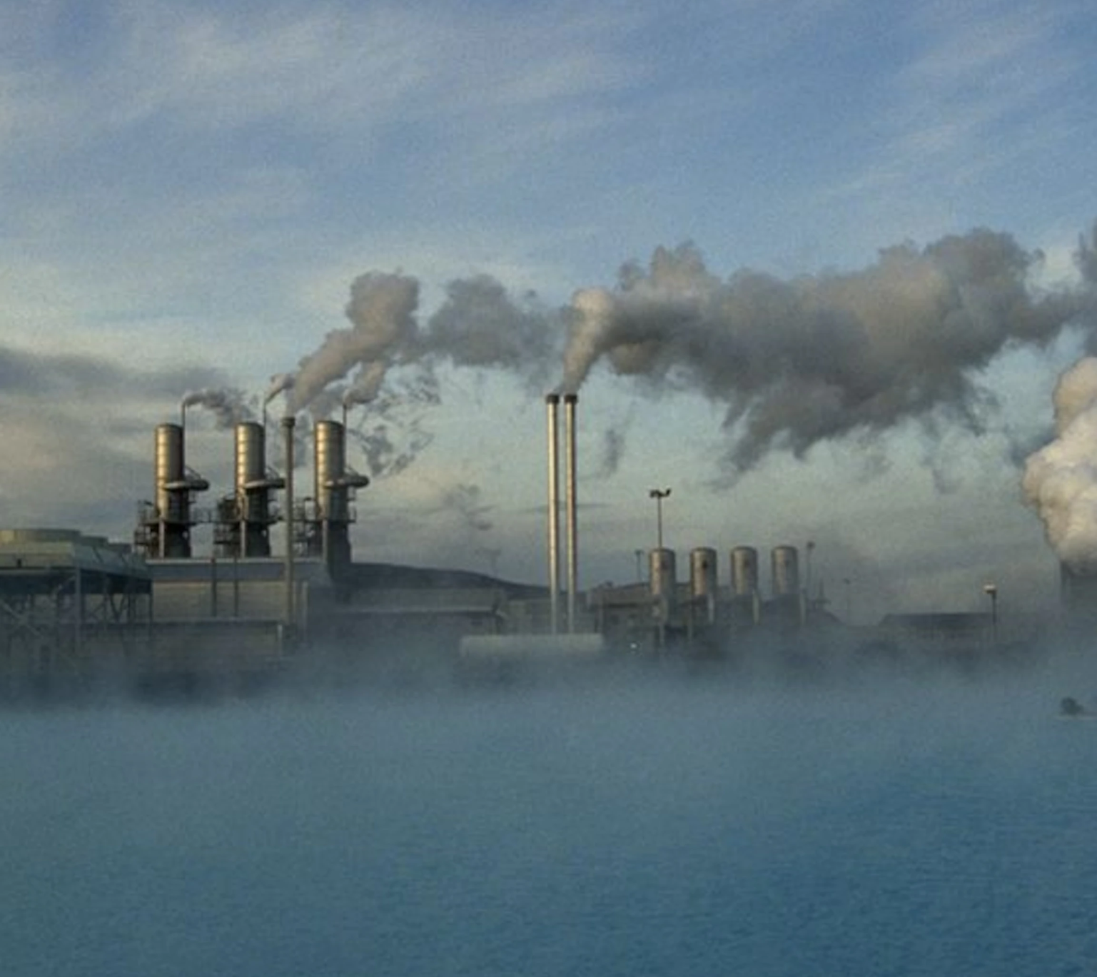
Conclusions
Basic components
Pipes, pumps, exhcangers
Coaxial system
Benefits
Charging and discharging
Sustainable
Smart grid
Future considerations
Vantaan Energia’s deep heat project in Varisto.
https://www.nationalgeographic.com/environment/article/geothermal-energy

Slide 11
Source material used
https://www.treehugger.com/what-is-geothermal-energy-5105305
https://www.rakennusteollisuus.fi/Tietoa-alasta/Ilmasto-ymparisto-ja-energia/Materiaalitehokkuus/
https://ieeexplore.ieee.org/document/9262850
Figure 2: Pressure drop and mass flow rate (Bashir et al, 2020)
https://www.sciencedirect.com/science/article/abs/pii/S0196890419304303
rlower cocts https://energy.mit.edu/wp-content/uploads/2006/11/MITEI-The-Future-of-Geothermal-Energy.pdf
https://www.vantaanenergia.fi/en/construction-of-vantaa-energys-geothermal-heating-plant-started/
https://www.nationalgeographic.com/environment/article/geothermal-energy

