Slide 1
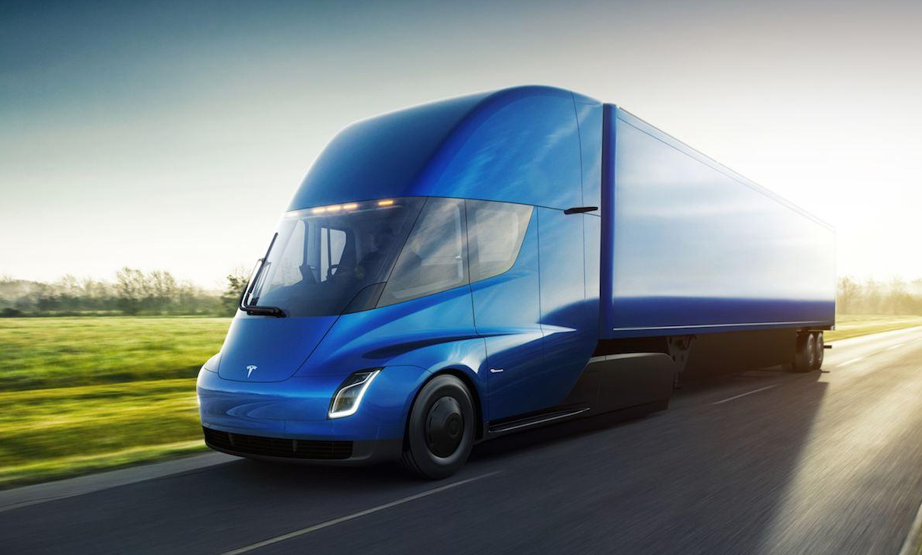
ELEC-E8423 - Smart Grid Electric trucks and their charging solutions
Julia Kondakov & Matias Mattheiszen
19.4.2022

Slide 2
Introduction
Globally, more than one-third of transport-related CO₂-emissions, and 7% of total energy-related CO₂ come from road freight transport
Only 31 000 electric trucks were on the road globally in 2020
Challenging to electrify heavy-duty transport:
High energy requirements and low energy density of batteries
Price and weight of massive batteries
Battery prices and battery technology are constantly evolving
Share of electric trucks must scale up from 1% to 30% by 2030
Different ways to electrify trucks: battery electric trucks (batteries with charging or swapping), hydrogen fuel cell electric vehicles and electrified road systems

Slide 3
Electric truck charging solutions today
Batteries with wired charging
Alternating current (AC) charging:
On-board charger
Power between 22-43 kW
Overnight charging
Relatively slow: 10h
More cost-effective
Direct current (DC) charging:
Charging station
Power starts above 20 kW and between 50-250 kW
Fast charging: 2h
For completing transport assignment

Slide 4
Electric truck charging solutions in the future
Electrified road systems
Power is transferred between a vehicle and the road that it is travelling on
Requires route predictability
Overhead conductive: charging power is continuously transferred from overhead lines to the vehicle through a pantograph
Conductive power transfer from road: power is transferred to the vehicle through rails embedded in or on top of the road surface
Inductive power transfer from road: power transfer takes place between coils embedded in the road and coils in the vehicle without any wires
On electrified road → uses propulsion system or charges on-board batteries
On normal road → switches to an electric or hybrid motor

Slide 5
Electric truck charging solutions in the future
Batteries with swapping
Batteries are removed and replaced with fully charged ones
Time-saving
Considerable costs
If different battery-pack configurations → costs will increase
Hydrogen fuel cells electric trucks
Extends the range
Short and easy refueling process and high energy density
High cost of building hydrogen infrastructure
Hydrogen is difficult and costly to transport

Slide 6
Electric truck market: Current state
The market share of Electric trucks is predicted to grow significantly
Cost and emission reductions
Charging network
Current state:
Non-existent infrastructure
Major development projects (Gothenburg)

Slide 7
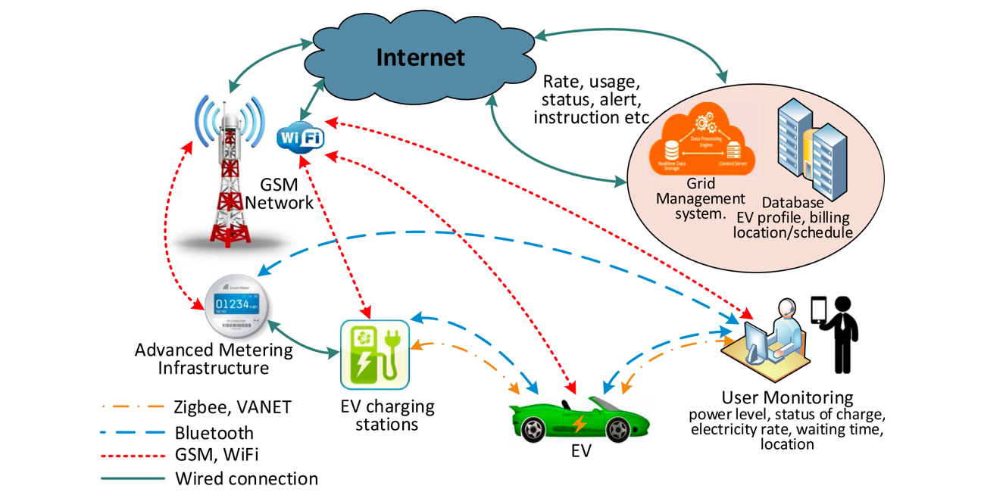
Impact on power grid
Higher market share –> increased demand of electricity
High local loads could cause grid failures
Smart charging
Enables cost savings and eases the stress of the Grid
E-truck and Smart Grid integration enables:
System flexibility
Local flexibility
Possibility for multiple ancillary services
(Das et al., 2020).

Slide 8
Potential in energy reserve market
Large amount of battery capacity available
Vehicle to Grid (V2G)
Battery capacity utilized to balance demand and supply
Swappable batteries could form an even more centralized and controlled energy reserve
Synergies between renewable electricity production and the increased amount of electric trucks.

Slide 9
Conclusions
In the coming years as the technology continues to improve, we will see more charging solutions, faster charging, more charging stations and better charging infrastructure made available to electric trucks.
The increase in available battery capacity could be exploited in numerous ancillary services.
Smart charging solutions combined with the increased amount of electric trucks provides synergies between renewable electricity production, electric truck charging and reserve markets.

Slide 10
Source material used
IEA. 2017. The Future of Trucks. https://www.iea.org/reports/the-future-of-trucks
IEA. 2021. Trucks and Buses. https://www.iea.org/reports/trucks-and-buses
Liimatainen, H., van Vliet, O. & Aplyn, D. 2019. The potential of electric trucks – An international commodity-level analysis. Applied
Energy. Vol. 236. pp. 804-814. doi:10.1016/j.apenergy.2018.12.017.
Jason Morgan. 2021. Understanding Electric Truck Charging Needs And Choice. Fleet Equipment. https://www.fleetequipmentmag.com/understanding-electric-truck-charging/
Henrik Engdahl. 2021. How a good charging strategy can extend an electric truck’s range. Volvo Trucks.
https://www.volvotrucks.com/en-en/news-stories/insights/articles/2021/nov/How-a-good-charging-strategy-can-extend-an-electric-trucks-range.html
Lars Mårtensson. 2020. Electric Roads: A niche solution for confined areas? Volvo Trucks. https://www.volvotrucks.com/en-en/news-stories/insights/articles/2020/jul/electric-roads-a-niche-solution-for-confined-areas.html
Furnari, E., Johannes, L., Pfeiffer, A. & Sahdev, S. 2020. Why most eTrucks will choose overnight charging. McKinsey & Company.
https://www.mckinsey.com/industries/automotive-and-assembly/our-insights/why-most-etrucks-will-choose-overnight-charging
Lars Mårtensson. 2020. Hydrogen fuel cells: All your questions answered. Volvo Trucks. https://www.volvotrucks.com/en-en/news-stories/insights/articles/2020/jun/hydrogen-fuel-cells-all-your-questions-answered.html
Das, H. S., Rahman, M. M., Li, S., Tan, C. W. (2020). Electric vehicles standards, charging infrastructure, and impact on grid integration: A technological review. Renewable and Sustainable Energy Reviews. Vol. 120. S. 109618. ISSN 1364-0321. Available: https://doi.org/10.1016/j.rser.2019.109618

Slide 11
Other issues ….
Send the presentation to matti.lehtonen@aalto.fi for check latest the day before the scheduled presentation

