Slide 1
ELEC-E8423 - Smart Grid Fuel Cells as a Part of a Power System
Flora von Mikulicz-Radecki & Frans Lucenius
26.04.2021

Slide 2
Contents
Basics of a Fuel Cell
Fuel Cell Technology
Application & Use of Fuel Cells
Hydrogen Production
Hydrogen Infrastructure
Future Hydrogen Economy in Finland
Take Home Message

Slide 3
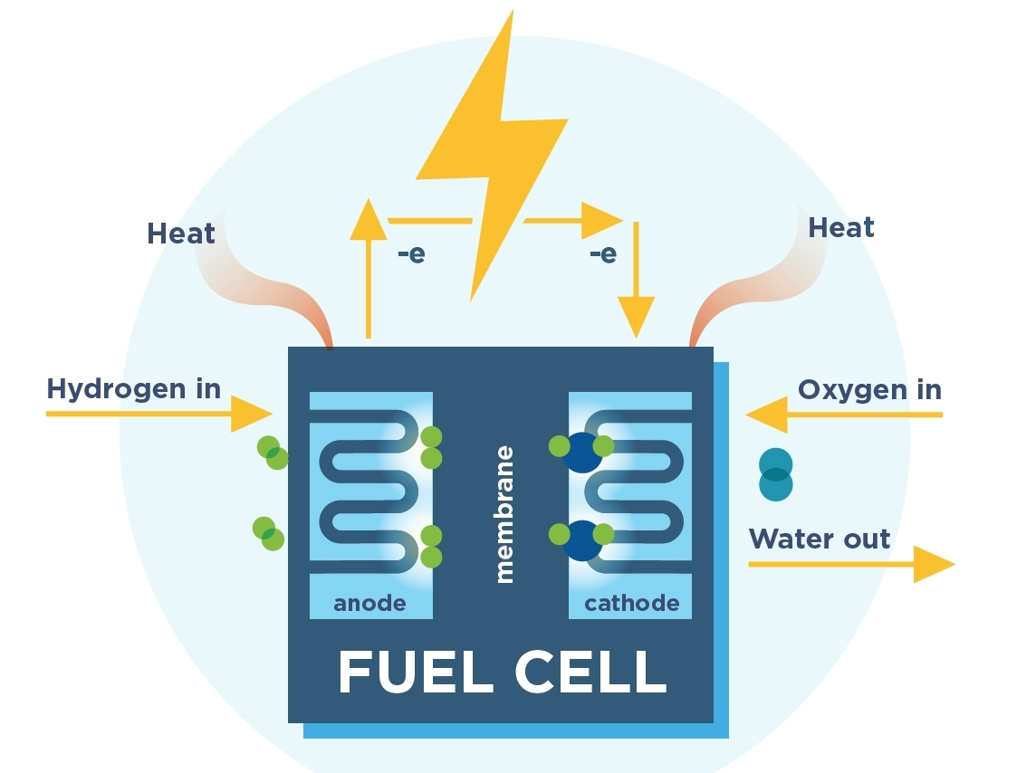
Basics of Fuel Cells
A device that turns fuel and O2 directly into electricity and heat by electrochemical reactions
“Battery that uses fuel”
Few moving parts
Less maintenance
Cells can be made very small
Cells can be stacked to increase max. voltage and current
Notes:
A fuel cell is any device that turns the chemical energy of fuel to electricity and heat, by
oxidizing it with a pair electrochemical reactions.
A fuel cells construction is very similar to a battery. It has an anode and a cathode and an electrolyte that allows ions to move between the anode and the cathode.
Batteriy is self contained, a fuel cell needs a constant supply of fuel and oxygen
Compared to an ICE, very few moving parts, so less maitanance
Individual cells can be made very small, and stacked together to increase voltage or current

Slide 4
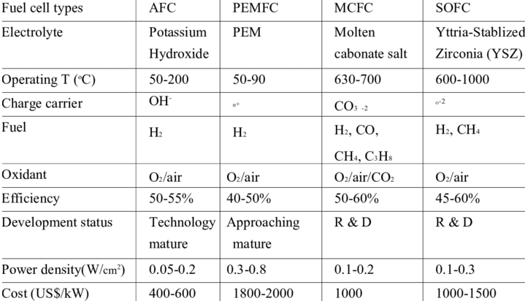
Fuel Cell Technology
Multiple different materials and technologies available
Basic principle remains the same
Specific reactions, features & operating temperature differs
Efficiency 40-60%
Expensive
Notes:
There are many different materials and technologies which exist for fuel cells
The basic operating remains the same
Materials, reactions, operating temperature and electrical efficiency differs.
For example, Alkaline Fuel Cells, AFC, and Proton-exchange membrane fuel cells PEMFC can't handle Carbon monoxide.
Molten carbonate fuel cells (MCFCs) and Solid Oxide Fuel cells can handle carbon monoxide, and even use methane as a fuel
For a fuel cells electrical efficiency is usually around 40-60%
One of the main drawbacks is the high price of FC

Slide 5
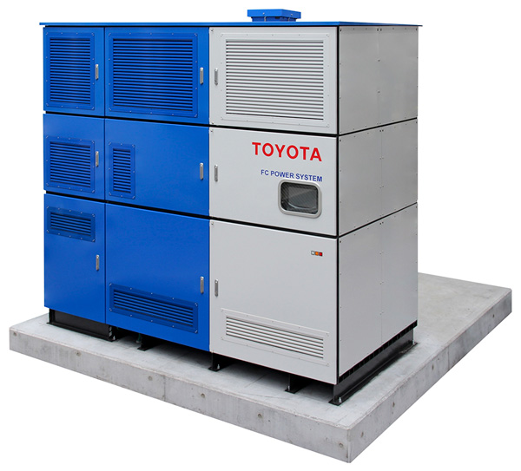
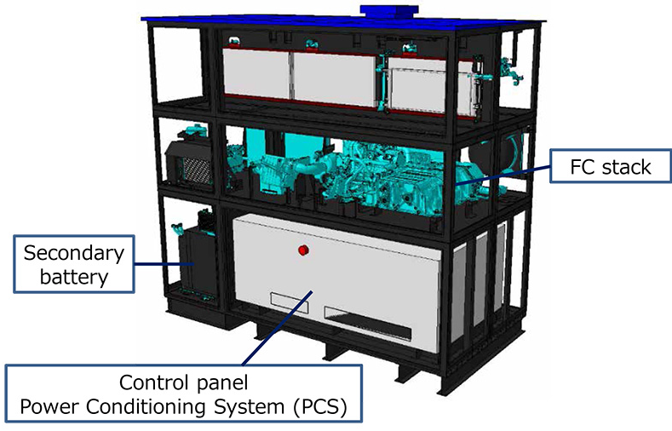
Application & Use of Fuel Cells
Fuel cells are versatile and can be emission free with hydrogen
Fast speed
Peak power, frequency & voltage regulation
Modular
Primary or backup power, stationary or portable
CHP
Long-term energy storage
P2H
Transportation
Needs more H2 production and infrastructure
Notes:
Why would we like to use fuel cells?
Very versatile, no emissions when using hydrogen
other fuels like methane would produce CO2
For power systems, Fuel cells offer many uses
They are quite fast
For example, Toyota fuel cell generator, power output of 50 kW, startup time of 40s
Peak power generation, frequency and voltage regulation.
Modular, you can have smaller or larger generators
In Korea there is 79 MW fuel cell power plant
Fuel cells can be primary or secondary power sources
CHP
FC produce a lot of heat, heat up a building. Japan and South Korea use FC for residential heating
FC could be utilized as long-term energy-storage, by utilizing power-to-hydrogen
Transportation
Power a car or a truck with a fuel cell, don’t need the heavy batteries
Overall efficiency is lower
Long distance transport
Large scale use of FC and H2 require a lot more production and infrastructure, and Flora will tell you about that

Slide 6
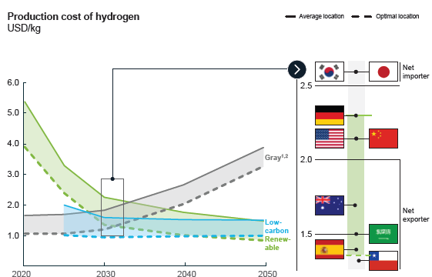
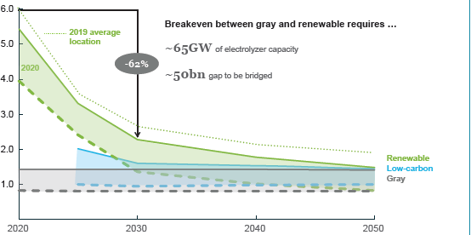
The form of production is key for decarbonization
Method | Source | t CO2 per t H2 | Costs (USD/kg)
Gasification | Coal | 25.56 | 1.2-2.2
Steam Reforming | Natural Gas | 10.79 | 0.9-3.2
Steam Reforming with CCUS | Natural Gas | 0.5-1.62 | 1.5-2.9
Electrolysis | Renewable electricity | 0 | 3.0-7.5
Notes:
Electrolysis
Steam Reforming
Compressed/liquified
Carriers
Pipelines
https://www.iea.org/reports/the-future-of-hydrogen
Horng, P. and Kalis, M. (2020). Wasserstoff-Farbenlehre. IKEM – Institut für Klimaschutz,
Energie und Mobilität e.V. url: https://www.ikem.de/wp-content/uploads/
2021/01/IKEM_Kurzstudie_Wasserstoff_Farbenlehre.pdf (visited on 05/22/2021).
https://newsroom.posco.com/en/posco-to-establish-hydrogen-production-capacity-of-5-million-tons/

Slide 7
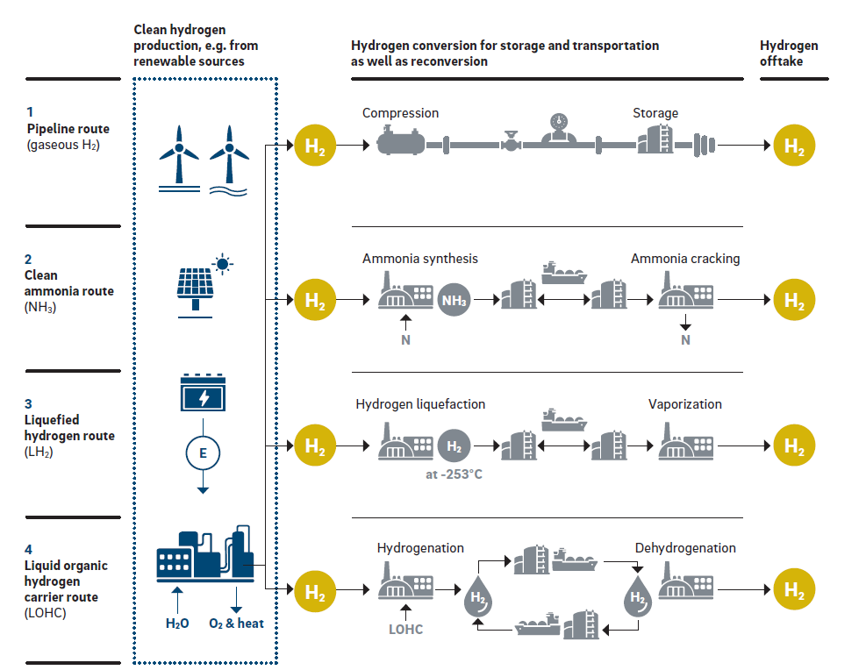
How to build a hydrogen infrastructure?
Long distances, cheap, high investment costs
Conversion losses, existing infrastructure, shipping
Shipping, expensive, poor volumetric energy density
New technology, no existing infrastructure, expensive
Notes:
Storage option and compression not included?
https://www.rolandberger.com/en/Insights/Publications/Transporting-the-fuel-of-the-future.html

Slide 8
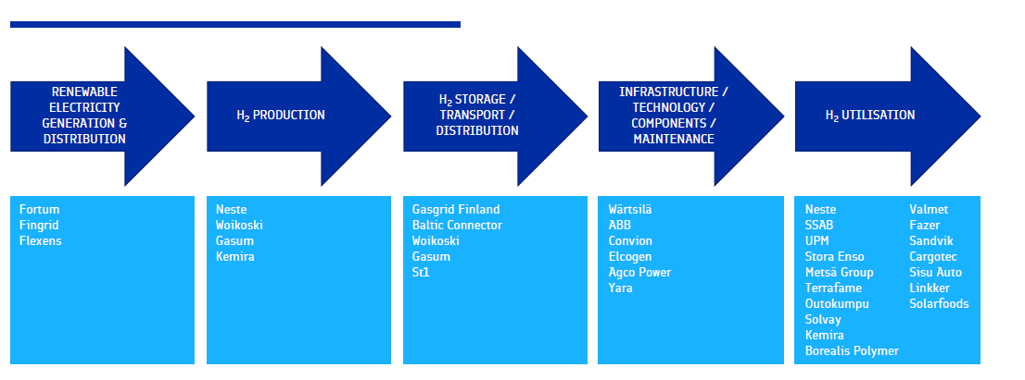
How could an economy in Finland look like?
Strengths
Good wind resources,
Strong transmission grid
Stable political environment
Experience in industrial hydrogen handling
Wide applications
Weaknesses
High electricity price
No hydrogen transportation infrastructure
No natural storage options
High CO2 price required to stay competitive
Notes:
https://www.google.com/url?sa=t&rct=j&q=&esrc=s&source=web&cd=&ved=2ahUKEwi7lMv-56n3AhXIl4sKHdPiDyQQFnoECAkQAQ&url=https%3A%2F%2Fwww.businessfinland.fi%2F4abb35%2Fglobalassets%2Ffinnish-customers%2F02-build-your-network%2Fbioeconomy--cleantech%2Falykas-energia%2Fbf_national_hydrogen_roadmap_2020.pdf&usg=AOvVaw15I66yVYVis46mWcIU25iX
To utilize fuel cells in a smart grid energy system we need a hydrogen economy

Slide 9
Take Home Message
Hydrogen fuel cells offer a lot of potential to decarbonization as it can be wide applied.
Emission free storage option for electricity at peak loads.
Challenges:
Renewable Hydrogen and thus fuel cells are currently very expensive.
Transportation and Production need to be ensured in large qualtities.

Slide 10
Sources
https://www.fchea.org/fuelcells
https://www.energy.gov/eere/fuelcells/fuel-cells
https://fuelcellsworks.com/knowledge/applications/
https://www.researchgate.net/figure/Characteristics-of-fuel-cell-technologies_tbl1_267563944
https://ieeexplore.ieee.org/document/660236
https://global.toyota/en/newsroom/corporate/32732488.html
https://fuelcellsworks.com/news/south-korea-worlds-largest-hydrogen-fuel-cell-power-plant-opened-by-korean-southern-power-kospo/
https://www.iea.org/reports/the-future-of-hydrogen
https://www.ikem.de/wp-content/uploads/ 2021/01/IKEM_Kurzstudie_Wasserstoff_Farbenlehre.pdf
https://www.rolandberger.com/en/Insights/Publications/Transporting-the-fuel-of-the-future.html
https://www.h2knowledgecentre.com/content/government621
https://hydrogencouncil.com/wp-content/uploads/2021/02/Hydrogen-Insights-2021.pdf

