Slide 1

Introduction to Smart Grid
Matti Lehtonen, 1.3.2022

Slide 2
SMART GRIDS
The motivation of Smart Grids is to enable integration of renewable power generation, distributed energy resources and energy efficiency in power and energy systems.

Slide 3
Integrating renewables and distributed resources
The active control of power system is extended over the
Distribution system till the customers resources ⬄ As a control problem this is huge !

Slide 4
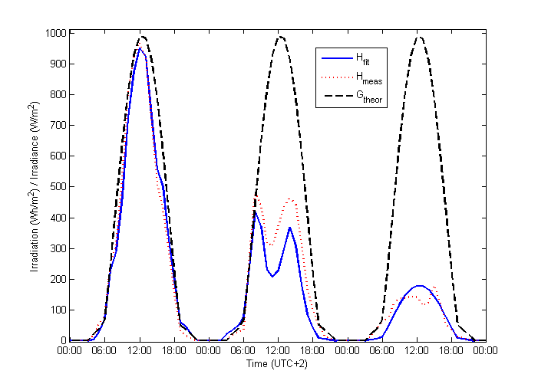
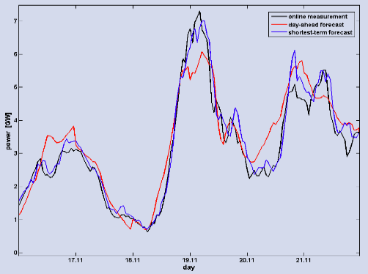
Challenge of renewables: intermittent production and power balance
Variation of wind power in
Three subsequent days in Germany
Variation of PV production in three subsequent days in Finland

Slide 5
Smart Grids and Power Balance
In present power systems even moderate share of renewables cause difficulties:
  In Denmark wind production frequently exceeds power demand ⬄ negative prices in electricity exchange !
  In Germany 3% share ot PV production has led to 50.2 Hz problem ⬄ requirements to tune down PV production !
Substantial increase of renewable power generation, both in centralized plants and at distributed locations, is impossible without better control of power balance using Smart Grid technologies

Slide 6
DEVELOPMENT OF MARKETS – PRICE VOLATILITY AND BALANCE MANAGEMENT DUE TO RENEWABLES
Picture: M. Supponen
When markets integrate, energy balance gets more challenging also in Nordic countries
Nordic hydro used more for leveling German wind and solar…
Prices of power today more volatile in Central Europe (red: german, blue Nordic), what about in future ….

Slide 7
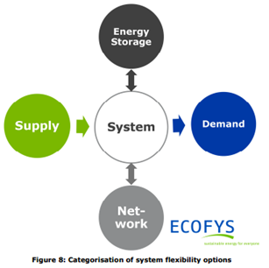
Flexibility gap and options

Slide 8
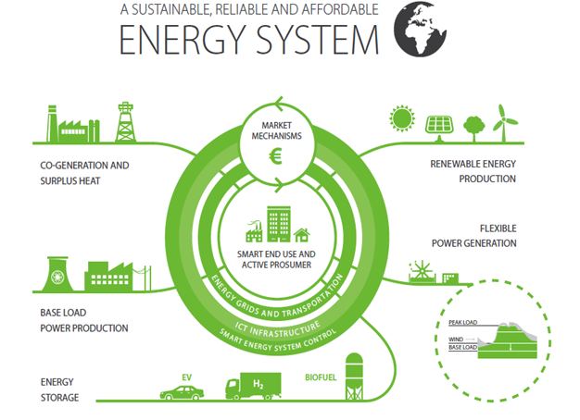

Slide 9
Resources for Power Balance and Energy Efficiency
Control of local generation
  Local wind and PV are intermittent, not suitable for control
  Local microCHP (based on biofuels) – high control potential
Energy Storages
  Thermal storages
  Batteries & Electric Vehicles Smart Charging
Demand Response (DR)
  Large share of loads suitable for shifting timely use
  Generation / load balancing & as reserve capacity
Prosumers (producer – consumers): customers having their
  own generation, and
  possibly flexible loads, and
  possibly storages (BES, TES)

Slide 10
Future energy system control levels
Control architecture for Smart Energy System, levels:
  Transmission: Balance management – Markets – Renewables integration – system security
  Distribution: Aggregation of customer resources to VPP – local renewables – network disturbance management – retail market operations
  Customer & Prosumer level: Production, storages, EV charging control – energy efficiency monitoring and control & demand response
States: Normal state energy optimization (hrs) – Local network disturbances (min) – system security & capacity adequacy (sec)

Slide 11
Model of heating loads for DR
AHU
T_{s}
H_{as}
H_{ae}
T_{e}
T_{a}
C_{a}
φ_{hc}
H_{ame}
H_{ag}
T_{g}
Demand Response in optimizing partial storage
Modeling the house (to the left) and
Modeling the controlled targets in heating system

Slide 12
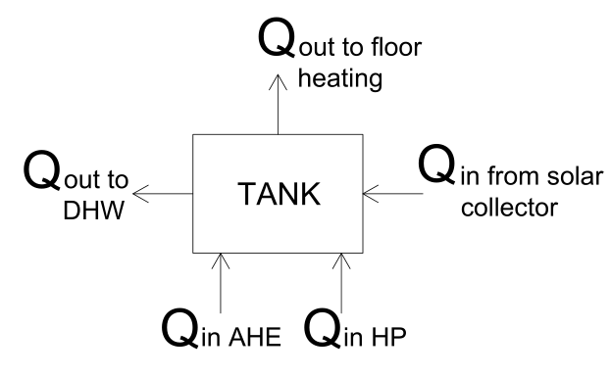
Schematic of Energy Hub
Temp. band
Heat Gains
TES Losses

Slide 13
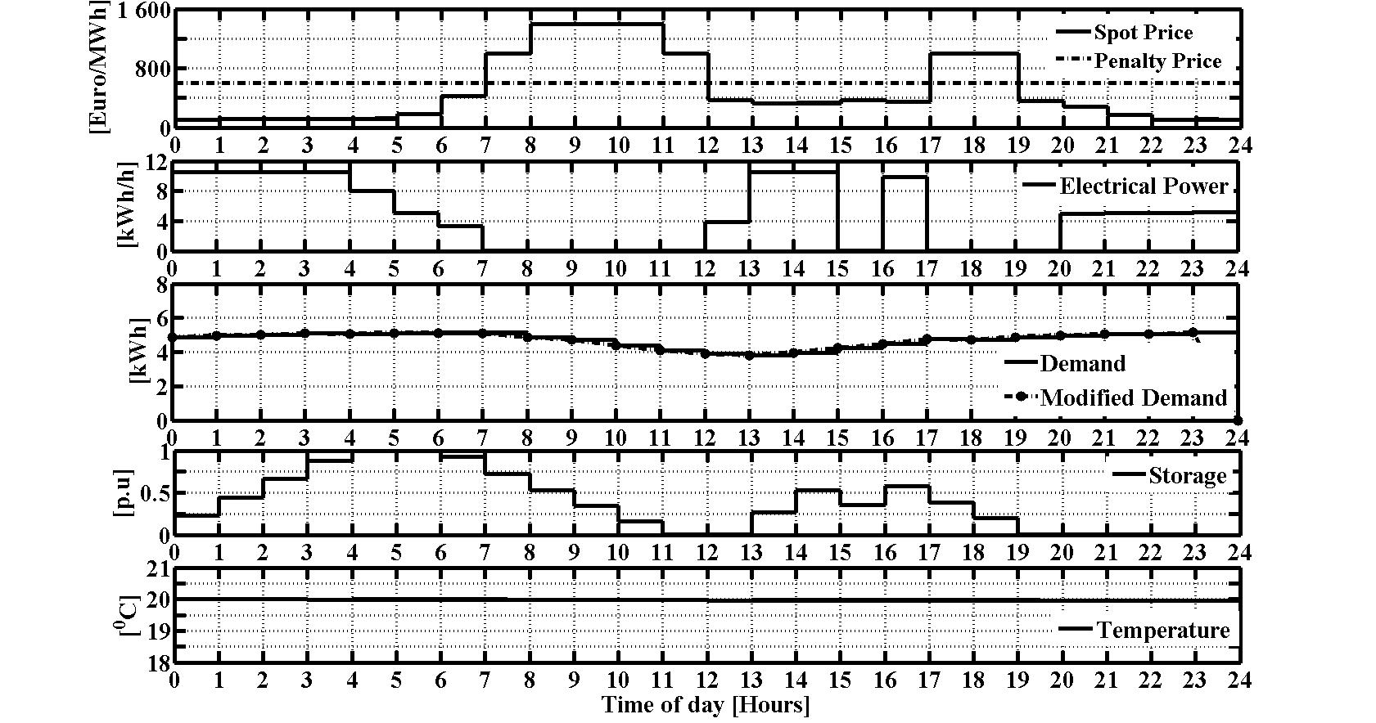
DR in market optimization
Demand Response in optimizing partial storage
Space heating ⬄ shifting demand from peak price

Slide 14
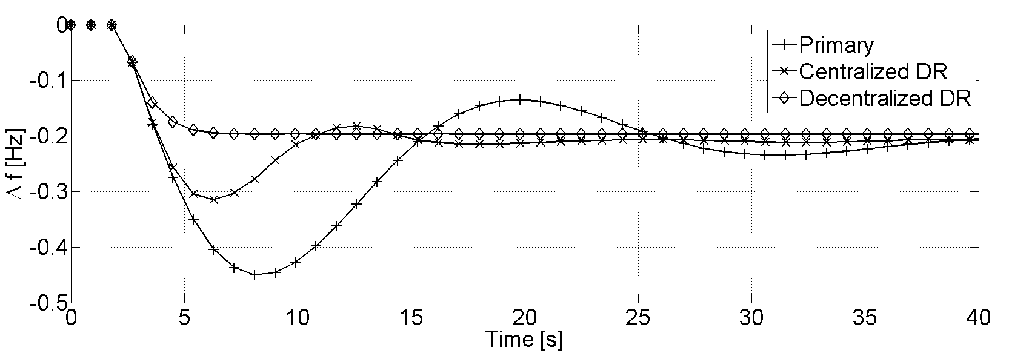
DR in balance management
MAJOR DISTURBANCE IN SYSTEM
CENTRALIZED ⬄ Central control as today
Primary ⬄ Control by DSO & aggregator
Decentralized DR ⬄ Control by Prosumer

Slide 15
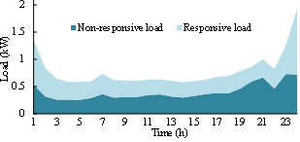
Demand Response potential
Of household loads about 50% are timely flexible
This is 10-20% of system peak load
Can be used for leveling renewable variations
In future, another 10-20% can be obtaned
From intelligent EV charging

Slide 16

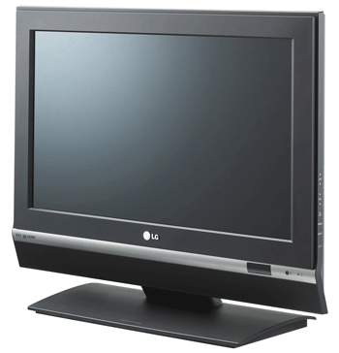
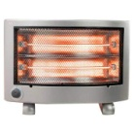
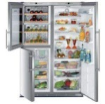
DR and distributed resources
8
Demand
To ensure power balance flexibility is needed both in generation, in system (networks) and in loads (DR)
With increase od intermittent renewables the reserve capacity comes more crucial
Many load equipment have a capacity of short term DR, but for longer time periods this capacity decreases
DR alone is not enough, also storages are needed (BES, TES)
GW
6
4
Mix of different energy sources
for base load and peak load
2
00 h
12 h
00 h
12 h
00 h
Future energy system is a mix of DR, storages and flexible generation units
Notes:
16
The demand of electrical energy varies over the day but also over the year. The electric system has to provide sufficient energy any time.
Even though the reserve capacities to deliver in times of peak demand is not used all the time, it must be in stand-by.
With more renewable power the energy mix gets more complex and intermittent renwable sources like wind or solar cannot be used as reserve capacities.
The challenge for the utilities is to always have sufficient reserve capacity to cope with peak demand.
A good forecast of wind or sun condition and a good network for import of energy is necessary.
To further support the reliable supply storage of electrical energy is required.
On top of that any measure to reduce the variation between peak and lower demand will help to use the generation plants more efficiently.

Slide 17
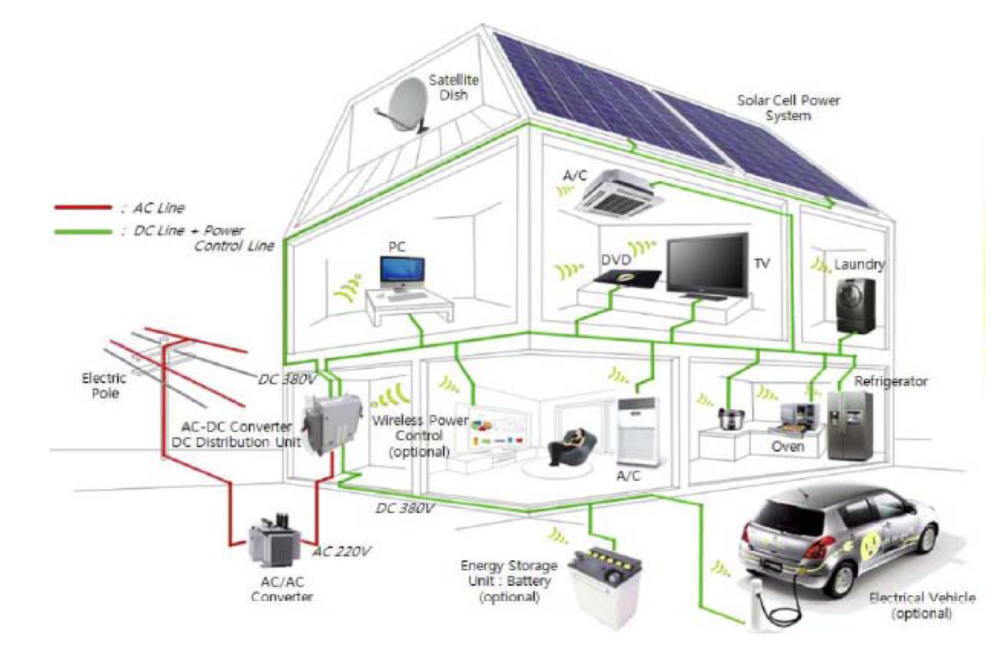
DC in future houses

Slide 18
Smart Grid integrates decentralized energy sources,
Controlled flexible loads and energy storages
Source: European technology plateform (ETP)
Notes:
The ETP SmartGrids was set up in 2005 to create a joint vision for the European networks of 2020 and beyond. The platform includes representatives from industry, transmission and distribution system operators, research bodies and regulators. . It has identified clear objectives and proposes an ambitious strategy to make a reality of this vision for the benefits of Europe and its electricity customers.

Slide 19
A Smart Grid Control Architecture for DER and DR
TSO/Aggregator:
Generation scheduling
Balance management
System disturbance management
DSO/Aggregator:
Aggregation of DER
Local production
Demand Response
Local network management
Capacity congestions
Local disturbances
Self-healing networks
Prosumer
Optimizing local energy use
Participation in markets
Balance management resource
Network mitigation resource

Slide 20
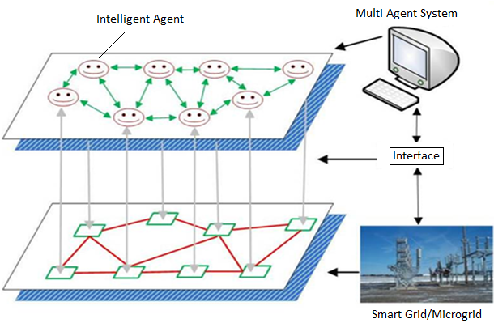
Distributed fault management – self healing networks
  s
Control Strategies | Communication hops |  | Delay time due to communication hops
 | m_{min} | m_{max} | m_{min} | m_{max}
Centralized | n²+7n+5=1253 | n²+7n+5=1253 | 1253Δt | 1253Δt
Distributed Agent | 2m_{min}+2=4 | 2m_{max}+2=66 | 4Δt | 66Δt
Autonomous Agent | 4 | m_{max}+5=37 | 4Δt | 6Δt
Time delays in network fault management. Number of substations n = 32, for different faulty sections between substations m = 1…n. And Δt is the communication latency.

Slide 21
An Example of Self-Healing Network
looped MV-system with remote control

Slide 22
WIND POWER PARKS IN GERMANY
FAST INCREASE IN WIND CAPACITY IN GERMANY

Slide 23
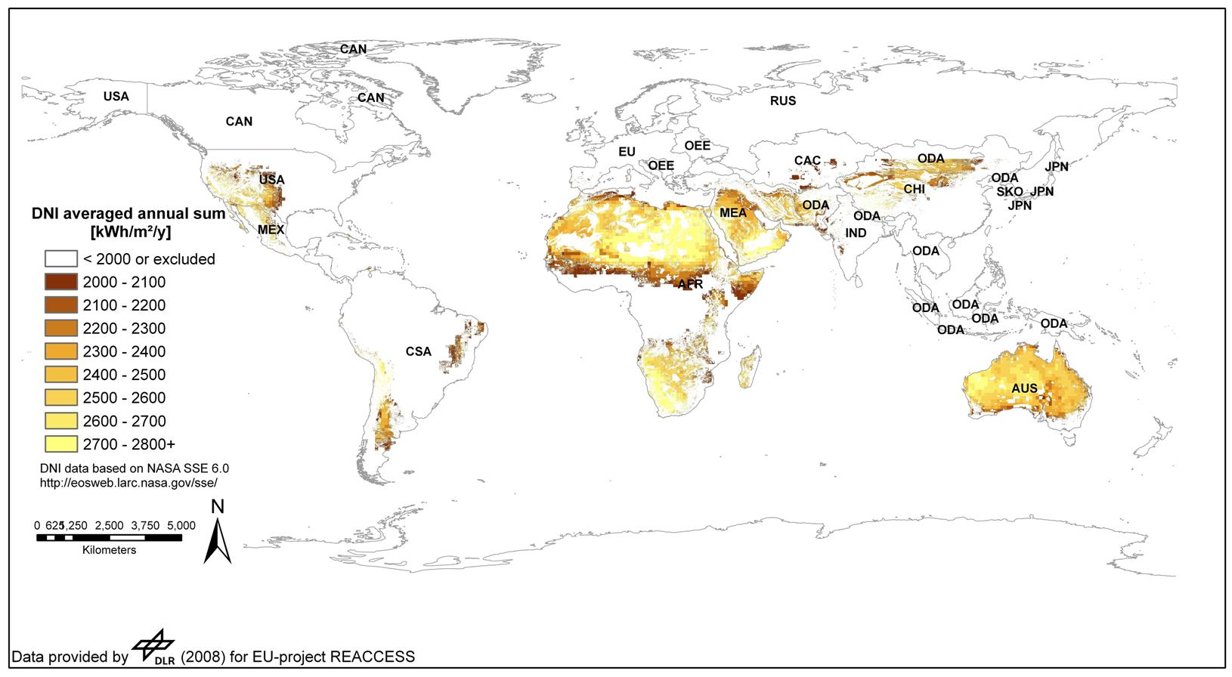
POTENTIAL OF SOLAR POWER

Slide 24
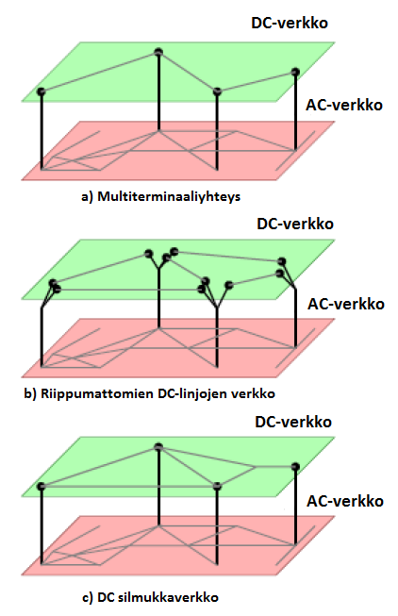
Smart Grid ⬄ Supergrid
Voltage | 735 kV AC | 500 kV DC | 800 kV DC
losses/1000 km | 6,7 % | 6,6 % | 3,5 %
Capacity | 3 GW | 3 GW | 6,4 GW

Slide 25
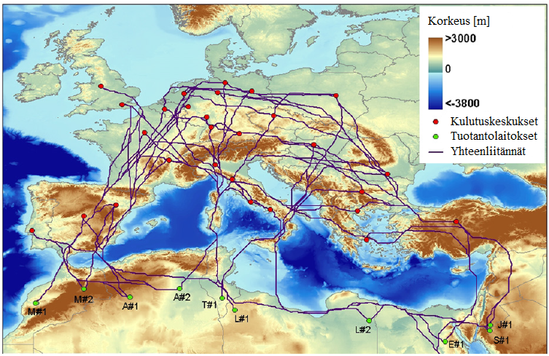
Desertec – solar power from North-Africa to Europe ?

